Slide 1
WIS2 Metadata and Global Discovery Catalogue Deep Dive 2026-04-01
Tom Kralidis Senior Geospatial Architect WIS 2.0, WIS 2.0 in a box

Slide 2
Outline
Recaps
WCMP2
GDC
wis2-gdc RI
pywiscat
Sensor Centres for GDC

Slide 3
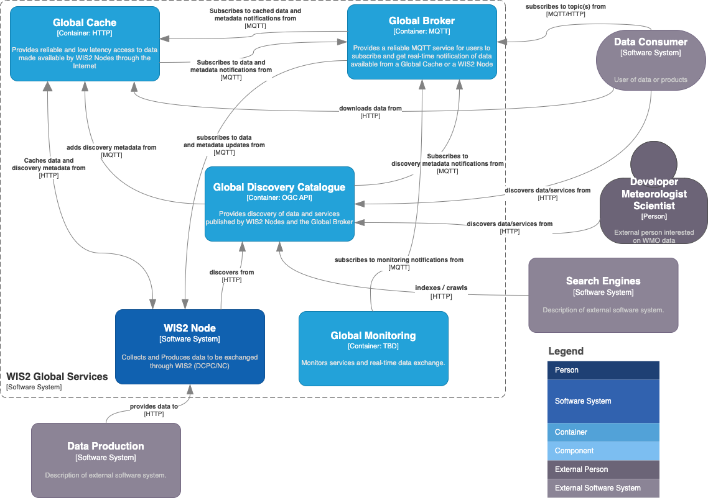

Slide 4
WIS 2.0 Value Proposition
Built on formal international standards
OGC, ISO, etc.
WIS2 standards defined by exception
Low barrier data exchange
Publishing metadata
Publishing data
Easy access to any weather/climate/water data
Real-time
Delayed mode
Archive
GTS data is available on WIS2 as a transitionary measure
Supports the Earth system data approach
Cloud capable “at scale”

Slide 5



Publish, Find, Subscribe, Download
WIS2 Global Services
Global Broker
Subscribe
Find
Global Discovery Catalogue
Publish
WIS2 Node
Download
recommended data
Download
core data
Global Cache

Slide 6
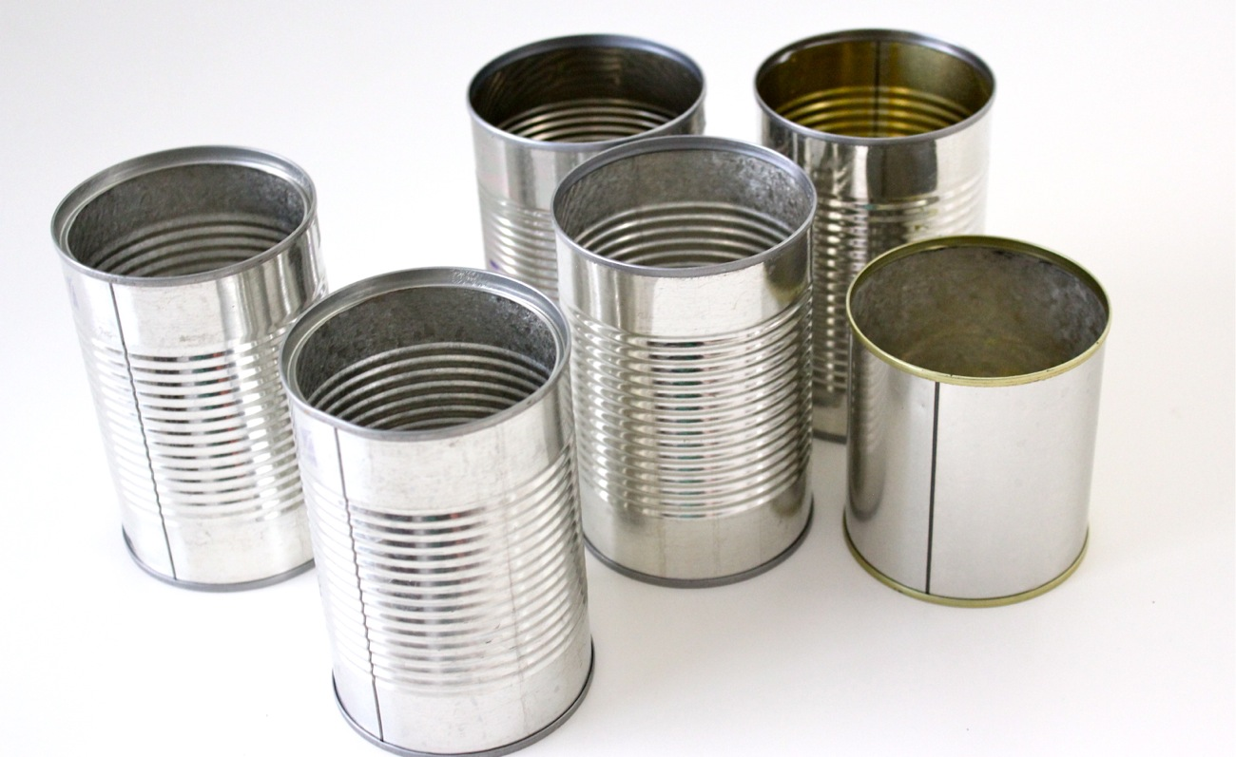
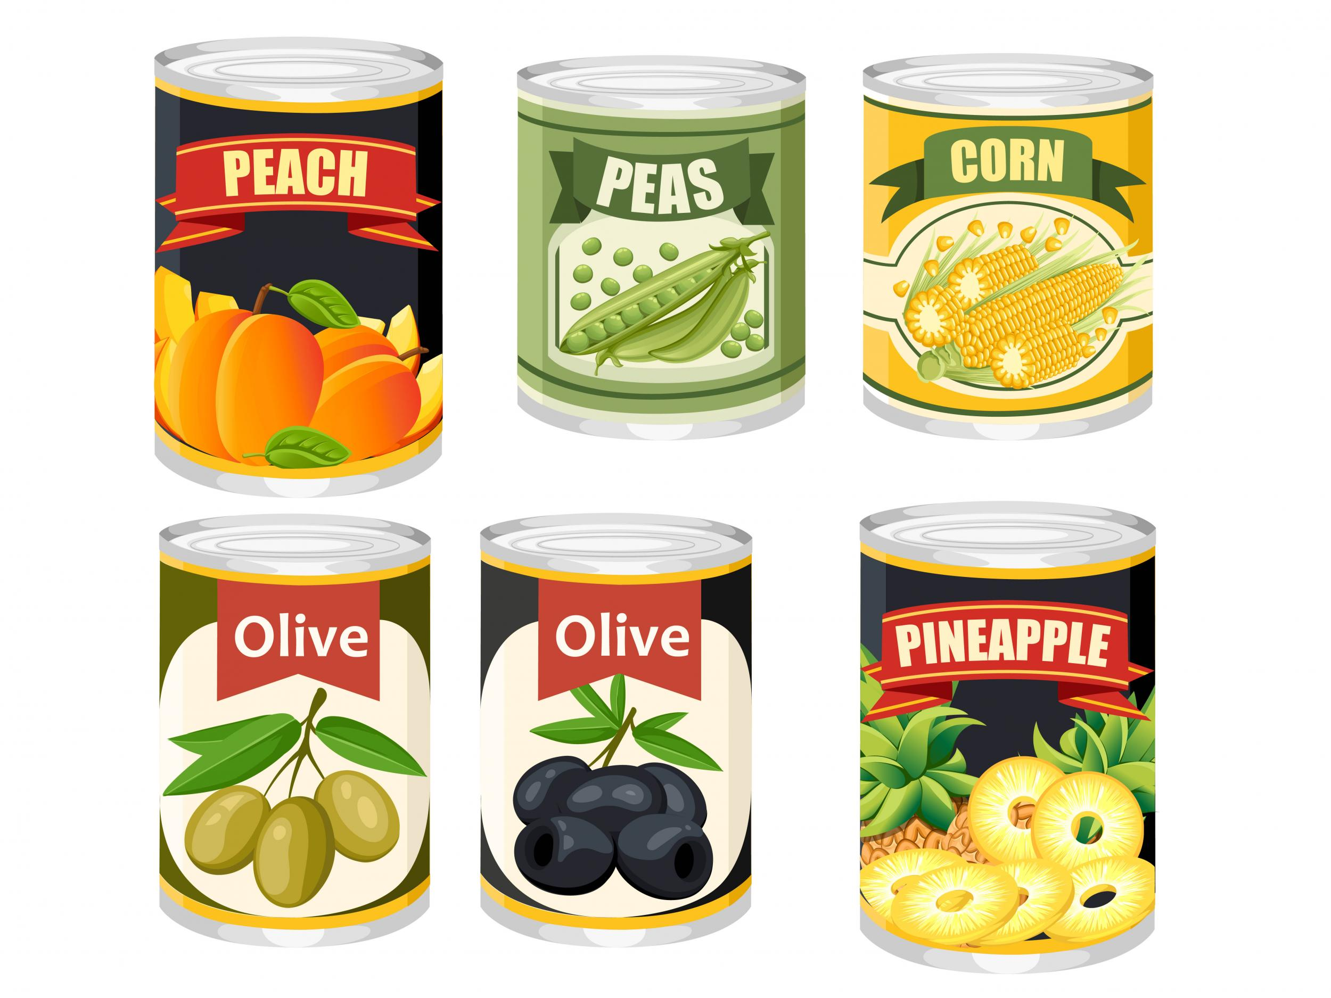
Datasets need metadata
Description/documentation
Identification
Key words
Temporal/Spatial Extents
Data Provider Contact(s)
Access control mechanism
Rights and License
Discovery Metadata in WIS2 is defined by the WMO Core Metadata Profile 2 (WCMP2)
Notes:
https://www.independent.co.uk/life-style/food-and-drink/features/tips-on-how-to-transform-a-humble-tin-can-of-food-a9432041.html
https://www.madeeveryday.com/tutorial-tin-can-caddy-for-earth-day-and-mothers-day

Slide 7
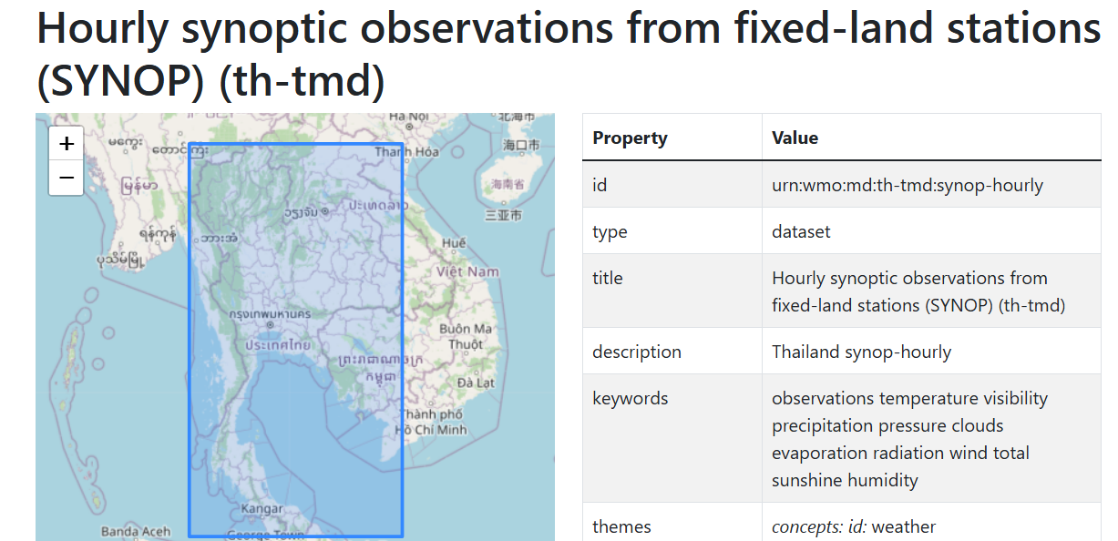
Datasets in WIS2
A Dataset groups data items into a single, conceptual resource (collection):
Helps to categorize and make easier to analyze
Statements about the Dataset (metadata) apply to the entire collection
The dataset has an identifier (metadata-id) associated to all data items
Examples of datasets
Synoptic observations from fixed-land stations
Predictions from NWP models
Archive of daily climate observations
Real-time water levels and flow (discharge)
¹ Guide to WIS (WMO No. 1061), Vol II, §1.1.4 Why are datasets so important

Slide 8


The Dataset concept
¹ Guide to WIS (WMO No. 1061), Vol II, §1.1.4 Why are datasets so important
The Dataset concept is central for WIS 2.0:
Dataset properties provided by Discovery Metadata using WMO Core Metadata Profile 2 (WCMP2)
Search for Datasets that using the Global Discovery Catalogue (GDC)
Subscribe to notifications about updates for a Dataset via a Global Broker (GB)
Access the data that comprises a Dataset using HTTP/HTTPS
WIS 2.0
Global Discovery Catalogue
HTTP search
HTTP
WIS2 Node
MQTT
Global Broker
HTTP
Global Cache
HTTP

Slide 9

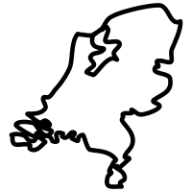


Sharing data in WIS 2.0
I want to share data from my national network of land-based, fixed observing stations
I need real-time weather data for my application

Slide 10





Sharing data in WIS 2.0
¹ Guide to WIS (WMO No. 1061), Vol II, §1.1.4 Why are datasets so important [draft]
² Guide to WIS (WMO No. 1061), Vol II, §1.3.1 How to get started [draft]
³ Manual on WIS (WMO No. 1060), Vol II, Appendix E: Notification Message [draft]
⁴ Manual on WIS (WMO No. 1060), Vol II, Appendix D: WIS2 Topic Hierarchy [draft]
For WIS 2.0 I see that my collection of real-time observation data is called a ‘Dataset’¹
WIS2 Node
Following instructions in the WIS2 Guide², I establish a WIS2 Node to share my Dataset
files in BUFR format
or other WMO approved data formats
HTTPS
00110001
00110000
interactive API (optional)
self-describing RESTful APIs, ideally with OpenAPI metadata
» »
OpenAPI
WIS2 Notification Messages³
GeoJSON published on standardised topic hierarchy⁴
MQTTS
But I still don’t know anything about your Dataset!

Slide 11



Sharing metadata in WIS 2.0
Ahh, good point! The next section in the WIS2 Guide⁵ says that I need to provide ‘discovery metadata’⁶ about my Dataset
That’s great. I can find the description of your Dataset.
I can understand what it contains and how to access it. The conditions of use are clear, and I see how I can attribute you as the source of the data !
Description of the Dataset
WIS2 Node
Identifier
Title
Description
Keywords
Geometry (extent)
Time (extent)
HTTPS
Who to contact
Publisher contact
publish
How to access
OpenAPI
search engines
Data access (files)
Data access (API)
Data access (notifications)
Global Discovery Catalogue
index
WCMP2
Conditions of use
JSON
Data policy
Rights
License
MQTTS
How to attribute
Citation
⁵ Guide to WIS (WMO No. 1061), Vol II, §1.3.2 How to provide discovery metadata to WIS2
⁶ Manual on WIS (WMO No. 1060), Vol II, Appendix F: WMO Core Metadata Profile 2

Slide 12
Discovering datasets in WIS2
Global Discovery Catalogues provide an OGC API – Records endpoint to search for data on WIS2
GDC ECCC, Canada: wis2-gdc.weather.gc.ca/collections/wis2-discovery-metadata/items
GDC DWD, Germany: wis2.dwd.de/gdc/collections/wis2-discovery-metadata/items
GDC CMA, China: gdc.wis.cma.cn/collections/wis2-discovery-metadata/items
WIS 2.0
Searching the Global Discovery Catalogue for datasets that match my requirements…
Global Discovery Catalogue
HTTP search
HTTP
WIS2 Node
MQTT
Global Broker
HTTP
Global Cache
HTTP

Slide 13
Inspecting WCMP2
Reviewing live WCMP2 records in a GDC

Slide 14
GDC Overview
Provides cataloguing and discovery capability of WMO dataset collections
Web-based API facilitating search/browse data published via WIS
Harvests WIS 2 discovery metadata from WIS2 Nodes
Yellow pages (discovery metadata) gateway into WIS data and services
Provides indexing capability to mass market search engines
Provides WCMP2 validation and quality assessment “as a service” in support of WIS2 compliance and continuous improvement in alignment with WIS 2 metadata Key Performance Indicators (KPIs)

Slide 15
Component Definition (WIS2 Guide)
WIS2 includes several Global Discovery Catalogues.
A Global Discovery Catalogue enables a data consumer to search and browse descriptions of data published by each WIS2 Node. The data description (discovery metadata) provides sufficient information to determine the usefulness of the data and how it may be accessed.
A Global Discovery Catalogue subscribes to notification messages about the availability of new (or updated) discovery metadata via a Global Broker. It downloads a copy of the discovery metadata and updates the catalogue.
A Global Discovery Catalogue amends discovery metadata records to add details of where one can subscribe to updates about the dataset at a Global Broker.
A Global Discovery Catalogue makes its content available for indexing by search engines.
Link: WIS2 Guide: section 2.4.4

Slide 16
Technical Considerations (WIS2 Guide)
The Global Discovery Catalogue provides data consumers with a mechanism for discovering and searching for datasets of interest as well as learning how to interact with and find out more information about those datasets.
The Global Discovery Catalogue implements the OGC API – Records – Part 1: Core standard^{[49]}, adhering to the following conformance classes and their dependencies:
Searchable Catalog (Deployment);
Searchable Catalog - Sorting (Deployment);
Searchable Catalog - Filtering (Deployment);
JSON (Common Component);
HTML (Common Component).
The Global Discovery Catalogue will make discovery metadata available via the collection identifier wis2-discovery-metadata.
The Global Discovery Catalogue advertises the availability of datasets and how to access them or subscribe to updates.
The Global Discovery Catalogue does not advertise or list the availability of individual data objects that comprise a dataset (that is, data files).
Link: WIS2 Guide: section 2.7.5

Slide 17
Technical Considerations (WIS2 Guide)
A single Global Discovery Catalogue is sufficient for WIS2.
Multiple Global Discovery Catalogues may be deployed for resilience.
Global Discovery Catalogues operate independently of each other; each Global Discovery Catalogue holds all discovery metadata records. Global Discovery Catalogues do not need to synchronize with each other.
A Global Discovery Catalogue is populated with discovery metadata records from a Global Cache and receives messages about the availability of discovery metadata records via a Global Broker.
The subscription topic shall be cache/a/wis2/+/metadata/#.
A Global Discovery Catalogue should connect to and subscribe to more than one Global Broker to ensure that no messages are lost in the event of a Global Broker failure. A Global Discovery Catalogue will discard duplicate messages as needed.
A Global Discovery Catalogue will verify that a discovery metadata record identifier’s centre-id token (see Manual on WIS, Volume II – Appendix F. WMO Core Metadata Profile (Version 2)) matches the centre-id level of the topic from which it was published (see Manual on WIS, Volume II – Appendix D. WIS2 Topic Hierarchy) to ensure that discovery metadata are published by the authoritative organization.
Link: WIS2 Guide: section 2.7.5

Slide 18
Technical Considerations (WIS2 Guide)
A Global Discovery Catalogue will validate discovery metadata records against the WCMP2. Valid WCMP2 records will be ingested into the catalogue. Invalid or malformed records will be discarded and reported to the Global Monitor against the centre-id associated with the discovery metadata record.
A Global Discovery Catalogue will only update discovery metadata records to replace links for dataset subscription and notification (origin), with their equivalent links for subscription at Global Brokers (cache).
A Global Discovery Catalogue will periodically assess discovery metadata provided by NCs and DCPCs against a set of key performance indicators (KPIs) in support of continuous improvement. Suggestions for improvement will be reported to the Global Monitor against the centre identifier associated with the discovery metadata record.
A Global Discovery Catalogue will remove discovery metadata that are marked for deletion as specified in the data notification message.
A Global Discovery Catalogue should apply faceting capability as specified in the cataloguing considerations of the WCMP2 specification, as defined in OGC API - Records.
A Global Discovery Catalogue will provide human-readable web pages with embedded markup using the schema.org vocabulary, thereby enabling search engines to crawl and index its content. Consequently, data consumers should be able to discover WIS content via third party search engines.
Link: WIS2 Guide: section 2.7.5

Slide 19
Technical Considerations (WIS2 Guide)
A Global Discovery Catalogue will generate and store a zip file of all WCMP2 records once a day; this file will be made be accessible via HTTP. The zipfile will include a directory named after the centre-id of the Global Discovery Catalogue containing all WCMP2 records.
A Global Discovery Catalogue will publish a WIS2 Notification Message of its zip file of all WCMP2 records on its centre-id’s metadata topic (for example, origin/a/wis2/centre-id/metadata, where centre-id is the centre identifier of the Global Discovery Catalogue).
A Global Discovery Catalogue may initialize itself (cold start) from a zip file of all WCMP2 records published.
As a convention, a Global Discovery Catalogue’s centre-id will be {tld}-{centre-name}-global-discovery-catalogue.
Link: WIS2 Guide: section 2.7.5

Slide 20
Searchable Catalogue
Predicate | Example(s)
Spatial | bbox=minx,miny,maxx,maxy
Temporal | datetime=t1 datetime=t1/t2 datetime=t1/..
Freetext | q=air+temperature
Attributes | title=air+temperature nested.attribute=ozone wmo:dataPolicy=core
Sorting/paging | sortby=title&limit=100&startindex=11 “prev” / ”next” link relations
Filter returnable properties | properties=title,description

Slide 21
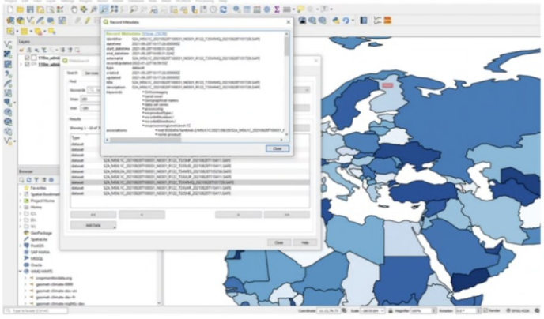
GDC Catalogue Search
Better metadata results in better findability/use
The WIS2 Global Discovery Catalogue will work with multiple applications and environments (mobile, web application, workstation, GIS, etc.)
Example: using QGIS, users will be able to search the GDC, view results and choose to subscribe and/or download data of interest

Slide 22

WIS2 functions and components
Function | WIS2 Global Service | WIS2 Standard
Discovery | Global Discovery Catalogue | WMO Core Metadata Profile (WCMP2)
Subscription | Global Broker | WIS2 Notification Message (WNM) WIS2 Topic Hierarchy (WTH)
Download | Global Cache | WIS2 Notification Message (WNM)

Slide 23
Publish, Find, Subscribe, Download
WIS2 Global Services
Global Broker
Subscribe
Find
Global Discovery Catalogue
Publish
WIS2 Node
Download
recommended data
Download
core data
Global Cache

Slide 24
Inspecting GDC
Reviewing a live GDC

Slide 25
Measure twice, cut once
WIS2 is built on standards
Any tools supporting the standards can discovery, subscribe and download data from WIS2
Discover
use the UI, pywiscat, QGIS, etc.
Subscribe / download
WIS2 Downloader
pywis-pubsub
¹ Guide to WIS (WMO No. 1061), Vol II, §1.1.4 Why are datasets so important

Slide 26
wis2-gdc: the GDC RI
WIS2 GDC server
To provide a Global Discovery Catalogue, Members may use whichever software components they consider most appropriate to comply with the WIS2 technical regulations.
To assist Members in participating in WIS2, a free and open-source Global Discovery Catalogue Reference Implementation, wis2-gdc, is available for download and use. wis2-gdc builds on mature and robust free and open-source software components that are widely adopted for operational use.
wis2-gdc provides the functionality required for the Global Discovery Catalogue, including the following technical functions:
Discovery metadata subscription and publication from the Global Broker;
Discovery metadata download from the Global Cache;
Discovery metadata validation, ingest and publication;
WCMP2 compliance;
Quality assessment (KPIs);
OGC API - Records - Part 1: Core compliance;
Metrics reporting;
Implementation of metrics.
wis2-gdc is managed as a free and open source project. Source code, issue tracking and discussions are hosted openly on GitHub: github.com/wmo-im/wis2-gdc
¹ Guide to WIS (WMO No. 1061), Vol II, §1.1.4 Why are datasets so important

Slide 27
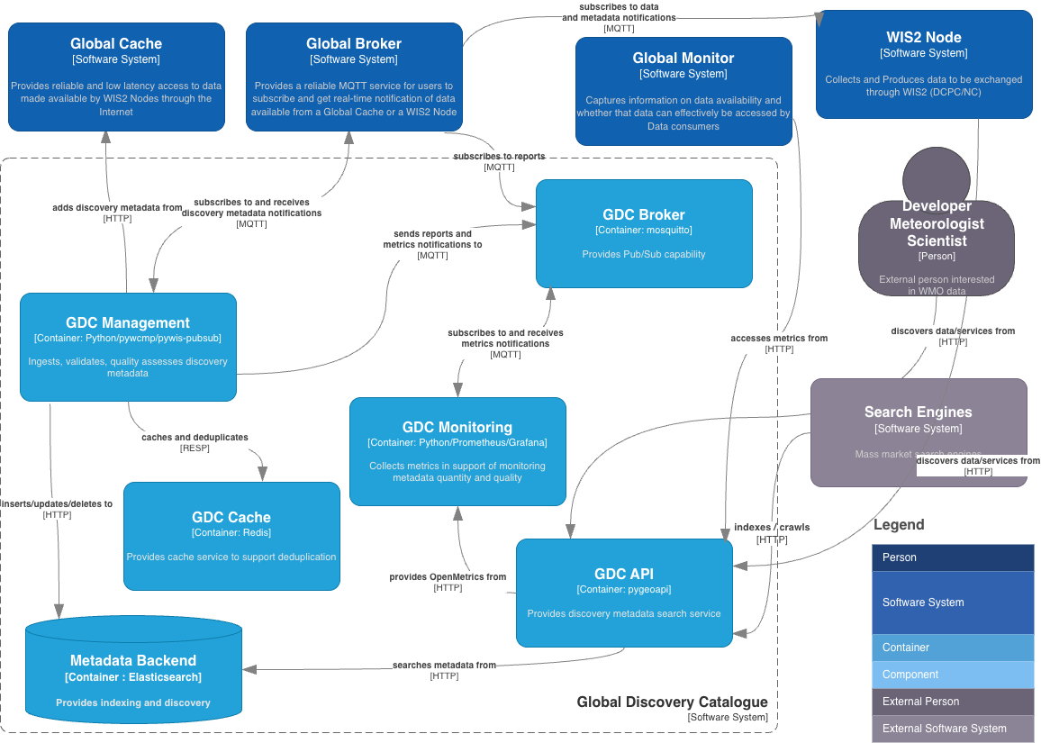

Slide 28
Sensor Centre for GDCs
Current guidance to be proposed at INFCOM-4:
github.com/wmo-im/wis2-guide/blob/INFCOM-4/guide/sections/part3/sensor-centres.adoc#3341-technical-considerations
Functionality added to pywiscat
github.com/wmo-im/pywiscat?tab=readme-ov-file#running
Download all GDC archives
Run comparative analysis
¹ Guide to WIS (WMO No. 1061), Vol II, §1.1.4 Why are datasets so important

Slide 29
wis2-gdc exercise
Follow steps at:
github.com/wmo-im/wis2-champions/blob/main/Bali-workshop-MAR2026/presentations/day3/wis2-gdc-exercise.md

Slide 30
pywiscat: the Python GDC CLI
WIS2 GDC client
Utility to interact with WIS2 GDCs
Hides GDC query and search behind a Python Command Line Interface (CLI)
github.com/wmo-im/pywiscat
Installed on your VM:
pywiscat –version
pywiscat
Exercise: query the GDC using your choice of tools
Web browser
Python requests
pywiscat
Something else/develop your own!
¹ Guide to WIS (WMO No. 1061), Vol II, §1.1.4 Why are datasets so important

Slide 31
Thank you Merci Gracias

