Slide 1

Publishing real-time data notifications in MeteoGate
Jeremy Tandy | October 2025
1

Slide 2



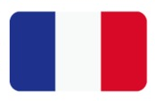
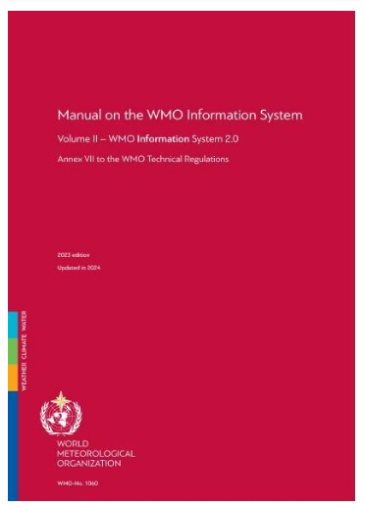
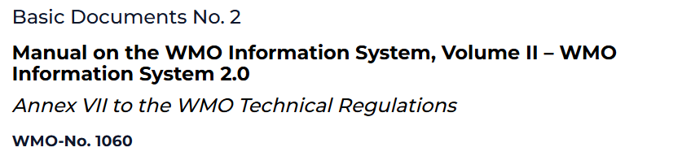
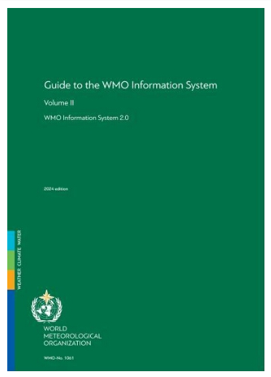


WMO Information System version 2 (WIS2) is defined in the Tech-Regs…
There’s also a ‘cookbook’ in draft
If you need / want to find out more – get reading!
WIS2 Node
Data Access (APIs)
Local Broker
Global Broker
Data Consumers
https://library.wmo.int/idurl/4/68731
https://library.wmo.int/idurl/4/69130
WIS2 Cookbook (draft)
Local Components
Community Components
2
Notes:
Manual on WIS (WMO No. 1060), Volume II
https://library.wmo.int/idurl/4/68731
Guide to WIS (WMO No. 1061), Volume II
https://library.wmo.int/idurl/4/69130
WIS2 Cookbook (draft)
https://wmo-im.github.io/wis2-cookbook/cookbook/wis2-cookbook-DRAFT.html

Slide 3
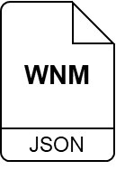
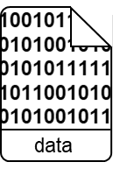

WIS2 uses real-time notifications published via the MQTT protocol to tell users about new data
WIS2 notifications must follow the spec
WIS2 Notification Messages are GeoJSON
Here’s how it works …
publish
origin/a/wis2/{centre-id}/data/…
WIS2 Node
②
③
subscribe
origin/a/wis2/{centre-id}/data/#
Data Access (APIs)
Local Broker
Global Broker
mqtts
Data Consumers
①
④
publish
origin/a/wis2/{centre-id}/data/…
subscribe
origin/a/wis2/{centre-id}/#
1. Publish a notification message to the Local Broker advertising availability of new data
2. Global Broker subscribes to the Local Broker; it validates received messages and republishes them
3. Data Consumer subscribes to the Global Broker and receives notifications about the availability of new data
4. Data Consumer downloads data from the Data Supply Capability (aka. WIS2 Node) using the link in the notification message
Local Components
Community Components
3
Notes:
Publish a notification message to the Local Broker advertising availability of new data
Global Broker subscribes to the Local Broker; it validates received messages and republishes them
Data Consumer subscribes to the Global Broker and receives notifications about the availability of new data
Data Consumer downloads data from the Data Supply Capability (aka. WIS2 Node) using the link in the notification message
Note that WIS2 recommends that Data Consumers subscribe to at least 2 Global Brokers for resilience. Data Consumers need to be able to hand de-duplication of messages (based on the unique message `id`) coming from each Global Broker instance.

Slide 4
WIS2 has hundreds of (meta)data publishers – how do we keep the notification messages organised?
WIS2 requires that notification messages are published on specific topics according to a well-defined topic hierarchy (spec)
Valid terms for each level in the topic hierarchy are published on the WMO Codes Registry
Global Brokers will discard messages published on unregistered topics (i.e., not in the spec)
publish
origin/a/wis2/{centre-id}/data/…
WIS2 Node
Data Access (APIs)
Local Broker
Global Broker
mqtts
Data Consumers
publish
origin/a/wis2/{centre-id}/data/…
subscribe
origin/a/wis2/{centre-id}/#
{1:channel}/{2:version}/{3:system}/{4:centre-id}/{5:notification-type}/{6:data-policy}/{7:earth-system-discipline}/…
origin
cache
a
wis2
see http://codes.wmo.int/wis/topic-hierarchy/centre-id
data
metadata
core
recommended
atmospheric-composition
climate
cryosphere
hydrology
ocean
space-weather
weather
Local Components
Community Components
4
Notes:
Manual on WIS (WMO No. 1060), Volume II
https://library.wmo.int/idurl/4/68731
Appendix D WIS2 Topic Hierarchy
https://wmo-im.github.io/wis2-topic-hierarchy/standard/wis2-topic-hierarchy-STABLE.html
WMO Unified Data Policy, Resolution 1 (Cg-Ext(2021))
https://library.wmo.int/idurl/4/58009
1:channel
… `origin` for messages coming from WIS2 Nodes, or `cache` for messages coming from Global Caches
… I’ll talk about this in a moment – but mainly it’s done so we drive traffic to the highly-available Global Services rather than swamping WIS2 Nodes with requests
… only Core data is cached, and this may be overridden by the Data Publisher
2:version
… just `a` for now – but we’re ready for breaking changes in years to come such as modifying the structure of the topic hierarchy
3:system
… just `wis2` for now – but who knows if we’ll want to reuse this mechanism for other WMO initiatives?
… you’re free to re-use this messaging pattern, and the infrastructure you’ve deployed, for other purposes; just use a different value for {system} and the WIS2 Global Services will ignore the messages
4:centre-id
… the centre identifier of your WIS2 Node agreed with WMO Secretariat
… we talked about centre identifiers previously – their structure, and how you get one
… the official list is published on WMO Codes Registry at http://codes.wmo.int/wis/topic-hierarchy/centre-id
5:notification-type
… data or metadata; we want don’t want to mix these resources because we use them in different ways / at different times
6:data-policy
… based on the terminology described in the WMO Unified Data Policy
… it’s the `data-policy` value you put in your discovery metadata record
… when choosing the data policy you need consider the expectations of Data Consumers. Core data is largely analogous to what is shared on the GTS today as Essential data (albeit there's more NWP data coming soon!). Really high-frequency datasets (e.g., once-per-minute observations) or high-resolution (e.g., NWP data with resolution that significantly exceeds the WMO requirements, as specified in the Manual on WIPPS) might overwhelm Data Consumers. They would get much more data than they’re expecting? Basically, we need to consider the end users expectations in choosing Core or Recommended. GISCs can help with this decision.
7:earth-system-discipline
… based on the set of disciplines described in the WMO Unified Data Policy
---
How do you get a {centre-id} allocated?
You need to register your Data Supply Capability as a WIS2 Node
Instructions are in the Guide to WIS (WMO No. 1061), Volume II: §2.6.1.1 Registration and decommissioning of a WIS2 Node
The TL;DR version?
You are ready to run a WIS2 Node and your Permanent Representative to WMO (PR) has given approval
Choose a {centre-id} based on the specification and guidance (your GISC can help with this)
Via your WIS National Focal Point (NFP, see here: Web, Excel) propose your {centre-id} to WMO Secretariat who will validate against the specification
Once {centre-id} is agreed, the NFP completes the WIS2 register with details of your WIS2 Node, including the address of your Local Broker and the credentials required for Global Services to subscribe
Your GISC then assesses that your WIS2 Node meets all the WIS2 requirements
If all OK, your WIS2 Node is connected to the WIS2 Global Services and (meta)data starts flowing!
Who is my GISC?
GISC-Offenbach (Germany)
Germany + Austria, Bosnia & Herzegovina, Bulgaria, Croatia, Cyprus, Czechia, Denmark, Estonia, EUMETSAT, Finland, Greece, Hungary, Israel, Italy, Jordan, Kenya, Latvia, Lithuania, Montenegro, North Macedonia, Norway, Poland, Romania, Serbia, Slovakia, Sweden, Switzerland, Turkiye
GISC-Toulouse (France)
France (& Clipperton, French Guyana, Guadeloupe, St Martin, St Barthelemy, Kerguelen Islands, La Reunion, Martinique, St Pierre & Miquelon, Wallis & Futuna) + Algeria, Belgium, Luxemberg, Monaco, Portugal, Spain
GISC-Exeter (UK)
UK (& British Antarctic Survey, Ascension, Bermuda, Gibraltar, Pitcairn Islands, St Helena Island)+ ECMWF, Ireland, Iceland, Netherlands

Slide 5
WIS2 has hundreds of (meta)data publishers – how do we keep the notification messages organised?
WIS2 requires that notification messages are published on specific topics according to a well-defined topic hierarchy (spec)
Each earth-system-discipline is further organised into sub-disciplines according to recommendations of domain experts
Sub-disciplines are the same for both Core and Recommended branches of the topic-hierarchy
experimental is your play-space ☺
publish
origin/a/wis2/{centre-id}/data/…
WIS2 Node
Data Access (APIs)
Local Broker
Global Broker
mqtts
Data Consumers
publish
origin/a/wis2/{centre-id}/data/…
subscribe
origin/a/wis2/{centre-id}/#
{1:channel}/{2:version}/{3:system}/{4:centre-id}/{5:notification-type}/{6:data-policy}/{7:earth-system-discipline} / {8:sub-discipline} / {9:sub-sub-discipline}
atmospheric-composition
climate
cryosphere
hydrology
ocean
space-weather
weather
advisories-warnings
aviation
prediction
space-based-observations
surface-based-observations
experimental
fixed-marine-platforms
ship
synop
temp
temp-ship
temperature-profile-radar
wind-profile
wind-profile-radar
wind-profile-ship
Local Components
Community Components
5
Notes:
8:sub-discipline
… `space-based-observations` = those taken from orbiting satellite platforms; `surface-based-observations` = everything else
… including upper-air observations; the observing platforms are either on the surface (wind-profiler) or launched from the surface (radio-sonde)
… sub-topics on `experimental` aren’t validated by the Global Brokers, so you can use what you like
… however, as a Data Consumer, you shouldn’t expect these terms to be long-lasting, nor provide quality data at an operational SLA
9:sub-sub-discipline
… here, the types are a mixture of GTS bulletin types and observing platforms; it’s a bit confusing – to be resolved

Slide 6

WIS2 also has the concept of a Global Cache
Multiple, globally-distributed, highly-available instances serving Core data
WIS2 encourages data consumers to download data from the Global Caches – not the “origin” WIS2 Nodes
publish
origin/a/wis2/{centre-id}/data/…
WIS2 Node
Data Access (APIs)
Local Broker
Global Broker
mqtts
Data Consumers
publish
origin/a/wis2/{centre-id}/data/…
subscribe
origin/a/wis2/{centre-id}/#
Core vs. Recommended? WMO Unified Data Policy
Core data that are necessary for the provision of services in support of the protection of life and property and for the well-being of all nations
Recommended data that are required to support Earth system monitoring and prediction activities at the global, regional and national levels […]
Global Cache
mqtts
https
Local Components
Community Components
6
Notes:
WMO Unified Data Policy, Resolution 1 (Cg-Ext(2021))
https://library.wmo.int/idurl/4/58009
core data that are necessary for the provision of services in support of the protection of life and property and for the well-being of all nations
recommended data that are required to support Earth system monitoring and prediction activities at the global, regional and national levels and to further assist other Members with the provision of weather, climate, water and related environmental services in their States and Territories

Slide 7
WIS2 also has the concept of a Global Cache
Multiple, globally-distributed, highly-available instances serving Core data
WIS2 encourages data consumers to download data from the Global Caches – not the “origin” WIS2 Nodes
Here’s how the Global Caches work …
Given there are multiple Global Caches, Data Consumers need to be able to handle multiple notification messages on cache/… about the same data object
publish
origin/a/wis2/{centre-id}/data/…
⑤
WIS2 Node
④
cache/a/wis2/{centre-id}/data/…
subscribe
cache/a/wis2/{centre-id}/data/#
Data Access (APIs)
Local Broker
Global Broker
mqtts
Data Consumers
publish
origin/a/wis2/{centre-id}/data/…
subscribe
origin/a/wis2/{centre-id}/#
①
Subscribe
cache/a/wis2/+/data/#
Subscribe*
origin/a/wis2/+/data/#
⑥
1. Global Cache subscribes to Global Broker
③
2. Global Cache receives notification messages, downloads data objects from WIS2 Node into the cache, and publishes new notification messages on cache/… topic about availability of the data objects from its cache
Global Cache
3. Global Broker subscribes to messages from the Global Cache and gets notifications about cached data
mqtts
https
download
(https)
4. Global Broker republishes notifications on cache/…
5. Data Consumer subscribes to the Global Broker on cache/… topic and receives notifications about new Core data available from the Global Cache
②
6. Data Consumer downloads data from the Global Cache using the link in the notification message
Local Components
Community Components
* Global Caches actually subscribe to both origin and cache so that they get notifications from other Global Caches about data they might have missed from origin WIS2 Nodes
7
Notes:
Global Cache subscribes to Global Broker
Global Cache receives notification messages, downloads data objects from WIS2 Node into the cache, and publishes new notification messages on cache/… topic about availability of the data objects from its cache
Global Broker subscribes to messages from the Global Cache and gets notifications about cached data
Global Broker republishes notifications on cache/…
Data Consumer subscribes to the Global Broker on cache/… topic and receives notifications about new Core data available from the Global Cache
Data Consumer downloads data from the Global Cache using the link in the notification message
Note that
When the Global Cache publishes notifications the topic is identical to that used by the WIS2 Node – albeit with `origin` replaced by `cache`
If the Data Publisher overrides the cache behaviour by setting property.cache = False in the notification message, the Global Cache will _not_ download the data, but _will_ publish a new notification message on cache/…; the URL in this notification message will point to the origin WIS2 Node (i.e., it’s the same URL used in the notification message on origin/…; this behaviour means that Data Consumers can expect notifications about all Core data on the cache/… topics
Global Caches will cache metadata resources too – for simplicity, the +/a/wis2/+/metadata topics aren’t shown

Slide 8
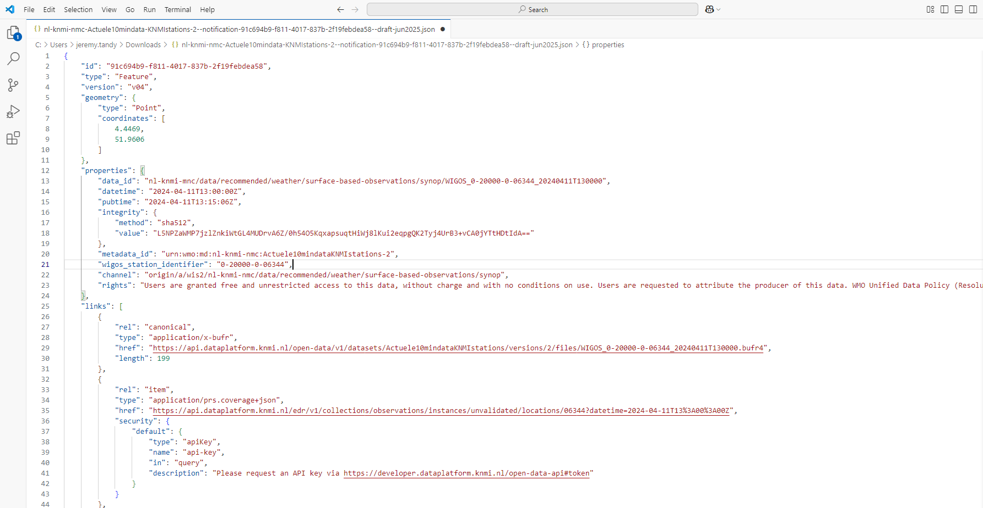
So – what do we need to know about WIS2 Notification Messages for data?
Let’s take a look at a fictional example providing a notification advertising availability of new data from WIGOS Station 0-20000-0-06344 (ROTTERDAM THE HAGUE AP, Netherlands) as part of KNMI’s current 10-minute observation dataset (Actuele10mindataKNMIstations-2):
Notification identifier id must always be unique – use a UUID
"id": "91c694b9-f811-4017-837b-2f19febdea58"
Including geometry for the data item is good practice – it helps Data Consumers decide if this particular data item is one they want
"geometry": {
"type": "Point",
"coordinates": [
4.4469,
51.9606
]
}
8
Notes:
Note that the {centre-id} `nl-knmi-nmc` is not registered with WIS2
Manual on WIS (WMO No. 1060), Volume II
https://library.wmo.int/idurl/4/68731
Appendix E WIS2 Notification Message
https://wmo-im.github.io/wis2-notification-message/standard/wis2-notification-message-STABLE.html
WIS2 Cookbook (draft)
https://wmo-im.github.io/wis2-cookbook/cookbook/wis2-cookbook-DRAFT.html

Slide 9
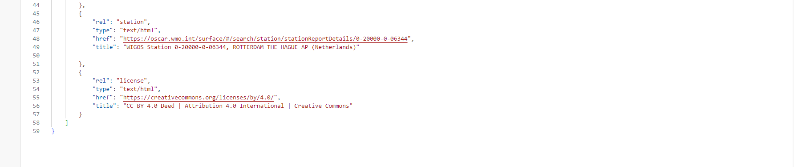
Identifier for the data item data_id must always be unique; you can decide how to do this, but most people are appending a local identifier (i.e., file/object name) to the topic
"data_id": "nl-knmi-nmc/data/recommended/weather/surface-based-observations/synop/WIGOS_0-20000-0-06344_20240411T130000"
datetime is the time associated with the data (i.e., the observation time) – also useful for users to determine if this is data they need
"datetime": "2024-04-11T13:00:00Z"
pubtime is the time when the notification message was sent; a CORRECTION must always have a later pubtime than the original message _and_ have a link with rel=update (see more on links later)
"pubtime": "2024-04-11T13:15:06Z"
Discovery metadata for the dataset _must_ exist before the data is shared. The Global Broker will discard messages for which there is no associated metadata record. This is also useful for Data Consumers – they find more context about this data item by searching in the Global Discovery Catalogue (or maybe their favourite search engine)
"metadata_id": "urn:wmo:md:nl-knmi-nmc:Actuele10mindataKNMIstations-2"
9
Notes:
`metadata_id` is not (yet) mandatory in the notification message – but the specifications will change in the next 12-months to make it so. For now, the Global Broker determines if there’s associated metadata by comparing the topic that a notification message is publish on against a list of _all_ topics from _all_ discovery metadata records published in the Global Discovery Catalogue. Not perfect, but it works (albeit with a few edge cases).
Manual on WIS (WMO No. 1060), Volume II
https://library.wmo.int/idurl/4/68731
Appendix E WIS2 Notification Message
https://wmo-im.github.io/wis2-notification-message/standard/wis2-notification-message-STABLE.html
WIS2 Cookbook (draft)
https://wmo-im.github.io/wis2-cookbook/cookbook/wis2-cookbook-DRAFT.html

Slide 10
The properties section in a GeoJSON record can contain anything. Here we’ve added the property wigos_station_identifier; given that KNMI’s 10-minute observations dataset contains 10s if not 100s of stations, this is a really easy way to help Data Consumers find the data items they need without them needing to download the data and unpack it to see if it’s what they need. This is called “client-side filtering”. See WIS2 Cookbook §3.6 Advertising client-side filters for data subscriptions in WCMP2 and WNM for details on this.
"wigos_station_identifier": "0-20000-0-06344"
We shouldn’t assume that Data Consumers know what they’re allowed to do with the data. Yes, they could look this up in the metadata record, but is does no harm to remind them in the notification message itself – at the point of data use ☺
"rights": "Users are granted free and unrestricted access to this data, without charge and with no conditions on use. Users are requested to attribute the producer of this data. WMO Unified Data Policy (Resolution 1 (Cg-Ext 2021))“
… and also providing a link to a license …
{
"rel": "license",
"type": "text/html",
"href": "https://creativecommons.org/licenses/by/4.0/",
"title": "CC BY 4.0 Deed | Attribution 4.0 International | Creative Commo
}
10
Notes:
Manual on WIS (WMO No. 1060), Volume II
https://library.wmo.int/idurl/4/68731
Appendix E WIS2 Notification Message
https://wmo-im.github.io/wis2-notification-message/standard/wis2-notification-message-STABLE.html
WIS2 Cookbook (draft)
https://wmo-im.github.io/wis2-cookbook/cookbook/wis2-cookbook-DRAFT.html

Slide 11
Here’s the crucial part of the notification message: the link to the data! Each link follows a similar structure. rel is the “link relation” type. A link with rel=canonical is always the default one to look at. Other link types include update and license (mentioned earlier), item and station (coming next), and more. A table (albeit incomplete) of link types is provided in the WCMP2 specification.
type provides the media type (MIME type) of the resource. length enables a simple integrity check. href provides the URL for the resource – in this case an observation for The Hague encoded in BUFR4. For Core data, it’s the URL in the canonical link that Global Caches will download from. For Core data, the URL in the canonical link _must_ be directly resolvable – i.e., no access controls or URL templates!
See the WIS2 Cookbook for information on how to embed that data within the message.
"links": [
{
"rel": "canonical",
"type": "application/x-bufr",
"href": "https://api.dataplatform.knmi.nl/open-data/v1/datasets/Actuele10mindataKNMIstations/versions/2/files/WIGOS_0-20000-0-06344_20240411T130000.bufr4",
"length": 199
},
…
]
11
Notes:
> `length` enables a simple integrity check
WIS2 Notification Messages have a more extensive mechanism to check integrity of the data. See the WIS2 Notification Message specification more information
Section 7. WIS2 Notification Message > #1 Requirements Class Core > #1.14 Integrity
https://wmo-im.github.io/wis2-notification-message/standard/wis2-notification-message-STABLE.html#_1_14_properties_integrity
Note that a WIS2 Node may restrict access to Core data using IP address filtering – WIS2 Global Services must be added to the IP whitelist so they can access and download. This is allowed because we encourage Data Consumers to download Core data from the Global Caches rather than the WIS2 Nodes themselves.
What is a URL template? A URL template, also known as a URI template, is a way to define a URL structure that can be dynamically modified by substituting placeholder values with specific data. These placeholders, often enclosed in curly braces {}, allow you to create URLs that change based on user context, data, or other factors.
Manual on WIS (WMO No. 1060), Volume II
https://library.wmo.int/idurl/4/68731
Appendix E WIS2 Notification Message
https://wmo-im.github.io/wis2-notification-message/standard/wis2-notification-message-STABLE.html
Appendix F WMO Core Metadata Profile version 2 (WCMP2)
https://wmo-im.github.io/wcmp2/standard/wcmp2-STABLE.html
Section 7: WMO Core Metadata Profile (Version 2) > #1 Requirements Class Core > #1.19 Links and distribution information > #1.19.5 Link relation section
https://wmo-im.github.io/wcmp2/standard/wcmp2-STABLE.html#_1_19_5_link_relation_selection
WIS2 Cookbook (draft)
https://wmo-im.github.io/wis2-cookbook/cookbook/wis2-cookbook-DRAFT.html
Section 3.3. Publishing a WIS2 Notification Message with embedded data
https://wmo-im.github.io/wis2-cookbook/cookbook/wis2-cookbook-DRAFT.html#_publishing_a_wis2_notification_message_with_embedded_data

Slide 12
KNMI also provide access to this data via an OGC-API EDR endpoint that requires an API key to access. The link relation item is used here to say that this link points to a resource that is a single item within the dataset (i.e., an observation at given place and time). The security block must follow one of the OpenAPI Security Schemes. In this case, we’re indicating the API key must be added to the API call using the query parameter api-key, and where you can request an API key. More information about providing resources with access control can be found in the WIS2 Cookbook.
{
"rel": "item",
"type": "application/prs.coverage+json",
"href": "https://api.dataplatform.knmi.nl/edr/v1/collections/observations/instances/unvalidated/locations/06344?datetime=2024-04-11T13%3A00%3A00Z",
"security": {
"default": {
"type": "apiKey",
"name": "AUTHORIZATION",
"in": “header",
"description": "Please request an API key via https://developer.dataplatform.knmi.nl/open-data-api#token"
}
}
}
12
Notes:
Manual on WIS (WMO No. 1060), Volume II
https://library.wmo.int/idurl/4/68731
Appendix E WIS2 Notification Message
https://wmo-im.github.io/wis2-notification-message/standard/wis2-notification-message-STABLE.html
Appendix F WMO Core Metadata Profile version 2 (WCMP2)
https://wmo-im.github.io/wcmp2/standard/wcmp2-STABLE.html
WIS2 Cookbook (draft)
https://wmo-im.github.io/wis2-cookbook/cookbook/wis2-cookbook-DRAFT.html
Section 3.2. Publishing a WIS2 Notification Message with access control
https://wmo-im.github.io/wis2-cookbook/cookbook/wis2-cookbook-DRAFT.html#_publishing_a_wis2_notification_message_with_access_control

Slide 13
We can also use links to point to other useful information – such as a details of the observing platform where the data was collected. Here we use link relation station to indicate we’re referring to only one station. The resource we’re linking to is the description in OSCAR Surface.
{
"rel": "station",
"type": "text/html",
"href": "https://oscar.wmo.int/surface/#/search/station/stationReportDetails/0-20000-0-06344",
"title": "WIGOS Station 0-20000-0-06344, ROTTERDAM THE HAGUE AP (Netherla
}
13
Notes:
Manual on WIS (WMO No. 1060), Volume II
https://library.wmo.int/idurl/4/68731
Appendix E WIS2 Notification Message
https://wmo-im.github.io/wis2-notification-message/standard/wis2-notification-message-STABLE.html
Appendix F WMO Core Metadata Profile version 2 (WCMP2)
https://wmo-im.github.io/wcmp2/standard/wcmp2-STABLE.html
WIS2 Cookbook (draft)
https://wmo-im.github.io/wis2-cookbook/cookbook/wis2-cookbook-DRAFT.html

Slide 14
Questions?
14

