Slide 1
WIS2 Downloader: A detailed look inside
Alberto Helguera
WMO Secretariat
WIS Section, Infrastructure Department

Slide 2
Agenda
Introduction & Background
Quick Start
User Guide
REST API Reference
Administration Guide
Developer Guide
Summary & Key Takeaways

Slide 3
Introduction

Slide 4
What is WIS2?
WMO Information System 2.0 (WIS2)
Next-generation framework for meteorological data exchange
Replaces the legacy Global Telecommunication System (GTS)
Uses open standards: MQTT, HTTP, WMO Core Metadata Profile
Global Broker Network
Publicly accessible MQTT brokers operated by WMO Members
Data published as WIS2 Notifications with download links
Transition period: 2025 - 2030
NMHSs migrate progressively; GTS remains operational in parallel

Slide 5
What is WIS2 Downloader?
Open-source tool for automated data acquisition from WIS2
Subscribes to WIS2 Global Brokers via MQTT
Automatically downloads meteorological data files
Containerised deployment using Docker & Docker Compose
Designed for NMHSs, researchers, and WIS2 node operators
Key design goals
Ease of deployment - one command to start
Reliability - deduplication, SHA-512 verification
Flexibility - topic wildcards, filter rules, multiple brokers
Observability - Prometheus metrics & Grafana dashboards

Slide 6
Key Features
Web UI with multi-language support (EN, FR, ES, AR, ZH, RU)
REST API for programmatic subscription management
MQTT topic wildcards (+ single level, # multi-level)
Topic search included via UI using GDC data
Pre- and post-download filtering by media type or custom rules
Automatic deduplication using Redis
SHA-512 integrity verification of downloaded files
File organisation: DownloadPath/YYYY/MM/DD/<filename>
Prometheus metrics + Grafana dashboards out of the box
Horizontal scaling: multiple workers or subscriber instances

Slide 7
System Requirements
Software prerequisites
Docker 20.10 or later
Docker Compose 2.0 or later
Network
Outbound access to WIS2 Global Broker on port 443 (MQTT over TLS)
Hardware (minimum for production)
4 GB RAM (8 GB recommended)
Sufficient disk space for downloaded data
Permissions
Linux: create downloads directory owned by UID 10001 / GID 988
Windows/macOS: Docker handles volume permissions automatically

Slide 8
Quick Start

Slide 9
Installation
Clone from GitHub
git clone https://github.com/World-Meteorological-Organization/wis2downloader
Run the setup script
bash setup.sh
Generates .env with a random FLASK_SECRET_KEY and REDIS_PASSWORD
Create the downloads directory (Linux)
mkdir -p downloads && sudo chown 10001:988 downloads
Edit the WIS2DOWNLOADER_BASE_URL env variable
Example:
WIS2DOWNLOADER_BASE_URL= http://alberto.champion.wis2dev.io
Start all services
docker compose up -d

Slide 10
First Steps after Launch
Web interface - http://BASE_URL
Browse the WIS2 catalogue or topic tree
Create your first subscription
REST API - http:// BASE_URL/api
POST /subscriptions to create a subscription programmatically
Grafana dashboard - http:// BASE_URL/grafana
Monitor download counts, bytes, queue length in real time
Verify downloads
Files appear in downloads/YYYY/MM/DD/ immediately

Slide 11
User Guide

Slide 12
Web Interface
Six main views - navigate with Alt+1 through Alt++7
Metrics | Catalogue | Topic Tree | Manual Subscription
Manage Downloads | Settings | Help
Catalogue search
Queries three GDC (Global Discovery Catalogue) endpoints
Full-text and faceted search
Topic tree browser
Hierarchical view of all available WIS2 topics
Language switcher
English, French, Spanish, Arabic, Chinese, Russian

Slide 13
Understanding WIS2 Topics
MQTT topic hierarchy
{origin|cache}/a/wis2/{centre-id}/data/{data-policy}/{domain}/...
Wildcard characters
+ matches a single topic level
# matches all remaining levels (must be last)
Example subscriptions
origin/a/wis2/+/data/core/# - all core data from any centre
origin/a/wis2/ro-roshydromet/data/core/weather/surface-based-observations/#
Data policies
core - freely available, no restrictions
recommended - available with conditions

Slide 14
Managing Subscriptions
Create via Web UI
Enter topic pattern and optional target sub-directory
Add filter rules interactively
Create via REST API
POST /subscriptions
{ "topic": "origin/a/wis2/+/data/core/#", "target": "mydata" }
List active subscriptions
GET /subscriptions
Delete a subscription
DELETE /subscriptions/{topic}

Slide 15
Filtering System
Optional filter object attached to each subscription
Ordered rule evaluation
Rules are evaluated in order; first match wins
Default action when no rule matches: accept
Filter stages
Pre-download - evaluate WIS2 notification metadata
Post-download - evaluate the downloaded file content
Built-in conditions
accepted_media_types - allow list of MIME types
Default: BUFR, GRIB, NetCDF, HDF, GIF, JPEG, PNG, TIFF, PDF, text
Custom conditions can be added by developers

Slide 16
File Organisation
Base directory: ./downloads
Date-based sub-directories
downloads/YYYY/MM/DD/<original-filename>
Date derived from download timestamp (UTC)
Optional target sub-directory
Specified per subscription
downloads /<target >/YYYY/MM/DD/<filename>
Original filenames are preserved
Duplicate detection
Redis tracks notification IDs to avoid re-downloading
SHA-512 checksum verified against notification metadata

Slide 17
Monitoring
Health check endpoint
GET /api/health - always returns 200 OK
Prometheus metrics endpoint
GET /api/metrics
Key metrics exposed
notifications_total - WIS2 notifications received
downloads_total - files successfully downloaded
downloads_bytes_total - total bytes downloaded
skipped_total - notifications skipped by filters
failed_total - download failures
celery_queue_length - pending download tasks
disk_total_bytes – total space on disk
disk_used_bytes – used space on disk
disk_free_bytes – unused space on disk
disk_downloads_bytes – disk space taken by downloads folder
Grafana dashboards with Prometheus and Loki data sources

Slide 18
REST API Reference

Slide 19
REST API Overview
Base URL: http://BASE_URL/api
OpenAPI specification
GET /openapi - machine-readable spec
GET /swagger - interactive Swagger UI
Three endpoint groups
Subscriptions - CRUD operations on topic subscriptions
Monitoring - health check and Prometheus metrics
Documentation - OpenAPI spec and Swagger UI
No built-in authentication on the API
Protect with reverse proxy, firewall, or VPN

Slide 20
Subscription API Endpoints
GET /subscriptions
List all active subscriptions (200 or 503)
POST /subscriptions
Body: { "topic": "...", "target": "...", "filters": {...} }
Returns 202 (accepted), 400 (bad request), or 503
GET /subscriptions/{topic}
Retrieve a specific subscription by topic (200, 400, 404, 503)
DELETE /subscriptions/{topic}
Remove a subscription (200, 400, or 503)

Slide 21
Monitoring API Endpoints
GET /health
Lightweight health probe - always returns HTTP 200
Use in container health checks and load balancer probes
GET /metrics
Prometheus text-format metrics
Scrape with Prometheus; visualise in Grafana
GET /openapi
Full OpenAPI 3 specification in JSON
GET /swagger or GET /
Swagger UI for interactive API exploration

Slide 22
Administration Guide

Slide 23
Security Considerations
WIS2 Downloader has NO built-in authentication or authorisation
Web interface and REST API are open by default
Required hardening steps
Set a strong, unique REDIS_PASSWORD (generated by setup.sh)
Use a cryptographically random FLASK_SECRET_KEY
Network-level protection (choose one or combine)
Reverse proxy with authentication (NGINX, Traefik, Caddy)
Firewall rules restricting access to trusted IP ranges
VPN - expose services only inside a private network
Container isolation: non-root user wis2 (UID 10001 / GID 988)

Slide 24
Scaling the Downloader
Increase download throughput
Raise Celery worker concurrency in docker-compose.yml
Deploy additional Celery worker containers
Subscribe to multiple Global Brokers
Run additional subscriber service instances
Each subscriber connects to a different Global Broker
Shared state
All instances share a single Redis backend
Redis deduplication prevents duplicate downloads across instances
All scaling is horizontal - no application code changes required

Slide 25
Maintenance Tasks
Data retention
Compress old downloads: tar -czf archive.tar.gz downloads/YYYY
Remove old date directories to free disk space
Redis snapshots
Redis RDB persistence enabled by default
Back up the redis-data volume regularly
Clearing state via Redis CLI
redis-cli DEL subscriptions - remove all subscriptions
redis-cli FLUSHDB - clear all cached data (use with caution)
Updating the downloader
docker compose pull && docker compose up -d

Slide 26
Developer Guide

Slide 27
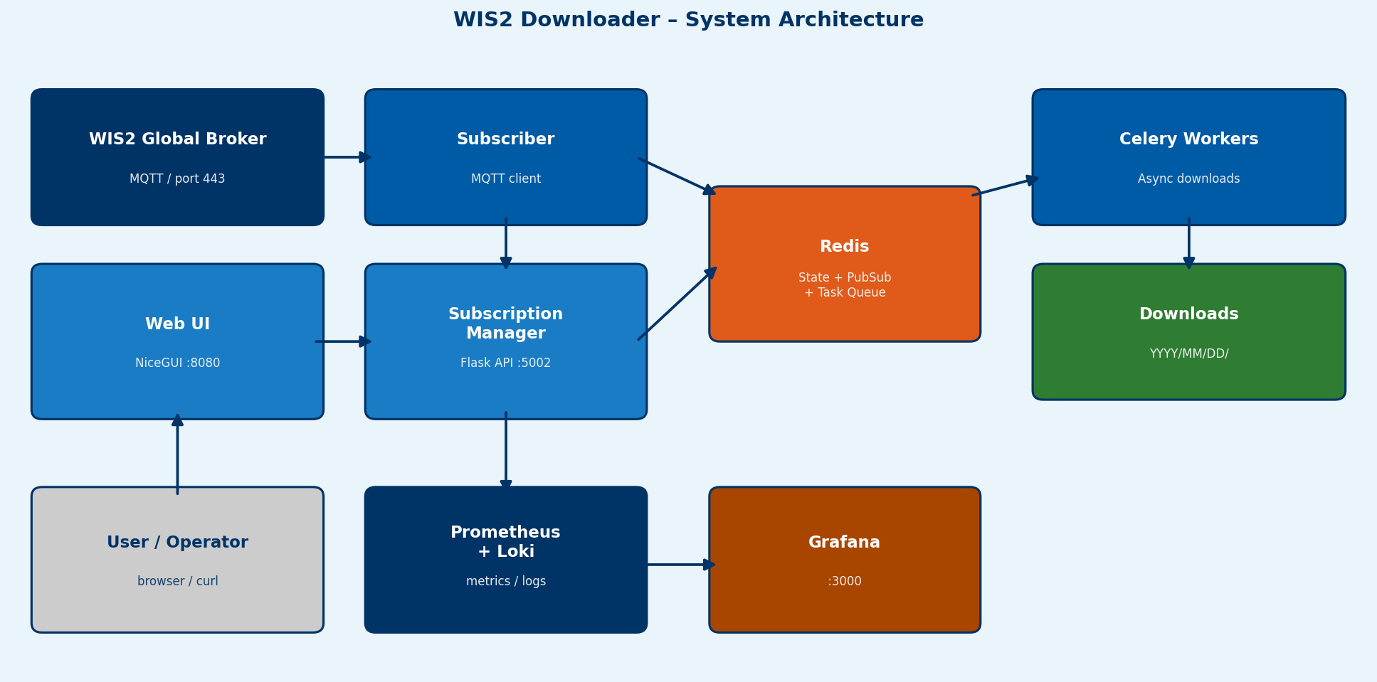
System Architecture

Slide 28
Module Structure
modules/
shared/ - Redis client, logging, filter engine
subscriber/ - MQTT connectivity and notification handling
subscription_manager/ - Flask REST API + Redis persistence
task_manager/ - Celery workers, download logic, SHA-512 check
ui/ - NiceGUI web application, catalogue search, i18n
Key design patterns
Deduplication using three Redis keys per notification
Modular filter engine - pluggable rule conditions
Metrics stored as atomic Redis hashes
GDC hierarchy cached in Redis to reduce API calls

Slide 29
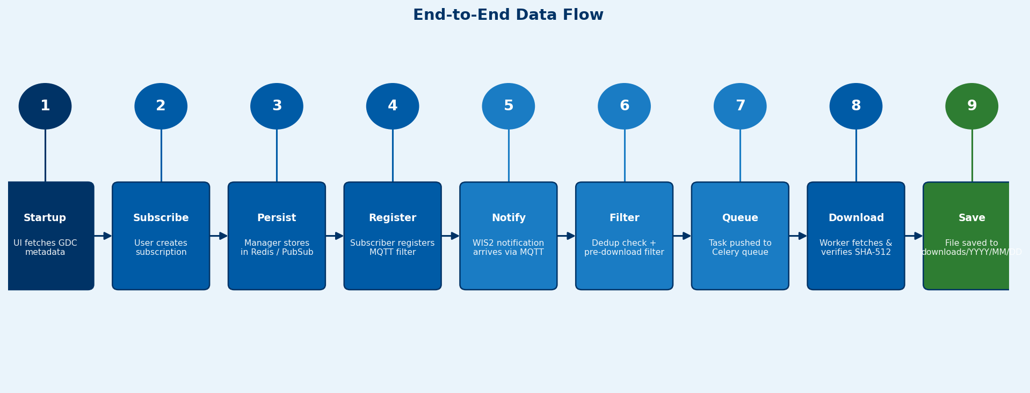
End-to-End Data Flow

Slide 30
Extending the System
Add a new filter condition
Implement the FilterCondition interface in modules/shared/filters/
Register condition in the filter engine factory
Add a new web UI view
Create a NiceGUI page module in modules/ui/
Register the route and keyboard shortcut
Add a new language
Create a translations/<lang>.json file with all UI keys
English is the automatic fallback for missing keys
Add new Prometheus metrics
Define metric names in modules/shared/metrics.py
Increment counters in task_manager or subscriber code

Slide 31
Key Takeaways
WIS2 Downloader simplifies WIS2 data acquisition
Docker-based deployment, up and running in minutes
Flexible subscription model
MQTT topic wildcards cover broad or narrow data interests
Production-ready features out of the box
Deduplication, SHA-512 verification, filtering, metrics
Horizontally scalable
Add workers or subscribers without code changes
Secure by configuration
No built-in auth - protect at network level with proxy/firewall/VPN
Active open-source project by WMO
github.com/World-Meteorological-Organization/wis2downloader

Slide 32
Thank You

