Slide 1

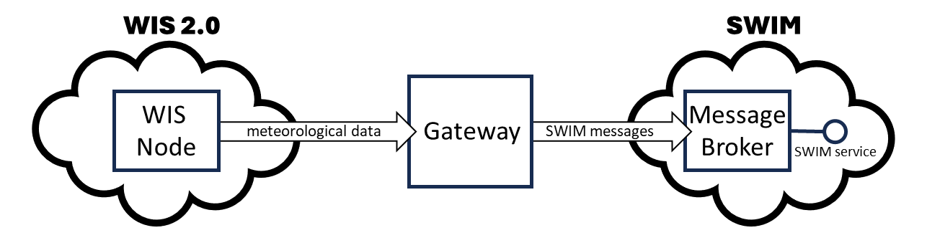
Editable:
WIS 2.0
SWIM
WIS
Node
Message
Broker
meteorological data
Gateway
SWIM messages
SWIM service
Image:

Slide 2
Editable:
WIS 2.0
ODIS
WIS 2.0
ODIS
GDC
WCMP2
GDC
WCMP2
Metadata
Metadata
WCMP2 + schema.org
WCMP2 + schema.org
WIS 2.0
ODIS
WIS 2.0
ODIS
GDC
WCMP2
GDC
WCMP2
Metadata
Metadata
WCMP2 + schema.org
WCMP2 + schema.org

Slide 3
Editable:
Global
Discovery
Catalogue
download (HTTPs) [configuration information]
download (HTTPs) [discovery metadata]
SWIM service
WIS
Node
download (HTTPs) [data]
Message
Broker
Gateway
subscribe (MQTT)
[notification message]
push (MQTT)
[notification message]
push
[data message]
(AMQP)
push (MQTT) [notification message]
push (MQTT)
[notification message]
subscribe (MQTT) [notification message]
Global
Broker
subscribe (MQTT)
[notification message]
WMO responsibility
ICAO responsibility

Slide 4
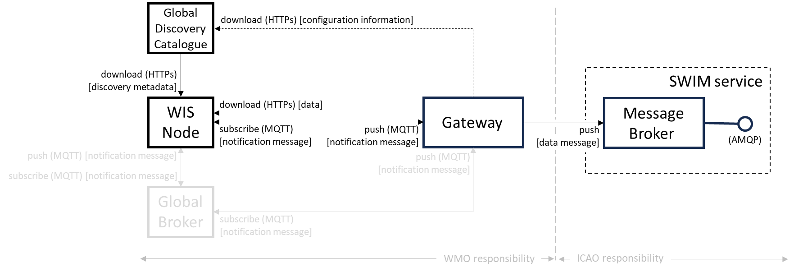
Image:

