Slide 1

WIS 2.0 Training Workshop, Windhoek, Namibia, 20-24 March 2023​
BUFR in a nutshell
Enrico Fucile
Head, Data and Information Management Division

Slide 2
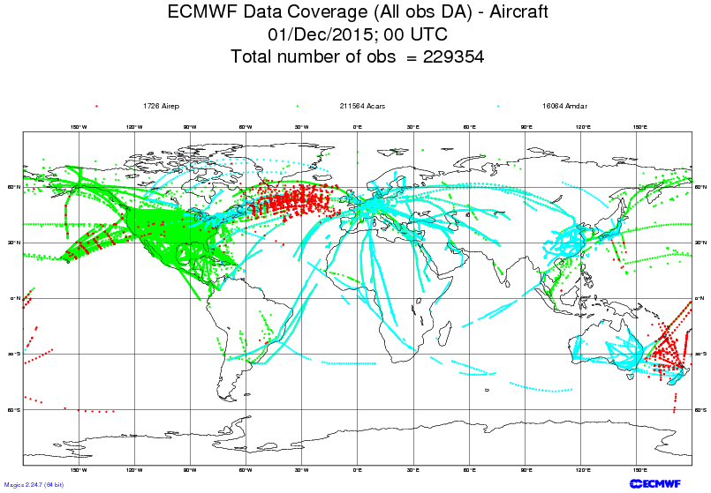
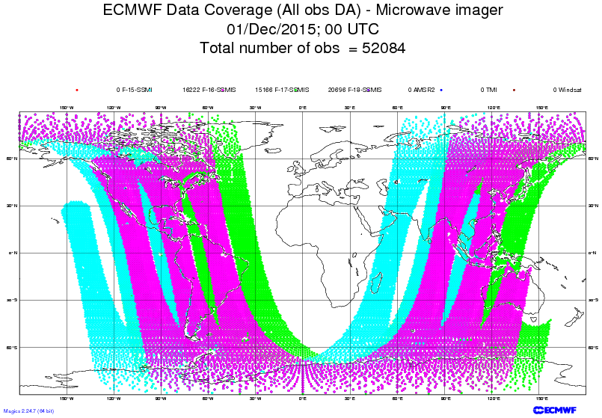
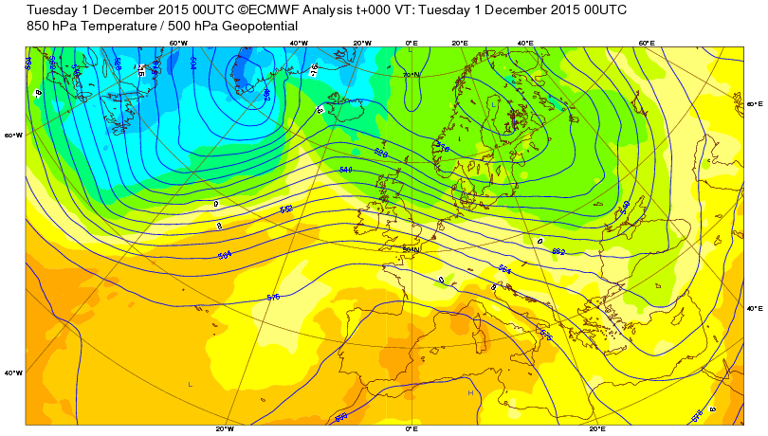
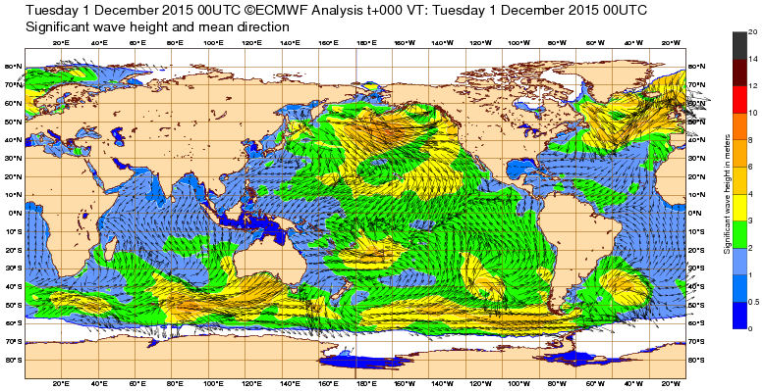
WMO Binary codes
BUFR (Binary Universal Form for the Representation of meteorological data)
a flexible binary format
mainly used to encode in situ and satellite observations
can also represent forecast data (e.g. tropical cyclone tracks)
GRIB (General Regularly-distributed Information in Binary form)
designed to encode data produced by numerical weather prediction models.
can also represent observations, but on a regularly distributed coverage

Slide 3
WMO Binary codes
Fully describes GRIB and BUFR coding standards
It is publicly accessible on the WMO web site https://library.wmo.int/doc_num.php?explnum_id=11283
Some freely available decoders
https://confluence.ecmwf.int/display/ECC/ecCodes+Home
A new version of the tables which are part of the manual is released every six months
Latest version of the tables is accessible in several formats from the WMO web site https://community.wmo.int/en/activity-areas/wis/latest-version

Slide 4
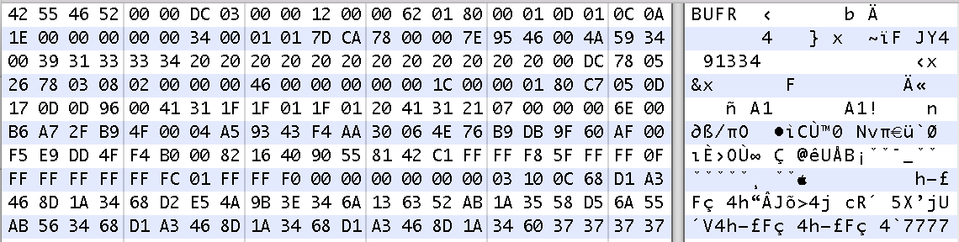
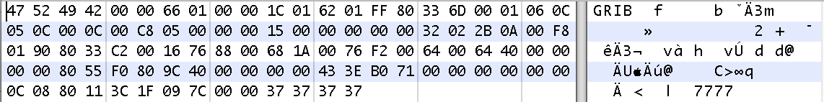
WMO Binary codes

Slide 5
GRIB vs. BUFR
GRIB structure
BUFR structure
SECTION 0 – Indicator
SECTION 0 – Indicator
Any kind of information you can describe using elements from the BUFR tables
SECTION 1 – Identification
SECTION 1 – Identification
SECTION 2 – Optional Local Use
Physical quantity on a space-time domain
SECTION 2 – Optional Local Use
SECTION 3 – Grid Definition
SECTION 4 – Product Definition
SECTION 3 – Data Description
SECTION 5 – Data Representation
SECTION 4 – Binary Data
SECTION 6 – Bitmap
SECTION 7 – Binary Data
SECTION 5 – End Section
SECTION 8 – End Section

Slide 6
BUFR structure
SECTION 0 – Indicator
Describes the structure of the data
SECTION 1 – Identification
HEADERS
SECTION 2 – Optional Local
SECTION 3 – Data Description
DATA
SECTION 4 – Binary Data
Contains the encoded data values
SECTION 5 – End Section

Slide 7
BUFR headers
SECTION 0 – Indicator
BUFR
Total length of BUFR message
BUFR edition number
SECTION 1 – Identification
Length of section
BUFR master table
Identification of originating/generating centre
Identification of originating/generating sub-centre
Data category
International data sub-category
Local data sub-category
Version number of master tables
Version number of local tables
Year
Month
Day
Hour
Minute
Second
SECTION 2 – Optional Local
Whatever the originating centre needs for internal purposes (processing, archiving)

Slide 8
Contains a list of six digit descriptors in the form F-X-Y → 0-04-006
Descriptors starting with
F=0 are elements listed in Table B
F=1 denote replication of descriptors
F=2 are operators acting on descriptors
F=3 are sequences of descriptors listed in Table D
recipe
SECTION 3
301051 004006 007002 010004 012001 011001 011002 011031 011032 011033 020041
SECTION 4
Contains the encoded values as a bit stream which can be decoded
Implementing the decoding regulations and notes
Using the Tables
01001010111010100101010101010101000100010101010100010101001010010101001001010010100101010101010101111000010101001001
ingredients

Slide 9
BUFR Table B (descriptors starting with 0)
encoding parameters
meaning
Elements descriptors
9

Slide 10
Replication (descriptors starting with 1)
103002 004006 007002 010004 012001 011001 011002 011031 011032 011033 020041
004006 007002 010004 004006 007002 010004 012001 011001 011002 011031 011032 011033 020041
unexpanded
106002 008002 104003 005002 006002 010002 012001
Expansion
expanded
008002 104003 005002 006002 010002 012001 008002 104003 005002 006002 010002 012001
008002 005002 006002 010002 012001 005002 006002 010002 012001 005002 006002 010002 012001 008002 005002 006002 010002 012001 005002 006002 010002 012001 005002 006002 010002 012001

Slide 11
Delayed replication (descriptors starting with 1)
103000 031001 004006 007002 010004 012001 011001 011002 011031 011032 011033 020041
004006 007002 010004 004006 007002 010004 012001 011001 011002 011031 011032 011033 020041
2
01001010111010100101010101010101000000010101010100010101001010010101001001010010100101010101010101111000010101001001

Slide 12
Operators (descriptors starting with 2)
004006 012001 011001 011002 011031 011032 011033 020041
201131 004006 201000 012001 011001 011002 011031 011032 011033 020041
131-128=3
Add 3 bits
6 + 3 = 9 bits
6 bits
01001010111010100101010101010101000000010101010100010101001010010101001001010010100101010101010101111000010101001001
01001010111010100101010101010101000000010101010100010101001010010101001001010010100101010101010101111000010101001001

Slide 13
Bitmap and quality information
Wind speed (7th element in referred by the bitmap, corresponds to the zero → present )
012001 011001 011002 011031 011032 011033 020041 012001 011001 011002 011002 011032 011033 020041 236000 101010 031031 033007
Percent confidence of wind speed
Bitmap
031031
Data present indicator
0 → present
1 → not present
0100101011101010010101010101010101010100011111101110010101001001010010100101010101010101111000010101001001
10 bits

Slide 14
BUFR Table D (descriptors starting with 3)
Sequence description
Sequence descriptor
In section 3 is equivalent to the list of descriptors
Names of the descriptors in the sequence
List of descriptors. It can contain sequence descriptors

Slide 15
Tables versions
0 -> meteorology
No other values defined
SECTION 1 – Identification
Length of section
BUFR master table
Identification of originating/generating centre
Identification of originating/generating sub-centre
Data category
International data sub-category
Local data sub-category
Version number of master tables
Version number of local tables
Year
Month
Day
Hour
Minute
Second
Master tables are the official WMO tables
Local tables are defined by the originating Centre and can be used to exchange data by bilateral agreement. No WMO official. Versions are maintained by the Centre

Slide 16
Thank you
Merci

