Slide 1

WIS 2.0 Training Workshop, Windhoek, Namibia, 20-24 March 2023​
WIS2 in a box Architecture
Tom Kralidis
Senior Geospatial Architect
Meteorological Service of Canada
tom.kralidis@ec.gc.ca
@tomkralidis

Slide 2
Table of Contents
Architecture and design
Components deep dive

Slide 3
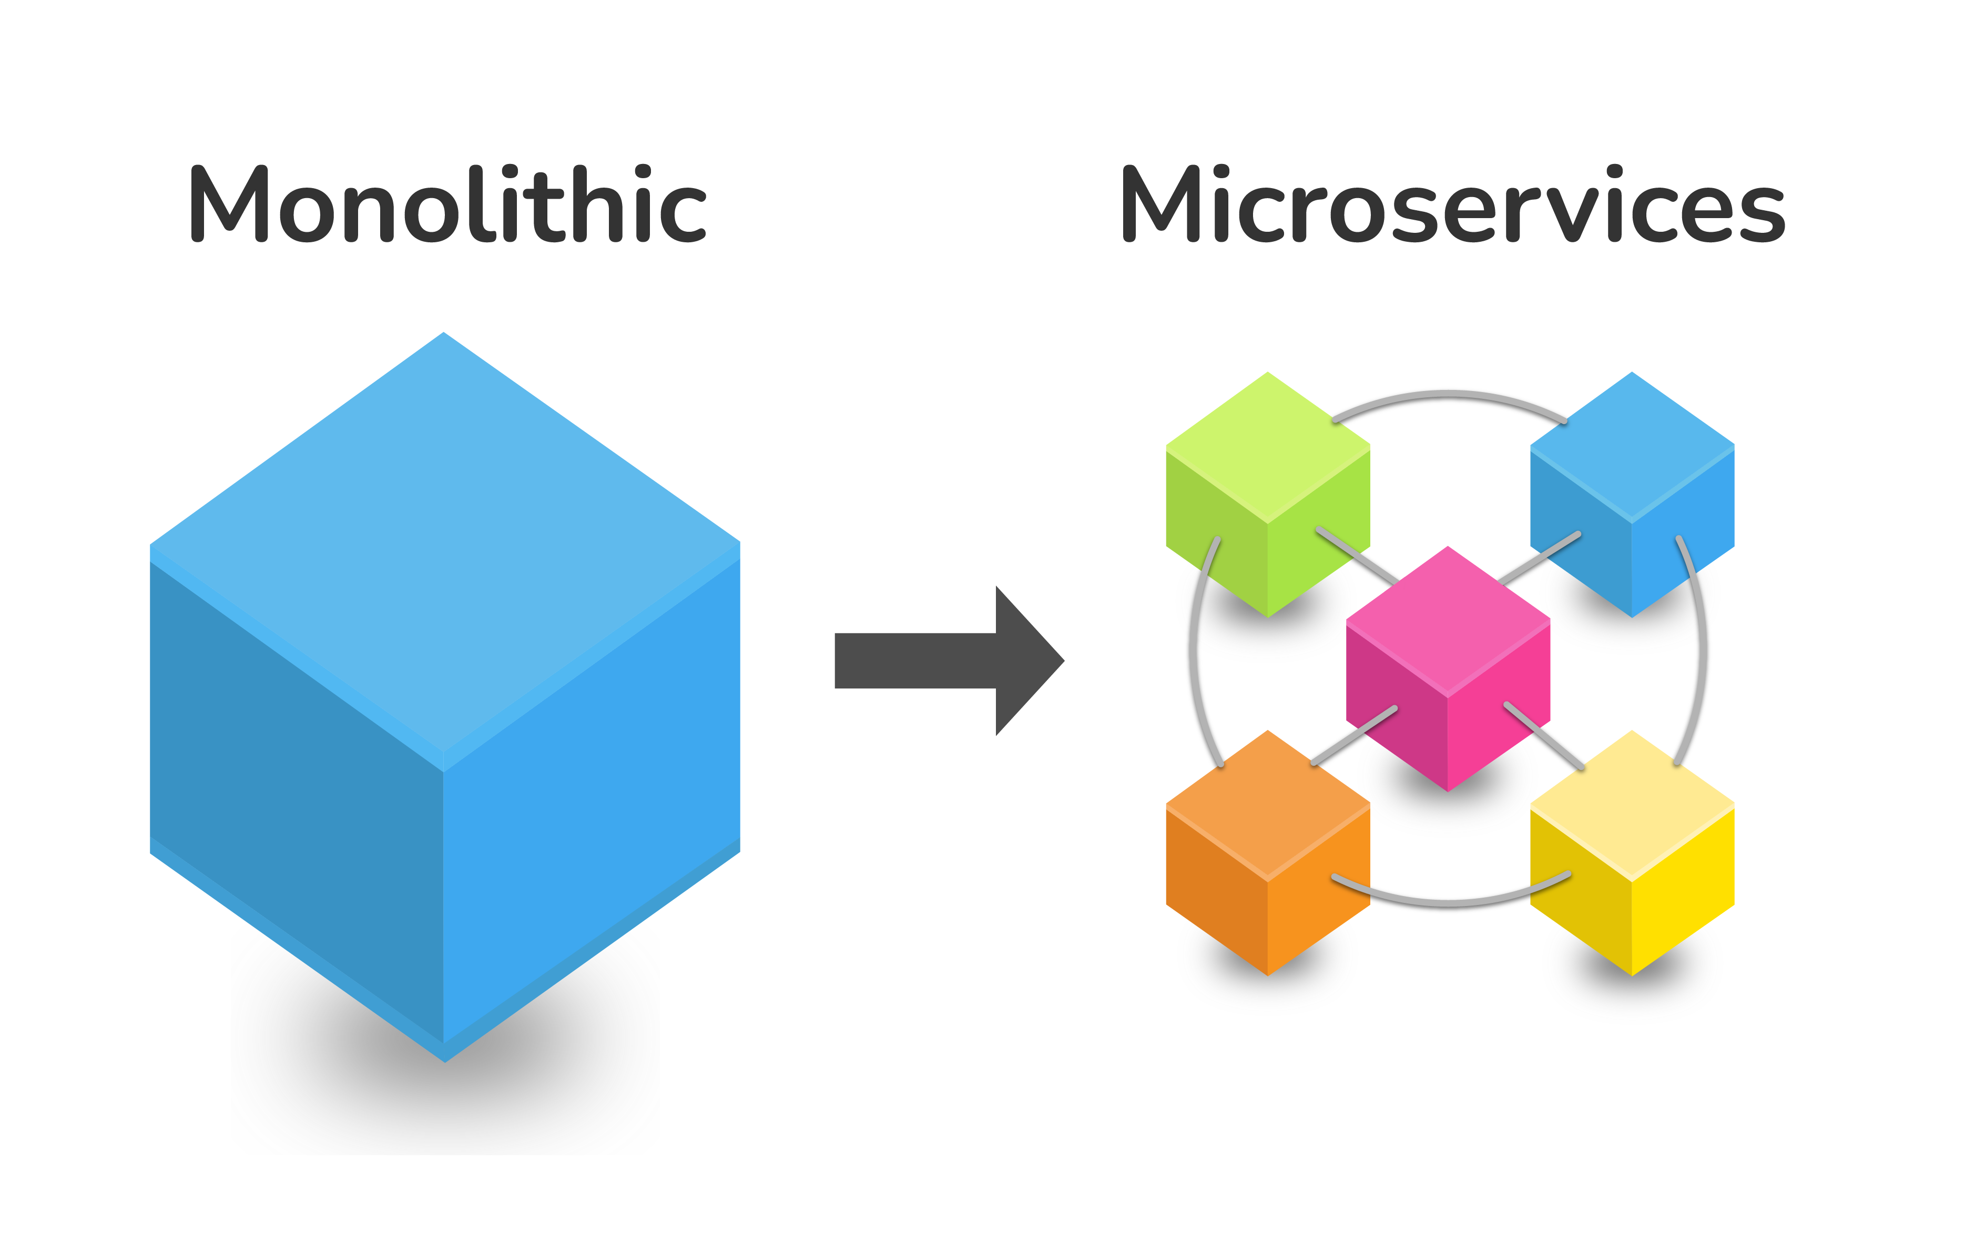

Docker
wis2box uses Docker for application management
Containerization
Microservices
Building blocks

Slide 4


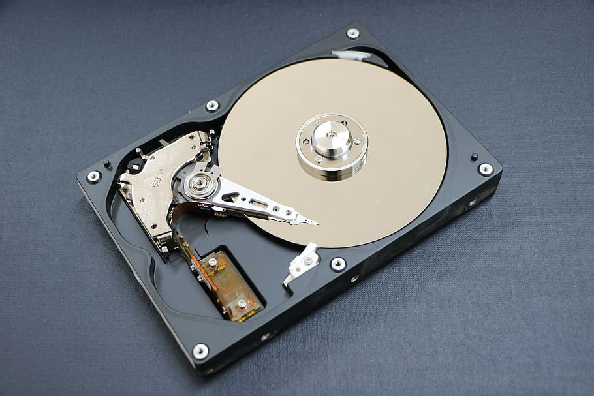
Docker Terminology
Image: a recipe on how to create a running system
Build
Container: a running system based on an image
Run
Volume: data storage
Store
Notes:
This Photo by Unknown Author is licensed under CC BY-SA
This Photo by Unknown Author is licensed under CC BY-NC

Slide 5
Containers
Broker
Web Application
Management
API
Storage
Metrics

Slide 6
WIS2 Components
Component | Technology | Docker Container
Storage | MinIO | wis2box-minio
Broker | mosquitto | wis2box-broker
Management | Python | wis2box-management
API | pygeoapi | wis2box-api
Web Application | Vue.js/LeafletJS | wis2box-ui
Metrics | Grafrana/ Prometheus/Loki | grafana

Slide 7

Storage
Technology: MinIO
Object storage (S3)
Container: wis2box-minio
Management of:
Data (observations, etc.)
Metadata (discovery, station)
Configuration

Slide 8

Broker
Technology: mosquitto
Container: wis2box-broker
Subscription and notifications
Data ingest
Data publication to WIS2

Slide 9

Management
Technology: Python
Container: wis2box-management
Metadata management
Discovery
Station
Configuration

Slide 10

API
Technology: pygeoapi
Container: wis2box-api
Geospatial web API
OGC standards
Discovery
Access
Visualization
Processing

Slide 11


Web Application
Technology: Vue.js/Leaflet
Container: wis2box-ui
Visualization (stations, observations)
Maps
Tables
Graphs

Slide 12
Core Workflows
Publish
Discovery metadata
Data
Notifications
Subscribe
WIS 2.0 Global Services subscription
Notifications
Download
Notifications
Core data
Design Time
Run Time
This Photo by Unknown Author is licensed under CC BY-NC

Slide 13

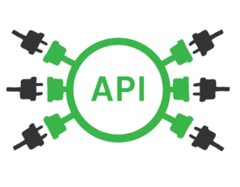


Data Exchange Lifecycle (Runtime)
Data (file) arrival
API Publication
Data pipeline
(Transformation or passthrough)
Identification
PubSub Notification
Data Publication (WAF)

Slide 14
Containers
Data (file) arrival
Broker
Web Application
Management
API
Storage
Metrics

Slide 15
wis2box configuration basics
WIS2 Discovery metadata (YAML)
Station metadata (CSV)
Data mappings (YAML)
Plugins

Slide 16

wis2box plugins
Plugins enable custom data integration into wis2box
Python
Abstract model/approach
Extensibility
Reuse
Notes:
Image credit: https://ithemes.com/blog/what-is-a-plugin/

Slide 17
wis2box plugins Concept
Configuration (data mappings)
wis2box core
wisbox plugin
code
Notes:
Image credit: https://ithemes.com/blog/what-is-a-plugin/

Slide 18
wis2box csv2bufr plugin
wisbox plugin
wis2box core
Configuration (data mappings)
csv2bufr
mwi.mwi_met_centre.data.core.weather.surface-based-observations.synop:
plugins:
csv:
- plugin: wis2box.data.csv2bufr.ObservationDataCSV2BUFR
template: synop_bufr.json
notify: true
file-pattern: '^WIGOS_(\d-\d+-\d+-\w+)_.*\.csv$'
bufr4:
- plugin: wis2box.data.bufr2geojson.ObservationDataBUFR2GeoJSON
file-pattern: '^WIGOS_(\d-\d+-\d+-\w+)_.*\.bufr4$'
Notes:
Image credit: https://ithemes.com/blog/what-is-a-plugin/

Slide 19
wis2box synop2bufr plugin
wisbox plugin
wis2box core
Configuration (data mappings)
synop2bufr
rou.rnimh.data.core.weather.surface-based-observations.synop:
plugins:
txt:
- plugin: wis2box.data.synop2bufr.ObservationDataSYNOP2BUFR
notify: true
file-pattern: ‘^*_(\d{4})(\d{2}).*.txt$'
bufr4:
- plugin: wis2box.data.bufr2geojson.ObservationDataBUFR2GeoJSON
file-pattern: '^A_SMR.*EDZW_(\d{4})(\d{2}).*.bufr4$'
Notes:
Image credit: https://ithemes.com/blog/what-is-a-plugin/

Slide 20
wis2box bufr plugin
wisbox plugin
wis2box core
Configuration (data mappings)
ecCodes
dza.alger_met_centre.data.core.weather.surface-based-observations.synop:
plugins:
bufr4:
- plugin: wis2box.data.bufr4.ObservationDataBUFR
notify: true
buckets:
- ${WIS2BOX_STORAGE_INCOMING}
file-pattern: '^.*\.bufr4$'
- plugin: wis2box.data.bufr2geojson.ObservationDataBUFR2GeoJSON
buckets:
- ${WIS2BOX_STORAGE_PUBLIC}
file-pattern: '^WIGOS_(\d-\d+-\d+-\w+)_.*\.bufr4$'
Notes:
Image credit: https://ithemes.com/blog/what-is-a-plugin/

Slide 21
Wis2box BUFR plugin
Uses ecCodes
wisbox plugin
ecCodes
bufr2geojson
Notes:
Image credit: https://ithemes.com/blog/what-is-a-plugin/

Slide 22

Thank you
Merci
Gracias
شكرا
谢谢

