Slide 1

WMDR2 bootstrap
Tom Kralidis
Chair, ET-Metadata
22 January 2026

Slide 2
Outline
OSCAR/Surface renewal recap
Overviews
  OGC API – Records
  WMO Core Metadata Profile (WCMP2)
  WIS2 Global Discovery Catalogue
WMDR2 Bootstrap

Slide 3
Summary
Ad hoc Task Team on OSCAR/Surface established in early 2025 to decide on:
  Operational model
  Prioritize use cases and functionalities for a MVP
Steps:
  Identification of Stakeholders, evaluation of current and potential use cases
  First draft of system requirements
  Proposal for the system architecture
  Identification of implementers
  Priorisation of requirements for the MVP and effort estimations

Slide 4
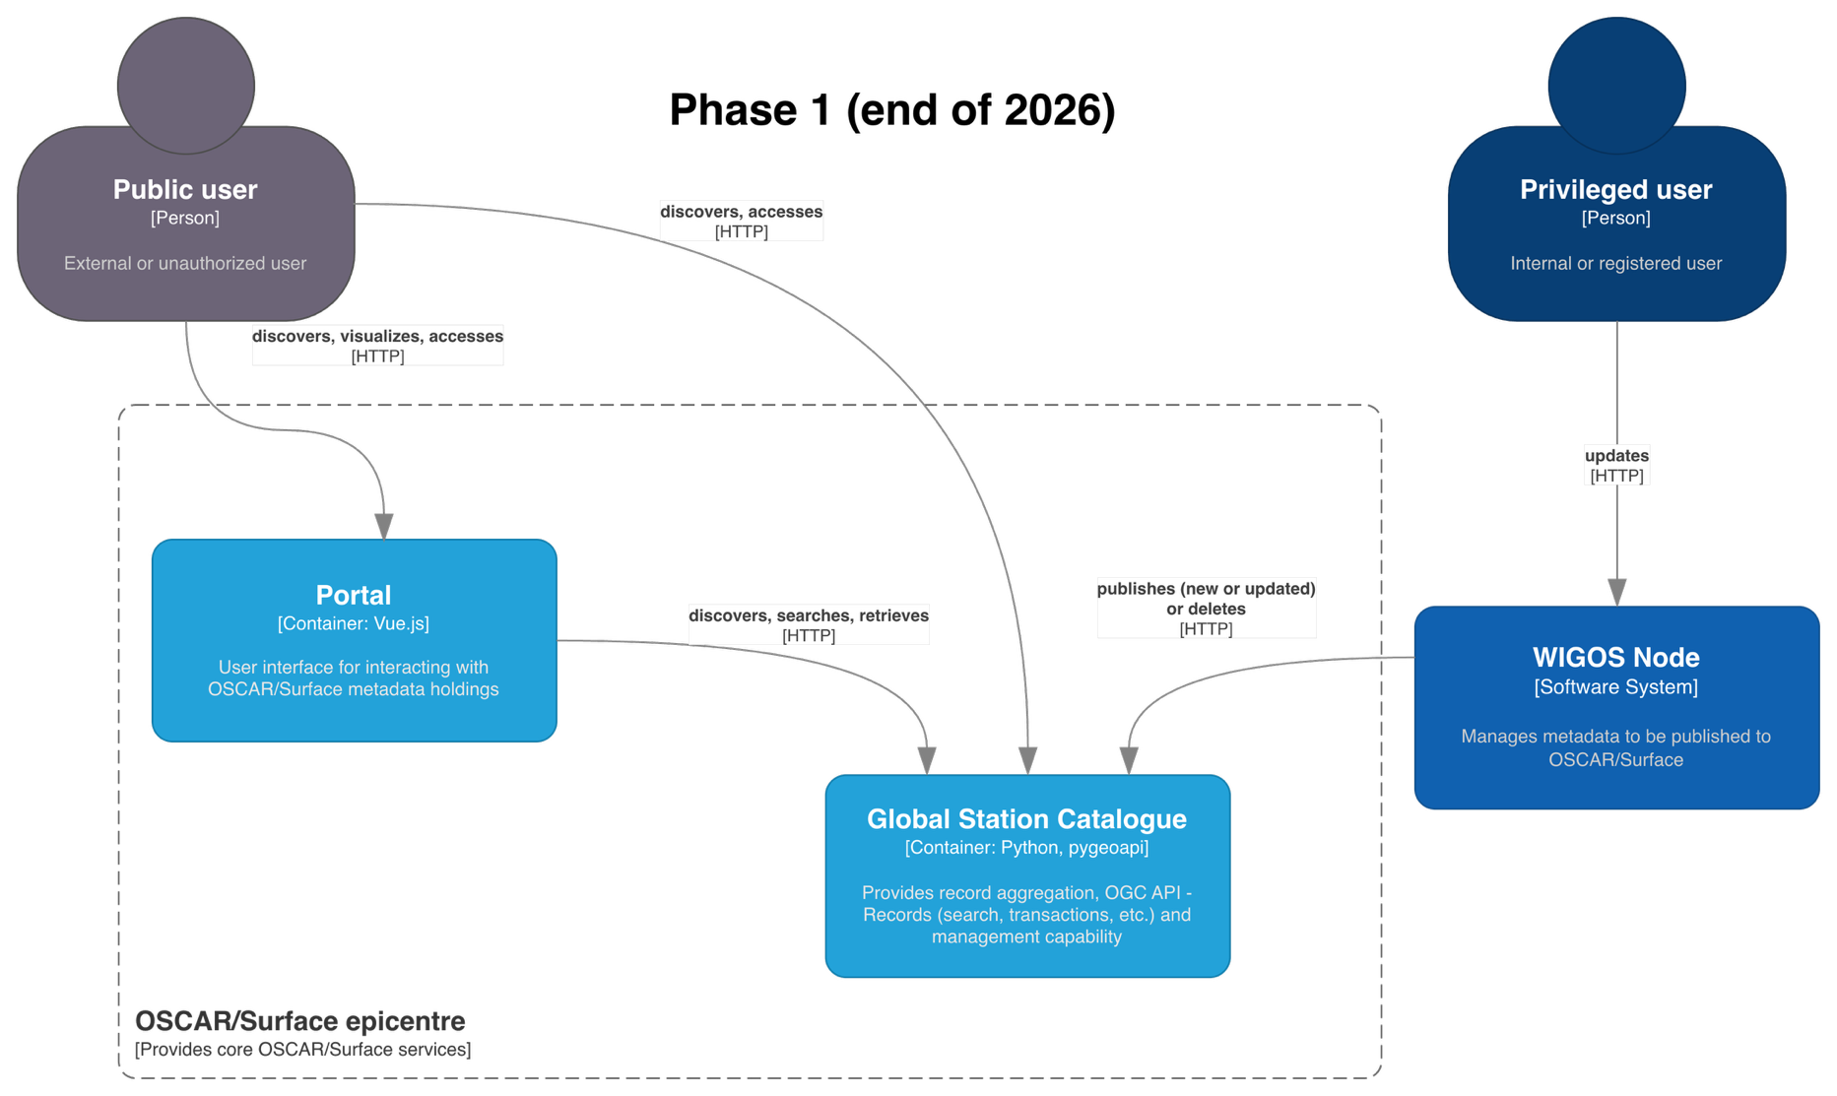

Slide 5
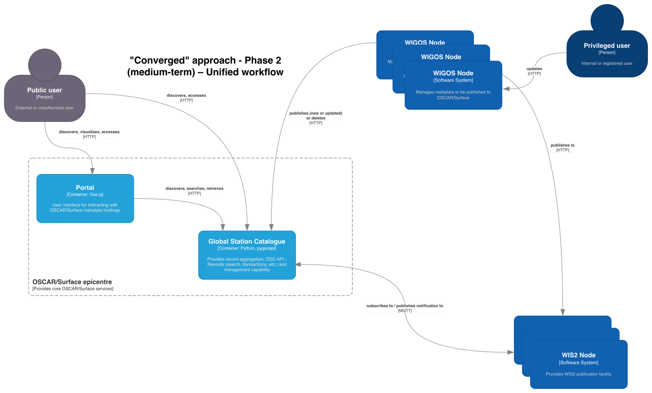

Slide 6
OSCAR next gen
Components
  WIGOS Node
  WIGOS Global Catalogue
  WIGOS Portal
Standards development
  WMDR2: JSON encoding rules (via TT-WIGOSMD)
    WCMP2 compatible
    github.com/wmo-im/wmdr2 (working area)
    wmo-im.github.io/wmdr2 (draft spec)
  WIGOS Global Catalogue
    WIS2 GDC compatible
    Component definition
    Technical considerations

Slide 7
OSCAR next gen
Standards implementation
  WMDR2: JSON encoding rules
    pywmdr Reference Implementation / test suite
    github.com/wmo-im/pywmdr
  WIGOS Global Catalogue
    wis2-gdc Reference Implementation
    github.com/wmo-im/wis2-gdc
    Extend to support WMDR2 and WIGOS Global Catalogue
Target: December 2026

Slide 8
OGC API - Records
Standard that provides discovery, query and modify capability for geospatial metadata about any resource on the Web
  APIs
  Content models
Published 2025
  ogcapi.ogc.org/records
  Specification: docs.ogc.org/is/20-004r1/20-004r1.html
Part 1: Core
  Record Core
  Searchable Catalog
  …
Part 2: Facets
Part 3: Create, Replace, Update, Delete, Harvest

Slide 9
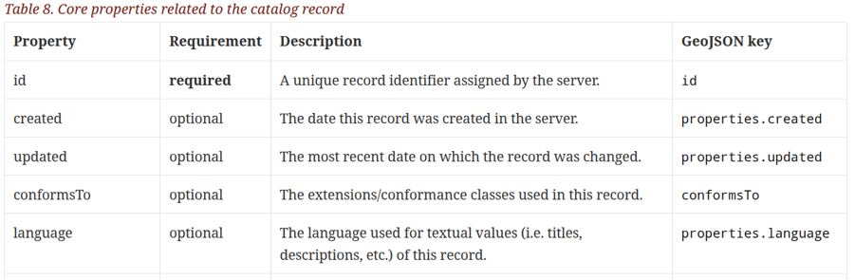
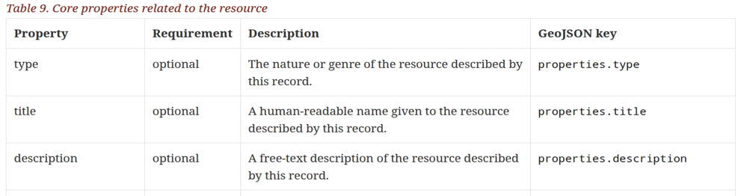
Record Core requirements class
A Record is the atomic unit of information in a catalogue
A Record provides a description of a resource to make it discoverable
This requirements class defines the schema of Record
HTML and GeoJSON encodings are defined; others allowed
Record Core is a Common Component that can be used as a Building Block for an Application Profile
  Broad interoperability: provides baseline elements for description and discovery

Slide 10
Record Core key primitives
id: unique record identifier
conformsTo: conformance / version declaration
type: fixed to “Feature” for GeoJSON interoperability
geometry: location definition (any geometry type: Point, LineString, Polygon, MultiPoint, etc.)
properties: attributes
  Can be a flat mapping (key => value) or nested (key1.key2 => value)
links: 1..n link object definitions
  IANA link relations
  Network accessible resources (e.g. HTTP)

Slide 11
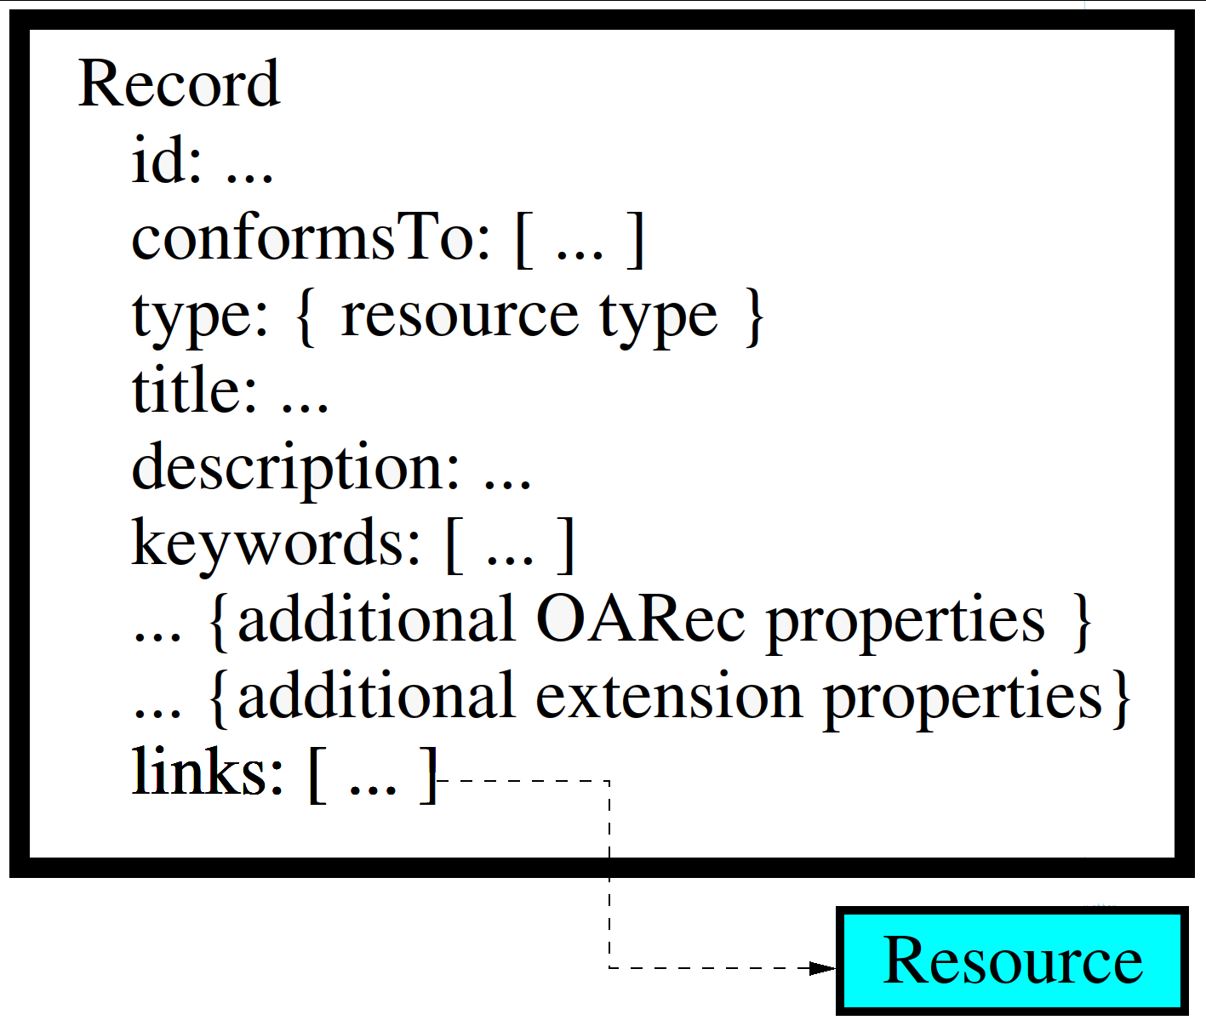
A typical record...
A record is the atomic unit of information in a catalog
It provides a summary description of one or more resources that are being made discoverable by the publisher of those resources
It includes references, via the "links" section, to the resources that it describes (i.e. binds)

Slide 12
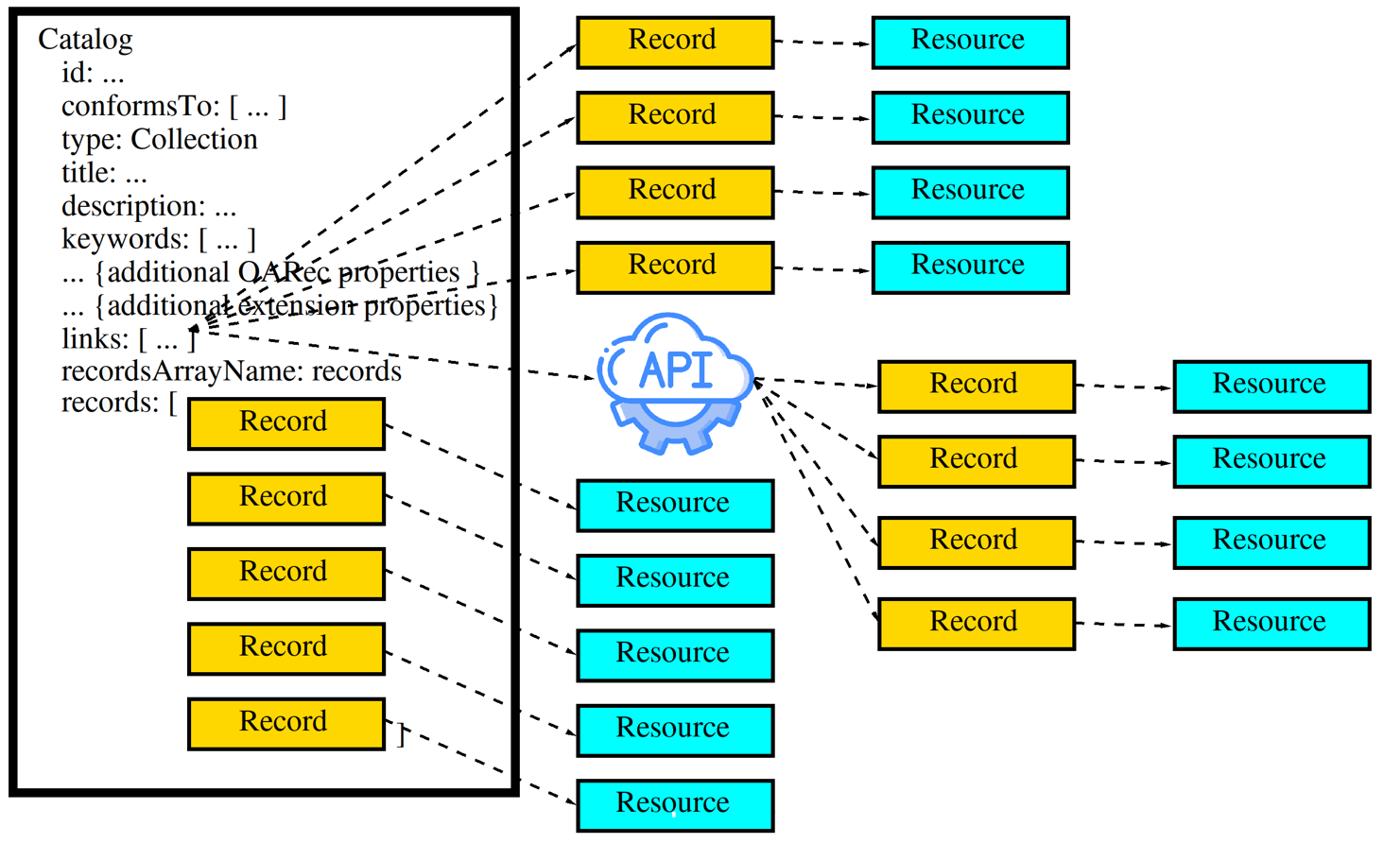
Putting it all together: catalogue of records about resources

Slide 13

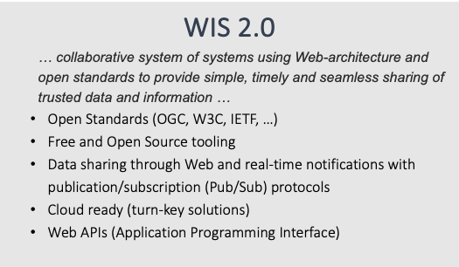
Implementations/Adoption: WMO WIS2
UN/WMO Information System (WIS2)
  next generation international data exchange
  for all Earth System Data
    weather, climate, water
  193 countries
  Discovery, access, retrieval
  Replaces WMO legacy systems
  (Global Telecommunication System [GTS])

Slide 14
Key documents
Manual on the WMO Information System, Volume II - WMO Information System 2.0
Guide to the WMO Information System Volume II - WMO Information System 2.0
Provisions for the Transition from the WMO Information System (WIS) 1.0 and Global Telecommunication System to WIS 2.0
WMO Unified Data Policy for the International Exchange of Earth System Data (Resolution 1 (Cg-Ext(2021)))
For informative purposes, the WIS2 Cookbook provides numerous examples, code snippets, recipes and workflows in support of WIS2 requirements.

Slide 15








Global Services
WIS2 Components: Global Services
Data users
Global Monitoring
Discovers datasets
Subscribes to topics
Downloads core data
Global Discovery Catalogue
Global Broker
Global Cache
Downloads recommended data
Downloads recommended data
Downloads recommended data
  Provides an API to discover datasets and services
  Sends notifications of new data to be downloaded from Global Caches or WIS2 nodes
Provides users HTTP download of core data cached from WIS2 nodes
WIS2 Node
WIS2 Node
WIS2 Node
Scale to highly-available, global data sharing

Slide 16
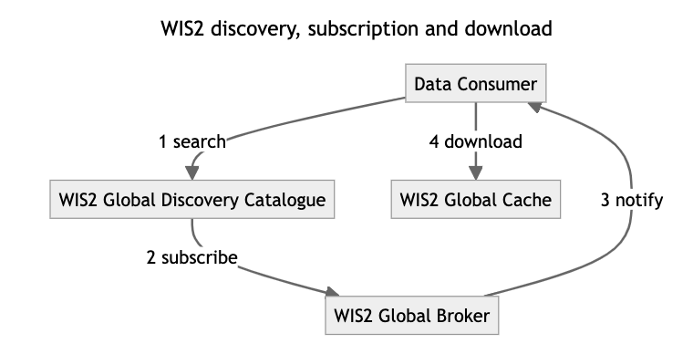
WMO WIS2 data consumer workflow

Slide 17




WMO Core Metadata Profile (WCMP2)
extension of OGC API - Records - Record Core
discovery metadata describing a given dataset or collection
  1 record = 1 dataset/collection
aligning with the WIS 2.0 Principles, discovery metadata published to the Global Discovery Catalogue
Description of the Dataset
Identifier
Title
Description
Keywords
Geometry (extent)
Time (extent)
Who to contact
Publisher contact
How to access
Data access (files)
Data access (API)
Data access (notifications)
search engines
WCMP2
«publish»
Global
Discovery
Catalogue
«index»
Conditions of use
Data policy
Rights
License
JSON
Manual on WIS (WMO No. 1060), Vol II, Appendix F: WMO Core Metadata Profile 2 [approved]
How to attribute
Citation
Guide to WIS (WMO No. 1061), Vol II, §1.3.2 How to provide discovery metadata to WIS2 [approved]

Slide 18
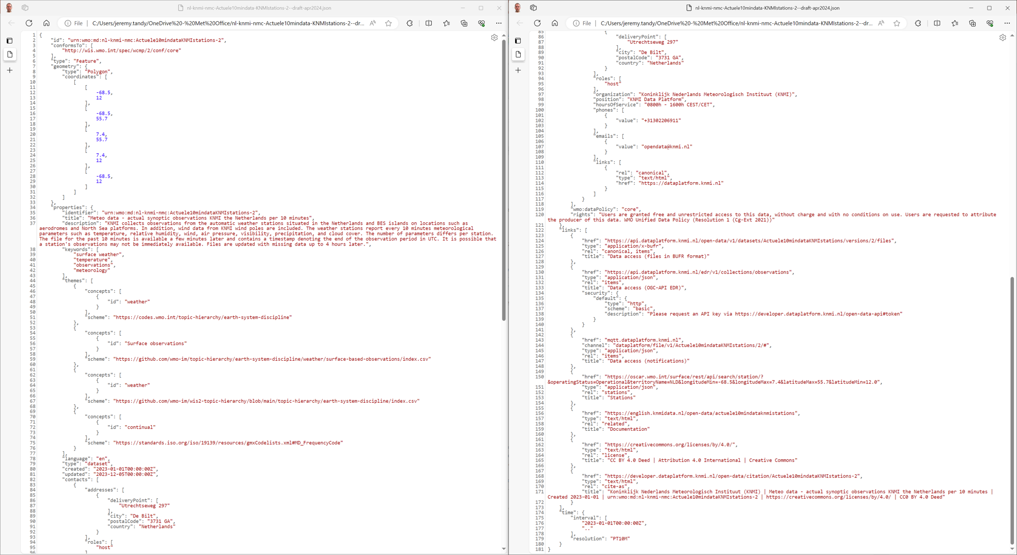
--------------------------------------
--------------------------------------
Geometry (extent)
Publisher contact (cont.)
Identifier
Data policy
Title
Rights
Description
Data access (files)
Keywords
Data access (API) with security info
Themes/concepts
Data access (notifications)
Additional info (OSCAR/Surface)
Additional info (Developer docs)
License
Publisher contact
Citation
Example: KNMI dataset (draft)
Time (extent) and update frequency

Slide 19
WCMP2 themes/concepts
Controlled vocabulary definitions
The themes property is a list of concepts that are referenced to a vocabulary or knowledge organization system used to classify the resource
A theme’s scheme property provides a remote reference to a controlled vocabulary, code list or knowledge organization system
A concept’s id provides an identifier for the given concept, as well as optional title, description and URL properties to further describe the concept as desired
A concept’s optional URL property can provide a remote reference to a given concept (for example, to an online ontology or code registry)

Slide 20
WCMP2 themes/concepts
"themes": [
{
"concepts": [
{
"id": "001",
"title": "Temperature/air temperature",
"url": "http://codes.wmo.int/bufr4/b/12/001"
},
{
"id": "003",
"title": "Dewpoint temperature",
"url": "http://codes.wmo.int/bufr4/b/12/003"
}
],
"scheme": "http://codes.wmo.int/bufr4/b"
}
]

Slide 21
WCMP2 links
Actionable
Meaningful (IANA link relations)
  https://www.iana.org/assignments/link-relations/link-relations.xhtml
The links property describes URLs and APIs for accessing the dataset or for subscribing to dataset notifications. Links are the primary mechanism for interacting with the data, and provide an "actionable" workflow to enhance and improve the user experience with "less clicks" for subscriptions and downloads
The links property may also describe URLs for licensing, related documentation, related data or visual images of the dataset

Slide 22
WCMP2 links
Subscription
{
"rel": "items",
"type": "application/geo+json",
"title": ”Real-time notifications",
"href": "mqtts://globalbroker.meteo.fr:8883",
"channel": "cache/a/wis2/ca-eccc-msc/data/core/weather/surface-based-observations"
}
API
{
"rel": "service-desc",
"type": "application/vnd.oai.openapi+json;version=3.0",
"title": "Data API",
"href": "https://example.org/api"
}

Slide 23
WCMP2 Extensions
Domain and discipline specific extensions to WCMP2
Namespaces/Earth system disciplines
  Weather
  Climate
  Space weather
  Cryosphere
  Hydrology
  Ocean
  Atmospheric Composition
Similar setup to STAC Extensions
github.com/wmo-im/wcmp2-extensions

Slide 24
WIS2 Global Discovery Catalogue (GDC)
Provides a cataloguing and discovery capability of WMO dataset collections (WCMP2 records) using the OGC API – Records standard
Web-based API facilitating search/browse data published via WIS
Harvests WIS 2 discovery metadata from WIS2 Nodes
Yellow pages (discovery metadata) gateway into WIS data and services
Provides indexing capability to mass market search engines
Provides quality assessment services of discovery metadata in support of continuous improvement in alignment with WIS 2 metadata Key Performance Indicators (KPIs)

Slide 25
Searchable Catalogue
Predicate | Example(s)
Spatial | bbox=minx,miny,maxx,maxy
Temporal | datetime=t1 datetime=t1/t2 datetime=t1/..
Freetext | q=air+temperature
Attributes | title=air+temperature nested.attribute=ozone
Sorting/paging | sortby=title&limit=100&startindex=11 “prev” / ”next” link relations
Filter returnable properties | properties=title,description

Slide 26
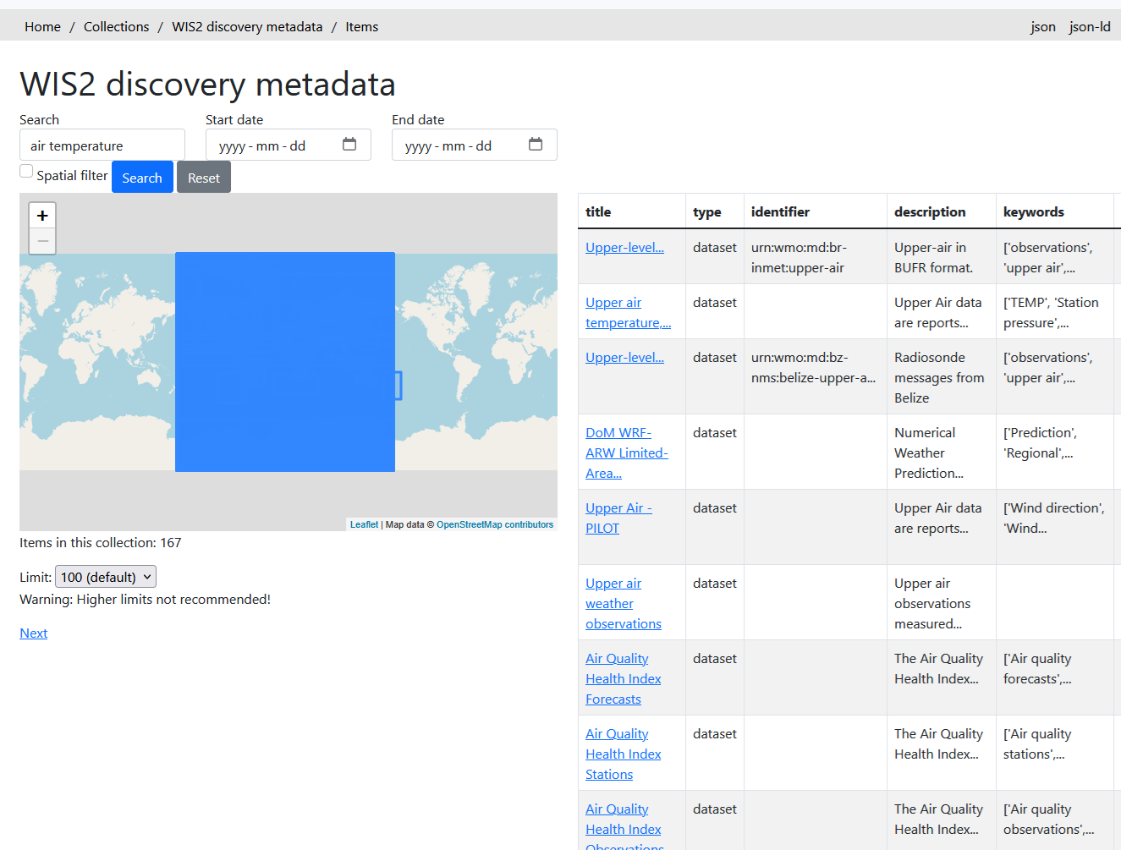
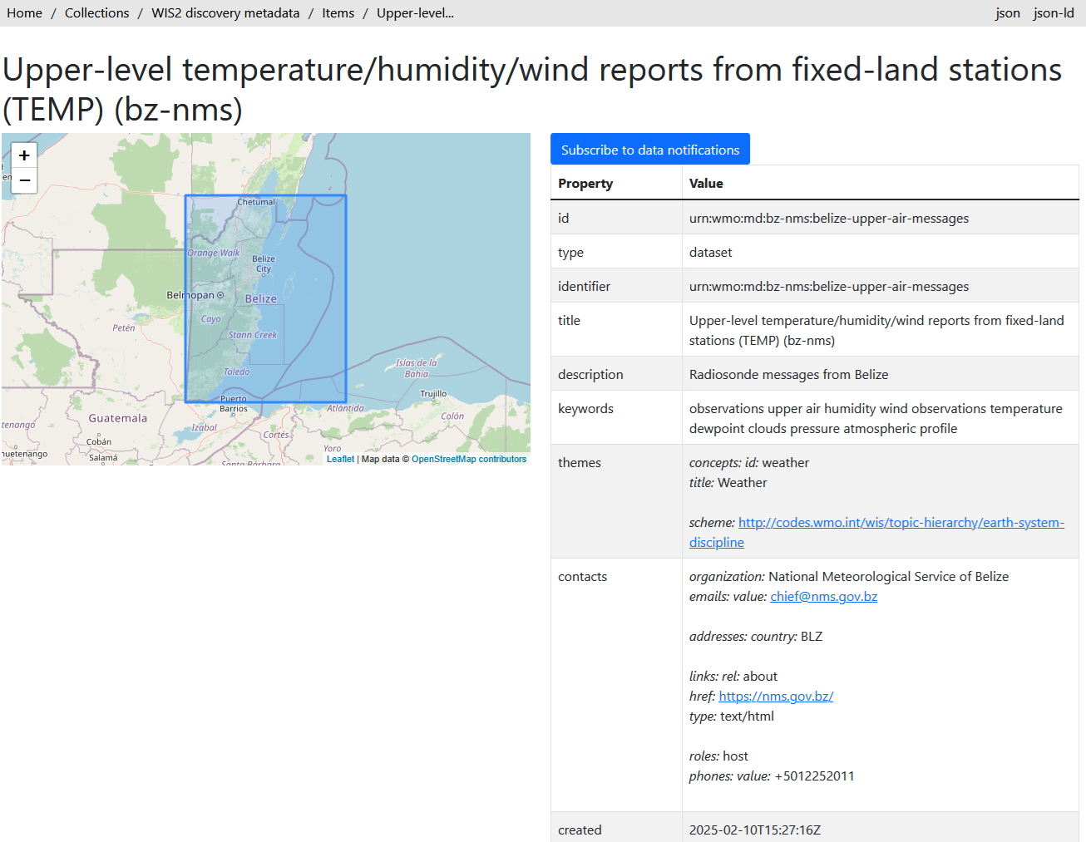
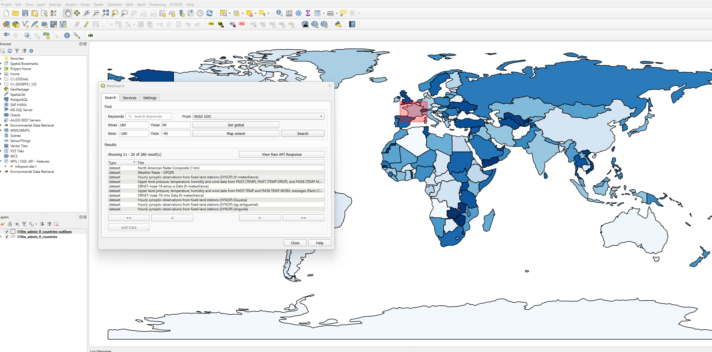
Catalogue search

Slide 27
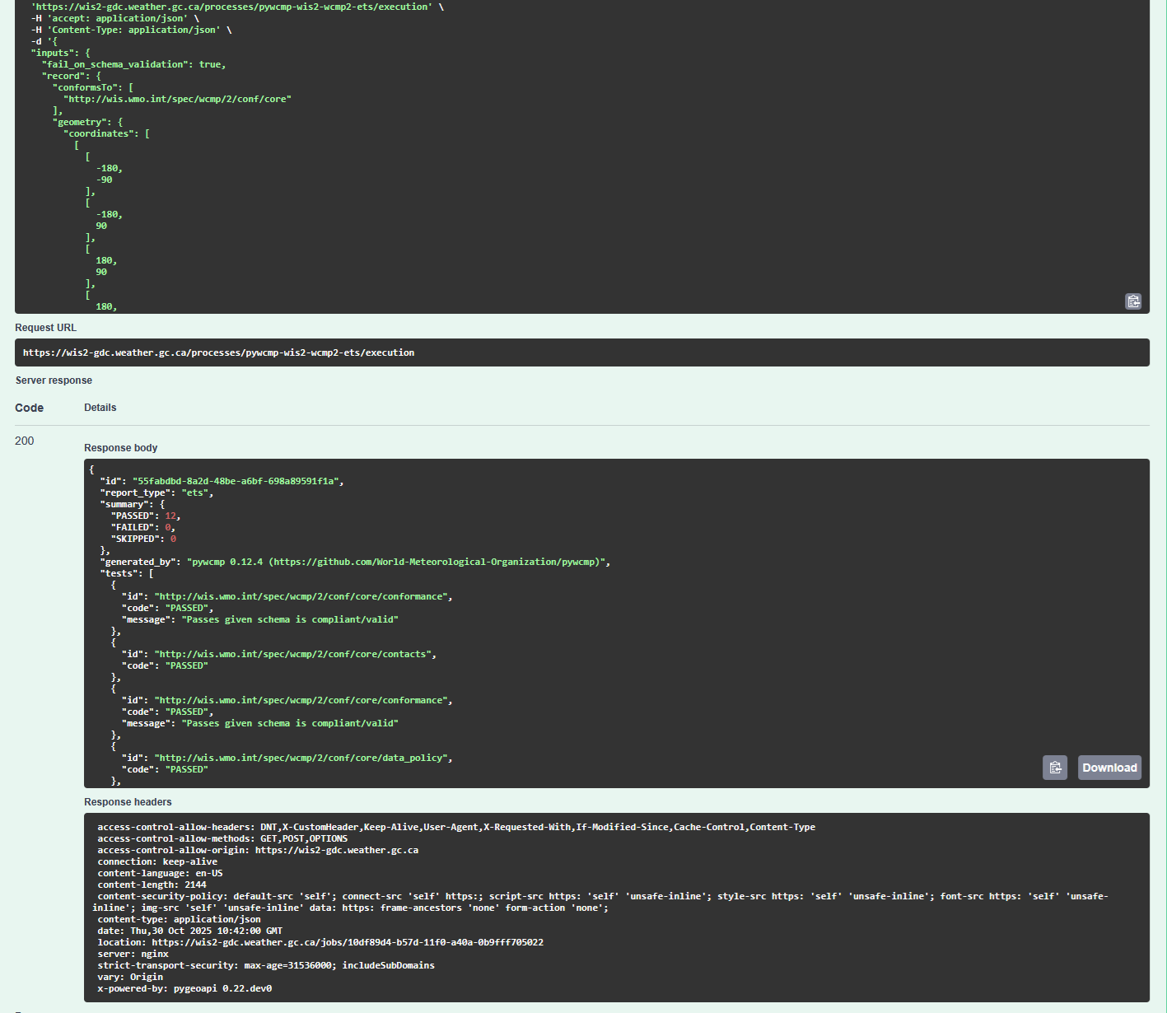
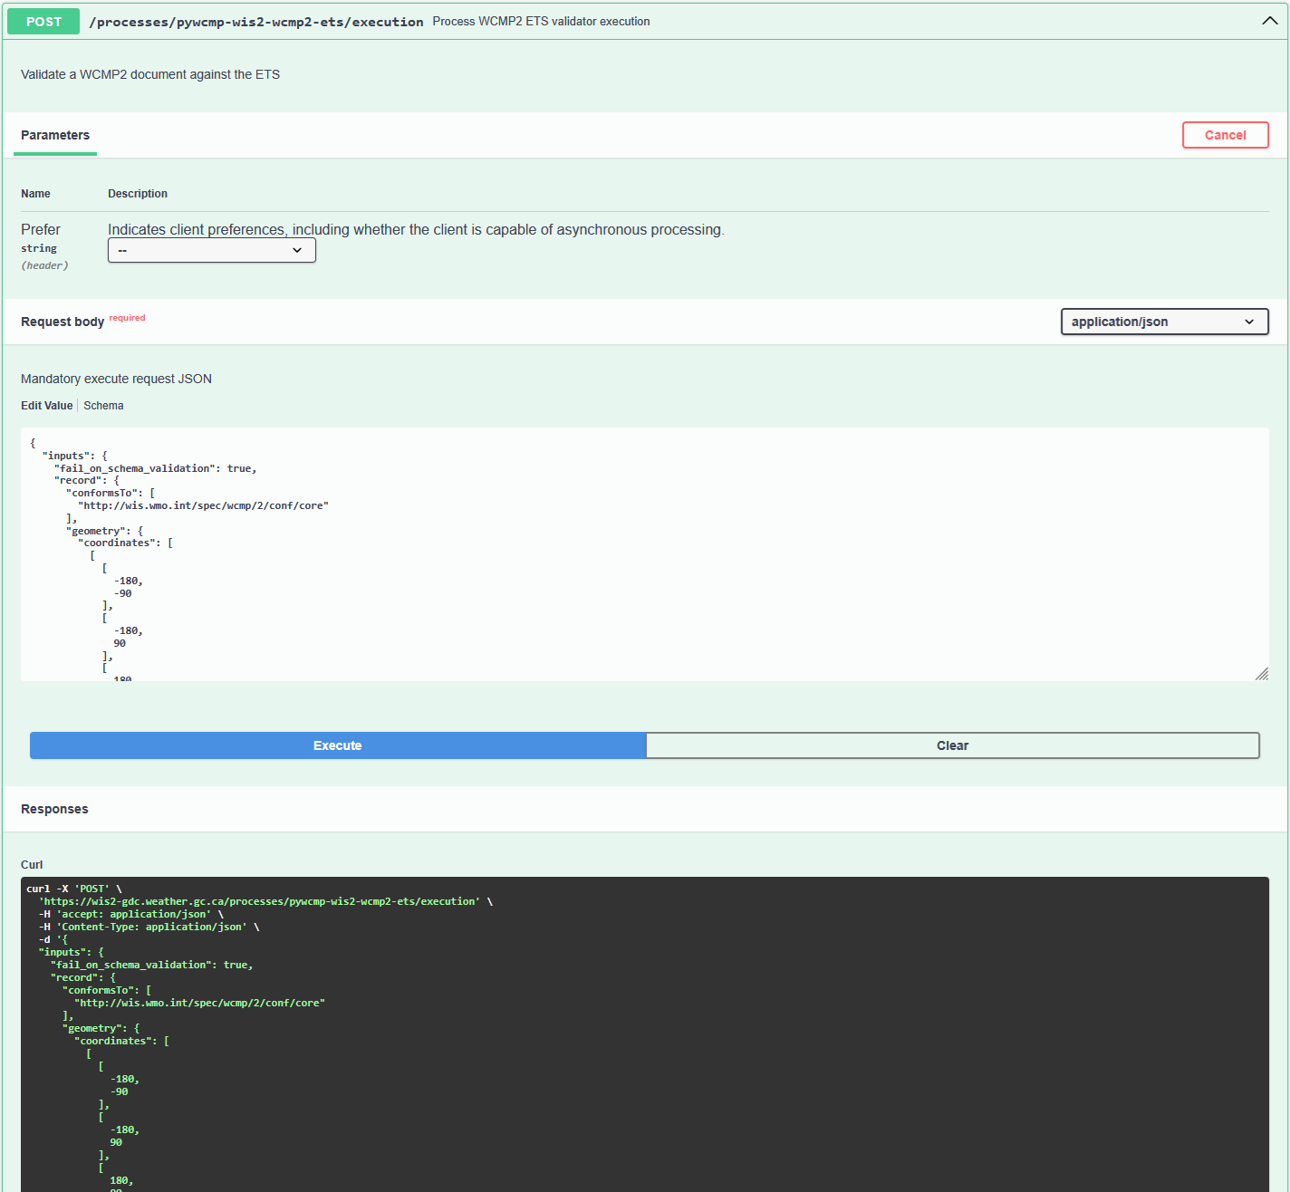
ETS and KPI checks

Slide 28
pywcmp
WMO Reference Implementation for WCMP2
Full ETS and KPI implementation
Entry points
  CLI
  Python application(s)
‘As a service’: provides pygeoapi-based OGC API – Processes for ETS and KPI as online services

Slide 29
pygeometa
GDAL-like tooling for Geospatial metadata
Read-write for numerous geospatial metadata formats
CLI or Python API
Focus on automated workflow / runtime pipelines
Multilingual Support
Core model (‘Metadata Control File’ MCF)
  Support for ‘base’ MCF reuse (i.e. contacts)
Schema validation
Extensible (plugins)
  allows for additional properties
  add your own Metadata Formats

Slide 30
WCMP2 recap
Profile of OGC API – Records – Part 1: Core: Record Core
  Additional encoding rules, controlled vocabularies
  Written as an OGC Modular Specification (ModSpec)
Requirements/Conformance
  Abstract Test Suite (ATS)
  Executable Test Suite (ETS)
Recommendations/Permissions
  Key Performance Indicators (KPI)
Domain extensions
  Domain / discipline specific encoding rules
JSON Schema
Code: Tooling / validator (pywcmp)

Slide 31
WCMP2 recap
Standard (STABLE)
  wmo-im.github.io/wcmp2/standard/wcmp2-STABLE.html
Working area on GitHub
  github.com/wmo-im/wcmp2
  Document: github.com/wmo-im/wcmp2/tree/main/standard
  Schema: github.com/wmo-im/wcmp2/blob/main/schemas/wcmpRecordGeoJSON.yaml
Code:
  pywcmp: github.com/World-Meteorological-Organization/pywcmp
  wis2-gdc: github.com/wmo-im/wis2-gdc

Slide 32
WMDR2 implementation and framework bootstrap
Principles
  Broad interoperability
  WCMP2 Compatible
  Extensible
  v1.x -> v2: breaking changes not prohibited
Document and schema
  ModSpec
  JSON Schema
  github.com/wmo-im/wmdr2
Tooling
  pywmdr: github.com/wmo-im/pywmdr

Slide 33
Thank you
^{wmo.int}

