Slide 1
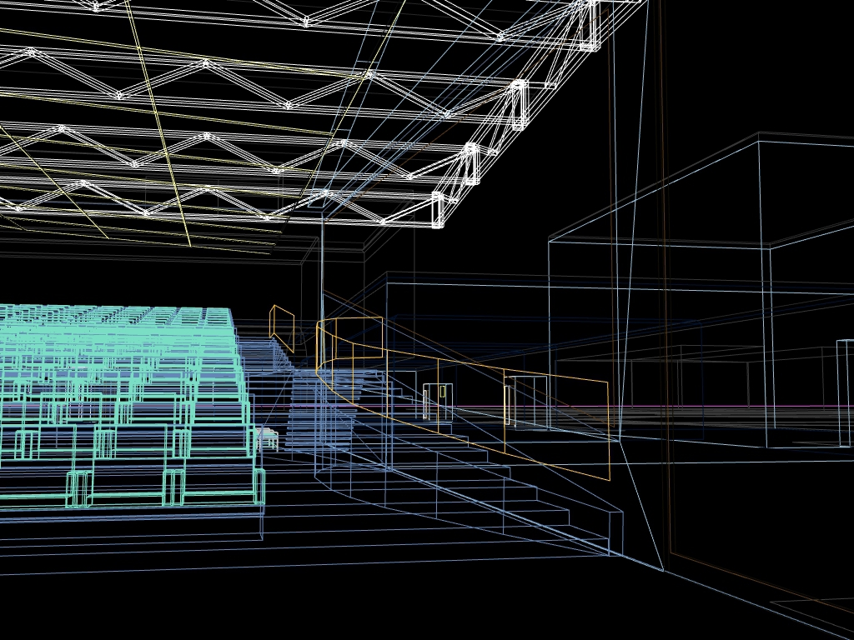
VECTORS WITH VIDEO GAMES
Will Monroe
Splash! Teaching Program
April 22, 2012
Image credit: Wikimedia Commons user Manop

Slide 2
Video: Portal clip

Slide 3

y
(x, y)
x
Image credit: DGBthekafu / Wikimedia Commons user Bouncey2k

Slide 4
y
(x, y, z)
x
z

Slide 5
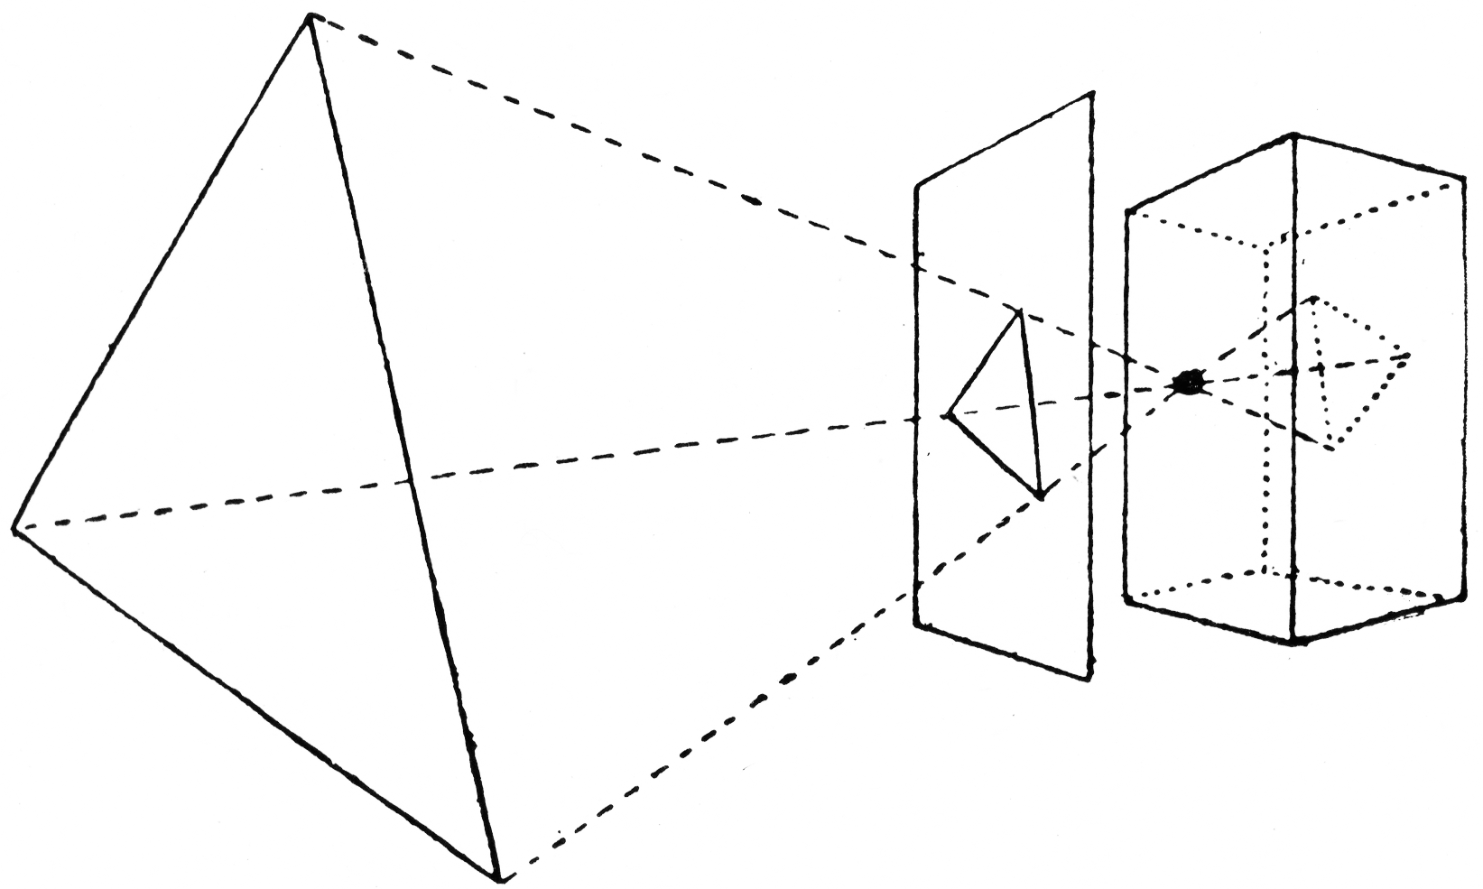
The pinhole camera
(the original graphics hardware)
1
5
1
5
Image credit: L.P. Clerc/Wikimedia Commons user Atelierelealbe

Slide 6
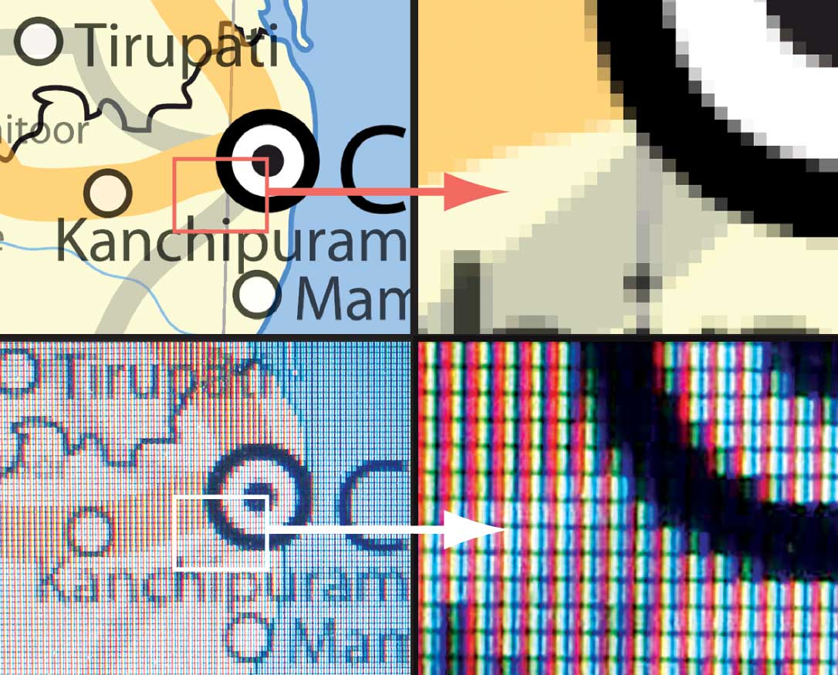
Pixels
Image credit: Wikimedia Commons user Planemad

Slide 7
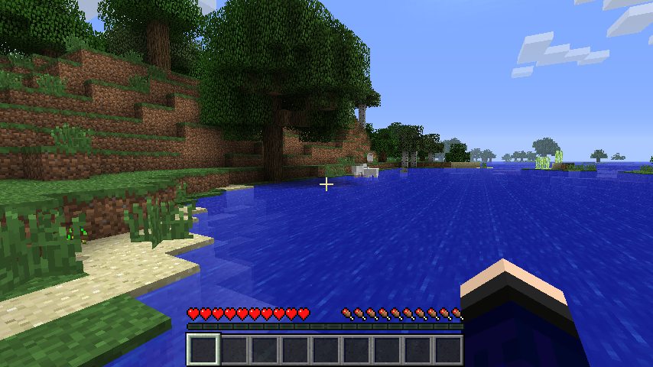
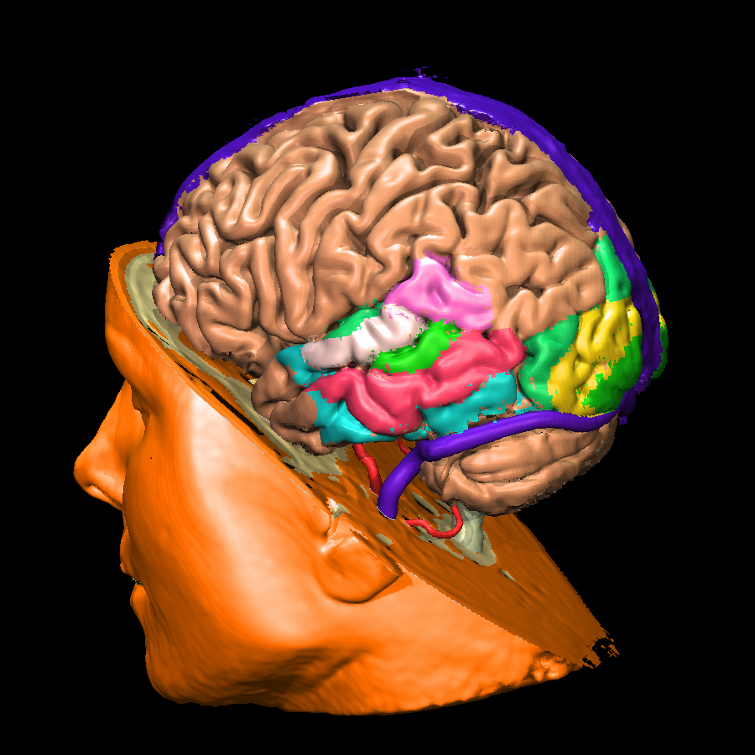
Voxels?
Voxel-based
brain imaging
Minecraft
How many voxels
do we need?
Image credits: Mojang AB/Wikimedia Commons users 4urge, Muehlenau

Slide 8
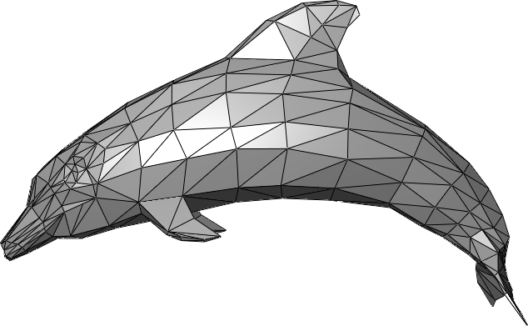
Triangles!
Image credit: Wikimedia Commons user Chrschn

Slide 9
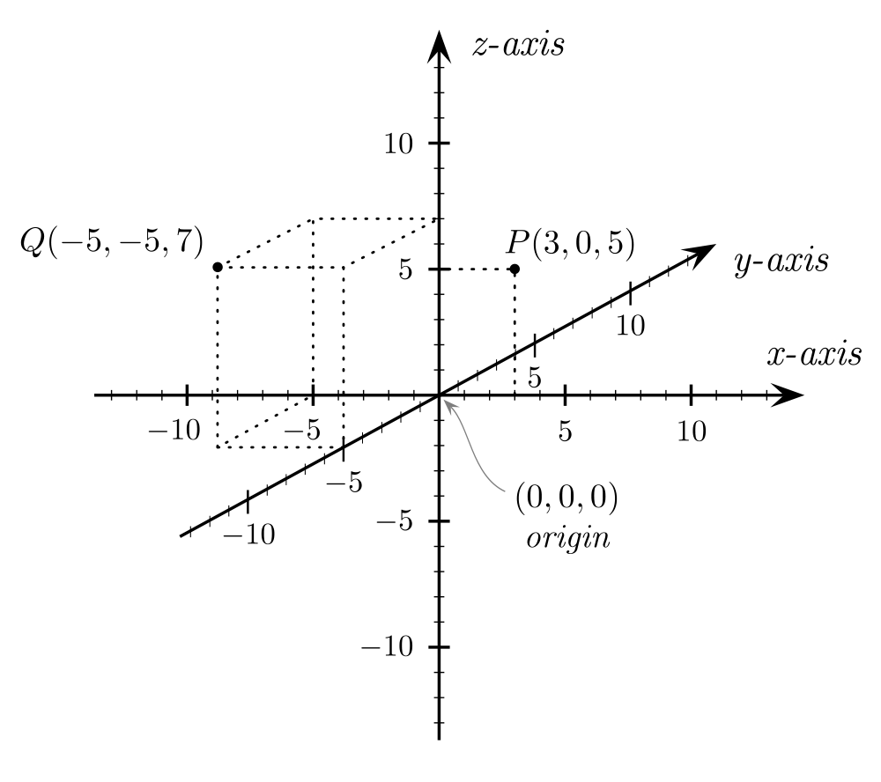
3-D Cartesian coordinates
Image credit: Wikimedia Commons user Gustavb

Slide 10
Vector addition
a = ( 5, 6, -3)
b = (-1, 7, 2)
a + b = (5 + (-1), 6 + 7, (-3) + 2)
= (4, 13, -1)

Slide 11
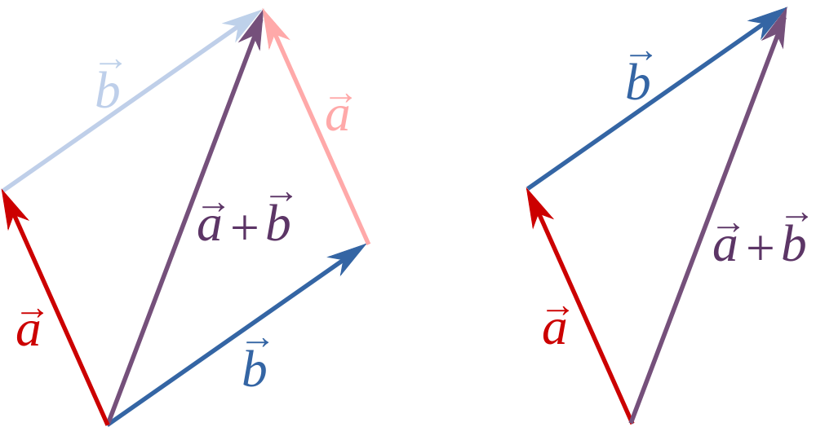
Vector addition
Image credit: Wikimedia Commons user 石庭豐

Slide 12
Points → vectors from the origin
Q
P

Slide 13

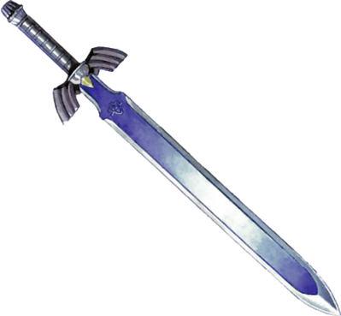
Relative positioning of objects
O
Image credits: kasuto.net, zelda.wikia.com

Slide 14
Vector subtraction
a = ( 5, 6, -3)
b = (-1, 7, 2)
a – b = (5 – (-1), 6 – 7, (-3) – 2)
= (6, -1, -5)

Slide 15
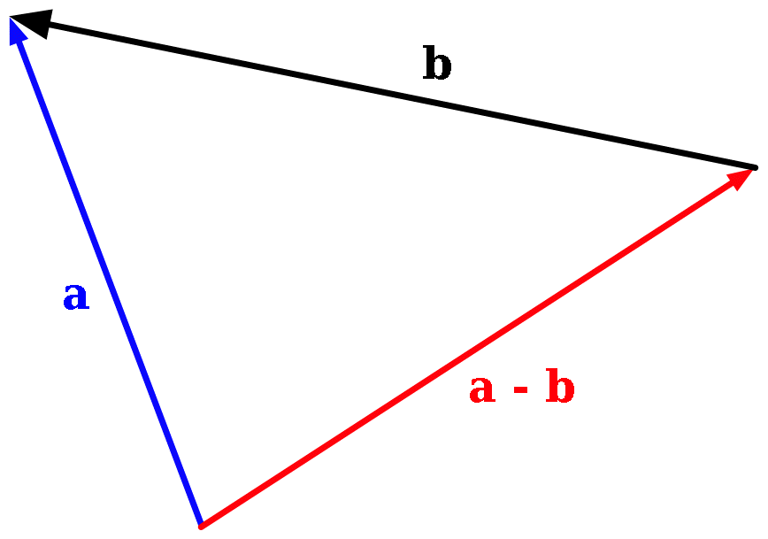
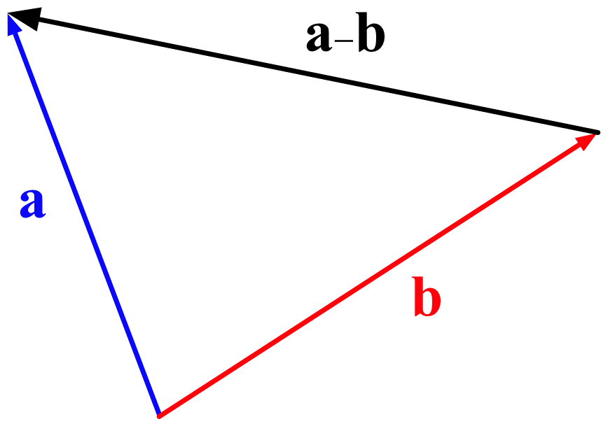
Vector subtraction
Image credit: Wikimedia Commons user bdesham

Slide 16
Scalar multiplication
a = ( 5, 6, -3)
5a = (5·5, 5·6, 5·(-3))
= (25, 30, -15)

Slide 17
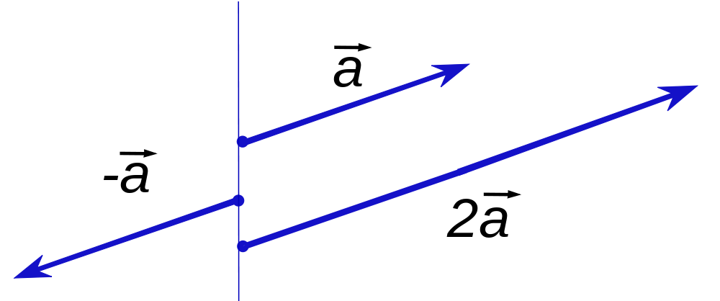
Scalar multiplication
Image credit: Silly rabbit/Wikimedia Commons user Konradek

Slide 18
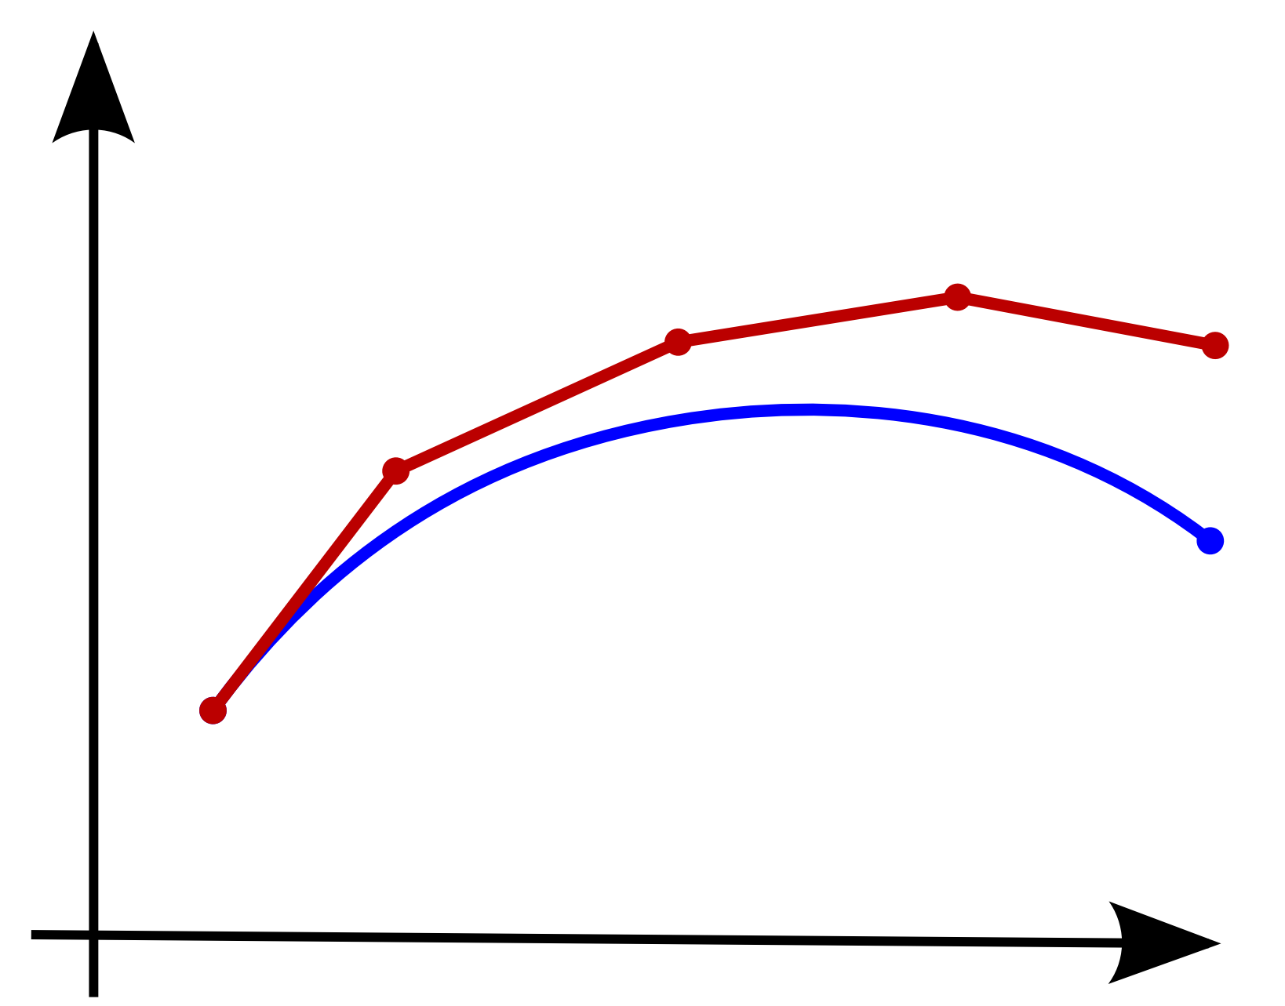
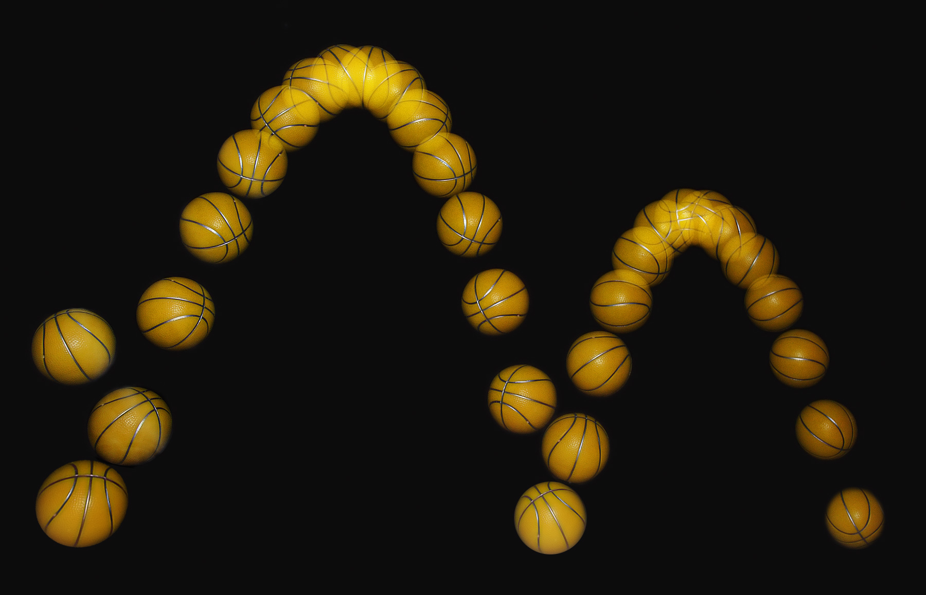
Applying force in small steps
(This is called “Euler's method for numerical integration.”
No, you don't have to remember that. But you can if you want.)
Image credit: L.P. Clerc/Wikimedia Commons user Atelierelealbe

Slide 19
Demo: launching snowballs

Slide 20
The dot product
a = ( 5, 6, -3)
b = (-1, 7, 2)
a · b = 5·(-1) + 6·7 + (-3)·2
= -5 + 42 + -6 = 31

Slide 21
An illustrative example
 | Heller (R) | Reid (D)
37 | Y | Y
38 | Y | N
39 | N | Y
40 | N | N
41 | N | Y
42 | Y | N
43 | Y | N
45 | N | N
46 | Y | Y
54 | N | Y
Source: http://govtrack.us/

Slide 22
An illustrative example
 | Heller (R) | Reid (D) | product
37 | +1 | +1 | +1
38 | +1 | -1 | -1
39 | -1 | +1 | -1
40 | -1 | -1 | +1
41 | -1 | +1 | -1
42 | +1 | -1 | -1
43 | +1 | -1 | -1
45 | -1 | -1 | +1
46 | +1 | +1 | +1
54 | -1 | +1 | -1
Total:
-2
Source: http://govtrack.us/

Slide 23
An illustrative example
 | Boxer (D) | Feinstein (D)
37 | N | N
38 | N | N
39 | Y | Y
40 | N | N
41 | Y | Y
42 | N | N
43 | N | N
45 | N | N
46 | Y | Y
54 | Y | Y
Source: http://govtrack.us/

Slide 24
An illustrative example
 | Boxer (D) | Feinstein (D) | product
37 | -1 | -1 | +1
38 | -1 | -1 | +1
39 | +1 | +1 | +1
40 | -1 | -1 | +1
41 | +1 | +1 | +1
42 | -1 | -1 | +1
43 | -1 | -1 | +1
45 | -1 | -1 | +1
46 | +1 | +1 | +1
54 | +1 | +1 | +1
Total:
+10 (!)
Source: http://govtrack.us/

Slide 25
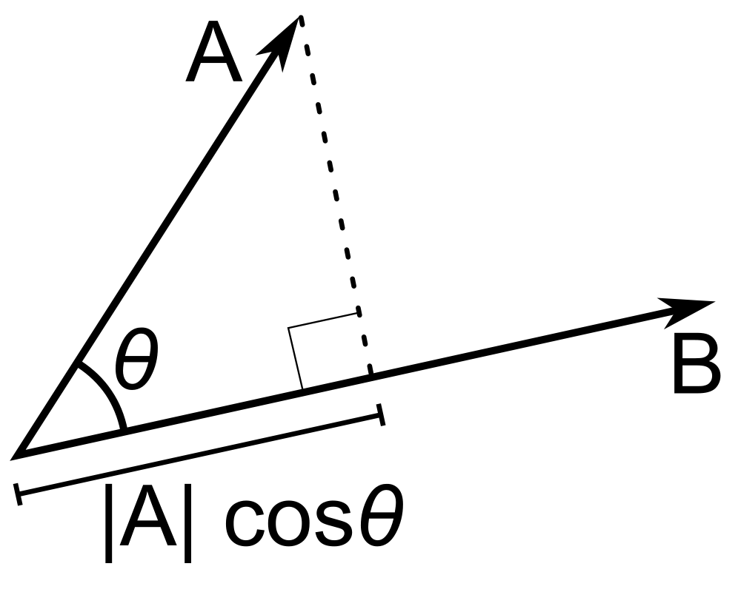
Projecting one vector onto another
The real dot product:
|A| |B| cos θ
Image credit: Wikimedia Commons user Mazin07

Slide 26
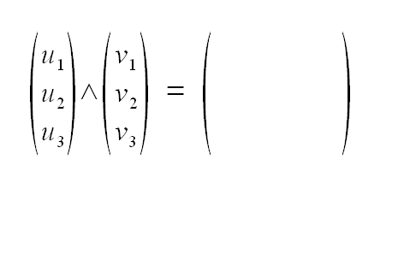
The cross product
Image credit: Wikimedia Commons user Ravahimanana

Slide 27
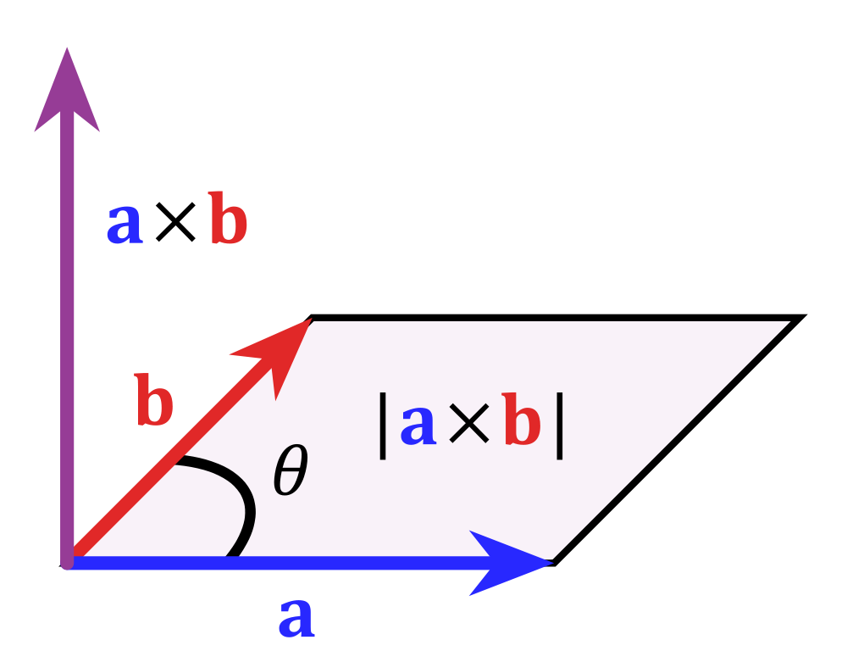
The cross product
Image credit: Wikimedia Commons user Acdx

Slide 28

Lighting matters
Image credit: Wikimedia Commons user Pokipsy76

Slide 29
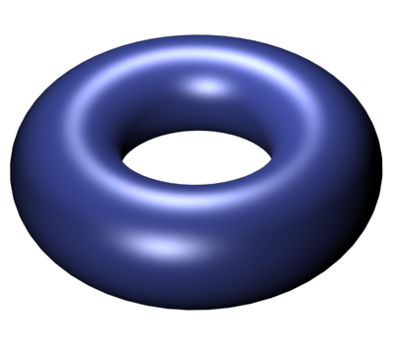
Lighting matters
Image credit: Wikimedia Commons user Pokipsy76

Slide 30
Video: Phong shading

Slide 31
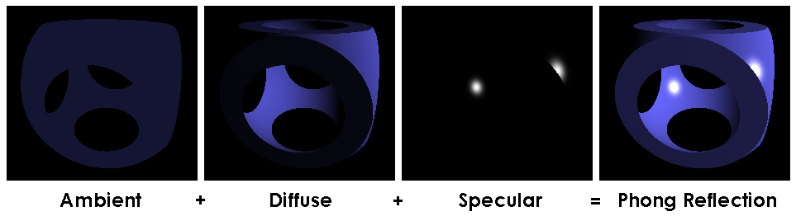
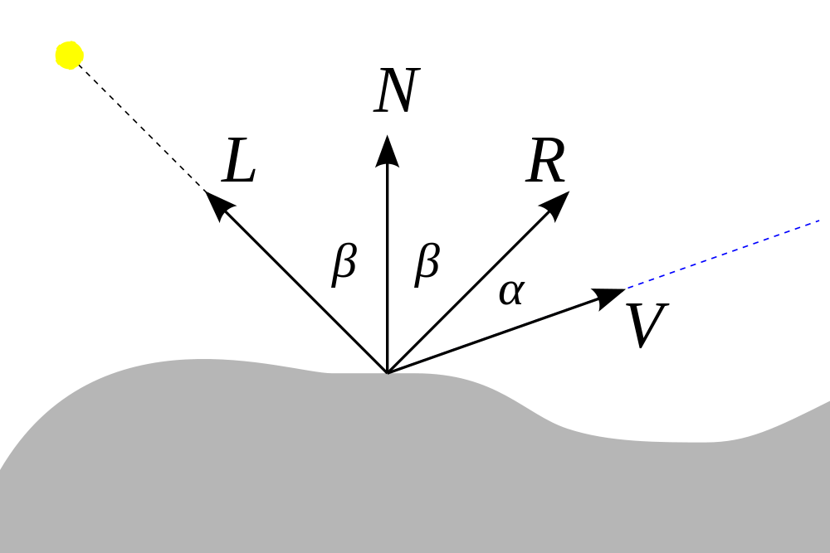
Lighting
The Phong illumination model
Ambient: constant
Diffuse: L · N = cos β
Specular: (R · V)^{k} = (cos α)^{k}
Image credit: Brad Smith/Wikimedia commons user Rainwarrior

