Slide 1
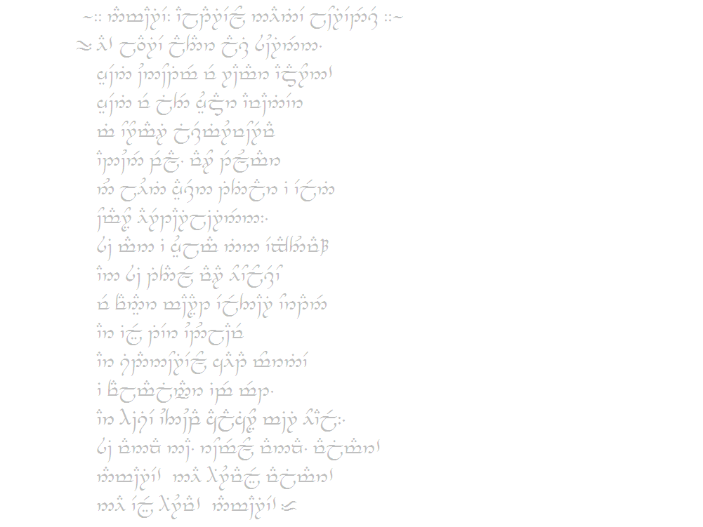
An Introduction to Phonetics
with Elvish Writing
Will Monroe
Stanford Splash!
November 8-9, 2014
Image credit: user “Eruhildo,” from commons.wikimedia.org

Slide 2
A Disclaimer

Slide 3
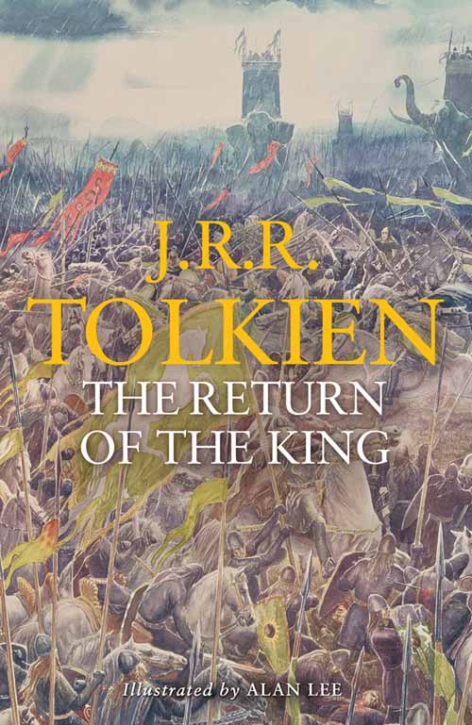
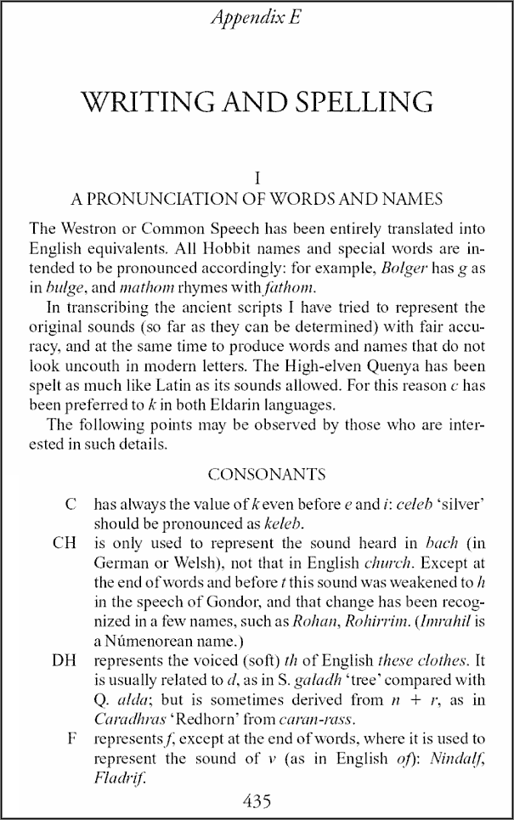
The Tengwar
Image credit: (left) Lee, Alan, from tolkienlibrary.com; (right) Tolkien, John Ronald Reuel, The Return of the King, from books.google.com

Slide 4

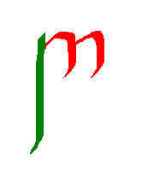
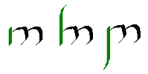
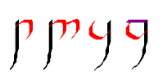
How Tengwar Are Written
Each of the main consonants has two parts: a stem and a bow.
The stem can be short, extend above the bow, or extend below the bow.
The bow can be single or doubled, face up or down, and be open or closed.
Every main letter is a consonant; vowels are added as small marks (tehtar) above (or below) the letters.

Slide 5
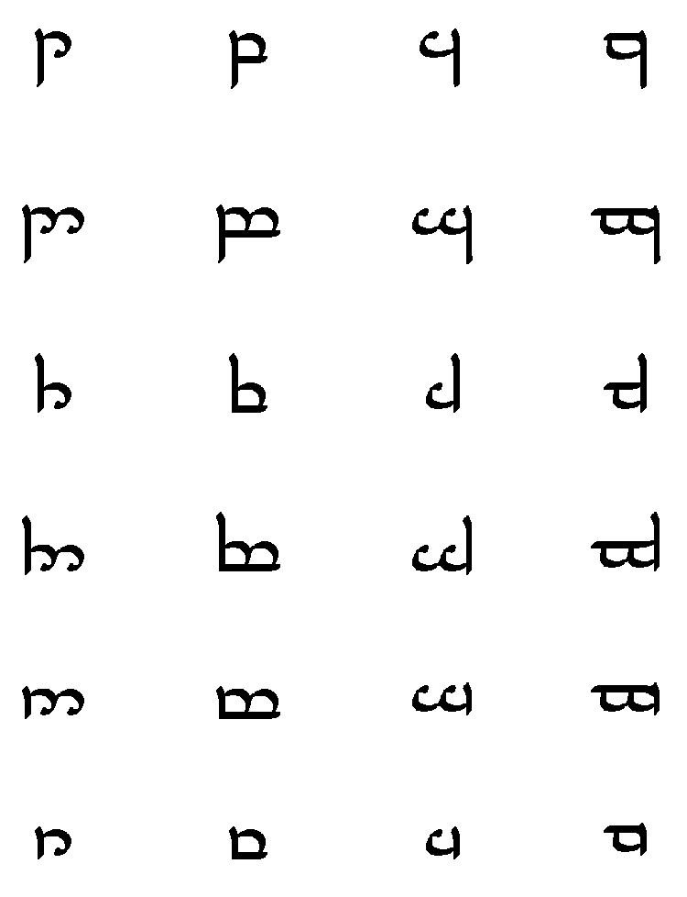
Letters and Sounds of Tengwar
dental
labial
palatal
velar
unvoiced
t p ch k
plosives
voiced
d
b
j
g
unvoiced
th
f
sh
(kh)
fricatives
voiced
dh
v
zh
(gh)
nasals
n
m
(ny)
ng
approximants
r w y (lh)
Image credit: user “Maxim Razin,” from commons.wikimedia.org

Slide 6
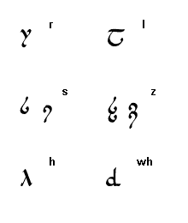
But Wait: There's More!

Slide 7
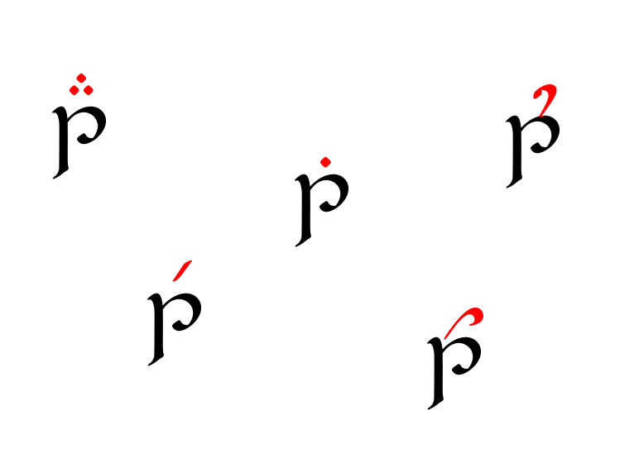
Dn't frgt bt th vwls...
at
ut
it
et
ot

Slide 8
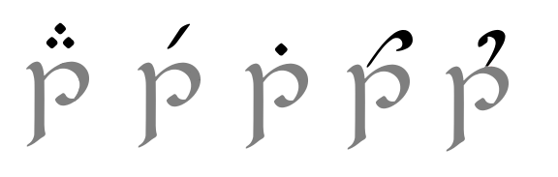



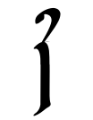
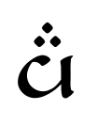
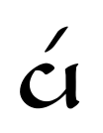
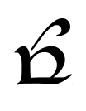
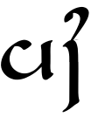
Dn't frgt bt th vwls...
ăt ĕt ĭt ŏt o͝ot ŭ/ət
aa=ä
ii=ē
uu=o͞o
ay=ī
ey=ā
ow=ō
yuu=ū

Slide 9
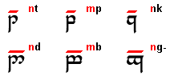

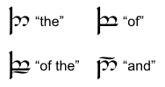
A Few More Miscellaneous Rules...
Image credit: Måns Björkman, from at.mansbjorkman.net

Slide 10
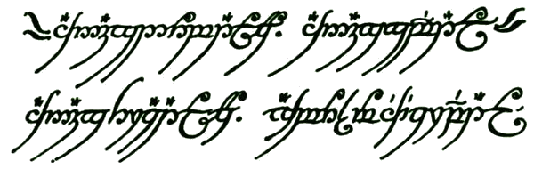
Making Sense of the One Ring
Image credit: Tolkien, John Ronald Reuel, The Fellowship of the Ring, from 2lincolns.com

Slide 11
Break time!

Slide 12
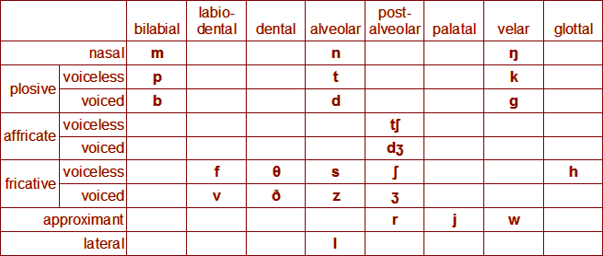
The Phonology of English
Consonants
Source: Wikipedia (Don't use this for your research, kids.)‏

Slide 13
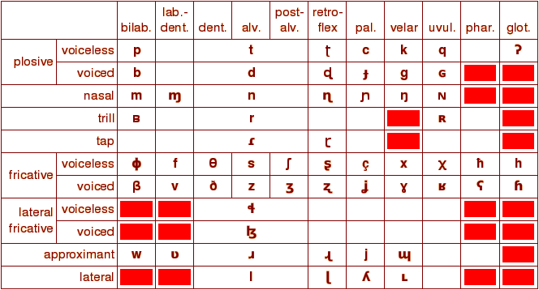
IPA in All Its Glory
Don't worry, this won't be on the test.
Source: Peter Ladefoged, UCLA Phonetics Lab (phonetics.ucla.edu). Now that's a good source.

Slide 14
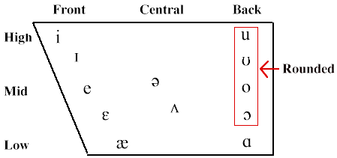
The Phonology of English
Vowels
Source: University of Texas, Department of Linguistics

Slide 15
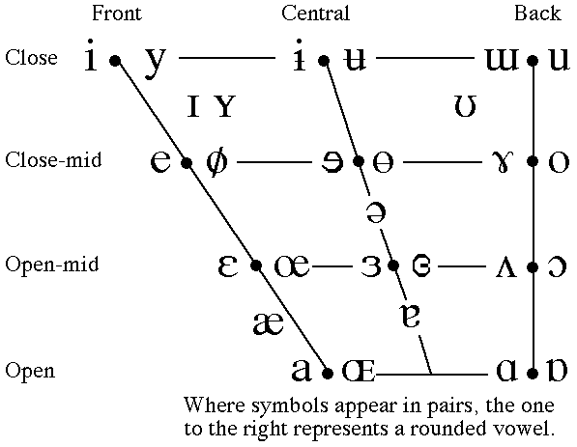
Vowels of the World
Source: Peter Ladefoged, UCLA Phonetics Lab

Slide 16
Is That It?
Consonants
  Other places of articulation
  Gemination
  Airstream
    clicks and pops
    ejectives
    implosives
  ...
Vowels
  Diphthongs
  Length
  Nasals
  Voicing
  Tone
  ...

Slide 17
