Slide 1
Ray Tracing
TI1805 Computer Graphics project
Mitchell Hoppenbrouwer 4243889
Lars den Herder 4216873
Jan-Willem Gmelig Meyling 4305167
Sam Smulders 4225007
Liam Clark 4303423
Daan Schipper 4155270
Julian Hols 4247930
Carsten Grießmann 4166930

Slide 2
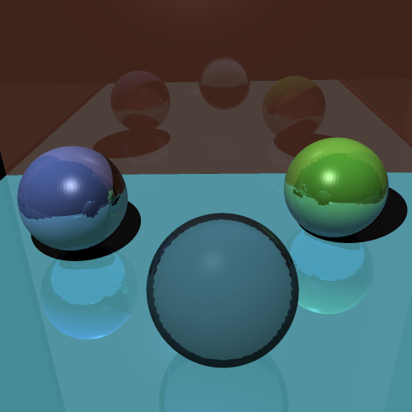
Competition Image
The fruit of hard labour

Slide 3
Work Distribution
Who did what?
In our final version:
RayTriangleIntersect - Sam & Jullian
Blinn-Phong Shading – Julian, Carsten, Jan-Willem, Sam, Liam
Reflection & Mirror - Carsten & Liam
Rays / pixel - Jullian & Sam (LAS)
Refraction - Carsten, Liam, Julian
Shadows - Carsten & Liam
Not in our final version:
Datastructure for Acceleration - Mitchell & Sam & Daan
SphereRayIntersect – Jan Willem
Ray rectangle/box intersect - Sam & Jullian
Smooth Shading – Liam, Lars

Slide 4
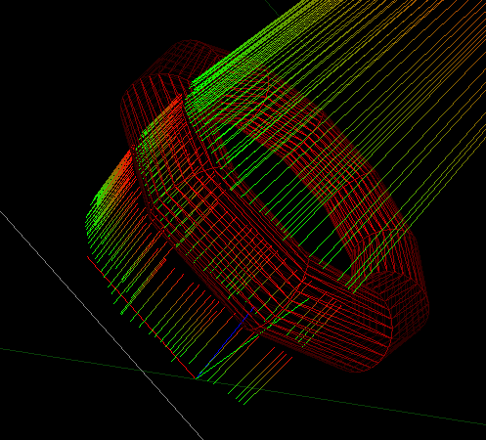
Debug
Visualizing rays in the preview window
Shooting rays from camera
position
Useful for debugging
reflection and refraction

Slide 5
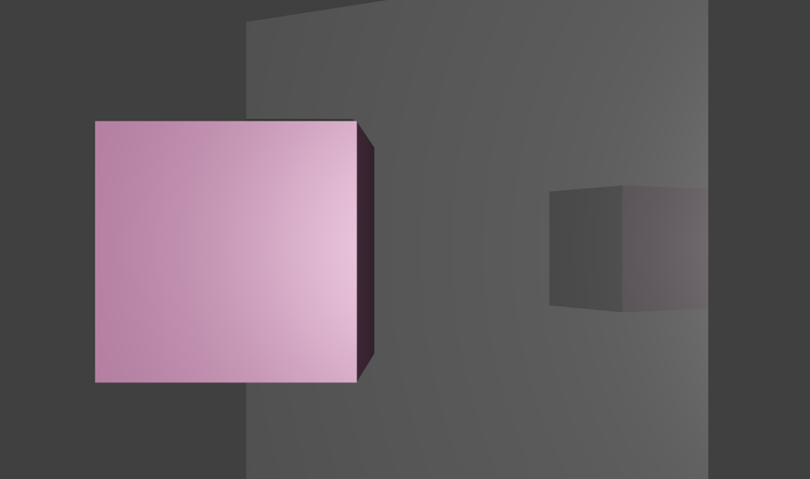
Techniques
Feature list for our ray tracer
Blinn-phong diffuse and specular shading
Reflection
Refraction
Anti-aliasing

Slide 6
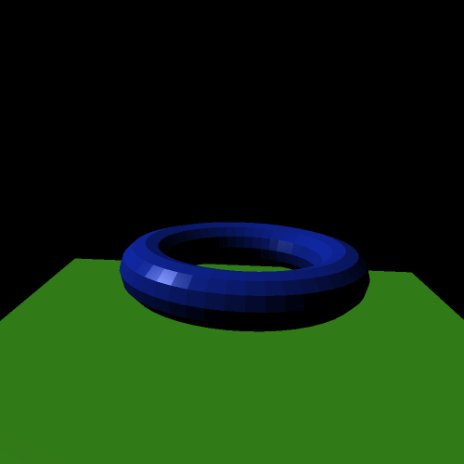

Blinn-Phong Shading

Slide 7
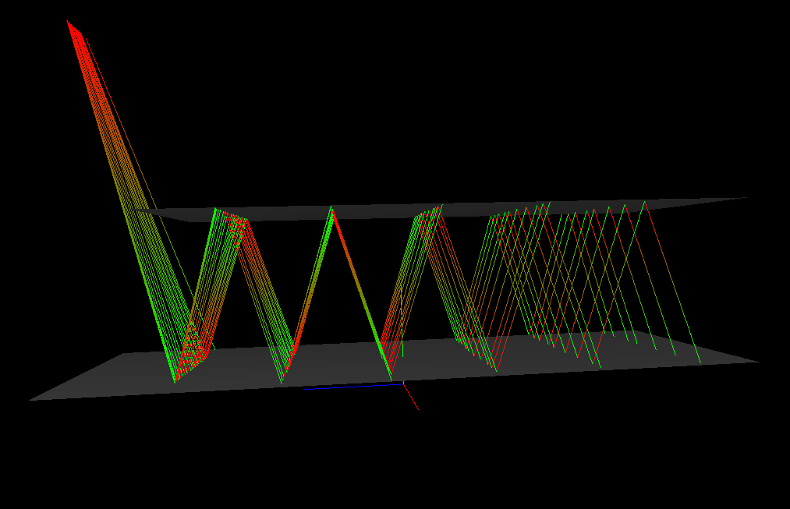
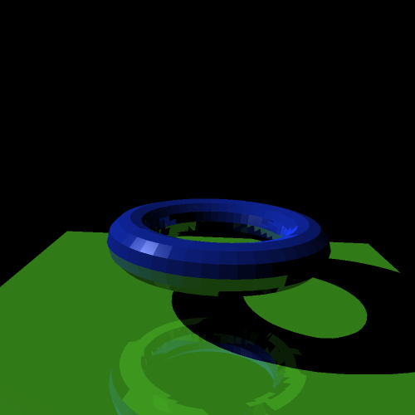
Reflection

Slide 8
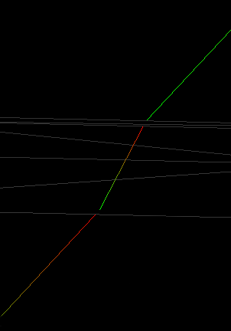
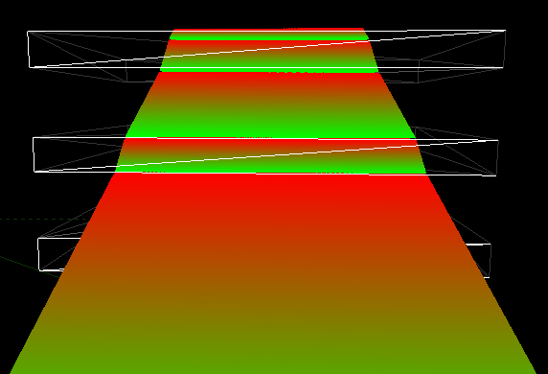
Refraction

Slide 9
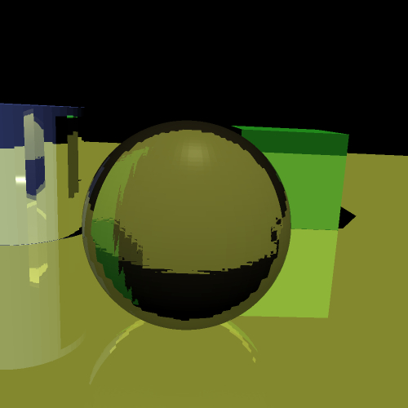
Refraction

Slide 10
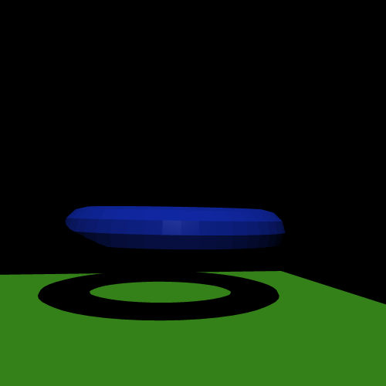
Shadow

Slide 11
Improvements
Things we couldn’t complete in time
More efficient data structure (Kd-tree)
Define objects with rectangles, boxes and spheres for faster and more precise rendering
Soft shadows
Texture mapping

Slide 12
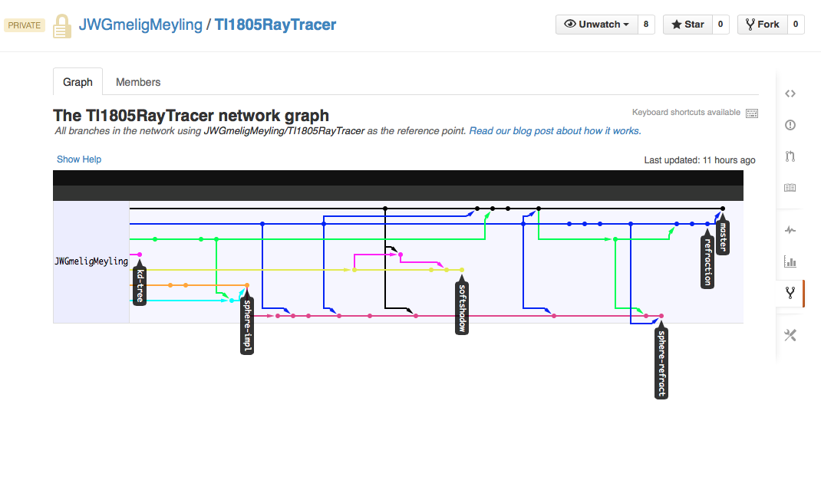
Teamwork
Usage of git, relying heavily on branches

Slide 13
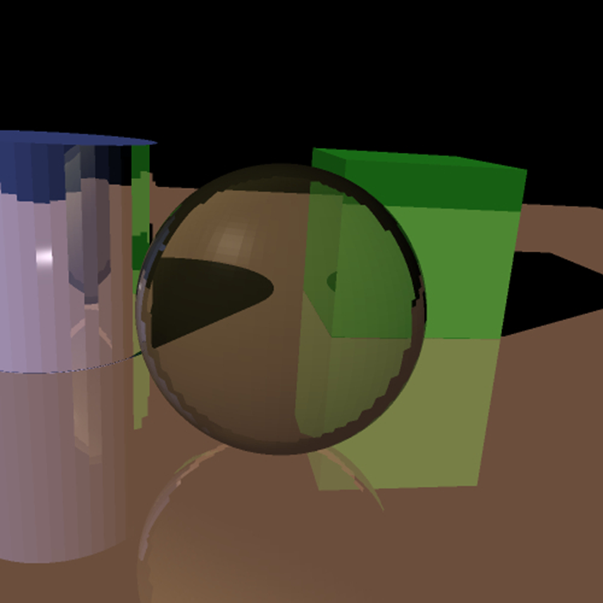
Some final resutls

