Slide 1
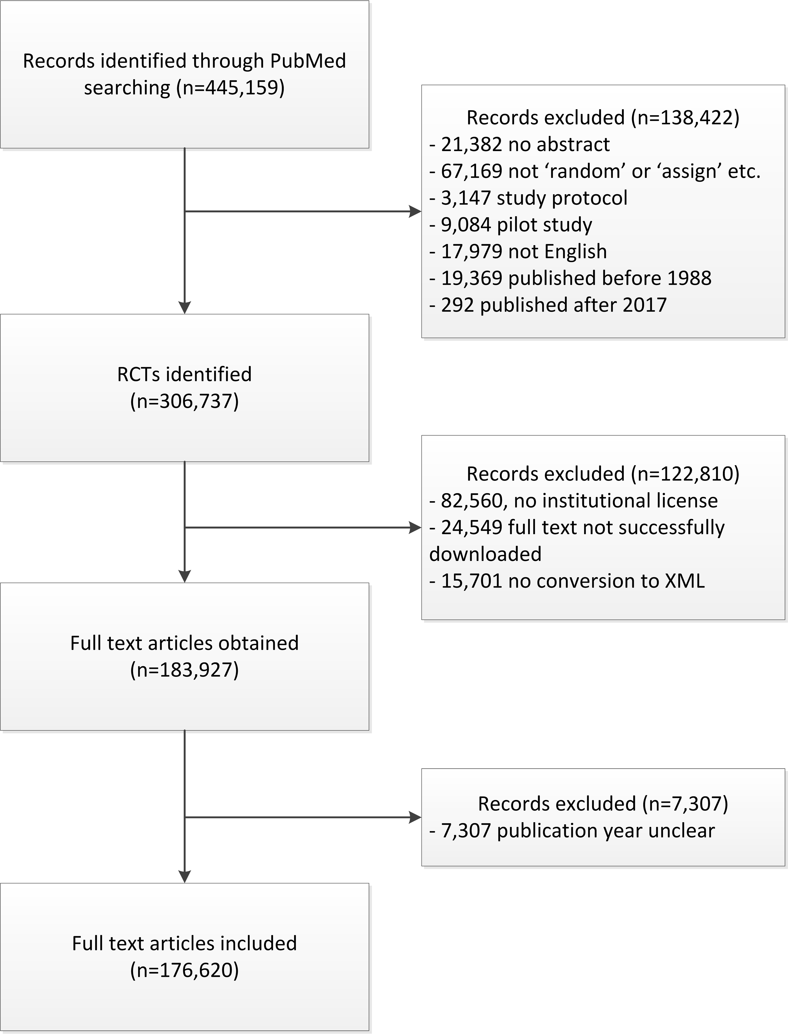
Records identified through PubMed: n=445,159
Records excluded:
n=21,382 – no abstract
n=67,169 – not ‘random’ or ‘assign’
n=3,147 – study protocol
n=9,084 – pilot study
n=17,979 – not in English
n=292 – published after study period
Identified RCTs:
n=326,106
Records excluded:
n=82,560 – no license
n=43,918 – full text not downloaded
n=15,701 – no XML conversion
Full text obtained:
n=183,927
Records excluded:
n=7,307 – year of publication unclear
Full text included:
n=176,620
Comparative analysis

