Slide 1

Team 2 Presentation
Amin, Shamel, Patryk, William

Slide 2
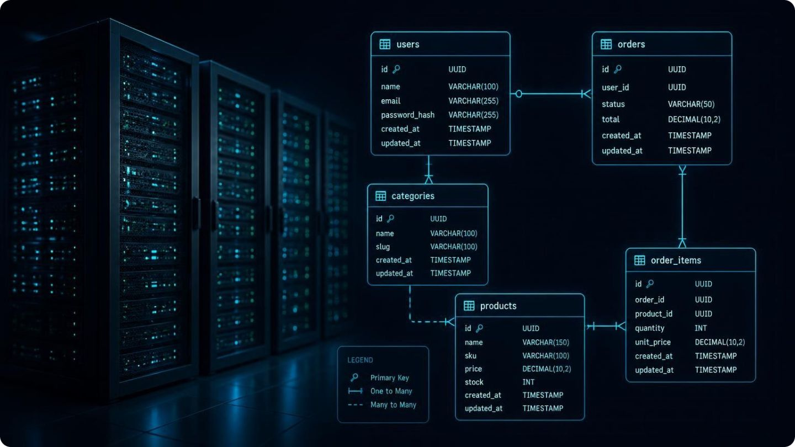
Storing builds in SQL
We were tasked with building 12 workstations for staff across 4 roles.
Selected components using buildcore.com
Stored the final builds in a SQL database
Logged each build with its justification in a document

Slide 3
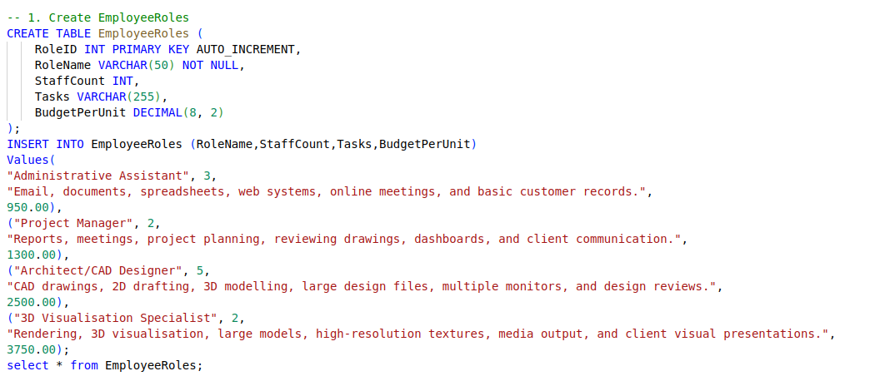
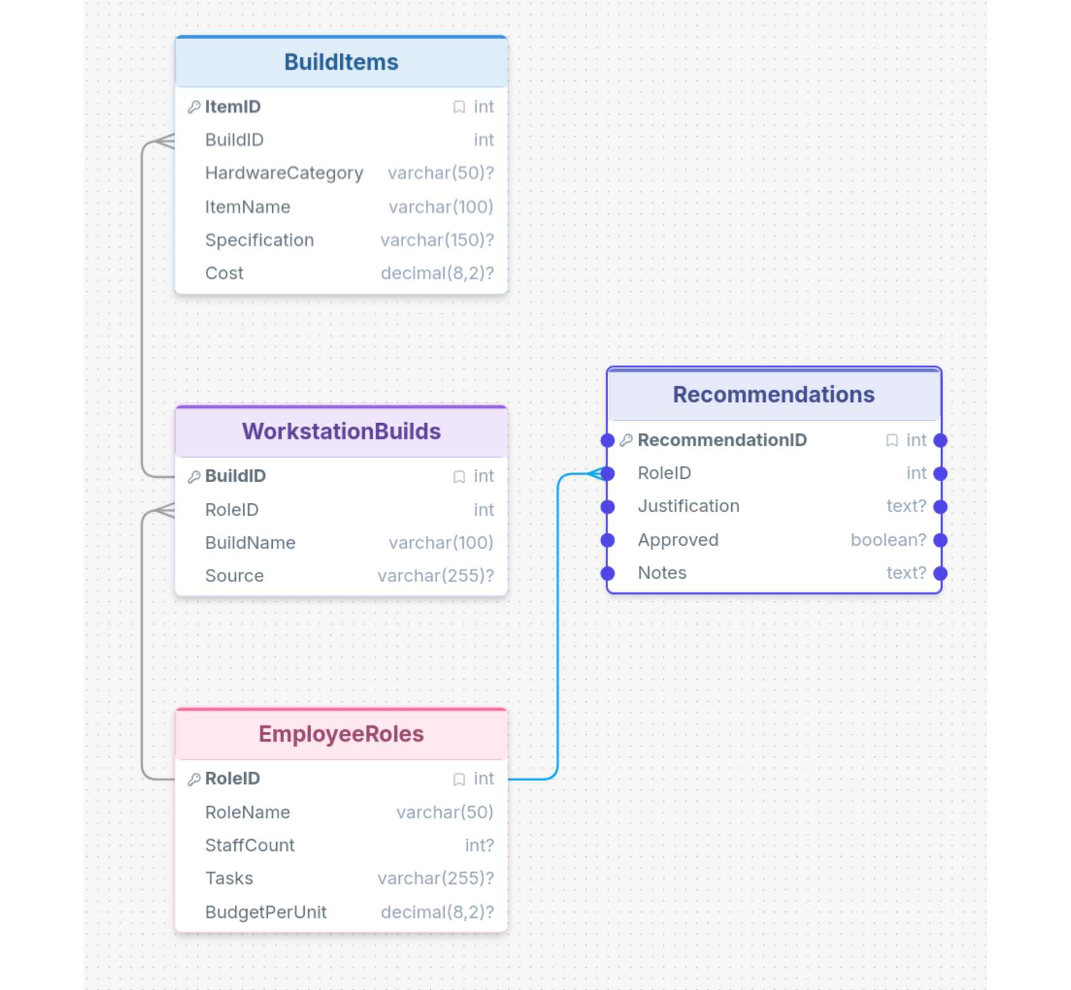
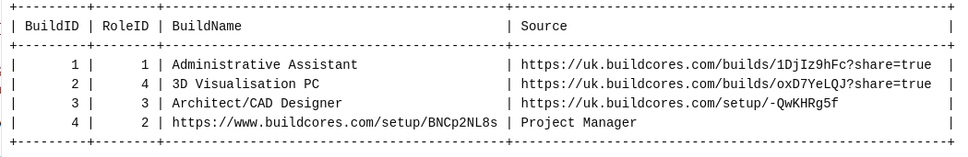
SQL Demonstration

Slide 4
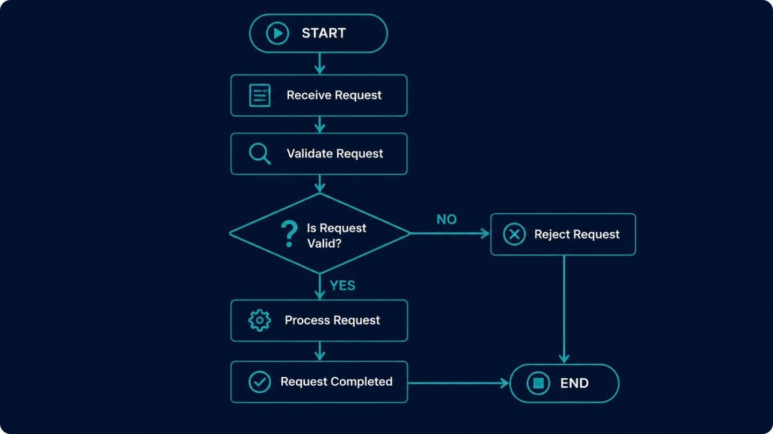
Flowgorithm
The task
Outlined the task and the workflow we needed to model in Flowgorithm

Slide 5
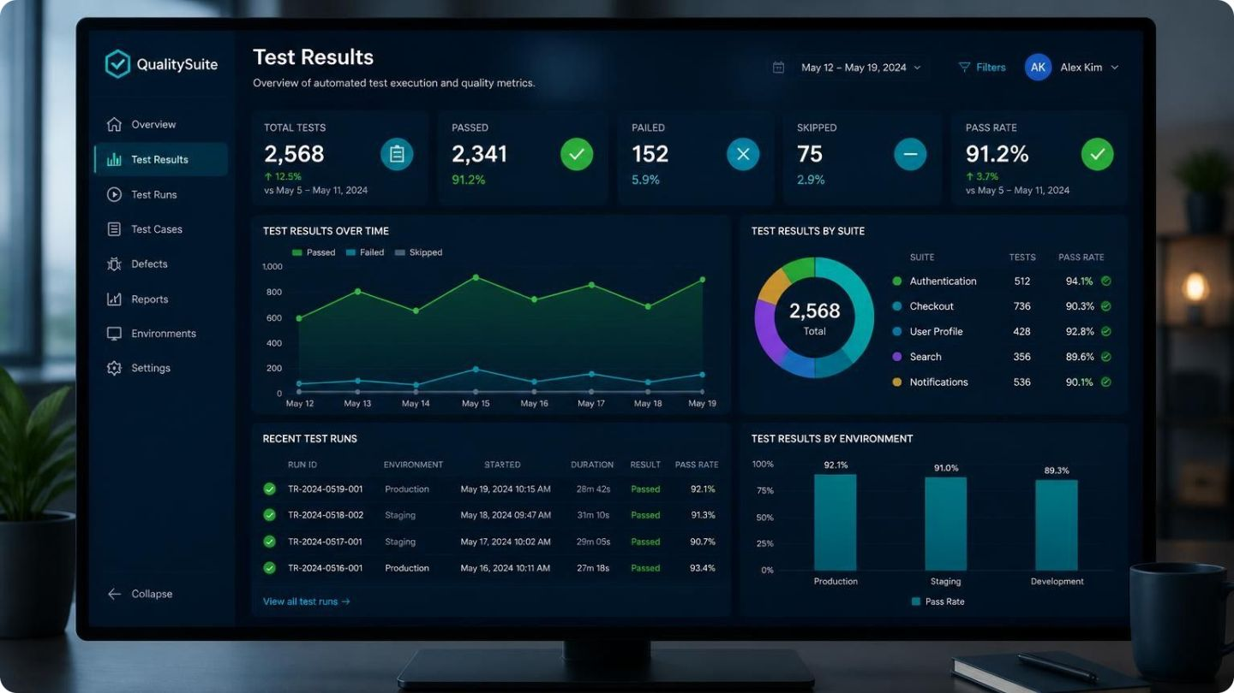
Evidence and
Demonstration
Screenshots and results from the Flowgorithm

Slide 6
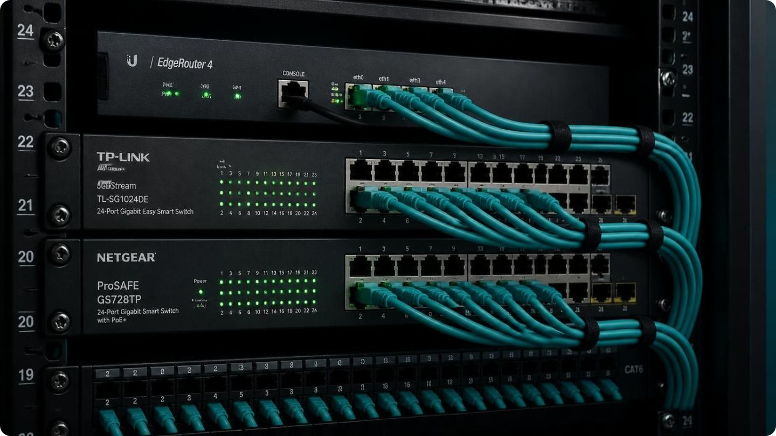
Setting up the network
Building on our custom PC builds, we created and tested a network for the business.
The goal was a working network that lets the built PCs communicate with local and remote servers.

Slide 7
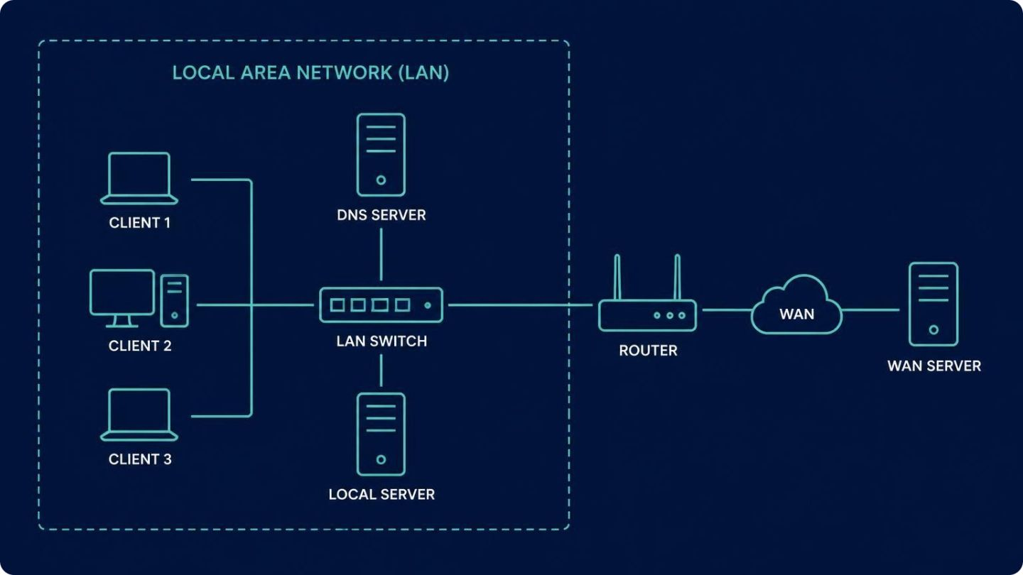
How we approached the network
We created a local LAN with:
A shared IP range
A router
A DNS server
A local server
A WAN server

Slide 8
Evidence and
Demonstration
Screenshots and results from the build and network tests

Slide 9

Cybersecurity report
General overview
Password hygiene
Two-factor and multi-factor authentication
Phishing and social engineering
Safe use of devices
Safe use of public Wi-Fi
Use of AI

Slide 10
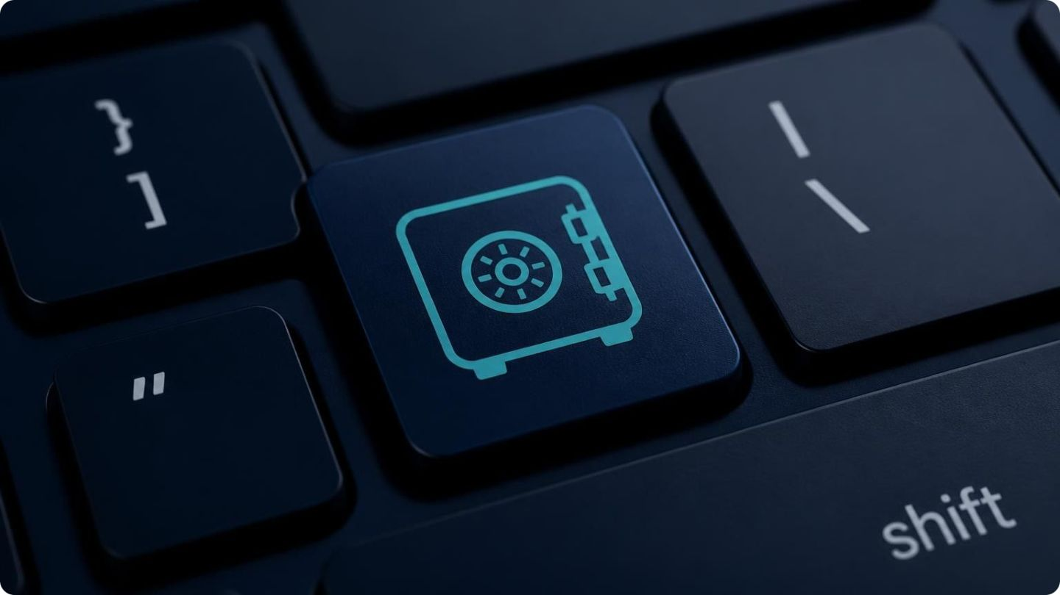
Password hygiene
Use long, unique passphrases for every account
Never reuse a password across services
Store passwords in a reputable password manager
Change any password immediately after a suspected breach

Slide 11
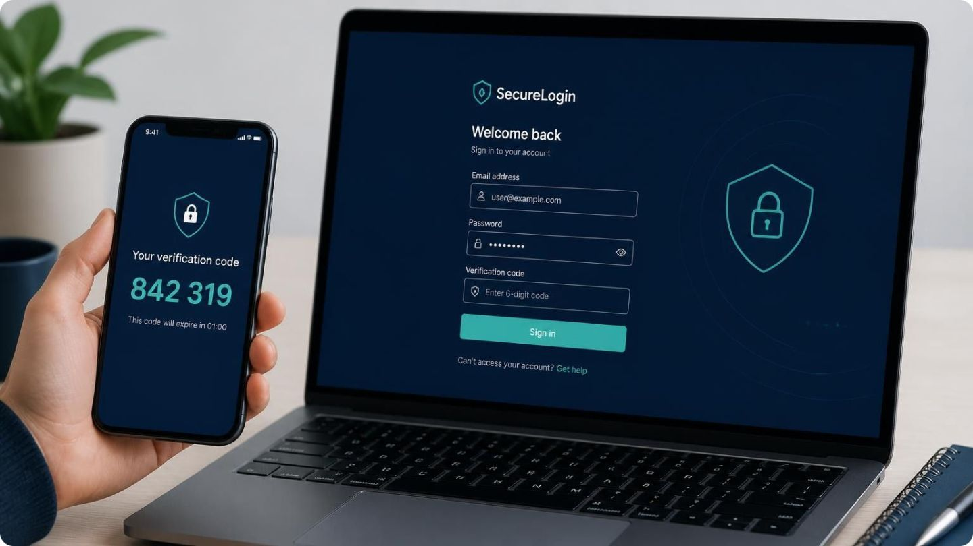
Two-factor and multi-factor authentication
Identification factors:
Category | Description | Examples
Something You Know | Secrets stored in memory | Passwords, PINs, security questions
Something You Have | Physical or digital devices owned | Hardware keys, TOTP apps, SMS/email codes
Something You Are | Biometric characteristics | Fingerprints, facial scans, iris scans

Slide 12
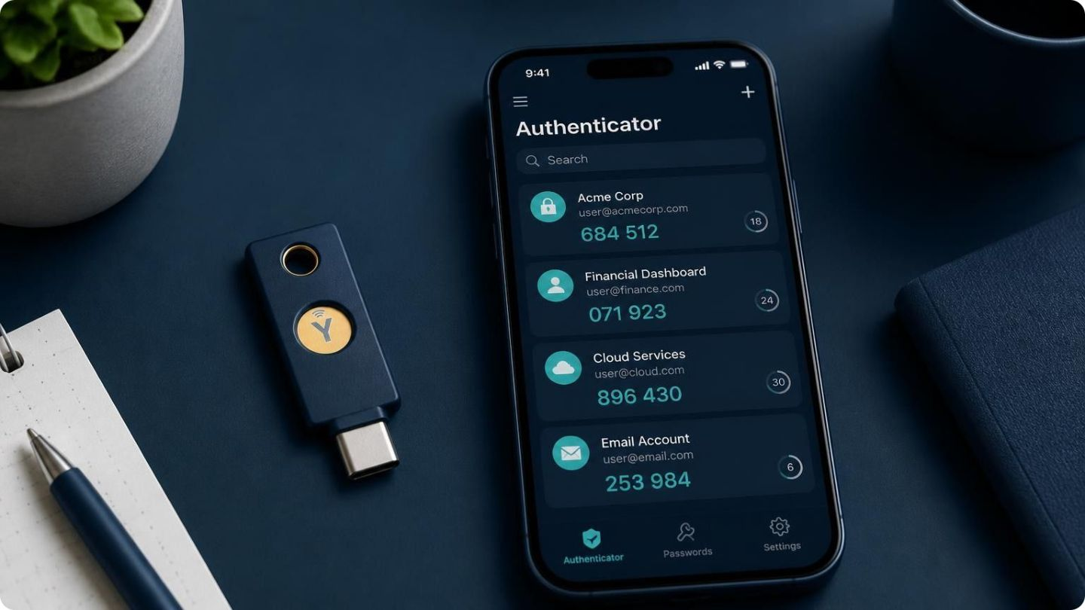
Implementation methods
Flaws and benefits of each method
Method | Primary Category | Phishing-Resistant? | Vulnerable to SIM-Swapping? | Key Advantage | Key Vulnerability
SMS Passcodes | Something You Have | No | Yes | High convenience | SIM-swapping, phishing
TOTP Apps | Something You Have | No | No | Works offline without signal | Real-time phishing sites
Hardware Keys | Something You Have | Yes | No | Phishing-resistant security | Losing the physical key

Slide 13
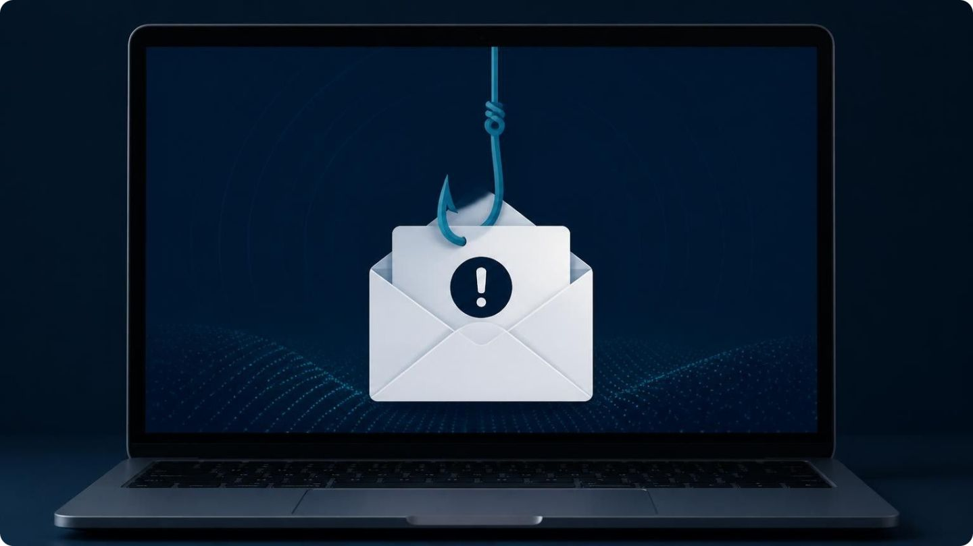
Phishing and social engineering
Verify unexpected requests through a second channel
Check sender addresses and links before clicking
Be wary of messages that create urgency or pressure
Report suspicious messages to IT

Slide 14
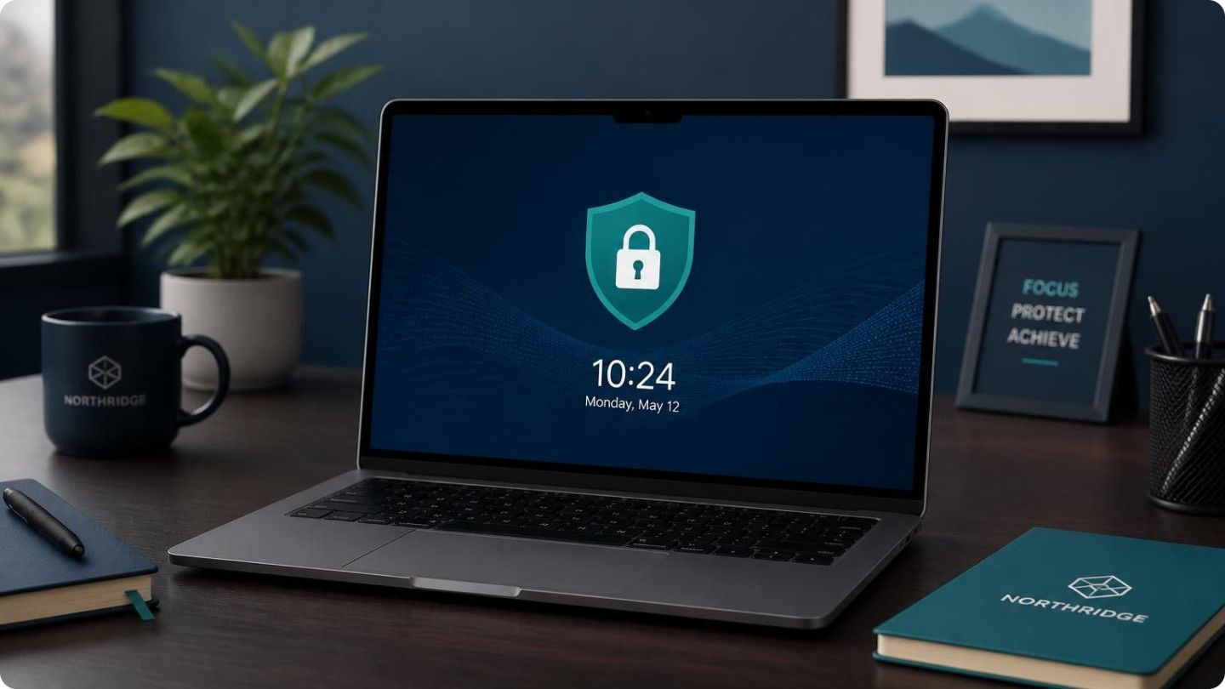
Safe use of devices
Keep operating systems and software up to date
Lock your screen whenever you leave your desk
Use antivirus software and enable disk encryption
Install only approved software

Slide 15
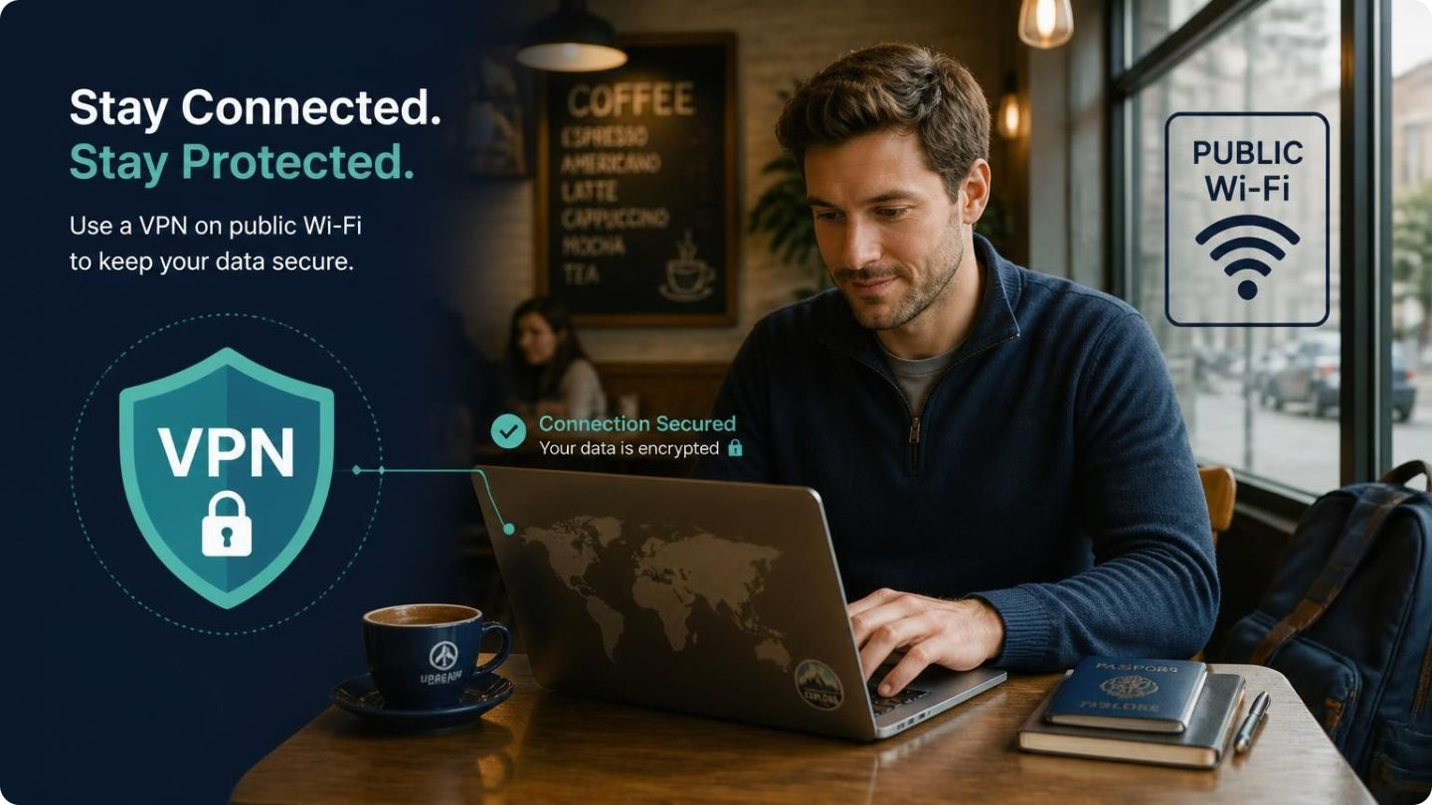
Safe use of public Wi-Fi
Never use public Wi-Fi unprotected; use a VPN
Avoid banking and logging into accounts on public Wi-Fi
Be aware of man-in-the-middle attacks
Consider a travel router for an added layer of security

Slide 16

Any Questions?
Thank you for listening

