Slide 1
ReadmitGuard
A Leading Provider Of Analytic Solutions
Healthcare Management:
Patient Readmission Prediction
Prevention And The Path Forward
Capstone Presentation (Rough Draft) May 17, 2026

Slide 2
We at ReadmitGuard, was asked to analyzed a dataset to identify patients being readmitted to a healthcare facility within 30 days after being treated and discharged from the facility. Identify the treatment provided and through data analysis aid healthcare providers with how they can proactively intervene to prevent readmissions which can cause improvements to a patient’s outcome and reduce the cost of healthcare. Share findings with all levels of management of healthcare facilities.
The main dataset analyzed consisted of 10 years of clinical care data from 1999 – 2008 collected from 130 US hospitals totaling 101, 766 rows. The lookup or data mapping datasets analyzed consisted of supportive values for admission type, which contained 8 rows; admission source, which contained 25 rows; discharge disposition which contained 30 rows and diagnosis which contained 19 rows.
Handling of missing data denoted by a question mark, in the main dataset, was replaced with ‘Not Captured’ or 799 in the case of diagnosis id. The main dataset was separated into two datasets, patient data and patient encounter data, and duplicates were removed from the patient dataset.
Utilized MySQL for data storage, data modeling, data querying and aggregations. Python was utilized for data querying, aggregations and virtualizations. Power BI was utilized for data modeling, aggregations and virtualizations.

Slide 3
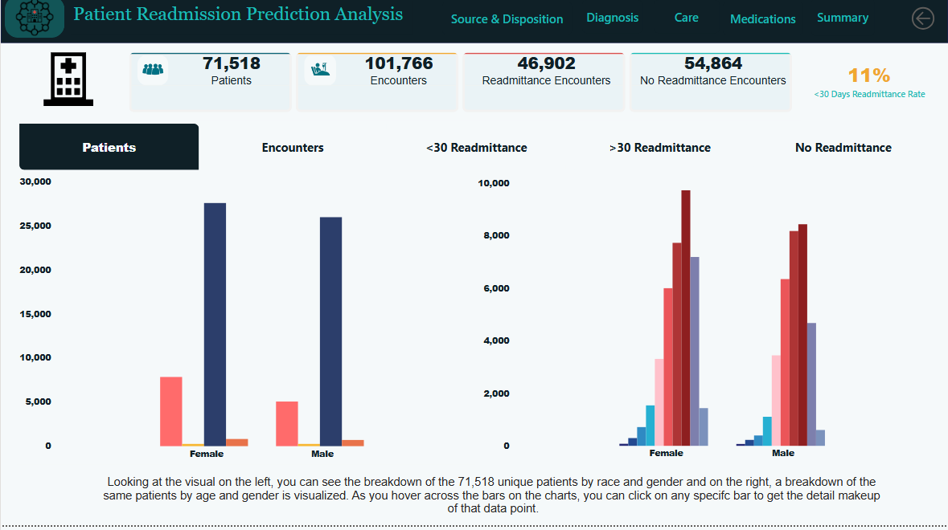
Total unique patients were 71, 518 of which there were 101, 766 encounters or visits to all healthcare facilities within the period. The visuals provide a makeup of the patients by race and gender (left visual) and age and gender (right visual).

Slide 4
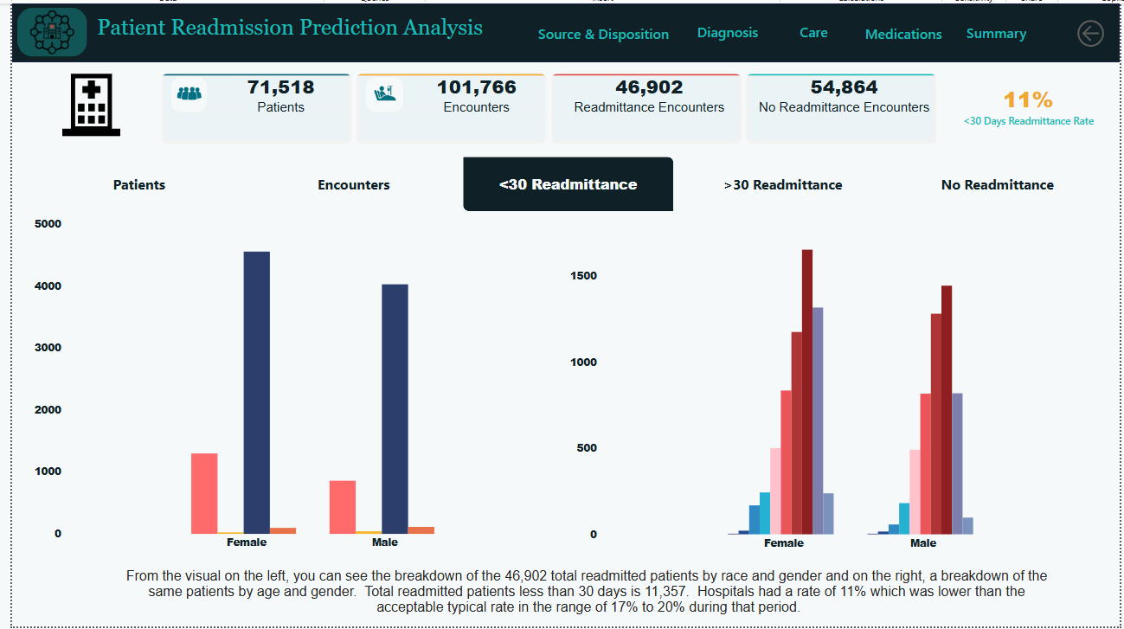
Of the 101, 766 encounters or visits, there were a total 46, 902 readmitted encounter, of which 11, 357 where less than thirty days. The visuals provide a makeup of the patients by race and gender (left visual) and age and gender (right visual).

Slide 5
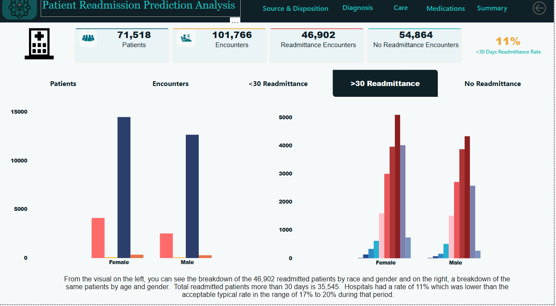
Of the total 46, 902 readmitted encounter, 35, 545 where greater than thirty days. The visuals provide a makeup of the patients by race and gender (left visual) and age and gender (right visual).

Slide 6
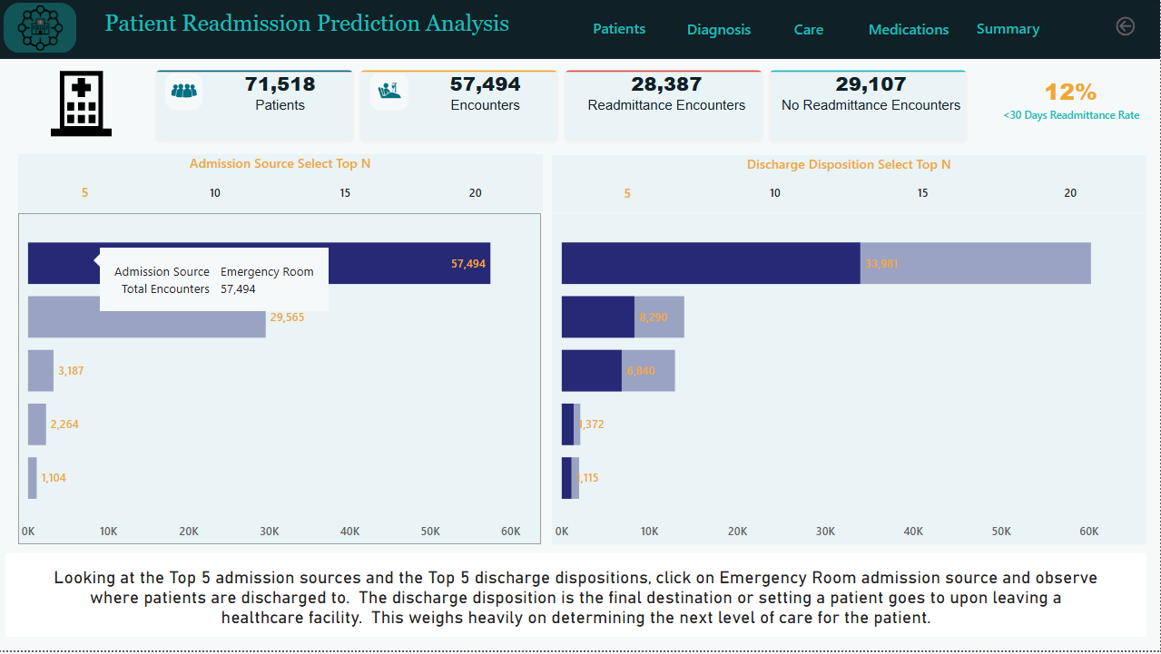
Looking at the top five admission sources, the admission source identifies the location or context of the patient immediately prior to being admitted into the healthcare facility, and the top five discharge dispositions, we get a glimpse of where most patients enter from and where they where discharge to. The discharge disposition, weighs heavily on the next level of care patients receive after being discharged.

Slide 7
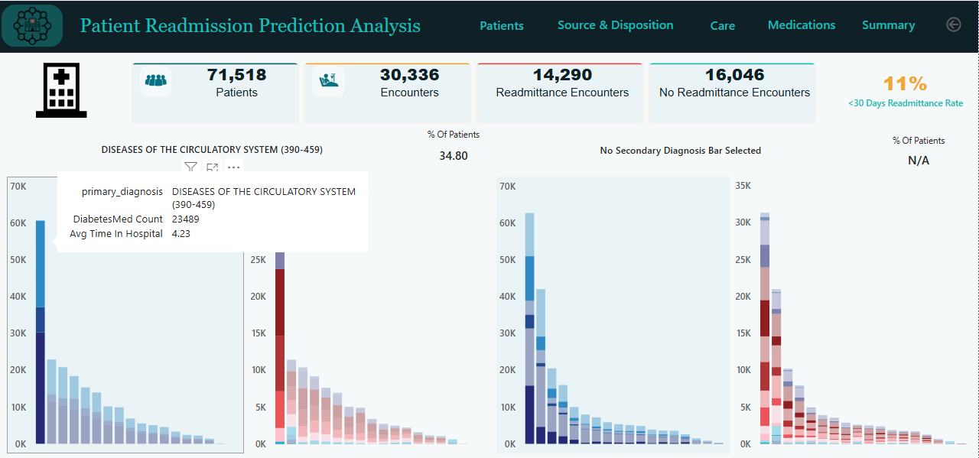
Taking a quick view of the top primary diagnosis, Disease of the Circulatory System, provides a breakdown of diabetic and non-diabetic patients and the avg time spent in the hospital. Additionally, you can see the makeup of the patients by age for the selected primary diagnosis. The same is provide for secondary diagnosis represented in the next couple of visual as you move toward the right.

Slide 8
In summary, patients admitted into the one hundred thirty hospitals during the period no matter the location patients entered from, the treatment and care provided, impacted the amount of time each patient stayed in the facility as well as it aided in their recovery. Patients treated for complicated diagnosis did not stay any longer than those treated for non complicated diagnosis on average. Finally, considering the age and gender of patients, admission source, diagnosis, and treatment, the average readmittance rate less that 30 days of 11% achieved by the hospitals was lower than the acceptable typically range of 17% to 20% during that period. Inviting patients through collaboration, offering understandable specific health information, aiding patients to make informed decisions based on their input can lead to them making healthy decisions regarding treatment and recovery especially after discharge. Having a process whereby patients can be involved in understanding their health risks, benefits and alternative treatments may empower patients to take an active stance in their health which will benefit all streams of patient health management.

