Slide 1
SECOM Yield Optimization
Predicting low-yield wafers in semiconductor manufacturing
Industrial IoT · Smart-Factory Yield · Semiconductor Packaging & Test
1,567
590
~14:1
4
wafers
sensors
pass : fail
runnable notebooks
MSc Data Science & Analytics — Final Data Management Project · Suhaimi · P165962
Notes:
Open with the headline: yield is the dominant cost lever in high-volume packaging & test. This project turns 590 anonymous fab sensors into a short, actionable watch-list, and demonstrates the full data-management workflow across four engines.

Slide 2
Why this problem — and why it matters
Semiconductor packaging & test is a high-value, high-demand domain, and central to Malaysia
The business question
6th
~13%
Which process signals predict low-yield (fail) wafers, and how can the fab use them to raise yield and cut per-unit cost?
largest chip exporter (Malaysia)
of global packaging & test
Every wafer passes hundreds of monitored process steps.
A failed wafer is lost yield and wasted cost.
Features are anonymized, so we deliver ranked sensor IDs as engineering leads.
US$130B
~5%
semiconductor exports, 2024
global sales from Penang
Notes:
Malaysia is the 6th-largest semiconductor exporter and handles ~13% of global OSAT (packaging/assembly/test) — the exact back-end stage SECOM comes from. A single yield point is worth millions, which is why this is a genuinely high-impact data-science question. Sources are cited in the README.

Slide 3
The dataset — UCI SECOM
Real wafer-fab process data; the defects are exactly what a data-management project must handle
1,567
590
104
production wafers
anonymized sensors
fails vs 1,463 passes
~41,951
~347
-1 / +1
missing values
near-constant sensors
pass / fail label
Honest limitations: features are anonymized (we report sensor IDs, not step names), only 104 failures cap achievable precision, and the AI4I add-on is synthetic and kept secondary.
Notes:
Three defects drive the whole methodology: missing values (~42k), near-constant sensors (~347), and a severe 14:1 imbalance. Note the honesty slide-line — stating limitations up front is part of the grade and good practice.

Slide 4
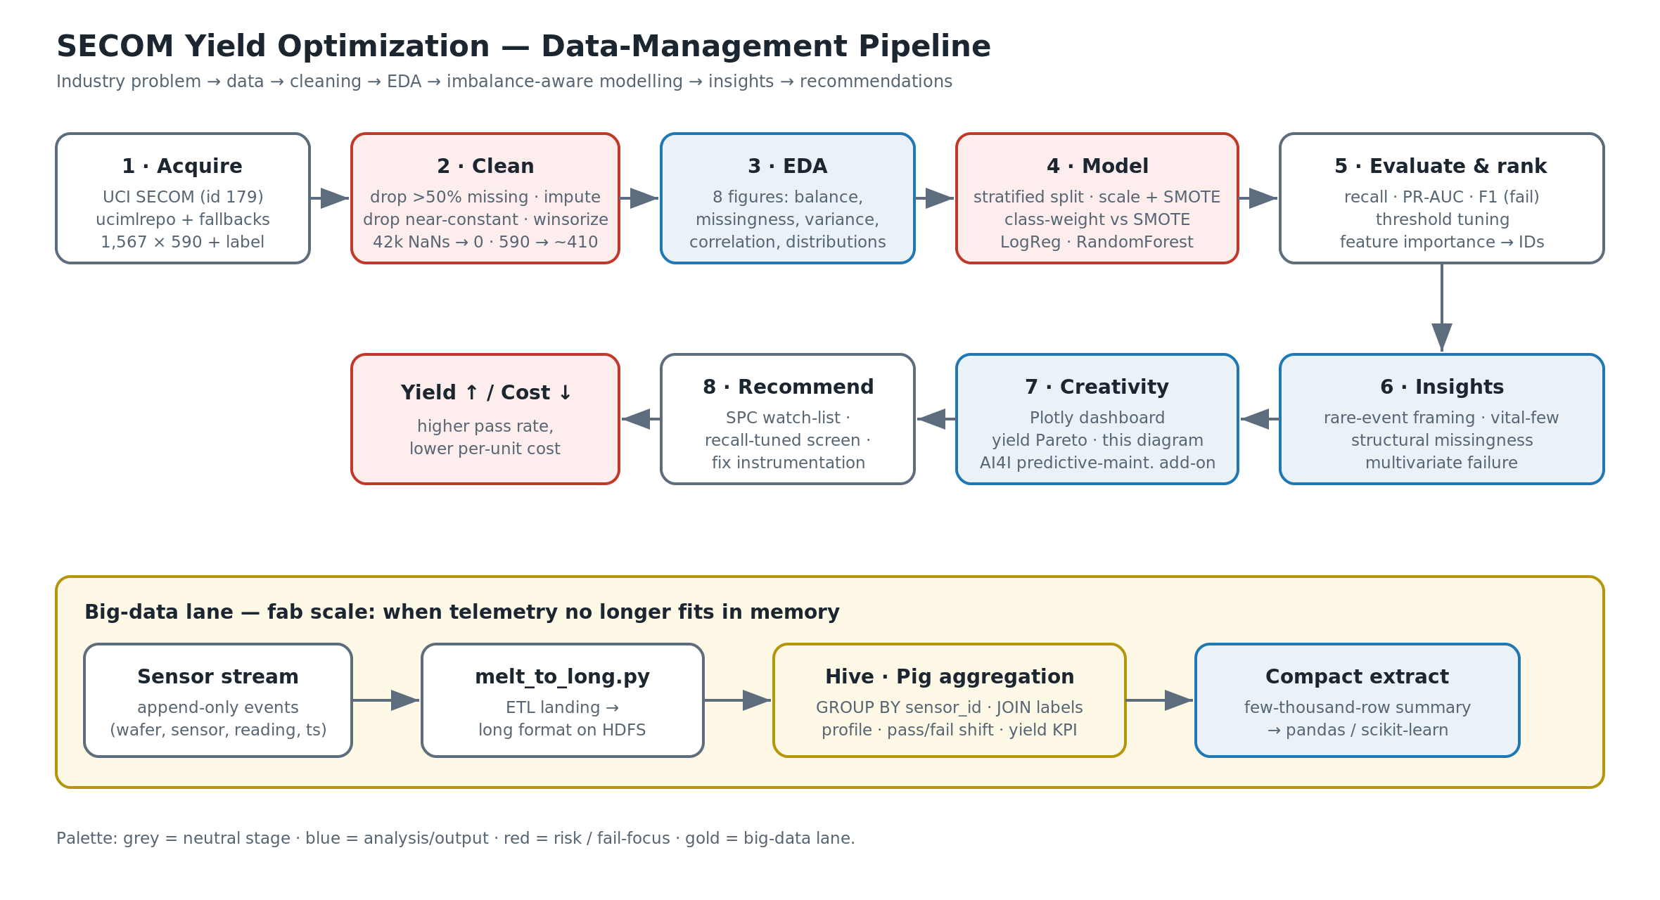
The data-management pipeline
Industry problem to data to cleaning to modelling to insights — plus a fab-scale big-data lane
Notes:
Walk the top lane left-to-right: acquire, clean, EDA, model, evaluate, then insights and recommendations flowing back to the yield/cost outcome. The gold lane at the bottom is the big-data engineering path we demonstrate in three separate notebooks.

Slide 5
Cleaning & preprocessing
Leakage-safe order, with a written justification and before/after audit for every step
1
Drop >50%-missing sensors
Before → After
Can't impute more than half a column honestly.
Sensors
2
Median imputation
590 → ~410
Robust to the skew and spikes of sensor data.
Missing cells
3
Drop near-constant sensors
~41,951 → 0
No discriminative power; only add noise.
Failure rows
4
Winsorize outliers
104 → 104 (kept all)
Clip, never delete — failures are precious.
Imbalance
5
Scale + SMOTE in-pipeline
handled via weights / SMOTE
Fit on the training fold only (no leakage).
Notes:
Emphasise leakage-safety: scaling and SMOTE live inside the pipeline and are fit on the training fold only. And we never delete a failure row — with only 104, every one matters.

Slide 6
Exploratory data analysis
Six-plus deliberate charts; red always means fail / risk
Accuracy is a trap
A 'predict pass' model scores ~93% and catches zero failures — we optimise recall / PR-AUC.
Signal is concentrated
A vital few sensor IDs carry most predictive power (yield Pareto).
Missingness is structural
It clusters in specific sensors offline for a period — a fixable data-quality gap.
Notes:
The chart makes the 14:1 imbalance visceral with the real counts. Then the three takeaways reframe the task as rare-event detection and point to the vital-few signals.

Slide 7
Imbalance-aware modelling
Optimise for catching the rare failure — not headline accuracy
Validation
Two remedies compared
1
Stratified 75/25 hold-out keeps the 14:1 ratio in both splits.
2
Cost-sensitive class weights vs SMOTE, head-to-head.
Two models
Honest metrics
3
Logistic Regression (interpretable) and Random Forest (interactions).
4
Recall, precision, F1 and PR-AUC for the fail class — never accuracy.
Threshold tuning
Leads, not black box
5
Maximise fail-recall within a false-alarm budget.
6
Feature importance to ranked sensor IDs + a yield Pareto.
Notes:
The key mindset shift: under 14:1 imbalance, accuracy is meaningless. We select on PR-AUC and fail-recall, and expose the decision threshold as the knob a fab actually turns — miss vs false alarm.

Slide 8
Insights — the 'why', not just the 'what'
Data-driven findings tied back to semiconductor context
Rare-event detection
The vital few
With ~14:1 imbalance the task is catching a rare event; the whole method follows from that.
Of 590 sensors, a small minority carry the signal — exactly SECOM's documented feature-selection use.
Failure is multivariate
Structural missingness
Top sensors overlap heavily; no single red line works, so monitor a small set together.
Gaps mean sensors were offline — an instrumentation fix, not random noise.
Notes:
Each insight links a data finding to a fab consequence. The associational caveat matters: high-importance sensors are leads to investigate, confirmed by a designed experiment — not proven root causes.

Slide 9
Recommendations for the fab team
Realistic, finding-supported, highest-leverage first
1
Stand up a 'vital-few' SPC watch-list
Tighten control on the top sensor IDs — the cheapest yield win.
2
Deploy a recall-tuned early-warning screen
Flag at-risk wafers for review; keep an engineer in the loop, don't auto-scrap.
3
Fix the offline-sensor instrumentation gaps
Treat structural missingness as a data-quality maintenance ticket.
4
Confirm leads with designed experiments
Take top sensors into a DOE before changing recipes — importance is associational.
5
Retrain on a rolling cadence
Handle drift; use active learning to grow the scarce failure set.
Notes:
Order matters — SPC on the vital few is the cheapest win. Frame the model as decision-support that prioritises engineering attention, not an automatic reject gate.

Slide 10
Big-data engineering — one job, four engines
Choosing the engine by data volume and infrastructure is the data-management skill on show
Engine | Reach for it when | In this project
pandas / scikit-learn | Fits in RAM; iterative analysis & ML | secom_yield_analysis.ipynb
DuckDB | Bigger than pandas, want fast SQL, zero infra | Pig + DuckDB notebook
Hive (via Spark SQL) | Partitioned TB-scale tables; BI access | Pig + Hive/Spark notebook
Apache Pig | Long procedural ETL dataflows | runs in local mode
Real Hadoop + Hive | The authentic warehouse stack | Hadoop + Hive notebook
Rule of thumb: prototype & model in pandas; push recurring full-history aggregation down to the cluster (Hive/Pig) and pull back a small, query-ready extract.
Notes:
The same per-sensor + pass/fail aggregation is expressed in Pig, Hive (Spark SQL and real Hadoop+Hive), and DuckDB. The point isn't any single tool — it's demonstrating deliberate engine selection across the volume/infrastructure spectrum.

Slide 11
Conclusion
Stop optimising for accuracy and stop monitoring all 590 signals equally. Catch the rare failure, watch the vital few — and the data pipeline becomes a durable lever on yield and per-unit cost.
1
Honest, leakage-safe pipeline
2
Vital-few sensor IDs
cleaning → imbalance-aware modelling → recall-focused evaluation
ranked engineering leads + a yield Pareto
3
Four working engines
4
GitHub-ready pack
pandas · DuckDB · Hive/Spark · Pig + real Hadoop+Hive
README, /src, /docs, /notebooks, diagram, reproducible
Thank you · Suhaimi · P165962 · MSc Data Science & Analytics
Notes:
Land the one-liner, then the four proof points. Close by inviting questions and offering to open any of the four notebooks live.

