Slide 1
TROOPOOL
The network
is the product.
A verified networking platform for professionals who happen to commute together. The commute is the reason to meet - meet people on your route, swipe to connect, carpool, build circles. LinkedIn x sRide, not Uber x sRide.
Business case study - product (v4) - market & monetization - India-first, 2026

Slide 2
01
The problem
Indian commutes are long, costly and lonely - and hybrid work removed the office as the professional/social layer.

Slide 3
THE PROBLEM
A double pain: cost and isolation
Rs 200-300
spent per day on cab commutes
44%
drive private cars - empty seats
35%
of urban adults chronically lonely
+28%
YoY friendship-app downloads
Sources: Statista 2024, Market Research Future, loneliness-economy reports. [C]/[E]
Troopool - Case Study - A double pain: cost and isolation
01

Slide 4
OPPORTUNITY
The white space nobody owns
Carpool apps (sRide, Quick Ride, Scoop)
Utility, no network - you book a seat, then nothing brings you back. (Scoop users met cross-department colleagues - but it never built the network layer.)
Social apps (Bumble BFF, Meetup, Nextdoor)
Citywide strangers - no commute context, no real-orbit trust.
Troopool = verified real-orbit + swipe-to-match + B2B distribution
The professional-networking engine no one owns. Carpool is the wedge; the network is the product.
Troopool - Case Study - The white space nobody owns
02

Slide 5
02
The reposition
Troopool is NOT a carpool app. It is a networking platform for professionals who happen to commute together.

Slide 6
THE MODEL - LINKEDIN X SRIDE
The winning loop
Route match -> Swipe -> Match -> Chat
Meet people in your orbit and connect on a mutual like - the sRide-iOS Meet People mechanic.
Carpool -> Friendship -> Circle -> Community
The commute creates the first interaction; networking creates retention; community creates daily engagement.
First screen is People in your orbit - never Find a ride
Carpool is the daily habit. The network is the point.
Troopool - Case Study - The winning loop
03

Slide 7
THE PRODUCT
How it works
1 - Build your Trust Score
Phone + work email required; DigiLocker / selfie optional, each raising a visible 0-100 score. No LinkedIn.
2 - Network - swipe to connect
Tinder-style deck of people on your route / nearby / interests. Pass or connect; mutual -> match -> chat.
3 - Do something real
Chat chips: Coffee, Carpool, Walk, Event, Circle. Carpool a match -> host accepts -> ride group chat.
4 - Community & daily engagement
Pro circles with events & polls; Home dashboard + smart notifications; people-you-may-know after 3 connects.
Troopool - Case Study - How it works
04

Slide 8
03
Goal & market
Save money and build a real professional network on the daily commute - for employees and the companies that employ them.

Slide 9
GOAL
Goal & success metric
Goal
Turn the daily commute into a professional network - meet, carpool, join circles. For companies: engagement, retention, parking relief and BRSR Scope-3 reporting.
Success
A verified professional who, within 2 weeks, has made real connections (matches), carpooled once, and joined a circle - and keeps opening the app daily.
Troopool - Case Study - Goal & success metric
05

Slide 10
MARKET
Primary market & personas
Primary market
Personas
- Verified corporate professionals, Indian IT corridors
- 25-40 - Infosys / TCS / Wipro / Cognizant campuses
- Pune, Bengaluru, Hyderabad, Mumbai, Delhi-NCR
- Dense corridors + employer rollout = solves cold-start
- B2B buyer: HR / facilities / sustainability
- Aisha, 26 - new to city: meet people fast + save
- Rahul, 31 - hybrid: fuel savings + wider network
- Ankit, 29 - wants founders & AI peers (circles)
- Priya, 34 - safety-first: high-trust matches
- Sahil - HR/ESG: engagement + ESG dashboard
Troopool - Case Study - Primary market & personas
06

Slide 11
MARKET ANALYTICS - INDIA
Market size & growth
Rs 88.3M+
India carpooling 2024 - 7.8% CAGR
Rs 282M-1.32B
India friendship/dating by 2035 - 15% CAGR
~Rs 280-370B
carpool TAM (urban India, annual)
Rs 420-500M
realistic Year-1 SOM via B2B anchor
TAM/SAM/SOM from BUSINESS-ANALYSIS.md. [C] market figures, [E] SOM model.
Troopool - Case Study - Market size & growth
07

Slide 12
COMPETITION
Competitive landscape
Player | Scale | Model | Gap Troopool fills
sRide | 3M+ - 400+ corps | subscription + B2B | No network / community layer
Quick Ride | $15.8M raised | commission | No network layer
Scoop (US) | acq. 2024 (Spacer) | employer-paid TDM | Single-mode; no community; folded
BlaBlaCar | EUR 253M - 92M pax | 10-12% commission | Long-distance DNA
Bumble BFF / Meetup | 200M / 60M | subscription / events | No commute - low India ARPU
Troopool - Case Study - Competitive landscape
08

Slide 13
POSITIONING
Positioning - a quadrant no one owns
High network value x verified marketplace x B2B distribution
sRide/Quick Ride/Scoop = transport utility, low social. Bumble/Meetup = social, no commute or India monetization.
Troopool = the upper-right
Professional networking on a verified daily orbit, distributed through corporates - defensible by real-orbit trust and repeated proximity.
Troopool - Case Study - Positioning - a quadrant no one owns
09

Slide 14
04
Business & monetization
Carpool is the wedge; B2B SaaS + ride commission are the money. No consumer paywall.

Slide 15
BUSINESS MODEL
How it makes money
1 - Consumer ride commission - 6-8% on the cost-share
Rs 5-10 on a Rs 70-100 carpool. Cost-sharing-compliant, far below Uber's 25-30%.
2 - B2B SaaS (flagship) - Rs 30-50 / employee / month
Networking + ride matching + HR portal + BRSR Scope-3 carbon & engagement dashboard. 70-80% gross margin.
3 - Community experiences
Ticketed circle events & partner perks. No consumer subscription - the network stays free to grow.
Troopool - Case Study - How it makes money
10

Slide 16
B2B - ESG
The B2B / ESG engine - why companies pay
Scope-3
BRSR commuting disclosure - top-1,000 listed
~22%
corporate transport cost cut
8.4/10
employee engagement score (in-app)
~70%
retention uplift (Zeelo)
Sources: SEBI BRSR, Zeelo, GHG Protocol Ch.7. [C]/[E]
Troopool - Case Study - The B2B / ESG engine - why companies pay
11

Slide 17
05
Product walkthrough
Start to finish on the live prototype (troopool-v4.html) - people first, swipe to connect.

Slide 18
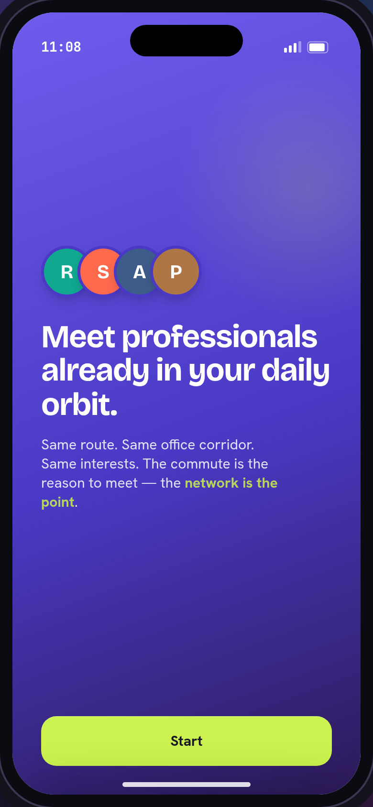
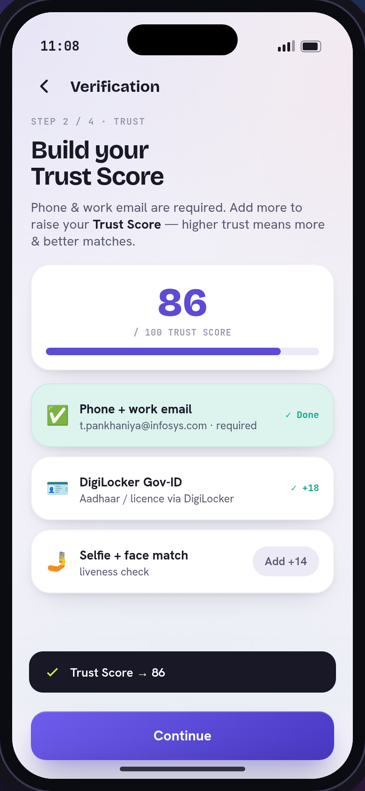
WALKTHROUGH - 1 OF 6
Onboard & build trust
Welcome
Meet professionals already in your daily orbit.
Build your Trust Score
Phone + email required; DigiLocker / selfie raise a 0-100 score.
Troopool - Case Study - Onboard & build trust
12

Slide 19
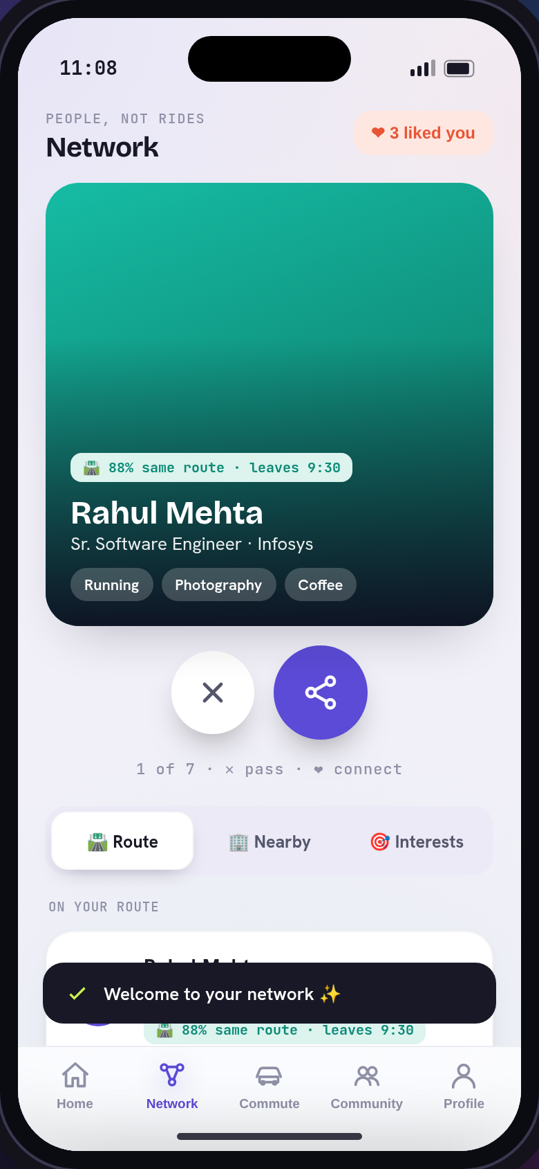
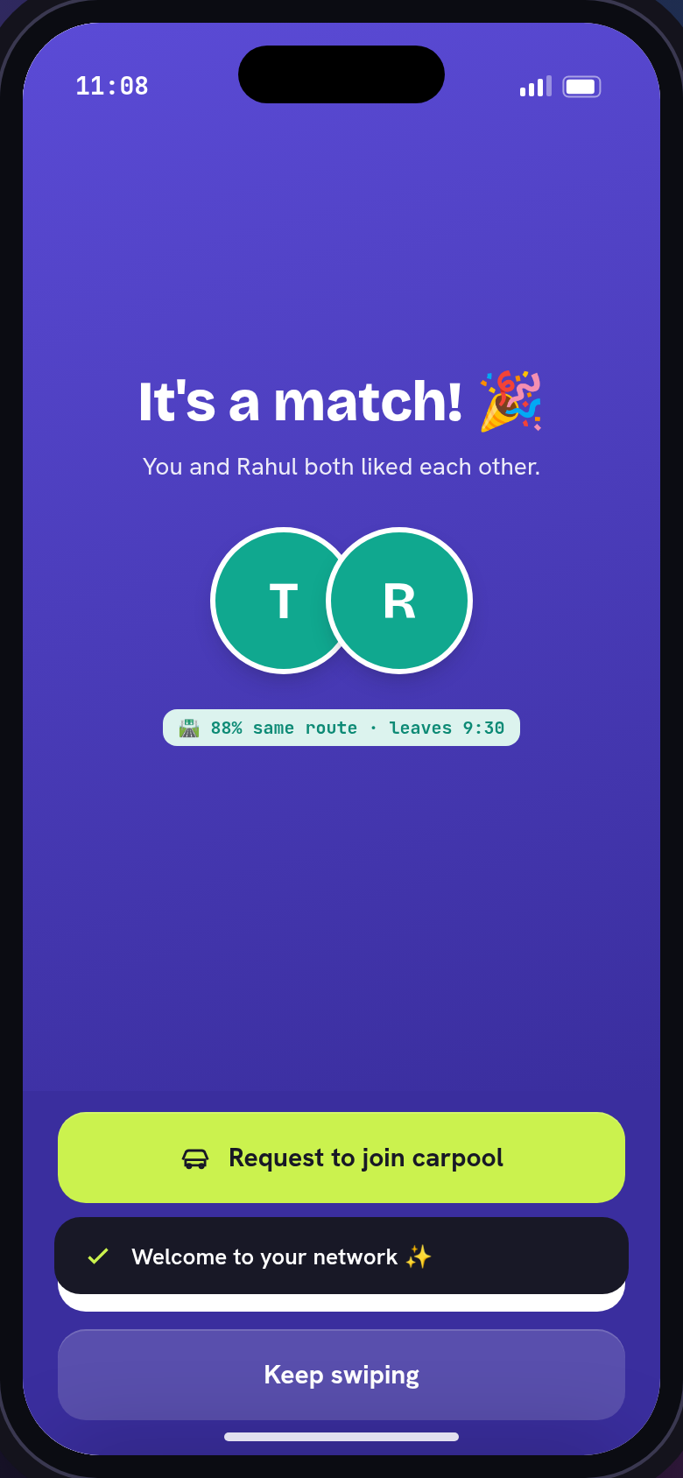
WALKTHROUGH - 2 OF 6
Connect by swiping (sRide-style)
Network - people, not rides
Swipe pass / connect through your orbit.
It's a match!
A mutual like opens a chat - no connect-request.
Troopool - Case Study - Connect by swiping (sRide-style)
13

Slide 20
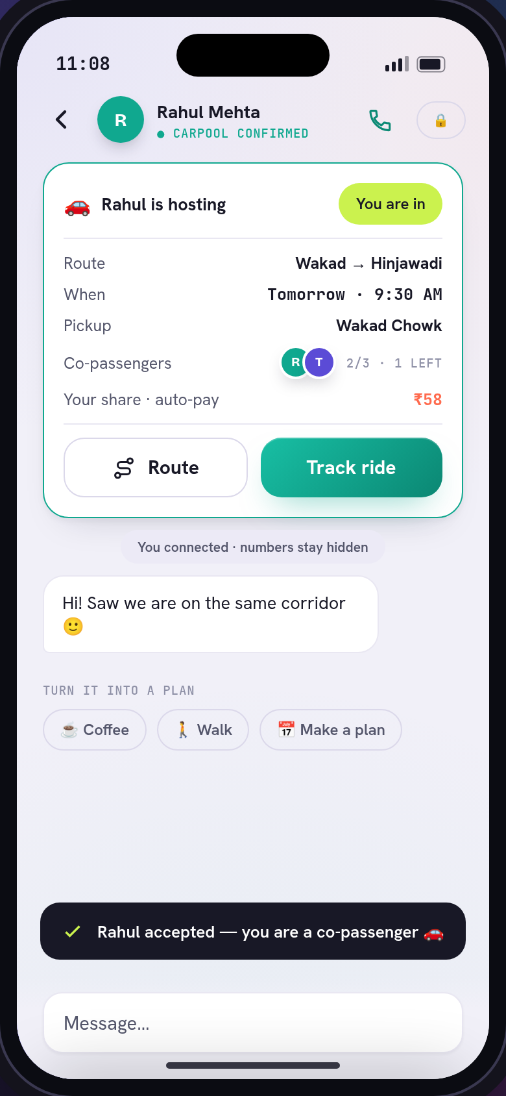
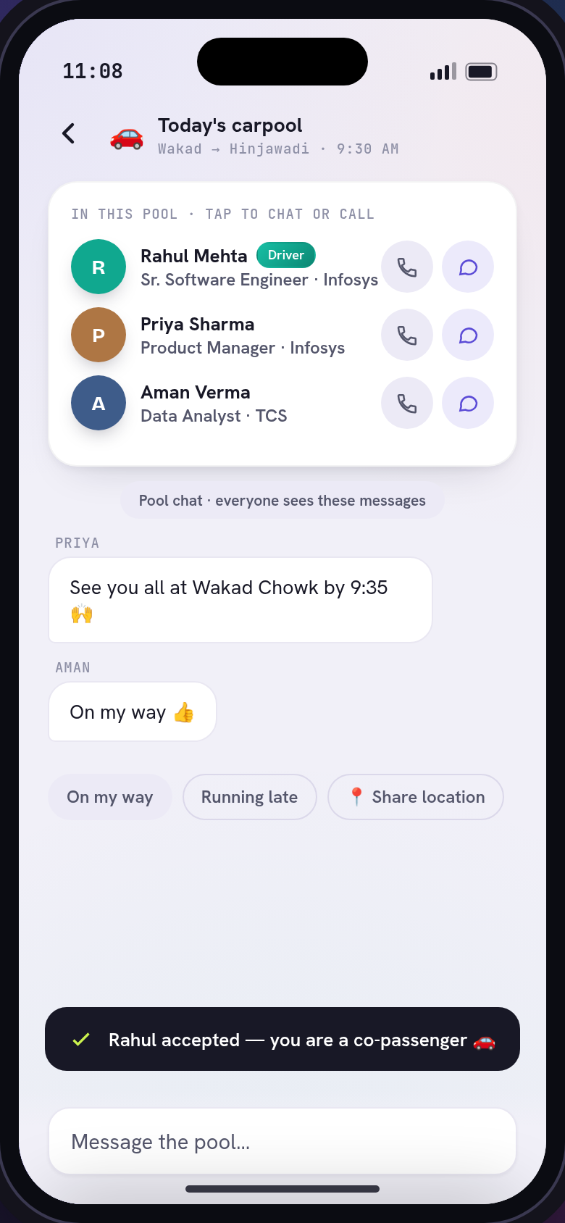
WALKTHROUGH - 3 OF 6
Carpool - the reason to meet
Carpool a match
Request -> host accepts -> confirmed pool, scoped to the chat.
Ride group chat
Driver + all co-passengers connect - networking, not just a ride.
Troopool - Case Study - Carpool - the reason to meet
14

Slide 21
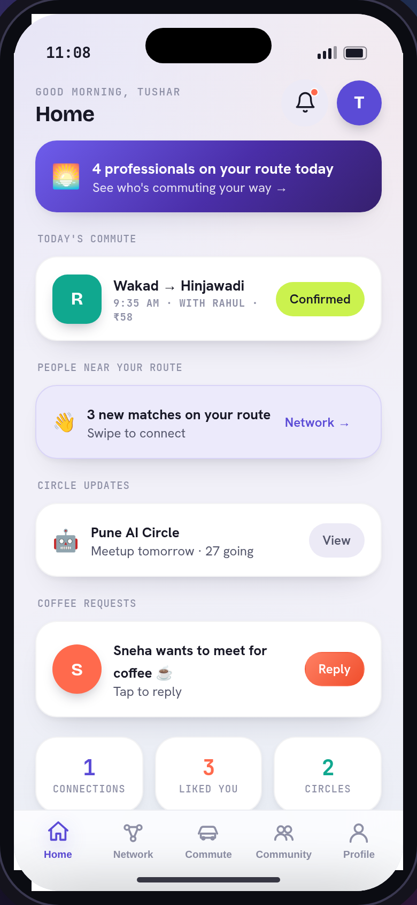
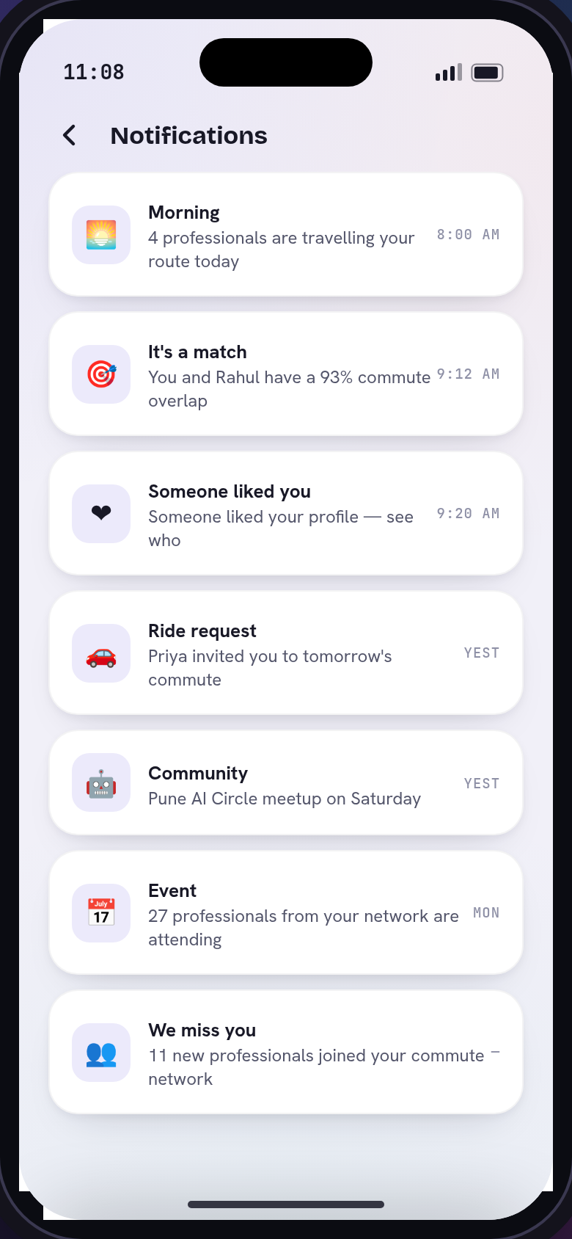
WALKTHROUGH - 4 OF 6
Daily engagement
Home dashboard
Today's commute, new matches, circle updates, coffee requests.
Smart notifications
Morning, match, ride, event - categorized, never spam.
Troopool - Case Study - Daily engagement
15

Slide 22
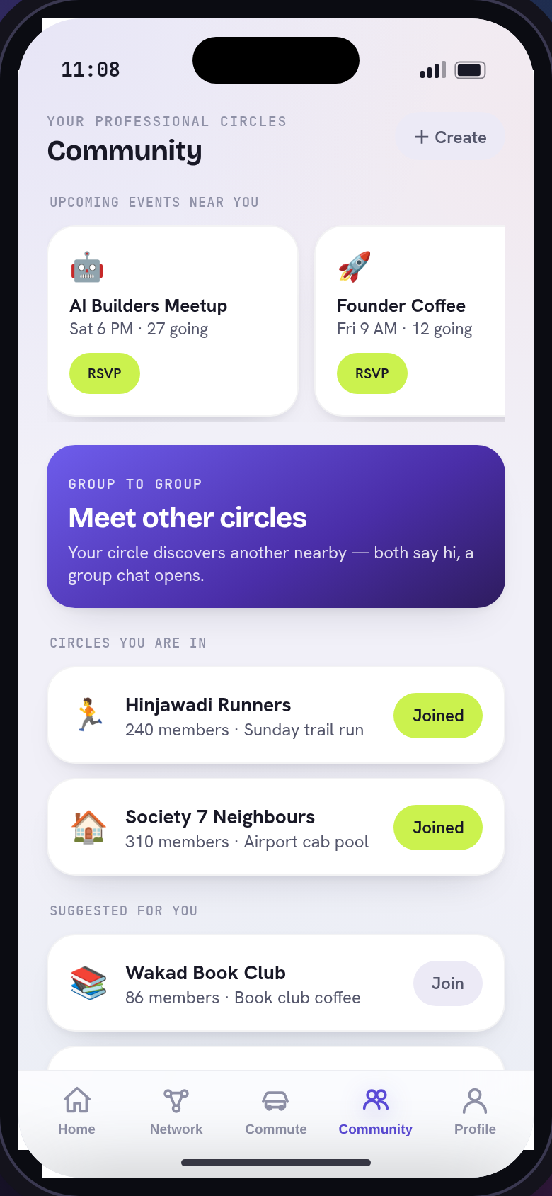
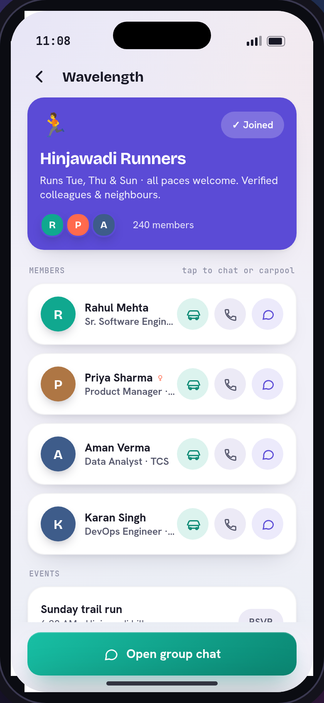
WALKTHROUGH - 5 OF 6
Community
Professional circles + events
RSVP events, vote polls, post carpool requests.
Inside a circle
Members you chat / call / carpool - events - polls.
Troopool - Case Study - Community
16

Slide 23
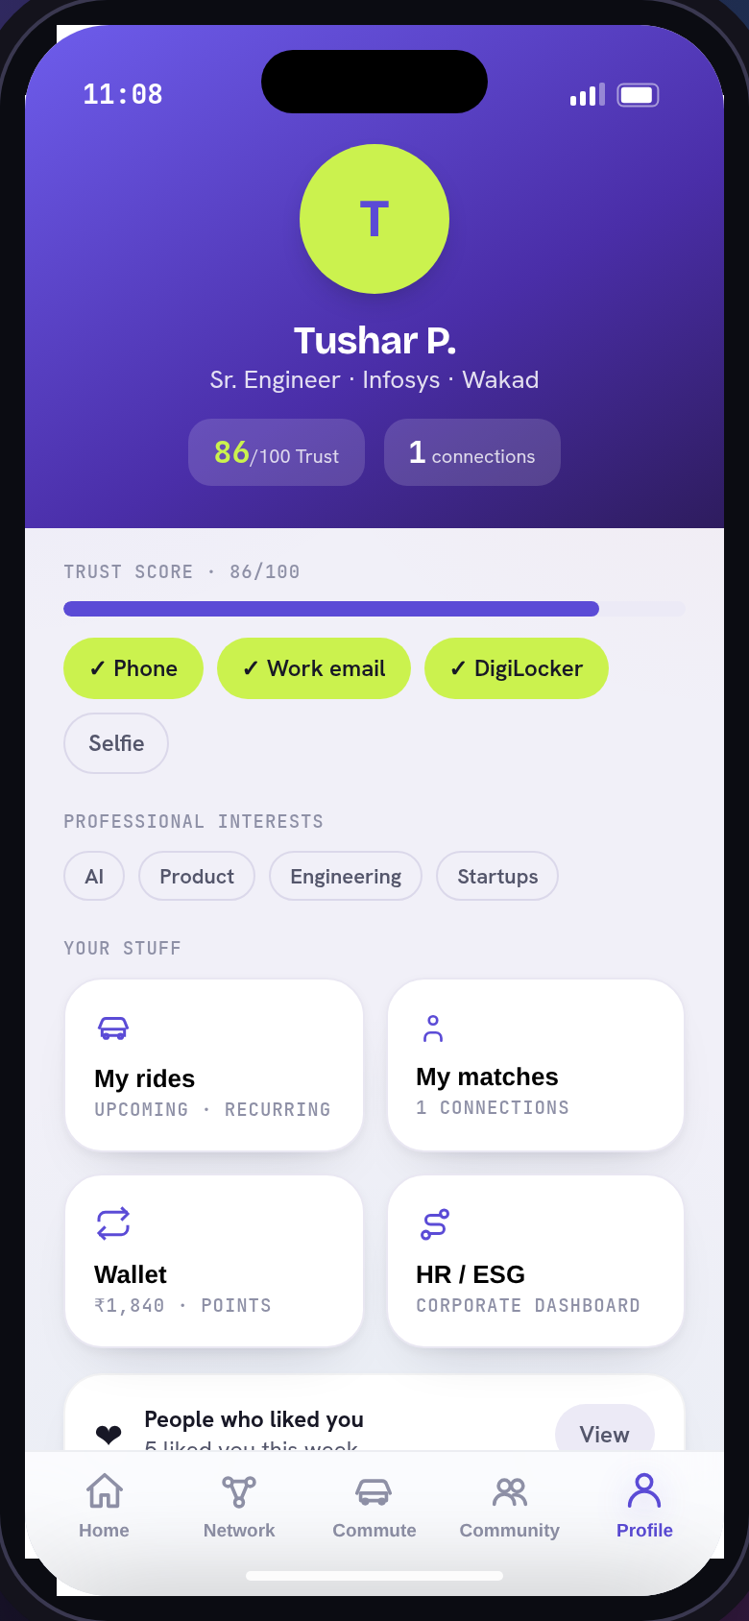
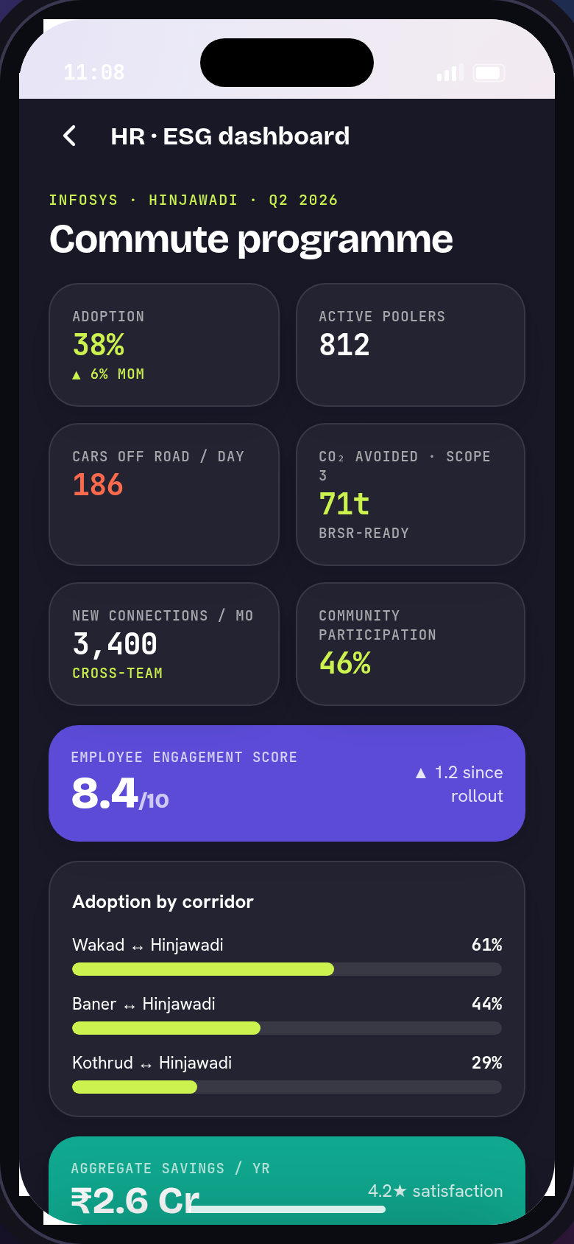
WALKTHROUGH - 6 OF 6
Trust & the B2B story
Profile + Trust Score
Verification badges, professional interests, connections.
HR / ESG dashboard
Adoption - new connections - engagement 8.4/10 - CO2 Scope-3.
Troopool - Case Study - Trust & the B2B story
17

Slide 24
USER PERSPECTIVE
The user story
What the user wants
The journeys
- See people in my orbit, not a ride search
- Swipe & connect on a mutual like (sRide-style)
- A Trust Score that gets me better matches
- Turn a match into a carpool / coffee / circle
- A ride group where co-passengers all connect
- A reason to open the app daily - no spam
- A - Trust -> swipe -> match -> chat -> carpool -> rate
- B - Join a circle -> RSVP event -> vote poll -> meet circles
- C - Home -> morning route -> matches -> circle updates
- D - HR -> adoption - connections - engagement - CO2
Troopool - Case Study - The user story
18

Slide 25
06
Go-to-market, economics & roadmap
Anchor on corporates in the Maharashtra legal window; the network drives retention carpool can't.

Slide 26
GTM
Cold-start - the B2B anchor (Scoop/Karos playbook)
Phase 0 - 0-3 mo
5-10 marquee campuses (Bengaluru + Mumbai). Employer subsidises fares; 80% match-rate by week 2; guaranteed-ride-home.
Phase 1 - 3-6 mo
Swipe network + referrals (k 1.2-1.4). HR champions. 100-200K users.
Phase 2 - 6-12 mo
Hyderabad + Delhi. Circle events. 200-400K users - Rs 420-500M run-rate.
Troopool - Case Study - Cold-start - the B2B anchor (Scoop/Karos playbook)
19

Slide 27
KPIS
Unit economics & KPIs (Year-1 targets)
75-80%
ride match rate
40-45%
D30 retention (network-boosted)
3:1 - 5:1
LTV : CAC
70-80%
B2B SaaS gross margin
Benchmarks vs BlaBlaCar Daily, NFX cold-start, SaaS standards. [C]/[E]
Troopool - Case Study - Unit economics & KPIs (Year-1 targets)
20

Slide 28
FINANCIALS
3-year financial outline
 | Year 1 | Year 2 | Year 3
Cities | 4 | 8 | 12-15
MAU | 0.2-0.4M | 1-1.5M | 3-5M
B2B clients | 50-100 | 200-400 | 800-1,200
ARR | Rs 420-500M | Rs 2.5-3.5B | Rs 8-10B
Troopool - Case Study - 3-year financial outline
21

Slide 29
RISK REGISTER
Risks & mitigation
Regulation (top risk)
Launch Maharashtra (legal Apr 2025); corporate-transport framing; Delhi deferred.
Safety / women-safety
Trust Score + KYC, women-only mode, SOS, live tracking, 2-way ratings.
Cold-start liquidity
B2B anchor; subsidised drivers M1-3; guaranteed-ride-home; 80% match-rate.
Single-mode fragility (Scoop's lesson)
Network + community + multi-modal so value survives when carpool dips.
Troopool - Case Study - Risks & mitigation
22

Slide 30
People first. Rides second.
The network is the product.
Verified real-orbit + swipe-to-match + B2B/ESG distribution - the engagement engine carpool apps can't build.
Troopool - meet the people on your way.

