Slide 1
BMI & Heart Disease
DS-160
William Muckler

Slide 2
Introduction
Body Mass Index (BMI)
A measure of body composition based on the height and weight of adults.
Can use your number to help predict overall health or the likelihood of various diseases.
Heart Disease
Encompasses a variety of conditions that affect the heart and blood vessels.
The leading cause of death in the United States.
702,880 deaths in 2022.

Slide 3
Research Questions
Can we create a model to predict BMI? What are the largest indicators of this measure?
Can we predict whether a person has heart disease using the variables given in our dataset?

Slide 4
About the Dataset:
health_activity_data.csv from Kaggle
16 columns: 11 numeric and 5 categorical
Numeric Variables: ID #, Age, Height (cms), Weight (kgs), BMI, Daily Steps, Caloric Intake, Hours of Sleep, Heart Rate, Weekly Hours of Exercise, and Weekly Alcohol Consumption.
Categorical Variables: Gender, Smoker, Diabetic, Heart Disease, and Blood Pressure
1,000 total rows of data
Complete dataset, no missing values

Slide 5
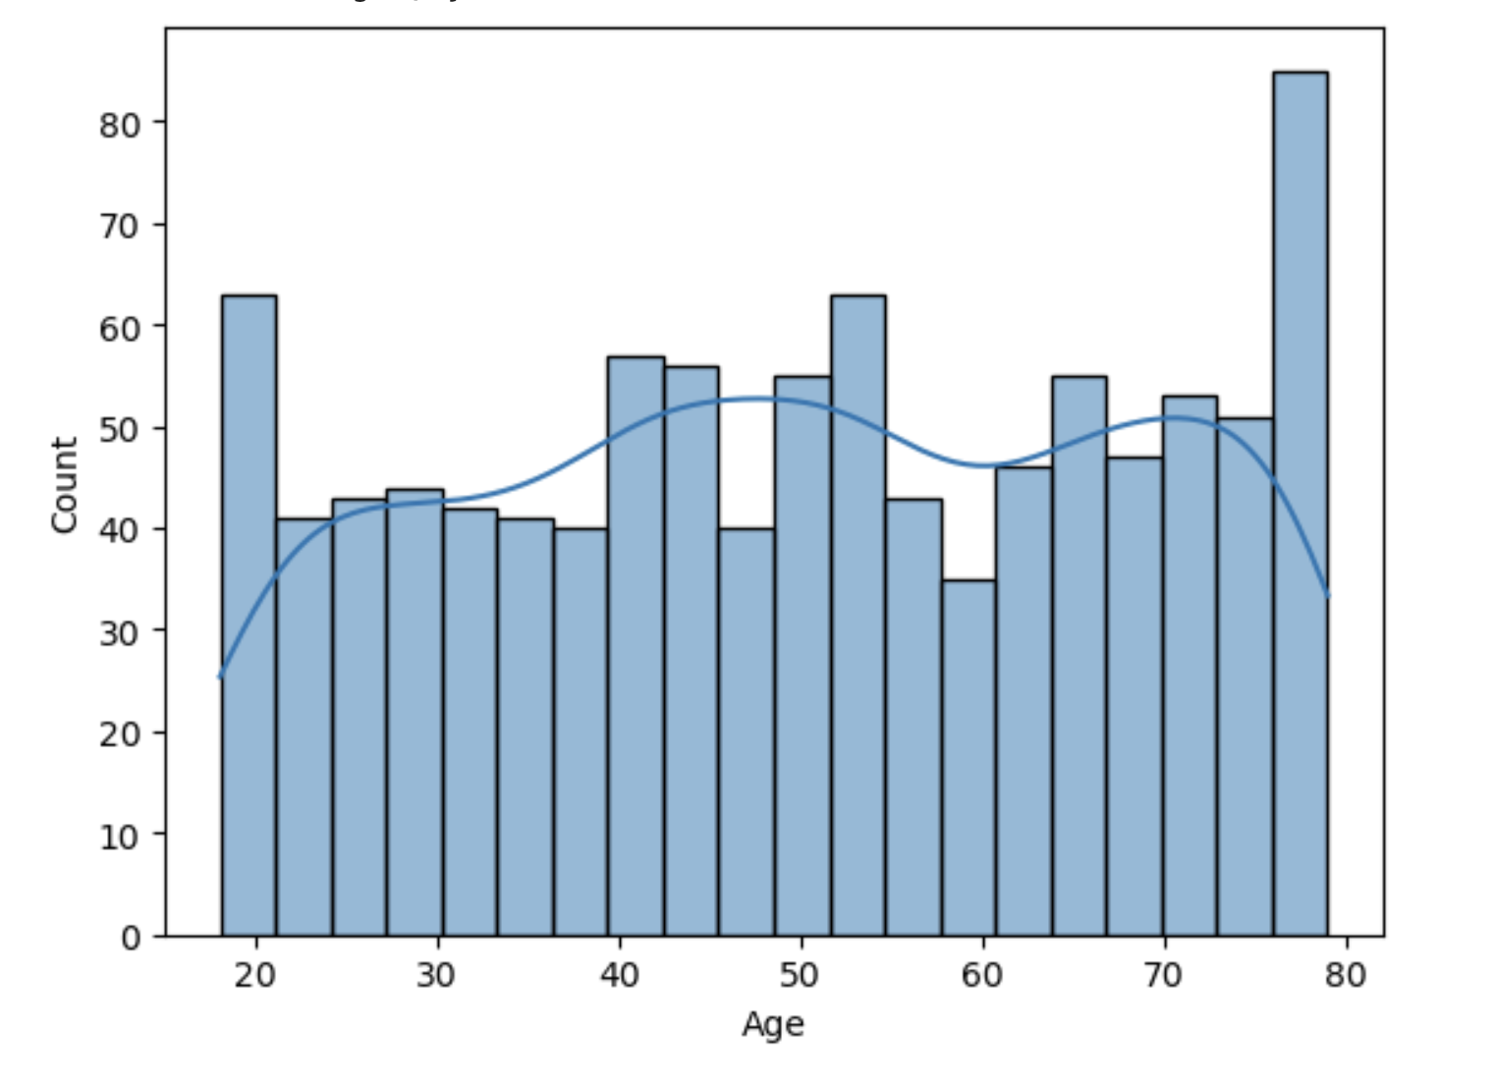
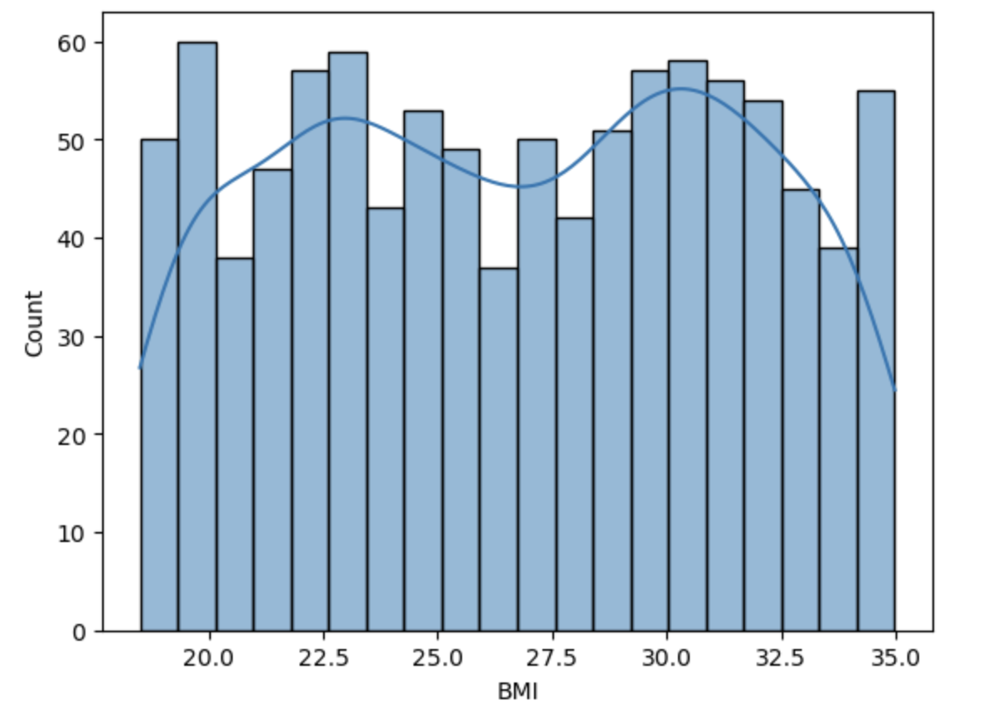
Distribution of Age & BMI
Average Age: 49.86
Average BMI: 26.73

Slide 6
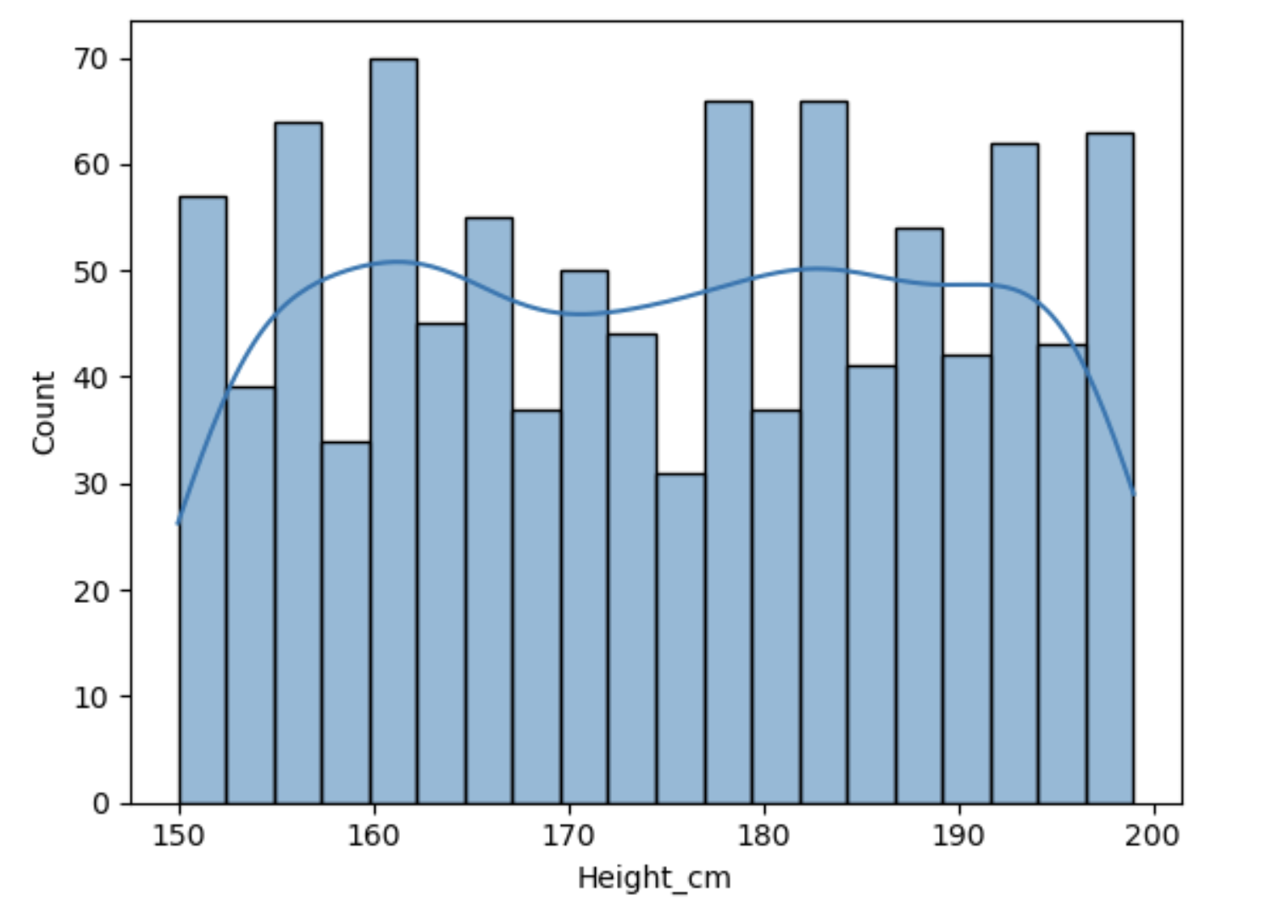
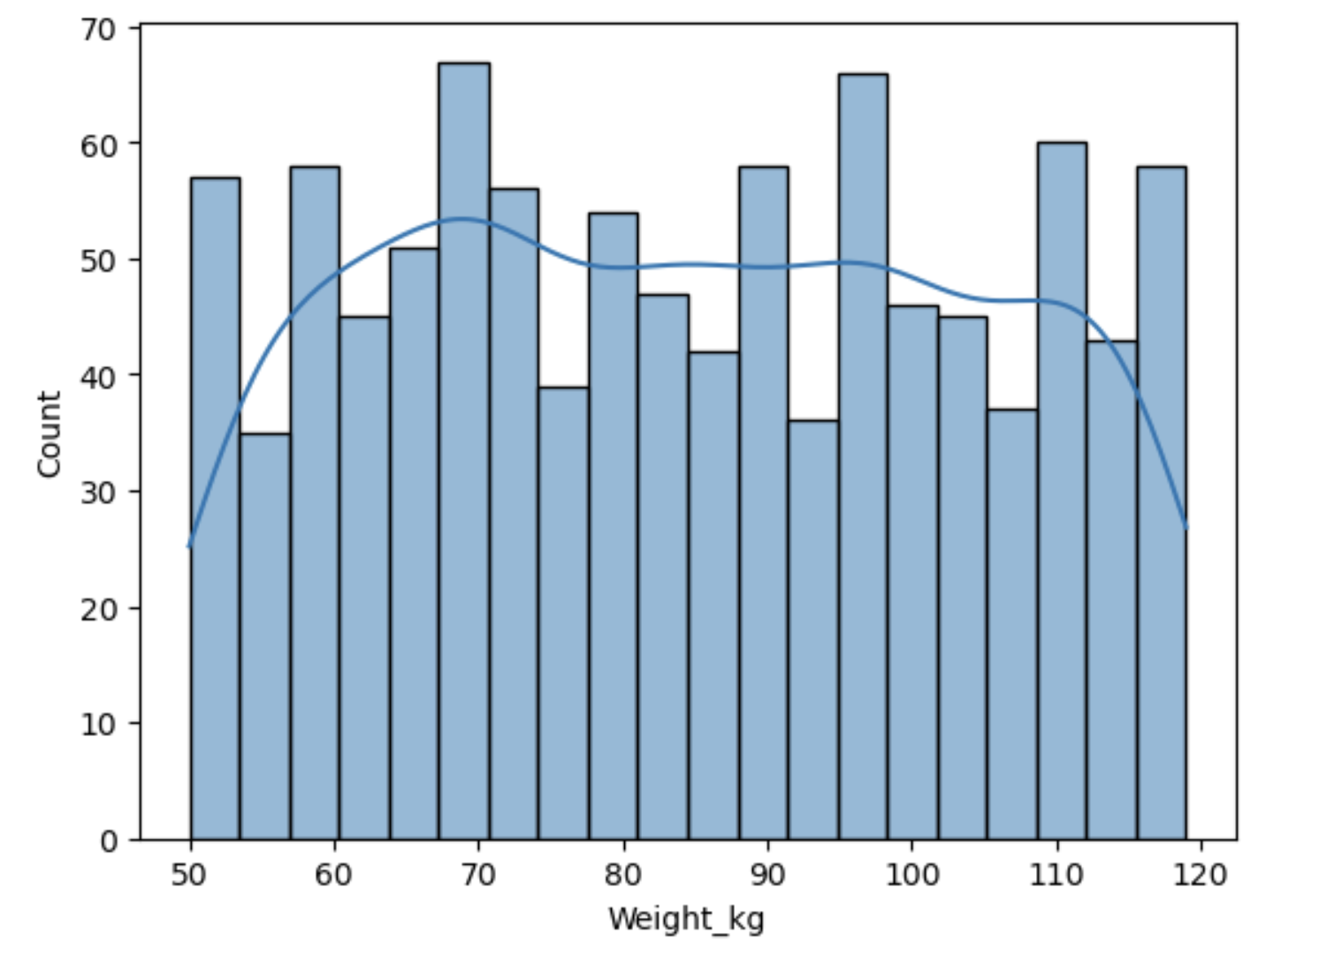
Distribution of Height and Weight
Average Height: 174.75 cms, ~5’8”
Average Weight: 49.86 kgs, ~110 lbs

Slide 7
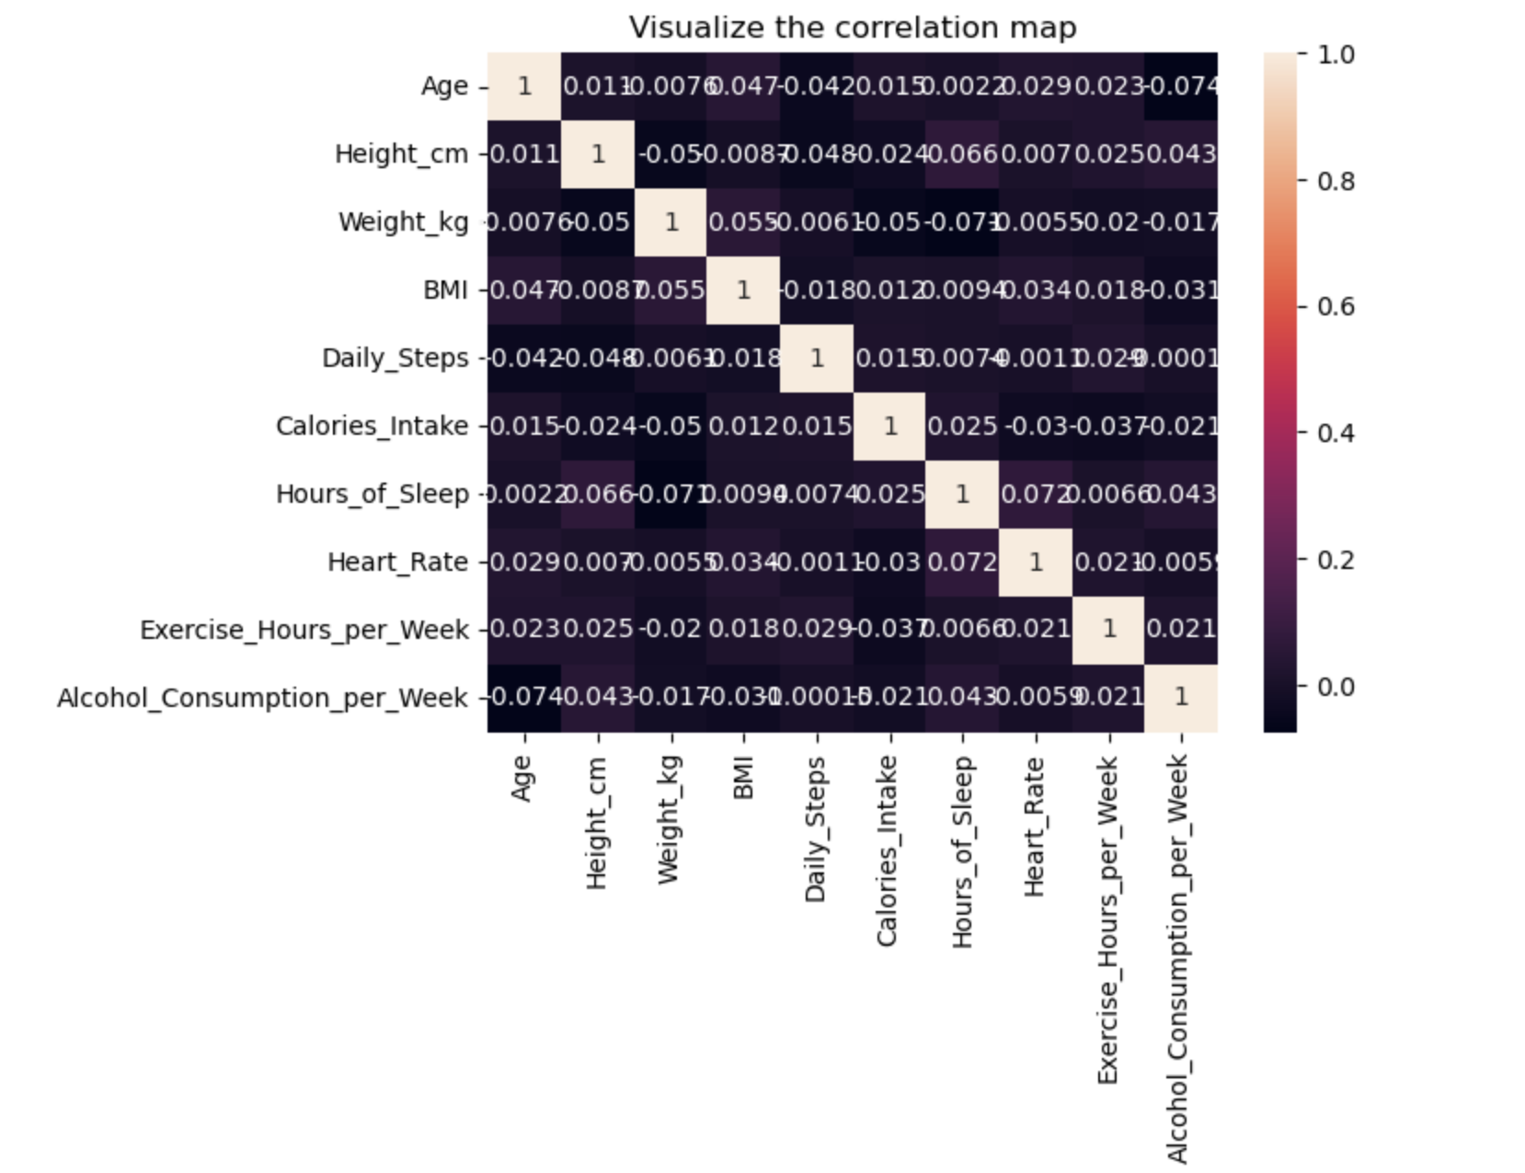
Correlation Heatmap
Very little correlation throughout the dataset.
Highest correlation: .072 between hours of sleep and heart rate.

Slide 8
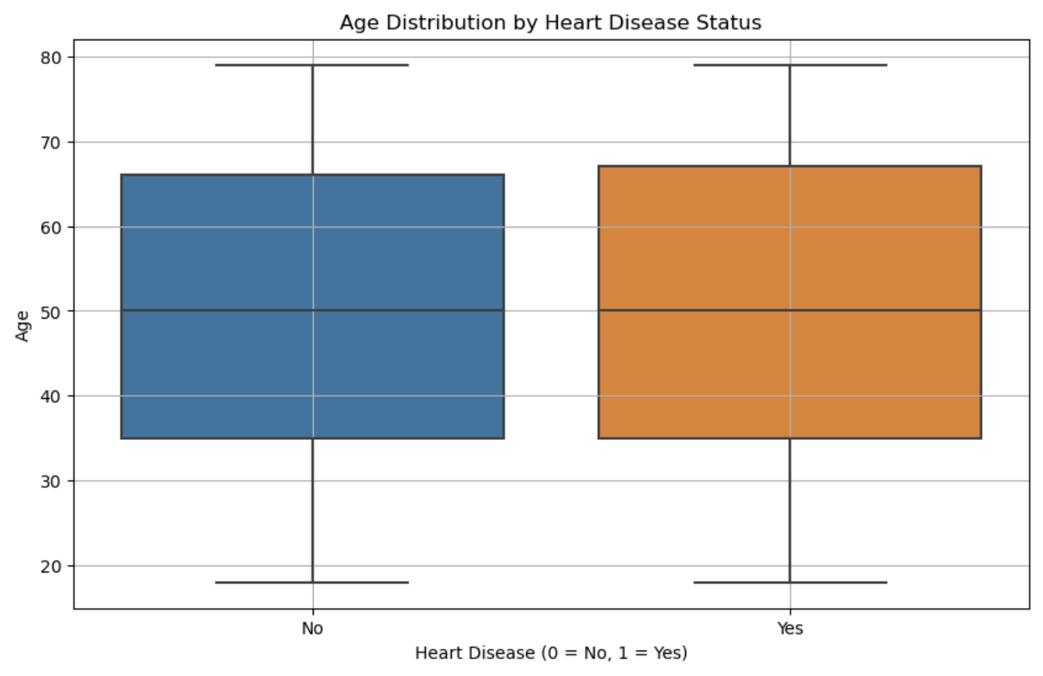
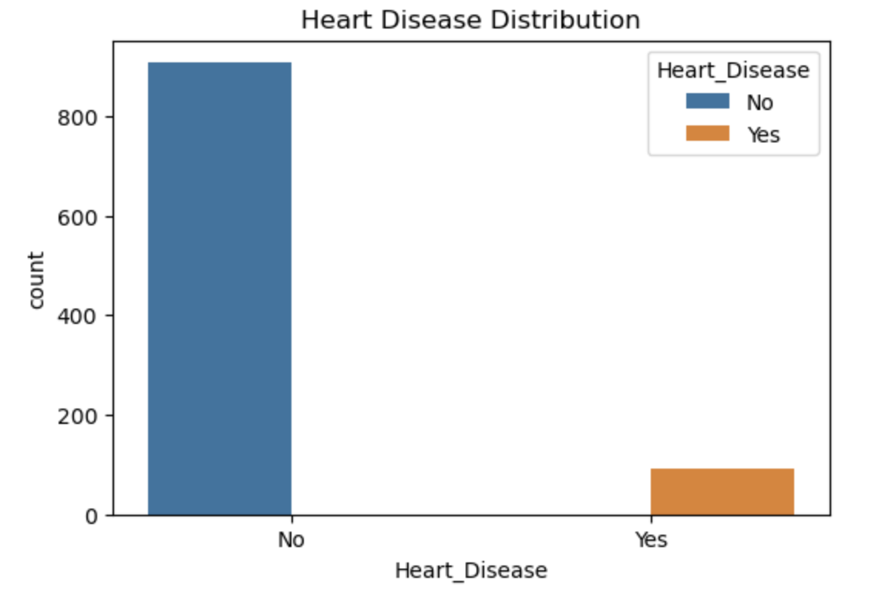
Heart Disease Distributions

Slide 9
Linear Regression: BMI
Goal: Predict BMI through the variables given in the dataset using linear regression.
Creating two models would show how the absence and presence of height and weight would effect these.
Would either model be close to the formula in accuracy?
BMI Formula:
BMI= Weight (kgs)
Height(meters)^2
Height and weight were given within the dataset.

Slide 10
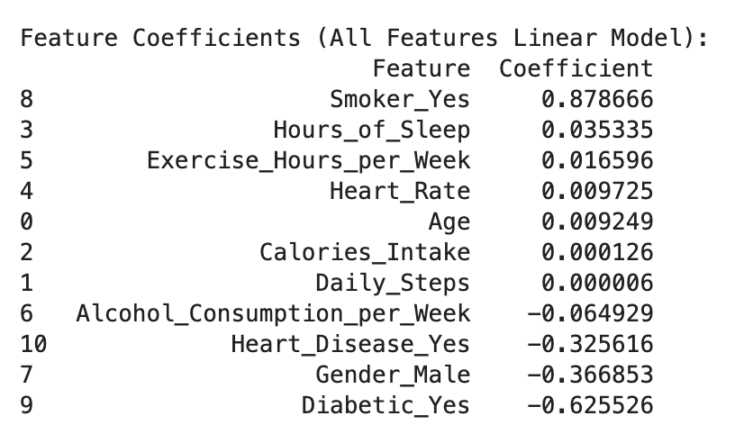
Linear Regression: Model 1
Linear Model 1: Using many variables
Variables: Smoker, Hours of Sleep, Exercise hours per week, Heart rate, Age, Caloric intake, Daily steps, Alcohol consumption per week, Heart Disease, Gender, Diabetic.
Metrics:
Mean absolute error: 4.12
Mean squared error: 23.06
R^2: .005739

Slide 11
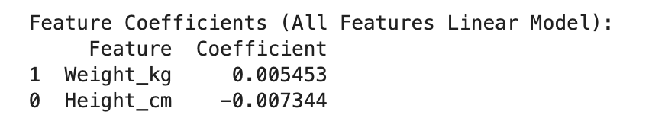
Linear Regression: Model 2
Linear Model 2: Using Height & Weight
Variables: Height (cm), weight (kg)
Metrics:
Mean absolute error: 4.21
Mean squared error: 22.61
R^2: .004915

Slide 12
Linear Regression: Two Model Evaluation
Predicting BMI using Model 1:
25-year-old man, 10,000 daily steps, 2500 calories, 8 hours of sleep, 60 resting heart rate, 5 hrs of exercise, 5 drinks/week, no smoking, no heart disease, non diabetic.
Outcome: 26.43
Predicting BMI using Model 2:
180 cm tall, 70 kgs.
Outcome: 30.05
Actual: 21.6
Mean absolute error, mean squared error, and R^2 values didn’t point towards the models predicting well.
Why is this?

Slide 13
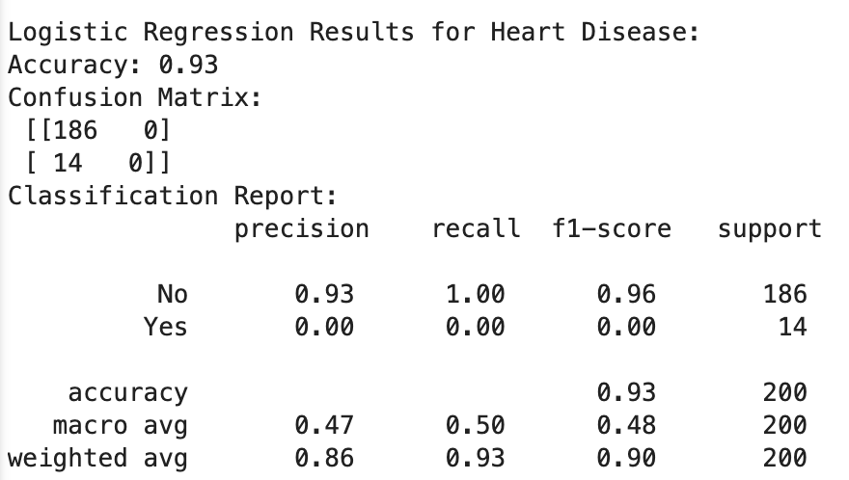
Logistic Regression: Model 1
Goal: Predict whether an individual has heart disease or not.
Variables used: all except for ID # and blood pressure.
Result of logistic regression model:

Slide 14
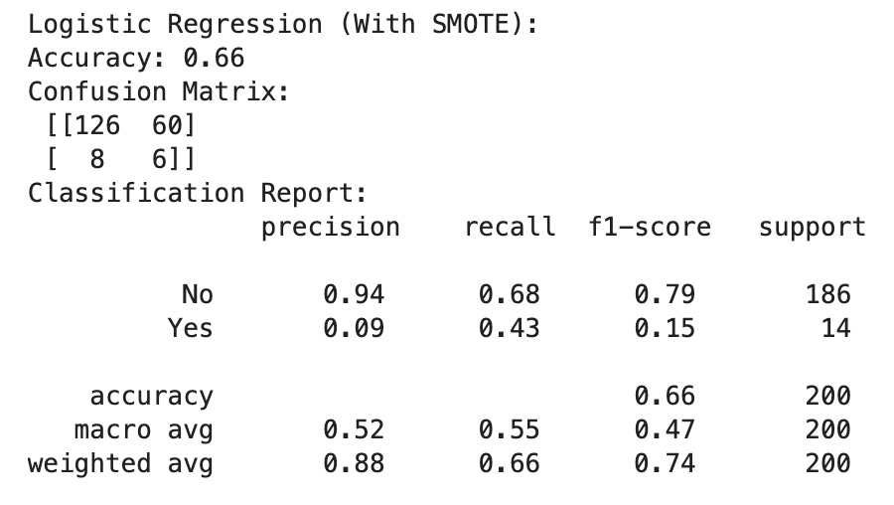
Logistic Regression: SMOTE Method
Synthetic Minority Oversampling Technique (SMOTE).
Used for an unbalanced dataset. Two observations, with one being the majority.
The first model was accurate in predicting negative results, but inaccurate in predicting positive results.

Slide 15
Future Analysis:
Linear Regression
Find a model which can accurately predict BMI
Create a calculator using height and weight
Logistic Regression
Look into other resampling techniques, some may be more accurate.
Find out how to increase the accuracy of the SMOTE model. Although the second model found positive results, the accuracy had dropped.

Slide 16
Conclusions:
Overall, I would consider this project a success.
I was unable to find a model for BMI, but my work pushed me in the direction of a viable solution.
There could be a better regression model to predict BMI without using height and weight.
More research needs to be done on logistic regression. There may be a better model out there.

Slide 17
Thank You

