Slide 1
Hackathon, v105
Bill Munyan
Carl-Heinz Genzel (remotely)
Henk approves of this hackathon

Slide 2
Objectives
Determine a data model representing “what to collect”
Determine a data model representing “what was collected”
Implement a simple collector
Do cool things with XMPP
Use XMPP’s eXtensible <iq> stanza to orchestrate collection
Use various XMPP features (IQ’s and PubSub) to push collected information between XMPP entities
Do cool things with concise map
Translate collected information to MAP CBOR data
Publish translated CBOR data to MAP
Extract CBOR data from MAP and reconstruct collected XML data

Slide 3
Data Model(s)
Prior to hackathon, Bill worked on some (quick & dirty) modifications to OVAL
Current OVAL structure couples collection and evaluation
There’s no way to indicate collection only
Redefined some namespaces, and created a new “OVAL collections” schema
Allows for OVAL XML to only specify collection activities
The <oval_objects> element
Reduced scope (for this hackathon) to just the core and platform-independent schemas

Slide 4
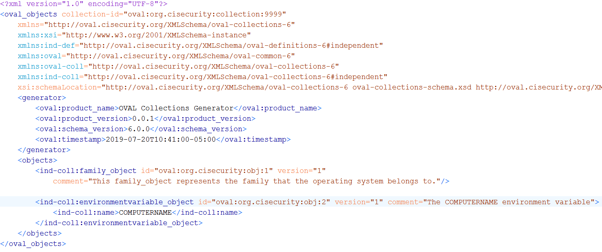
Collection Example

Slide 5
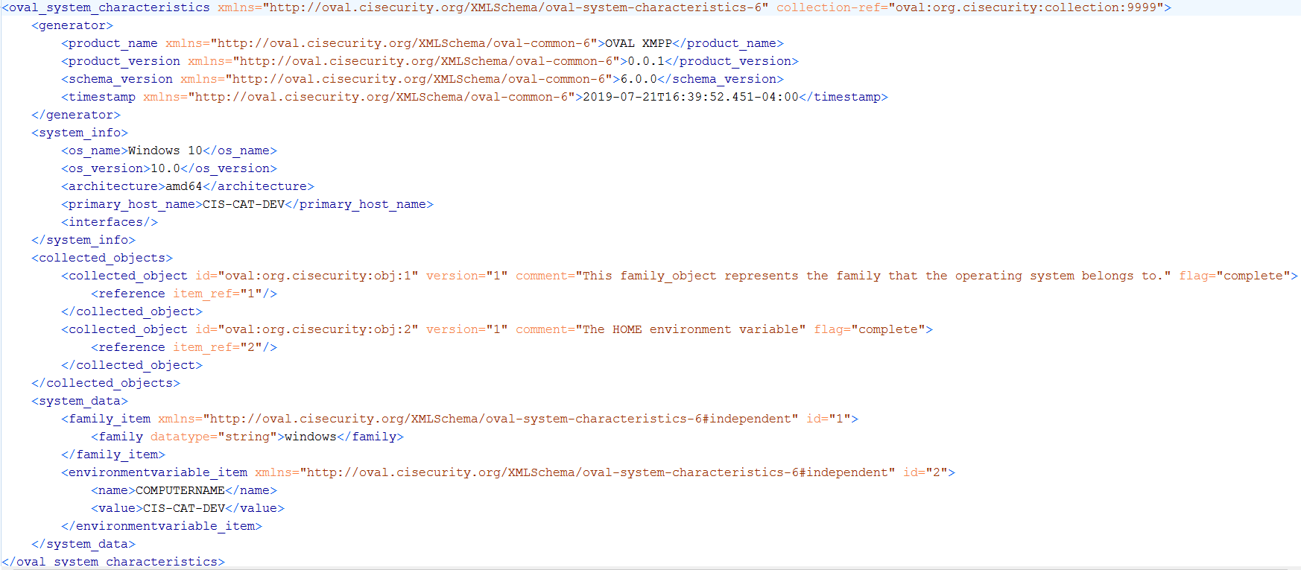
System Characteristics Example

Slide 6
Who did what?
Bill was again joined (remotely from Germany) by Carl-Heinz
CH is a MAP ninja and a java wizard
Bill
Create/Enable XMPP extensions to handle collection requests (OVAL objects) and collection results (OVAL system characteristics)
Trigger collection through XMPP IQ stanzas
Collect Items at an endpoint via OVAL collection implementation
Push collected OVAL system characteristics to CH (2 methods)
Publish OVAL system characteristics to XMPP pub/sub topic
Enable OVAL system characteristics to be sent directly to CH via XMPP IQ stanzas
Carl-Heinz
Receive collected system characteristics via XMPP adapter (pub/sub, <iq>, <message>)
Translate OVAL system characteristics to MAP CBOR data
Publish translated CBOR data to MAP
Search via MAP Client for Data
Translate Data from MAP to XML and see if it is the same as original OVAL Results

Slide 7
Who did what? Bill Edition
Create/Enable XMPP extensions to handle collection requests (OVAL objects) and collection results (OVAL system characteristics)
Trigger collection through XMPP IQ stanzas
Collect Items at an endpoint via OVAL collection implementation
Push collected OVAL system characteristics to CH (3 methods)
Publish OVAL system characteristics to XMPP pub/sub topic
Enable OVAL system characteristics to be sent directly to CH via XMPP <iq> stanzas
Enable OVAL system characteristics to be sent directly to CH via XMPP <message> stanzas

Slide 8
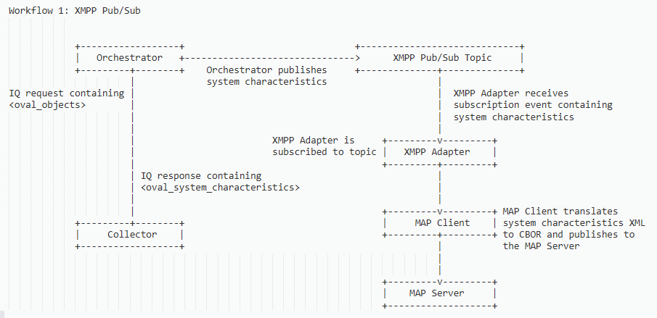
Workflow 1: Pub/Sub

Slide 9
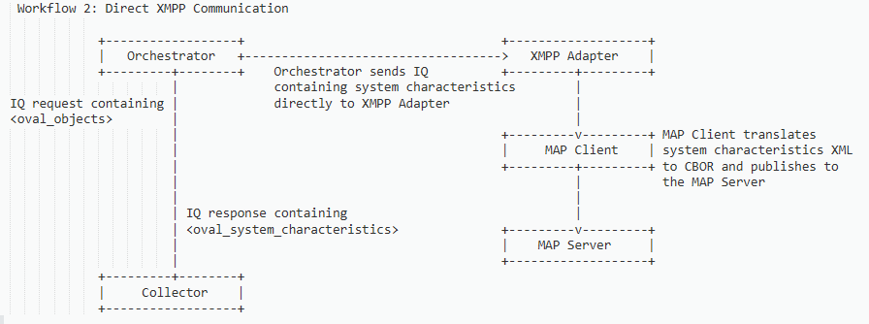
Workflow 2: Direct XMPP <iq>

Slide 10
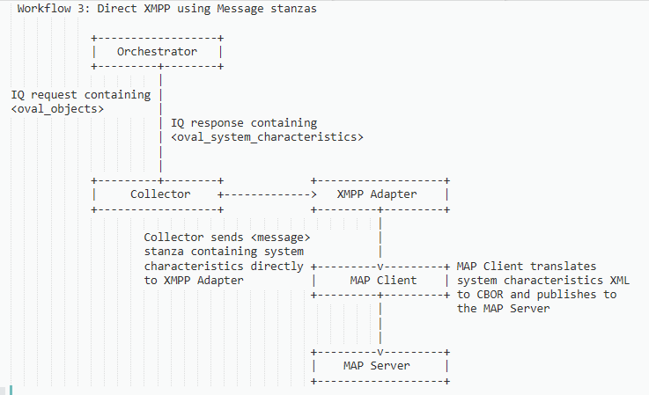
Workflow 3: Direct XMPP <message>

Slide 11
Who did what? Carl-Heinz Edition
Subscribe to XMPP pub/sub topic to receive collected system characteristics
Translate OVAL system characteristics to MAP CBOR data
Publish translated CBOR data to MAP
Search via MAP Client for Data
Translate Data from MAP to XML and see if it is the same as original OVAL Results

Slide 12
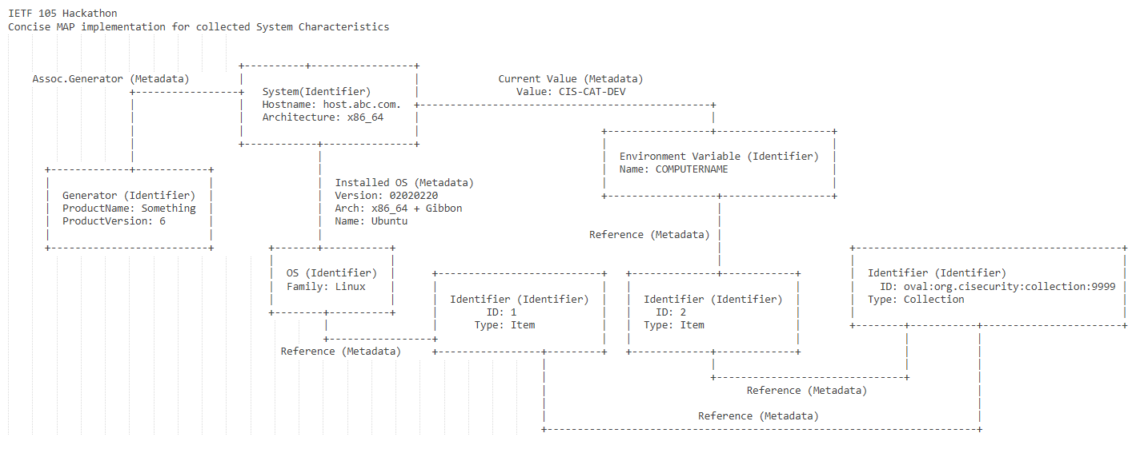
Storage: Concise Map

Slide 13
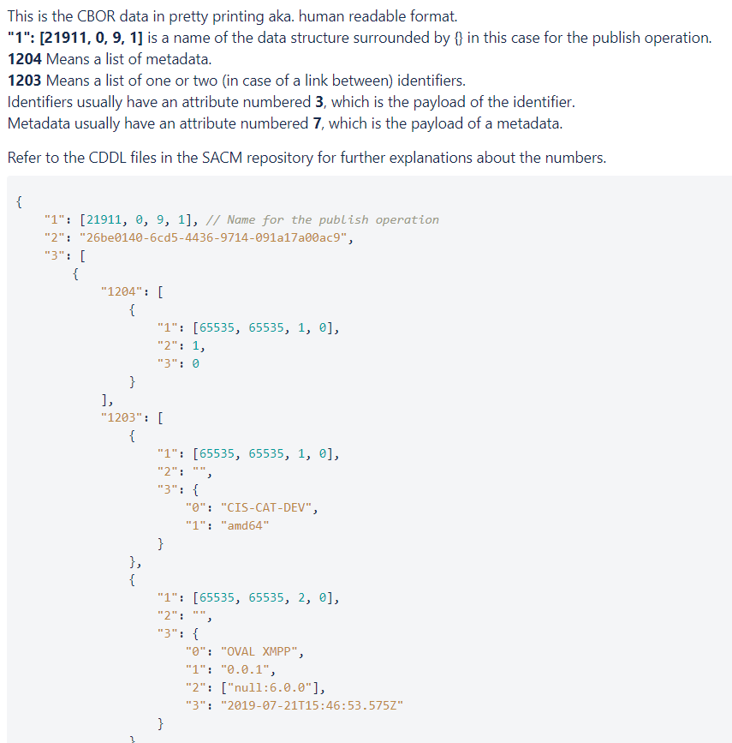
Translation to CBOR
“1203” Identifies a link between System Identifier and Generator
System Identifier
Generator

Slide 14
Things we Learned
We were able to move data between components using 3 methods supported by XMPP
Publish/Subscribe
Direct messaging via <iq> stanzas containing custom payload
Direct messaging via <message> stanzas containing custom payload
Carl-Heinz was also able to query the MAP data and reconstruct the OVAL system characteristics from it.
May enable downstream operations if they require the XML data
Right now there's no way to configure a MAP client with the things you want to know. There's only pre-configured clients.
Meaning, specific CDDL and implementation was required before the MAP client could translate the system characteristics.
This could fall under capability discovery, i.e. “what specific system characteristics can my MAP client handle?”

Slide 15
What’s next?
Keep Going!
As we define operations, start to include them as part of the architecture draft and build a library of data models
Can we define a core set of operations, and build upon them with extension points?
(use XMPP as an example – there’s only 3 core operations, and XEPs build upon that)
Can we define an “architecture core” and enable “SACM extension protocols”?
Continue to refine the OVAL collection models
More platform-specific schema migrations
Propose to SCAP 2.0 working groups (endpoint data collection, OVAL)
Build more collection capabilities based on the models
Evaluation (or other downstream) operations

Slide 16
Thanks
BIG THANKS to Carl-Heinz for his contributions to the Hackathon
Especially for staying awake into the wee hours of the morning
Also thanks to Henk for enabling collaboration between Bill and Carl-Heinz, and getting us going on various calls before Hackathon

