Slide 1

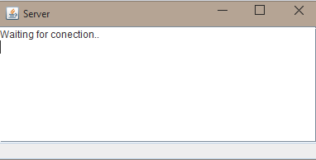

PROJECT OVERVIEW
1
2
Wilo Muyoma
Project
3
4
Challenges
Demo
Wilo Muyoma

Slide 2
1
NEXT
UI
2
3
4
…?
MOBILE APP
MORE 2 PEOPLE
Wilo Muyoma

Slide 3
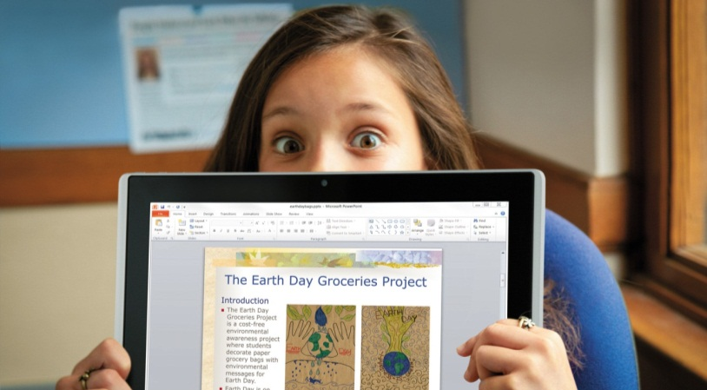

Thank You!
THANK
QUESTIONS
YOU
Wilo Muyoma

