Slide 1





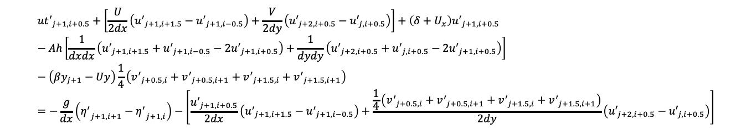



${u′}_{t}+\left[\overline{u}{u^{′}}_{x}+\overline{v}{u^{′}}_{y}\right]+\left(δ+{\overline{u}}_{x}\right)u^{′}−Ah\left({u^{′}}_{xx}+{u^{′}}_{yy}\right)−\left(f−{\overline{u}}_{y}\right)v^{′}=−g{η^{′}}_{x}−\left[u′{u^{′}}_{x}+v′{u^{′}}_{y}\right]$
${{u′}_{x}}_{j+1,i+0.5}=\frac{1}{2dx}\left({u^{′}}_{j+1,i+1.5}−{u^{′}}_{j+1,i−0.5}\right)$
${{u′}_{xx}}_{j+1,i+0.5}=\frac{1}{dxdx}\left({u^{′}}_{j+1,i+1.5}+{u^{′}}_{j+1,i−0.5}−2{u^{′}}_{j+1,i+0.5}\right)$
${{u′}_{y}}_{j+1,i+0.5}=\frac{1}{2dy}\left({u′}_{j+2,i+0.5}−{u′}_{j,i+0.5}\right)$
${{u′}_{yy}}_{j+1,i+0.5}=\frac{1}{dydy}\left({u′}_{j+2,i+0.5}+{u′}_{j,i+0.5}−2{u′}_{j+1,i+0.5}\right)$
${v′}_{j+1,i+0.5}=\frac{1}{4}\left({v^{′}}_{j+0.5,i}+{v^{′}}_{j+0.5,i+1}+{v^{′}}_{j+1.5,i}+{v^{′}}_{j+1.5,i+1}\right)$
$U_{j+1,i+0.5}=\frac{1}{2}\left(U_{j+1,i}+U_{j+1,i+1}\right)$
$V_{j+1,i+0.5}=\frac{1}{2}\left(V_{j+1,i}+V_{j+1,i+1}\right)$
${U_{y}}_{j+1,i+0.5}=\frac{1}{4dy}\left(U_{j+2,i}−U_{j,i}+U_{j+2,i+1}−U_{j,i+1}\right)$
${U_{x}}_{j+1,i+0.5}=\frac{1}{dx}\left(U_{j+1,i+1}−U_{j+1,i}\right)$
${{η^{′}}_{x}}_{j+1,i+0.5}=\frac{1}{dx}\left({η^{′}}_{j+1,i+1}−{η^{′}}_{j+1,i}\right)$
$${{ut}^{′}}_{j+1,i+0.5}+\left[\frac{U}{2dx}\left({u^{′}}_{j+1,i+1.5}−{u^{′}}_{j+1,i−0.5}\right)+\frac{V}{2dy}\left({u′}_{j+2,i+0.5}−{u′}_{j,i+0.5}\right)\right]+\left(δ+U_{x}\right){u^{′}}_{j+1,i+0.5}−Ah\left[\frac{1}{dxdx}\left({u^{′}}_{j+1,i+1.5}+{u^{′}}_{j+1,i−0.5}−2{u^{′}}_{j+1,i+0.5}\right)+\frac{1}{dydy}\left({u^{′}}_{j+2,i+0.5}+{u^{′}}_{j,i+0.5}−2{u^{′}}_{j+1,i+0.5}\right)\right]−\left(βy_{j+1}−Uy\right)\frac{1}{4}\left({v^{′}}_{j+0.5,i}+{v^{′}}_{j+0.5,i+1}+{v^{′}}_{j+1.5,i}+{v^{′}}_{j+1.5,i+1}\right)=−\frac{g}{dx}\left({η^{′}}_{j+1,i+1}−{η^{′}}_{j+1,i}\right)−\left[\frac{{u^{′}}_{j+1,i+0.5}}{2dx}\left({u^{′}}_{j+1,i+1.5}−{u^{′}}_{j+1,i−0.5}\right)+\frac{\frac{1}{4}\left({v^{′}}_{j+0.5,i}+{v^{′}}_{j+0.5,i+1}+{v^{′}}_{j+1.5,i}+{v^{′}}_{j+1.5,i+1}\right)}{2dy}\left({u′}_{j+2,i+0.5}−{u′}_{j,i+0.5}\right)\right]$$

Slide 2
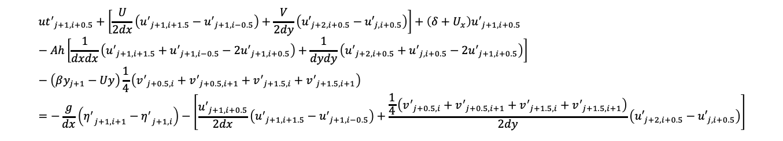
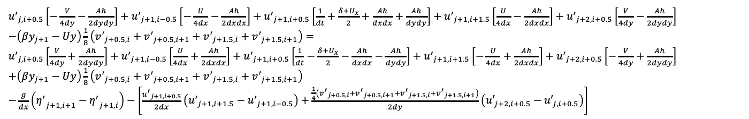
$${{ut}^{′}}_{j+1,i+0.5}+\left[\frac{U}{2dx}\left({u^{′}}_{j+1,i+1.5}−{u^{′}}_{j+1,i−0.5}\right)+\frac{V}{2dy}\left({u′}_{j+2,i+0.5}−{u′}_{j,i+0.5}\right)\right]+\left(δ+U_{x}\right){u^{′}}_{j+1,i+0.5}−Ah\left[\frac{1}{dxdx}\left({u^{′}}_{j+1,i+1.5}+{u^{′}}_{j+1,i−0.5}−2{u^{′}}_{j+1,i+0.5}\right)+\frac{1}{dydy}\left({u^{′}}_{j+2,i+0.5}+{u^{′}}_{j,i+0.5}−2{u^{′}}_{j+1,i+0.5}\right)\right]−\left(βy_{j+1}−Uy\right)\frac{1}{4}\left({v^{′}}_{j+0.5,i}+{v^{′}}_{j+0.5,i+1}+{v^{′}}_{j+1.5,i}+{v^{′}}_{j+1.5,i+1}\right)=−\frac{g}{dx}\left({η^{′}}_{j+1,i+1}−{η^{′}}_{j+1,i}\right)−\left[\frac{{u^{′}}_{j+1,i+0.5}}{2dx}\left({u^{′}}_{j+1,i+1.5}−{u^{′}}_{j+1,i−0.5}\right)+\frac{\frac{1}{4}\left({v^{′}}_{j+0.5,i}+{v^{′}}_{j+0.5,i+1}+{v^{′}}_{j+1.5,i}+{v^{′}}_{j+1.5,i+1}\right)}{2dy}\left({u′}_{j+2,i+0.5}−{u′}_{j,i+0.5}\right)\right]$$
${u^{′}}_{j,i+0.5}\left[−\frac{V}{4dy}−\frac{Ah}{2dydy}\right]+{u^{′}}_{j+1,i−0.5}\left[−\frac{U}{4dx}−\frac{Ah}{2dxdx}\right]+{u^{′}}_{j+1,i+0.5}\left[\frac{1}{dt}+\frac{δ+U_{x}}{2}+\frac{Ah}{dxdx}+\frac{Ah}{dydy}\right]+{u^{′}}_{j+1,i+1.5}\left[\frac{U}{4dx}−\frac{Ah}{2dxdx}\right]+{u^{′}}_{j+2,i+0.5}\left[\frac{V}{4dy}−\frac{Ah}{2dydy}\right]$
$−\left(βy_{j+1}−Uy\right)\frac{1}{8}\left({v^{′}}_{j+0.5,i}+{v^{′}}_{j+0.5,i+1}+{v^{′}}_{j+1.5,i}+{v^{′}}_{j+1.5,i+1}\right)=$
${u^{′}}_{j,i+0.5}\left[\frac{V}{4dy}+\frac{Ah}{2dydy}\right]+{u^{′}}_{j+1,i−0.5}\left[\frac{U}{4dx}+\frac{Ah}{2dxdx}\right]+{u^{′}}_{j+1,i+0.5}\left[\frac{1}{dt}−\frac{δ+U_{x}}{2}−\frac{Ah}{dxdx}−\frac{Ah}{dydy}\right]+{u^{′}}_{j+1,i+1.5}\left[−\frac{U}{4dx}+\frac{Ah}{2dxdx}\right]+{u^{′}}_{j+2,i+0.5}\left[−\frac{V}{4dy}+\frac{Ah}{2dydy}\right]$
$+\left(βy_{j+1}−Uy\right)\frac{1}{8}\left({v^{′}}_{j+0.5,i}+{v^{′}}_{j+0.5,i+1}+{v^{′}}_{j+1.5,i}+{v^{′}}_{j+1.5,i+1}\right)$
$−\frac{g}{dx}\left({η^{′}}_{j+1,i+1}−{η^{′}}_{j+1,i}\right)−\left[\frac{{u^{′}}_{j+1,i+0.5}}{2dx}\left({u^{′}}_{j+1,i+1.5}−{u^{′}}_{j+1,i−0.5}\right)+\frac{\frac{1}{4}\left({v^{′}}_{j+0.5,i}+{v^{′}}_{j+0.5,i+1}+{v^{′}}_{j+1.5,i}+{v^{′}}_{j+1.5,i+1}\right)}{2dy}\left({u′}_{j+2,i+0.5}−{u′}_{j,i+0.5}\right)\right]$

Slide 3





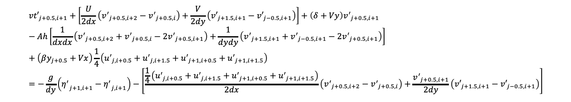


${v′}_{t}+\left[\overline{u}{v^{′}}_{x}+\overline{v}{v^{′}}_{y}\right]+\left(δ+{\overline{v}}_{y}\right)v^{′}−Ah\left({v^{′}}_{xx}+{v^{′}}_{yy}\right)+\left(f+{\overline{v}}_{x}\right)u^{′}=−g{η^{′}}_{y}−\left[u′{v^{′}}_{x}+v′{v^{′}}_{y}\right]$
${{v′}_{x}}_{j+0.5,i+1}=\frac{1}{2dx}\left({v^{′}}_{j+0.5,i+2}−{v^{′}}_{j+0.5,i}\right)$
${{v′}_{xx}}_{j+0.5,i+1}=\frac{1}{dxdx}\left({v^{′}}_{j+0.5,i+2}+{v^{′}}_{j+0.5,i}−2{v^{′}}_{j+0.5,i+1}\right)$
${{v′}_{y}}_{j+0.5,i+1}=\frac{1}{2dy}\left({v′}_{j+1.5,i+1}−{v′}_{j−0.5,i+1}\right)$
${{v′}_{yy}}_{j+0.5,i+1}=\frac{1}{dydy}\left({v′}_{j+1.5,i+1}+{v′}_{j−0.5,i+1}−2{v′}_{j+0.5,i+1}\right)$
${u′}_{j+0.5,i+1}=\frac{1}{4}\left({u^{′}}_{j,i+0.5}+{u^{′}}_{j,i+1.5}+{u^{′}}_{j+1,i+0.5}+{u^{′}}_{j+1,i+1.5}\right)$
$U_{j+0.5,i+1}=\frac{1}{2}\left(U_{j,i+1}+U_{j+1,i+1}\right)$
$$V_{j+0.5,i+1}=\frac{1}{2}\left(V_{j,i+1}+V_{j+1,i+1}\right)$$
${V_{y}}_{j+0.5,i+1}=\frac{1}{dy}\left(V_{j+1,i+1}−V_{j,i+1}\right)$
${V_{x}}_{j+0.5,i+1}=\frac{1}{4dx}\left(V_{j,i+2}−V_{j,i}+V_{j+1,i+2}−V_{j+1,i}\right)$
${{η^{′}}_{y}}_{j+0.5,i+1}=\frac{1}{dy}\left({η^{′}}_{j+1,i+1}−{η^{′}}_{j,i+1}\right)$
$${vt′}_{j+0.5,i+1}+\left[\frac{U}{2dx}\left({v^{′}}_{j+0.5,i+2}−{v^{′}}_{j+0.5,i}\right)+\frac{V}{2dy}\left({v′}_{j+1.5,i+1}−{v′}_{j−0.5,i+1}\right)\right]+\left(δ+Vy\right){v^{′}}_{j+0.5,i+1}−Ah\left[\frac{1}{dxdx}\left({v^{′}}_{j+0.5,i+2}+{v^{′}}_{j+0.5,i}−2{v^{′}}_{j+0.5,i+1}\right)+\frac{1}{dydy}\left({v^{′}}_{j+1.5,i+1}+{v^{′}}_{j−0.5,i+1}−2{v^{′}}_{j+0.5,i+1}\right)\right]+\left(βy_{j+0.5}+Vx\right)\frac{1}{4}\left({u^{′}}_{j,i+0.5}+{u^{′}}_{j,i+1.5}+{u^{′}}_{j+1,i+0.5}+{u^{′}}_{j+1,i+1.5}\right)=−\frac{g}{dy}\left({η^{′}}_{j+1,i+1}−{η^{′}}_{j,i+1}\right)−\left[\frac{\frac{1}{4}\left({u^{′}}_{j,i+0.5}+{u^{′}}_{j,i+1.5}+{u^{′}}_{j+1,i+0.5}+{u^{′}}_{j+1,i+1.5}\right)}{2dx}\left({v^{′}}_{j+0.5,i+2}−{v^{′}}_{j+0.5,i}\right)+\frac{{v^{′}}_{j+0.5,i+1}}{2dy}\left({v′}_{j+1.5,i+1}−{v′}_{j−0.5,i+1}\right)\right]$$

Slide 4
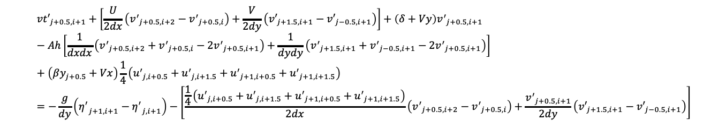
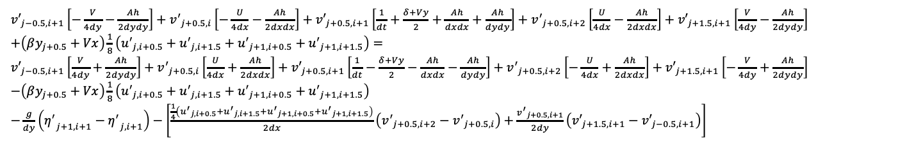
$${vt′}_{j+0.5,i+1}+\left[\frac{U}{2dx}\left({v^{′}}_{j+0.5,i+2}−{v^{′}}_{j+0.5,i}\right)+\frac{V}{2dy}\left({v′}_{j+1.5,i+1}−{v′}_{j−0.5,i+1}\right)\right]+\left(δ+Vy\right){v^{′}}_{j+0.5,i+1}−Ah\left[\frac{1}{dxdx}\left({v^{′}}_{j+0.5,i+2}+{v^{′}}_{j+0.5,i}−2{v^{′}}_{j+0.5,i+1}\right)+\frac{1}{dydy}\left({v^{′}}_{j+1.5,i+1}+{v^{′}}_{j−0.5,i+1}−2{v^{′}}_{j+0.5,i+1}\right)\right]+\left(βy_{j+0.5}+Vx\right)\frac{1}{4}\left({u^{′}}_{j,i+0.5}+{u^{′}}_{j,i+1.5}+{u^{′}}_{j+1,i+0.5}+{u^{′}}_{j+1,i+1.5}\right)=−\frac{g}{dy}\left({η^{′}}_{j+1,i+1}−{η^{′}}_{j,i+1}\right)−\left[\frac{\frac{1}{4}\left({u^{′}}_{j,i+0.5}+{u^{′}}_{j,i+1.5}+{u^{′}}_{j+1,i+0.5}+{u^{′}}_{j+1,i+1.5}\right)}{2dx}\left({v^{′}}_{j+0.5,i+2}−{v^{′}}_{j+0.5,i}\right)+\frac{{v^{′}}_{j+0.5,i+1}}{2dy}\left({v′}_{j+1.5,i+1}−{v′}_{j−0.5,i+1}\right)\right]$$
${v′}_{j−0.5,i+1}\left[−\frac{V}{4dy}−\frac{Ah}{2dydy}\right]+{v^{′}}_{j+0.5,i}\left[−\frac{U}{4dx}−\frac{Ah}{2dxdx}\right]+{v′}_{j+0.5,i+1}\left[\frac{1}{dt}+\frac{δ+Vy}{2}+\frac{Ah}{dxdx}+\frac{Ah}{dydy}\right]+{v^{′}}_{j+0.5,i+2}\left[\frac{U}{4dx}−\frac{Ah}{2dxdx}\right]+{v′}_{j+1.5,i+1}\left[\frac{V}{4dy}−\frac{Ah}{2dydy}\right]$
$+\left(βy_{j+0.5}+Vx\right)\frac{1}{8}\left({u^{′}}_{j,i+0.5}+{u^{′}}_{j,i+1.5}+{u^{′}}_{j+1,i+0.5}+{u^{′}}_{j+1,i+1.5}\right)=$
${v′}_{j−0.5,i+1}\left[\frac{V}{4dy}+\frac{Ah}{2dydy}\right]+{v^{′}}_{j+0.5,i}\left[\frac{U}{4dx}+\frac{Ah}{2dxdx}\right]+{v′}_{j+0.5,i+1}\left[\frac{1}{dt}−\frac{δ+Vy}{2}−\frac{Ah}{dxdx}−\frac{Ah}{dydy}\right]+{v^{′}}_{j+0.5,i+2}\left[−\frac{U}{4dx}+\frac{Ah}{2dxdx}\right]+{v′}_{j+1.5,i+1}\left[−\frac{V}{4dy}+\frac{Ah}{2dydy}\right]$
$−\left(βy_{j+0.5}+Vx\right)\frac{1}{8}\left({u^{′}}_{j,i+0.5}+{u^{′}}_{j,i+1.5}+{u^{′}}_{j+1,i+0.5}+{u^{′}}_{j+1,i+1.5}\right)$
$−\frac{g}{dy}\left({η^{′}}_{j+1,i+1}−{η^{′}}_{j,i+1}\right)−\left[\frac{\frac{1}{4}\left({u^{′}}_{j,i+0.5}+{u^{′}}_{j,i+1.5}+{u^{′}}_{j+1,i+0.5}+{u^{′}}_{j+1,i+1.5}\right)}{2dx}\left({v^{′}}_{j+0.5,i+2}−{v^{′}}_{j+0.5,i}\right)+\frac{{v^{′}}_{j+0.5,i+1}}{2dy}\left({v′}_{j+1.5,i+1}−{v′}_{j−0.5,i+1}\right)\right]$

Slide 5


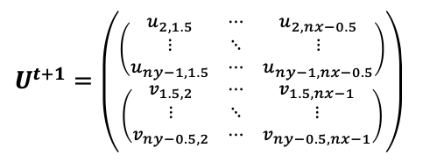




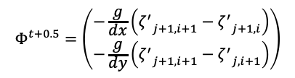

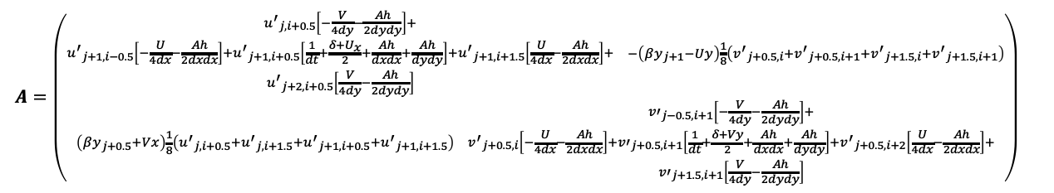

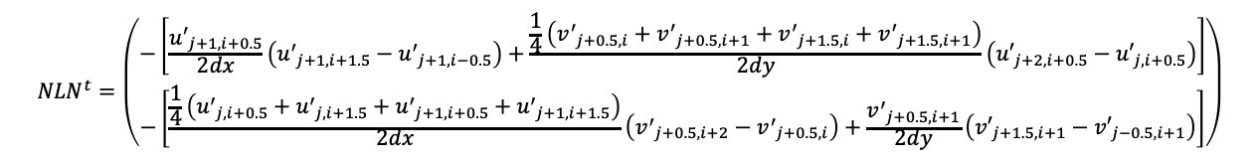
$U_{j+1,i+0.5}=\frac{1}{2}\left(U_{j+1,i}+U_{j+1,i+1}\right)$
$V_{j+1,i+0.5}=\frac{1}{2}\left(V_{j+1,i}+V_{j+1,i+1}\right)$
$U_{j+0.5,i+1}=\frac{1}{2}\left(U_{j,i+1}+U_{j+1,i+1}\right)$
$$V_{j+0.5,i+1}=\frac{1}{2}\left(V_{j,i+1}+V_{j+1,i+1}\right)$$
${U_{y}}_{j+1,i+0.5}=\frac{1}{4dy}\left(U_{j+2,i}−U_{j,i}+U_{j+2,i+1}−U_{j,i+1}\right)$
${V_{y}}_{j+0.5,i+1}=\frac{1}{dy}\left(V_{j+1,i+1}−V_{j,i+1}\right)$
${U_{x}}_{j+1,i+0.5}=\frac{1}{dx}\left(U_{j+1,i+1}−U_{j+1,i}\right)$
${V_{x}}_{j+0.5,i+1}=\frac{1}{4dx}\left(V_{j,i+2}−V_{j,i}+V_{j+1,i+2}−V_{j+1,i}\right)$
$U^{t+1}=\left({\left(\begin{matrix}u_{2,1.5} & ⋯ & u_{2,nx−0.5} \\ ⋮ & ⋱ & ⋮ \\ u_{ny−1,1.5} & ⋯ & u_{ny−1,nx−0.5}\end{matrix}\right) \atop \left(\begin{matrix}v_{1.5,2} & ⋯ & v_{1.5,nx−1} \\ ⋮ & ⋱ & ⋮ \\ v_{ny−0.5,2} & ⋯ & v_{ny−0.5,nx−1}\end{matrix}\right)}\right)$
$$AU^{t+1}=BU^{t}+Φ^{t+0.5}+{NLN}^{t}+B_{b}{U_{b}}^{t}−A_{b}{U_{b}}^{t+1}$$
$A=\left({\begin{matrix}\begin{aligned}{u^{′}}_{j,i+0.5}\left[−\frac{V}{4dy}−\frac{Ah}{2dydy}\right]+ \\ \begin{aligned}{u^{′}}_{j+1,i−0.5}\left[−\frac{U}{4dx}−\frac{Ah}{2dxdx}\right]+{u^{′}}_{j+1,i+0.5}\left[\frac{1}{dt}+\frac{δ+U_{x}}{2}+\frac{Ah}{dxdx}+\frac{Ah}{dydy}\right]+{u^{′}}_{j+1,i+1.5}\left[\frac{U}{4dx}−\frac{Ah}{2dxdx}\right]+ \\ {u^{′}}_{j+2,i+0.5}\left[\frac{V}{4dy}−\frac{Ah}{2dydy}\right]\end{aligned}\end{aligned} & −\left(βy_{j+1}−Uy\right)\frac{1}{8}\left({v^{′}}_{j+0.5,i}+{v^{′}}_{j+0.5,i+1}+{v^{′}}_{j+1.5,i}+{v^{′}}_{j+1.5,i+1}\right)\end{matrix} \atop \begin{matrix}\left(βy_{j+0.5}+Vx\right)\frac{1}{8}\left({u^{′}}_{j,i+0.5}+{u^{′}}_{j,i+1.5}+{u^{′}}_{j+1,i+0.5}+{u^{′}}_{j+1,i+1.5}\right) & \begin{aligned}{v′}_{j−0.5,i+1}\left[−\frac{V}{4dy}−\frac{Ah}{2dydy}\right]+ \\ \begin{aligned}{v^{′}}_{j+0.5,i}\left[−\frac{U}{4dx}−\frac{Ah}{2dxdx}\right]+{v′}_{j+0.5,i+1}\left[\frac{1}{dt}+\frac{δ+Vy}{2}+\frac{Ah}{dxdx}+\frac{Ah}{dydy}\right]+{v^{′}}_{j+0.5,i+2}\left[\frac{U}{4dx}−\frac{Ah}{2dxdx}\right]+ \\ {v′}_{j+1.5,i+1}\left[\frac{V}{4dy}−\frac{Ah}{2dydy}\right]\end{aligned}\end{aligned}\end{matrix}}\right)$
$$Φ^{t+0.5}=\left({−\frac{g}{dx}\left({ζ^{′}}_{j+1,i+1}−{ζ^{′}}_{j+1,i}\right) \atop −\frac{g}{dy}\left({ζ^{′}}_{j+1,i+1}−{ζ^{′}}_{j,i+1}\right)}\right)$$
$${NLN}^{t}=\left({−\left[\frac{{u^{′}}_{j+1,i+0.5}}{2dx}\left({u^{′}}_{j+1,i+1.5}−{u^{′}}_{j+1,i−0.5}\right)+\frac{\frac{1}{4}\left({v^{′}}_{j+0.5,i}+{v^{′}}_{j+0.5,i+1}+{v^{′}}_{j+1.5,i}+{v^{′}}_{j+1.5,i+1}\right)}{2dy}\left({u′}_{j+2,i+0.5}−{u′}_{j,i+0.5}\right)\right] \atop −\left[\frac{\frac{1}{4}\left({u^{′}}_{j,i+0.5}+{u^{′}}_{j,i+1.5}+{u^{′}}_{j+1,i+0.5}+{u^{′}}_{j+1,i+1.5}\right)}{2dx}\left({v^{′}}_{j+0.5,i+2}−{v^{′}}_{j+0.5,i}\right)+\frac{{v^{′}}_{j+0.5,i+1}}{2dy}\left({v′}_{j+1.5,i+1}−{v′}_{j−0.5,i+1}\right)\right]}\right)$$

