Slide 1

Movie Rating Prediction
CMPE 256 Group 5
Xiaoming liu 013763646
Kangjun Lou 013736593
Mandy Wong 014558570
Ping Chen 013855049
Notes:
Group number
Project topic

Slide 2
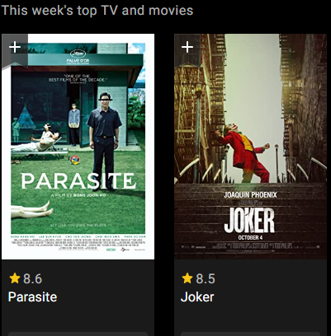
Purpose
Predict movie ratings based on multiple datasets
general audiences
advertisers
cinema
Recommend movies

Slide 3
Methodology
Content Based Prediction
Collaborative Filtering

Slide 4
Data Resources
MovieLens
IMDb Datasets

Slide 5
Content Based Prediction
Datasets: (data preprocessed with original IMDb data)
imdb.csv: (247043, 12)
imdb_clean_all.csv: (82368, 12)
imdb_clean_1990.csv: (54054, 12)

Slide 6
Content Based Prediction
Keywords: Genres, Directors, Writers, Actors
Combine genres, directors, writers and actors in keywords column
Vectorize the keywords by using CountVectorizer() from scikit-learn
Calculate the cosine similarity

Slide 7
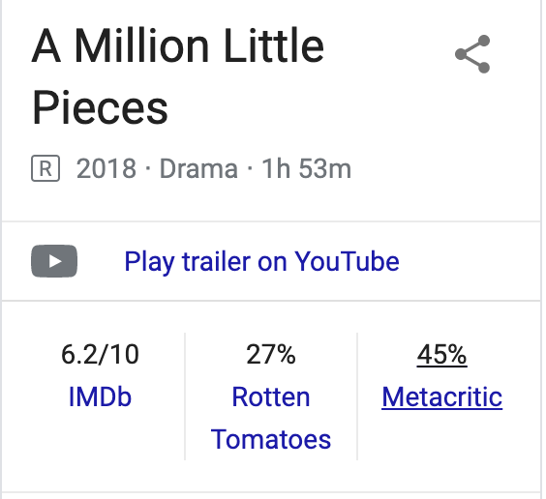
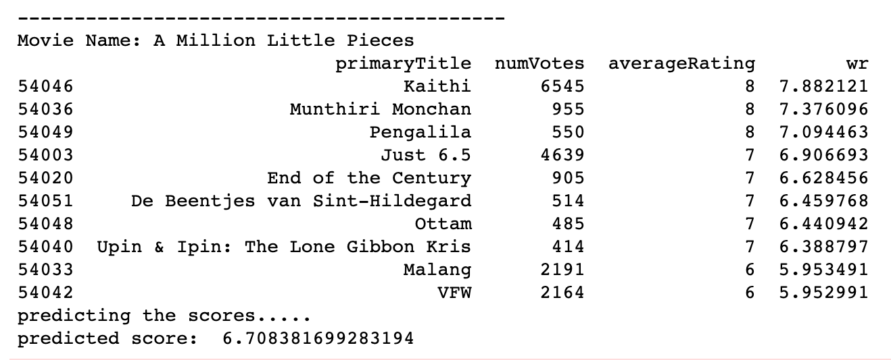

Content Based Prediction
Input: movie name
* Keywords (genres, directors, writers and actors) of the predicting movie should include in dataset
Output:

Slide 8

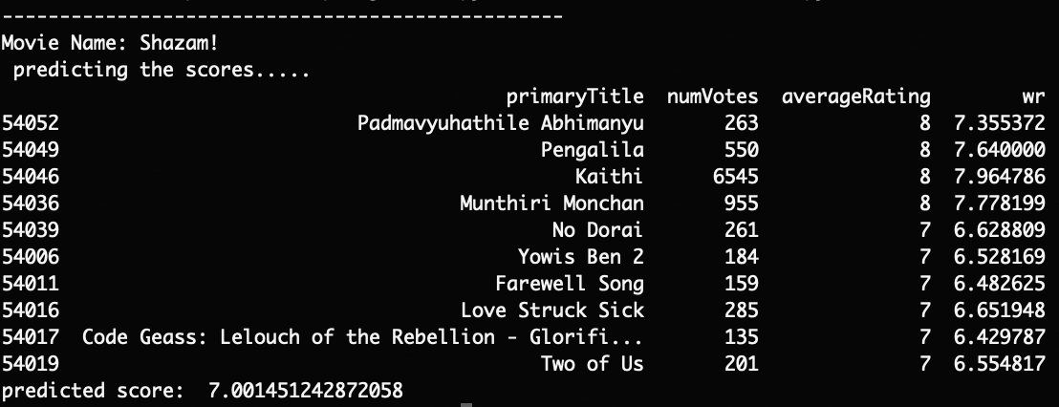
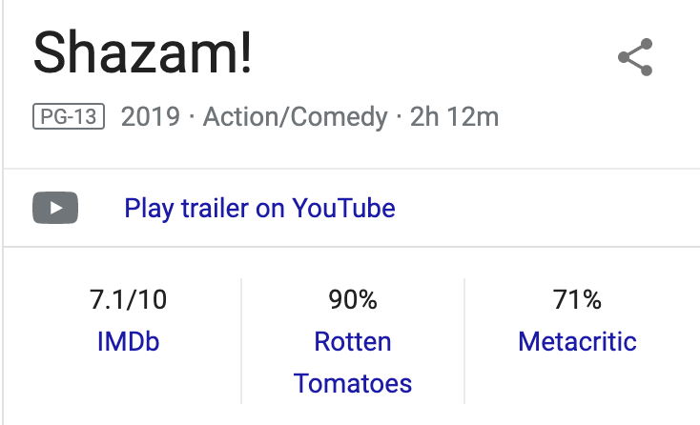
Content Based Prediction

Slide 9
Collaborative Filtering
Datasets: MovieLens 10M dataset
- UserIDs range between 1 and 71567
- MovieIDs range between 1 and 10681
- Ratings are made on a 5-star scale

Slide 10

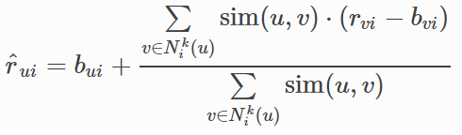
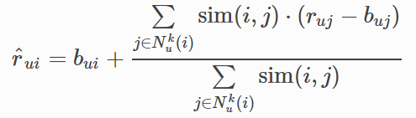

Collaborative Filtering
1. BaseLine only prediction
 | RMSE | MAE
BaseLineOnly | 0.9906 | 0.7218
User-User CF | 0.9903 | 0.7838
Item-Item CF | 0.9900 | 0.7821
SVD | 0.9892 | 0.7876
2. User-user collaborative filtering
3. Item-item collaborative filtering
4. SVD

Slide 11
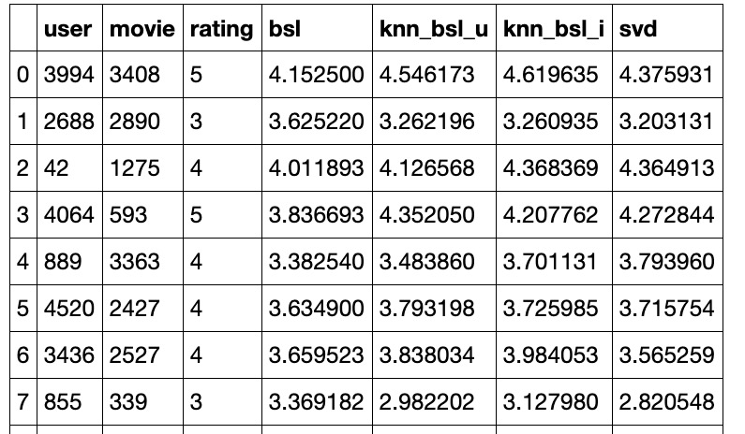
Collaborative Filtering

Slide 12
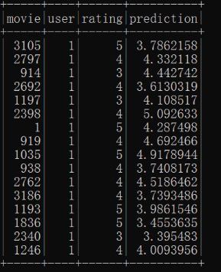
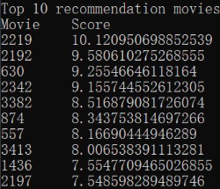
Collaborative Filtering
Build a CF recommender using in Spark:
Generate top 10 movie recommendations for each user
Latent factor models: RMSE 0.8814
Prediction results: Recommender results:

Slide 13
Conclusion
1.The whole data is too big to run, even on HPC. The size of the training data is 100M ratings.
2.The accuracy of the content based rating prediction is low, lower than 50%.
3.It is proved that blending of different models (SVD,KNN,BaseLine) with XGBoost can decrease rmse more than other single model.

Slide 14
Thank You!

