Slide 1

Movie Rating Prediction
CMPE 256 Group 5

Slide 2
Methodology
Content Based Prediction
Collaborative Filtering

Slide 3
Content Based Prediction
Datasets: (data preprocessed with original IMDb data)
imdb.csv: (247043, 12)
imdb_clean_all.csv: (82368, 12)
imdb_clean_1990.csv: (54054, 12)

Slide 4
Content Based Prediction
Keywords: Genres, Directors, Writers, Actors
Combine genres, directors, writers and actors in keywords column
Vectorize the keywords by using CountVectorizer() from sklearn
Calculate the cosine similarity

Slide 5
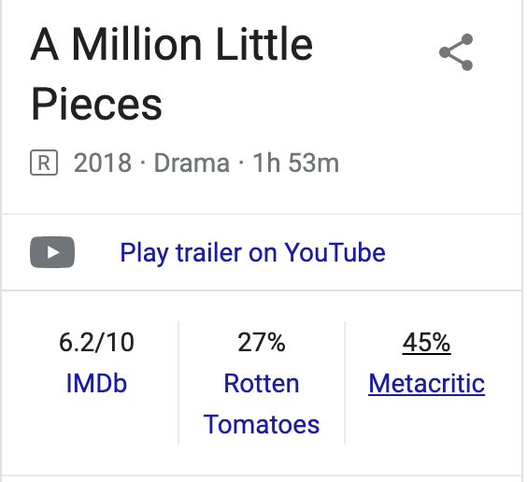
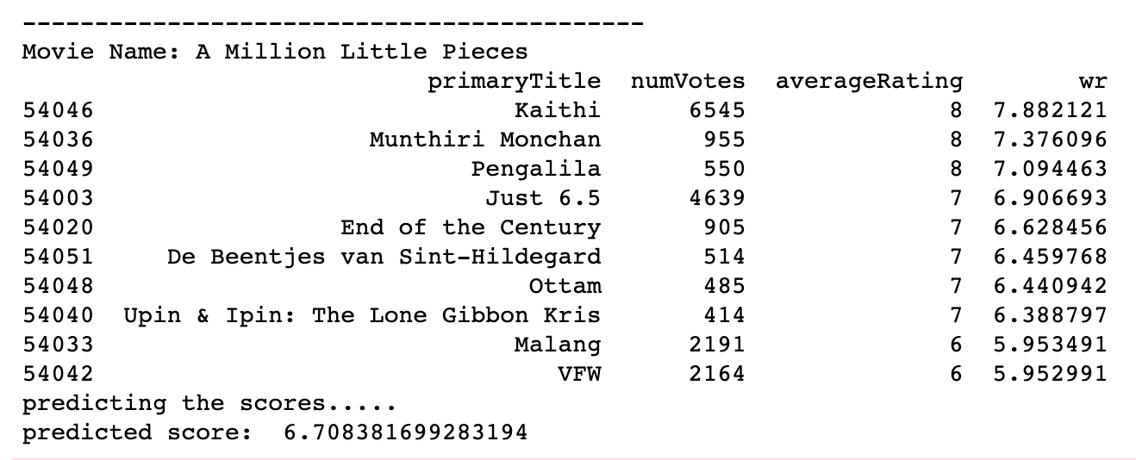
Content Based Prediction
Input: movie name
* Keywords (genres, directors, writers and actors) of the predicting movie should include in dataset
Output:

Slide 6
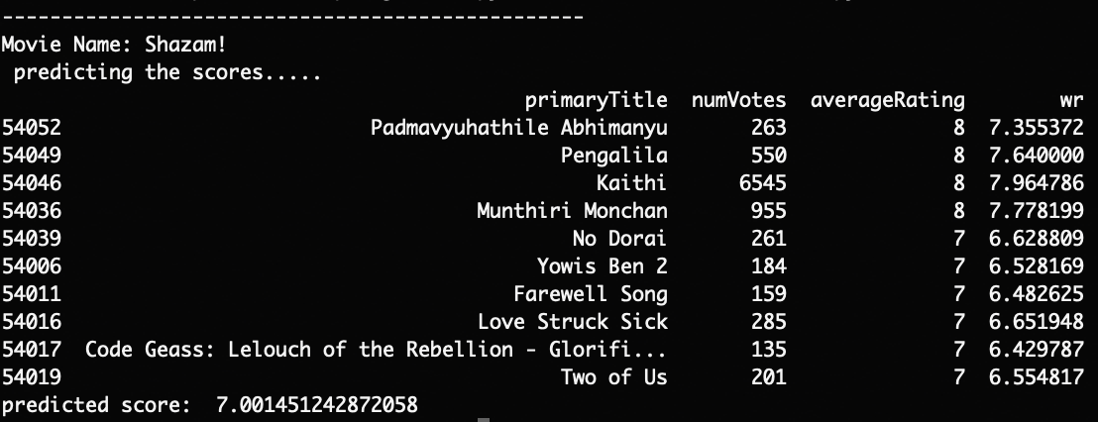
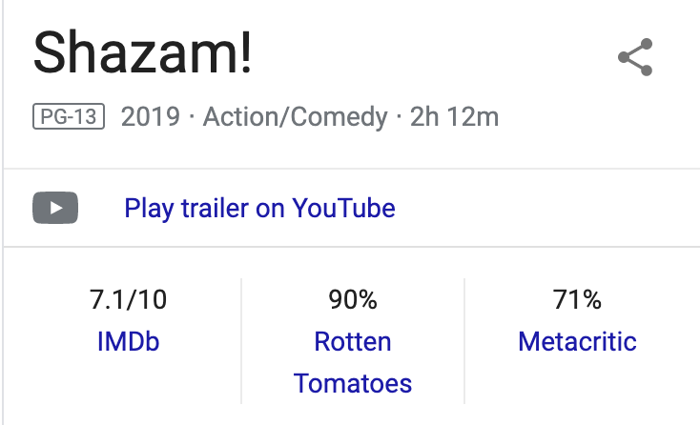
Content Based Prediction

Slide 7
Collaborative Filtering

