Slide 1

Popular Venues in San Francisco
Mandy Wong

Slide 2
Introduction
San Francisco is a densely populated city over the United States.
Since San Francisco is a diverse city, there are variety of different race of people living in this prosperous city. It would be a great investment if there is a good business plan.
Question?
What shop or store should the businessman open in this area?
This project :
provides the rough idea or research for doing business in San Francisco.
help the businessman or company to understand which type of business is too less or too much in certain zip code area, so that the better business planning could be developed.

Slide 3
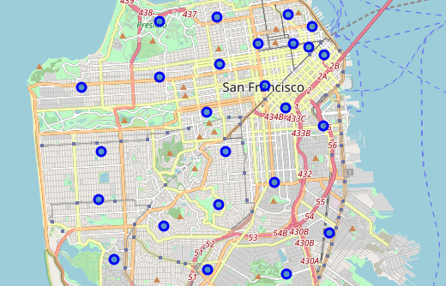
The Visualization of 25 neighborhoods in SF
zipcode | neighborhood
94102 | Hayes Valley , Tenderloin, North of Market
94103 | South of Market
94104 | Financial District
94105 | Embarcadero South
94107 | Portrero Hill
94108 | Chinatown
94109 | Polk Hill, Nob Hill, Russian Hill
94110 | Mission District , Inner Mission, Bernal Heights
94111 | Embarcadero North
94112 | Ingleside
94114 | Castro, Noe Valley
94115 | Pacific Heights, Western Addition, Japantown
94116 | Outter Sunset, Parkside, Forest Hill
94117 | Haight District, Cole Valley
94118 | Richmond District, Inner Richmond
94121 | Outter Richmond
94123 | Cow Hollow, Marina District
94124 | Bayview
94127 | St Francis Wood , Miraloma West Portal
94122 | Sunset District
94129 | Presidio
94131 | Twin Peaks, Glen Park
94132 | Lake Merced
94133 | North beach, Fishermans Wharf, Chinatown
94134 | Visitacion Valley, Sunnydale

Slide 4
Count of Nearby Venues
By using FourSquare API
Neighborhood | Count | Neighborhood | Count
Bayview | 26 | Outer Richmond | 50
Castro, Noe Valley | 82 | Outer Sunset, Parkside, Forest Hill | 45
Chinatown | 82 | Pacific Heights, Western Addition, Japantown | 98
Cow Hollow, Marina District | 77 | Polk Hill, Nob Hill, Russian Hill | 81
Embarcadero North | 100 | Potrero Hill | 31
Embarcadero South | 82 | Presidio | 28
Financial District | 100 | Richmond District, Inner Richmond | 60
Haight District, Cole Valley | 39 | South of Market | 77
Hayes Valley, Tenderloin, North of Market | 95 | St Francis Wood, Miraloma, West Portal | 2
Ingleside | 34 | Sunset District | 7
Lake Merced | 51 | Twin Peaks, Glen Park | 17
Mission District, Inner Mission, Bernal Heights | 51 | Visitacion Valley, Sunnydale | 4
North beach, Fishermans Wharf, Chinatown | 100

Slide 5
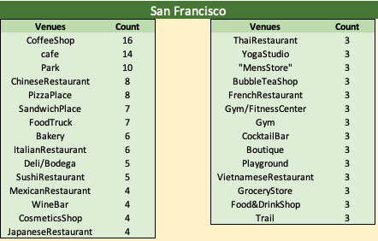
Popular Venues in San Francisco

Slide 6
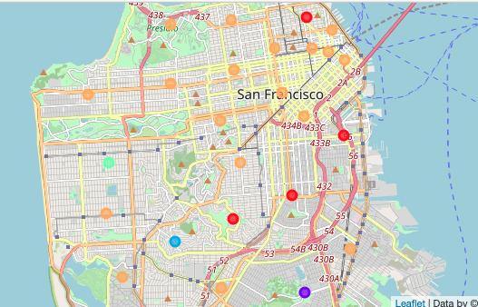
Visualization of 5 Clusters

Slide 7
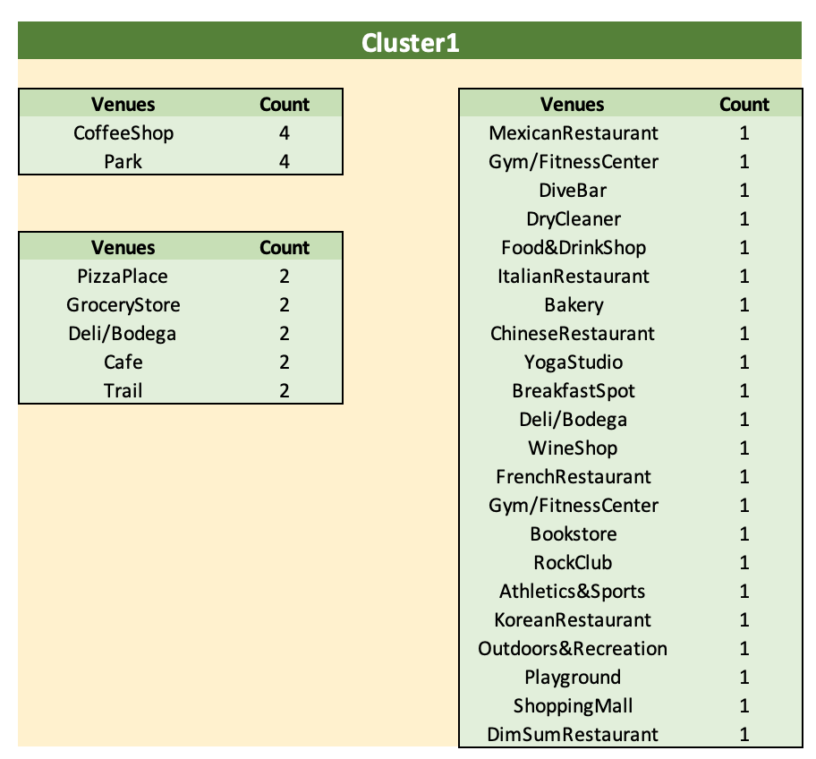
Cluster 1 (red dots)
4 neighborhoods:
Potrero Hill, Mission District, Twin Peaks and North beach

Slide 8
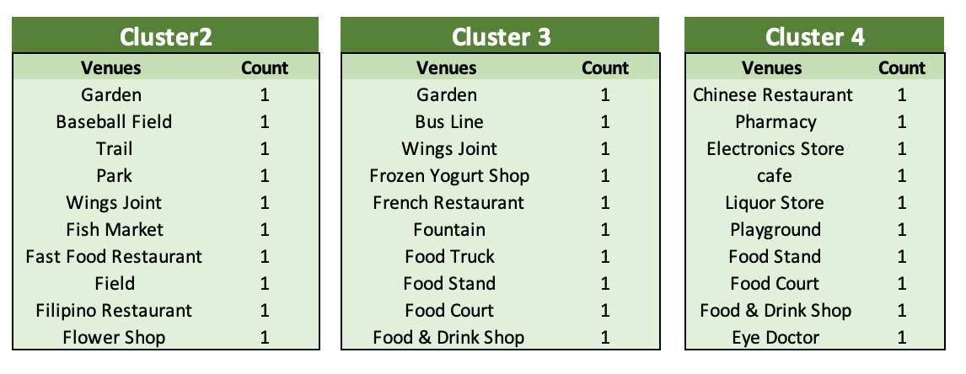
Cluster 2,3,4
Cluster 2: the purple dot - Visitacion Valley
Cluster 3: the blue dot - Saint Francis Wood
Cluster 4: the turquoise dot - Sunset District

Slide 9
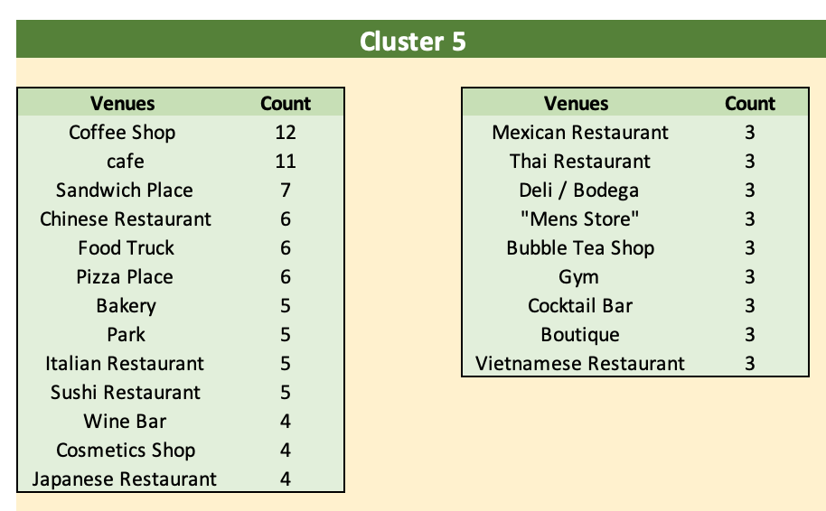
Cluster 5 (orange dots) - 18 neighborhoods

Slide 10
Conclusion
The most popular venues in San Francisco are Coffee Shop, Café and Park.
Other popular venues are variety of cuisine.
Analyzing the top 10 most common venues of each neighborhood either individually or in groups to better understand the ‘trends’ in intended neighborhoods ,in order to, develop a successful business plan

