Slide 1

Versioning of data and code using Git
Introduction to Data Management Practices course
NBIS DM Team
data-management@scilifelab.se
https://nbisweden.github.io/module-versioning-dm-practices/

Slide 2
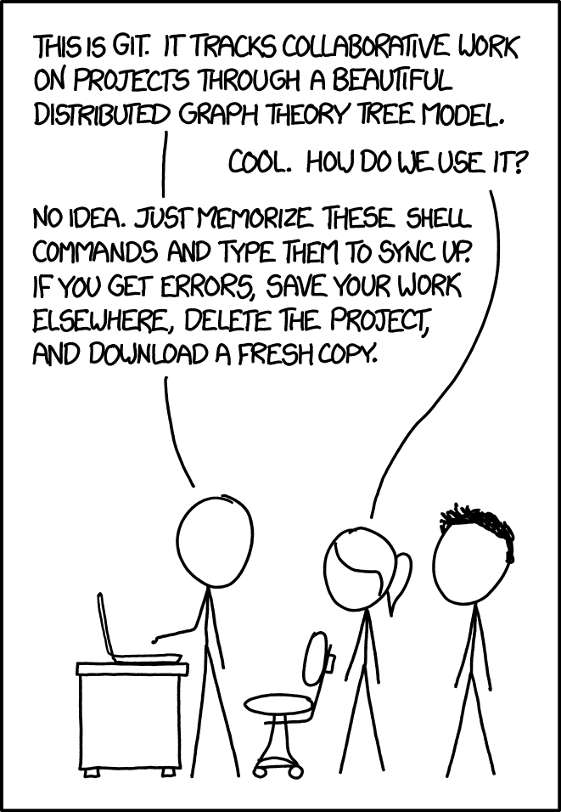
Learning Objectives
Explain the benefits of version control
Explain the differences between git and GitHub
Create your first GitHub project
Understand how one can collaborate with others using GitHub
xkcd:Git by xkcd - CC-BY-NC
Notes:
I want to start by setting the stage/expectations of this part of the course around version control using git and GitHub. Git is a complex system and today we will give you a brief introduction to the basic concepts, the opportunity to try it out and get you started. We don’t aim for you to understand how it works behind the scenes and we will not use the command line but instead use the GitHub website in your browser and the app GitHub Desktop on your laptop. At the end of this session, you will be able to:
Explain version control and its benefits
Explain the differences between git and GitHub
Create their first GitHub project
Understand how one can collaborate with others using GitHub
Image Credit: xkcd:Git from https://xkcd.com/1597/ is used under a CC-BY-NC licence. From the material: This tutorial provides a brief but hands-on introduction to Git and GitHub to exercise useful workflows within GitHub. Git is a version control system which allows files and data to be tracked synchronized, which allows collaboration and reproducibility. GitHub is a popular website that stores these repositories. This tutorial avoids using the command line. Instead, we will practice collaborating and sharing using either the GitHub website or GitHub Desktop application. Why? Because for many cases, it is enough. Especially if you are contributing to existing non-code projects, this may be the fastest, easiest way to do it. Git and GitHub provide collaboration tools to all kinds of projects, and there are all kinds of good ways to use it.

Slide 3
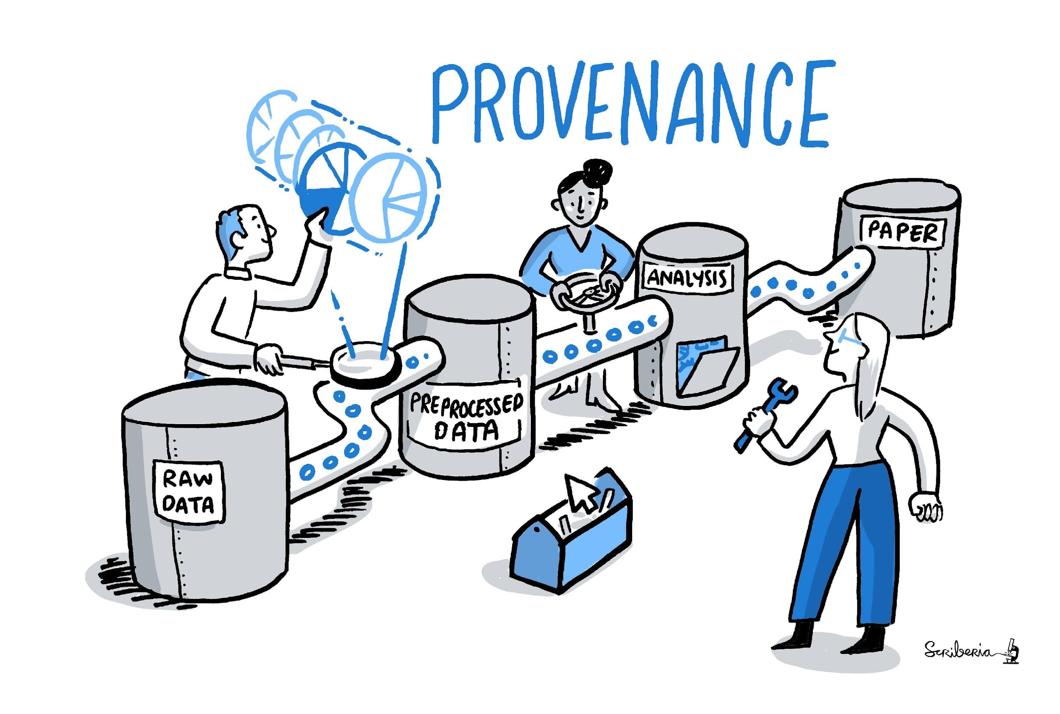
Why use versioning for research projects?
Track project history and increase reproducibility
Keeping a record of the changes made ensures that the research findings can be:
validated
collaborated upon
documented accurately
Image from The Turing Way community by Scriberia - CC-BY 4.0
DOI: 10.5281/zenodo.3332807
Notes:
In research, it is vital to keep track of changes made to data, documentation and software by you or your collaborators. This allows you to easily reference or retrieve a specific version of the entire project, which promotes reproducibility. Keeping a record of the changes made ensures that the research findings can be validated, collaborated upon, and documented accurately, enhancing the reliability and transparency of the research work.
Image from The Turing Way community by Scriberia - CC-BY
DOI: 10.5281/zenodo.3332807

Slide 4
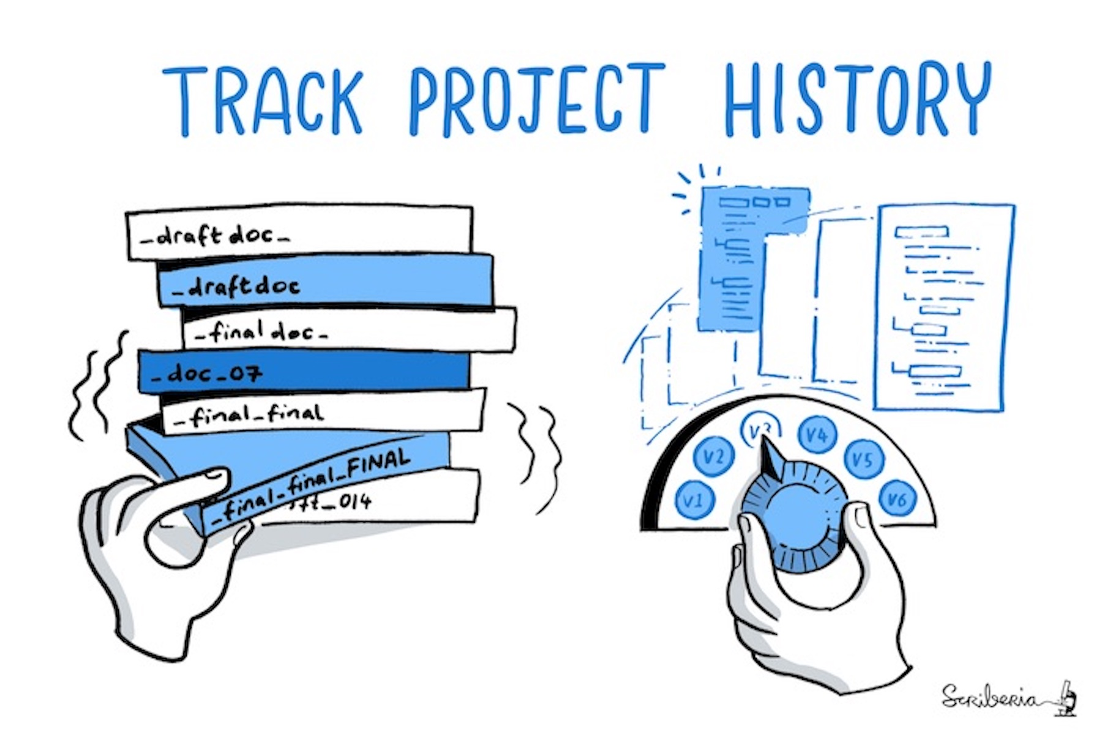
Why use versioning for research projects?
Benefits:
Store history of changes, who changed what and when
Go back to a previous version
Find out when a problem was introduced
Formalise ways of collaborating
Useful for many types of files
Access to same files from different computers - lightweight backup
Image from The Turing Way community by Scriberia - CC-BY 4.0
DOI: 10.5281/zenodo.3332807
Notes:
We can always go back if we make a mistake.
We have the means to refer to a well-defined version of a project when sharing, collaborating, and publishing.
If we discover a problem, we can find out when it was introduced.
Basically all work you do where tracking changes is useful:
Software (this is how it started but Git/GitHub can track a lot more)
Scripts
Documents (plain text file much more suitable than Word documents)
Manuscripts (Git is great for collaborating/sharing LaTeX manuscripts)
Configuration files
Website sources
Data
Image Credit: This image was created by Scriberia for The Turing Way community and is used under a CC-BY licence. DOI: 10.5281/zenodo.3332807
We can attempt to do this manually but this is difficult and prone to error

Slide 5
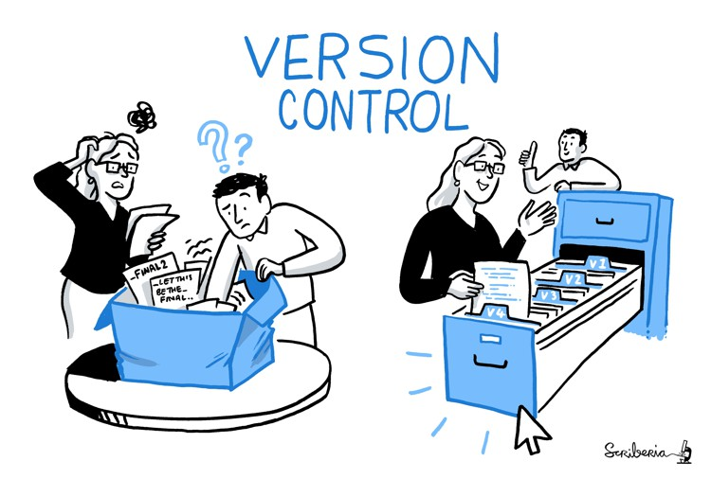
What is version control?
Automatically creates a robust and rigorous log of changes to a file, without renaming files (v1, v2, final_copy)
Minimal storage requirements - securely stores only the necessary information to recreate previous versions
Prevents user errors and performs conflict checks
Coordinate collaborative changes
Image from The Turing Way community by Scriberia - CC-BY 4.0 DOI: 10.5281/zenodo.3332807
Slide adapted from: Malvika Sharan. (2020). GitHub-Developing-Collaborative-Document. See DOI: 10.5281/zenodo.3835657
Notes:
Addressing these issues by tracking changes with a tool specific for this purpose is called version control. Some benefits compared to doing this manually:
When making changes to file names and their content, we risk losing previous content or entire files by overwriting them, hoping they will not be needed. Additionally, there may be unintended side effects, such as breaking analysis pipelines when renaming files. By using a VCS we get a robust and rigorous log of changes since the system :
Automatically names versions - VCS automatically timestamps all saved changes, ensuring efficient tracking and organization of revisions.
Accurate change log - VCS prompts users to document changes every time a modification is saved. Also keeps a 100% accurate record of what was actually changed, as opposed to what the user thought they changed.
Minimal storage requirements - VCS securely stores only the necessary information to recreate previous versions, not a full copy of each version
Prevents user errors - VCS performs conflict checks to ensure that no one's work will be overwritten. If conflicts are detected, they are identified, making it easier to resolve and integrate changes.
Furthermore, when collaborating with others, it is necessary to coordinate and resolve conflicts arising from concurrent changes made by collaborators.
There are several Version control systems, today we will try out git.

Slide 6
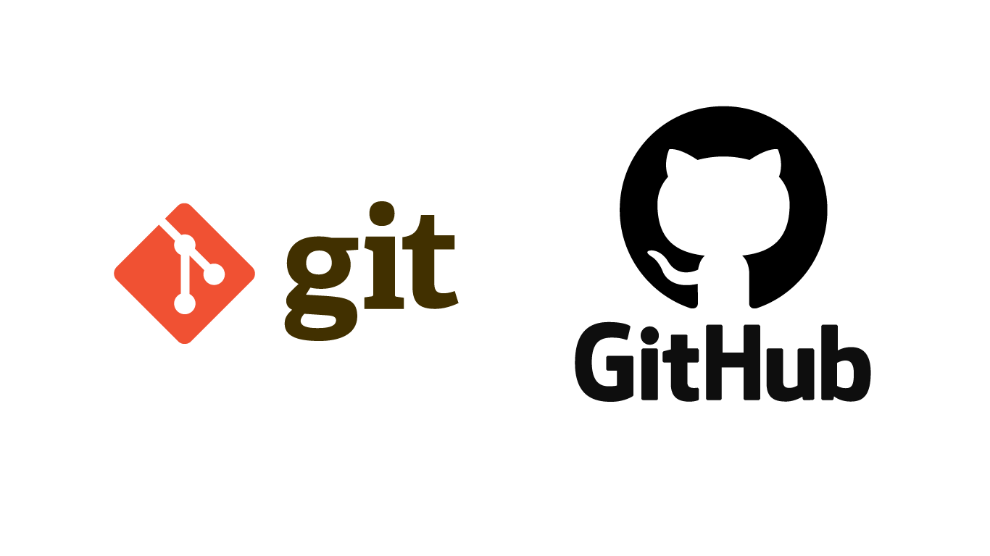

GitHub Desktop
Git is one of the most widely used version control systems in the world. It is a free, open source tool you can install locally on your computer
GitHub on the other hand is a popular website for hosting and sharing Git repositories remotely. It offers a web interface!
GitHub Desktop is an app on your computer and replaces the use of a terminal window to use git and GitHub
Slide adapted from: Malvika Sharan. (2020). GitHub-Developing-Collaborative-Document. See DOI: 10.5281/zenodo.3835657
Notes:
What’s the difference between git, GitHub and GitHub Desktop? To put it simply, Git is a version control system and a program that you install on your computer, like Word, which helps you keep track of changes in files. It acts like a virtual folder called a repository where all changes are stored as snapshots, also known as commits.
On the other hand, GitHub is a web-based hosting service for Git repositories. It provides a platform for collaborative work, where you can store and manage your Git repositories online. GitHub acts as a remote repository that can communicate with your local Git repository. Just like OneDrive can synchronize Word documents across multiple devices, GitHub can propagate changes made in Git repositories across different computers and provide a centralized location for collaboration and version control in a group setting.
GitHub Desktop is an app, which runs locally on your computer, that provides a graphical user interface to Git and GitHub. Using it, you don't have to write commands in order to communicate changes between the remote GitHub repository and your local Git repository. There are other tools that can do this too (e.g. Sourcetree). So how can git, GitHub and GH Desktop be used? We will look at some terminology now and then try it out together.

Slide 7

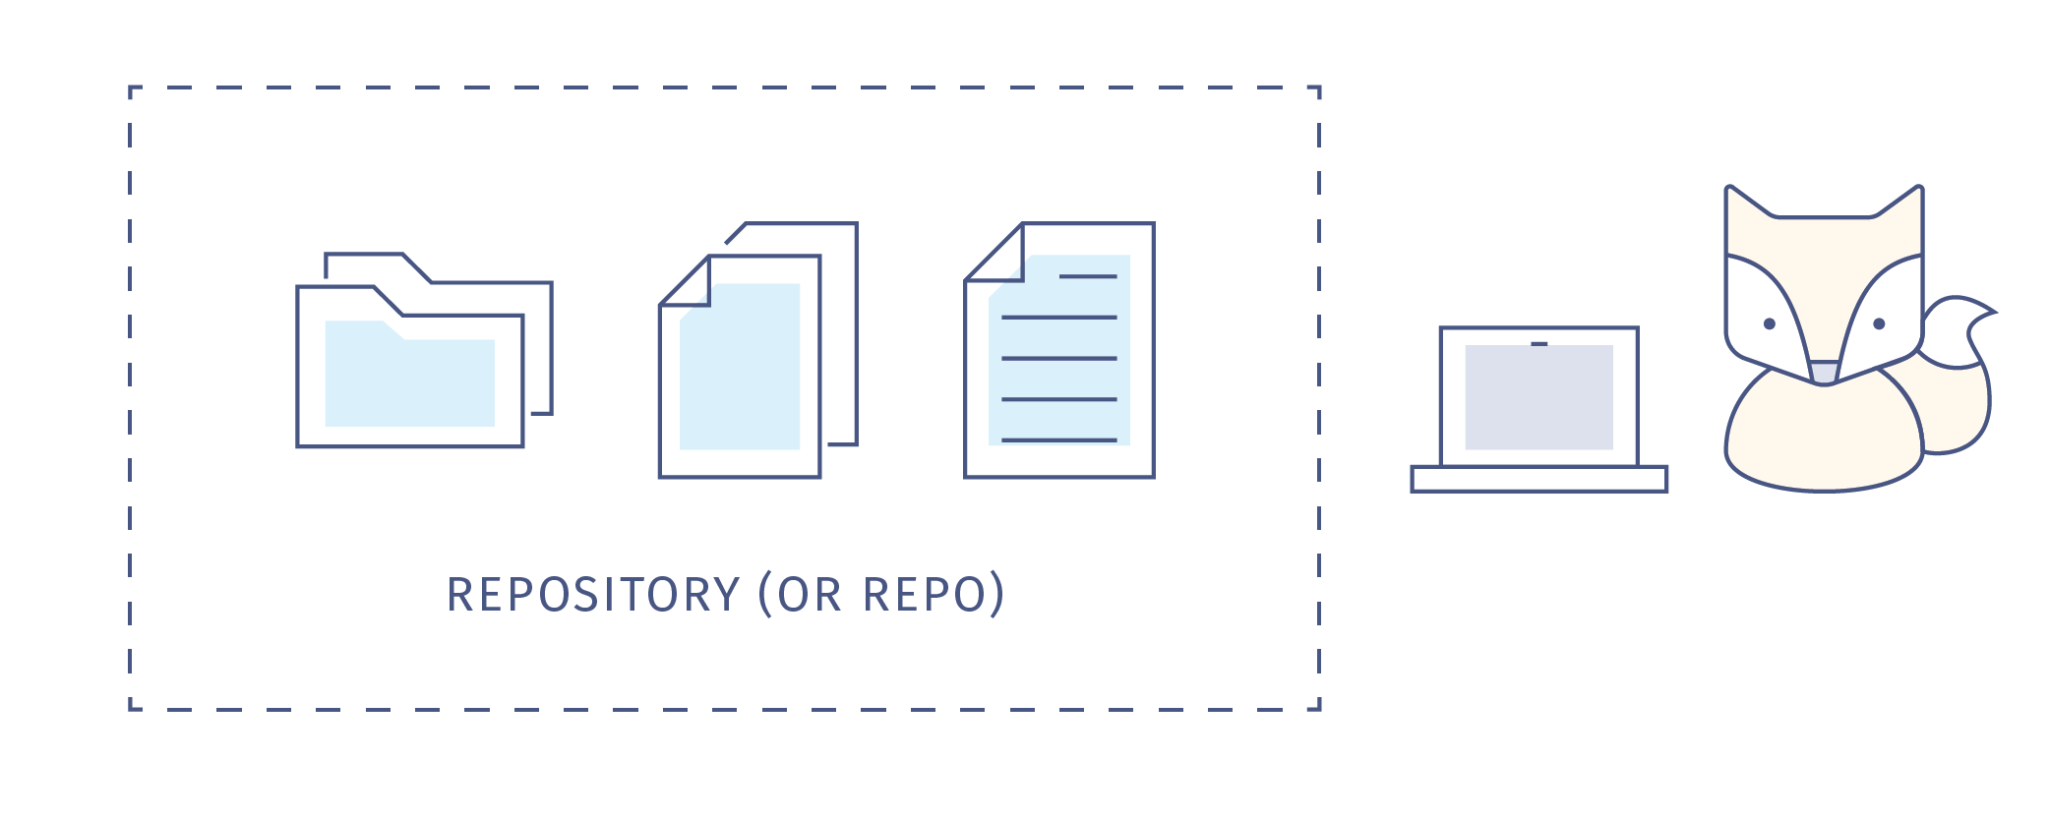
Repository
A repository can be private or public.
Make sure public repositories don’t contain any secrets or ‘sensitive’ information.
Notes:
The first term we need to know when using git is a repository - This is a collection of files in a folder or directory related to your project, in which you create and save new code or content. It can be located on GitHub or locally on your computer. It contains the changelog of your project and all the infor,ation needed to recreate different versions of your project. (Including commits, branches etc.) A note on Public versus Private: If you know that the repository you create is for your own purpose only, or you know that there might be content that is ‘sensitive’, you set it as Private. However, if this repository is going to be shared with the world, set it as Public. A repository doesn’t need to be public in order to collaborate. Collaborators can be added to a private repository as well.

Slide 8

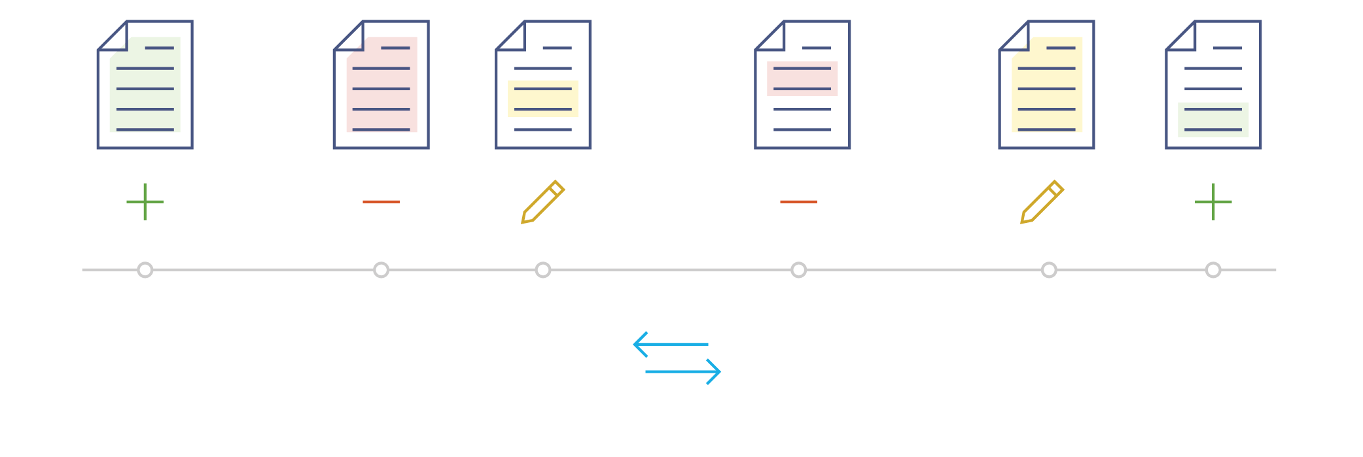
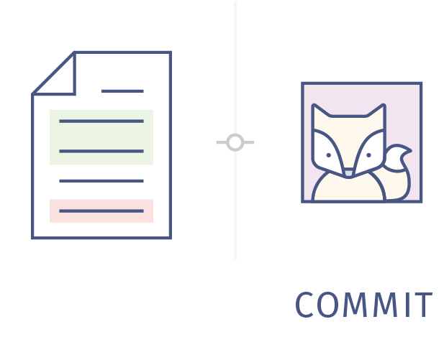

Real-time tracking of changes - commits and tags
Phd-thesis printed
Add references for chapter 05
Notes:
Changes made to files in your repository is saved and tracked in real-time, You don’t save copies of your document, you just save the the life story of the document, or its timeline. This timeline is also called a branch. Each saved change in the repository is called a commit. In a local repository you can save changes to your files without making a commit. Each commit has a unique identifier but it also comes with a commit message describing what has been changed, ie “Add references for chapter 05”. This is important to be able to find the correct time point if you want to go back and undo changes/revert to a previous version later. In addition, to make it easier to keep track of which version is used for what purpose, we can use tags in GitHub. A tag is like a sticky note that you attach to a particular commit (e.g. phd-printed or paper-submitted)

Slide 9
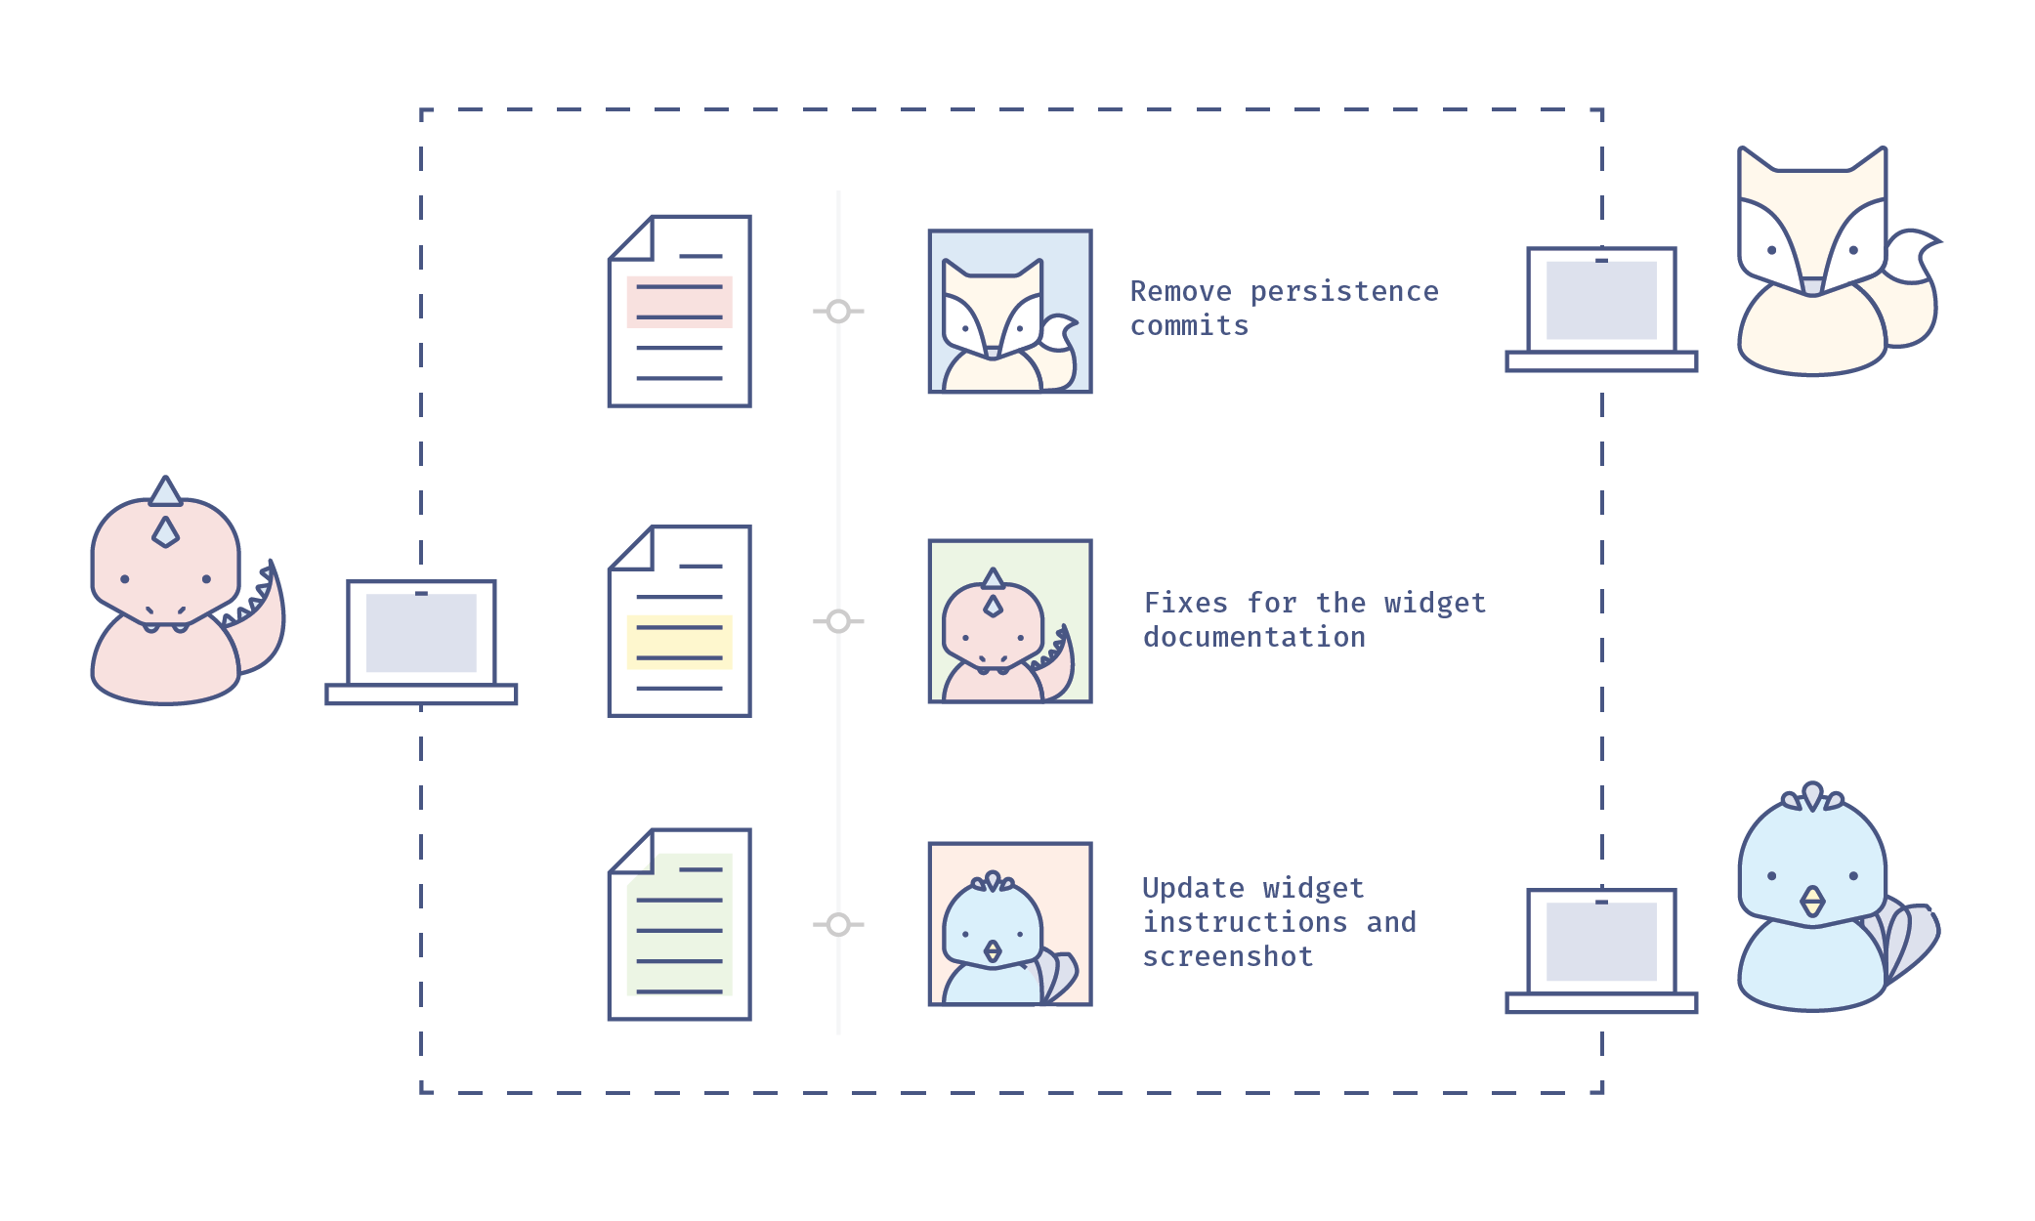
Collaborating
Notes:
Several ppl can work on the same remote repository on a local server or online. Each commit is associated with an ID but also with the contributor. Each collaborator can have a local repository and then send off their commits to the remote repository via a push and integrate the commits to the original repository . This can in principal be done directly to the same timeline or branch but many times it is useful to work with git branches when collaborating.

Slide 10



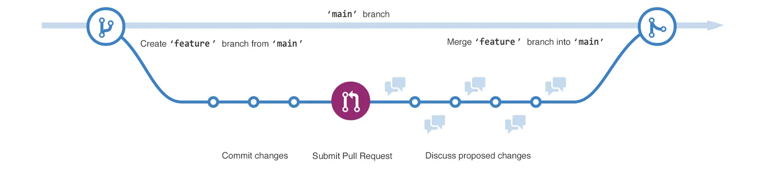
Collaborating using branches
main
merge
chapter_05
Pull Request (PR)
Default branch
Feature branch
Notes:
The default branch is called “main” but you can create additional branches in the repository in order to have different versions of a repository at one time within the same repository. Branches allow you to work on different parts of a project in parallel without impacting the main branch. When the work is complete, a branch can be integrated with the main project via a merge and PR.
You can even switch between branches and work on different projects without them interfering with each other.
Branching is helpful when you want to add new features to a project without changing the main source of code. The work done on different branches will not show up on the main branch until you merge it, which we will cover later in this guide. You can use branches to experiment and make edits before committing them to main.
Here is an example workflow:
The main branch
A new branch called feature is created and worked on with several commits’
A PR is initiated - it’s a way to ask to integrated the changes made on the feature branch to the main branch
GitHub provides an interface where the changes can be reviewed and discussed and once everything looks good the branch can be merged into the main branch.
The commits from the feature branch will then be added to the main branch history. Why is this god for collaborating: reviewing and validating each other's work
Image 1: https://docs.github.com/en/pull-requests/collaborating-with-pull-requests/proposing-changes-to-your-work-with-pull-requests/about-branches

Slide 11
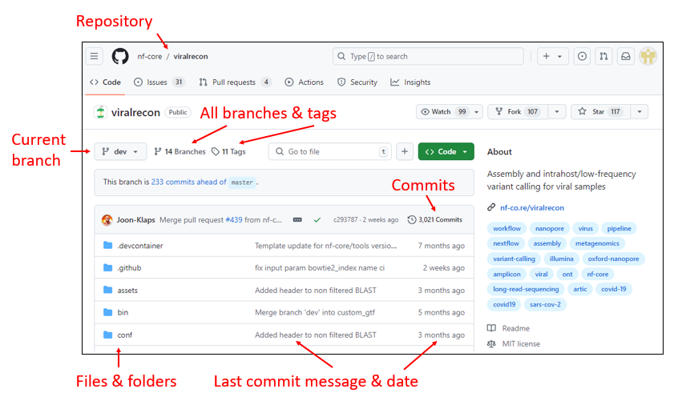
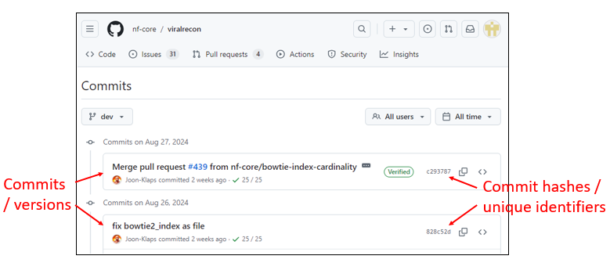
Navigating the GitHub web interface
Login to GitHub and explore the nf-core/viralrecon repository
Change branch from master to dev
Click on the commits of viralrecon-commits-dev
Notes:
Login to GitHub and briefly explore the nf-core/viralrecon repository. Try out changing branch from master to dev.
Point out Repository, Branches, Tags, Commits, Files & folders, Commit messages, dates
Go to commits, Point out commits / versions and commit hashes / unique identifiers

Slide 12

Glossary for Git & GitHub
repository/repo: a collection of documents related to your project, contains all data and history (commits, branches, tags)
cloning: copying the whole repository to your laptop - the first time
commit: a saved change/version of the project, gets a unique identifier (commit hash)
tag: a pointer to one commit, to be able to refer to it later. Like a sticky note that you attach to a particular commit (e.g. phd-printed or paper-submitted)
Icons: Octicons by GitHub from Icon Archive - MIT licence
Notes:
repository, or repo - a collection of documents related to your project, in which you create and save new code or content. Cloning - copying the whole repository to your laptop - the first time - in one go, you don’t need to copy each file on it’s own
Commit - a saved change to a document in a repository.
Tag - a pointer to one commit, to be able to refer to it later. Like a sticky note that you attach to a particular commit (e.g. phd-printed or paper-submitted)
Inspired from: https://mozillascience.github.io/working-open-workshop/github_for_collaboration/#glossary

Slide 13
Glossary for Git & GitHub
branch: a copy of a repo that is contained within the original repo. Branches are used to work on different project features without altering the original or "main" repo.
merge: the act of incorporating new changes (commits) from one branch to another.
pull request (PR): a request to merge a commit or collection of commits to a repository
Icons: Octicons by GitHub from Icon Archive - MIT licence
Notes:
Branch - a copy of a repo that is contained within the original repo. Branches are used to work on a project features without altering the original or "master" repo.
pull request - a request to add a commit or collection of commits to a repository.
Merge - the act of incorporating new changes (commits) into a repository.
Inspired from: https://mozillascience.github.io/working-open-workshop/github_for_collaboration/#glossary

Slide 14
Quiz
Which of the following statements are correct concerning version control?
Version control serves as a standalone backup system.
Version control systems makes it easier to collaborate when working with the same file.
Using a version control system, I don't have to wonder which version of the manuscript was sent to publisher.
Git is exclusively designed for managing software development and cannot track changes in other types of files like documents or data.
GitHub Desktop is a version control system.
Cloning a repository in GitHub copies the repository to your local machine.
Notes:
Cloning a repository in GitHub copies the repository to your local machine, while forking creates a copy of someone else's repository to your personal account on the GitHub server.

Slide 15
Quiz - solution
No, version control keeps track of different versions, but your work still needs to be backed up. Relying on only the remote repository at GitHub, does not comply with the 3-2-1 backup rule of having at least 3 copies, on 2 different types of digital media, and at least 1 separate location.
Yes, collaborations, and resolution of conflicts when editing the same file, is much easier with a version control system.
Well no, all versions are safely kept, but unless you put a (name) tag on a specific version, the system will not be able to help you on which version was sent to publisher.
No, Git started out as a software versioning control system, but can track a lot of other types of data as well.
No, GitHub Desktop is an app that provides a graphical user interface to the version control system Git, by communicating with the web service GitHub.
Yes, the cloned repository is stored on your local computer and connected to the remote repository on GitHub. Changes made locally can then be transferred by pushing them to the remote repository and in the other direction by pulling commits.

