Slide 1


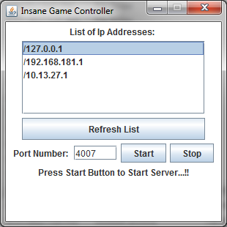
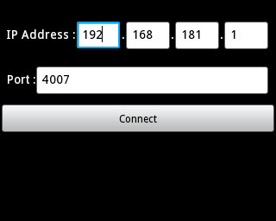

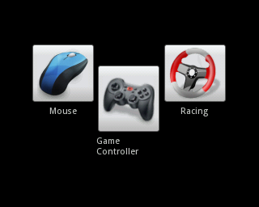
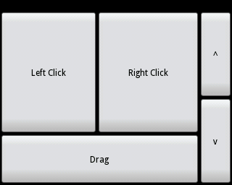
ANDROID GAME CONTROLLER
JAVA : PC Application
User Interface
Program
User Interface of Game Controller PC Application have two parts.
First part shows the list of IP Addresses our Server is broadcasting. In the phone application we have to use the one on which phone is connected.
Second Part of application gives user option to chose port to start the socket server to receive phone data. There are start and stop buttons to start and stop the server.
Program for PC Application is written in JAVA programming language. User Interface is made using Swing library. Connection is done using sockets in which are PC acts as server and waits for client i.e. Mobile phone to connect to our server on the specified port. Server programming is done using java.net when connected with client input and output stream are initialized which can receive and send bytes. Finally virtual key press and mouse actions are done using Robot library in java. When phone sends data which is than evaluated and executed.
LINK
https://github.com/wncc/android-game-controller
CONTACT
Android : Mobile Application
Mayank Meghwanshi
B. Tech. 1st Year,
Computer Science Engineering
IIT Bombay
mayankmeghwanshi@gmail.com
User Interface
Program
First our mobile should be connected to PC via hotspot. Now turning on android mobile application user is asked to insert IP address and port number which can be seen from UI of PC application. After entering data user can start socket connection to pc.
Now user enters next screen which has three options mouse, racing and game controller. In Mouse option user can control mouse with motion and mouse keys using touch. In Racing option turning left right is controlled using motion and option of up-down and other important keys are in touch interface. In Game Controller all the 8 directions can be controlled with motion.
Program for phone application is written using android SDKs . Layout is done in xml files and program is written in java. Using android libraries When connect button is pressed it searches for server and when found it establishes input and output streams and acts as client. Now using sensor manager whenever accelerometer values are changed data is sent to PC according to selected option in options menu i.e. mouse, race etc. For example for mouse “M 1.2 2.3” is sent M indicating mouse and two floats denoting tilt level of device. Also button clicks are informed to pc by sending message similar to above example and then PC application evaluates and executes. When application is closed “bye” message is sent which closes sockets and disconnects.
IIT BOMBAY

