Slide 1

Donorville

Slide 2
Problems
Lack of awareness
Myths
Lack of correct knowledge. Eg :
Rh –ve consists of only 5% in India
Platelets can be donated again after 3 days
No weakness/side effects

Slide 3
Problems
Voluntary Donations:
No incentives
Volunteers forget to donate
Rare blood groups problem
Blood donation cards don’t always work
Professional donors

Slide 4
Problems
Logistics:
SBTC not functioning properly
Hospitals don’t reveal blood units
No central database to manage donors and units
No attested donors database

Slide 5
Our Vision
To create a platform which connects blood donors to recipients
Is mobile
Is Gamified

Slide 6
Flow of App
Step 1 – Sign Up
Users can send requests for blood to any other user for approval.
Step 3 - Requests
Can view nearby users’ profiles (with donation history)
Step 2 – Login
Provide details like name, blood group etc.

Slide 7
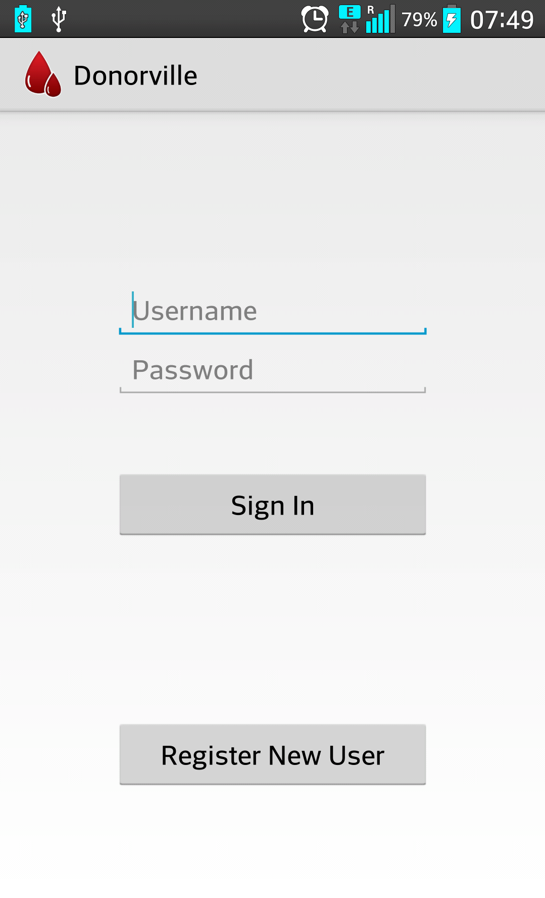
Walkthrough
Login Page:
Every user needs to register before using the app.

Slide 8
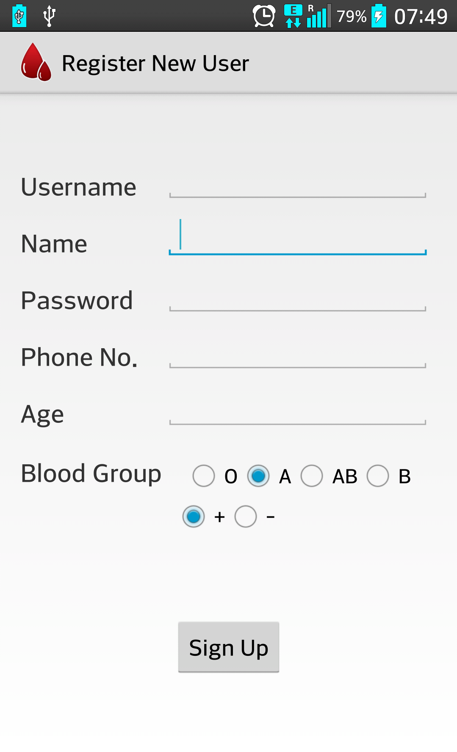
Walkthrough
Login Page:
Phone number is kept hidden from other users until the donation is approved
Blood Group makes selective search easy.

Slide 9
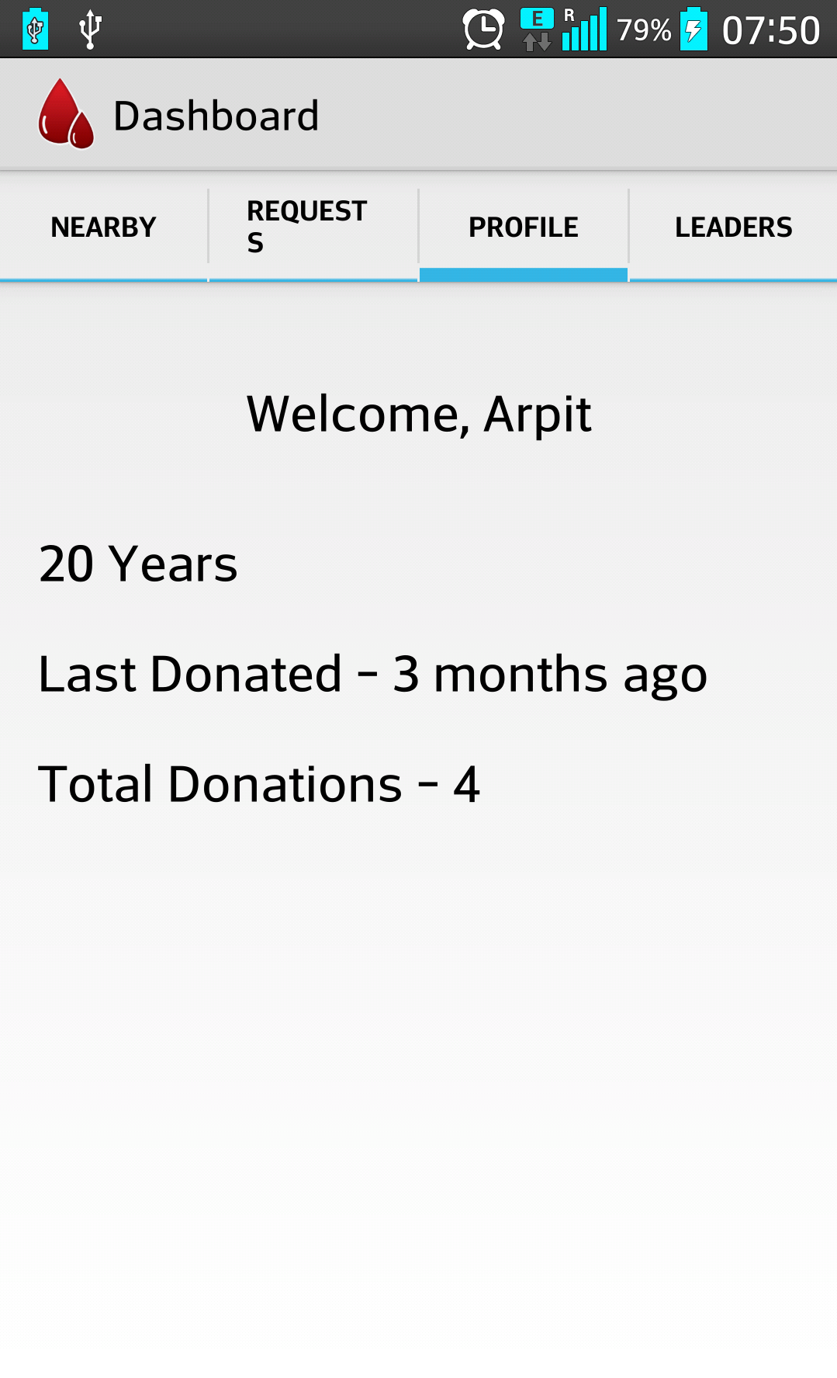
Walkthrough
After Login :
Nearby : Contains a list of donors nearby user’s location.
Requests : Contains all the requests from other users for donation. User can accept or reject.
Profile : Contains user information and donation history.
Leaders : List of users sorted according to their total donation

Slide 10
Gamification
Milestones
Virtual Trophies
Leader Board

