Slide 1
Coursera Capstone
For Applied Science

Slide 2
Introduction/Business Problem
Using the collisions data provided by Coursera for the final capstone course, I wanted to look into the severity of car accidents that are due to bad weather conditions. How many car accidents are caused due to bad weather conditions? This data will bring awareness to people to drive extra cautiously during bad weather!

Slide 3
Data
Using the data provided by Coursera on Collisions, I will investigate the connection between severity of car accidents and weather conditions. This data provides collisions from 2004 to the present in Seattle.

Slide 4

Methodology
First, I had to read the data from the provided csv file. Then, I used df.dtypes to see what type of data are the columns in the file. To investigate the connection between car accidents and weather conditions, I chose to focus on SEVERITYCODE (int), SEVERITYDESC (object), WEATHER (object), and ROADCOND (object)

Slide 5
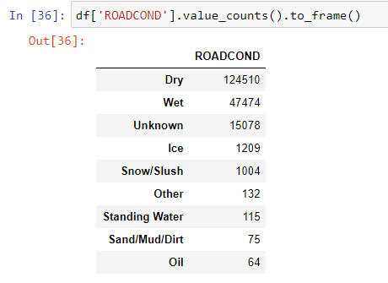
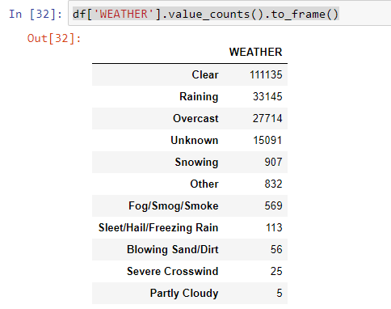
Methodology
I ran a value count on WEATHER to see which weather condition had the most accidents. I also ran a value count on ROADCOND to see which type of roads had more accidents.
Results: Clear weather condition had the most incidents of collisions. Dry road conditions had the most incidents of collisions.
A new dataframe table was created just to show the focused columns.

Slide 6
Conclusion
According to this data on collisions in Seattle from 2004 to the present, I do not see any relationship between bad weather conditions and wet road conditions that affected collisions. From the data, we see that there were a lot more collisions that happened on dry roads and also clear weather conditions. There are actually much less collisions that happen when weather and road conditions are not that great. This does not really surprise me since drivers tend to be more careful while driving when conditions are bad. The data shows that drivers are more likely to have a collision when weather conditions are good and roads are dry. This can be because the drivers are less careful in their driving during good conditions.

