Slide 1
Backtracking:
Traveling Salesperson Problem
Edmonton
500
Boston
300
350
470
350
Chicago
240
110
Denver
200
150
Austin

Slide 2
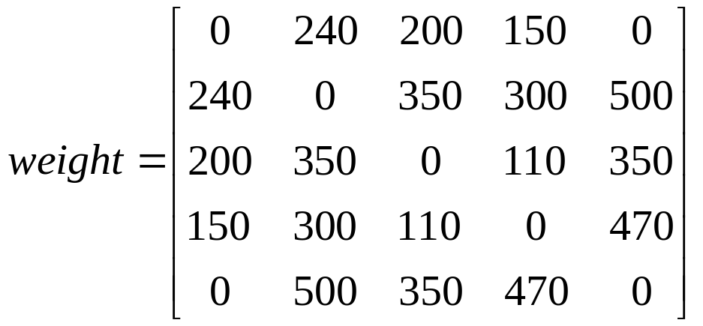
5
500
2
300
350
470
350
3
240
110
4
200
150
1

Slide 3
minCost = MAXINT
minTour = [ ]
x = [1, , , , ]
5
500
2
350
300
470
350
110
3
240
4
200
150
1

Slide 4
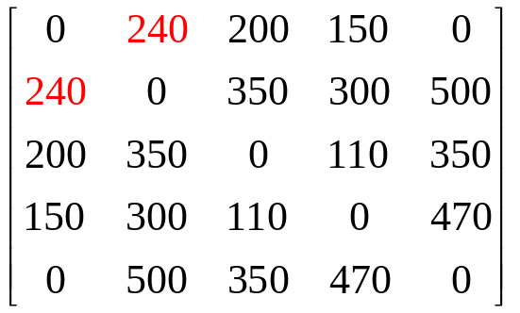
minCost = MAXINT
minTour = [ ]
x = [1, , , , ]
x = [1, 2, , , ]
5
500
2
350
300
470
350
110
3
240
4
200
150
1

Slide 5
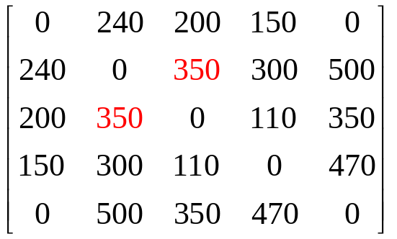
minCost = MAXINT
minTour = [ ]
x = [1, , , , ]
x = [1, 2, , , ]
5
500
2
x = [1, 2, 3, , ]
350
300
470
350
110
3
240
4
200
150
1

Slide 6
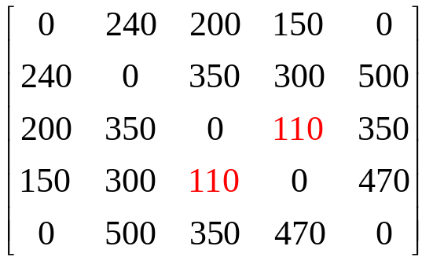
minCost = MAXINT
minTour = [ ]
x = [1, , , , ]
x = [1, 2, , , ]
5
500
2
x = [1, 2, 3, , ]
350
300
470
350
x = [1, 2, 3, 4, ]
110
3
240
4
200
150
1

Slide 7
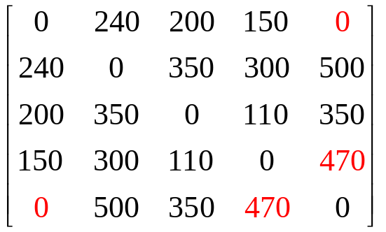
minCost = MAXINT
Vertex 5 is not adjacent to vertex 1
minTour = [ ]
x = [1, , , , ]
x = [1, 2, , , ]
5
500
2
x = [1, 2, 3, , ]
350
300
470
350
x = [1, 2, 3, 4, ]
110
3
240
4
200
150
x = [1, 2, 3, 4, 5]
1
Not a cycle!

Slide 8
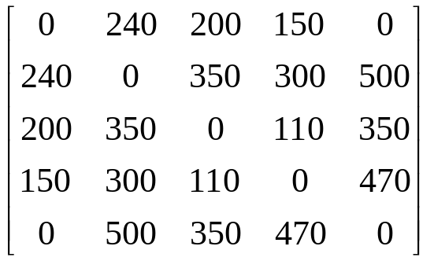
minCost = MAXINT
minTour = [ ]
x = [1, , , , ]
x = [1, 2, , , ]
5
500
2
x = [1, 2, 3, , ]
350
300
470
350
x = [1, 2, 3, 4, ]
110
3
240
x = [1, 2, 3, 5, ]
4
200
150
x = [1, 2, 3, 4, 5]
1

Slide 9
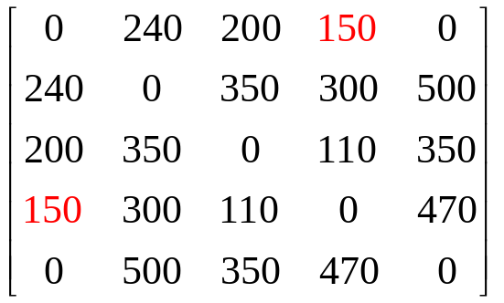
minCost = MAXINT
minTour = [ ]
x = [1, , , , ]
x = [1, 2, , , ]
5
500
2
x = [1, 2, 3, , ]
350
300
470
350
x = [1, 2, 3, 4, ]
110
3
240
x = [1, 2, 3, 5, ]
4
200
150
x = [1, 2, 3, 4, 5]
x = [1, 2, 3, 5, 4]
1
Cycle!

Slide 10
minCost = MAXINT
minTour = [ ]
x = [1, , , , ]
x = [1, 2, , , ]
5
500
2
x = [1, 2, 3, , ]
350
300
470
350
x = [1, 2, 3, 4, ]
110
3
240
x = [1, 2, 3, 5, ]
4
200
150
x = [1, 2, 3, 4, 5]
x = [1, 2, 3, 5, 4]
1
Cycle!

Slide 11
minCost = MAXINT
UPDATE:
minTour = [ ]
x = [1, , , , ]
x = [1, 2, , , ]
5
500
2
x = [1, 2, 3, , ]
350
300
470
350
x = [1, 2, 3, 4, ]
110
3
240
x = [1, 2, 3, 5, ]
4
200
150
x = [1, 2, 3, 4, 5]
x = [1, 2, 3, 5, 4]
1
cost = 240 + 350 + 350 + 470 + 150 = 1560
< minCost

Slide 12
minCost = 1560
UPDATE:
minTour = [1, 2, 3, 5, 4]
x = [1, , , , ]
x = [1, 2, , , ]
5
500
2
x = [1, 2, 3, , ]
350
300
470
350
x = [1, 2, 3, 4, ]
110
3
240
x = [1, 2, 3, 5, ]
4
200
150
x = [1, 2, 3, 4, 5]
x = [1, 2, 3, 5, 4]
1
cost = 240 + 350 + 350 + 470 + 150 = 1560
< minCost

Slide 13
minCost = 1560
minTour = [1, 2, 3, 5, 4]
x = [1, , , , ]
x = [1, 2, , , ]
5
500
2
x = [1, 2, 3, , ]
x = [1, 2, 4, , ]
350
300
470
350
110
3
240
4
200
150
1

Slide 14
minCost = 1560
minTour = [1, 2, 3, 5, 4]
x = [1, , , , ]
x = [1, 2, , , ]
5
500
2
x = [1, 2, 3, , ]
x = [1, 2, 4, , ]
350
300
470
350
110
3
240
x = [1, 2, 4, 3, ]
4
200
150
1

Slide 15
minCost = 1560
minTour = [1, 2, 3, 5, 4]
x = [1, , , , ]
x = [1, 2, , , ]
5
500
2
x = [1, 2, 3, , ]
x = [1, 2, 4, , ]
350
300
470
350
110
3
240
x = [1, 2, 4, 3, ]
4
200
150
x = [1, 2, 4, 3, 5]
1

Slide 16
minCost = 1560
minTour = [1, 2, 3, 5, 4]
x = [1, , , , ]
x = [1, 2, , , ]
5
500
2
x = [1, 2, 3, , ]
x = [1, 2, 4, , ]
350
300
470
350
110
3
240
x = [1, 2, 4, 3, ]
4
200
150
x = [1, 2, 4, 3, 5]
1

Slide 17
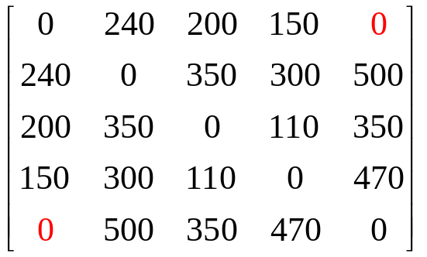
minCost = 1560
minTour = [1, 2, 3, 5, 4]
x = [1, , , , ]
x = [1, 2, , , ]
5
500
2
x = [1, 2, 3, , ]
x = [1, 2, 4, , ]
350
300
470
350
110
3
240
x = [1, 2, 4, 3, ]
4
200
150
x = [1, 2, 4, 3, 5]
1
Not a cycle!

Slide 18
minCost = 1560
minTour = [1, 2, 3, 5, 4]
x = [1, , , , ]
x = [1, 2, , , ]
5
500
2
x = [1, 2, 3, , ]
x = [1, 2, 4, , ]
350
300
470
350
110
3
240
x = [1, 2, 4, 5, ]
4
200
150
x = [1, 2, 4, 5, 3]
1

Slide 19
minCost = 1560
minTour = [1, 2, 3, 5, 4]
x = [1, , , , ]
x = [1, 2, , , ]
5
500
2
x = [1, 2, 3, , ]
x = [1, 2, 4, , ]
350
300
470
350
110
3
240
x = [1, 2, 4, 5, ]
4
200
150
x = [1, 2, 4, 5, 3]
1
Cycle!

Slide 20
minCost = 1560
minTour = [1, 2, 3, 5, 4]
x = [1, , , , ]
x = [1, 2, , , ]
5
500
2
x = [1, 2, 3, , ]
x = [1, 2, 4, , ]
350
300
470
350
110
3
240
x = [1, 2, 4, 5, ]
4
200
150
x = [1, 2, 4, 5, 3]
1
cost = 240 + 300 + 470 + 350 + 200 = 1560
NOT less than minCost

Slide 21
minCost = 1560
UPDATE:
minTour = [1, 2, 3, 5, 4]
x = [1, , , , ]
x = [1, 2, , , ]
5
500
2
x = [1, 2, 3, , ]
x = [1, 2, 5, , ]
350
300
470
350
110
3
240
x = [1, 2, 5, 3, ]
4
200
150
x = [1, 2, 5, 3, 4]
1
cost = 240 + 500 + 350 + 110 + 150 = 1350
< minCost

Slide 22
minCost = 1350
UPDATE:
minTour = [1, 2, 5, 3, 4]
x = [1, , , , ]
x = [1, 2, , , ]
5
500
2
x = [1, 2, 3, , ]
x = [1, 2, 5, , ]
350
300
470
350
110
3
240
x = [1, 2, 5, 3, ]
4
200
150
x = [1, 2, 5, 3, 4]
1
cost = 240 + 500 + 350 + 110 + 150 = 1350
< minCost

Slide 23
minCost = 1350
minTour = [1, 2, 5, 3, 4]
x = [1, , , , ]
x = [1, 2, , , ]
5
500
2
x = [1, 2, 3, , ]
x = [1, 2, 5, , ]
350
300
470
350
110
3
240
x = [1, 2, 5, 4, ]
4
200
150
x = [1, 2, 5, 4, 3 ]
1
cost = 240 + 500 + 470 + 110 + 200 = 1520
NOT less than minCost

Slide 24
minCost = 1350
minTour = [1, 2, 5, 3, 4]
x = [1, , , , ]
x = [1, 2, , , ]
x = [1, 3, , , ]
etc.

Slide 25
minCost = 1350
minTour = [1, 2, 5, 3, 4]
x = [1, , , , ]
x = [1, 2, , , ]
x = [1, 3, , , ]
x = [1, 4, , , ]
etc.
etc.

Slide 26
minCost = 1350
minTour = [1, 2, 5, 3, 4]
x = [1, , , , ]
x = [1, 2, , , ]
x = [1, 3, , , ]
x = [1, 4, , , ]
x = [1, 5, , , ]
etc.
etc.

Slide 27
minCost = 1350
minTour = [1, 2, 5, 3, 4]
5
500
2
350
300
470
350
110
3
240
4
200
150
1

