Slide 1
Calculations of electric dipole moments in two-electron diatomic molecules
Written under the guidence of :
prof. dr hab. Krzysztof Pachucki
mgr Michał Siłkowski
Wojciech Noskowiak

Slide 2
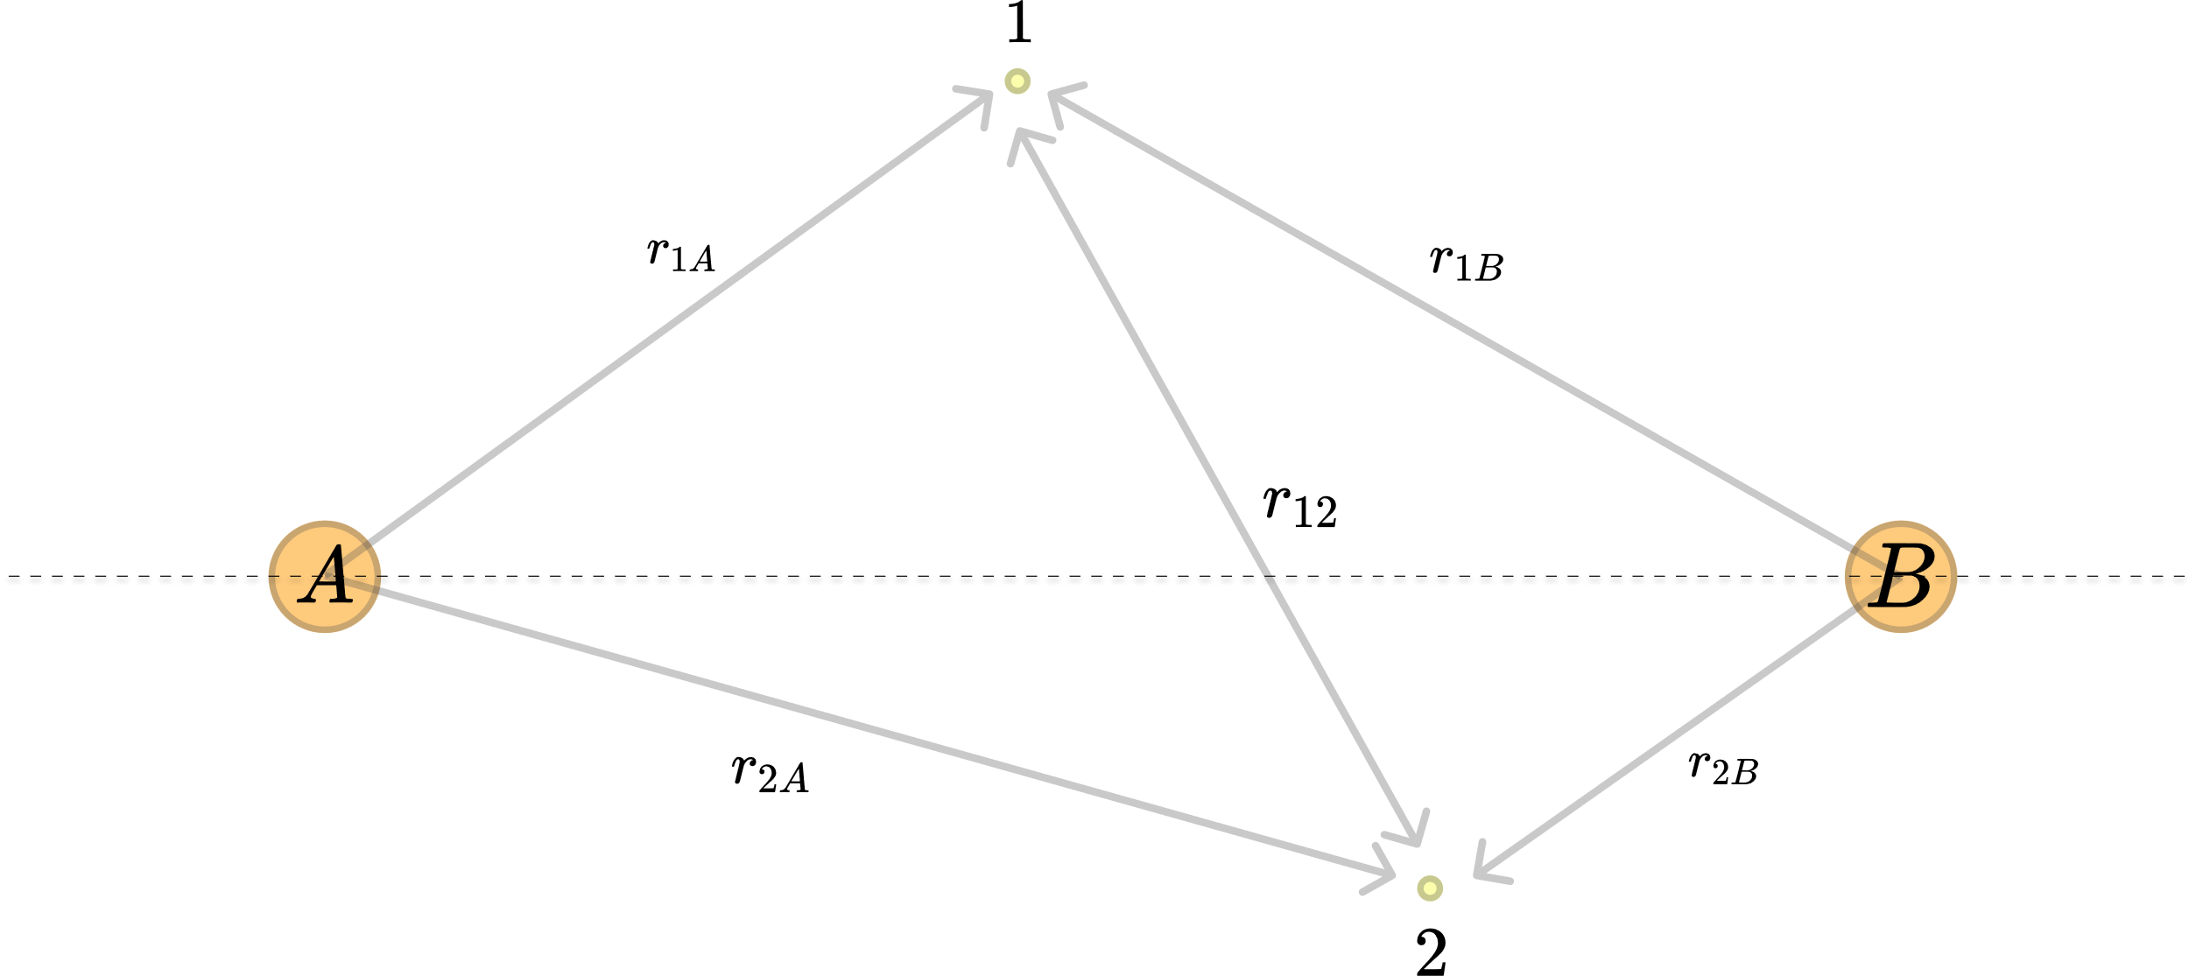

Kołos-Wolniewicz functions
$$φ\left({r,n}_{0}, n_{1},n_{2},n_{3},n_{4}\right)=e^{−y\left(r_{1A}−r_{1B}\right)−x\left(r_{2A}−r_{2B}\right)−u\left(r_{1A}+r_{1B}\right)−v\left(r_{2A}+r_{2B}\right)}$$ $r_{12}^{n_{0}}{\left(r_{1A}−r_{1B}\right)}^{n_{1}}{\left(r_{2A}−r_{2B}\right)}^{n_{2}}$ ${\left(r_{1A}+r_{1B}\right)}^{n_{3}}{\left(r_{2A}+r_{2B}\right)}^{n_{4}}$

Slide 3
$$n_{0}+n_{1}+n_{2}+n_{3}+n_{4}≤Ω$$

Slide 4
Why these functions?
The basis is defined by only five parameters. This makes it easy to optimize
It has interesting mathematical properties that are very helpful when performing calculations

Slide 5
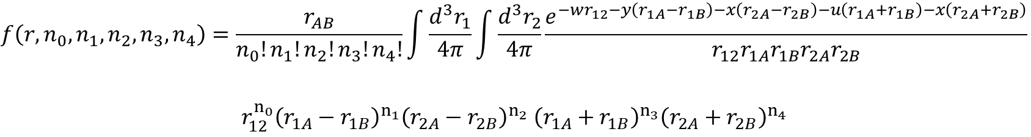
$$f\left(r,n_{0},n_{1},n_{2},n_{3},n_{4}\right)=\frac{r_{AB}}{n_{0}!n_{1}!n_{2}!n_{3}!n_{4}!}\int{\frac{d^{3}r_{1}}{4π}}\int{\frac{d^{3}r_{2}}{4π}\frac{e^{−wr_{12}−y\left(r_{1A}−r_{1B}\right)−x\left(r_{2A}−r_{2B}\right)−u\left(r_{1A}+r_{1B}\right)−x\left(r_{2A}+r_{2B}\right)}}{r_{12}r_{1A}r_{1B}r_{2A}r_{2B}}}$$ $$r_{12}^{n_{0}}{\left(r_{1A}−r_{1B}\right)}^{n_{1}}{\left(r_{2A}−r_{2B}\right)}^{n_{2}} {\left(r_{1A}+r_{1B}\right)}^{n_{3}}{\left(r_{2A}+r_{2B}\right)}^{n_{4}}$$

Slide 6
$$f\left(r,0,0,0,0,0 \right)=r\int{\frac{d^{3}r_{1}}{4π}}\int{\frac{d^{3}r_{2}}{4π}}\frac{e^{−wr_{12}−y\left(r_{1A }−r_{1B}\right)−x\left(r_{2A}−r_{2B}\right)−u\left(r_{1A}+r_{1B}\right)−v\left(r_{2A}+r_{2B}\right)}}{r_{12}r_{1A}r_{1B}r_{2A}r_{2B}}$$
$$f\left(r,n_{0},n_{1},n_{2},n_{3},n_{4}\right)=\frac{r}{n_{0}!n_{1}!n_{2}!n_{3}!n_{4}}{\left.{\left(−\frac{∂}{∂w_{1}}\right)}^{n_{0}}\right|}_{w_{1}=0}{\left(−\frac{∂}{∂y}\right)}^{n_{1}}{\left(−\frac{∂}{∂x}\right)}^{n_{2}}{\left(−\frac{∂}{∂u}\right)}^{n_{3}}{\left(−\frac{∂}{∂w}\right)}^{n_{4}}f\left(r\right)$$

Slide 7
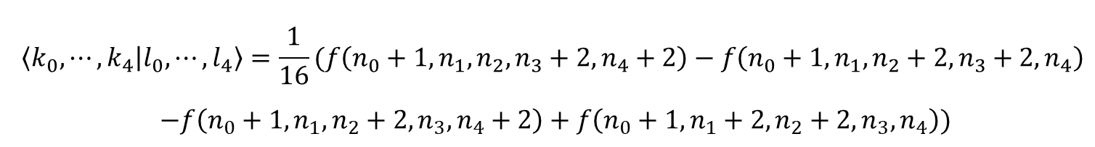
$$\left\langle k_{0},⋯,k_{4} | l_{0},⋯,l_{4}\right\rangle =\frac{1}{16}(f\left(n_{0}+1,n_{1},n_{2},n_{3}+2,n_{4}+2\right)−f\left(n_{0}+1,n_{1},n_{2}+2,n_{3}+2,n_{4}\right)$$ $−f\left(n_{0}+1,n_{1},n_{2}+2,n_{3},n_{4}+2\right)+f\left(n_{0}+1,n_{1}+2,n_{2}+2,n_{3},n_{4}\right))$

Slide 8
$$M=\left\langle Ψ | r_{1}+r_{2} | Φ\right\rangle$$

Slide 9
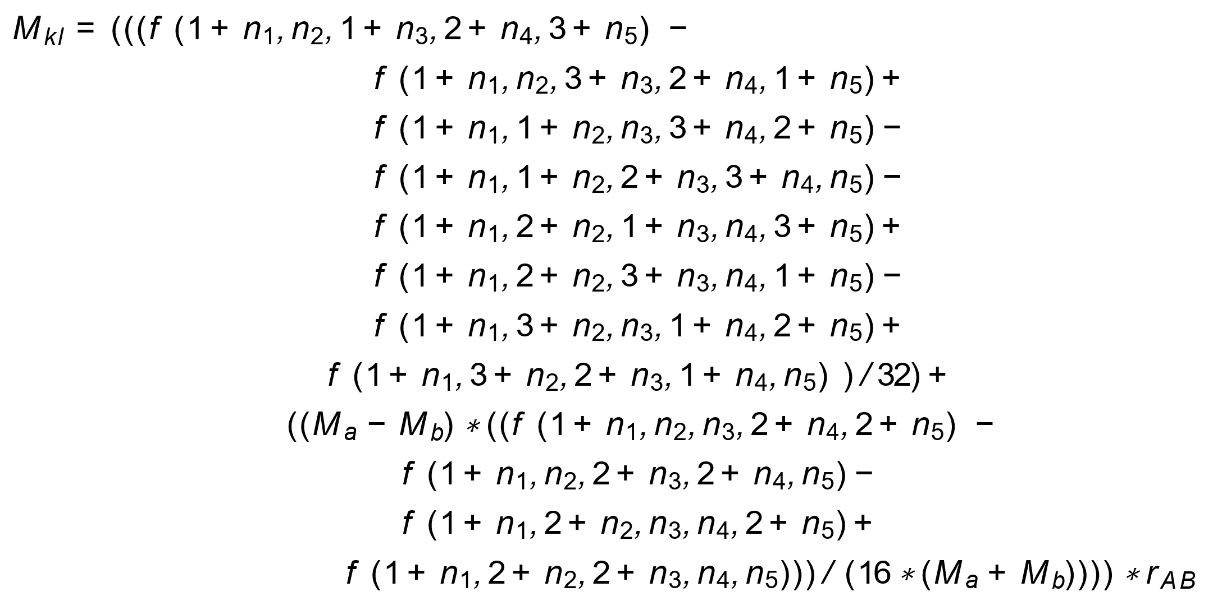

Slide 10
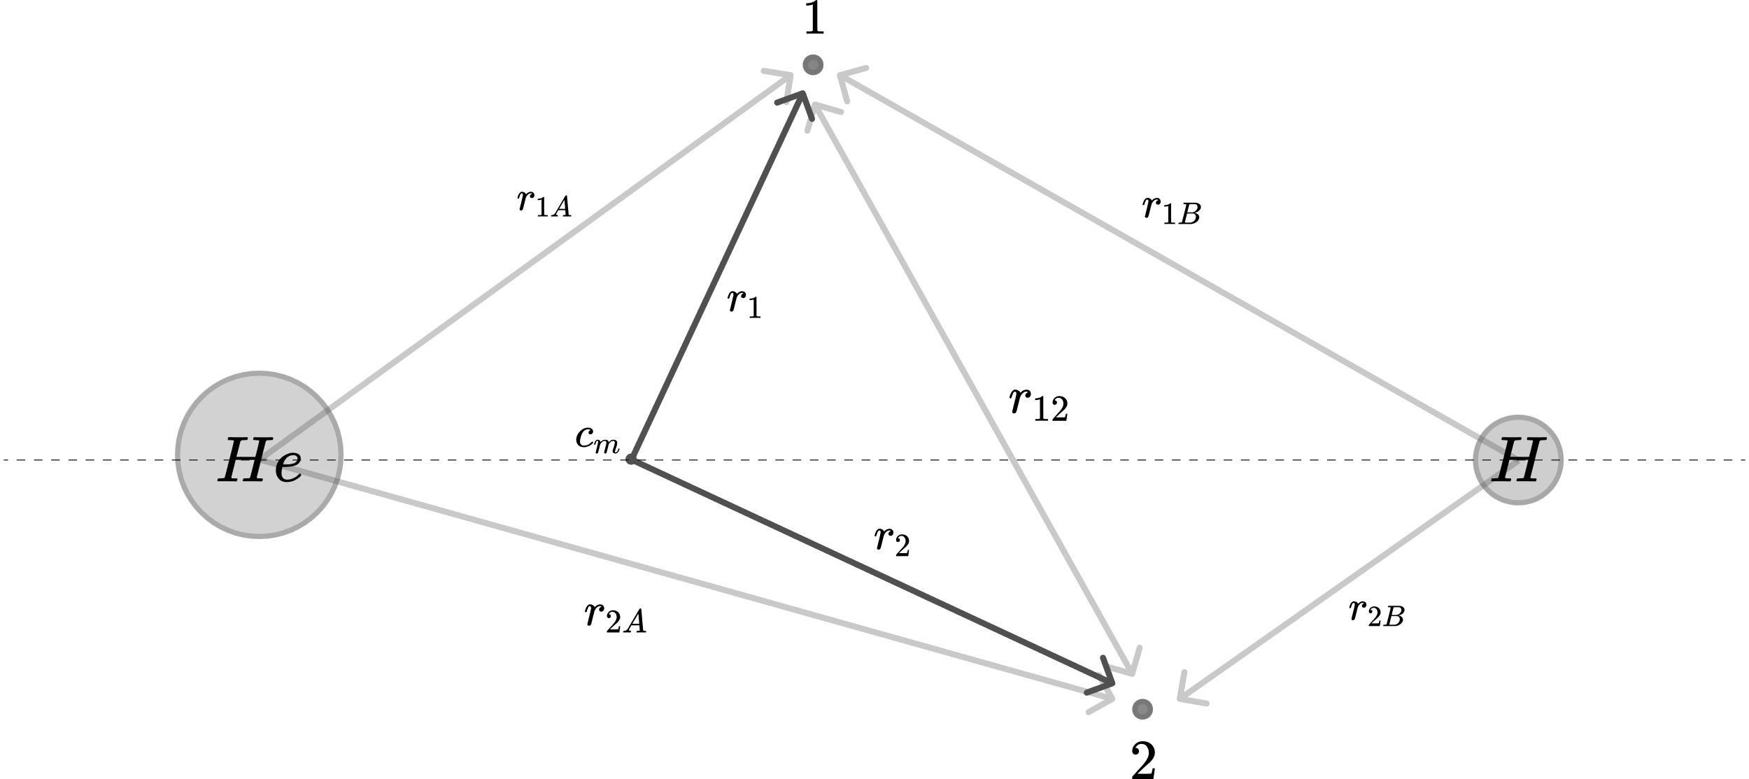

Slide 11
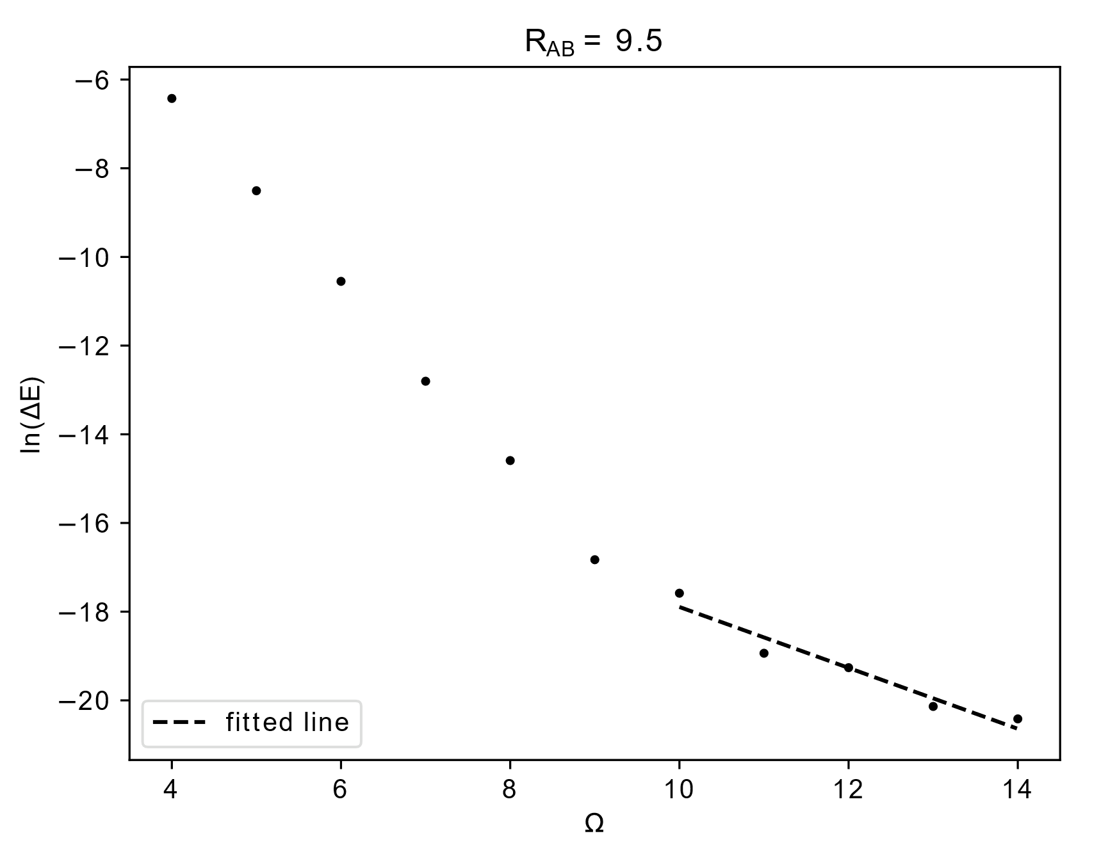

Slide 12
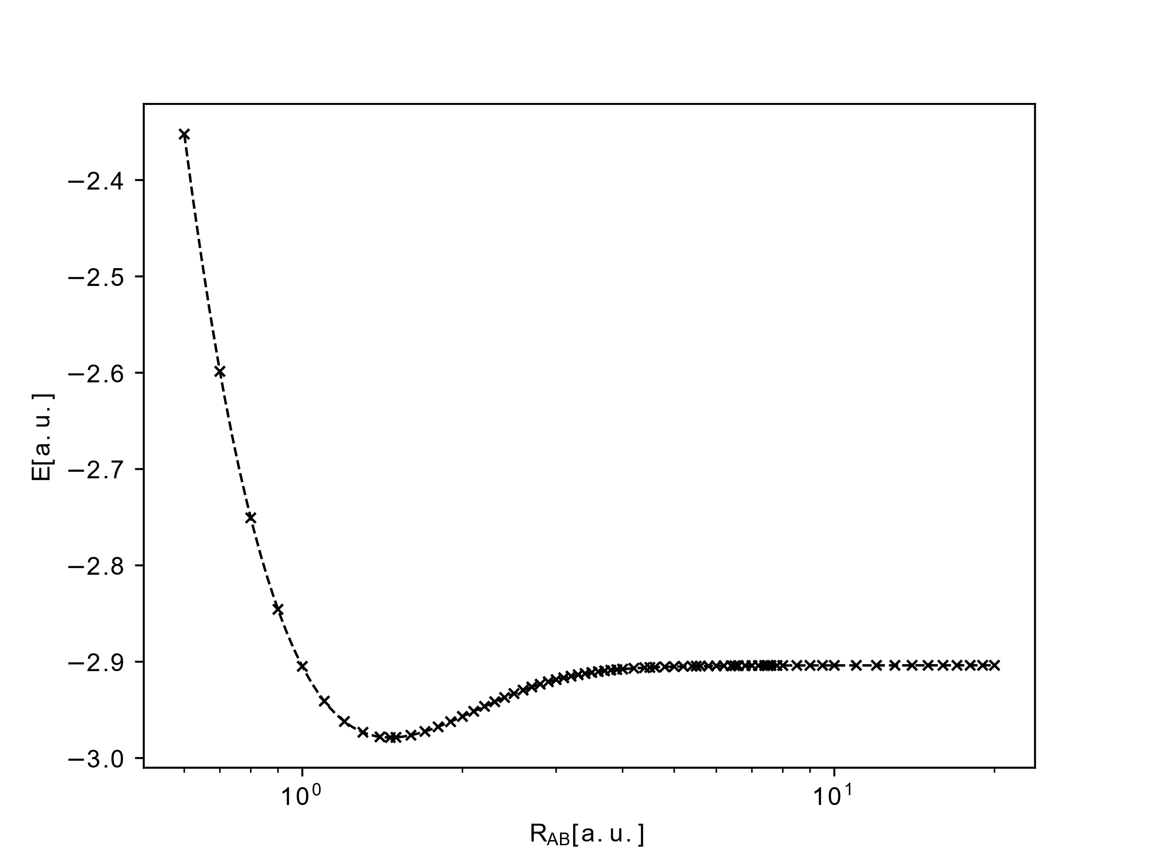

Slide 13
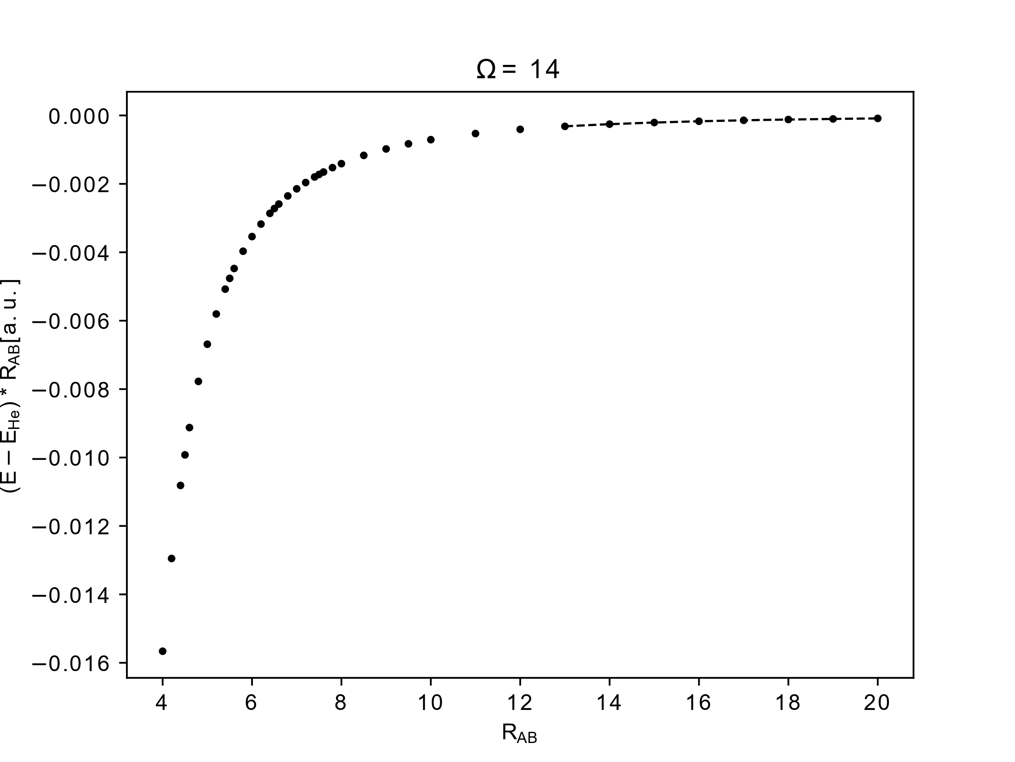
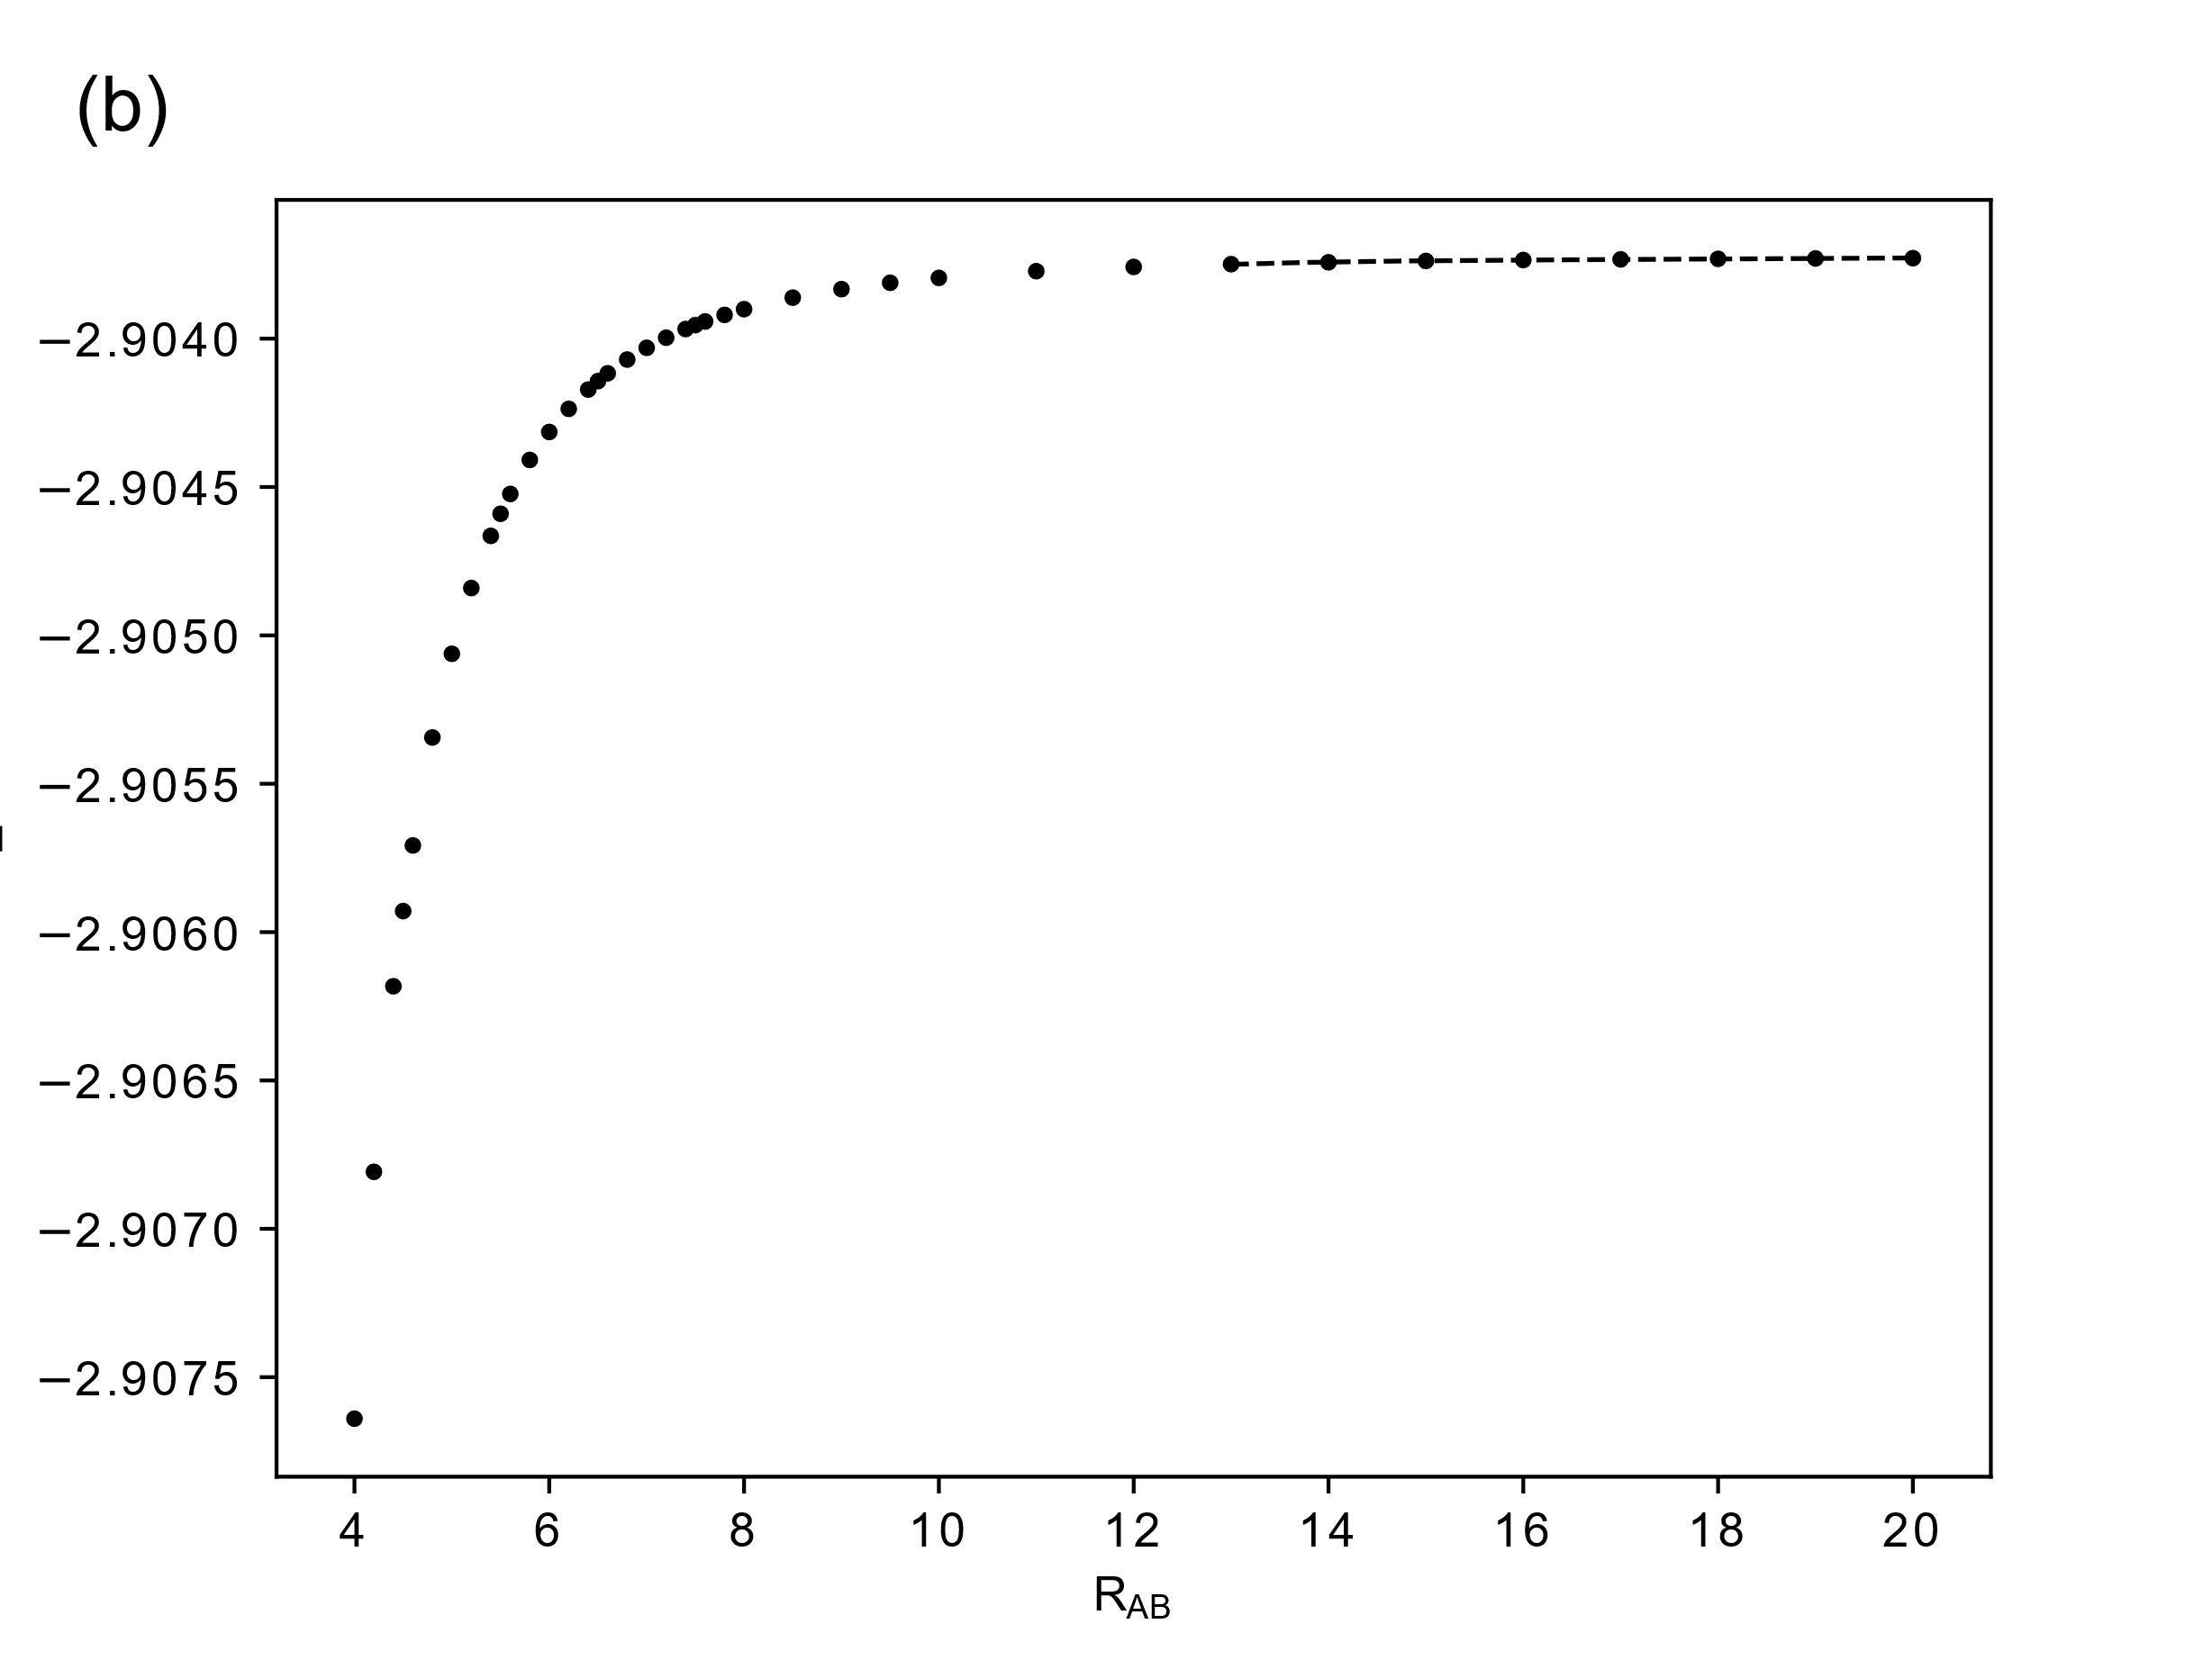


$$\frac{-0.6987(6) }{R_{AB}^{3}}$$
$$\frac{-0.6987(6) }{R_{AB}^{4} }\text{−2.903724377}$$

Slide 14
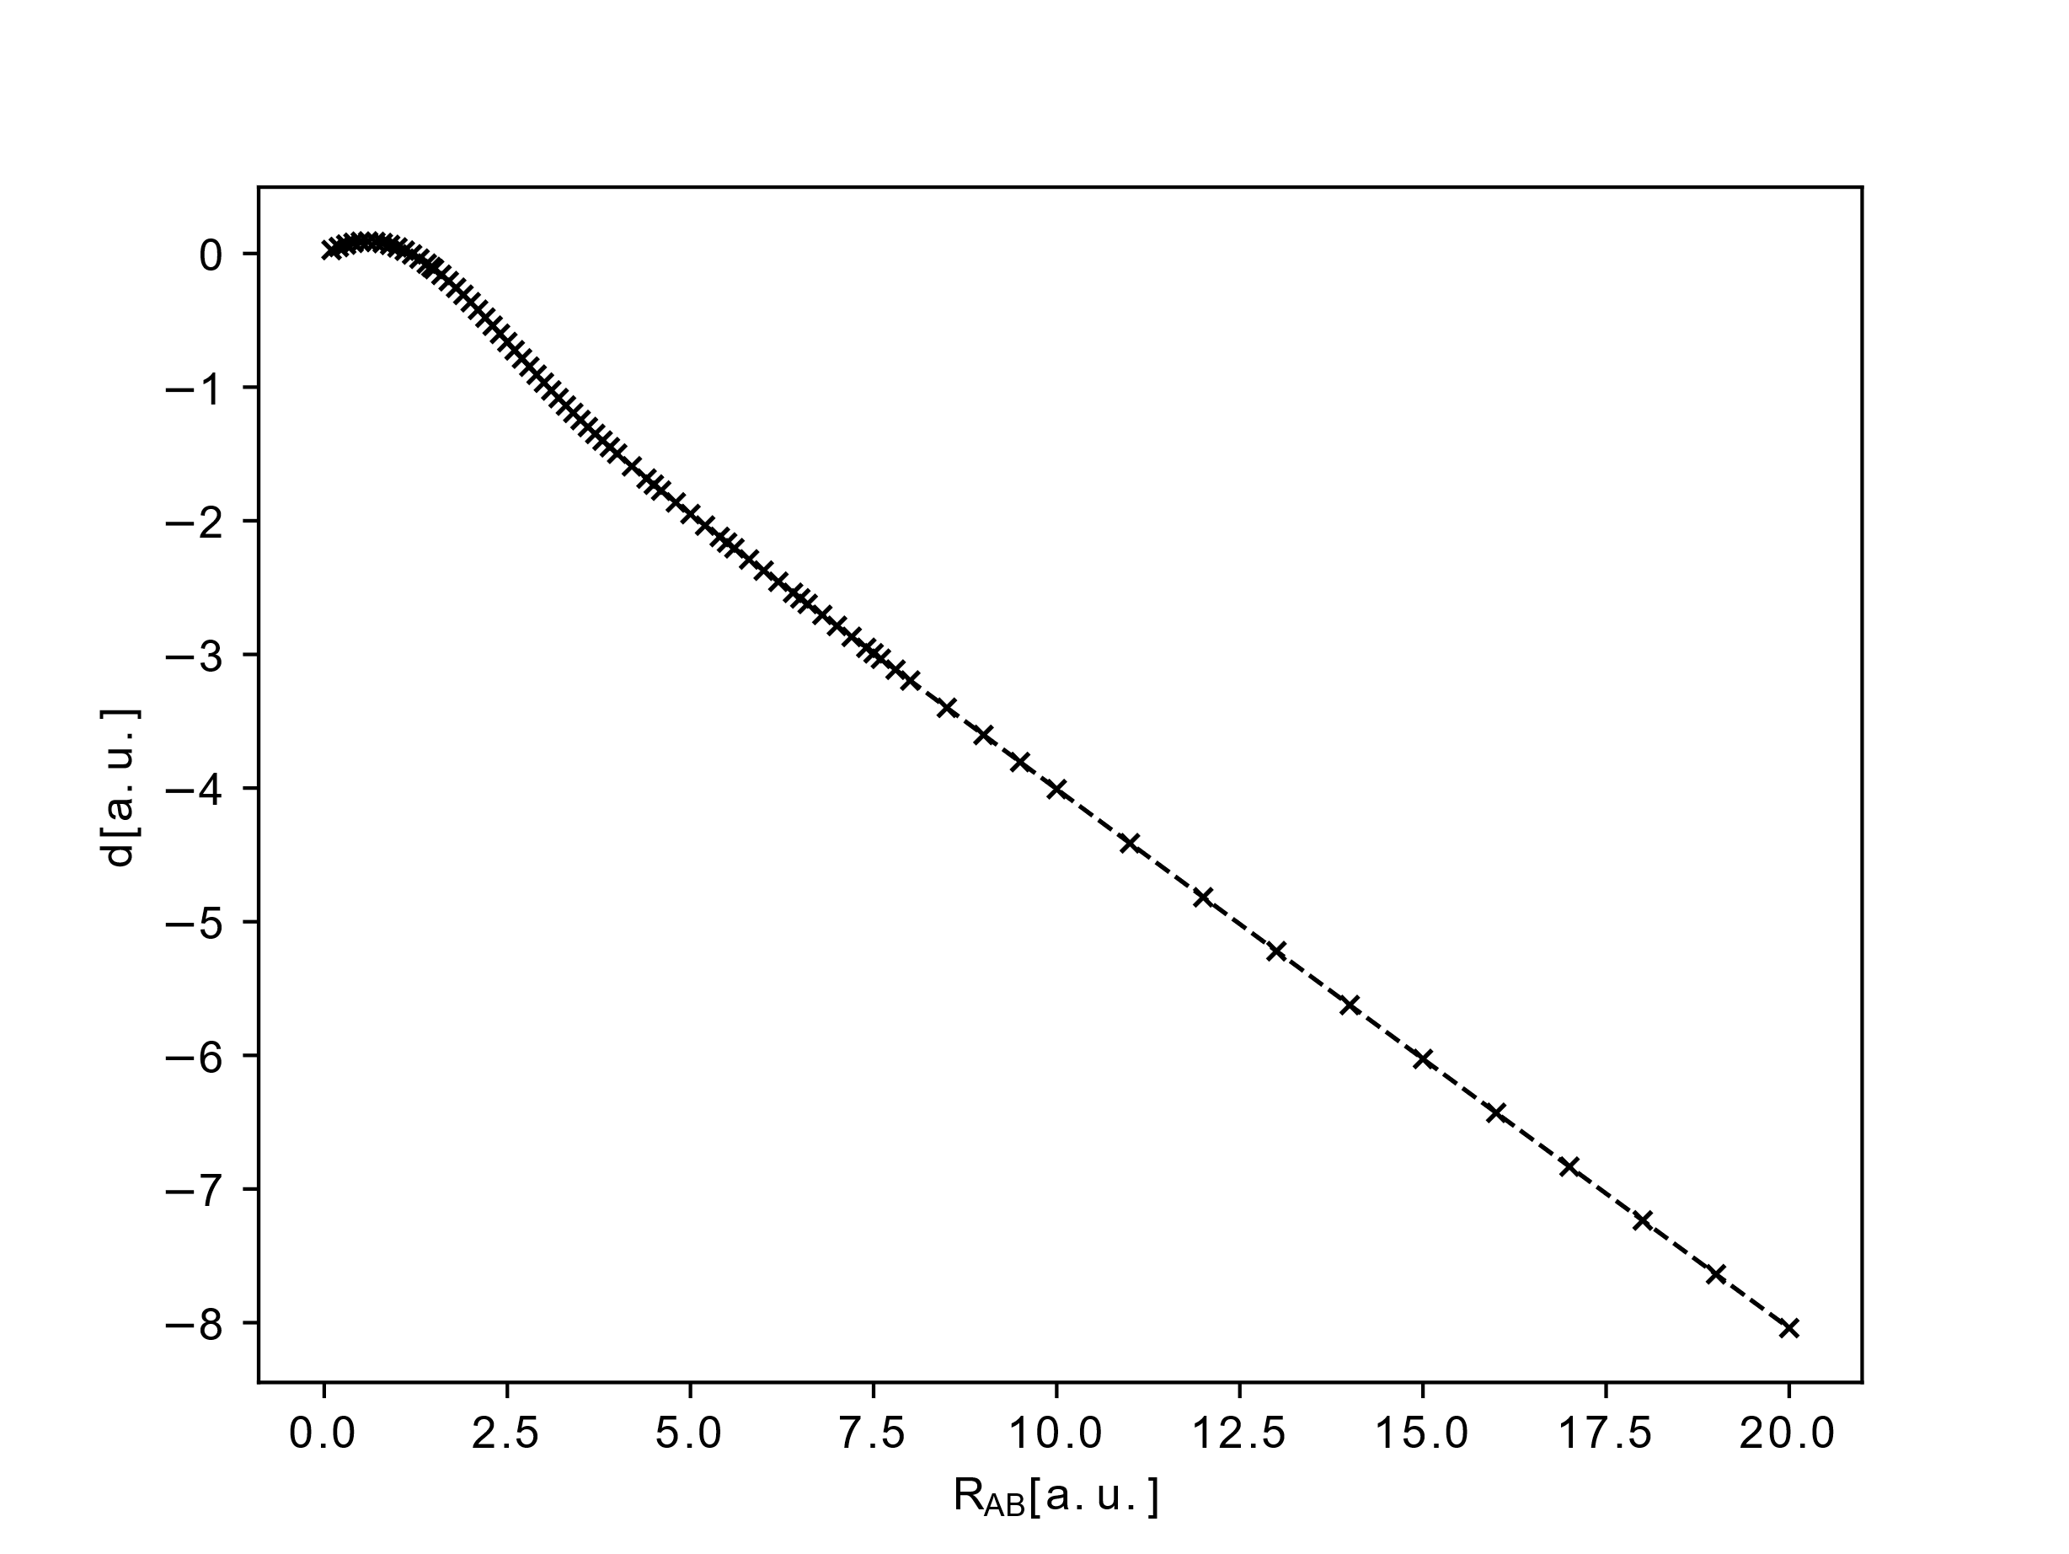

Slide 15
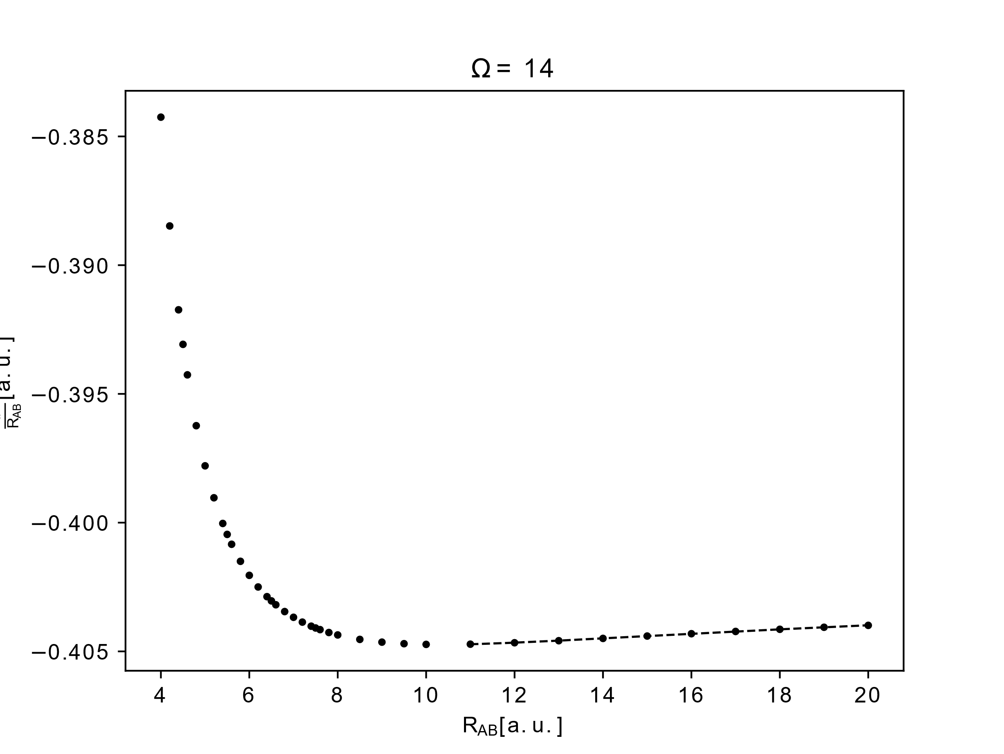
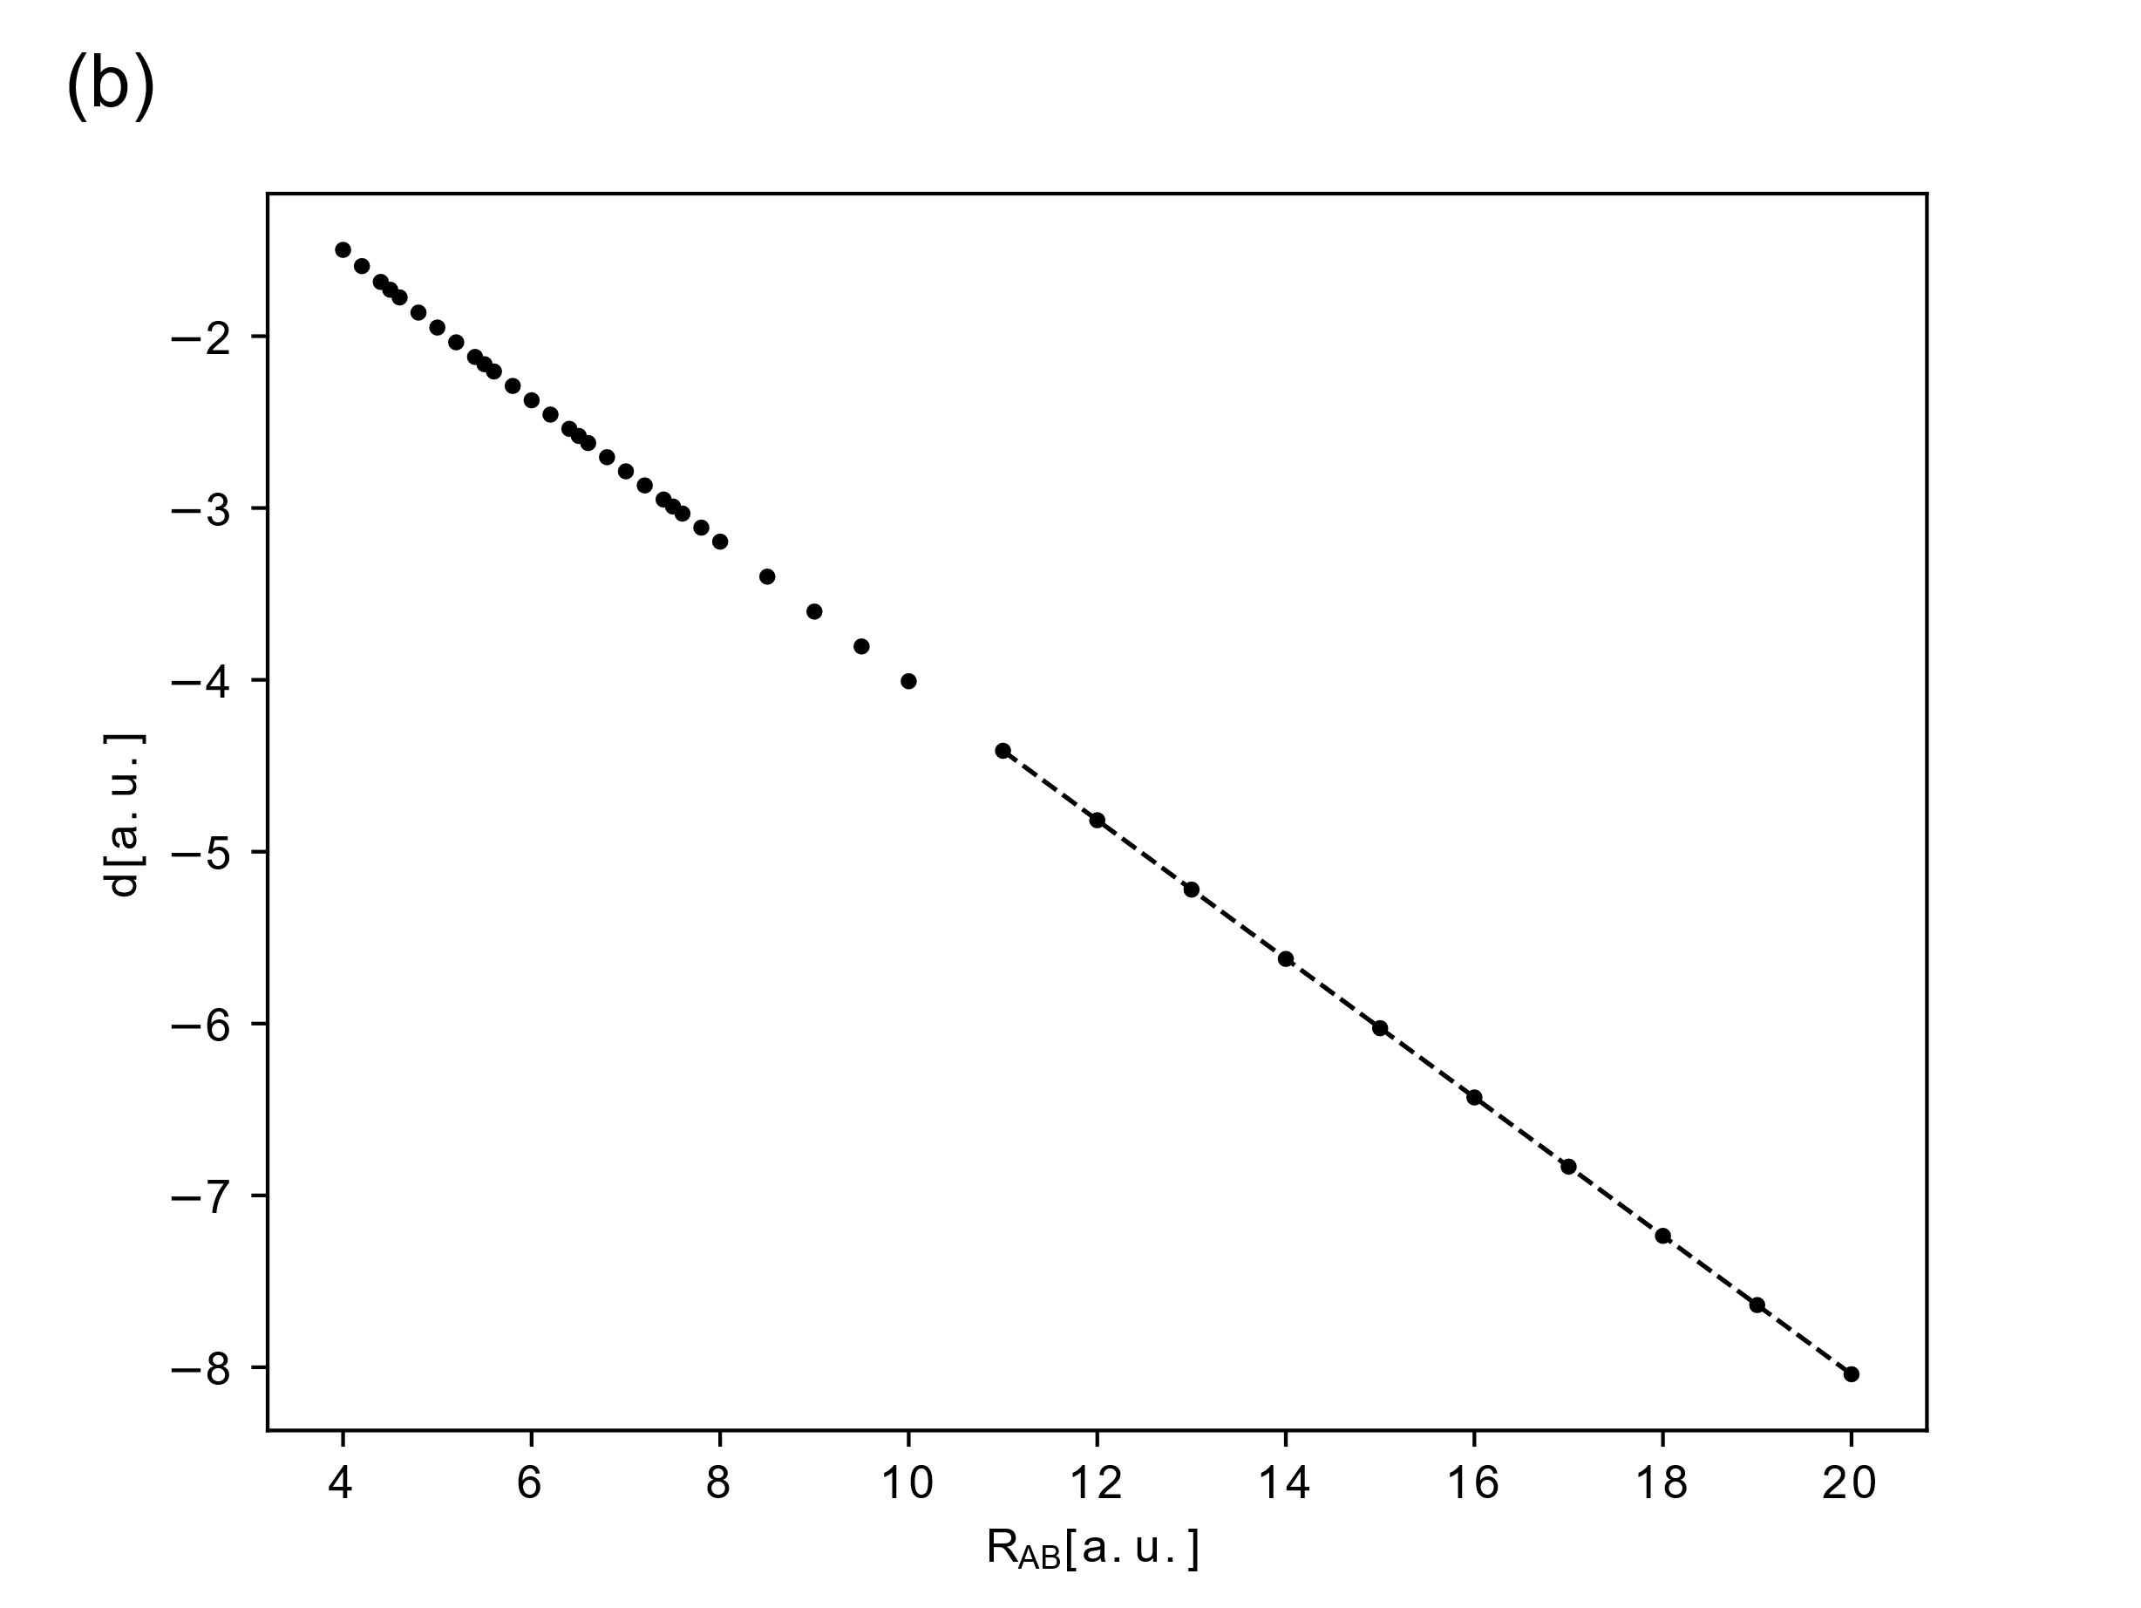


$$\text{-}\text{0.40174}\text{(3)}−\frac{\text{0.0595}(8) }{R_{AB}}+\frac{\text{0.294}(6) }{R_{AB}^{2}}$$
$$\text{−}\text{0.40174}\text{(3)}R_{AB}−\text{0.0595}(8)+\frac{\text{0.294}(6) }{R_{AB}}$$

Slide 16
Summary
Overall the obtained values behaved as predicted. Most of the values were calculated with almost a 10 decimal place accuracy .

Slide 17
Thank you

