Slide 1
Course Name: Artificial Intelligence Laboratory Course No.: CSE4110 Presentation on Eat Best Game
Presented by:
Nohel Kumar Nath (1607013)
Md. Noyan Ali (1607021)
Shahriar Hossain Sato (1607023)

Slide 2
Game Description
Collection of different types of fruit . Each fruit has a predefined calorie value with it’s weight.
Randomly 5 fruits will be selected for each player ( Human and Computer) in each term. Player can consume total 1000g fruit.
Fruit selection criteria is 0/1 Knapsack Algorithm.
After 5 terms or exceeding weight, scores will be evaluated.
High scorer will be winner.

Slide 3
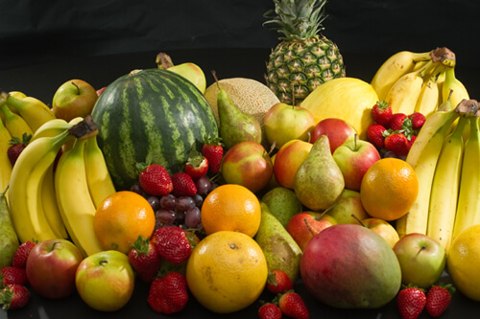

Game Simulation
Collection of different fruits. Each fruit has it’s weight and calorie.
Randomly selected 5 fruits from collection of fruits.
Randomly selected 5 fruits from collection of fruits.
Player
Computer

Slide 4
Fruits Table
Table 1: Fruit Table with weight and calorie
Fruit Name | Weight (g) | Calorie
Mango | 200 | 150
Apple | 100 | 225
Banana | 50 | 200
Guava | 100 | 150
And So On…

Slide 5
Flowchart of Game
Start
Initialize Turn (T), Weight (W) & Score (S) [T = W = S = 0]
Lose
W or T exceed
Compare Score
Check W & T
Find Maximum Calorie / Weight
Win
Update W, S & T
Show W, S & T

Slide 6
Let’s Play
Table 2 : Table of fruits with Calorie / Weight
Fruit Name | Weight (g) | Calorie | Calorie/ Weight
A | 100 | 200 | 2
B | 50 | 150 | 3
C | 100 | 100 | 1
… | … | … | …
First Turn:
Second Turn:
Player1
Computer
Player1 eats c & New Turn
Computer eats A and New Turn
A
B
C
T = 1
W = S = 0
Amount : 500g
D
B
C
T = 1
W = S = 0
Amount : 500g
A
E
F
T = 2
W = 50
S = 150
Amount : 450g
A
G
B
T = 2
W = 100
S = 200
Amount : 400g

Slide 7
Result Evaluation
At the end :
Computer is Winner!
Player 1
Turn = 5
Score = 450
Remaining Amount = 30 g
Computer
Turn = 5
Score = 600
Remaining Amount = 5 g

Slide 8
Question
Any Question ?

Slide 9
The End
Thanks.

