Slide 1


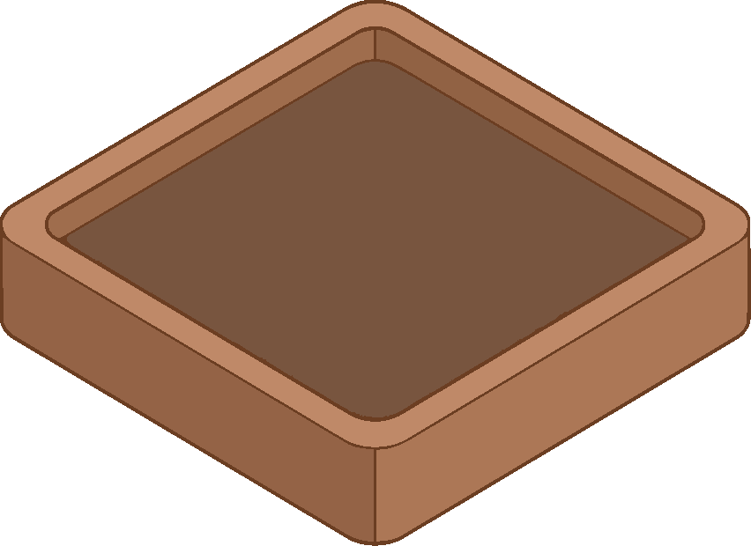
T
TerraTwin
ITU AI READINESS HACKATHON — KINGDOM OF SAUDI ARABIA
Test the decision
before you test
the crop.
An AI readiness digital twin for sustainable agriculture in Jazan, Saudi Arabia. Built on Recommendation ITU-T Y.3172.
Wanas Zakri
Management Information Systems · Jazan University
Notes:
TerraTwin. An AI readiness digital twin for farms in Jazan, Saudi Arabia, built on ITU-T Y.3172. The one line to remember: test the decision before you test the crop. My name is Wanas Zakri and this is a solo submission.

Slide 2

THE PROBLEM
AI reaches the farm as an order, not a conversation
1
The farm cannot receive it
2
The farmer cannot be wrong safely
No soil-moisture history, no field connectivity, no sensor coverage, and no settled answer to who owns the data. A model trained on someone else's ground is deployed onto a farm that can neither feed it nor check it — and it fails quietly, which is worse than failing loudly.
On a smallholding a mistaken irrigation is not a poor output on a screen; it is a lost season on a holding that had one. Between accepting a recommendation and living with it there is a single growing cycle, and no rehearsal space in between.
Jazan makes both sharper.
Five different farming systems inside one region — humid coast, wadi floodplain, inland plain, foothill and highland terrace — sharing a market and a ministry but almost nothing agronomically. Advice built for one part of it can be actively harmful in another.
TerraTwin · Wanas Zakri
02
Notes:
Two failures, not one. The farm is not ready to receive AI, and the farmer has no safe place to be wrong. Jazan sharpens both because five farming systems sit inside one administrative region.

Slide 3
THE GROUND
One region, five farming systems
Every figure in the application is set against the sub-region it belongs to. Site is chosen before seed — you cannot move the land, so the land decides what is sensible to plant in it.
Tihama Coast
Wadi Sabya
Abu Arish Plain
Al-Reeth Foothills
Fifa Highlands
~20 m · 33 °C
~120 m · 32 °C
~90 m · 33 °C
~900 m · 28 °C
~1,600 m · 24 °C
Hot, humid Red Sea plain. Sandy, fast-draining soils — mango and banana country.
Seasonal floodplain fed by highland runoff. Deep silt loam — the most fertile farmland in the region.
Open inland plain. Heavier clay soils, irrigated field cropping — sorghum, sesame, fodder.
Terraced middle slopes. Cooler nights and monsoon-tail rain in late summer.
Cool terraced peaks. Rocky terrace soils — home of Khawlani coffee, inscribed by UNESCO in 2022.
Three crops are simulated in depth — Khawlani coffee, mango and corn — across five sub-regions, eleven soils, four seasons and four weather patterns.
TerraTwin · Wanas Zakri
03
Notes:
Five sub-regions, each with its own soils, elevation and temperature baseline. The simulator models all of them.

Slide 4

THE ANSWER
One step before the recommendation, and one step around it
01
Measure whether the farm is ready
Nineteen questions across five weighted dimensions, scored out of 100, naming the weakest dimension as the priority gap.
02
Let the decision be rehearsed
A season simulator where every weekly decision runs the full Y.3172 pipeline and can be refused, visibly, by the Policy node before it reaches the plant.
03
Run the farm day to day
Plant register, camera diagnosis, weather alerts, forum and market — so readiness is not a form the farmer fills in, but something the farm demonstrates by being used.
Farmy — the built-in
assistant, 500+ topics
TerraTwin · Wanas Zakri
04
Notes:
Three layers. Measure, rehearse, operate. The third is the design argument: readiness data a farmer assembles specially gets assembled once. Readiness data that accumulates because they are already using the tool stays true.

Slide 5
LAYER ONE
The AI readiness scorecard
100
POINTS · 19 QUESTIONS
Answers save as they are given and feed the dashboard immediately. The weakest dimension is named as the priority gap — so the output is a next action, not a grade.
Data readiness
Infrastructure
Governance
Availability, granularity and history of farm data — the largest weight, because nothing downstream works without it.
Connectivity, sensors, compute access and power in the field.
Data handling, consent, and awareness of the PDPL and SDAIA guidance.
TerraTwin · Wanas Zakri
05
Notes:
Nineteen questions, five dimensions, one hundred points. Data carries the largest weight at thirty because everything downstream depends on it.

Slide 6
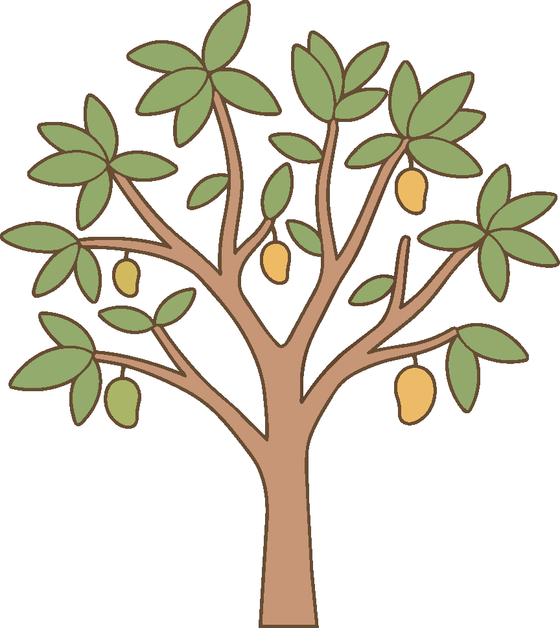
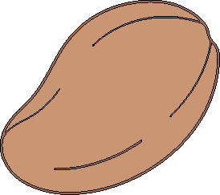

LAYER TWO
A season you can lose safely
Choose the sub-region, the soil, the season and the character of the year. Plant. Then take one decision a week — irrigate, fertilise, treat, inspect, or hold — and watch health, growth, moisture, nutrients, pest pressure and salinity move.
Seed → harvest → failure. Every state is drawn.
◷
One decision per week
◈
Six live vitals
The real constraint on a smallholding, made explicit in the interface.
Health, growth, moisture, nutrients, pest pressure and soil salinity, all coupled.
⊘
A Policy node that refuses
◎
900 climate combinations
A fourth fertiliser dose, irrigation into saturated soil — blocked, in red, with the reason.
Five sub-regions × eleven soils × four seasons × four weather patterns.
TerraTwin · Wanas Zakri
06
Notes:
The sandbox is playable. That matters — a farmer who has lost a simulated season to over-irrigation understands salinity in a way no leaflet achieves.

Slide 7
ARCHITECTURE
ITU-T Y.3172, implemented rather than cited
Every sandbox decision traverses the clause 8.1 pipeline, orchestrated by the MLFO inside the ML Sandbox. The nodes light in sequence on screen as the decision is processed — the standard becomes behaviour rather than a table in a document.
SRC
C
PP
M
P
D
SINK
Data source
Collector
Pre-processor
Model
Policy
Distributor
Sink
The Policy node turns red and states its reason when it blocks a request.
M — Model
P — Policy
MLFO + Sandbox
Rule-based growth, stress and pest engine. Designed to be swapped for a trained predictor with no other node changing.
Rule checks that can refuse a decision before it reaches the plant, with the reason surfaced to the farmer.
The orchestrator sequences the nodes; the simulator itself is the ML Sandbox the Recommendation defines.
Prototype disclosure: the Model node is rule-based, not trained. All farm figures are illustrative. No accuracy or production-readiness claims are made.
TerraTwin · Wanas Zakri
07
Notes:
Seven nodes, plus the MLFO and the Sandbox. The Policy node is the one the judges should watch — it is where refusal becomes visible.

Slide 8
LAYER THREE · OPERATIONS
A diagnosis in seconds, online or off
◉
With a Gemini key
◐
With no key at all
The photo goes to Gemini vision with the Jazan context in the prompt
Returns species, life stage, a health score out of 100, and a status band
Plus a diagnosis, likely causes, and concrete steps to take this week
Scans attach to a registered plant and build a diagnostic history
An on-device analysis samples the image pixel by pixel
Measures healthy chlorophyll green against chlorotic and necrotic tissue
Returns a health score and applicable guidance, labelled as the fallback it is
No network, no account, no cost — which is what a smallholder can actually use
Every network-dependent feature degrades rather than fails, and says which mode it is in. That is a design position, not a limitation: a tool that goes dark when the signal does is not a tool for a field.
TerraTwin · Wanas Zakri
08
Notes:
The fallback is the point. The vision model is better; the offline path is what makes it usable on a farm with no signal.

Slide 9
LAYER THREE · OPERATIONS
Weather that carries the decision
☀
Heat stress above 42 °C
↕
Sharp temperature swing
Transpiration outruns root supply and flowering crops abort fruit set.
Six degrees or more in a day cracks fruit skin and shocks transplants.
→ Irrigate before sunrise, shade seedlings, hold mulch on the root zone.
→ Bring irrigation forward; delay transplanting until it settles.
☂
Rain inside the window
≋
Humidity above 70%
Ten millimetres is roughly ten litres per square metre — free irrigation.
Anthracnose on mango, sigatoka on banana, powdery mildew everywhere.
→ One button pushes the schedule past the rain and counts the litres saved.
→ Open the canopy, water at the root, inspect leaf undersides twice.
Water saved by skipping an unnecessary irrigation is counted at the point where the decision is made — per plant, per plot, in litres.
TerraTwin · Wanas Zakri
09
Notes:
Six alert types, each with its action. The rain-skip button is the one to demo: it moves the schedule and shows the litres saved.

Slide 10
LAYER THREE · THE REGION
The knowledge is already here
❝
Farmers' forum
⬡
Local market
Text, photograph, or a recorded voice note
Voice is not decoration — a tool that requires typing quietly excludes the growers who know the most
Tagged, searchable, with replies
A camera diagnosis can be pushed straight into a draft post with the photo attached
Seed, seedlings, plants, inputs and farm services, priced in riyals
Filtered by category and searchable
Any account can publish a listing
Requests carry the seller's own number — nothing is charged, no intermediary is inserted
Khawlani coffee — a cultivation practice inscribed by UNESCO in 2022, and the crop the highland side of this tool exists to support.
Every listing, post and voice note is knowledge the region already holds. The application's job is to keep it, not to replace it.
TerraTwin · Wanas Zakri
10
Notes:
Forum and market. The voice note is the feature I would defend hardest — it is what makes the tool reachable for the growers with the most experience.

Slide 11
VALUE ADDED
What changes if this is on the farm
For the farmer
For the sector
For the Kingdom
A wrong decision costs a simulated season, not a real one
Irrigation stops depending on memory — where most avoidable loss begins
A plant problem gets a first answer in seconds, at any hour
Weather becomes an instruction rather than a number
Readiness measured per holding, not estimated per region
Water saved counted where the decision is taken
The record a farm builds by using the tool is the dataset a trained model will need
Highland coffee gets support that knows it is not a coastal crop
Vision 2030 food-security and water-efficiency goals
SDAIA's staged, sector-by-sector approach to AI adoption
PDPL consent and data-handling practice built into the rubric
Reef programme value chains — coffee, honey, fruit, rainfed crops
TerraTwin · Wanas Zakri
11
Notes:
Three audiences. The middle column is the one that matters to a hackathon judge: the tool generates its own successor's training data.

Slide 12
POLICY GAPS IDENTIFIED
Four gaps a feature cannot close
01
Data ownership is unsettled
02
No accreditation route for AI advice
When a smallholder's irrigation record trains a supplier's model, no instrument states who owns the record or what the farmer is owed. The PDPL governs personal data; agricultural operational data sits outside its clearest provisions.
A pesticide is regulated; an application that tells a farmer to apply it is not. Even a disclosure standard — training data, tested crops, known failure modes — would separate a tested tool from a demonstration.
03
Readiness is measured too coarsely
04
Sandbox testing has no status
National and regional statistics cannot distinguish a farm blocked by connectivity from one blocked by data literacy. They look identical in aggregate and need entirely different support.
Y.3172 defines the ML Sandbox, but no national process treats a documented sandbox trial as evidence when approving an AI-informed practice for subsidy or extension support.
Each of these was surfaced by building the application, not by reading about it. That is the argument for prototyping as a policy instrument.
TerraTwin · Wanas Zakri
12
Notes:
Four gaps. Ownership, accreditation, granularity of measurement, and the standing of sandbox evidence. All four came out of building the thing.

Slide 13
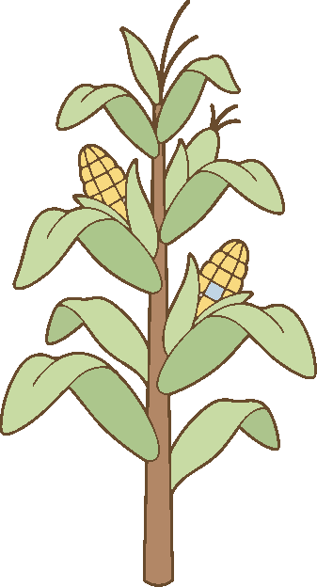
WHERE IT GOES NEXT
Built to be
replaced from
the inside.
The Model node is rule-based today. Every other node — collection, pre-processing, policy, distribution — is built so that swapping in a predictor trained on real Jazan farm records changes nothing around it. The plant register is already accumulating those records.
Train the Model node on collected farm records
Extend the climate envelope to all fifteen registered crops
Move the forum and market to a server with real identity
Validate the vision diagnosis against expert labelling on Jazan crops
Ship an Arabic right-to-left interface for field use
Wanas Zakri
TerraTwin · ITU AI Readiness Hackathon, Kingdom of Saudi Arabia
Notes:
Close on the architecture argument: the rule-based model is a placeholder by design, and the application is already gathering the data that replaces it. Thank you.

