Slide 1
Help
Chess R Us

Slide 2
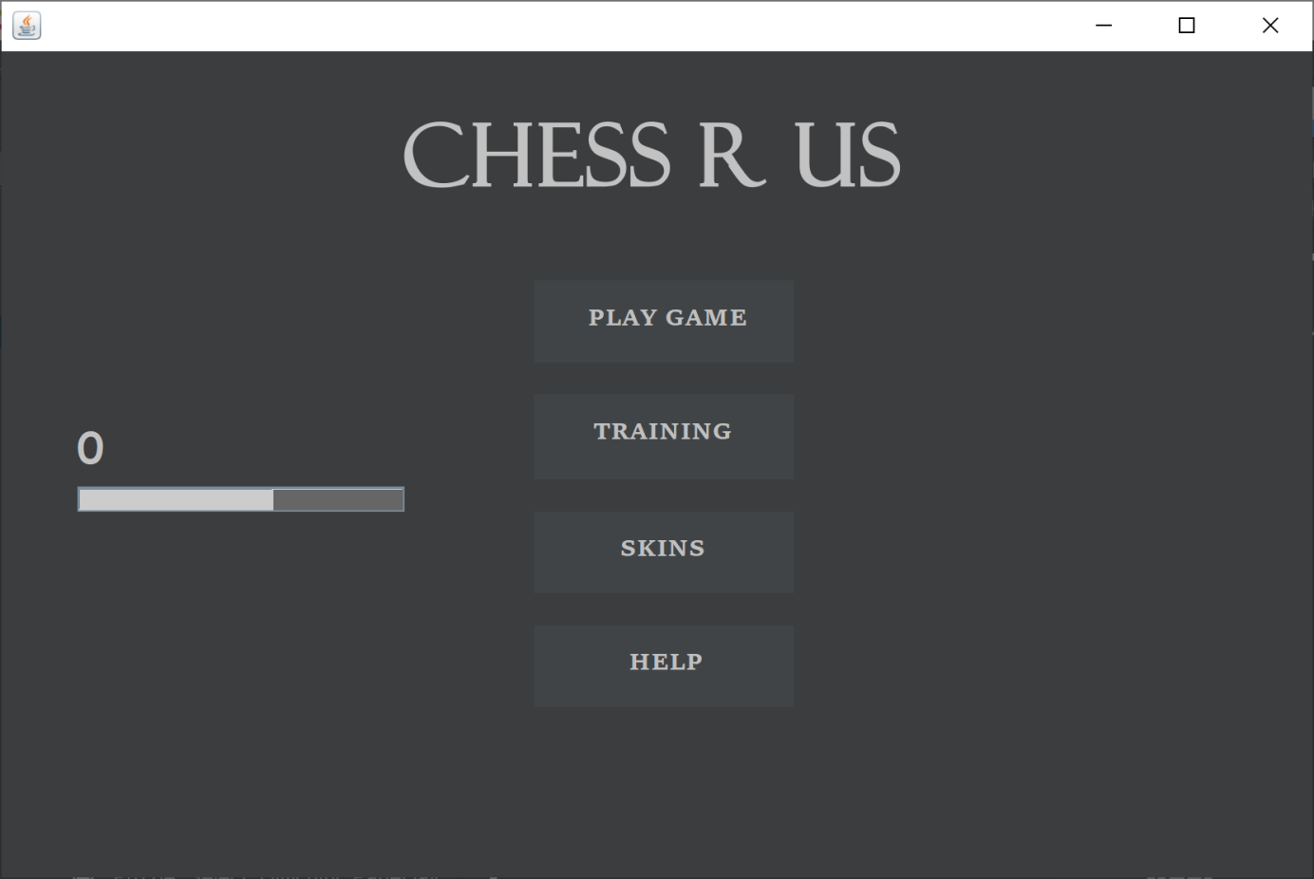
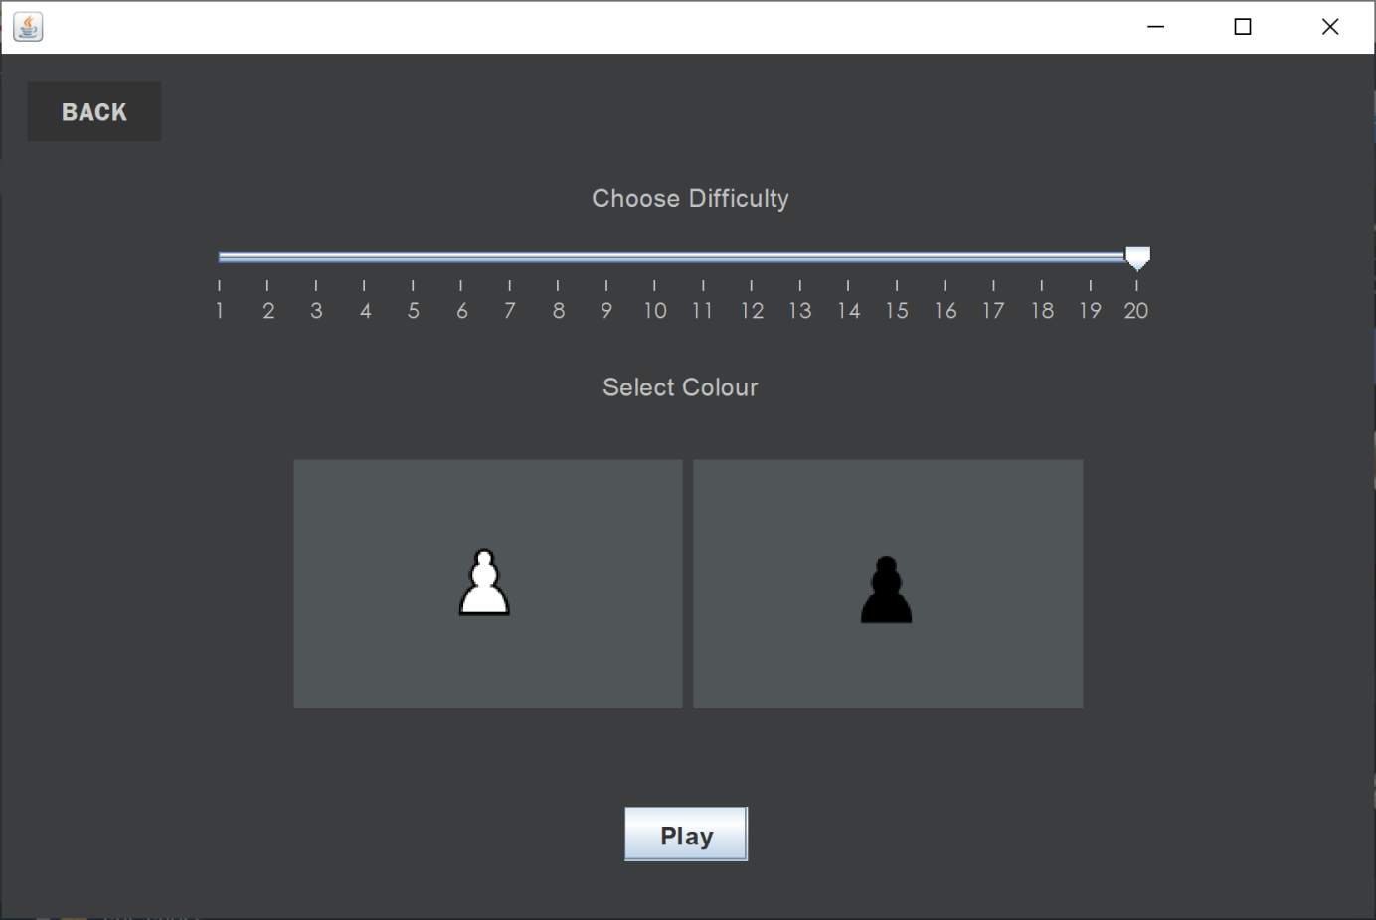
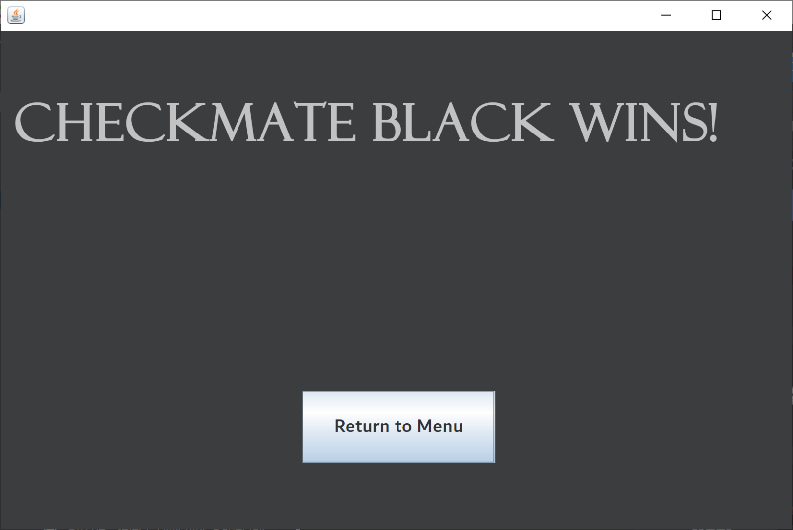
Menu and game help
The menu has the options of Play game, Chess trainer ,help and skins (temporarily diabled due to staffing issues)
Upon selecting play game you will prompted to choose between single player and multiplayer. If you select single player you will then be promoted to choose the difficulty and the colour you will play as.
You will either play until the game ends in a result(checkmate, stalemate etc) or the user can select the back button to return to the main menu
You will be awarded for playing a completed game in which you will receive both experience for a loss and a win but a larger amount based on if you won and the level of the AI.

Slide 3
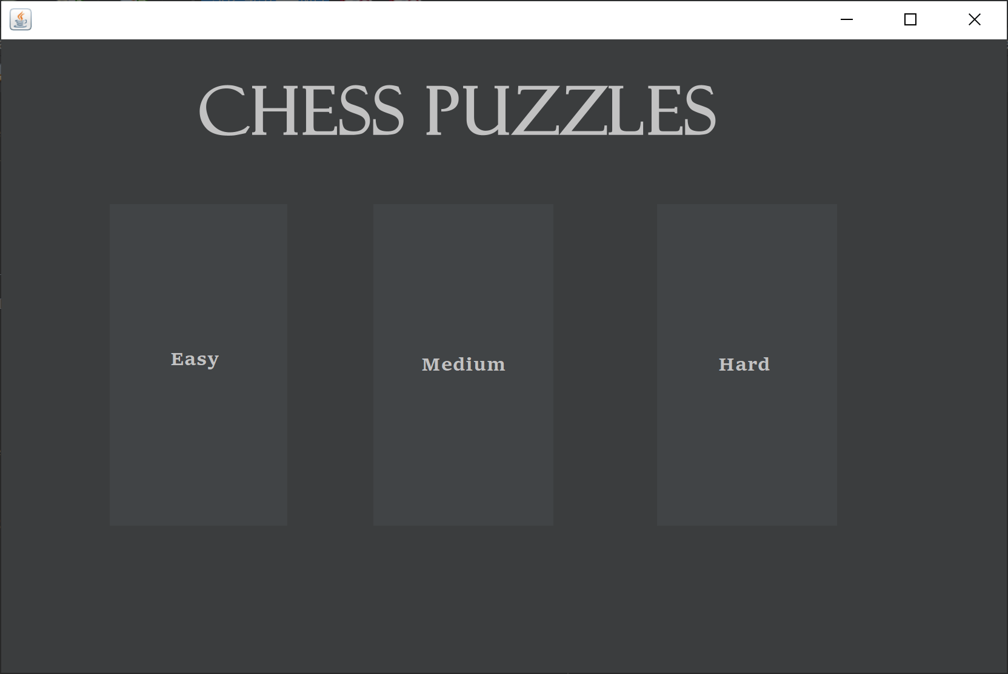
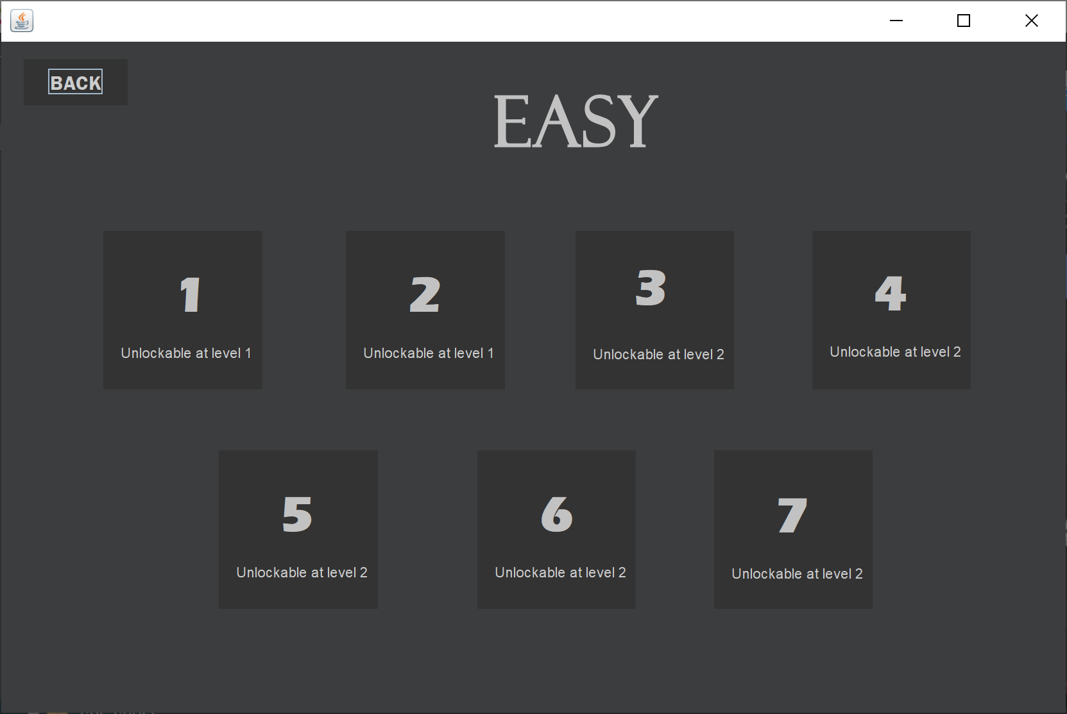
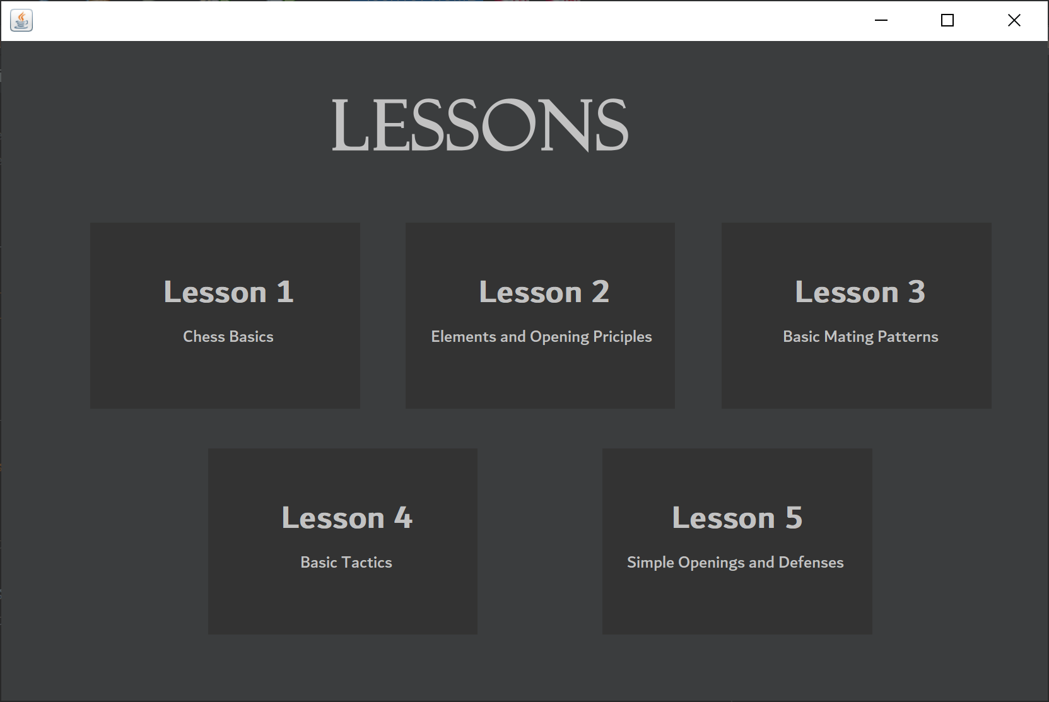
Lesson and puzzle Help and experience/xp
Puzzle instructions: Go to puzzles → Choose difficulty → Select puzzle → Solve puzzle
Lesson instructions: Go to Lessons → Choose Lessons → Complete Lessons
XP Instructions:
Xp is gained by playing a game of chess that results in either a checkmate or stalemate
100 xp to level up and you will receive a set amount for multiplayer and an amount based on your performance and the level of the ai in single player
After the beta you will be able to access skins based on your level.

