Slide 1


Oregon State University
School of Electrical Engineering and Computer Science
CS 261 – Recitation 7
Winter 2015
Notes:
Last updated on Oct 5, 2012 by Tuan Pham

Slide 2
Outline
AVL trees
Assignment 5 – Heap Implementation of a ToDo List
  File handling and standard I/O in C
Parts of this lecture were taken from: www.cs.txstate.edu/~rp44/cs3358_089/Lectures/bst.ppt
www.cs.sjsu.edu/~lee/cs146/Asami-avl-presentation.ppt
CS 261 – Data Structures

Slide 3

An AVL Tree is…
A binary search tree with a balance condition.
  The sub-trees of each node differ by at most 1 in their height
Named after its creators (Adelson-Velskii and Landis)

Slide 4
Definition of a balanced tree
Every node must have left & right sub-trees of heights that differ by no more than 1
  Ensures the tree’s height = log N
  Takes O(log N) time for searching, insertion, and deletion

Slide 5
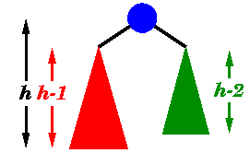
An AVL tree has the following properties
Sub-trees of each node can differ by at most 1 in their height
Every sub-tree is an AVL tree

Slide 6
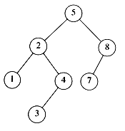
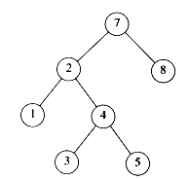
Are these AVL trees?
YES
Each left sub-tree has height 1 greater than each right sub-tree
NO
Left sub-tree of the root has height 2, but right sub-tree has height 0

Slide 7
Insertion and Deletions
Performed as in binary search trees
If the balance is destroyed, rotations are performed to correct balance
  For insertions, one single or double rotation is required.
  For deletions, at most O(log n) rotations are needed
Notes:
http://www.brpreiss.com/books/opus4/html/page327.html
When an AVL tree becomes unbalanced after an insertion, exactly one single or double rotation is required to balance the tree.

Slide 8
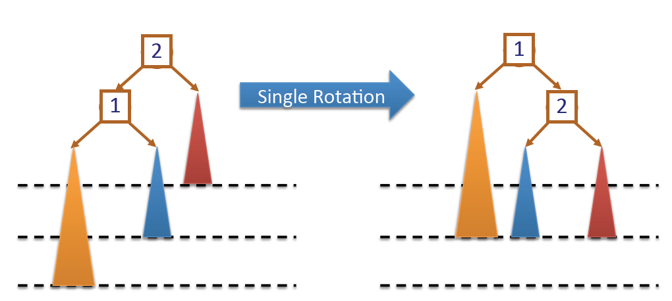
Single Rotation
Node (2) is heavy on the left child, which is also heavy on the left.
Rotate the heavy node (1) to the right.

Slide 9
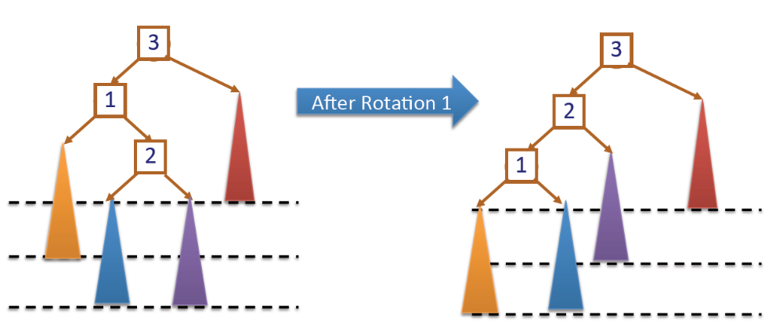
Double Rotation
Node (3) is heavy on the left child, which is heavy on the right.
First, rotate heavy node (1) to the left

Slide 10
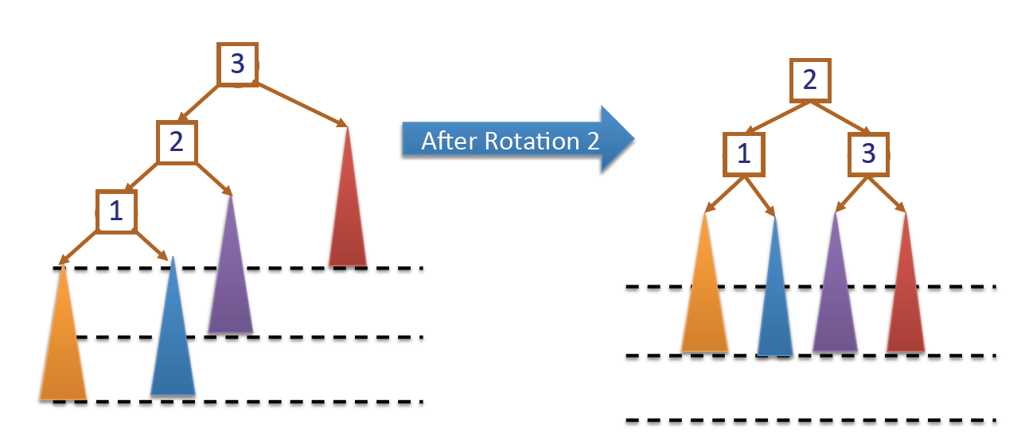
Double Rotation
Next, rotate unbalanced node (3) to the right

Slide 11
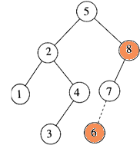
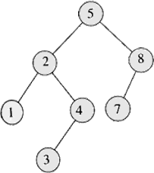
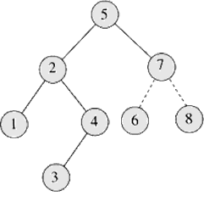
Insertion
Insert 6
Imbalance at 8
Perform rotate right

Slide 12
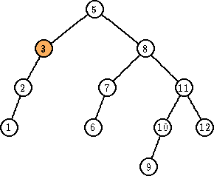
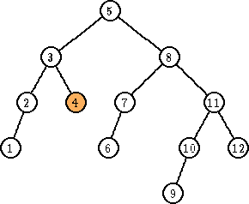
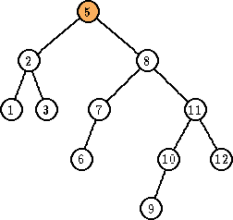
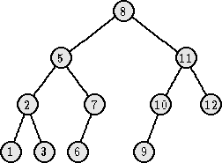
Deletion
Delete 4
Imbalance at 3
Perform rotation at 3
Imbalance at 5
Perform rotation at 5

Slide 13
Key Points
AVL tree remains balanced by applying rotations, therefore it guarantees O(log N) search time in a dynamic environment
Tree can be re-balanced in at most O(log N) time

Slide 14
Exercises: Insert 1-7 to an empty AVL tree
Rebalancing is performed bottom up after a new value has been inserted, and only if the difference in heights of the child trees are more than one.
1(1)
1(2)
2(1)
1(0)
2(1)
1(0)
3(0)
2(0)
3(0)
2(2)
2(3)
2(2)
1(0)
4(1)
1(0)
3(2)
1(0)
3(1)
3(0)
4(1)
4(0)
5(0)
5(0)
CS 261 – Data Structures

Slide 15
AVL Trees (cont.)
2(2)
2(3)
4(2)
1(0)
4(1)
1(0)
4(2)
2(1)
5(1)
3(0)
5(0)
3(0)
5(1)
1(0)
3(0)
6(0)
6(0)
4(2)
4(3)
2(1)
6(1)
2(1)
5(2)
1(0)
3(0)
5(0)
7(0)
1(0)
3(0)
6(1)
7(0)
CS 261 – Data Structures

Slide 16
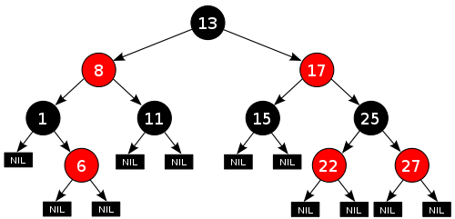
Another self-balancing BST: Red-Black tree
A node is either red or black.
The root is black.
All leaves (NIL) are black. (same color as the root.)
Both children of every red node are black.
Every simple path from a given node to any of its descendant leaves contains the same number of black nodes.
Source: Wikipedia
Notes:
From Wikipedia, “these constraints enforce a critical property of red–black trees: that the path from the root to the furthest leaf is no more than twice as long as the path from the root to the nearest leaf. The result is that the tree is roughly height-balanced”
Online Demo: http://www.ece.uc.edu/~franco/C321/html/RedBlack/redblack.html

Slide 17
Strings in C
In C, a string is an array of characters terminated by a null character (\0).

Slide 18
File Handling in C – File Pointers
C communicates with files using file pointers.
This data type is defined within stdio.h, and written as FILE *
Usage:
FILE *output_file;

Slide 19
Opening a file pointer
Your program can open a file using the fopen function, which returns the required file pointer.
If the file cannot be opened for any reason then NULL will be returned.
Usage:
output_file = fopen("filename.txt", "w");
if (!output_file)
fprintf(stderr, "Cannot open %s\n", "filename.txt");

Slide 20
Opening a file pointer (contd.)
fopen takes two arguments, both are strings:
  1. the name of the file to be opened (“filename.txt”).
  2. an access character, which is usually one of:
    “r” : open file for reading
    “w” : open file for writing (create file if it does not exists)
    “a” : open file for appending

Slide 21
Reading/Writing a file
Once the file is opened, you can use the fscanf/fprintf to read/write to a file.
int matched = fscanf(output_file,"%c %d %s\n", &cmd, &class, name);
fprintf(output_file, "%c \n", cmd);
fscanf() returns the number of items in the argument list it can match. Otherwise, EOF is returned.

Slide 22
Reading/Writing a file
EOF is a character which indicates the end of a file.
while (fscanf(output_file, “…", …) != EOF) { … }
EOF is returned by read commands of scanf functions when they try to read beyond the end of a file.

Slide 23
Closing a file pointer
The fclose command is used to disconnect a file pointer from a file.
Usage:
fclose(output_file);
Systems have a limit on the number of files which can be open simultaneously, so it is a good idea to close a file when you have finished using it.

Slide 24
Standard I/O in C
Standard I/O: input and output channels between a computer program and its environment.
  Standard input (stdin): usually input from the keyboard.
  Standard output (stdout): usually output to the text terminal (the screen).
  Standard error (stderr): to output error messages or diagnostics. Usually output to the screen also.
stdin, stdout, stderr are ‘special’ file pointers; don’t open or close them.

Slide 25
Standard I/O Functions
Output functions: printf()
Input functions: scanf()
int a;
printf("Please enter an integer: ");
scanf("%d", &a);
printf(“You typed: %d\n“, a);
Other input functions: getchar(), fgets(),…

Slide 26
fgets()
An input function (file get string)
char* fgets(char *string, int length, FILE *stream)
fgets() reads a string of specific length from a file (or standard input) pointed to by stream.
fgets() terminates reading:
    after a new-line character (\n) is found, OR
    after it reaches end-of-file (EOF), OR
    after (length - 1) characters have been read

