Slide 1
Kakao map api

Slide 2
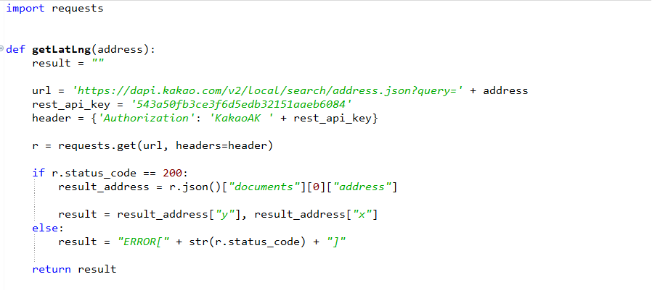
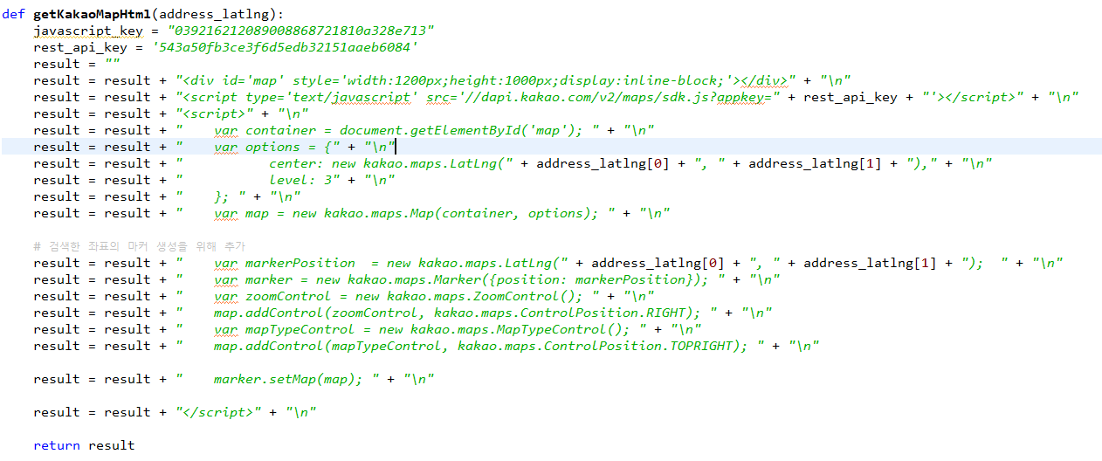
import requests
def getLatLng(address):
result = ""
url = 'https://dapi.kakao.com/v2/local/search/address.json?query=' + address
rest_api_key = '543a50fb3ce3f6d5edb32151aaeb6084'
header = {'Authorization': 'KakaoAK ' + rest_api_key}
r = requests.get(url, headers=header)
if r.status_code == 200:
result_address = r.json()["documents"][0]["address"]
result = result_address["y"], result_address["x"]
else:
result = "ERROR[" + str(r.status_code) + "]"
return result
def getKakaoMapHtml(address_latlng):
javascript_key = "039216212089008868721810a328e713"
rest_api_key = '543a50fb3ce3f6d5edb32151aaeb6084'
result = ""
result = result + "<div id='map' style='width:1200px;height:1000px;display:inline-block;'></div>" + "\n"
result = result + "<script type='text/javascript' src='//dapi.kakao.com/v2/maps/sdk.js?appkey=" + rest_api_key + "'></script>" + "\n"
result = result + "<script>" + "\n"
result = result + " var container = document.getElementById('map'); " + "\n"
result = result + " var options = {" + "\n"
result = result + " center: new kakao.maps.LatLng(" + address_latlng[0] + ", " + address_latlng[1] + ")," + "\n"
result = result + " level: 3" + "\n"
result = result + " }; " + "\n"
result = result + " var map = new kakao.maps.Map(container, options); " + "\n"
# 검색한 좌표의 마커 생성을 위해 추가
result = result + " var markerPosition = new kakao.maps.LatLng(" + address_latlng[0] + ", " + address_latlng[1] + "); " + "\n"
result = result + " var marker = new kakao.maps.Marker({position: markerPosition}); " + "\n"
result = result + " var zoomControl = new kakao.maps.ZoomControl(); " + "\n"
result = result + " map.addControl(zoomControl, kakao.maps.ControlPosition.RIGHT); " + "\n"
result = result + " var mapTypeControl = new kakao.maps.MapTypeControl(); " + "\n"
result = result + " map.addControl(mapTypeControl, kakao.maps.ControlPosition.TOPRIGHT); " + "\n"
result = result + " marker.setMap(map); " + "\n"
result = result + "</script>" + "\n"
return result
# main()
if __name__ == "__main__":
address = "대전광역시 중구 대흥동 500-5"
# 카카오 REST API로 좌표 구하기
address_latlng = getLatLng(address)
# 좌표로 지도 첨부 HTML 생성
if str(address_latlng).find("ERROR") < 0:
map_html = getKakaoMapHtml(address_latlng)
print(map_html)
else:
print("[ERROR]getLatLng")

Slide 3
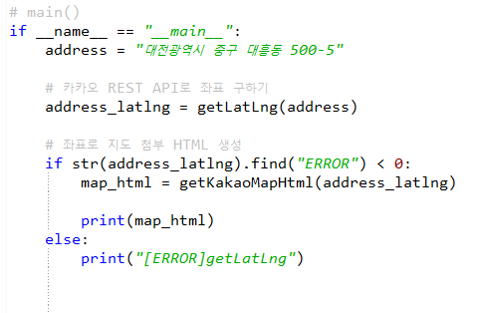
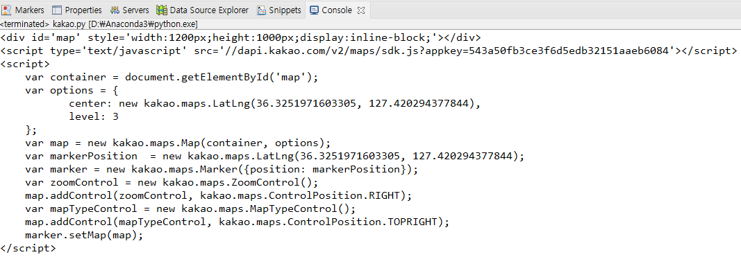
print된 콘솔창을 복사해서 html에 옮겨서 실행

Slide 4
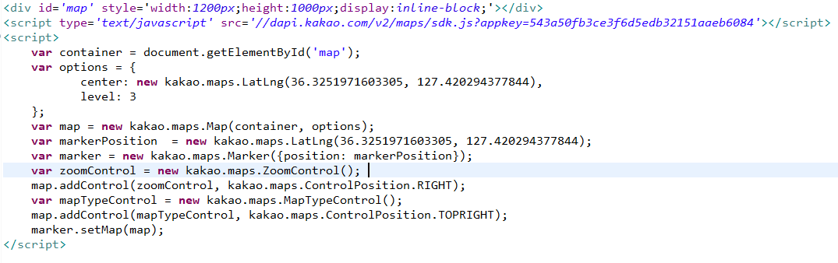
html

Slide 5
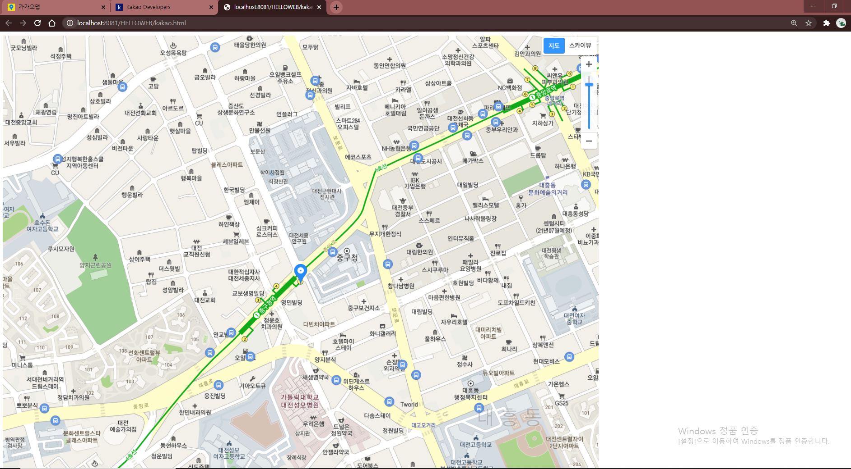
실행

