Slide 1
Finance Daily
- Minimal financial news website -
Junyoung Chu

Slide 2
What I Built
Home / Category / Article
Responsive Layout
Static HTML
Dynamic Lendering (articles.json)
Search / Filter
TradingView Chart
Chart.js
->

Slide 3
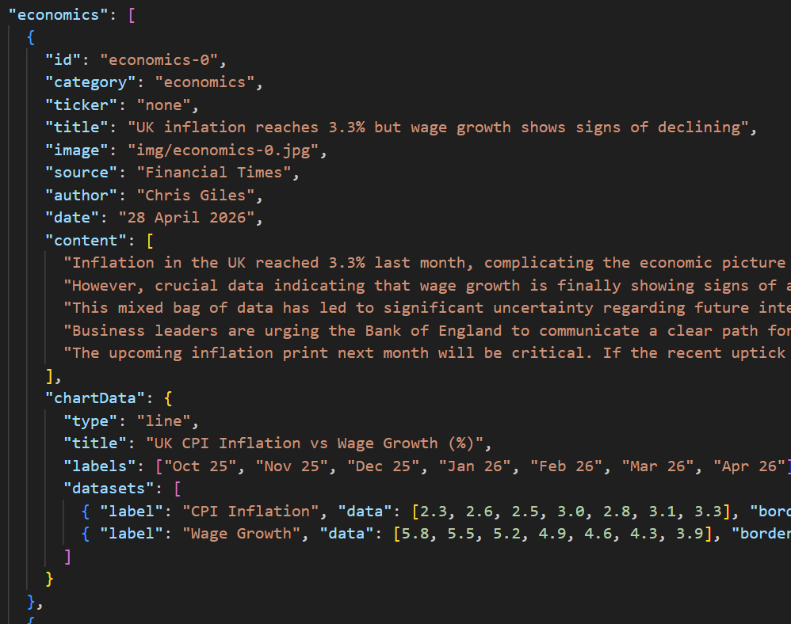
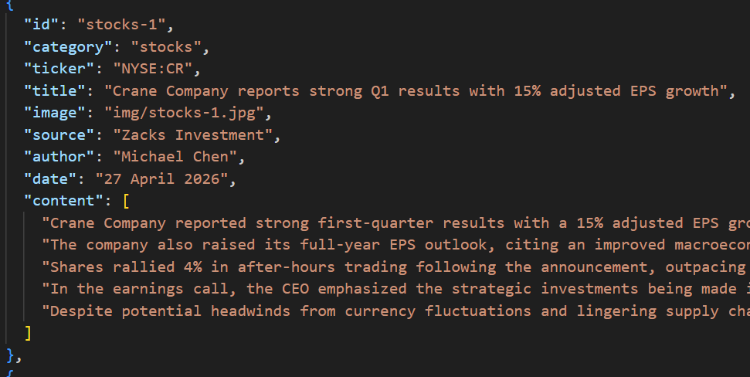
Code Snippet 0 : article.json

Slide 4
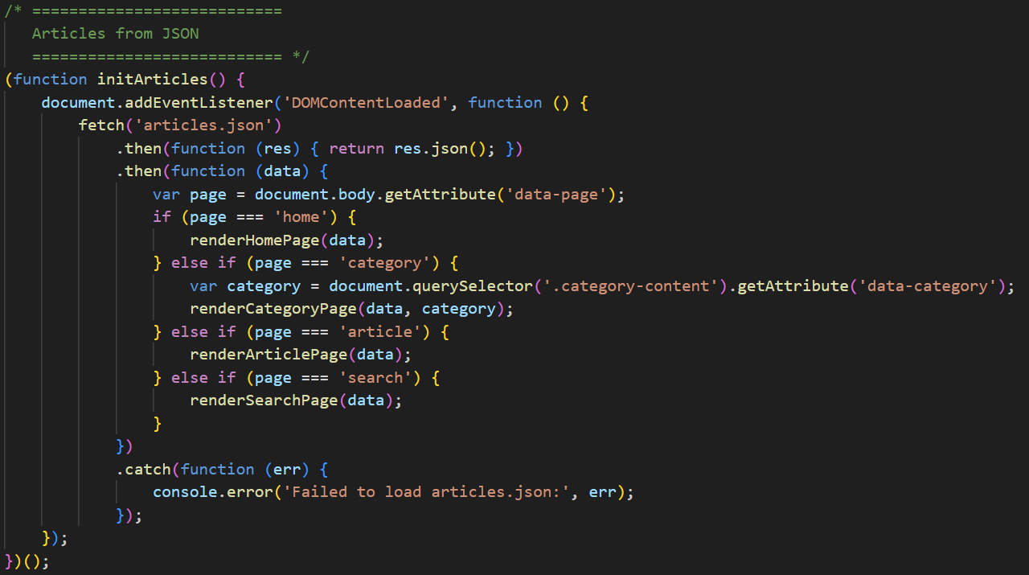
Code Snippet 1 : Dynamic Rendering

Slide 5
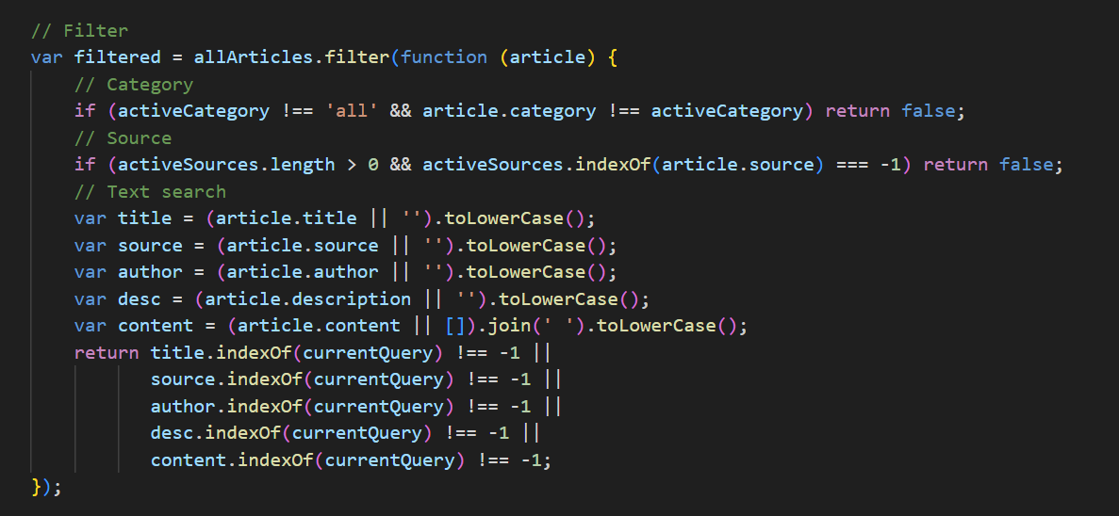
Code Snippet 2 : Search Filter Logic

Slide 6
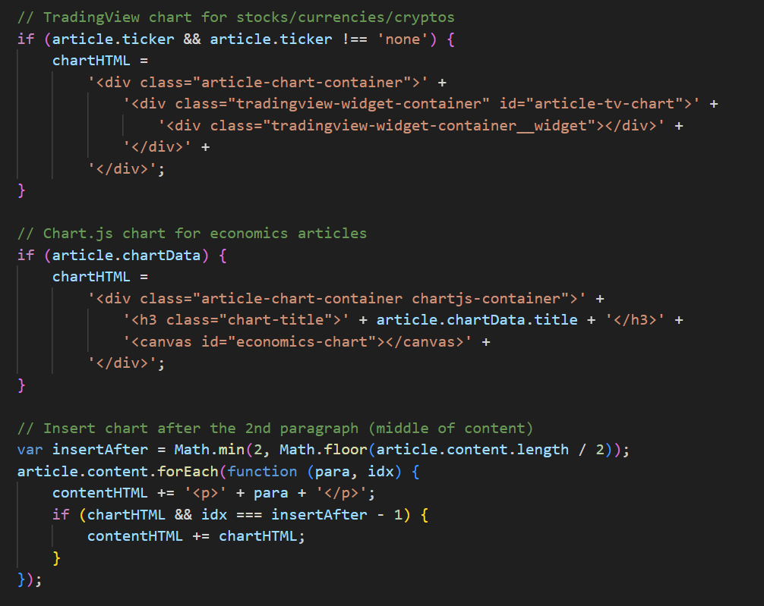
Code Snippet 3 : Dynamic Chart Insertion

Slide 7
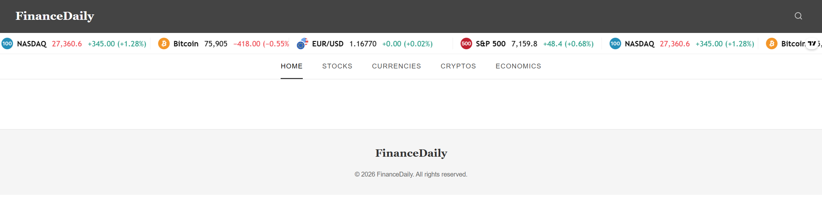
Issues Encountered
Local fetch blocked by CORS policy
Installed the Live Server extension in VS Code
Hosted the project on a local HTTP server (http://127.0.0.1:5500)

Slide 8
Next Steps
Backend Development - Replace json with a database
Real-Time News API - Auto-fetch the latest financial headlines instead of manual updates
User Features - Login / Bookmark / History

Slide 9
Thank You

