Slide 1
Finance Daily
- Minimal financial news website -
Junyoung Chu

Slide 2
Concept / Theme
A minimal news website where users can quickly find
key indicators and articles.

Slide 3
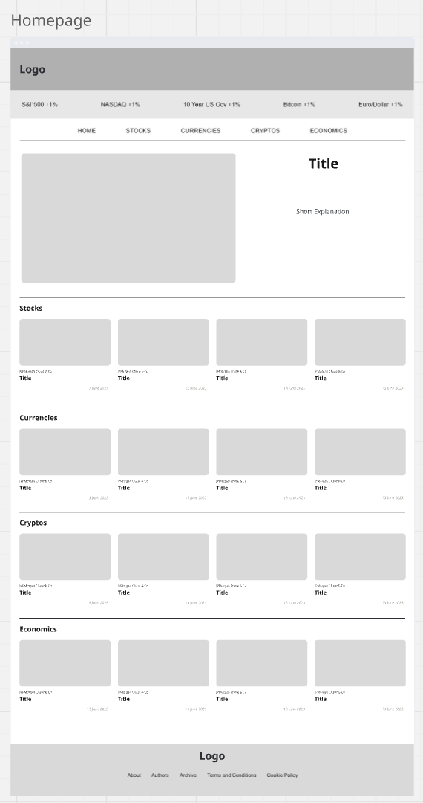
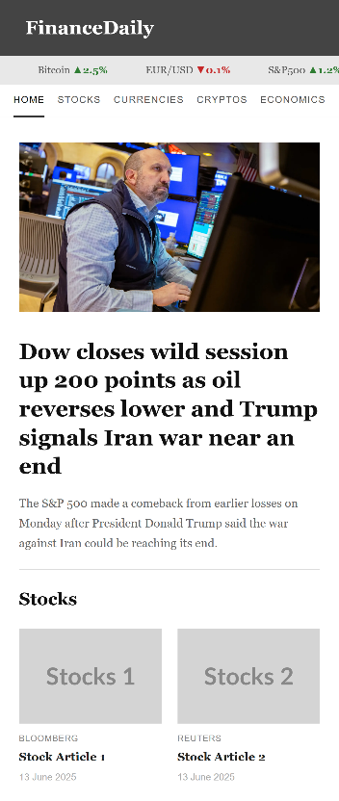
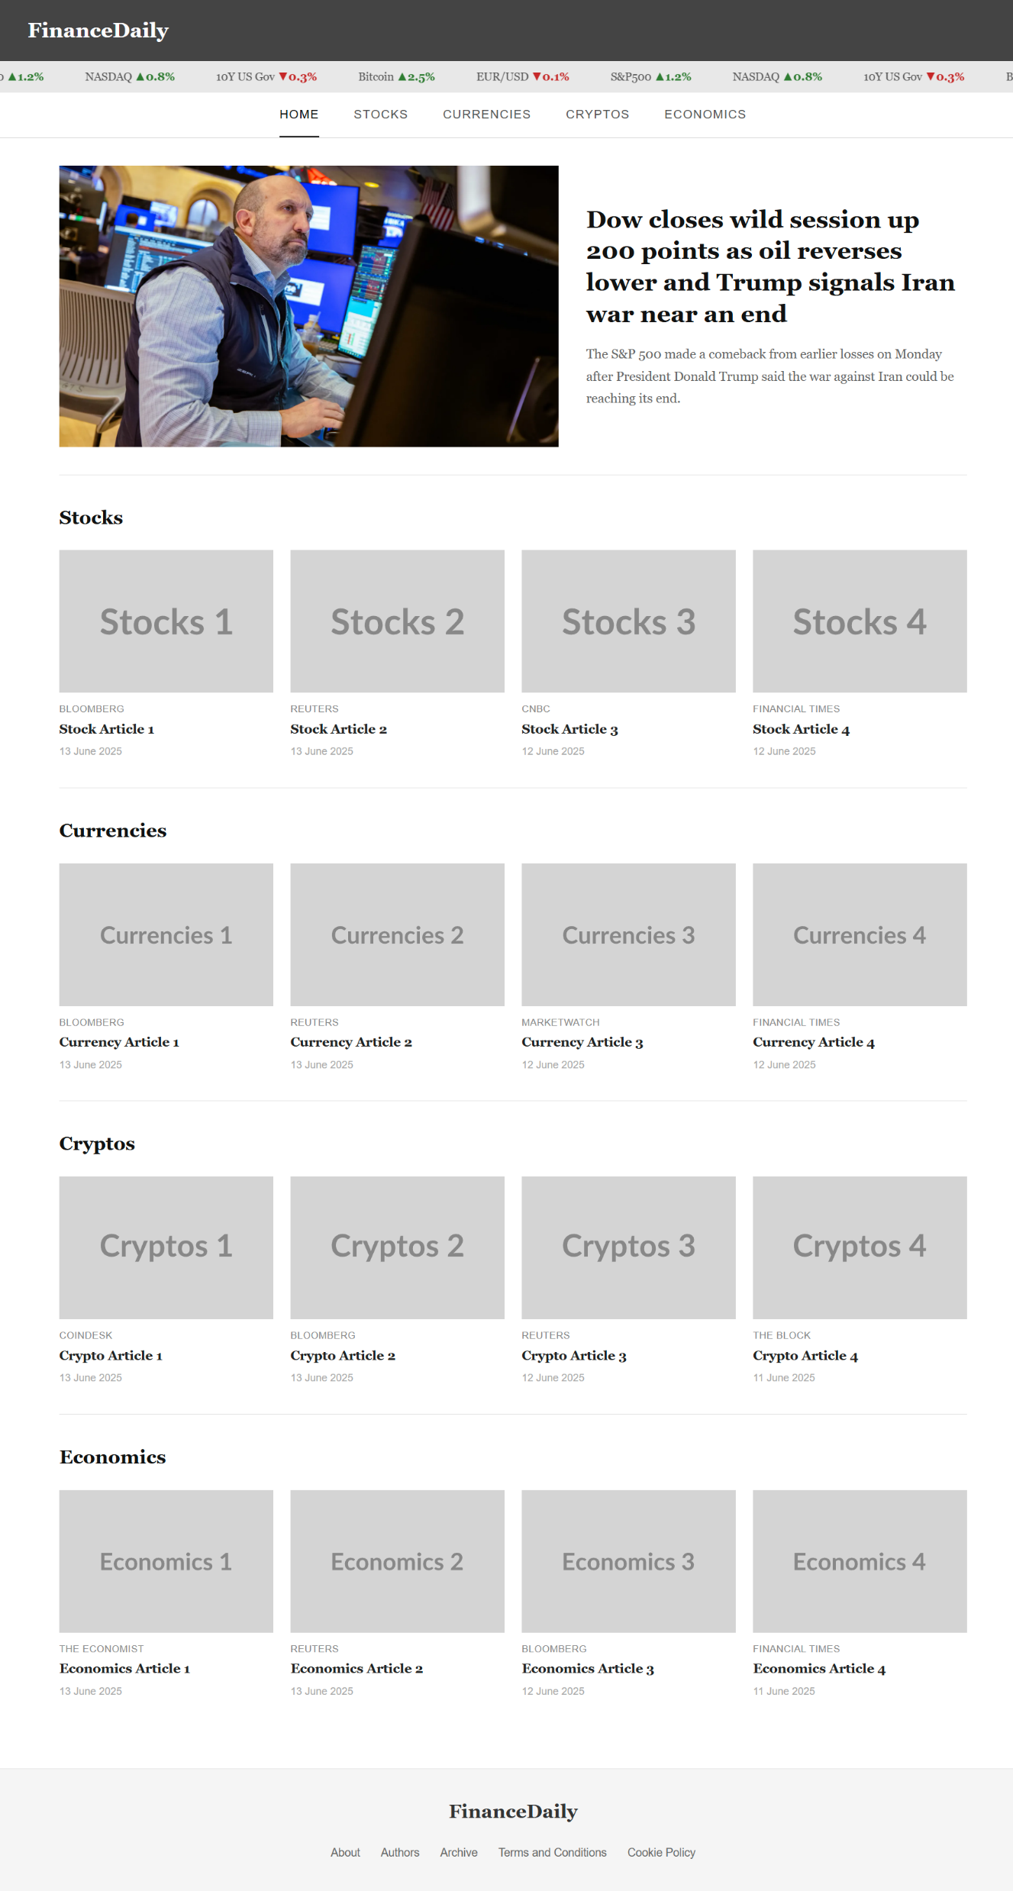
Site Demo (Home)

Slide 4
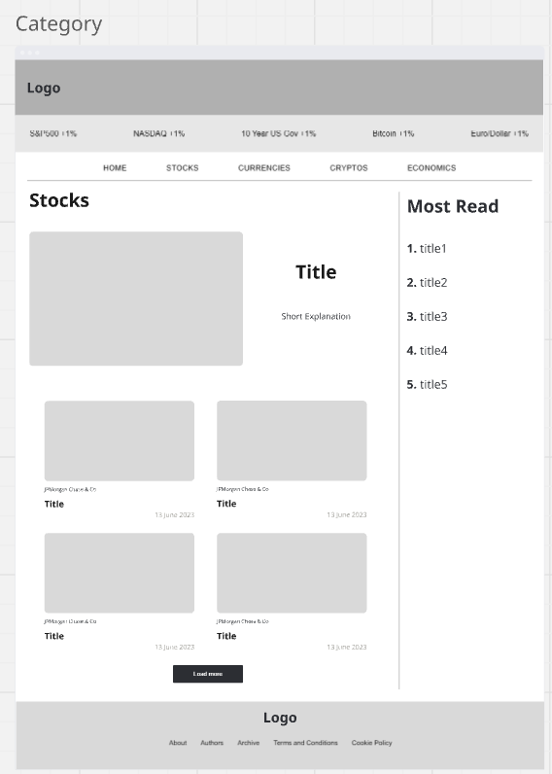
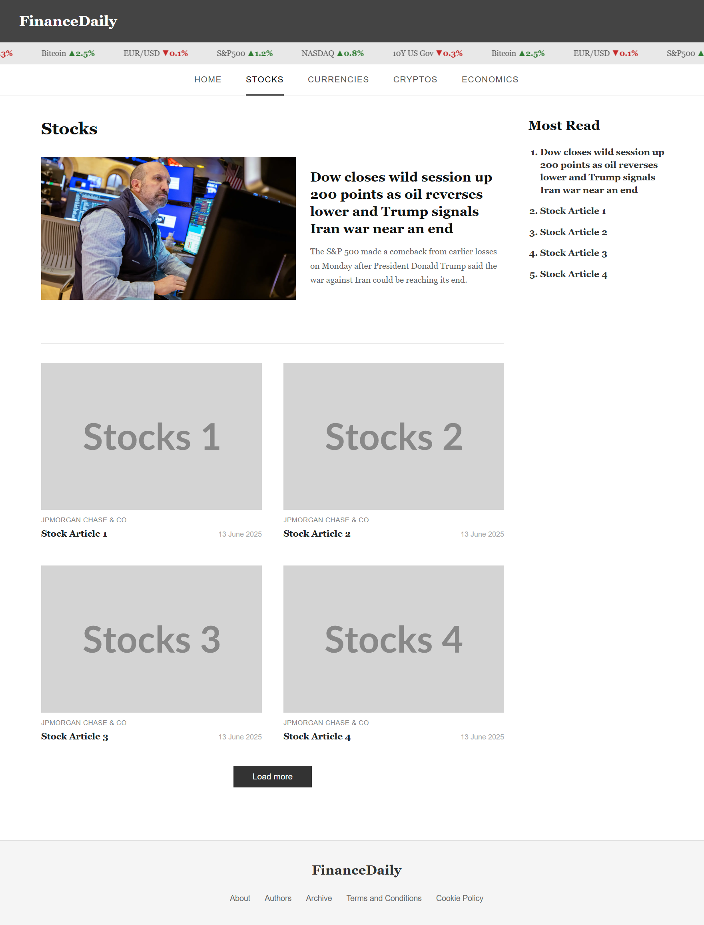
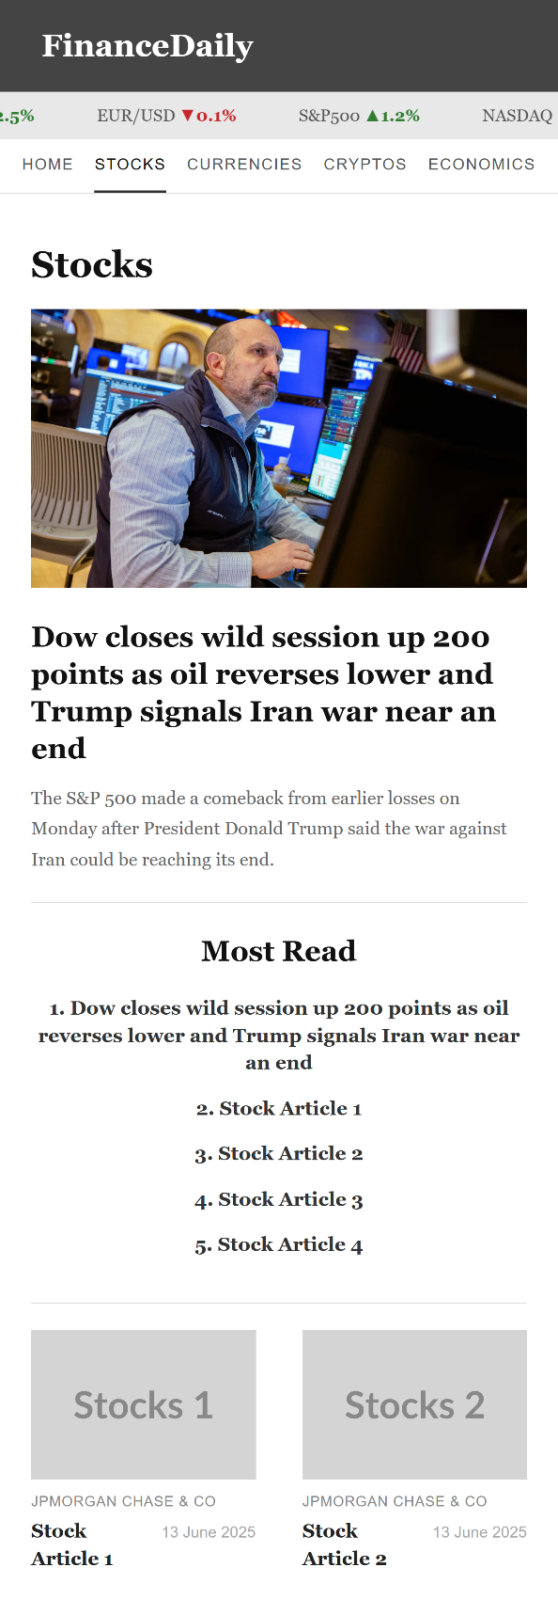
Site Demo (Categories)

Slide 5
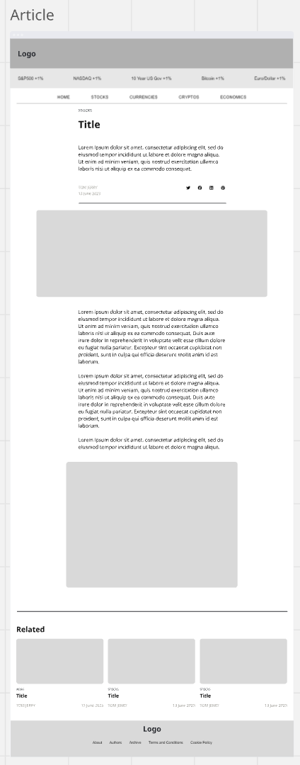
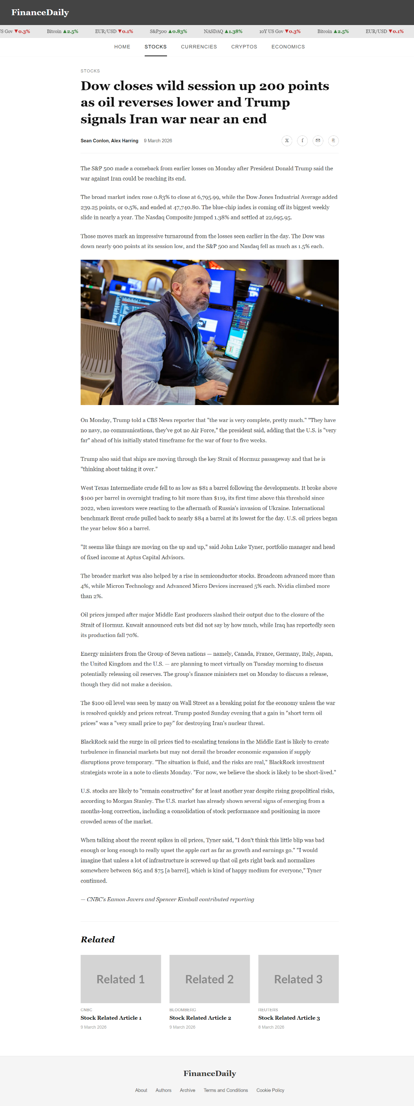
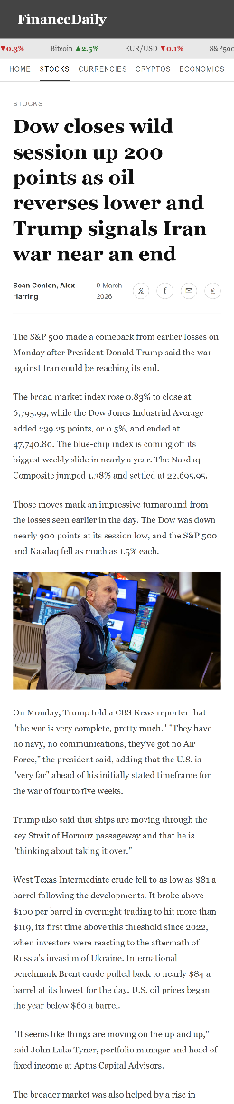
Site Demo (Article)

Slide 6
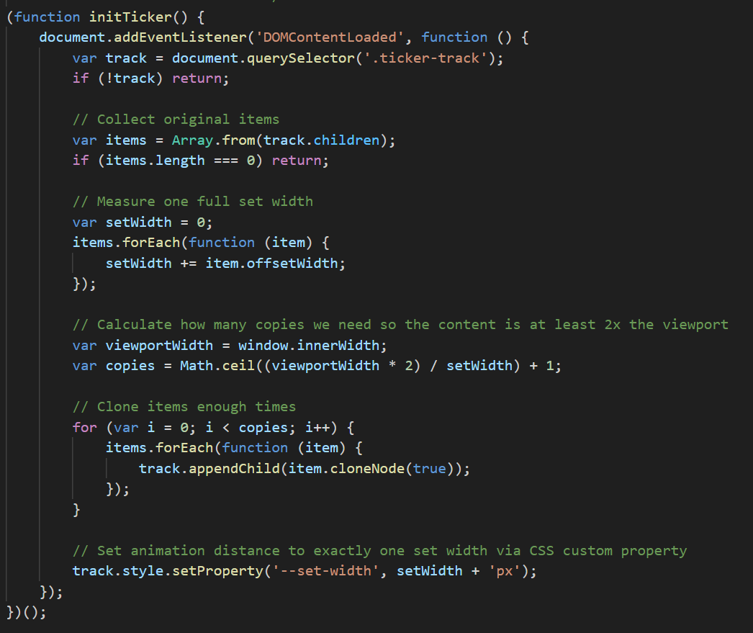
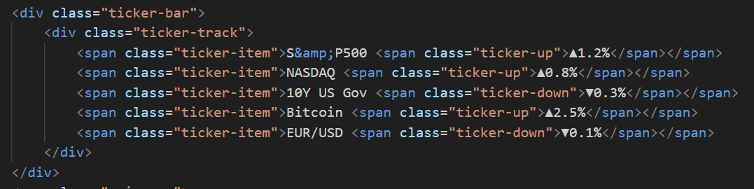
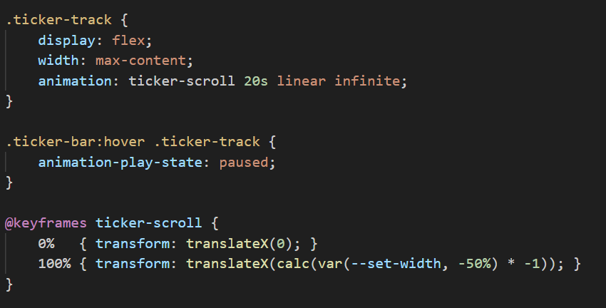
Code Snippet (Ticker Bar Animation)

Slide 7
Next Steps
Fetching tickers data in real-time via API.
Fetching article content and images from the database.
Implementing a Most Read feature based on the number of times I've read an article.

Slide 8
Thank You

