Slide 1
Finance Daily
- Minimal financial news website -
Junyoung Chu

Slide 2
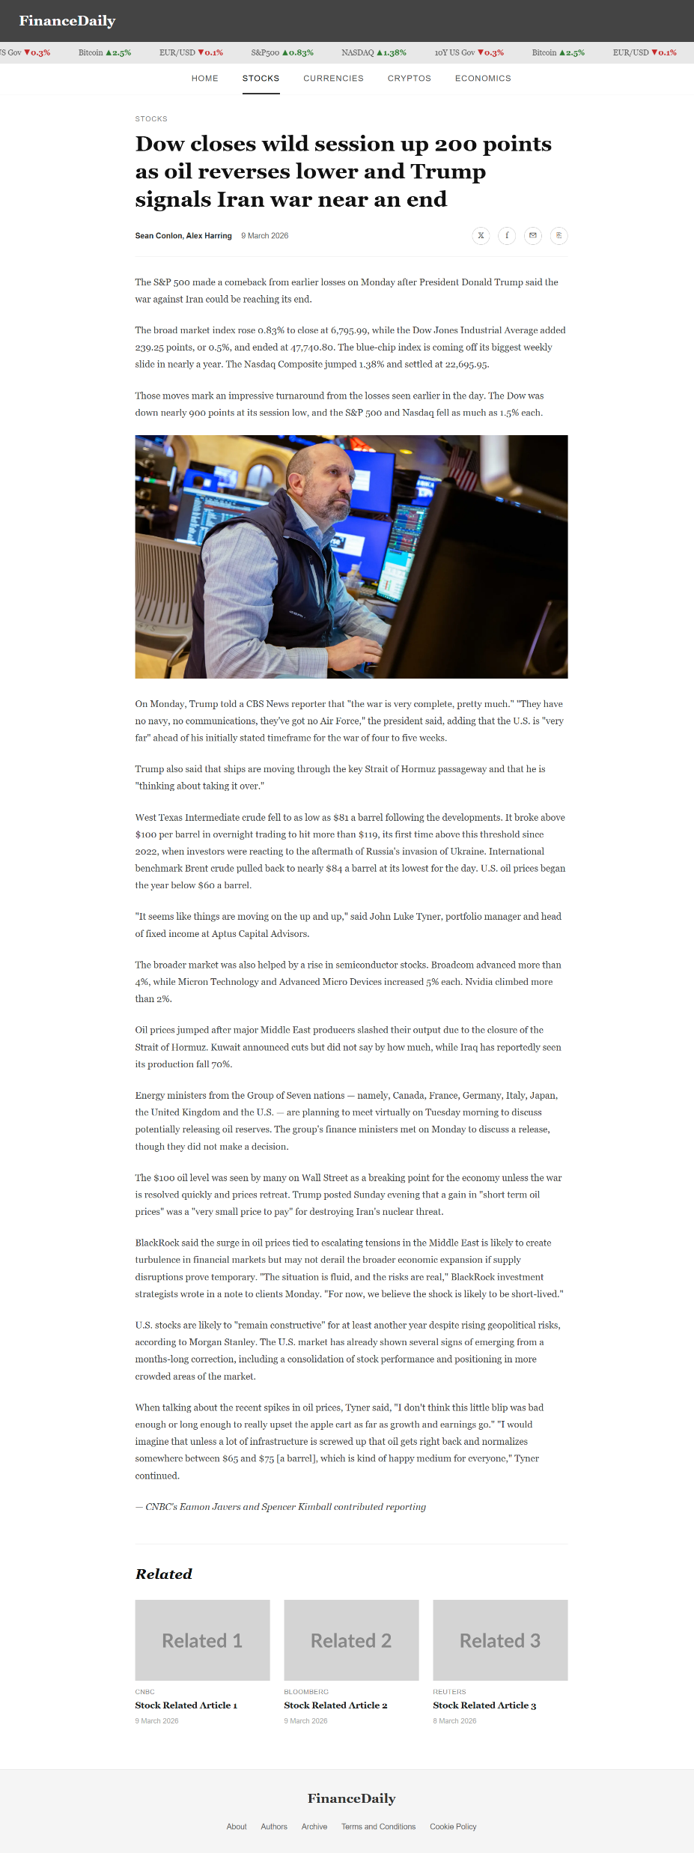
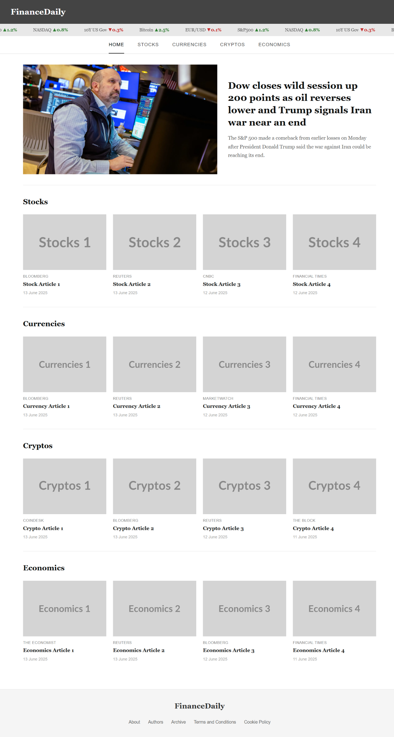
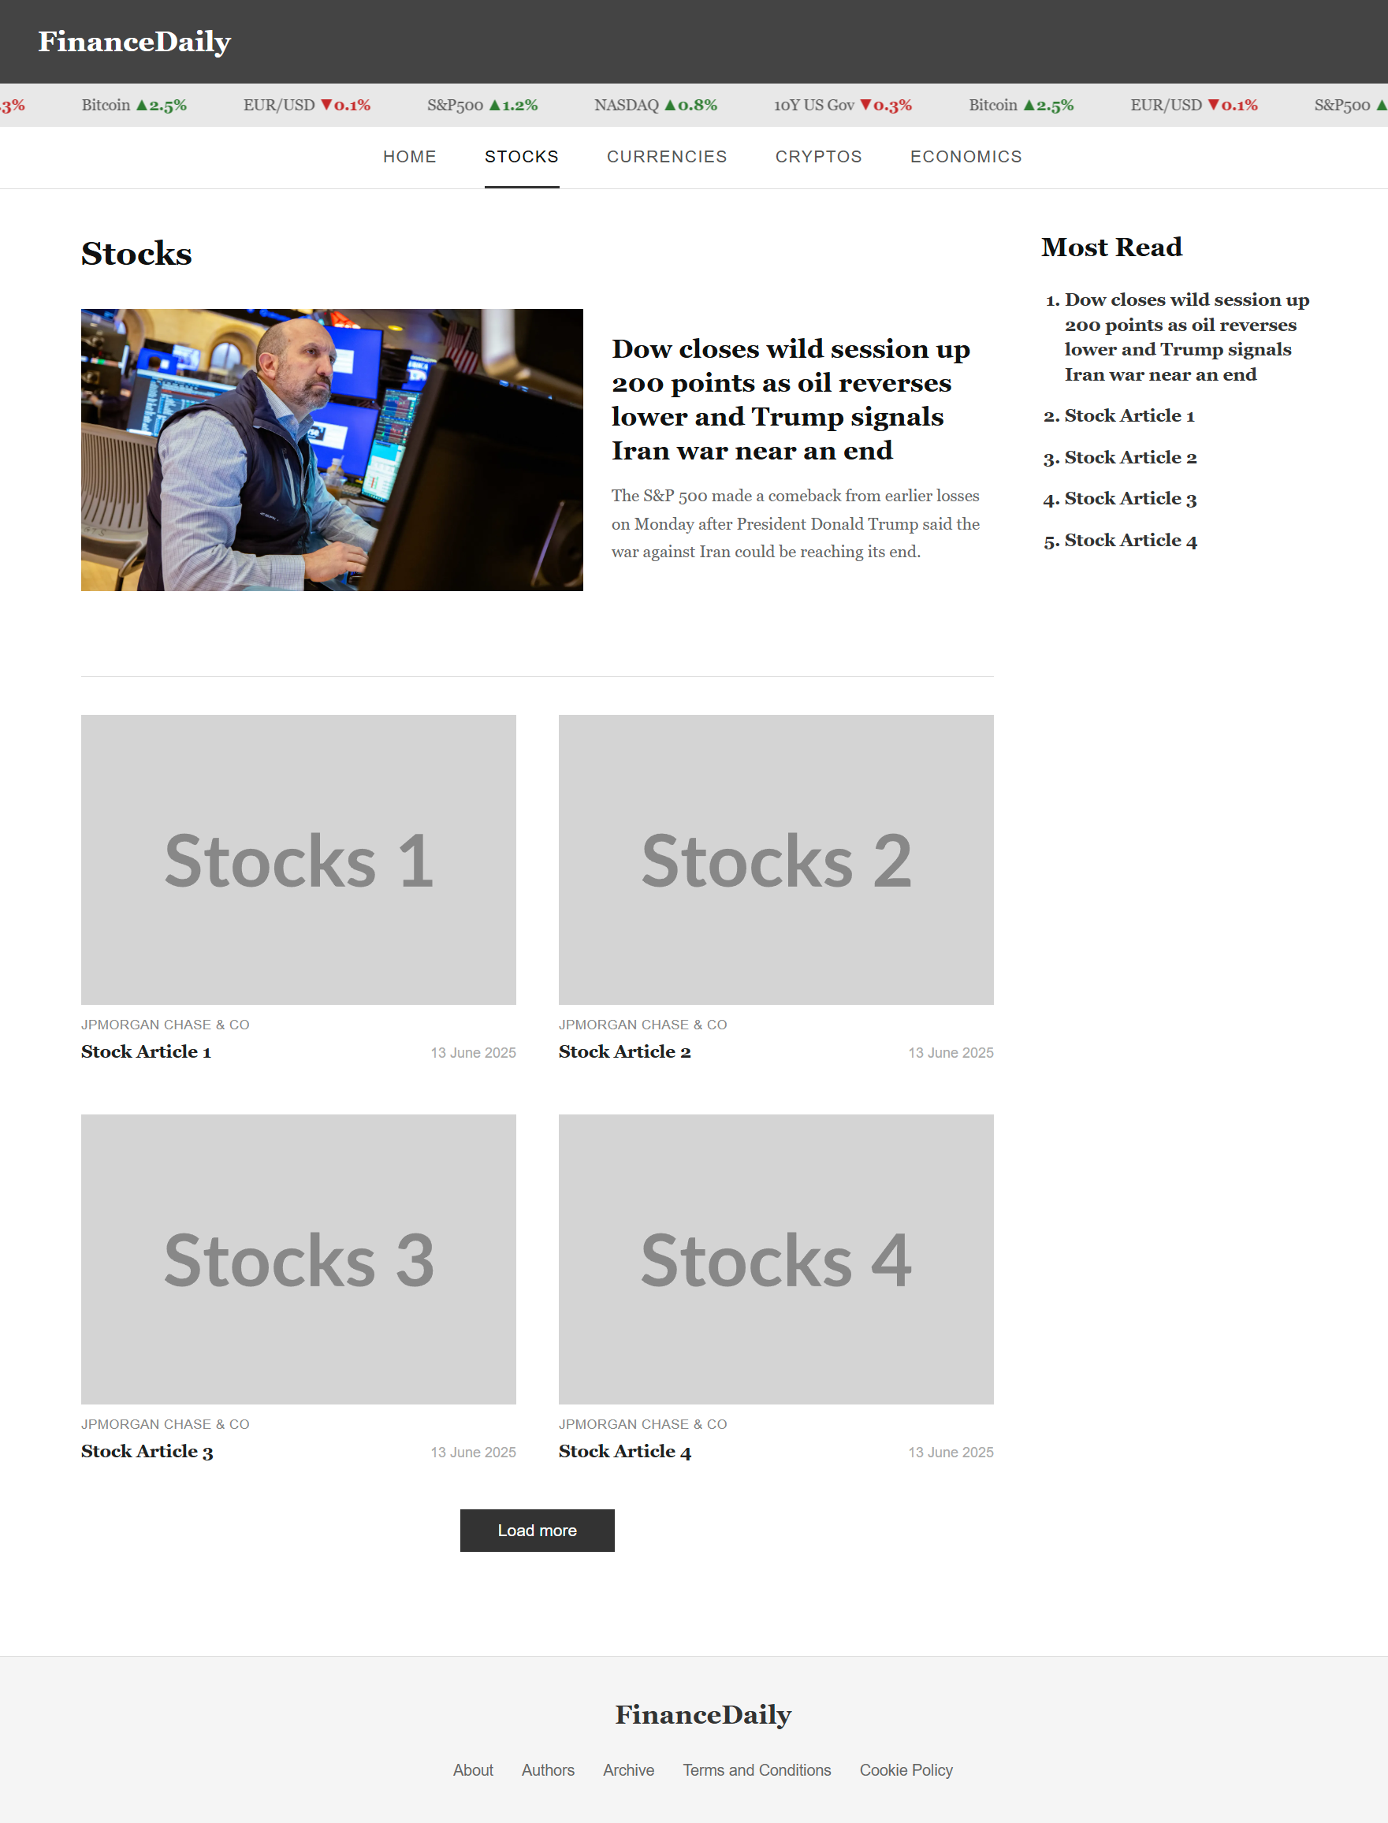
What I Built

Slide 3
Changes
Current : all articles are hardcoded directly in HTML
New: articles separated into a single articles.json file (32 articles across 4 categories)
JavaScript fetches the JSON and dynamically renders article cards

Slide 4
To-Do List
Fetch articles.json and render cards dynamically
Article search and category filtering
Chart.js - economic indicator charts on the Economics page (e.g. GDP, inflation)
TradingView – Ticker Tape, Stock Chart on article pages

Slide 5
Thank You

