Slide 1
Capstone Project
Setting Shop in the Neighborhoods of Toronto

Slide 2
Introduction
City of Toronto – Canada
Brief on Toronto
  Provincial capital of Ontario and the most populous metropolitan area in Canada with a population close to 3 million (as of July 2018).
  Most multicultural diverse city on the planet with over 180 languages and dialects being spoken.
  It's estimated that over half of Toronto's residents were born outside Canada.
  Toronto is also a global hub of commerce, technology, entertainment, culture and is constantly ranked as one of the world's most livable and competitive cities.

Slide 3
Business Problem
Mark already owns a courier business, delivering documents and large parcels to homes in the boroughs of Toronto. Recently he has observed a rise in people preferring to buy organic food and fresh farm produce because more and more people are adopting conscious health lifestyle.
He is now thinking of expanding his income stream by offering a service to people or restaurants that would like organic and fresh farm produce delivered directly to their door step.
In so doing, Mark eliminates the time consuming necessity of people going to the market every day. He has talked to some farmers and they have agreed to sell their products at a discount price, provided that he is able to move a large volume of goods to market quickly.
His potential clients are office workers, restaurants or individuals with a taste for organic food. Having saved some money, from his other business he is now looking for a borough/neighborhood where he can build/rent a warehouse.

Slide 4
Business Problem
The criteria for this borough/neighborhood should be:
The population of people must be large enough so that he has a ready supply of customers.
Average income of people must be high enough to be able to buy this type of food.
Rent or buying the warehouse should be in an ideal location that is not costly.
A reasonable number of restaurants that can potentially be his customers, e.g., more family themed restaurants instead of fast food outlets.

Slide 5
Data
Demographic data:
  Source : https://en.wikipedia.org/wiki/Demographics_of_Toronto_neighbourhoods
Neighborhoods data:
  Source:
  https://en.wikipedia.org/wiki/List_of_postal_codes_of_Canada:_M‘
  Geospatial data:
  http://cocl.us/Geospatial_data

Slide 6
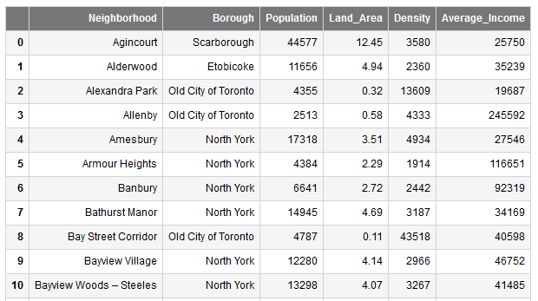
Methodology
BeautifulSoup4 used
Exploratory Data Analysis
Final table after web scrapping and cleaning data

Slide 7
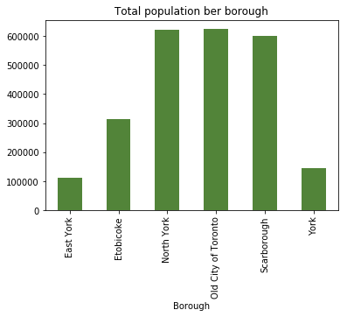
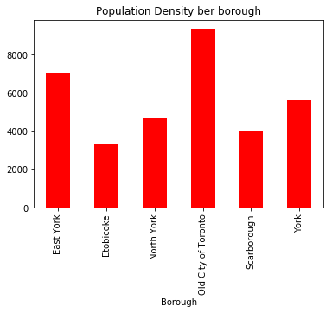
Methodology
Exploratory Data Analysis
Old City of Toronto has the largest population of all boroughs at 624 900, with North York a close second with 621 000.
Roughly the same population, the population densities are very different. North York has half the density of the Old City of Toronto.

Slide 8
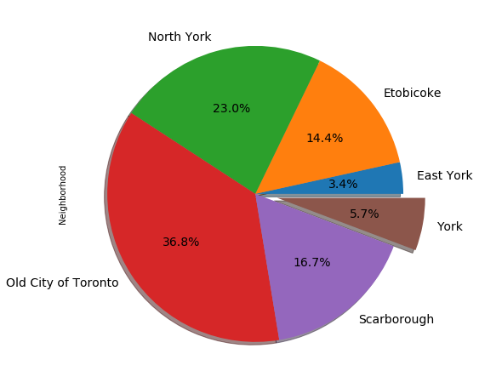
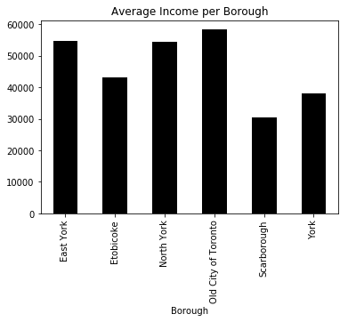
Methodology
Exploratory Data Analysis
Old city of Toronto has highest average income of the boroughs, with $58 400. Other boroughs are not far behind, with East York and North York having an average income of $54 600 and $54 400 respectively.
Old City of Toronto has the most number of neighborhoods, 37% of the total neighborhoods in Toronto, which equates to 64 out of 174.

Slide 9
Clustering
Scikitlearn’s KMeans clustering was used to determine similar neighborhoods based on a restaurant as venue category.
The point here is to find a ware house location that is in a borough that has the most family oriented restaurants and has the largest number of neighborhoods.
But also the location to be within a 5km radius to homes, offices etc.
Added to being in a high income neighborhood would result in more business opportunity because of the higher disposable income of the residents.
WE ALREADY KNOW
Old City of Toronto borough has the highest population density and average income.
THEREFORE in our clustering we will focus on the Old City of Toronto neighborhoods.

Slide 10
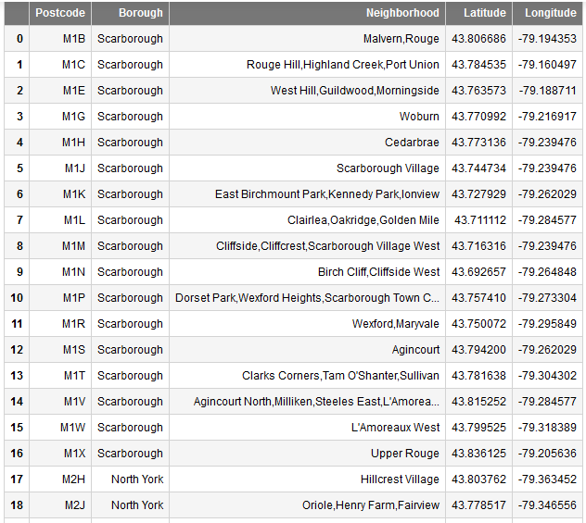
Clustering
DATA FRAME USED FOR K-MEANS CLUSTERING

Slide 11
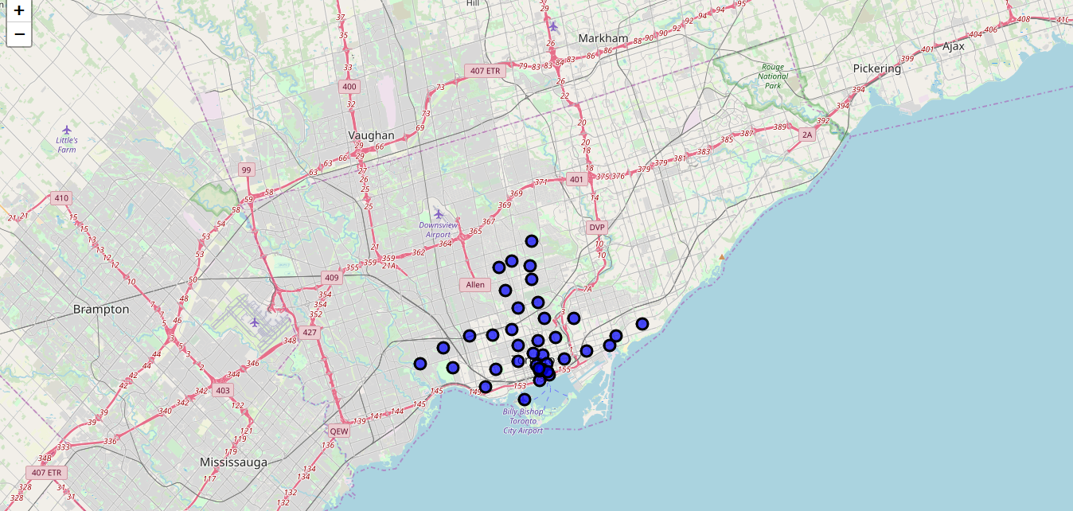
Clustering
Visualization of the neighborhoods to be clustered, superimposed on a Toronto map

Slide 12
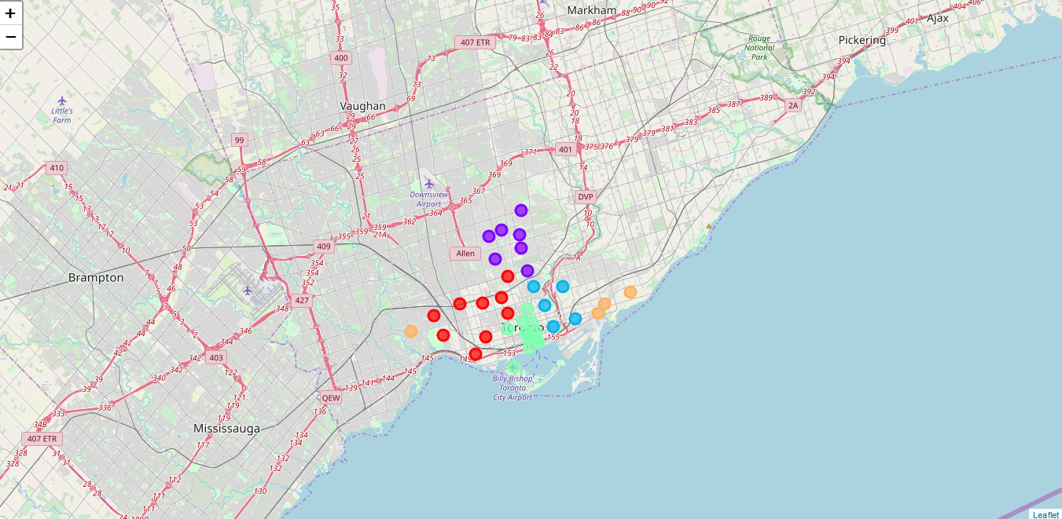
Results and Discussion
K-Means clustering algorithm was run on five different clusters
All the clusters are almost similar in size and are not that far dispersed from each other

Slide 13
Results and Discussion
Cafe's are the most popular type of eatery in Toronto neighborhoods.
Cluster 1 and Cluster 2, mainly found in the boroughs of Downtown Toronto, West Toronto and Central Toronto has a lot of restaurants that I would call family themed as compared to fast food.
Fast food outlets are not many in the neighborhoods analyzed.

Slide 14
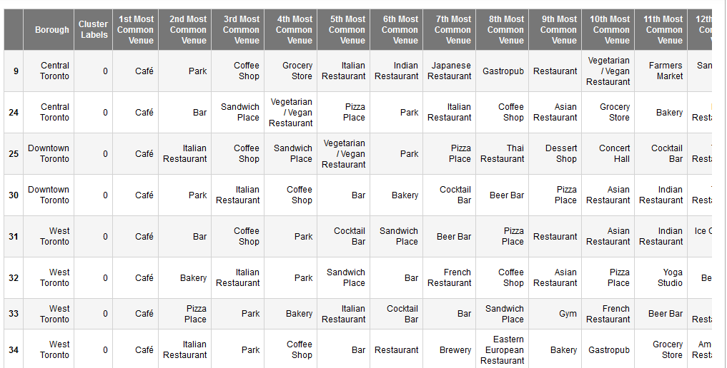
Results and Discussion
A snapshot of part of cluster 1

Slide 15
Results and Discussion
What we find from the clustering is that there is definitely a lost of restaurants in the 'Toronto' that could serve as Mark's customers.
Since the clusters are not far dispersed from each other, the best thing for Mark would be to find a central location that is at best equidistant, i.e., a ware house location that is in the middle of the five clusters on the Toronto map.
This would make it fast and easy to transport goods to all the neighborhoods. Ideally a centrally located warehouse should shorten shipping times since there's an increased chance that customers are geographically close to the warehouse.

Slide 16
Conclusion
From this project we can see how machine learning can be used in a real life data science project to gain insight to a business problem.
In this case K-Means clustering was used to segment and cluster the neighborhoods of Toronto to find the best location for a ware house .
I would however note that, I assumed the rental prices for buildings are the same for the 'Toronto' labeled boroughs. This is obviously not the case. Also the rental price will depend on the size of the building per square meter. This project could be expanded to include the effect of rental price on the choice of location. This improved project would could serve as a recommendation study for a professional realtor.
THANK YOU!!!

