Slide 1
MBTI APP
2018036010 김준성

Slide 2
Job interview tips infographics
How to get ready for the interview
MBTI APP소개
기존 APP과의 차이
지금까지 한 결과
다음 계획

Slide 3
App 소개
01
02
03
Keep it simple
Keep it relevant
Choose wisely
Mars is actually a very cold place
Venus has high temperatures
Mercury is the smallest planet
06
05
04
Show the basics
Get to the point
Be confident
Jupiter is the biggest planet
Saturn is a gas giant with rings
Neptune is far from the Sun

Slide 4
구상 이유
“During the interview”
01
Make a good first impression with a nice smile
02
Maintain correct posture while sitting
03
Be on time gives you extra travel time in case you get lost
04
Bring any materials you may need including portfolio
05
Dress professionally and make sure you are well groomed

Slide 5
기능
Types of a job interview
Mercury is the closest planet to the Sun and the smallest of them all
Venus has a beautiful name and is the second planet from the Sun
Despite being red, Mars is actually a cold place. It’s full of iron oxide dust
Structured
Not structured
Semi-structured

Slide 6
기존 앱들과의 차이
Mercury is the closest planet to the Sun and the smallest of them all
01
Saturn is a gas giant and the only planet with rings
Venus has extremely high temperatures and is toxic
02
Ceres was the first asteroid to ever be discovered
Earth is the only planet known to harbor life
03
The Moon is the Earth’s only natural satellite. It’s very beautiful
Despite being red, Mars is a very cold planet full of iron oxide dust
04
The Sun is the star at the center of the Solar System
Jupiter is a gas giant and the biggest planet of them all
05
Jupiter is a gas giant and it doesn’t have a solid surface

Slide 7
Job interview tips infographics
PHASES
BEFORE
DURING
AFTER
Mercury is the smallest planet
Venus has high temperatures
Jupiter is the biggest planet
Saturn is a gas giant with rings

Slide 8
Job interview tips infographics
01
Preparation
02
Development
03
Analysis
04
Selection
Describe here something important
Describe here something important
Describe here something important
Describe here something important
Describe here something important
Describe here something important
Describe here something important
Describe here something important
Describe here something important
Describe here something important
Describe here something important
Describe here something important

Slide 9
Job interview tips infographics
Common interview question and answer “First round”
01
Where do you see yourself in five years?
“Mercury's name has nothing to do with the liquid metal, since Mercury was named after the Roman god”
02
What are your strengths/weaknesses?
“Venus has a beautiful name and is the second planet from the Sun. It’s terribly hot, even hotter than Mercury”
03
Why should we hire you?
“Despite being red, Mars is actually a cold place. It's full of iron oxide dust, which gives the planet its reddish cast”

Slide 10
Job interview tips infographics
Common Interview question and answer “Second round”
04
What’s your current salary?
“Mercury's name has nothing to do with the liquid metal, since Mercury was named after the Roman god”
05
What’s your work style?
“Venus has a beautiful name and is the second planet from the Sun. It’s terribly hot, even hotter than Mercury”
06
What motivates you?
“Despite being red, Mars is actually a cold place. It's full of iron oxide dust, which gives the planet its reddish cast”

Slide 11
Job interview tips infographics
Show the basics
Keep it simple
Jupiter is the biggest planet
Mars is actually a very cold place
Choose wisely
Keep it relevant
Mercury is the smallest planet
Venus has very high temperatures

Slide 12
Job interview tips infographics
Mercury
25%
Jupiter
55%
It’s the closest planet to the Sun and the smallest in the Solar System
Jupiter is a gas giant and the biggest planet in the Solar System
Venus
50%
Neptune
60%
Venus has a beautiful name and is the second planet from the Sun
It's the fourth-largest object by diameter in the Solar System
Mars
75%
Saturn
80%
Despite being red, Mars is actually a cold place. It’s full of iron oxide dust
Saturn was named after the Roman god of wealth and agriculture

Slide 13
Job interview tips infographics
The common Interview question and answer “Selection phase”
Mercury is the closest planet to the Sun and the smallest one in the Solar System
Candidate 1
Candidate 2
Mars is actually a cold place
Earth is the planet with life
Mercury is a small planet
We all orbit around the Sun
Pluto is a dwarf planet
Only Saturn has rings

Slide 14
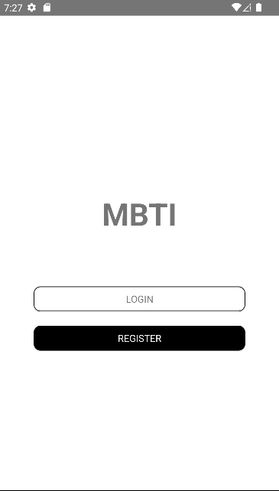
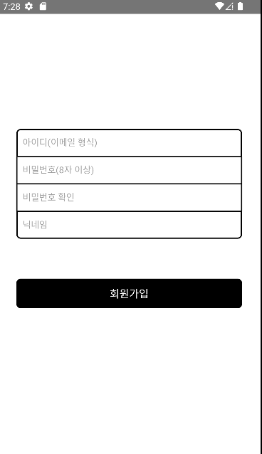
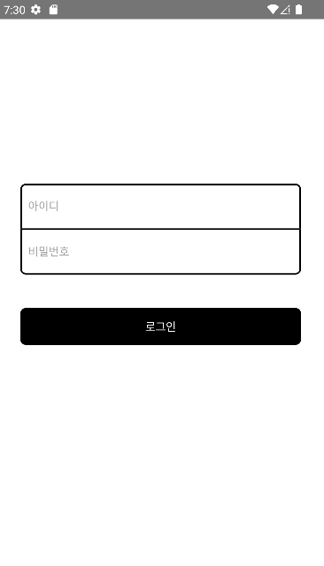
Job interview tips infographics

Slide 15
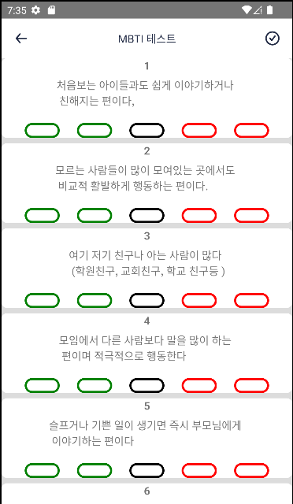
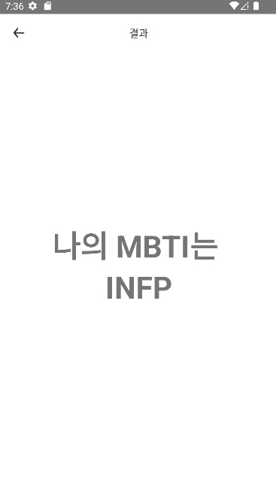
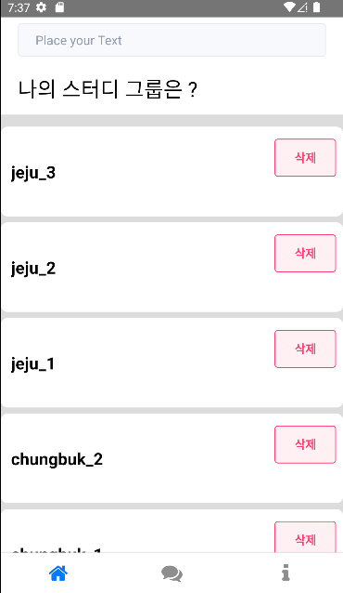
Job interview tips infographics

Slide 16
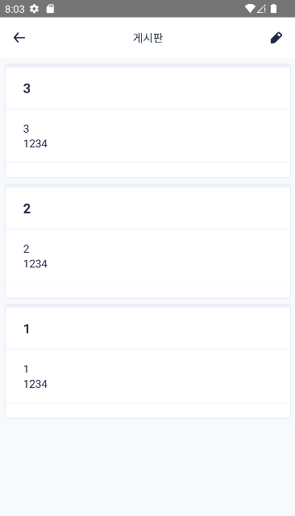
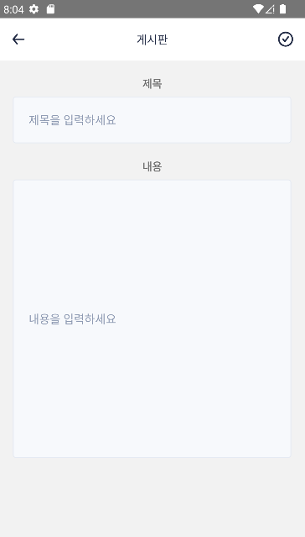
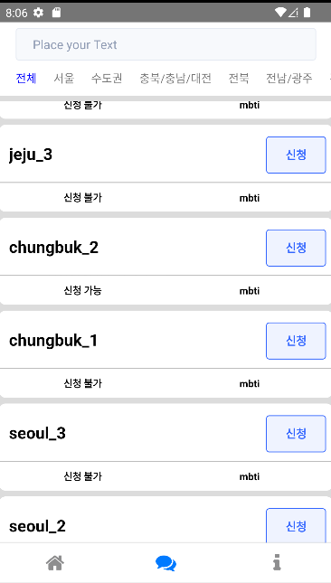
Job interview tips infographics

Slide 17
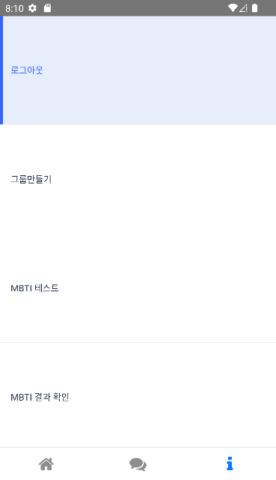
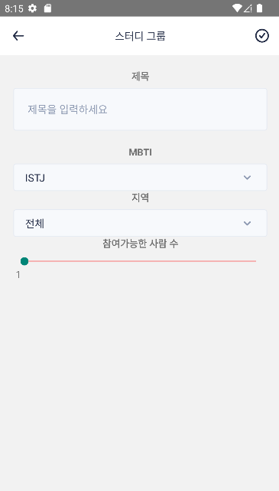
Job interview tips infographics

Slide 18
Job interview tips infographics
The best candidate
Capacity
Goals
Jupiter is the biggest planet
Jupiter is the biggest planet
Effort
Challenges
Venus is the second planet from the Sun
Saturn is composed mostly of hydrogen
Achievements
Learn
Mars is actually a very cold place
Neptune is very far from the Sun

Slide 19
Job interview tips infographics
Popular mistakes made during job interviews
Despite being red, Mars is actually a cold place. It's full of iron oxide dust
Earth is the third planet from the Sun and the only one with life
Mercury is the closest planet to the Sun and the smallest one
To do

Slide 20
Job interview tips infographics
Popular mistakes made during job interviews
Despite being red, Mars is actually a cold place. It's full of iron oxide dust
Earth is the third planet from the Sun and the only one with life
Mercury is the closest planet to the Sun and the smallest one
Not to do

Slide 21
Job interview tips infographics
Most valued features of the selection process
Education
Hobbies
Profile
Mercury is the closest planet to the Sun and the smallest one
Venus has a beautiful name and is the second planet from the Sun
Despite being red, Mars is actually a cold place. It’s full of iron oxide dust

Slide 22
Job interview tips infographics
How to ace a job interview
Saturn is the fourth-brightest object at night. It was named after the Roman god of the skies and lightning
Know your facts
Know the job
Mercury is the closest planet to the Sun
Venus has a beautiful name and high temperatures
Look the part
Plan the day before
Despite being red, Mars actually is a cold place
Saturn is a gas giant and has several rings

Slide 23
Job interview tips infographics
01
02
84%
Working together
Time management
Key concepts
Venus is the second planet from the Sun
Mercury is the closest planet to the Sun
Saturn is the fourth-brightest object in the night sky. It was named after a Roman god
04
03
Motivation
Creativity
Saturn is a gas giant and has several rings
Jupiter is the biggest planet of them all

Slide 24
Job interview tips infographics
Engage with the interviewers
It's the fourth-brightest object in the night sky. It was named after the Roman god of the skies and lightning
A good first impression
Be confident but not cocky
Mercury is the smallest planet of them all
Venus has a beautiful name and high temperatures
Step 1
Step 1
Jupiter is a gas giant and the biggest planet
Earth is the only planet that harbors life
Step 2
Step 2
Saturn is a gas giant and the only planet with rings
Despite being red, Mars is a very cold planet

Slide 25
Job interview tips infographics
84%
10%
Confidence
Posture
Mars is actually a very cold place
Venus has very high temperatures
Mercury is the smallest planet
Pluto is considered a dwarf planet
Clothes
Honesty
25%
37%

Slide 26
Job interview tips infographics
01
Mercury
This planet's name has nothing to do with the liquid metal, since Mercury was named after the Roman god
02
Venus
Venus has a beautiful name and is the second planet from the Sun. It’s terribly hot, even hotter than Mercury
03
Mars
Despite being red, It’s actually a cold place. It's full of iron oxide dust, which gives the planet its reddish cast
04
Neptune
Neptune is the farthest planet from the Sun. It's also the fourth-largest object by diameter in the Solar System

Slide 27
Job interview tips infographics
Recommended words
Disapproved words
Saturn is a gas giant and has several rings. It's composed mostly of hydrogen and helium
Neptune is the farthest planet from the Sun. It's also the fourth-largest object by diameter
01
Capacity
Mercury is the smallest planet
01
Blockage
Earth is where we all live
02
Nervous
Venus is a very
hot planet
02
Nervous
Neptune is very far from the Sun
03
Goals
Mars is actually a very cold place
03
Shy
Pluto is a
dwarf planet
04
Achievements
Jupiter is the biggest planet
04
Unsafety
Ceres is in the main asteroid belt

Slide 28
Job interview tips infographics
Popular nonverbal mistakes made during job interviews
01
Playing with hair
Crossing arms
04
Mars is actually a very cold place
Neptune is very far from the Sun
02
No smiling
Eye contact
05
Jupiter is the biggest planet
Saturn is composed of hydrogen
03
Wrong posture
No information
06
Ceres is in the main asteroid belt
Pluto is now considered a dwarf

Slide 29
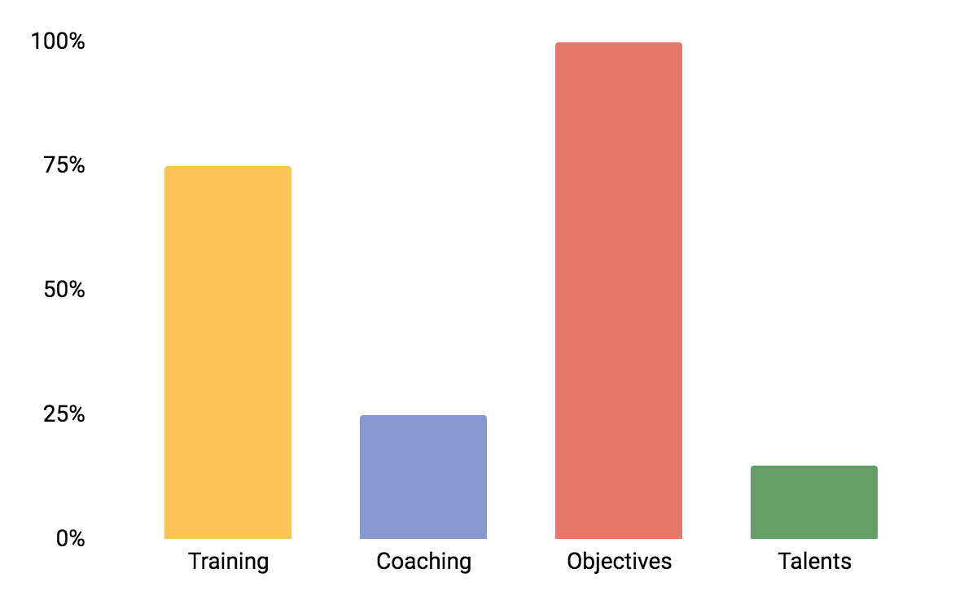
Job interview tips infographics
Mercury’s name has nothing to do with the liquid metal
Training
Venus has a beautiful name and is the second planet from the Sun
Coaching
Despite being red, Mars is actually a cold place. It's full of iron oxide dust
Objectives
Jupiter is a gas giant and the biggest planet in the Solar System
Talents

Slide 30
Job interview tips infographics
Objectives
Skills
25%
Mars is actually a very cold place
Neptune is very far from the Sun
85%
Mars is actually a very cold place
Mars
Mercury
It’s the closest planet to the Sun
It’s the biggest planet of them all
Jupiter
Sun
It’s the star we all orbit
Venus has a beautiful name
Venus
Ceres
Ceres is in the main asteroid belt

Slide 31
Job interview tips infographics
Top 4 questions to ask an interviewer
Mercury is the closest planet to the Sun and the smallest one in the Solar System. This planet's name has nothing to do with the liquid metal, since Mercury was named after the Roman messenger god
What do you expect from team members?
Will those expectations change over time?
What is a typical day like at [company name]?
Venus has a beautiful name and is the second planet from the Sun. It’s terribly hot, even hotter than Mercury, and its atmosphere is extremely poisonous. It’s the second-brightest natural object in the night
Where do you see the company in five years?

Slide 32
Job interview tips infographics
Interview job test question and answer
01
Why do you want this job?
03
What’s your current salary?
Mercury
Venus
Mars
Ceres
Earth
Pluto
02
Why were you fired?
04
What’s your work style?
Jupiter
Saturn
Neptune
Sun
Mars
Earth

Slide 33
Job interview tips infographics
Education
Mercury's name has nothing to do with the liquid metal
01
35%
Venus is the second brightest natural object in the night sky
Experience
02
45%
Goals
Mars is full of iron oxide dust, which gives the planet its color
03
55%

Slide 34
Instructions for use
In order to use this template, you must credit Slidesgo in your final presentation.
You are allowed to:
- Modify this template.
- Use it for both personal and commercial projects.
You are not allowed to:
- Sublicense, sell or rent any of Slidesgo Content (or a modified version of Slidesgo Content).
- Distribute Slidesgo Content unless it has been expressly authorized by Slidesgo.
- Include Slidesgo Content in an online or offline database or file.
- Offer Slidesgo templates (or modified versions of Slidesgo templates) for download.
- Acquire the copyright of Slidesgo Content.
For more information about editing slides, please read our FAQs or visit Slidesgo School:
https://slidesgo.com/faqs and https://slidesgo.com/slidesgo-school

Slide 35
Instructions for use (premium users)
As a Premium user, you can use this template without attributing Slidesgo
You are allowed to:
Modify this template.
Use it for both personal and commercial purposes.
Hide or delete the “Thanks” slide and the mention to Slidesgo in the credits.
Share this template in an editable format with people who are not part of your team.
You are not allowed to:
Sublicense, sell or rent this Slidesgo Template (or a modified version of this Slidesgo Template).
Distribute this Slidesgo Template (or a modified version of this Slidesgo Template) or include it in a database or in any other product or service that offers downloadable images, icons or presentations that may be subject to distribution or resale.
Use any of the elements that are part of this Slidesgo Template in an isolated and separated way from this Template.
Register any of the elements that are part of this template as a trademark or logo, or register it as a work in an intellectual property registry or similar.
For more information about editing slides, please read our FAQs or visit Slidesgo School:
https://slidesgo.com/faqs and https://slidesgo.com/slidesgo-school

Slide 36
Infographics
You can add and edit some infographics to your presentation to present your data in a visual way.
Choose your favourite infographic and insert it in your presentation using Ctrl C + Ctrl V or Cmd C + Cmd V in Mac.
Select one of the parts and ungroup it by right-clicking and choosing “Ungroup”.
Change the color by clicking on the paint bucket.
Then resize the element by clicking and dragging one of the square-shaped points of its bounding box (the cursor should look like a double-headed arrow). Remember to hold Shift while dragging to keep the proportions.
Group the elements again by selecting them, right-clicking and choosing “Group”.
Repeat the steps above with the other parts and when you’re done editing, copy the end result and paste it into your presentation.
Remember to choose the “Keep source formatting” option so that it keeps the design. For more info, please visit Slidesgo School.

