Slide 1
VectorNav-300 Interface Development

Slide 2
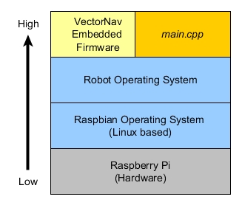
Development Environment
The target is to save IMU and GNS data from VectorNav-300 device.
ROS helps to develop our program to access the device via its firmware.
References
Code: https://github.com/dawonn/vectornav
VectorNav-300 User Manual
ROS: http://wiki.ros.org/ROS/Introduction

Slide 3
How to run the program
Launch ROS master: $roscore
Run our launch file: $roslaunch vectornav vectornav.launch
If we want to check data on command line (terminal), type
$rostopic list
$rostopic echo [rostopic_name] (e.g. rostopic echo /vectornav/GPS)
Vectornav.launch runs main.cpp which creates a node called vectornav.
Generate CSV files which can be seen under .ros folder

Slide 4
Update for camera triggering

Slide 5
Hardware Setup (Camera Triggering)
Raspberry pi & Pixhawk
Raspberry pi : 29 (signal), 30 (ground) GPIO pin
Pixhawk : 5 AUX_OUT
Mission Planner> Camera> Shutter => choose Relay option
Raspberry pi & Camera
Raspberry pi: 31 (signal), 2 (power), 39 (ground) GPIO pins

Slide 6
How to run
(1) Autorun after reboot
Seconds to wait can be modified in shell files after sleep command.
Log file can be checked in /home/pi/shell_files/vectornav_script.log
(2) Run from shell file
With FC control
Location : /home/pi/shell_files/
./start_FCSignalWait_script.sh
Without FC control
Location: /home/pi/shell_files/
./start_vectornav_launch_script.sh
(3) Run from launch file
roslaunch vectornav vectornav.launch
Stop the program
rosnode kill /vectornav

