Slide 1
Deep Learning and Robotics
A WORKING GUIDE FOR ENGINEERS
The ideas behind today's models and the robots they drive
Matthew Wnuk · www.matthewwnuk.com/guide.html
32 topics in five groups
Real measurements
Meant to be presented
From the training loop to the robot's hands, in the order the ideas build on one another.
Most charts come from real robot data or from experiments run for the guide. Illustrative ones are labelled.
Each slide has one message, a picture, and speaker notes. 27 notebooks reproduce the measurements.
Notes:
This deck accompanies the written guide at www.matthewwnuk.com/guide.html. Each section of the deck is one note of the guide, opened by a title slide with its key points. The slides carry the figures and the main results; the notes carry the full argument, the derivations and the references.

Slide 2
The map: 32 topics in five groups
OPENING
from how a network learns, to the models, to robot policies, to bodies and data, to how the work is done
Foundations
Models
Robot learning
Data and hardware
Practice
1 Things I know
6 Representation learning
14 Robotics fundamentals
21 Embodiments
28 Training at scale
2 Foundations that survived
7 Contrastive and multimodal learning
15 Robot learning basics
22 Senses beyond vision
29 Evaluation
3 Sequence-to-sequence models
8 Retrieval and multimodal retrieval
16 Reinforcement learning
23 Dexterous hands
30 Failure triage
4 The transformer
9 Generative modeling
17 Robot policies today
24 Data for robots
31 Deployment on the robot
5 Attention in depth
10 Stable Diffusion and latent diffusion
18 System 0, 1 and 2 architectures
25 Data quality and curation
32 Understanding and safety
11 Foundation models and adaptation
19 Long-horizon tasks
26 Data efficiency and generalisation
12 Vision-language models
20 World models
27 The data flywheel
13 Perception and 3D
Each group builds on the one before it; the numbers are the section numbers in this deck
Notes:
Use this slide to orient the room. Foundations explains how any network learns and the blocks everything is built from. Models covers the model families in use today. Robot learning turns those models into policies. Data and hardware covers the bodies, the senses and the data they produce. Practice is how the work is done and shipped.

Slide 3
How to use the guide
OPENING
read it in order, or start from what you already know
You know machine learning
You know robots
Run it
Start with the robot notes: sections 14 to 20.
Then bodies, senses and data: 21 to 27.
Then practice: 29 to 32.
Start with how networks learn: sections 1 to 5.
Then the model families: 6 to 12.
Then robot policies (17) and training at scale (28).
27 notebooks at github.com/wnukmat/robot-learning-notebooks, each tied to a section of a note.
Data and small checkpoints are on Hugging Face under mwnuk.
Section title slides name the notebooks that go with them.
The deck gives the result; the note gives the derivation; the notebook lets you change it and rerun
Notes:
The order of the deck is the order the ideas build in. The two reading paths are for people who already have one half of the background. Every section title slide lists its key points and, where one exists, the notebook that reproduces its measurements.

Slide 4
Things I know
FOUNDATIONS · TOPIC 1 OF 32
Six habits that outlast any model, and how silent failures are caught.
KEY POINTS
Data, scale and honest evaluation decide more than architecture does.
Know how much a number moves when nothing changes before reading a difference into it.
A falling loss proves the code runs, not that the model learned what you intended.
Run it: How much of a result is noise (github.com/wnukmat/robot-learning-notebooks)
Notes:
Things I know. Six habits that outlast any model, and how silent failures are caught. The full note is at www.matthewwnuk.com/guide-things-i-know.html.

Slide 5
Six principles that outlast any model
1 · THINGS I KNOW
model names change every few months; these habits decide whether a project works more often than the architecture does
Data beats clever algorithms
General methods that scale win
All models are wrong
The scale, variety and quality of the data set the ceiling.
A better dataset usually helps more than a new architecture.
Sutton's “bitter lesson”: methods that improve with data and compute keep overtaking hand-encoded knowledge.
Prefer designs that get better as the data grows.
A good score on held-out data is not a working robot.
Judge a model in the loop it will actually run in.
Failing models don't throw exceptions
Evaluation leaks
One variable per experiment
A broken pipeline still produces a loss curve.
The only way to know is to look at the inputs, labels and outputs yourself.
Every choice made against the test set moves a little of it into the model.
Public benchmarks may already be in the pretraining data.
Change one thing and keep a matched control.
Know what a trivial baseline scores before you start.
Data, scale and honest evaluation decide more than the choice of architecture
Notes:
These six habits frame the whole guide. The first two are about where progress comes from: the largest recent gains in robotics came from more varied data, and methods that improve with more data and compute keep overtaking methods that encode human knowledge by hand. The middle two are about trust: a held-out score is a proxy, and broken code does not announce itself. The last two are about measurement, and the rest of this section turns them into concrete checks.

Slide 6
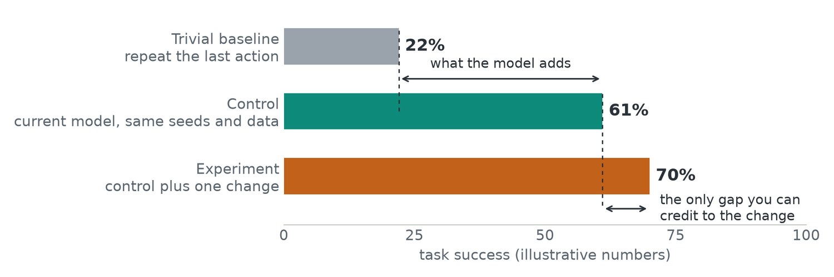
Three numbers make a result readable
1 · THINGS I KNOW
the last principle as a picture: a trivial baseline, a matched control and the experiment
Trivial baseline, 22%. What the simplest method scores. It shows how much of the result needed a model at all.
Control, 61%. A run identical to the experiment in every respect except the one thing being tested.
Experiment, 70%. It differs from the control in one way, so the marked gap belongs to that change.
Before the run. Know what the trivial baseline scores before you start, so the other two numbers have a floor.
An improvement can be attributed only when the control differs from the experiment in one way
Notes:
Read the three bars together. The baseline tells you what the task gives away for free. The control tells you what the existing method achieves under the same conditions. The experiment is then interpretable because it differs from the control in exactly one respect. Remove any of the three and the remaining numbers stop meaning anything: a 70% score alone could be a strong result or a trivial one.

Slide 7
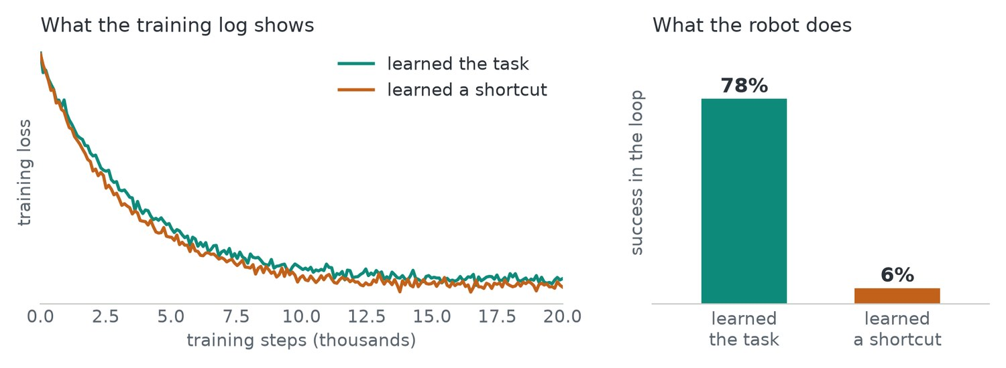
Silent failure: the logs look the same
1 · THINGS I KNOW
an illustrative pair of runs: one learned the task, one learned a shortcut
Left: two loss curves. Both training losses fall almost identically. Nothing crashes and nothing in the log separates the runs.
Right: success on the robot. The model that learned the task succeeds 78% of the time. The one that learned a shortcut succeeds 6%.
What it means. The loss went down in both, and one model still learned the wrong thing.
Deep learning code fails quietly, and only running the policy tells the two runs apart
Notes:
The pair of runs is illustrative, and the pattern is the common one. Deep learning code does not fail with an error. It fails by producing a plausible loss curve from a model that has learned something other than the task. Four kinds of failure account for most of these cases, and the next slide lists them with the symptom each one leaves.

Slide 8
Four failures account for most silent cases
1 · THINGS I KNOW
what went wrong in each, and the symptom it leaves in the numbers
Failure | What happened | Symptom
Label or input bug | Images and labels are misaligned, normalisation is wrong, or two cameras are swapped | The loss falls slowly and levels off high
Data leak | Test samples, or near-copies of them, are in the training set | The validation score looks too good
Shortcut learning | The model uses a cue that happens to correlate with the answer | Great on the benchmark, fails in new scenes
Evaluation bug | The metric is computed on the wrong split or the wrong output | The numbers do not match what you see
Each failure has a recognisable symptom; shortcut learning is the hardest of the four to spot
Notes:
Use the symptom column as a lookup when a result looks odd. Shortcut learning deserves the closest look because the usual metrics reward it. A classifier can learn the background in place of the object. A robot policy can learn to copy its previous action from its own joint readings, look fine on recorded data, and then freeze on the real robot. The next slide shows that case on real data.

Slide 9
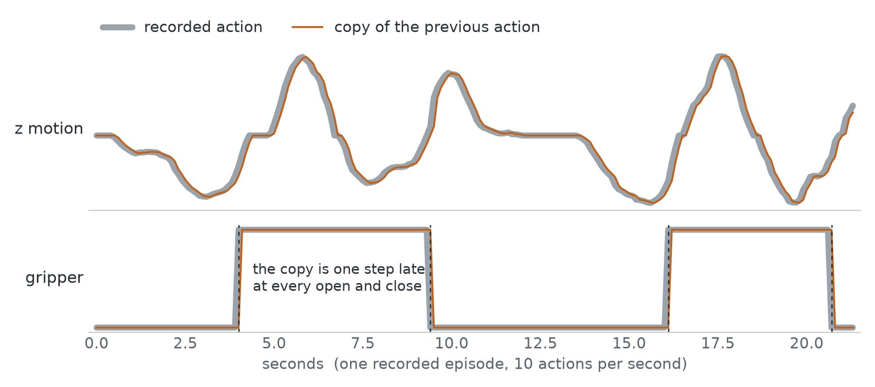
The copy shortcut, on real data
1 · THINGS I KNOW
z-motion and gripper actions from one LIBERO demonstration of 214 steps, with a copy of the previous action on top
Nearly indistinguishable. The copy of the previous action lies almost exactly on the recorded action.
13 times lower error. Repeating the previous action gives a mean absolute error of 0.020. Predicting the average action gives 0.253.
Still cannot do the task. The copy never starts a motion and is late at all four gripper changes.
The dumb baseline. On recorded data, “repeat the last action” is a strong score to beat.
A model that only matches “repeat the last action” has learned nothing about the task
Notes:
This is why the dumb baseline matters. Consecutive actions in a demonstration are nearly identical, so a policy that reads its own joint positions can score well on recorded data by copying. The error metric rewards it, and the policy then freezes on the real robot because it never initiates anything. Compute this baseline on your own data before training, and treat any model that only matches it as a failed run.

Slide 10
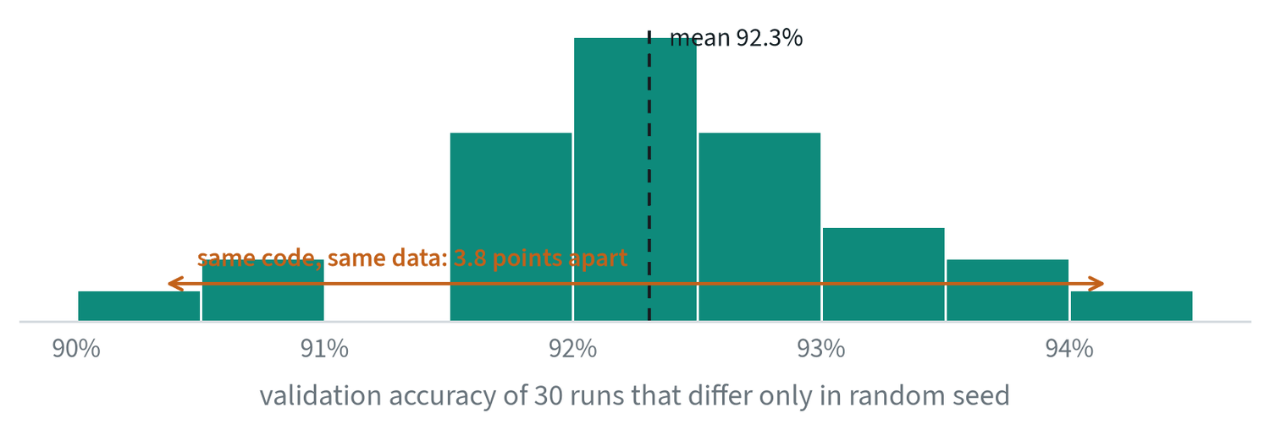
How much of a result is noise
1 · THINGS I KNOW
measured for this note: one small classifier, one dataset, one configuration, 30 random seeds
The spread. Runs range from 90.3% to 94.2%, mean 92.3%, standard deviation 0.8. A 1.5-point gain from single runs means nothing.
Run several seeds. Report the mean and the spread. Three is a minimum; five or more for a claim that matters.
Compare the gap with the spread. A difference between two means is interesting only when it is large compared with σ/√n.
Fix what can be fixed. Use the same seeds, data order and evaluation set for both arms.
Know how much a number moves when nothing changes before reading a difference into it
Notes:
Training is random in its initial weights, in the order of the data and in dropout, and that randomness shows up in the final score. Here the same code on the same data spans 3.8 points. The quantity σ/√n is the standard error: the standard deviation of the runs divided by the square root of how many there were. On a robot the problem is larger, because each evaluation is a few dozen physical trials on top of the training noise. The note on evaluation works out how many trials a comparison needs.

Slide 11
Numbers you can check before trusting a run
1 · THINGS I KNOW
several quantities have a known correct value; checking them costs minutes
Check | What it should be | What a wrong value means
Loss at the first step | ln C for C balanced classes. The small network above starts at 2.308; ln 10 = 2.303 | Much larger: bad initialisation or unnormalised inputs. Much smaller: a label in the input
Overfitting a single batch | Loss goes to zero and the model reproduces those samples exactly | If it cannot, there is a bug in the model, the loss or the labels
A shuffled-label run | Validation performance at chance | Anything better means information is leaking from the evaluation set
Input ablation | Blanking an input the task needs makes performance collapse | If nothing changes, the model is not using that input
Predicted against recorded, by eye | Plots of predicted and recorded actions for whole episodes overlap | A constant offset or a lag points to normalisation or timing
Five cheap checks with known answers catch most broken pipelines
Notes:
Each row is a test whose correct outcome is known in advance, which is what makes it useful. The first-step loss needs no training at all: the classifier from the seed experiment starts at 2.308 against a predicted 2.303. Overfitting one batch tests the model, loss and labels together. The shuffled-label run and the input ablation test the two things a loss curve cannot show: whether information leaks, and whether the model uses the inputs you think it uses.

Slide 12
Leakage in robot data
1 · THINGS I KNOW
consecutive frames are nearly identical, and episodes from one session share almost everything
Split by episode, never by frame
Then ask what else is shared
Frames 100 and 101 of one episode are the same image.
A random split by frame puts near-copies in training, and validation loss then measures memory.
Episodes from the same scene, object set or operator share more than the split suggests.
To claim generalisation to new scenes, hold out whole scenes.
Statistics from the training split only
Count the choices made on the test set
Normalisation means and ranges computed over all the data carry information from the validation set.
Every checkpoint, threshold or hyperparameter chosen on test results fits the test set a little.
Keep a final set that is looked at once.
Split by episode, hold out whole scenes for scene claims, and keep a final set that is looked at once
Notes:
Leakage is information about the evaluation set reaching the model. Robot datasets make it easy because the data is so strongly correlated in time and within a session. The four cards run from the most obvious leak to the most subtle. A frame-level split is a plain bug. Shared scenes and operators inflate a generalisation claim. Normalisation statistics leak a little. Repeated selection on the test set leaks slowly, through the experimenter.

Slide 13
Habits that catch it
1 · THINGS I KNOW
five routines that find silent failures before they cost a training run
Look at the data
Overfit one batch
Beat a dumb baseline
View raw samples after every transform, not before.
If the model cannot memorise ten samples, there is a bug.
Compare with “predict the mean” or “repeat the last action”.
If you cannot beat it, stop and find out why.
Ask what shortcut exists
Test in the loop
Ask whether the model could score well without solving the task.
Design a test that separates the two.
Run the policy. Do not only score it.
A falling loss proves that the code runs. It does not prove the model learned what you intended
Notes:
These five habits are the practical summary of the section. Each maps to something shown earlier. Looking at transformed samples catches label and input bugs. Overfitting a batch is the second row of the checks table. The dumb baseline is the copy-shortcut figure. The shortcut question is the one that separates the two runs with identical loss curves, and testing in the loop is how that pair was finally told apart.

Slide 14
Common mistakes
1 · THINGS I KNOW
three reflexes that waste the most time when a result surprises you
Changing the model first
Trusting an aggregate
Skipping the control
When a result surprises you, check the data and the evaluation before touching the architecture.
One average hides which cases fail.
Break results down before drawing a conclusion.
Without a matched run that differs in one way, an improvement cannot be attributed to anything.
Check the data and the evaluation first, break results down, and always run the control
Notes:
All three mistakes come from acting on a number before understanding it. The architecture is the most interesting thing to change and the least likely cause of a surprise. An average can hold steady while one category of cases collapses. And a result without a matched control is an observation, with nothing to attribute it to. The vocabulary to keep from this section is baseline, control, shortcut, leak, seed and standard error.

Slide 15
Foundations that survived
FOUNDATIONS · TOPIC 2 OF 32
The training loop, learning rates, losses, overfitting and the stabilisers that make deep networks trainable.
KEY POINTS
Training is a search for weights that make the loss small on data the model has not memorised.
If training diverges or stalls, look at the learning rate before anything else.
Pick the loss that matches the kind of output: a class, a number, a distribution, or a similarity.
Watch the gap between training and validation loss; that gap is overfitting.
Run it: The training loop, from scratch · Learning rate and optimisers · Why deep networks train at all (github.com/wnukmat/robot-learning-notebooks)
Notes:
Foundations that survived. The training loop, learning rates, losses, overfitting and the stabilisers that make deep networks trainable. The full note is at www.matthewwnuk.com/guide-foundations.html.

Slide 16
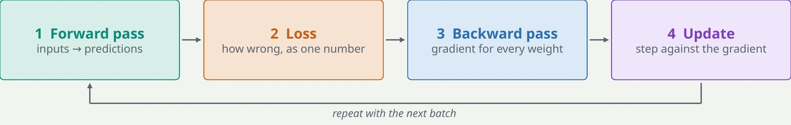
The training loop
2 · FOUNDATIONS THAT SURVIVED
every model in this guide, from a small classifier to a robot foundation model, is trained the same way
Forward pass and loss. A batch of inputs becomes predictions, and the loss scores how wrong they are as a single number.
Backward pass. Backpropagation applies the chain rule layer by layer to find how much each weight contributed. That is the gradient.
Update. Every weight is nudged a small step against its gradient, and the loop repeats with the next batch.
AdamW is the default optimiser. It gives every weight its own step size and applies weight decay as a separate step.
Training is a search for weights that make the loss small on data the model has not memorised
Notes:
The figure is one step of training. The optimiser decides the size of the update. AdamW keeps a running average of each weight's gradient and of its size, which is what gives each weight its own step size, and its weight decay is a gentle pull of every weight toward zero. Everything else in this section is a detail of one of these four boxes: what the loss is, how the gradient survives depth, and how large the step should be.

Slide 17
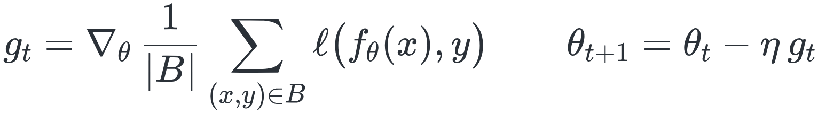
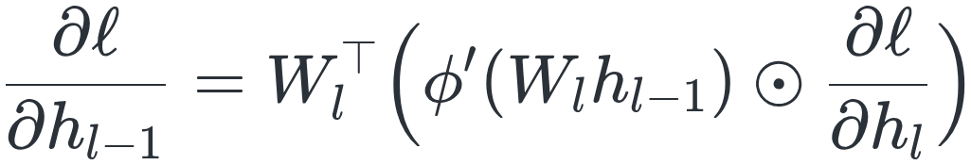
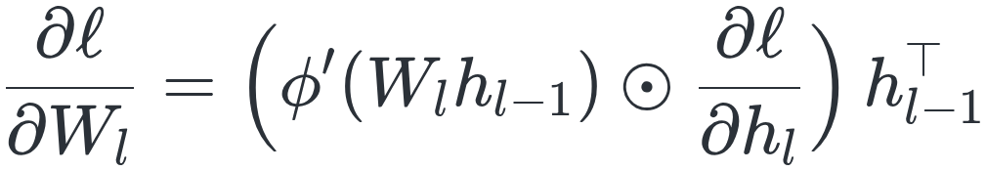
The same loop in symbols
2 · FOUNDATIONS THAT SURVIVED
a model f with parameters θ, a batch B, and the chain rule applied from the loss backwards
One step, and one layer of backpropagation
In words
Cost. The backward pass costs about the same as the forward pass, so a training step is roughly three times the cost of inference.
Fragile depth. If the per-layer terms are mostly smaller than one the product vanishes. If larger, it explodes.
Batch noise. The batch gradient is a noisy estimate of the full gradient, with noise that shrinks as 1/√|B|.
Average the loss over the batch, take its gradient, step against it by η
For a layer hₗ = φ(Wₗ hₗ₋₁), the gradient at its input follows from the gradient at its output
The same quantity times the layer's input gives the gradient for its weights
The gradient at an early layer is a product of one term per later layer, which is why depth is fragile
Notes:
Two consequences of these equations are worth carrying around. The first is the cost rule: backward costs about as much as forward. The second is that the backward equation is applied once per layer, so the gradient reaching an early layer is a product of per-layer terms. A later slide measures that product on a 32-layer network. The noise in the batch gradient is not purely a nuisance. It is part of why stochastic gradient descent finds solutions that generalise.

Slide 18
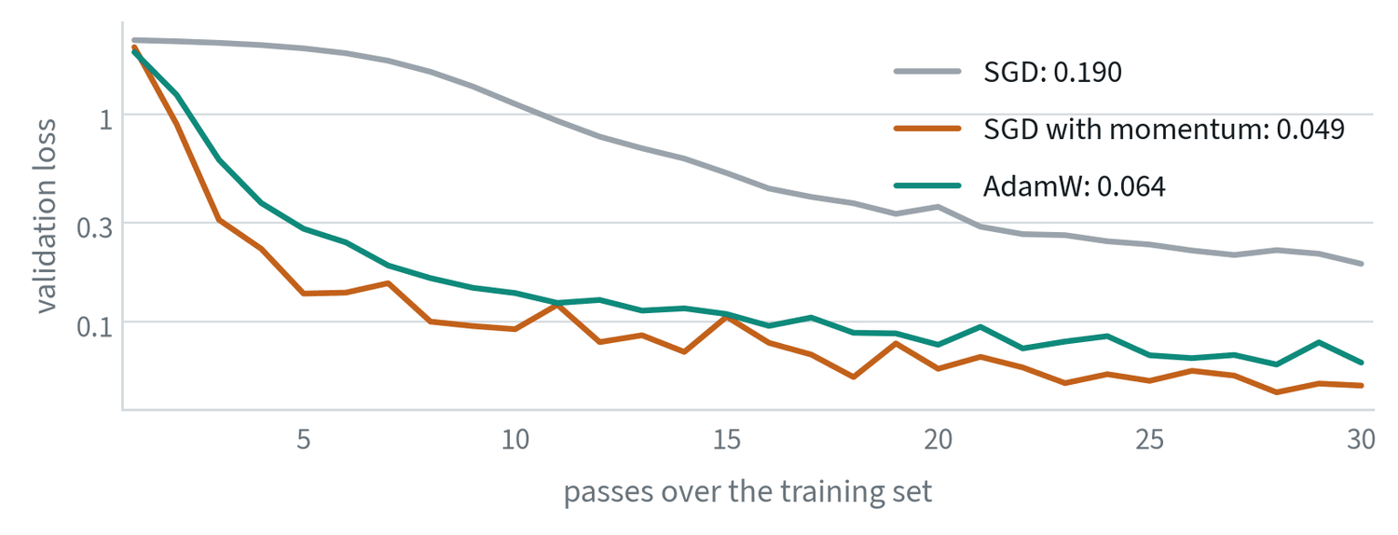
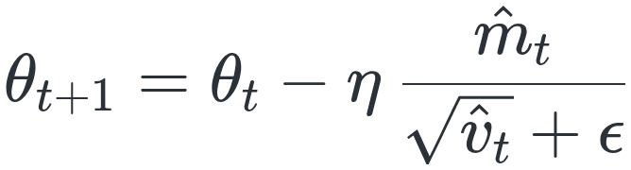
Optimisers add memory and per-parameter scaling
2 · FOUNDATIONS THAT SURVIVED
plain gradient descent uses one step size for every parameter and forgets the past
Momentum and Adam
Momentum: step along a running average of past gradients
Adam: running averages of the gradient and of its square
Same network and data, each optimiser at a reasonable learning rate, 30 passes. Validation loss: plain SGD 0.19 and still descending, momentum 0.049, AdamW 0.064.
Each parameter gets its own step: large where gradients were small, small where large
No optimiser is best in general; AdamW is the transformer default because it forgives the learning rate
Notes:
Momentum damps oscillation and speeds progress along consistent directions. In Adam the hats denote a correction for the averages starting at zero: m̂ is m divided by one minus β₁ to the power t, and likewise for v. Typical values are β₁ = 0.9 and β₂ = 0.999. AdamW adds weight decay as a separate step, θ ← θ − ηλθ, instead of folding it into the gradient where Adam's scaling would distort it. In the figure momentum edges out AdamW on this small problem. On large transformers AdamW is far more forgiving of the learning rate.

Slide 19
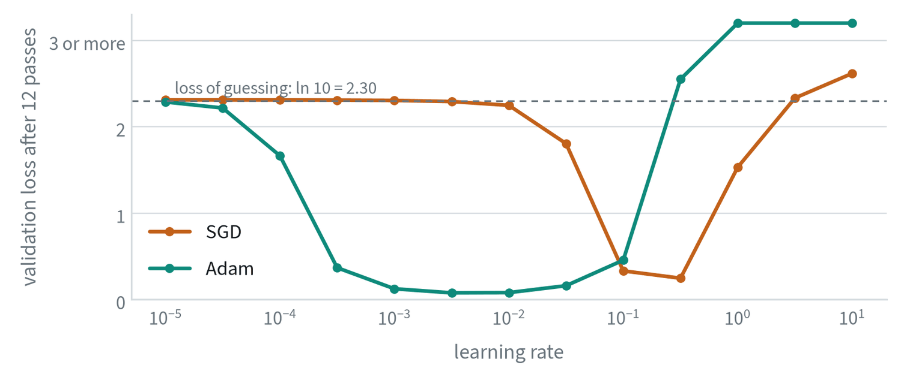
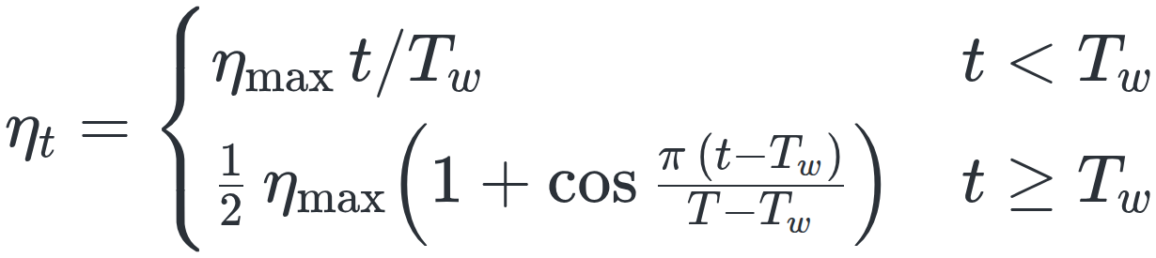
The learning rate is the most important number to tune
2 · FOUNDATIONS THAT SURVIVED
measured for this note on a small classifier: validation loss after 12 passes, mean of three runs per point
Warm up, then decay
Each optimiser has a basin. Adam works from about 0.0003 to 0.03 and diverges above 0.3. SGD needs a rate about a hundred times larger, near 0.1 to 0.3.
A linear ramp from zero over the first steps, then a decay along a cosine
If training diverges or stalls, look at the learning rate before anything else
Notes:
Two things in this sweep generalise. The usable range is roughly one to two orders of magnitude wide, so a sweep on a log scale finds it in a handful of runs. Too low and the loss never leaves the level of guessing; too high and training diverges. And the range depends on the optimiser, which is why a rate copied from one setup rarely transfers to another. The warmup exists because early gradients are large and noisy. One trap: a metric that stops improving only because the schedule has reached zero has not converged. Check that the model levelled off while the rate was still meaningfully above zero.

Slide 20
Loss functions tell the model what “wrong” means
2 · FOUNDATIONS THAT SURVIVED
the loss is the only signal the model gets, so pick the one that matches the kind of output
Loss | Use it when the output is | Intuition | Where you will see it
Cross entropy | One of several classes, or the next token | Penalises low probability on the correct answer | Classifiers, language models, action tokens
MSE | A continuous number | Penalises large errors heavily; predicts the average | Regression, diffusion and flow-matching targets
L1 or Huber | A continuous number with outliers | Penalises errors evenly | Action regression, depth, boxes
KL divergence | A probability distribution | How different two distributions are | VAEs, distillation from a teacher
Contrastive | An embedding | Pull matching pairs together, push the rest apart | CLIP-style models, retrieval
MSE predicts the mean, so a policy trained with it averages two valid ways of doing a task
Notes:
Choosing the loss is choosing what the model cares about. Read the table by the kind of output: a class, a number, a distribution, or a similarity. The second row matters most for robots. A model trained with mean squared error predicts the average of the answers it has seen, and the average of two valid ways of doing a task is often not a valid way. The note on robot policies shows why that fails.

Slide 21
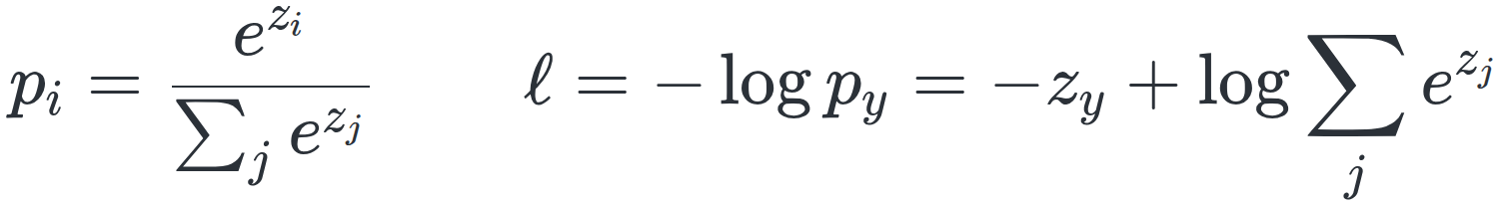
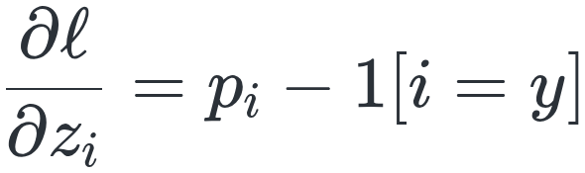
Why these losses: maximum likelihood
2 · FOUNDATIONS THAT SURVIVED
each loss in the table says the same thing: make the training data as probable as possible under the model
Softmax and cross entropy, written out
In words
Squared error assumes one right answer blurred by bell-shaped noise. Fitted to two right answers, a single bell curve sits in the middle.
Every position. A language model applies cross entropy at each position, with the vocabulary as the classes. Action-token policies do the same.
Label smoothing trains toward 1 − ε on the correct class, which stops the logits growing without bound and improves calibration.
Huber is quadratic for small errors and linear for large ones, so a few bad labels do not dominate the gradient.
Softmax turns logits z into probabilities; the loss is minus the log of the correct one
The gradient at the logits is the predicted probabilities minus the truth
Cross entropy is maximum likelihood for classes; squared error is the same idea under bell-shaped noise
Notes:
The losses are not arbitrary. Cross entropy is exactly maximum likelihood for a choice among classes. Mean squared error is maximum likelihood under the assumption that the right answer is one value blurred by bell-shaped noise, and that assumption is why it predicts the average. Generative models exist to replace that assumption with something that can hold several answers at once. The gradient formula is worth remembering for its simplicity: predicted probabilities minus the truth.

Slide 22
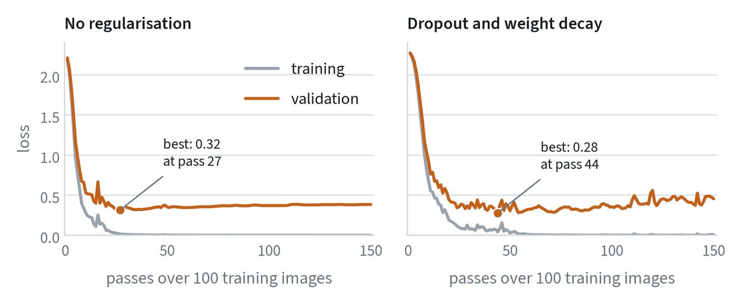
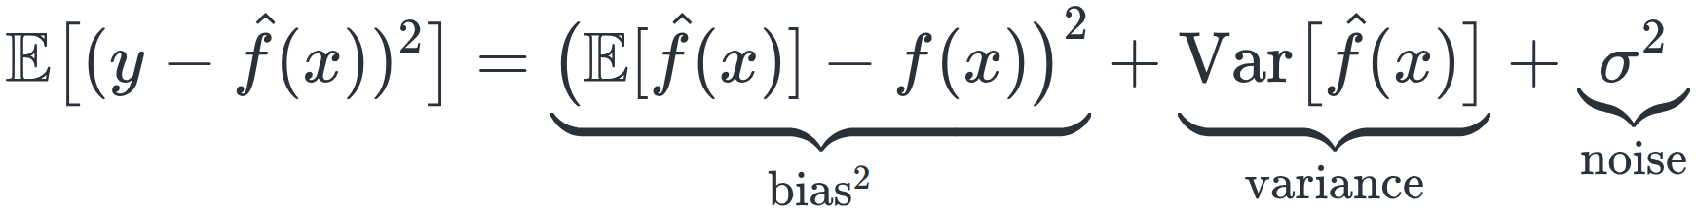
Overfitting and capacity
2 · FOUNDATIONS THAT SURVIVED
measured for this note: a network with far more parameters than its 100 training images, 150 passes
Bias, variance and noise
Training loss reaches zero in both runs. Unregularised, validation loss is lowest at pass 27, then creeps up. With dropout and weight decay the best is lower and later.
Expected error splits into a too-simple model, sensitivity to the sample, and noise
Watch the gap between training and validation loss; that gap is overfitting
Notes:
Capacity is how complex a function the model can represent. Too little capacity, or a broken run, gives high loss on both training and validation data: underfitting. A model that memorises shows training loss still falling while validation loss rises. After pass 27 every pass makes the model worse while the training loss says it is improving. Small models are high in bias and large ones in variance, which predicts a sweet spot. Very large models on very large datasets often keep improving past it, an effect called double descent. The practical rule has not changed: hold out data, plot both curves, keep the best validation checkpoint, and reach for more data first.

Slide 23
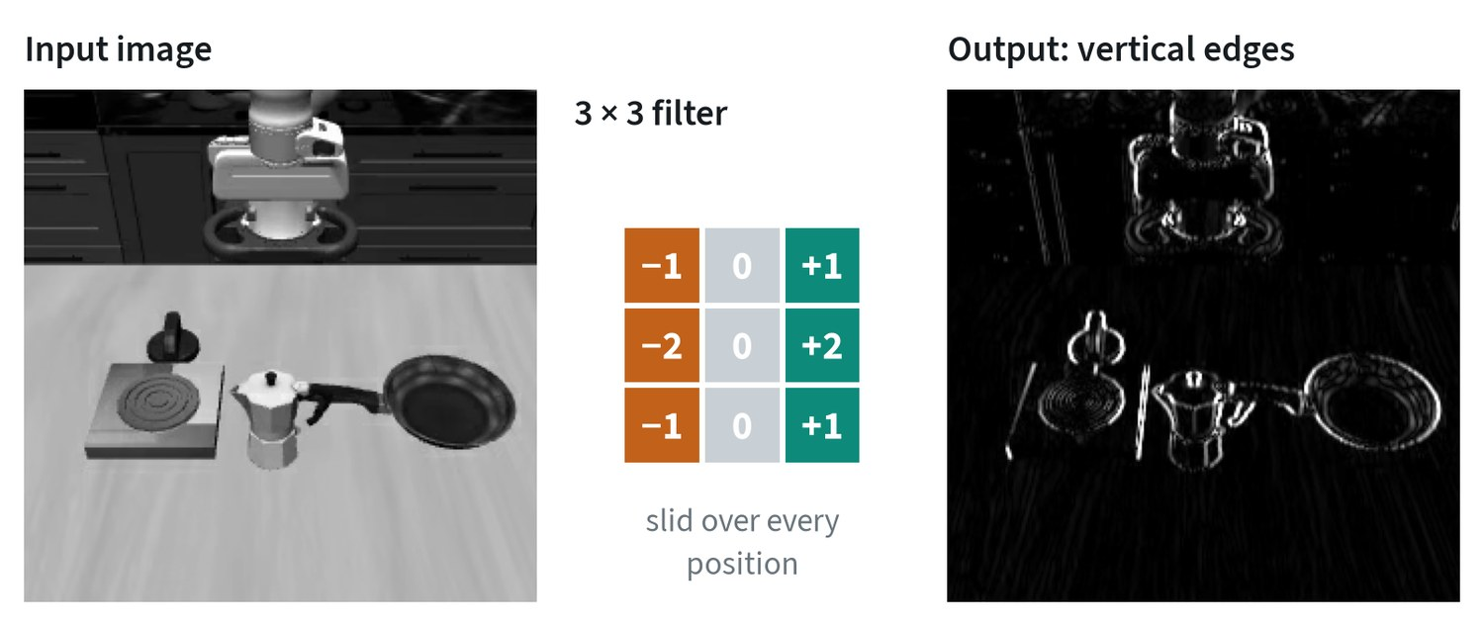
Convolutions: the older building block that stayed
2 · FOUNDATIONS THAT SURVIVED
a real camera frame passed through one hand-written 3 × 3 filter
What it does. A small grid of weights slides over the image and outputs, at each position, how well the patch underneath matches.
In the figure. Weights are negative on the left and positive on the right, so the output is bright along vertical edges of the objects.
Shared and local. The same weights are used at every position, and each output sees a small neighbourhood. Edges first, then parts and objects.
Where they remain. The patch-token step is a convolution. Image and video autoencoders are convolutional, as are some policies' vision networks.
Transformers replaced convolutions as the main architecture, and convolutions are still in most systems
Notes:
Before transformers, vision models were built from convolutions. A trained network learns thousands of filters like the hand-written one here and stacks them. Weight sharing means a feature learned in one corner is recognised in another. Locality means early layers find edges and later layers combine them into parts and objects. Both properties still earn their place: the step that cuts an image into patch tokens is a convolution, the autoencoders that compress images and video are convolutional, and several robot policies still use a convolutional network for vision.

Slide 24
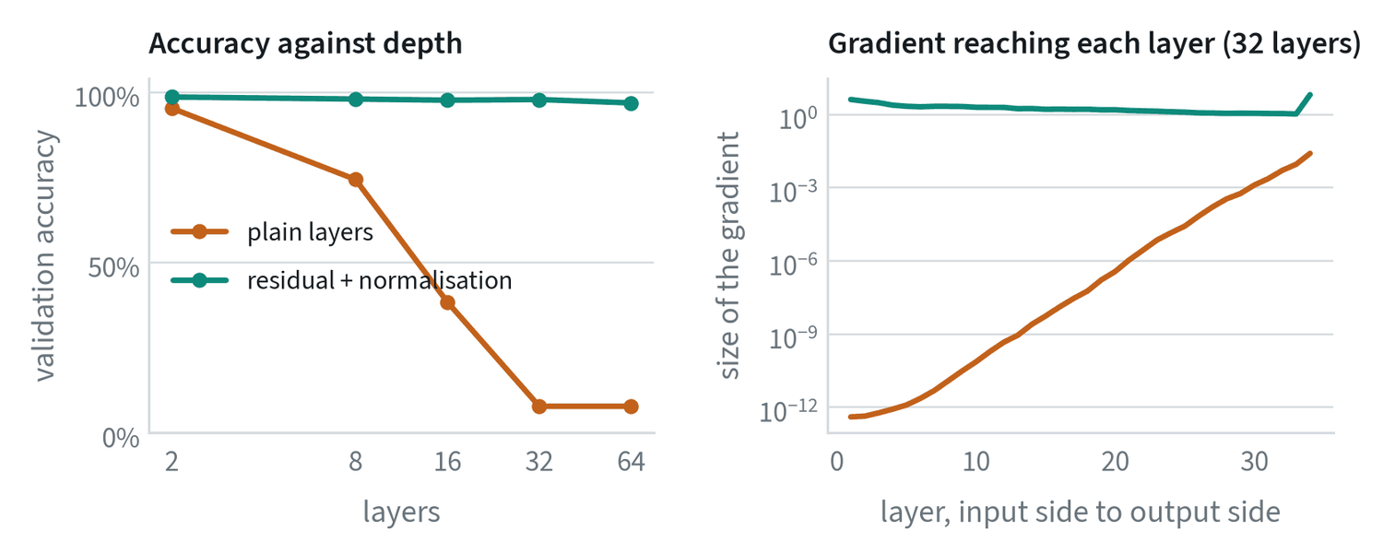
Why deep networks train at all
2 · FOUNDATIONS THAT SURVIVED
measured for this note: accuracy against depth, and the gradient reaching each layer of a 32-layer network before training
The stabilisers
Plain stacks fail. 95% at 2 layers, 38% at 16, chance at 32. The gradient shrinks by eleven orders of magnitude on its way to the first layer.
Initialisation and normalisation. Var(W) = 2/n_in for a ReLU layer keeps signals the same size. LayerNorm or RMSNorm rescales activations inside the network.
Residual connections. h + F(h) has derivative I + ∂F/∂h. The identity term is the flat line: 97 to 99% accuracy up to 64 layers.
Regularisation. Weight decay, dropout, augmentation and early stopping keep the model from memorising.
Residual connections and normalisation make deep models trainable; regularisation makes them generalise
Notes:
The right-hand panel is the product of per-layer terms from the backpropagation equation, measured. In the plain network the early layers never move. Layer normalisation computes γ times (x − μ)/σ plus β for each token, with μ and σ taken over that token's features. RMSNorm drops the mean and divides by the root mean square alone, which is cheaper and works as well in transformers; older convolutional networks use BatchNorm. Residual paths are what allow networks hundreds of layers deep. On regularisation, augmentation such as random crops and colour shifts acts as free extra data and matters a great deal when robot data is scarce.

Slide 25
Common mistakes
2 · FOUNDATIONS THAT SURVIVED
three errors in reading and running a training job
Tuning everything except the learning rate
Stopping at the step budget
Reading the training loss alone
If training diverges or stalls, look there first.
A run is finished when the validation curve has flattened, not when the counter runs out.
It always improves.
Only the validation curve says whether the model is learning or memorising.
Look at the learning rate first, and read the validation curve, not the step counter
Notes:
Each mistake has a figure behind it in this section. The learning rate sweep showed a basin only one to two orders of magnitude wide, outside of which nothing else matters. The schedule slide warned that a curve flattened by a learning rate at zero has not converged. The overfitting figure showed a training loss going to zero while the model got worse from pass 27 onward.

Slide 26
Sequence-to-sequence models
FOUNDATIONS · TOPIC 3 OF 32
One sequence in, another out: the bottleneck, attention, teacher forcing, decoding, and why robot control has the same shape.
KEY POINTS
The question in every design is how the output side reaches the input side.
A single vector between encoder and decoder fails on long inputs; attention removes the limit.
Teacher forcing makes training fast and leaves the model unused to its own mistakes.
Run it: Sequence to sequence: the bottleneck and how attention removes it (github.com/wnukmat/robot-learning-notebooks)
Notes:
Sequence-to-sequence models. One sequence in, another out: the bottleneck, attention, teacher forcing, decoding, and why robot control has the same shape. The full note is at www.matthewwnuk.com/guide-sequence-to-sequence.html.

Slide 27
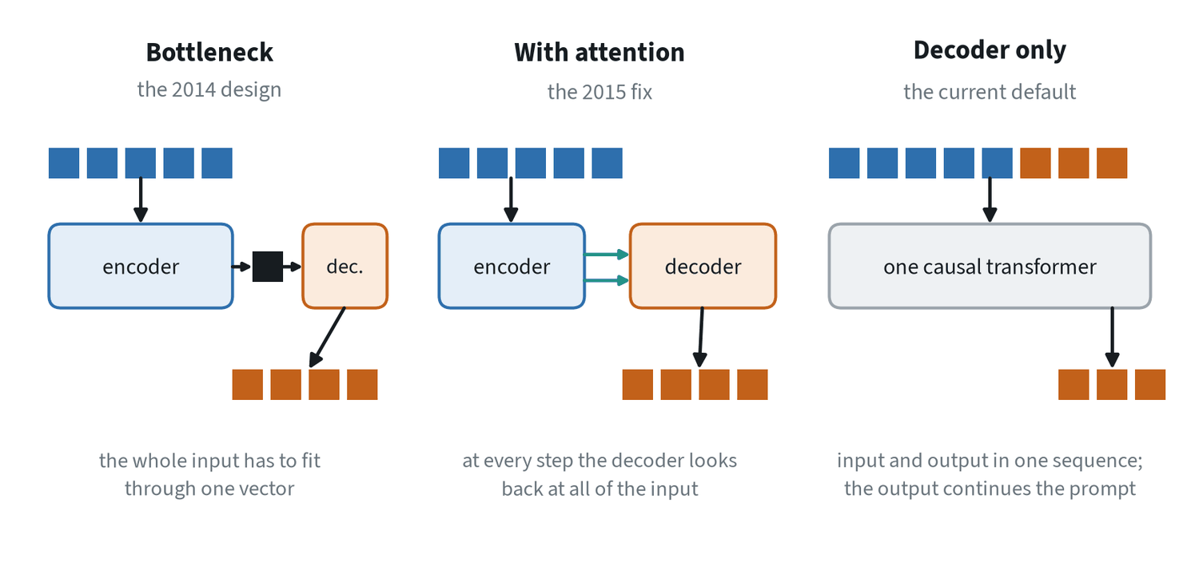
One sequence in, another out: three designs
3 · SEQUENCE-TO-SEQUENCE MODELS
translation, summarising, transcription and robot control share one shape; the designs are in the order they appeared
No fixed alignment. The third output word need not match the third input word, and the output can be longer or shorter.
The bottleneck. An encoder compresses the input into one vector and a decoder writes from it. All it knows of the input must fit there.
Attention. Keep every encoder output and let the decoder look back at all of them at every step, weighted by relevance.
Decoder only. Put input and output in one sequence and train a single causal model to continue it. The input is a prompt.
The question in every design is how the output side reaches the input side
Notes:
A sequence-to-sequence model reads one sequence and writes another, and the two may differ in length. Translation is the original example. Summarising, transcribing speech, answering a question and writing code from a description are the same shape, and so is robot control: observations in, actions out. The bottleneck was the first design to work end to end. Attention was invented here, as the fix for the bottleneck, three years before the transformer. The history of these models is the history of how the output side gets access to the input side.

Slide 28
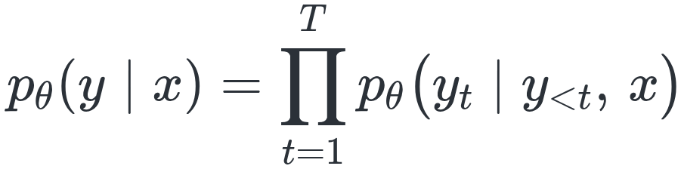
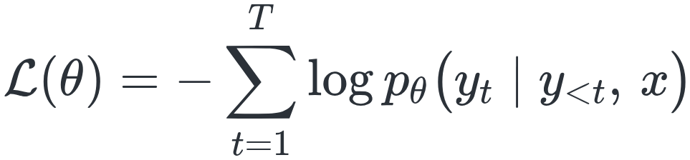
The model as a probability
3 · SEQUENCE-TO-SEQUENCE MODELS
the probability of an output sequence y given an input x, built one token at a time by the chain rule
Factorise, then maximise
In words
Each factor is a softmax over the vocabulary.
The loss is cross entropy summed over positions.
Perplexity is the exponential of the average per-token loss: roughly, how many equally likely choices the model hesitates between.
Each token is predicted from the input and the tokens before it
Training maximises the log-probability of the correct output
With an empty input the same factorisation is a language model, which is why the two share everything
Notes:
This is the formal statement behind every model in the section. The output probability is a product of per-token probabilities, each conditioned on the input and on the output so far. Taking the log turns the product into a sum, and maximising it is the cross entropy from the foundations note, applied at every position. Perplexity is the usual way to report that loss on a readable scale. Nothing here requires an input: drop x and the same formula describes a language model.

Slide 29
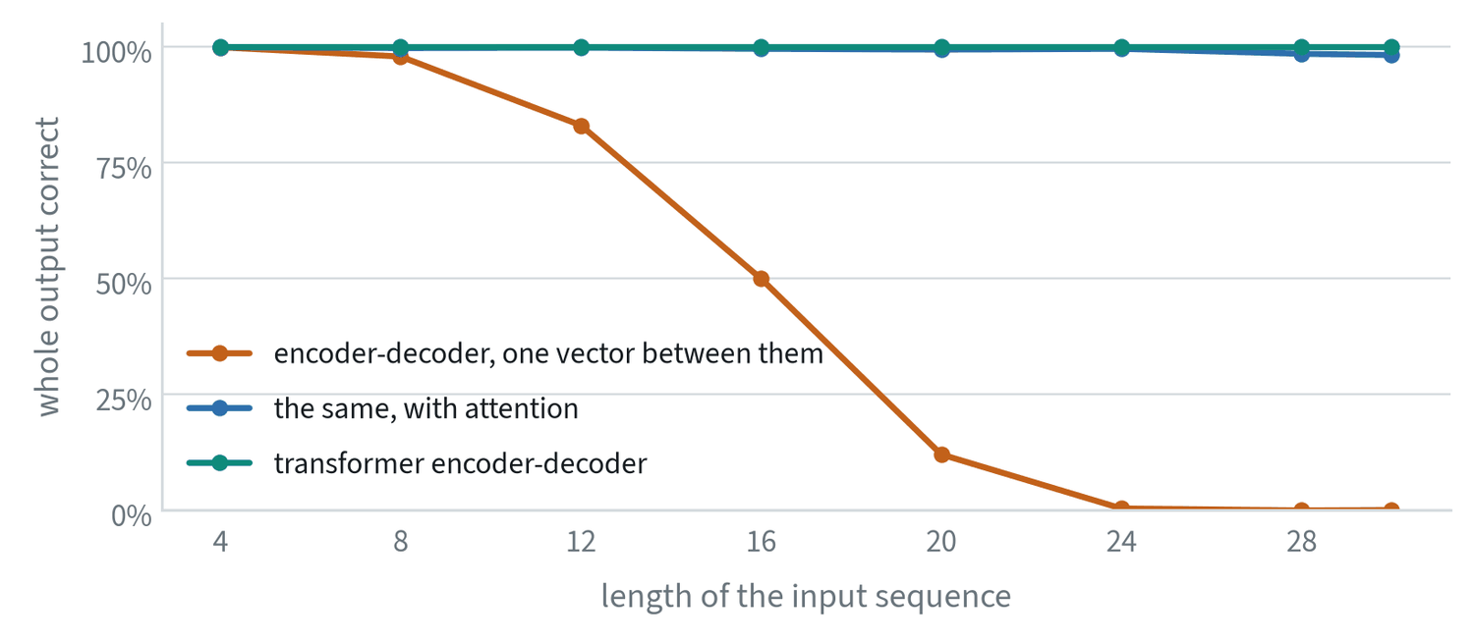
The bottleneck, measured
3 · SEQUENCE-TO-SEQUENCE MODELS
trained for this note: reverse the input sequence; lengths 3 to 30 seen in training; mean of three runs
One vector. Share of entirely correct outputs: 98% at length 8, 83% at 12, 50% at 16, 12% at 20, zero from 24.
Why. The encoder's single vector, 96 numbers here, cannot hold a long sequence precisely enough to reproduce it.
With attention. The same recurrent model plus about 30,000 parameters holds 98% or better at every length up to 30.
Transformer. Attention throughout, and no errors at all.
A single vector between encoder and decoder fails on long inputs; attention removes the limit
Notes:
The three models were trained on the same data for the same number of steps, so the comparison isolates the route from decoder to input. The metric is strict: an output counts only if every symbol is right. The collapse of the bottleneck model is gradual and then total. The fix is small in parameters and large in effect, which is the point of the figure: the limit was the single vector, and capacity elsewhere in the model could not make up for it.

Slide 30
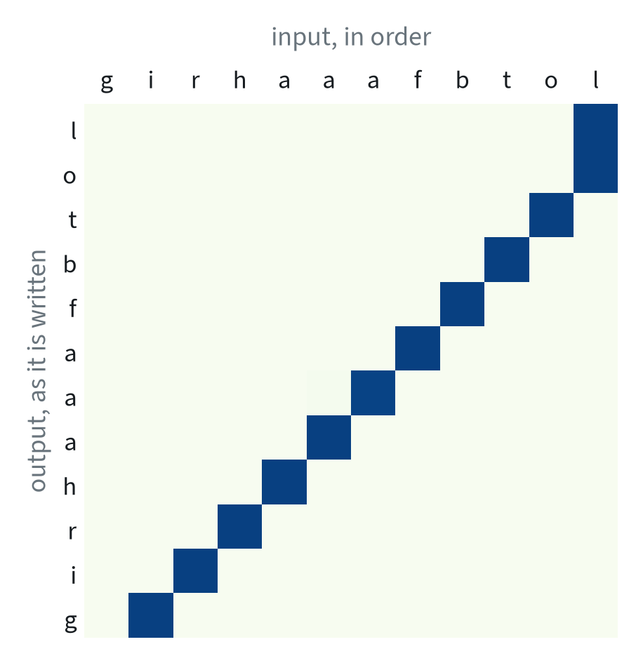
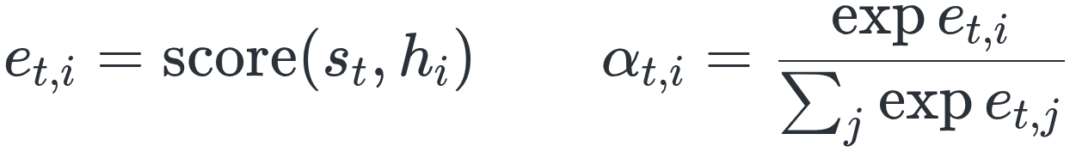
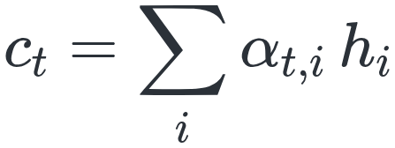
The attention step, written out
3 · SEQUENCE-TO-SEQUENCE MODELS
encoder outputs h₁ to hₙ, decoder state sₜ at step t
Score, normalise, average
Score every input position against the current state, then normalise
The context is the weighted average of the encoder outputs
Two scores: additive, the original, and dot-product, which the transformer adopted
The weights α of the middle model reversing a twelve-symbol sequence. Each row is one output step. One dark cell per row: it walks backwards through the input.
Nobody told the model that reversal means reading backwards; the attention weights show it found out
Notes:
The figure plots the weights α from the equations, with input symbols across the top and output symbols down the side. The diagonal runs from the last input symbol to the first, one position per step. In translation the same picture shows which source words each output word was drawn from, which is why these weights were first called an alignment. On the score: the original additive form used a small network. The dot-product form is cheaper, and it is what the transformer adopted and scaled up.

Slide 31
Training: teacher forcing and its cost
3 · SEQUENCE-TO-SEQUENCE MODELS
the decoder predicts each token from the tokens before it; in training those come from the correct output
Teacher forcing
Exposure bias
Remedies
Earlier tokens are taken from the correct output, not from the model's own predictions.
Every position is trained in parallel in a single pass, which is why these models train efficiently.
In training the model always sees a perfect history. In use it sees its own output, mistakes included.
One early error can send everything after it off course.
Train on more varied data.
Occasionally feed the model its own predictions during training.
Generate the output in a way that does not depend on a long chain of earlier choices.
Teacher forcing makes training fast and leaves the model unused to its own mistakes
Notes:
Exposure bias is the same problem as compounding error in imitation learning: the model is never shown the states its own mistakes lead to. A policy trained on expert demonstrations and a decoder trained with teacher forcing both see only perfect histories. The remedies are the same too, and the third one points ahead: methods that produce a whole output at once avoid the long chain of earlier choices altogether.

Slide 32
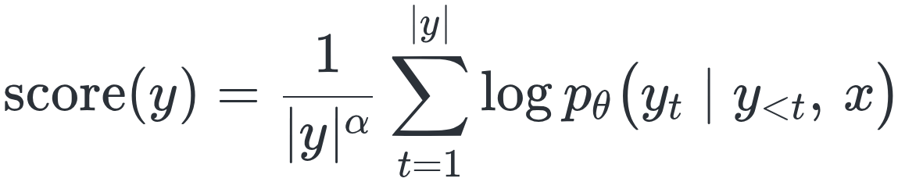
Decoding: choosing the output
3 · SEQUENCE-TO-SEQUENCE MODELS
four ways to turn per-token probabilities into a sequence, and the length correction beam search needs
Beam search score
In words
Greedy. The most probable token at each step. Fast and fine with one right answer; an early poor choice cannot be undone.
Beam search. Keeps the k best partial outputs and extends them all. For translation and transcription; slower, tends to short, bland text.
Sampling. Draws from the probabilities, often with a temperature or cut-off. Gives variety; can go wrong and is not repeatable.
Constrained. Allows only tokens that keep the output valid: code, coordinates, actions. Needs a description of what is valid.
Beam width. Widths of 4 to 8 capture most of the gain. Much wider beams often make output worse.
Total log-probability divided by a function of the length, with α between 0.6 and 1
For robot actions decoding is greedy or constrained, because a sampled outlier becomes a jerk of the arm
Notes:
Greedy decoding takes the best token at each step, which does not find the best sequence. Beam search extends each of its k partial outputs with every possible token, scores the results by total log-probability, and keeps the best k again. A raw sum favours short outputs, because every extra token adds a negative term, hence the division by length. Wider beams can hurt because the most probable sequence under the model is not always the best one. The model's probabilities are an imperfect guide.

Slide 33
What the tokens are
3 · SEQUENCE-TO-SEQUENCE MODELS
real outputs of a sub-word tokenizer with a vocabulary of about 257,000 entries
Text | Tokens | Pieces
pick up the red cup | 5 | pick · up · the · red · cup
teleoperation | 2 | tele · operation
proprioception | 3 | propri · o · ception
unscrewing the moka pot | 7 | uns · cre · wing · the · mo · ka · pot
3.14159 | 7 | 3 · . · 1 · 4 · 1 · 5 · 9
Unusual words cost more tokens, and numbers are split digit by digit
Notes:
The vocabulary is fixed in advance. Words would make it too large and unable to handle anything new, and characters would make sequences too long. Sub-word tokenisation starts from characters and repeatedly merges the most frequent adjacent pair into a new token until the vocabulary reaches a chosen size. Common words end up as one token and rare ones as several pieces, which are represented less well. A model that reads or writes coordinates as text handles each digit separately, which is one reason action values are given dedicated tokens instead.

Slide 34
Encoder-decoder or decoder only
3 · SEQUENCE-TO-SEQUENCE MODELS
two ways to arrange the same parts, compared row by row
 | Encoder-decoder | Decoder only
Input is read | In both directions, by a dedicated encoder | Left to right, as part of the same sequence
Parameters | Two stacks, with cross-attention between them | One stack
Reusing the input | The encoder's output is computed once and attended to throughout | The key-value cache does the same job
Pretraining | Needs paired inputs and outputs, or a denoising task | Next-token prediction on any text
Where it is used | Translation, speech recognition, some robot policies | Language models, vision-language models, most new systems
Decoder-only models won mainly on pretraining: next-token prediction works on any text
Notes:
The fourth row decided it. Decoder-only models can be pretrained on unlimited plain text and then asked to do any sequence-to-sequence task by phrasing it as a prompt. The encoder-decoder shape remains where the input and output are different kinds of thing and a specialised encoder helps. A third option skips the token-by-token chain entirely. Non-autoregressive models produce the whole output at once and refine it over a few passes. Diffusion and flow matching are of this kind, and they are how most robot policies now generate action chunks.

Slide 35
Robot control as sequence-to-sequence
3 · SEQUENCE-TO-SEQUENCE MODELS
a sequence of observations in, a sequence of actions out
Action chunking with a transformer
Actions as tokens
An encoder reads the camera images and joint positions.
A decoder writes the next chunk of actions, all at once. The encoder-decoder shape applied directly.
A decoder-only vision-language model continues its prompt with action tokens, exactly as it would continue a sentence.
Instructions to plans
Video to actions
A sentence in, a list of sub-tasks out.
A sequence of frames in, the actions that produced them out.
Bottlenecks, exposure bias and decoding were learned on text first, and each has a counterpart on a robot
Notes:
Seeing control this way explains why so much carries over from language. The single-vector bottleneck, the mismatch between training on perfect histories and running on your own output, and the choice of decoding method all reappear on a robot under other names. The first two cards are the encoder-decoder and decoder-only designs from the previous slide, applied to actions. The notes on attention and robot policies continue from here.

Slide 36
Common mistakes
3 · SEQUENCE-TO-SEQUENCE MODELS
three errors in evaluating and running sequence models
Judging by per-token accuracy
Forgetting the mismatch
Sampling where one answer is right
One wrong token can ruin an output.
Score whole outputs.
A model that looks perfect with the correct history can still drift on its own output.
Use greedy or beam search for translation, transcription and actions.
Score whole outputs, test the model on its own history, and do not sample where one answer is right
Notes:
The first mistake is why the reversal experiment counted only entirely correct outputs. The second is exposure bias seen from the evaluation side: a teacher-forced validation score says little about free-running behaviour, so evaluate with the model generating from its own output. The third follows from the decoding slide: sampling buys variety, and tasks with one right answer have no use for it.

Slide 37
The transformer
FOUNDATIONS · TOPIC 4 OF 32
One block, stacked many times, that now reads text, images, video and robot actions.
KEY POINTS
Everything is turned into tokens, and one block is repeated to process them.
Attention moves information between tokens. The MLPs, which hold most of the parameters, transform it.
A model of L layers and width d has about 12·L·d² parameters; cost scales with parameters times tokens.
Notes:
The transformer. One block, stacked many times, that now reads text, images, video and robot actions. The full note is at www.matthewwnuk.com/guide-transformer.html.

Slide 38
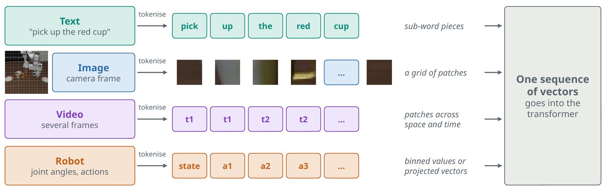
Everything becomes tokens
4 · THE TRANSFORMER
a transformer reads one sequence of vectors; the first job of any model is to build that sequence
Text is split into sub-word pieces, and each piece is looked up in a table of learned vectors.
Images are cut into patches, for example 16 by 16 pixels, each flattened and projected. A 224-pixel image gives 14 × 14 = 196 tokens.
Video adds a time axis.
Robot data. Joint angles and actions are sorted into numbered bins, so they look like words, or projected as continuous vectors.
After tokenising, the model neither knows nor cares where a token came from
Notes:
The figure shows four kinds of input joining one sequence. The image row is a real robot camera frame with real patches cut from it. The point to stress is the indifference that follows: once everything is a token, the same block processes all of it. That indifference is the reason one architecture now serves language, vision and robot control.

Slide 39
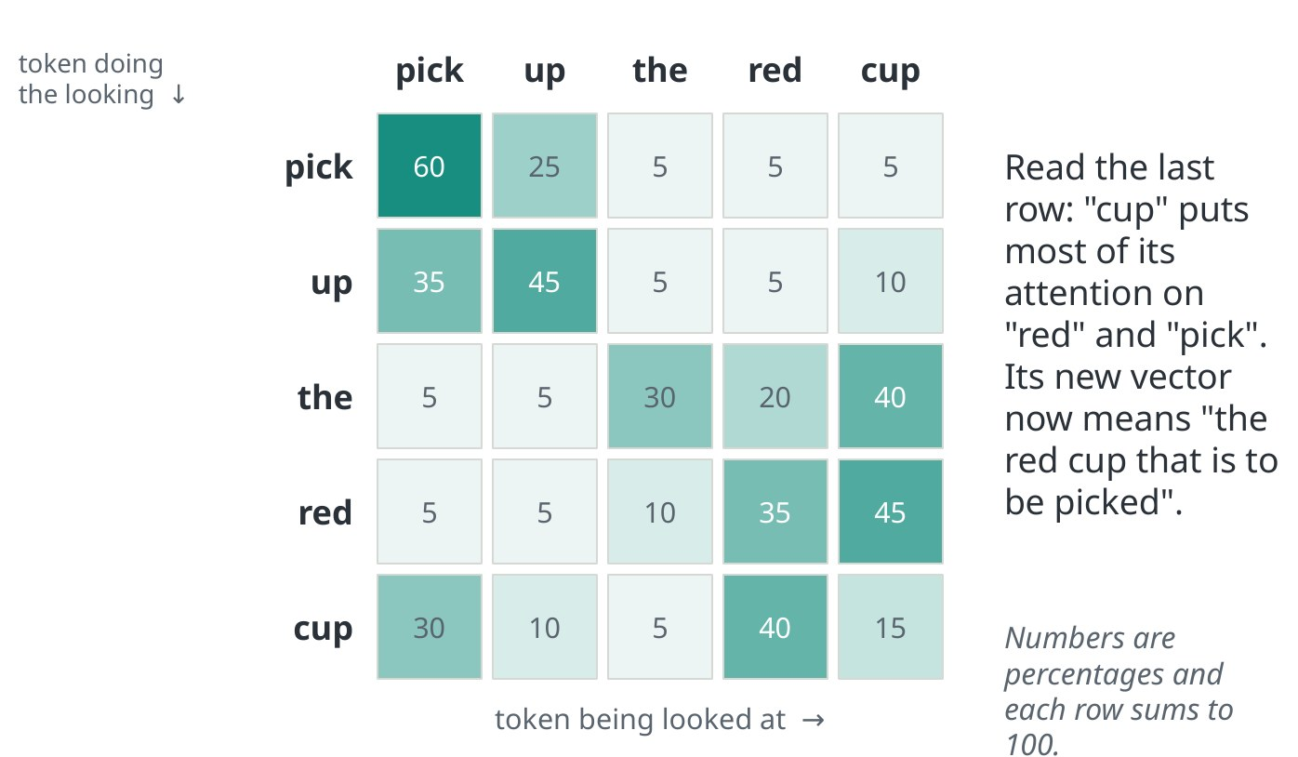
Attention: every token looks at every other token
4 · THE TRANSFORMER
illustrative weights, as percentages, for the words pick, up, the, red, cup
Query, key, value. Each token says what it looks for, what it contains and what it passes on. Queries are compared with every key.
Each row is one token deciding where to look. A softmax makes the weights sum to one, and the new vector is the weighted sum of values.
Read the last row. “Cup” puts most of its weight on “red” and “pick”, so it now means something like the red cup that is to be picked.
Heads. Several of these run in parallel so that different heads can follow different relationships.
Attention is how a token gathers context, at a cost that grows with the square of the sequence length
Notes:
The weights in the grid are illustrative. Self-attention relates tokens within one sequence. Cross-attention lets one sequence read another, for example action tokens reading image features. Because every token is compared with every other, the cost grows with the square of the sequence length, which is why video and long robot histories are expensive. The note on attention covers all of this in depth.

Slide 40
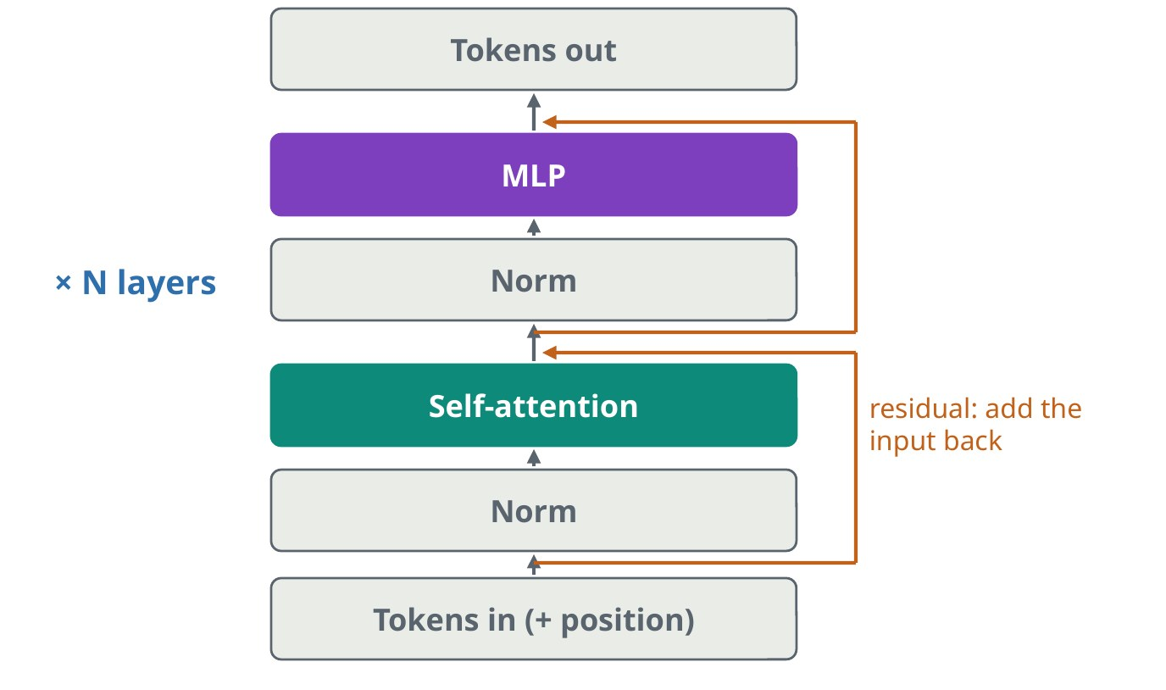
Inside one block
4 · THE TRANSFORMER
read from the bottom up: tokens, normalisation, self-attention, normalisation, MLP; orange lines are residual connections
Attention sub-layer. Moves information between tokens.
MLP sub-layer. A small network applied to each token on its own. It holds most of the model's parameters.
Normalise, then add back. The addition is the residual connection, a direct path for gradients that lets very deep stacks train.
Position. Attention has no sense of order. Rotary encoding rotates queries and keys by an angle that depends on position.
A transformer is the same block repeated: attention moves information, the MLP transforms it
Notes:
Each sub-layer first normalises its input and then adds its output back to that input. The residual path is the same idea measured in the foundations note, where it kept the gradient near one across many layers. Position has to be injected because attention alone has no sense of order. Most current models use rotary position encoding, and because the rotation depends on position, attention can reason about how far apart two tokens are.

Slide 41
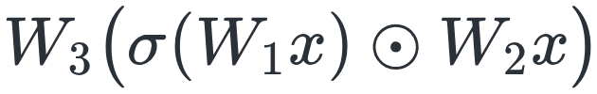
One block in equations
4 · THE TRANSFORMER
X holds n tokens of width d; the now-standard pre-normalisation form is two residual updates
Two residual updates
In words
Pre-normalisation. The original transformer normalised after each sub-layer. Normalising before it avoids a delicate warmup.
The output. After the last block, a final normalisation and a linear layer map each token to scores over the vocabulary.
Weight tying. Usually that linear layer shares its weights with the input embedding table.
Each sub-layer normalises its input and adds its output back
Per token: widen to d_ff, usually 4d, apply a non-linearity, narrow back
The gated variant, with three matrices, common in current language models
Normalising before each sub-layer keeps the residual path clean, so hundreds of layers train
Notes:
These equations are the previous diagram written down. The MLP acts on each token separately, so all communication between tokens happens in the attention term. The choice of where to normalise looks minor and is what lets hundreds of layers train: with pre-normalisation the residual path from input to output is never rescaled. Weight tying means the same matrix serves as the input embedding and the output layer.

Slide 42
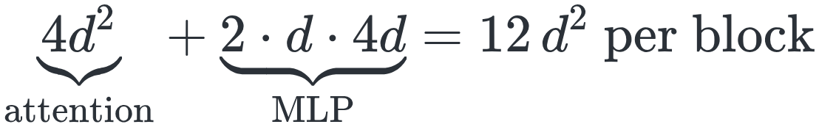

Where the parameters are
4 · THE TRANSFORMER
attention has four d × d matrices: query, key, value and output; the MLP has two of size d × d_ff
Counting one block
In words
Check on a real model. For a vision transformer with L = 12 and d = 768 the formula predicts 85 million. The real model has 87 million.
Two thirds MLP. Of the 12 d² in a block, 8 d² sit in the MLP.
Compute per token is about two floating-point operations per parameter, so cost scales with parameters times tokens.
Plus attention. On top of that comes the attention term that grows with the square of the sequence.
With d_ff = 4d, one block has about 12 d² parameters
A model of L layers has about 12 L d² parameters
A model of L layers and width d has about 12·L·d² parameters, and two thirds of each block is MLP
Notes:
This count is worth being able to do in your head. Four square matrices for attention, two rectangular ones for the MLP, and with the usual four-times widening the total is twelve d squared per block. The formula lands within a few percent of a real vision transformer. The compute rule of thumb follows from it: about two floating-point operations per parameter for each token, plus the quadratic attention term.

Slide 43
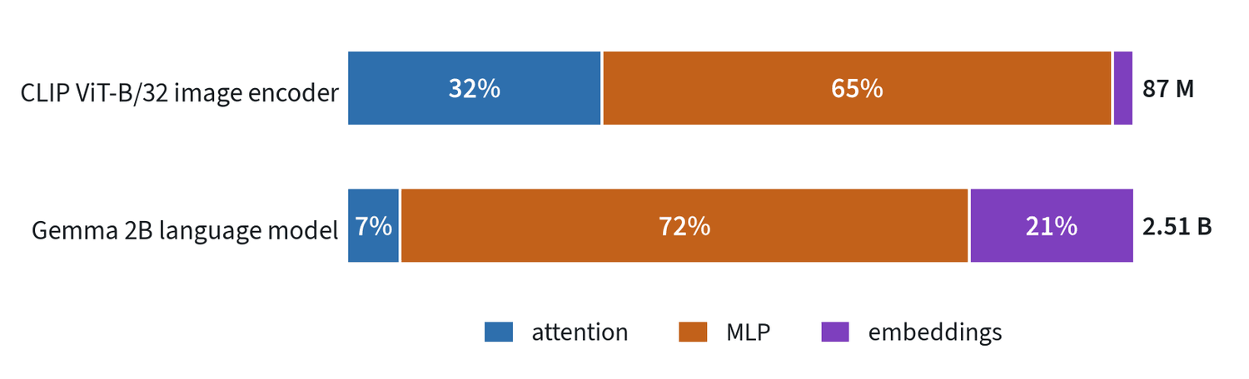
The count in two real models
4 · THE TRANSFORMER
counted from CLIP ViT-B/32's image encoder, 87 million, and the Gemma 2B language model, 2.51 billion
Image encoder. 32% attention and 65% MLP.
Language model. 7% attention, 72% MLP and 21% embeddings: one vector for each of 257,216 tokens.
Why attention is so small. 18 layers of width 2,048 with an MLP width of 16,384, and eight query heads sharing one key and value head.
Memory when generating. Each token stores 18 layers × 2 × 256 numbers: about 18 kilobytes at 16-bit precision.
Attention decides where information moves; the MLPs, where most weights sit, store and transform it
Notes:
The MLPs dominate both models. The language model pushes the pattern further than the twelve d squared rule: its MLP is eight times the token width, and sharing a single key and value head shrinks attention to 7% of the parameters. The embedding table is a fifth of the whole. On memory: when generating, each token stores its keys and values at every layer. At about 18 kilobytes per token, a thousand-token context needs about 18 megabytes.

Slide 44
Three shapes, and how they are made fast
4 · THE TRANSFORMER
the shapes differ in what a token is allowed to see
Shape | What a token can see | Good at | Where it is used
Encoder | All tokens, in both directions | Understanding an input | Vision encoders, embeddings, classifiers
Decoder | Only earlier tokens | Generating a sequence step by step | Language models, vision-language models
Encoder-decoder | The decoder also reads the encoder's output | Mapping one sequence to another | Translation, some action policies
The KV cache makes the next token far cheaper than reprocessing the whole prompt
Notes:
When a decoder generates, the keys and values of earlier tokens do not change, so they are stored and reused. This is the KV cache. Robot policies lean on the same idea: a large model encodes the camera images once, and a small action network reuses that result many times. The note on robot policies picks this up. Context length, the most tokens the model can read at once, is the other number that goes with these shapes.

Slide 45
Common mistakes
4 · THE TRANSFORMER
three errors that follow from forgetting how the block works
Forgetting position
Reading attention maps as explanations
Ignoring the quadratic cost
Without position information a transformer treats its input as an unordered set.
They show where weight went.
That is a hint about the model's reasoning and not a proof.
Doubling image resolution gives four times the tokens and about sixteen times the attention cost.
Supply position, treat attention maps as hints, and count tokens before raising resolution
Notes:
Each mistake maps to one part of the section. Position is the one thing attention does not provide by itself, so it must be injected. Attention weights are easy to plot and easy to over-read. And the quadratic term is where budgets go wrong: resolution doubles, the patch grid quadruples, and the attention cost rises about sixteen times.

Slide 46
Attention in depth
FOUNDATIONS · TOPIC 5 OF 32
One operation, many forms: self, cross and shared attention, heads and masks, what it costs, and the linear recurrent variants.
KEY POINTS
Every kind of attention is the same lookup. They differ in where queries, keys and values come from, and in the mask.
Standard attention costs time that grows with the square of the sequence, and remembers everything.
Linear recurrent forms cost the same per token forever, and remember a fixed-size summary.
Run it: Attention from scratch (github.com/wnukmat/robot-learning-notebooks)
Notes:
Attention in depth. One operation, many forms: self, cross and shared attention, heads and masks, what it costs, and the linear recurrent variants. The full note is at www.matthewwnuk.com/guide-attention.html.

Slide 47
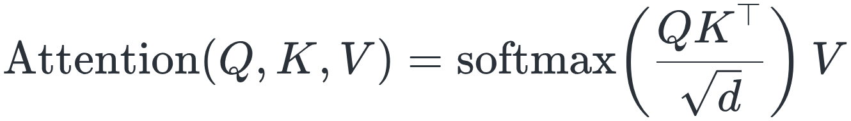
One operation: a soft lookup
5 · ATTENTION IN DEPTH
each token asks a question, every token offers an answer, and each leaves with a blend of the best matches
In symbols
In words
Query, key, value. Three learned matrices turn each token into what it looks for, what it contains and what it passes on.
Q Kᵀ is an n × n table of scores, one for every pair of tokens.
Softmax turns each row into positive weights that sum to one: one token deciding where to look.
× V replaces each token with the weighted average of the values.
Scores from queries and keys, turned into weights, applied to values
Attention moves information between tokens. It cannot create any; that is the MLP's job
Notes:
Everything else in this section is a variation on this one formula. Stress the two consequences. First, it is a soft dictionary lookup: every entry answers a little, in proportion to how well its key matches the query. Second, the output is always an average of existing values, so attention only routes information. New features are computed by the MLP that follows attention in every transformer block.

Slide 48
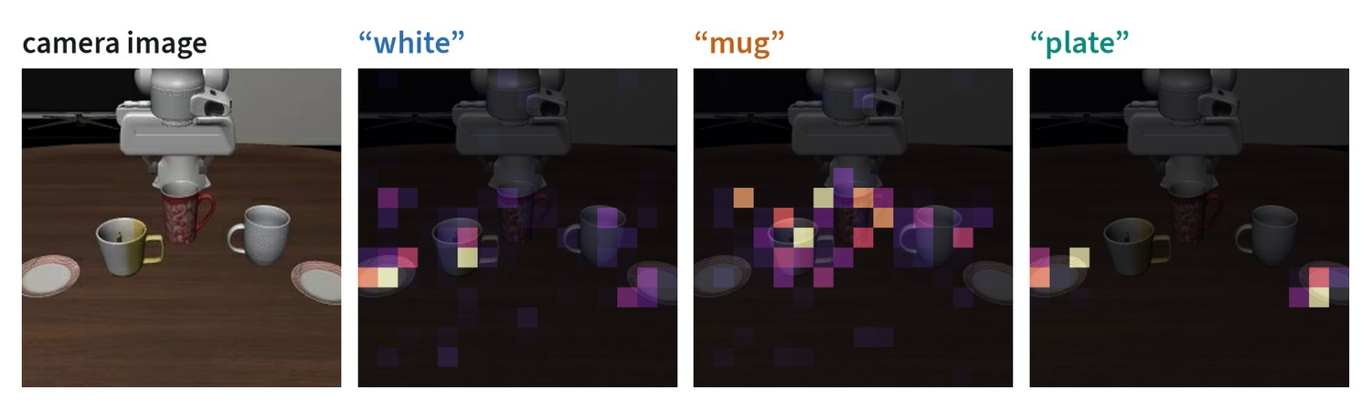
What it looks like in a real model
5 · ATTENTION IN DEPTH
attention from three words of a robot instruction onto the camera image, in a public vision-language model
One sequence. The image is 256 tokens and the instruction follows it, so a word can attend to any patch.
It lands on the object. "Plate" sends 96% of its attention to image tokens, on the two plates; "mug" sends 91%.
Chosen to be readable. Most of the model's 144 heads are not, and some park weight on background patches.
Evidence, not explanation. Use maps to form a hypothesis about a model, then test it another way.
A map shows where information was read from, not what was done with it
Notes:
These are real attention weights, not an illustration. The head shown was picked because it is easy to read. Most heads are not, and several put their weight on a few background patches that the model seems to use as scratch space. So an attention map is evidence about where a model read from, and never a full account of why it produced an output.

Slide 49
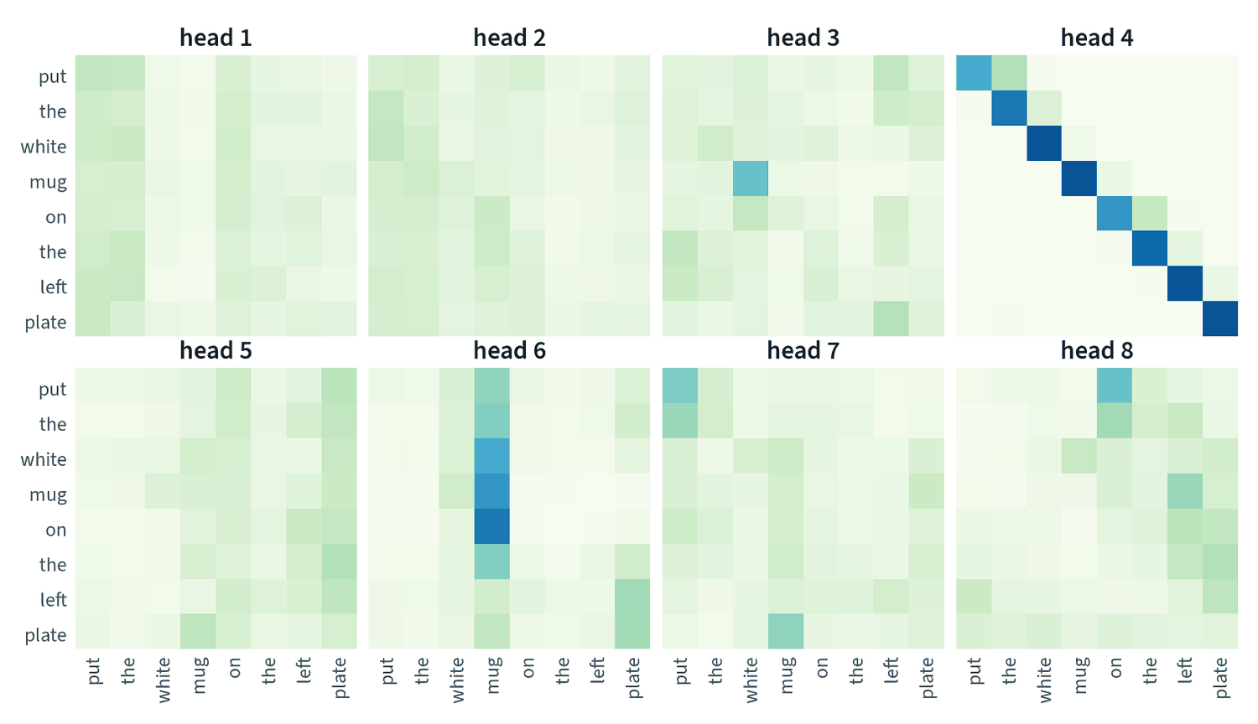
Why divide by √d, and why several heads
5 · ATTENTION IN DEPTH
two details of the formula that each fix a specific failure
Scale and heads
Scale. A dot product of two width-d vectors has a typical size of √d. Unscaled, the softmax saturates to one token and passes no gradient.
Heads. The width is split into h slices, each with its own queries, keys and values, run in parallel for about the same cost.
Different jobs. Here one head copies each word forward and one gathers everything toward "mug".
Grouped-query attention shares keys and values across heads, shrinking the memory used during generation.
The scale keeps the softmax trainable; heads let one layer follow several relationships at once
Notes:
At width 64, unscaled scores routinely differ by eight or more, which makes the softmax nearly a hard maximum with a vanishing gradient. Dividing by the square root of the width returns the scores to unit variance at any width. The figure shows all eight heads of one layer of a real model, restricted to the instruction words. The heads have plainly learned different jobs.

Slide 50
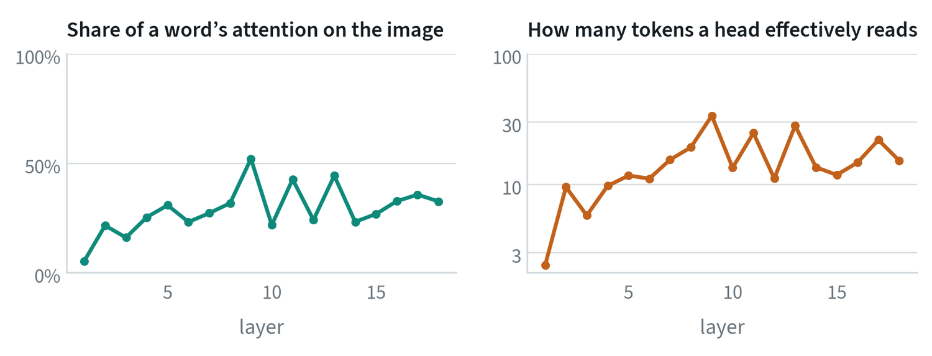
What changes with depth
5 · ATTENTION IN DEPTH
measured across the 18 layers of a real vision-language model
Layer 1 is local. A word sends 5% of its attention to the image and effectively reads two or three tokens.
Later layers mix. A fifth to a half of a word's attention is on the image, across ten to thirty tokens.
Effective count is the exponential of the entropy of a head's weights.
Reading it. Near 1, the head is a pointer to one token. Near the sequence length, it is averaging everything.
Early layers read locally; from the second layer on, words read the image
Notes:
The effective number of tokens is a diagnostic worth computing on any model. Take the entropy of a head's attention weights and exponentiate it. A value near one means the head points at a single token. A value near the sequence length means it averages everything, which adds context and little else.

Slide 51
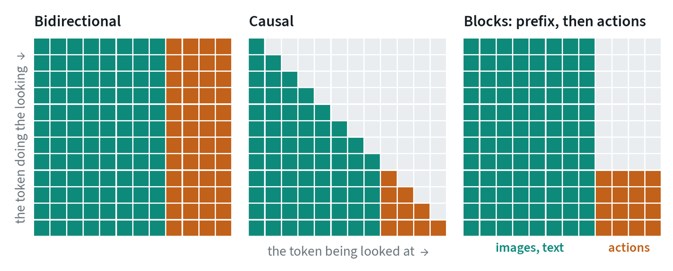
Masks decide who may look at whom
5 · ATTENTION IN DEPTH
the mask, more than the weights, is what distinguishes one architecture from another
Bidirectional: every token sees every other. Used by encoders.
Causal: a token sees itself and earlier tokens. Used for generation, and it allows cached keys and values.
Blocks: groups with different rules, such as action tokens that see everything while the prefix cannot see them.
Caching follows the mask. A stored result is reusable only if those tokens could not see what came later.
The mask, more than the weights, is what separates an encoder from a generator
Notes:
Self-attention draws queries, keys and values from the same sequence. Cross-attention takes queries from one sequence and keys and values from another, which is how a decoder reads an encoder or a diffusion model reads its text prompt. Shared attention concatenates the tokens of two models into one sequence under a block mask, which is how the action expert in a policy such as pi-zero reads its vision-language backbone.

Slide 52
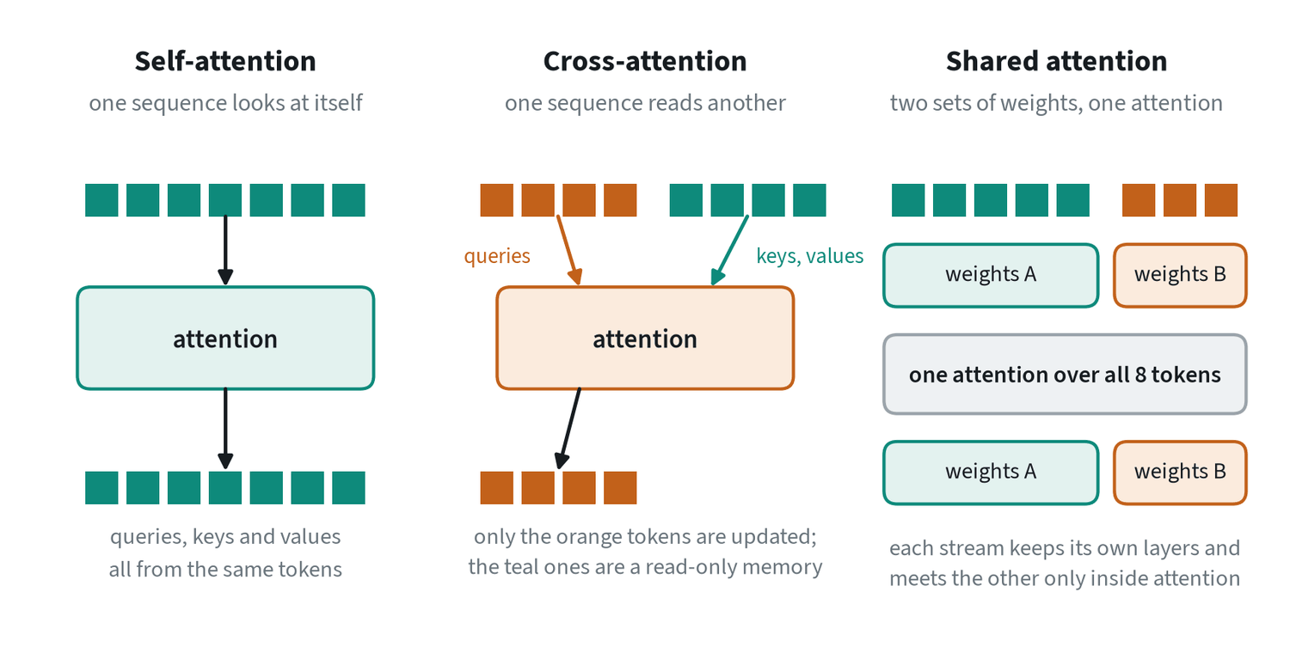
Self, cross and shared attention
5 · ATTENTION IN DEPTH
the formula does not say where the queries, keys and values come from
Self: queries, keys and values from one sequence. Every token is updated.
Cross: queries from A, keys and values from B. B is read-only, can be cached, and information flows one way.
Shared: two streams keep separate weights and concatenate their tokens inside attention only.
In robot policies the action network attends to the vision-language tokens, and a block mask stops them looking back.
Cross-attention conditions one model on another; shared attention lets two models meet with their own weights
Notes:
Cross-attention is the classic way to condition one model on another: an image generator reading its text prompt, or an action network reading a backbone's features. Shared attention, also called joint attention, keeps two token streams with their own layers and joins them only inside the attention operation. The streams can differ in width as long as their attention heads match. The simplest alternative to both is one sequence with one set of weights, which is what a vision-language model does with image and text tokens.

Slide 53
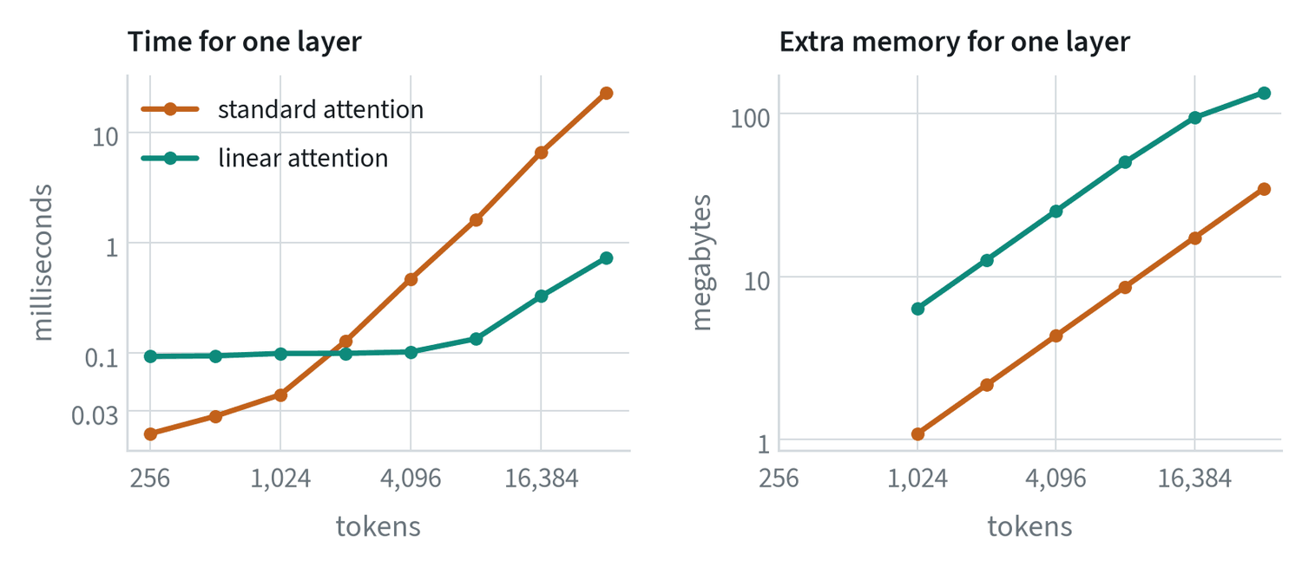
What attention costs
5 · ATTENTION IN DEPTH
measured on a desktop GPU: one layer, eight heads, 16-bit precision
Quadratic time. The score table has n × n entries. Eight times the tokens took 49 times as long: 0.47 ms at 4,096 and 22.8 ms at 32,768.
Linear memory. FlashAttention computes the table in blocks and discards them, so the result is exact and memory grows only with n.
Key-value cache. During generation, earlier keys and values are stored and each new token computes one row. The cache is the main memory cost.
Ways out: fewer tokens, local windows, or an operation that needs no table.
Time grows with the square of the token count, which is why token counts are the first thing to cut
Notes:
Position is the other thing the formula leaves out: shuffle the input and the output shuffles with it. Order is supplied either by adding a position vector to each token, or inside attention with rotary encoding, which rotates queries and keys so the score depends on how far apart two tokens are. On cost: the time is quadratic and the memory need not be. Modern implementations never store the full table.

Slide 54
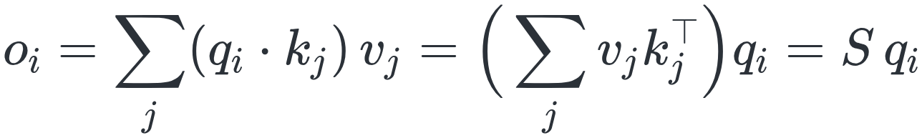
Linear attention is a recurrence
5 · ATTENTION IN DEPTH
drop the softmax and the order of the sums can be changed
Without the softmax
In words
Why the table exists. The softmax must see a whole row of scores before it can normalise them.
Associative memory. Writing adds a key and value pair. Reading with a query returns the values stored under similar keys.
No growing cache. The state has a fixed size, however long the sequence.
The price. Standard attention can retrieve any past token exactly. A d × d state blurs once it holds more than about d pairs.
One d × d matrix S answers every query, so the cost is proportional to n
With a causal mask, S is a running sum: a recurrent state
A fixed-size state costs the same per token forever, and holds about d clean associations
Notes:
This is the bridge between transformers and recurrent networks. Removing the softmax lets the sum over past tokens be collected into one matrix that does not depend on which token is asking. With a causal mask that matrix becomes a running sum, updated once per token. The trade is exact recall of everything against a fixed-size summary.

Slide 55
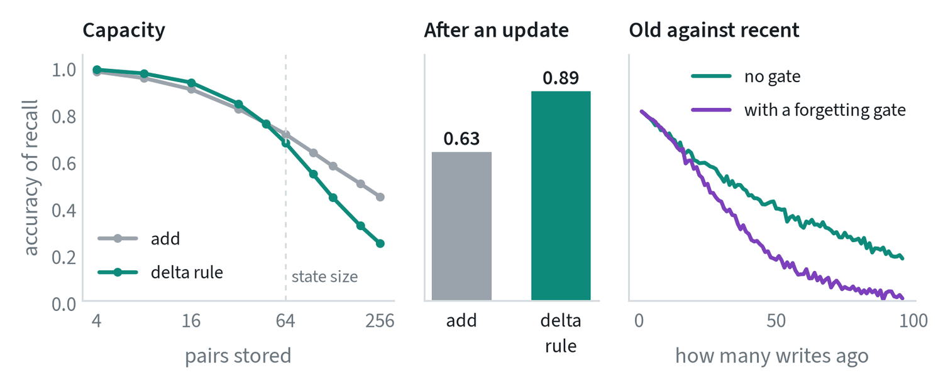
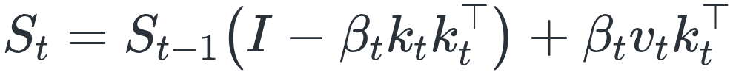
The delta rule and Gated DeltaNet
5 · ATTENTION IN DEPTH
a plain running sum can only add; these two refinements let the memory replace and forget
Replace, then forget
Delta rule: erase what is stored along the key, then write the new value
Random pairs written into a 64 × 64 state. After keys are given new values, recall is 0.63 with plain addition and 0.89 with the delta rule.
Gated DeltaNet: a learned gate α scales the whole previous state
The delta rule buys clean updates, not capacity; the gate clears the memory at a change of context
Notes:
If the same key arrives again with a new value, a running sum stores both and a read returns their mixture. The delta rule first removes what the memory already returns for that key, by a learned amount beta, and then writes. Gated DeltaNet adds a gate alpha between zero and one on the whole state: near one it behaves as the delta rule, near zero it wipes the memory. In the experiment the delta rule does not add capacity, and is slightly worse when the memory is overfull. Its gain is in replacing values cleanly. State-space models such as Mamba are close relatives.

Slide 56
Choosing between them
5 · ATTENTION IN DEPTH
standard attention remembers everything and pays in time; recurrent forms pay a fixed price and remember a summary
Situation | Reach for | Why
Up to a few thousand tokens | Standard attention | Exact retrieval of any token at an acceptable cost
One model conditioning another | Cross-attention | One-way, cacheable, cost set by the smaller side
A small specialist beside a large model | Shared attention with a block mask | Each keeps its own weights; the large side can be cached
Generation, one token at a time | Causal attention with a key-value cache | Each new token costs one row, not a table
Very long or unbounded streams | Linear recurrent layers, with some standard attention | Constant cost per token and no growing cache
Long video and world models | Compression first, then a mix | Token counts are the dominant cost
Mixed stacks take the cheap summary most of the time and the exact lookup where it matters
Notes:
Use this as the summary of the section. The choice is driven by sequence length, by whether one side can be cached, and by whether the task needs exact recall of a specific past token or only a running summary.

Slide 57
Common mistakes with attention
5 · ATTENTION IN DEPTH
four errors that are easy to make and cheap to avoid
Reading a map as an explanation
Forgetting the mask when caching
It shows where a head read from.
Confirm by removing the input and seeing whether the output changes.
A cached result is valid only if those tokens could not see what came later.
Treating linear attention as free
Counting only time
It trades exact recall for a fixed-size summary.
Check the task needs only the summary.
During generation the key-value cache, not the arithmetic, is often what runs out.
Check conclusions from attention maps by removing the input and watching the output
Notes:
Each of these has cost real projects time. The first is the most common: attention maps are persuasive pictures, and a persuasive picture is not a causal test.

Slide 58
Representation learning
MODELS · TOPIC 6 OF 32
How models learn useful features from data with no labels.
KEY POINTS
Self-supervision is why models can train on billions of images and hours of video.
Choose the encoder by what the features must capture: meaning in words, or geometry and detail.
Good embeddings turn hard problems into nearest-neighbour lookups.
Run it: Linear probes: what do frozen features know? (github.com/wnukmat/robot-learning-notebooks)
Notes:
Representation learning. How models learn useful features from data with no labels. The full note is at www.matthewwnuk.com/guide-representation-learning.html.

Slide 59
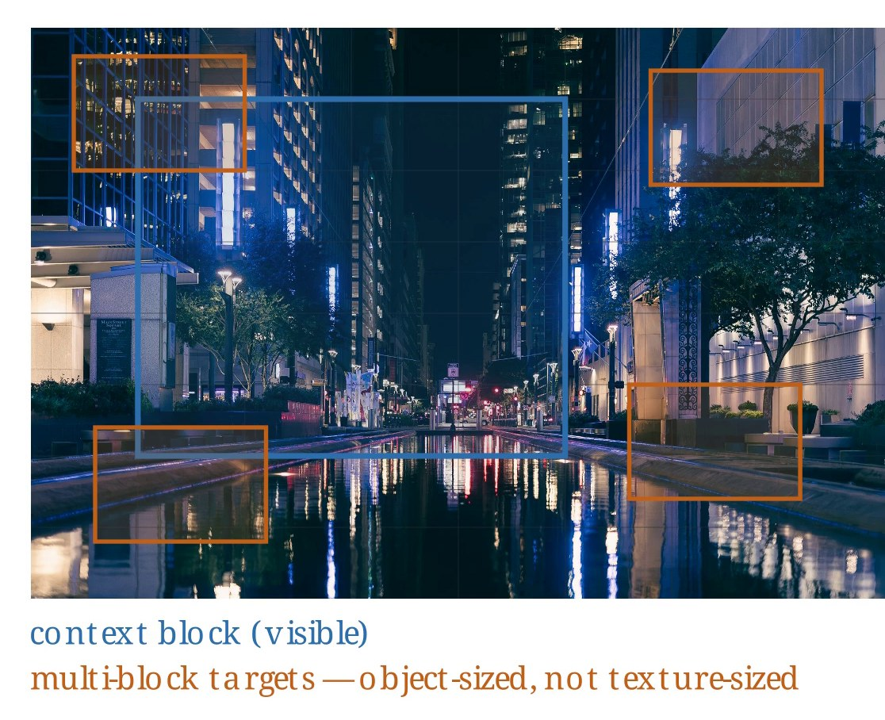
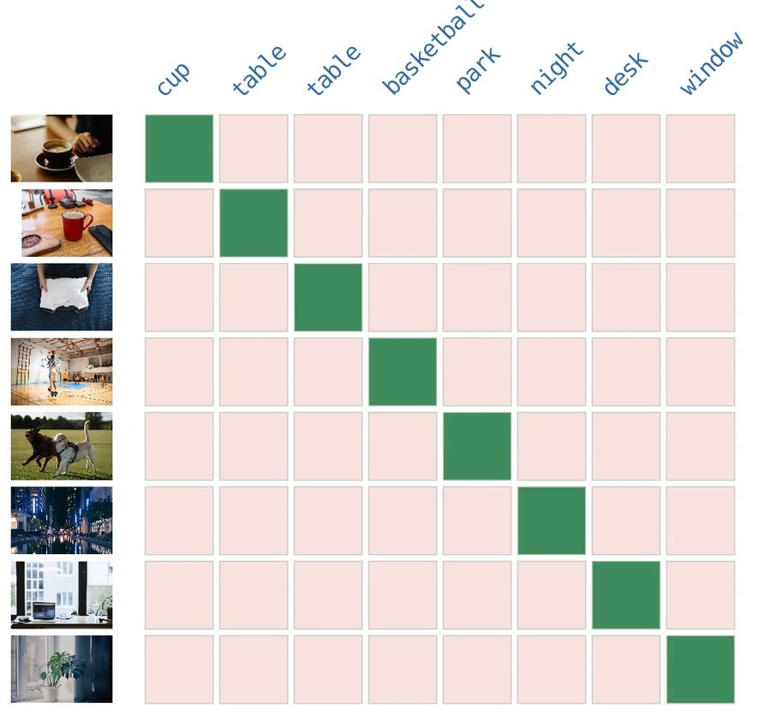
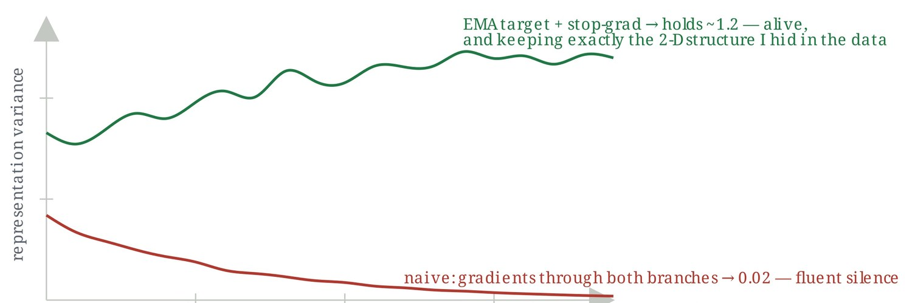
Three recipes make labels from the data itself
6 · REPRESENTATION LEARNING
self-supervised learning invents a prediction problem whose answer is already in the data
Self-distillation, toy run: with a slow teacher the features stay varied; without it they collapse.
Masked modeling: one visible context block and several hidden target blocks to predict.
Contrastive: eight images, eight captions. The diagonal is the truth; every other cell is rejected.
Masked and contrastive. Predict hidden words or patches, or make the embeddings of things that belong together match and push the rest apart.
Self-distillation. A student predicts a slowly updated copy of itself that sees a different view. It gives the DINO family's features.
With no labels to pay for, models can train on billions of images and hours of video
Notes:
Labelled data is expensive, and these three recipes avoid it. Masked modeling hides part of the input, so the model has to learn structure and context to fill the gaps. For text that means hidden or next words, for images and video hidden patches. Contrastive learning with images and captions as the pairs gives CLIP-style models. Self-distillation sounds circular, but it works. The right-hand panel is a toy experiment: with gradients through both branches the features decay to a constant, so the slow teacher is essential.

Slide 60
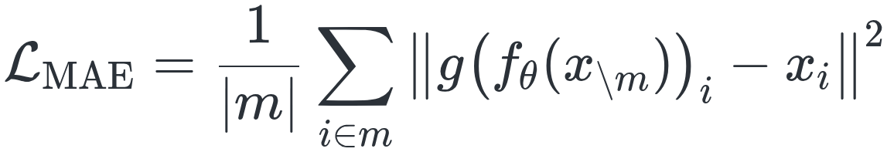
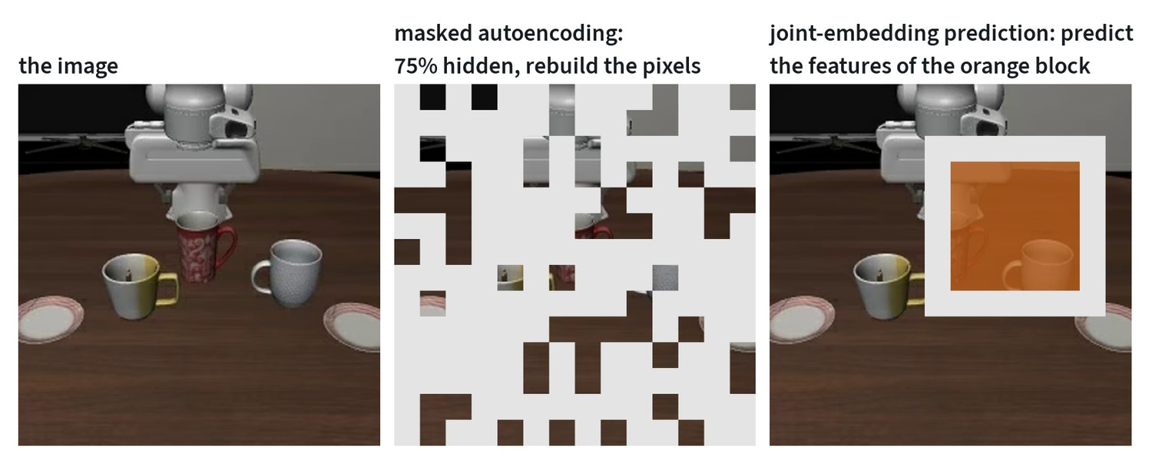
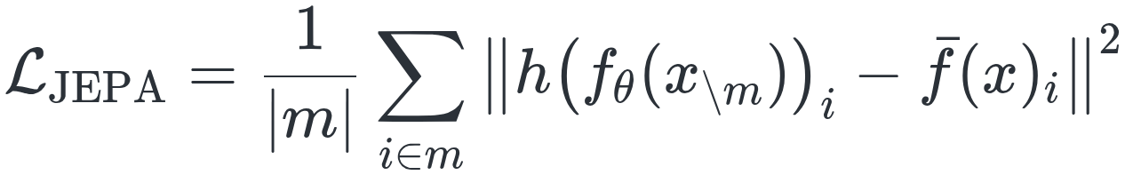
Masked objectives: rebuild pixels or predict features
6 · REPRESENTATION LEARNING
x is an image, m a set of hidden patches and f the encoder; each family is a different loss on the same data
Two targets
Masked autoencoding: a small decoder g rebuilds the hidden pixels from the visible patches
One real frame. Masked autoencoding hides three quarters of the patches and rebuilds their pixels. Joint-embedding prediction hides a block and predicts its features.
Joint-embedding prediction: a predictor h outputs the target encoder's features
The two losses have the same form. The target is pixels in one and features in the other
Notes:
Masked autoencoding encodes only the visible patches. Hiding as much as 75% makes the task hard enough to need real understanding, and it makes training cheap, because the encoder only processes the quarter that is visible. Joint-embedding prediction keeps the same squared error and changes the target. A context encoder sees part of the image, and the predictor must output the features that a slow-moving target encoder produces for the hidden block. The contrastive objective is the fourth family and has a note to itself.

Slide 61
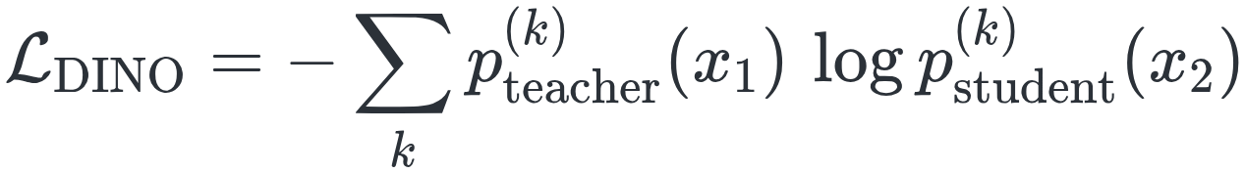
Self-distillation, and what stops it collapsing
6 · REPRESENTATION LEARNING
the DINO family: a student and a teacher see two different crops of one image
Student and teacher
In words
The gap in the loss. Nothing in it stops both networks outputting the same thing for every image.
Centring. A running mean is subtracted from the teacher's outputs.
Sharpening. The teacher's outputs pass through a low temperature.
Slow teacher. Its weights trail the student's, which is what a momentum encoder is.
The student is trained to match the teacher's output distribution on another crop
The teacher is an exponential moving average of the student
Centring, sharpening and a slow-moving teacher together keep the representation from collapsing
Notes:
The loss is a cross entropy between two output distributions, one from each network, computed on two different crops of the same image. On its own it has a trivial solution in which every image gets the same output. Two devices prevent that: the teacher's outputs are centred by subtracting a running mean, and they are sharpened with a low temperature. Together with the slow-moving teacher they keep the features varied. The toy experiment on the opening slide showed what happens when the teacher is not slow.

Slide 62
Vision encoders: the eyes of every modern system
6 · REPRESENTATION LEARNING
almost all are Vision Transformers; how each was trained decides what its features are good at
Encoder family | Trained by | Features are good at | Typical use in robotics
CLIP and SigLIP | Matching images with captions | Meaning that lines up with language | Vision-language models, open-vocabulary recognition
DINO family | Self-distillation on images only | Fine spatial detail, parts, correspondence | Manipulation features, tracking, depth
Masked autoencoders | Reconstructing hidden patches | Low-level structure | Pretraining on unlabelled domain data
Video encoders | Masked or predictive training on clips | Motion and change over time | Dynamics, world models
Choose the encoder by what the features must capture: meaning in words, or geometry and detail
Notes:
A vision encoder turns an image into a set of feature vectors that other models consume. The architecture is nearly always the same, so the training recipe is the thing to look at when choosing one. Many current robot models feed two encoders at once: a language-aligned one for meaning and a DINO-style one for spatial precision. That pairing follows directly from the third column of this table.

Slide 63
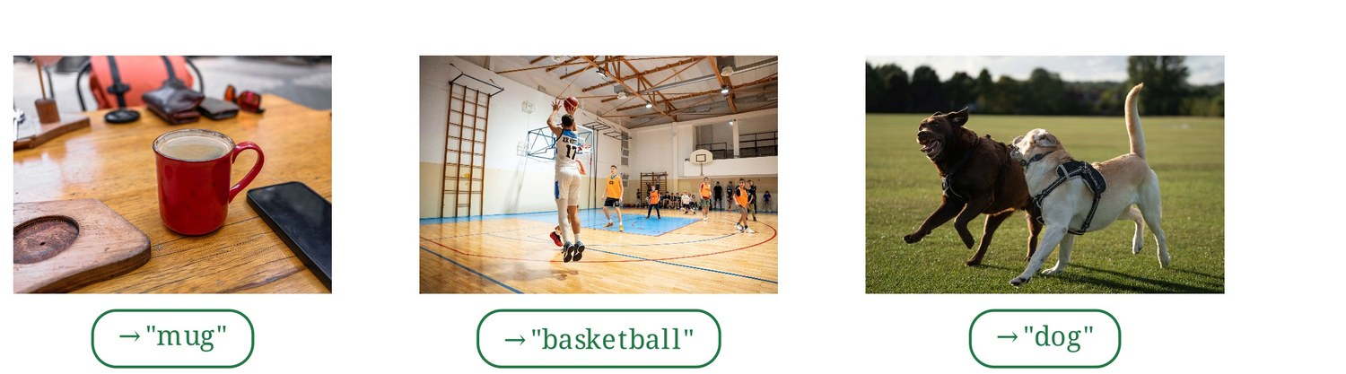
A language-aligned encoder classifies with no task training
6 · REPRESENTATION LEARNING
three photos labelled mug, basketball and dog by comparing each image with text prompts
How it works. Embed the image, embed each candidate label as text, and pick the label whose embedding is closest.
Why it works. The encoder was trained to match images with captions, so its features line up with language.
What it lacks. A language-aligned encoder can be weak on fine spatial detail, which is where DINO-style features are strong.
In robot models. Many feed both encoders at once: one for meaning and one for spatial precision.
Zero-shot recognition is a comparison of two embeddings, with no training examples for the task
Notes:
Zero-shot means doing a task with no training examples for it. Here no classifier was trained on these three classes. The image embedding is compared with the embedding of each candidate label and the nearest one wins. This is the practical consequence of the first row of the encoder table. It also sets up the limit discussed next: an encoder is good at the questions its training objective made it answer.

Slide 64

A representation is judged by what a linear layer can read
6 · REPRESENTATION LEARNING
measured for this note on 1,516 robot frames, whole episodes held out, mean of eight runs
Linear probe
The test. Freeze the encoder, train one linear layer on its features, and report the accuracy.
Which of 10 tasks. With one labelled frame per task, frozen CLIP scores 78% and raw pixels 70%. They reach 98% and 95%.
Which of four stages. Both start near chance. CLIP pulls ahead only at twenty labels, reaching 73% against 63% at 50.
Reading it. CLIP knows what objects are in the scene. It was never trained to notice how far a gripper has closed.
Good features is always relative to a question, and the pixel baseline shows how easy the question is
Notes:
A representation is useful if simple things can be read from it with little data. If a single linear layer suffices, the information was already laid out in an accessible form. The 78% from one labelled frame is the point of pretraining: the work was done before any labels arrived. The pixel baseline is close behind on the task question because these scenes look very different from one another. On the harder question of how far through the episode a frame is, pretraining helps much less.

Slide 65
Four protocols for judging a representation
6 · REPRESENTATION LEARNING
ordered by how much is trained on top of the frozen encoder
Protocol | What is trained | What it measures
k-nearest neighbours | Nothing | Whether similar inputs are already close together
Linear probe | One linear layer | Whether the information is linearly readable
Attentive probe | A small attention layer over patch features | Whether it is present in the patches, if not in one summary vector
Fine-tuning | Everything | How good a starting point the weights are
Each protocol trains more on top of the encoder and answers a different question about it
Notes:
The linear probe on the previous slide is the standard test, and it sits second in this list. Nearest neighbours trains nothing at all and asks only about distances. An attentive probe is the right choice when the information may live in individual patch features and be lost in a single summary vector. Fine-tuning changes every weight, so it measures how good a starting point the weights are.

Slide 66

Predict in feature space, then search by distance
6 · REPRESENTATION LEARNING
a joint-embedding predictive architecture, or JEPA, and what a good embedding space is used for
JEPA and retrieval
The problem with pixels. A model forced to predict every pixel spends capacity on texture and sensor noise that cannot be predicted.
The diagram. Visible input goes through an encoder and a predictor. Hidden input goes through a slow target encoder. The loss compares embeddings.
Hidden or future. The same design predicts the representation of a masked part or of what comes next.
Embeddings and retrieval. Once similar things land close together, search becomes finding the closest vectors.
What matters for a decision is where the cup will be, not the grain of the table under it
Notes:
Predicting in feature space is attractive for robots because the detail that pixel prediction struggles with rarely matters for a decision. The last bullet is a separate short section of the note. Good embeddings turn hard problems into nearest-neighbour lookups. Metric learning trains that distance directly, and it is how product search, re-identification and warehouse item matching work. The notes on contrastive learning and retrieval take both threads further.

Slide 67
Common mistakes with representations
6 · REPRESENTATION LEARNING
three errors in choosing, trusting and training an encoder
Using one encoder for everything
Assuming features transfer
Ignoring collapse
A language-aligned encoder can be weak on fine spatial detail, and the reverse.
Choose by what the features must capture.
Features learned on web photos can miss what matters in your domain, such as packaging or radar imagery.
Self-supervised training can quietly converge to a constant output.
Monitor the variance of the features.
Match the encoder to the question, test it on your own domain, and watch the feature variance
Notes:
Collapse is when every input maps to nearly the same embedding. It can happen quietly during self-supervised training, which is why the variance of the features is the thing to monitor. The other two mistakes are both about the same idea as the probe slide: a set of features is good or bad only relative to a question and a domain.

Slide 68
Contrastive and multimodal learning
MODELS · TOPIC 7 OF 32
Learning by comparison: triplet and batch-wide losses, mining, and how two kinds of data are brought into one space.
KEY POINTS
A contrastive loss needs only to know what belongs together.
Triplet losses depend on mining; batch-wide losses use every negative for free.
A single shared vector is powerful for retrieval and too blunt for detailed instructions.
Run it: Contrastive losses: triplet, hard mining, and InfoNCE (github.com/wnukmat/robot-learning-notebooks)
Notes:
Contrastive and multimodal learning. Learning by comparison: triplet and batch-wide losses, mining, and how two kinds of data are brought into one space. The full note is at www.matthewwnuk.com/guide-contrastive-learning.html.

Slide 69

Learning by comparison
7 · CONTRASTIVE AND MULTIMODAL LEARNING
a contrastive loss is told only which things belong together, and shapes an embedding space around that
No answer needed
The goal. Things that belong together land close in the embedding space. Everything else lands far apart.
Cheap pairs. Two photos of one product, an image and its caption, a camera frame and the touch reading from the same instant.
Multimodal learning is the second and third case: teaching a model to relate different kinds of data.
A triplet. Training moves the points until the negative is further from the anchor than the positive, by at least the margin.
A contrastive loss needs only to know what belongs together, and that is cheap to obtain
Notes:
Most losses compare a prediction with a correct answer. A contrastive loss needs no answer at all, which is why it can learn a great deal from data that nobody labelled. The figure shows the simplest version with three items. Before training the negative sits closer to the anchor than the positive does. After training it has been pushed out beyond the positive's distance plus a margin. The next slide writes that down.

Slide 70

Triplet loss and InfoNCE
7 · CONTRASTIVE AND MULTIMODAL LEARNING
three items at a time with a margin, or one positive against the whole batch as a classification
Two losses
In words
The zero is a weakness. Most randomly chosen triplets already satisfy the margin and teach nothing.
Mining is the search for the triplets that do not. Triplet training depends on it.
Free negatives. In InfoNCE every other item in the batch is a negative, which is why these models train with batches of thousands.
Temperature τ. A low value concentrates the loss almost only on the hardest, most confusing negatives.
Triplet: zero once the negative n is further from anchor a than positive p, by the margin
InfoNCE: cross entropy over N candidates, with the true partner as the correct class
Triplet losses depend on mining; batch-wide losses use every negative for free
Notes:
InfoNCE is the loss behind CLIP. Take a batch of N matched pairs. For each item, compute its similarity to all N candidates, divide by a small number called the temperature, and apply cross entropy with the true partner as the correct class. The triplet loss states the wanted ranking directly, and its zero is both its point and its weakness: once a triplet is satisfied it contributes no gradient.

Slide 71
Five contrastive losses compared
7 · CONTRASTIVE AND MULTIMODAL LEARNING
what each one compares, and what that buys and costs
Loss | Compares | Strength | Weakness
Contrastive (pairwise) | Two items: pull together if matched, push apart up to a margin if not | Simplest | Uses little of each batch
Triplet | Anchor, positive, negative | Directly states the ranking wanted | Most triplets are uninformative; needs mining
InfoNCE | One positive against every other item in the batch, as a classification | Uses every negative in the batch; no mining | Wants large batches; a temperature to tune
Supervised contrastive | As InfoNCE, with every same-class item as a positive | Uses labels when they exist | Needs labels
Sigmoid (SigLIP) | Every pair in the batch, each as its own yes or no | Works at small and very large batch sizes | Needs a bias term and care with the many negatives
The losses differ mainly in how much of each batch they use as negatives
Notes:
Read the table from top to bottom as a progression in how many comparisons each batch supplies. The pairwise loss uses two items, the triplet three, and InfoNCE the whole batch. Supervised contrastive is InfoNCE with labels deciding the positives. The sigmoid loss removes the dependence between pairs, which the slide on the CLIP and SigLIP objectives explains.

Slide 72


Three losses on the same data
7 · CONTRASTIVE AND MULTIMODAL LEARNING
run for this note on a public set of 1,797 handwritten digits with a small network
Two-dimensional embedding before and after triplet training. Only which images matched was given.
16-dimensional embedding, mean of five runs. Score: nearest neighbour is the same digit. Untrained: 84%.
Hard negatives. Taking the hardest in each batch cut the triplet error roughly in half: 98.0% to 98.9% accuracy, 2.0% to 1.1% error.
Whole batch. Contrasting against every item reached 99.2% and learned fastest, with nothing to mine.
Choosing negatives matters, and contrasting against the whole batch removes the need to choose
Notes:
On the left, the ten digits start as one overlapping cloud and end as ten separate clusters. Nothing told the network there were ten classes. On the right, the three curves are a triplet loss with random negatives, a triplet loss with the hardest negatives in the batch, and a contrast against the whole batch. Two lessons hold beyond this small case. InfoNCE-style losses displaced triplets for large-scale pretraining. Triplets with hard mining remain common where data is labelled and batches are small.

Slide 73


What the loss does to the space
7 · CONTRASTIVE AND MULTIMODAL LEARNING
with embeddings normalised to unit length, every point lies on a sphere and similarity is the cosine of an angle
Two goals at once
In words
Uniformity keeps information. Spreading the points evenly preserves as much information as possible.
Inside InfoNCE. The numerator is the alignment term. The denominator, summed over the batch, is the uniformity term.
Collapse explained. With nothing pushing points apart, one point for everything satisfies alignment perfectly.
Alignment pulls matched pairs together
Uniformity spreads all points evenly over the sphere
Alignment alone is minimised by mapping everything to one point; the negatives prevent that collapse
Notes:
This is a way of reading any contrastive loss as two pressures. One pulls each matched pair together. The other pushes every point away from every other, so that the embeddings cover the sphere evenly. The same reading explains why methods without negatives need another device to avoid collapse, as the representation learning note shows with centring, sharpening and a slow teacher.

Slide 74


The CLIP and SigLIP objectives
7 · CONTRASTIVE AND MULTIMODAL LEARNING
image embeddings u, text embeddings v; the loss is applied in both directions and averaged
Softmax and sigmoid
In words
No softmax. No sigmoid term depends on the rest of the batch, so the loss can be computed in pieces across machines.
Batch range. That is why it scales to very large batches and also works at small ones.
On the digits, no effect. Temperature from 0.01 to 1 moved accuracy between 98.5% and 99.1%. Batch 8 to 256: 98.2% to 98.9%.
Regime. A hyperparameter's reputation comes from the regime it was studied in.
InfoNCE from image to text and from text to image, with a learned temperature τ
Every pair is its own yes or no: z is +1 on the diagonal and −1 elsewhere
Temperature and batch size matter at scale, where hard negatives in a batch limit learning
Notes:
For two modalities the InfoNCE loss runs twice: each image must pick its caption among the texts in the batch, and each caption its image. The sigmoid variant drops the softmax and adds a scale t and a bias b. The sweep in the third bullet is on the small digits problem from the earlier slide, where neither temperature nor batch size made a real difference. They matter at scale, where the supply of hard negatives in a batch is what limits learning.

Slide 75

Two modalities, one space, and where it fails
7 · CONTRASTIVE AND MULTIMODAL LEARNING
a real test for this note: a public CLIP model, ten LIBERO frames and their ten task instructions
Shared space. CLIP trains an image encoder and a text encoder so an image and its caption land at the same point.
2 of 10. Asked which instruction goes with which frame, it is right twice and gives several frames the same instruction.
Three reasons. Near-identical tabletops that differ in small objects, long compositional instructions, and simulated images.
The consequence. Robot models use the vision encoder's patch features inside a language model instead.
A single shared vector is powerful for retrieval and too blunt for detailed instructions
Notes:
The same model recognises everyday photos very well, and a picture can be compared with a sentence directly, which gives recognition from a text description with no training on the classes involved. The grid is a useful warning. A single vector cannot hold an instruction such as the white mug on the left plate and the yellow mug on the right. The images are also simulated, which is far from what the model was trained on. The note on vision-language models picks up from here.

Slide 76
Beyond images and text
7 · CONTRASTIVE AND MULTIMODAL LEARNING
the same recipe works wherever two signals are known to belong together
More senses
Time
Sound, depth, touch and motion are each aligned with images.
They become comparable with each other without ever being paired directly.
Nearby video frames are positives and distant frames are negatives.
The embedding learns what changes slowly, often the task-relevant state.
Views
Touch and vision
Two cameras on the same moment form a positive pair.
The features stop depending on viewpoint.
A fingertip image is paired with the camera image of the same contact.
The touch encoder gets a start without scarce labelled touch data.
Anything paired with images becomes comparable with everything else paired with images
Notes:
Each card is a different answer to the question of what belongs together. Images act as the hub in the first case: because every other sense is paired with images, the senses line up with one another as a side effect. The time and view cases need no second modality at all, only a video or a second camera. The touch case matters in robotics because labelled touch data is scarce.

Slide 77
How contrastive training goes wrong
7 · CONTRASTIVE AND MULTIMODAL LEARNING
four failures that come from what the loss is and is not told
Failure | What happens | What to know
Collapse | Mapping everything to one point satisfies the loss if nothing pushes points apart | Negatives prevent it; methods without negatives need another device
False negatives | Two different images of the same thing in one batch are pushed apart as a mismatch | It worsens as batches grow
Shortcuts | Positives share something trivial, such as the same background or camera | The model learns that and nothing else
The modality gap | Even after training, images and texts tend to occupy separate regions of the shared space | Distances across modalities are meaningful only in relative terms
Check what the positives share and what the negatives contain before trusting the embedding
Notes:
The first row is the same collapse that the alignment and uniformity view explained. False negatives are the cost of free negatives: the larger the batch, the more likely it contains another view of the same thing. The modality gap is why a similarity score between an image and a text should be compared with other such scores, and never read as an absolute distance.

Slide 78
Common mistakes with contrastive learning
7 · CONTRASTIVE AND MULTIMODAL LEARNING
three errors in setting up the loss and in what is asked of the result
Training a triplet loss without mining
Leaving the temperature at a default
Expecting one vector to carry a sentence
Most triplets contribute nothing after the first few passes.
It changes which negatives matter and is worth tuning.
Fine for "a photo of a mug".
It does not hold a multi-step instruction.
Mine the triplets, tune the temperature, and do not ask one vector to carry a sentence
Notes:
The first two mistakes are about training and the third is about use. A hard negative is one the model currently places close to the anchor, and mining is how a triplet loss finds them. The temperature decides how sharply the loss focuses on those hard negatives. The third mistake is the lesson of the two-of-ten result on the robot frames.

Slide 79
Retrieval and multimodal retrieval
MODELS · TOPIC 8 OF 32
Finding instead of generating: embeddings, ranking metrics, searching across text and images, large collections, and uses in robotics.
KEY POINTS
Retrieval turns search into finding the nearest vectors.
Always score a trivial baseline, and choose the metric by what the results are for.
A shared embedding space lets text find images, and any sensor find another.
Run it: Retrieval on robot data (github.com/wnukmat/robot-learning-notebooks)
Notes:
Retrieval and multimodal retrieval. Finding instead of generating: embeddings, ranking metrics, searching across text and images, large collections, and uses in robotics. The full note is at www.matthewwnuk.com/guide-retrieval.html.

Slide 80

Finding instead of generating
8 · RETRIEVAL AND MULTIMODAL RETRIEVAL
retrieval answers a question by finding the right item in a collection
The standard pipeline
Generate or look up. A model that generates carries everything it knows in its weights. A model that retrieves can look things up.
Ahead of time. The collection is encoded once into an index holding one vector per item.
At query time. The query is encoded and the nearest stored vectors are looked up, here giving the top 100.
Re-ranker. A slower model optionally re-orders the short list, here down to the top 10.
Retrieved knowledge can be inspected, corrected and extended without retraining
Notes:
Modern retrieval is built on embeddings. An encoder turns each item into a vector such that similar items have similar vectors, and searching becomes finding the nearest vectors to the query. The note on contrastive learning covers how such encoders are trained. Everything in this section is a detail of one of the boxes in this figure: how to score the output, how to make the lookup fast, how to store the vectors, and when to add the re-ranker.

Slide 81


A worked example on robot data
8 · RETRIEVAL AND MULTIMODAL RETRIEVAL
1,516 frames, four from each of 379 LIBERO demonstrations, embedded with a public CLIP image encoder
Four queries and their five nearest neighbours from other episodes. Green means the same task.
The same test scored five ways, for CLIP and for each frame shrunk to 16 × 16 grey pixels.
The test. A query is one frame. A retrieved frame is relevant if it comes from a different episode of the same task.
The baseline. Recall at 1 is 96 for CLIP and 92 for raw pixels. Mean average precision is 77 against 70.
CLIP scores 96% and 256 grey pixels score 92%, so the high score says little about the encoder
Notes:
CLIP retrieves a frame of the right task first 96% of the time, and all twenty retrieved frames on the left are correct. The more instructive number is the baseline. These scenes differ so much in overall appearance that almost anything can tell the tasks apart. Without the baseline the 96% would have looked like an achievement. The first note's rule applies: know what the trivial method scores.

Slide 82
Scoring a ranking
8 · RETRIEVAL AND MULTIMODAL RETRIEVAL
five metrics, each answering a different question about the same ordered list
Metric | Question it answers | Use it when
Recall at k | Is at least one relevant item in the top k? | One good hit is enough, as in looking up an answer
Precision at k | What share of the top k is relevant? | The user reads the whole list
Mean reciprocal rank | How high is the first relevant item? Scores 1, ½, ⅓ for ranks 1, 2, 3 | Only the first hit matters and its position counts
Mean average precision | Are all the relevant items near the top? | There are many relevant items and all should be found
nDCG | As above, with graded relevance and a discount for lower ranks | Some results are better than others
Recall at 5 is 100% for CLIP while mean average precision is 77%: choose by what the results are for
Notes:
The worked example shows why the choice matters. For CLIP the first hit is nearly always right, so recall and reciprocal rank are close to their maximum. The full set of relevant frames is not all ranked at the top, so mean average precision is much lower. Both statements are true of the same system. Which number to report depends on what the retrieved items are for.

Slide 83



The metrics, written out
8 · RETRIEVAL AND MULTIMODAL RETRIEVAL
for one query: rel is 1 if the item at rank k is relevant, and R is the number of relevant items in the collection
Per query
In words
Means. Mean average precision and mean reciprocal rank are the averages of AP and RR over all queries.
Graded relevance. In nDCG, g is a relevance score, so a perfect match can count for more than a partial one.
Discount. The logarithm reduces the credit for items lower in the list.
Precision at k, and average precision: precision taken at each relevant rank
Reciprocal rank looks only at the first relevant item
Discounted gain, divided by the gain of the ideal ordering
Every ranking metric is a different weighting of the same list of relevant and irrelevant positions
Notes:
These are the definitions behind the table on the previous slide. Average precision adds up the precision at every rank that holds a relevant item and divides by the number of relevant items, so it is high only when all of them sit near the top. Reciprocal rank ignores everything after the first hit. The normalised form of discounted gain divides by the score of the ideal ordering, so a perfect ranking scores one.

Slide 84

Multimodal retrieval: text finds images
8 · RETRIEVAL AND MULTIMODAL RETRIEVAL
text queries against the same frames through CLIP's text encoder, top five from distinct episodes
Why it works. CLIP's text and image encoders share an embedding space, so a query of one kind retrieves items of the other.
Five of five. "A moka pot on a stove" and "a wicker basket" return the right scene every time.
One of five. "A microwave oven" returns the microwave once and a white cabinet four times.
Two of five. "A book" finds the book twice.
A shared embedding space lets a sentence search frames that were never labelled with those words
Notes:
The results are a fair picture of the technique. Distinctive scenes are found reliably. The microwave query returns a white cabinet four times, which is a reasonable confusion for a boxy white appliance in a simulated scene. The book is found in two of the five. No frame in the collection was ever labelled with these words, so every hit comes from the alignment learned in pretraining.

Slide 85
Kinds of multimodal retrieval
8 · RETRIEVAL AND MULTIMODAL RETRIEVAL
what the query is, what comes back, and an example of each
Kind | Query | Returns | Example
Text to image | A description | Images or video | Find every episode that contains a drawer
Image to image | A picture | Similar pictures | Find past scenes like the one in front of the robot
Image to text | A picture | Captions or documents | Find the manual page for this part
Composed | A picture and a modification in words | Images | Like this scene, with the door open
Cross-sensor | A reading from one sensor | Data from another | Find the camera frames that match this touch pattern
With a shared space, any sensor can find another
Notes:
The previous slide was the first row of this table. The worked example at the start of the section was the second. The remaining rows use the same machinery with different encoders on each side. Composed retrieval combines a picture with a modification in words. Cross-sensor retrieval depends on the sensors having been aligned in one space, which the contrastive learning note describes.

Slide 86

Searching large collections
8 · RETRIEVAL AND MULTIMODAL RETRIEVAL
measured for this note: exact search on a desktop processor, and a 32-cluster index on the robot frames
Exact and approximate
Exact search compares the query with every 512-number vector: 3 ms at 10,000 items, 9 ms at 100,000, 86 ms at a million.
Clustering (inverted file). Search only the clusters nearest the query. Examining 8% found 97% of the true top ten, and 11% found 99%.
Graphs (HNSW). Link each vector to its neighbours and walk toward the query. Fast and accurate, at the cost of memory for the links.
Product quantisation. Store each vector as a short code so far more fit in memory, with some loss of precision.
Below about 100,000 items exact search is usually fast enough and has nothing to tune
Notes:
Exact search costs time in step with the size of the collection. Approximate nearest-neighbour search gives up a little accuracy to avoid that, by examining part of the collection and accepting a small chance of missing a true neighbour. The right-hand panel uses the clustering method: the vectors are grouped ahead of time and only the few clusters nearest the query are searched. Reach for an index when exact search stops being fast enough.

Slide 87

Compressing the vectors
8 · RETRIEVAL AND MULTIMODAL RETRIEVAL
measured on the robot-frame collection; queries stay exact and only the stored vectors are compressed
Bytes per item
The cost. A million 512-number embeddings as 32-bit floats take two gigabytes, 2,048 bytes per item.
Scalar quantisation. 8 bits per number: a quarter of the memory for 91% of the true top ten, with no training.
Binary codes. Keep only the sign: a thirty-second of the memory and 69%. Usually used to find candidates to re-score.
Product quantisation. m sub-vectors, each replaced by an index into a codebook of 256: 62% at 64 bytes, 49% at 4 bytes.
Memory, not arithmetic, limits large indexes: search compressed vectors, then re-score with exact ones
Notes:
With product quantisation a vector becomes m bytes, and the squared distance from a query is approximated by summing, over the m sub-vectors, the distance from the query's sub-vector to the stored codebook entry. Those are table lookups. This test is a hard one, because the ten nearest neighbours of a frame are near-identical frames from similar episodes and small errors reorder them. On coarser questions compressed vectors lose much less. The standard remedy is the two-stage pattern: a generous short list from the compressed vectors, re-scored with the exact ones.

Slide 88
Beyond one vector, and retrieval in robotics
8 · RETRIEVAL AND MULTIMODAL RETRIEVAL
three ways to fix the mistakes of single-vector matching, and six places robots use retrieval
Re-ranking
Late interaction
Hybrid search
A slower model reads the query and each candidate together.
Its cost applies only to the short list.
One vector per token or patch, matched in detail at query time.
More accurate on long, specific queries. Stores many times more data.
Embeddings find paraphrases.
Keywords find exact names and part numbers.
Each covers the other's blind spot.
Robots: curating data
Robots: checking coverage
Robots: memory, facts, items
Retrieve episodes similar to a few demonstrations of a new task and train on both.
Find and remove near-identical episodes.
Retrieve the training episodes nearest a failure.
If nothing is close, the policy was never shown that situation.
Store what was seen, with where and when.
Put retrieved documents in a language model's prompt.
Match a camera view against a catalogue.
Retrieve a generous short list cheaply, then spend the expensive model only on that list
Notes:
The top row improves on matching one vector against one vector. The bottom row lists uses in robotics. Finding training data means retrieving similar episodes from a large unlabelled collection. Checking coverage is described in the failure triage note. Memory answers questions such as where the keys were last seen. Placing retrieved documents in a prompt lets answers rest on a source that can be checked. Recognising items matches a view against known products or parts. My CaseID and maritime retrieval projects are both of this kind.

Slide 89
Common mistakes with retrieval
8 · RETRIEVAL AND MULTIMODAL RETRIEVAL
four errors in how a retrieval system is tested and built
Reporting a score with no baseline
Letting the query retrieve itself
On an easy collection a trivial method scores highly too.
Exclude the query, and near-copies such as frames of the same episode, from the results.
Choosing one metric by habit
Building an index too early
Recall at 1 and mean average precision can tell different stories about the same system.
Exact search is simpler and exact.
Measure before replacing it.
Score a trivial baseline, exclude the query and its near-copies, and measure before adding an index
Notes:
The worked example in this section avoided the first two by design. It scored shrunken grey pixels beside CLIP, and it counted a retrieved frame only if it came from a different episode. The third mistake is the gap between 100% recall at 5 and 77% mean average precision. The fourth follows from the timing measurement: under about 100,000 items, exact search took single-digit milliseconds.

Slide 90
Generative modeling
MODELS · TOPIC 9 OF 32
Autoregression, diffusion and flow matching, and the latent spaces they work in.
KEY POINTS
Autoregressive suits discrete sequences; diffusion and flow suit images, video and actions.
The model never sees how to draw a whole sample; it only learns one small denoising step, applied repeatedly.
Flow matching keeps diffusion's regression trick and removes the noise schedule.
The quality ceiling of a latent generator is set by its autoencoder.
Run it: Flow matching against diffusion, on a problem small enough to see (github.com/wnukmat/robot-learning-notebooks)
Notes:
Generative modeling. Autoregression, diffusion and flow matching, and the latent spaces they work in. The full note is at www.matthewwnuk.com/guide-generative-modeling.html.

Slide 91
Two ways to generate
9 · GENERATIVE MODELING
a generative model learns a data distribution so that it can produce new samples from it
 | Autoregressive | Diffusion and flow matching
How it generates | One piece at a time: predict the next token, append it, repeat | All at once: start from noise and refine the whole sample over several steps
Training loss | Cross entropy on the next token | Regression: predict the noise, or the direction toward clean data
Strengths | Simple, handles variable length | Sharp continuous outputs; represents several valid answers
Limits | One step per token; continuous values must be binned first | Needs several refinement steps per sample
Used for | Language, reasoning, tokenised actions | Images, video, robot action chunks
Autoregressive suits discrete sequences; diffusion and flow suit images, video and actions
Notes:
Both families appear in robotics, sometimes in the same system. Action tokens are generated one at a time by an autoregressive model. Continuous action chunks are generated by diffusion or flow matching. The rest of this section follows the right-hand column in detail, then the latent spaces and tokenisers that both columns depend on.

Slide 92

Diffusion and flow matching, step by step
9 · GENERATIVE MODELING
a real toy model: one small network trained two ways on 2-D data with two clusters
Training. Mix a real sample with noise at a random level. The network predicts the noise, or the velocity from noise toward data.
Sampling. Start from pure noise and step along the predicted direction.
Conditioning. Feed the network text, images or robot state, and the same noise becomes a sample that fits the condition.
The paths. Diffusion wanders over 50 steps because fresh noise is injected at each. Flow matching runs nearly straight in 10.
The model never learns to draw a whole sample; it learns one small denoising step, applied repeatedly
Notes:
Training destroys data with noise, and the model learns to undo it. In the figure the dots are final samples and the faint lines are the paths they took from noise. The left panel is diffusion in 50 steps and the right is flow matching in 10. Straight paths need far fewer steps, and that difference is why recent robot policies favour flow matching.

Slide 93


The mathematics: autoregression and diffusion
9 · GENERATIVE MODELING
every generative model in use is fitted to maximise, or to bound, the probability of the data
Likelihood and noise
In words
Autoregressive. The likelihood is exact, training is one parallel pass, and sampling takes one model call per token.
Schedule. The forward process adds Gaussian noise over T steps. ᾱ falls from 1 to nearly 0 as t grows.
A bound in disguise. The simple loss is a re-weighted form of a bound on the log-likelihood.
Score. Predicting the noise is equivalent, up to scale, to predicting the gradient of the log-density of the noisy data.
Autoregressive: the log-likelihood is a sum over tokens, each given the earlier ones
Diffusion forward process: any noise step can be reached directly from the data
The network is trained to recover the noise that was added
Diffusion trains by plain regression onto the noise that a fixed forward process added
Notes:
The families differ in how they make the likelihood tractable. Autoregression factorises it exactly. Diffusion fixes a forward process and trains only the reverse direction. The score is the gradient of the log-density of the noisy data, equal to minus the noise divided by the square root of one minus alpha-bar. Sampling follows that gradient from noise toward data. In practice the network also receives the conditioning context alongside the noisy sample and the step.

Slide 94


Flow matching: a straight path and its velocity
9 · GENERATIVE MODELING
x₀ is a noise sample and x₁ a data sample; the path between them is chosen, and the network learns its velocity
Path, loss, sampler
In words
One fewer thing to tune. The velocity of a straight path is constant, so there is no noise schedule.
An average. The learned velocity averages over all the straight paths through a point, so real trajectories curve a little.
Steps. The straighter the trajectories, the fewer sampling steps are needed.
A straight path from noise to data
Regress the network onto the path's constant velocity, x₁ − x₀
Sampling integrates an ODE from t = 0 to 1, in the simplest case with Euler steps
Flow matching keeps diffusion's regression trick and removes the noise schedule
Notes:
Both objectives are plain regression losses. What differs is the path between noise and data. Diffusion's path is set by a noise schedule. Flow matching chooses a straight line between a noise sample and a data sample, notes that its velocity is constant, and regresses the network onto that velocity. Sampling is then a few equal deterministic steps from noise to data. The note also shows these equations as typeset figures, with the conditioning context as an extra input to the network.

Slide 95

Flow matching against diffusion, measured
9 · GENERATIVE MODELING
trained for this note: the same small network learns a two-crescent dataset with each loss
A fair comparison. Same architecture, same data, same number of training steps. Only the loss differs.
Few steps. At four steps flow matching is five times closer to the data. At one or two, diffusion produces nothing usable.
Why. The sixty trajectories on the left are nearly straight, so a few large steps follow them well.
More is not always better. The deterministic diffusion sampler gets worse again beyond 32 steps here.
With few sampling steps flow matching is far closer to the data; with 32 or more the two are equal
Notes:
The right-hand panel plots the energy distance between 3,000 generated samples and the data against the number of sampling steps, for flow matching and two diffusion samplers. The dashed line is the distance between two sets of real data. Flow matching is lower at every step count up to 16. The last bullet is a reminder that a sampler is a numerical method with its own errors.

Slide 96

Latent spaces: generate in a compressed world
9 · GENERATIVE MODELING
modern generators work on a compact code and decode it to pixels at the end
Pixels are expensive. A short 480p video clip is tens of millions of numbers.
Compression. An autoencoder often shrinks it eight times in each spatial direction and four times in time.
The ceiling. If the autoencoder cannot reconstruct small objects, thin structures or fast motion, the generator cannot produce them.
For robots. Grippers and contact points are exactly that kind of detail. Reconstruct real data first and look at it.
The quality ceiling of a latent generator is set by its autoencoder
Notes:
The figure shows the whole arrangement: pixels pass through an encoder into a small latent grid, the generator works on that grid, and a decoder expands the result back to pixels. Working on the small grid is what makes video generation affordable. The check in the last bullet is cheap. Pass real robot frames through the encoder and decoder with no generator involved, and see whether the gripper and the contact points survive.

Slide 97

Autoencoders and tokenisers
9 · GENERATIVE MODELING
an encoder squeezes the input into a small code and a decoder rebuilds it, trained together
The VAE bound
One encoder, two kinds of code. The upper path keeps continuous vectors. The lower path replaces each vector with the number of its nearest codebook entry.
The first term rewards reconstruction; the second keeps the codes close to a simple prior
One encoder gives continuous latents for diffusion and flow, or discrete tokens for a language model
Notes:
A variational autoencoder keeps its codes smooth and well spread, so a point between two codes still decodes to something sensible. In the autoencoders used for latent diffusion the second term of the bound is given a very small weight, so they behave as compressors with a smooth latent space. A vector-quantised autoencoder snaps each code to the nearest entry in a learned codebook and keeps only its number. An image becomes a short list of integers that a language-model-style generator can predict one at a time. The same idea compresses a chunk of robot actions into a few tokens, which is how a language model can output smooth motion without one token per number.

Slide 98
Making sampling controllable and fast
9 · GENERATIVE MODELING
three techniques applied on top of a trained diffusion or flow model
Technique | What it does | What it costs or buys
Guidance | Run the model with and without the condition and exaggerate the difference | Samples follow the prompt more closely, at the cost of variety
Few-step sampling | Flow matching and better solvers cut fifty steps to under ten | Each step is a full network pass. Robot action heads commonly use four to ten
Distillation | Train a student to match many teacher steps in one | A little quality traded for a large speed-up
An action generator that needs fifty passes cannot run at 10 Hz. One that needs four can
Notes:
Few-step sampling is what lets diffusion-style models run inside a robot's control loop. Every sampling step is a full pass through the network, so the step count multiplies directly into latency. Guidance is the knob that trades variety for closeness to the condition. Distillation goes furthest on speed by training a second model to jump many of the teacher's steps at once.

Slide 99
Video generation, and scoring generated samples
9 · GENERATIVE MODELING
video adds a choice that images do not have; neither has a single right answer to compare against
Whole clip at once
Frame by frame
Denoise all frames together.
Consistent from start to end, with a fixed length.
Each frame is conditioned on the ones before.
Any length, and new input can arrive mid-stream. Errors build up.
A noise level per frame
FID and FVD
Recent models combine the two.
Frames already produced are clean and frames still to come are noisy.
Compare features of many real and many generated samples.
Lower is better. They need thousands of samples to be stable.
FID and FVD measure realism, not correctness: track progress with them and look at the samples
Notes:
The per-frame noise level matters for robots, because a world model has to keep generating as new actions and observations arrive. On scoring: the standard metrics compare populations. FID for images and FVD for video pass real and generated samples through a pretrained network and measure how far apart the two sets of features are. A video can score well and ignore the action it was conditioned on, which is why the scores track progress and do not replace looking.

Slide 100
Common mistakes with generative models
9 · GENERATIVE MODELING
three errors in diagnosing and tuning a generator
Skipping the autoencoder check
Turning guidance up
Counting steps as free
Do not judge a generator without checking its autoencoder.
Blurry hands or grippers are often a reconstruction limit, not a generation failure.
Past a point, outputs become saturated and unnatural.
Every extra step is latency.
Check the autoencoder first, keep guidance moderate, and count every sampling step as latency
Notes:
The first mistake is the most common in robotics, because grippers and contact points are small, thin and fast, which is exactly what a compressing autoencoder loses. Reconstruct real data first and look at it. The other two are about sampling: guidance and step count are both knobs with a cost, and the cost of steps is paid on every control cycle.

Slide 101
Stable Diffusion and latent diffusion
MODELS · TOPIC 10 OF 32
One real image generator taken apart: the autoencoder, the text encoder, the denoiser, guidance and steps, and why robotics builds on it.
KEY POINTS
Latent diffusion is an autoencoder, a text encoder and a denoiser. Only the denoiser generates.
The autoencoder sets what can be represented; the step count sets the speed.
Robotics uses it as a world model, as a policy backbone and as a training recipe for actions.
Notes:
Stable Diffusion and latent diffusion. One real image generator taken apart: the autoencoder, the text encoder, the denoiser, guidance and steps, and why robotics builds on it. The full note is at www.matthewwnuk.com/guide-stable-diffusion.html.

Slide 102

Three parts, and only the denoiser generates
10 · STABLE DIFFUSION AND LATENT DIFFUSION
Stable Diffusion 1.5, the 2022 design called latent diffusion; parameter counts read from the model itself
Latent diffusion
Autoencoder, 84 million. Compresses an image into a small grid of numbers, the latent, and rebuilds an image from one. Trained first, then frozen.
Text encoder, 123 million. The text half of a CLIP model, also frozen. It turns the prompt into 77 token vectors.
Denoiser, 860 million. Takes a noisy latent, the text vectors and the noise level, and predicts the noise. The only part trained for generation.
Generation runs the denoiser 4 to 50 times on a 4 × 64 × 64 latent that starts as pure noise, then decodes once to 512 × 512.
Latent diffusion is a frozen autoencoder, a frozen text encoder and a trained denoiser
Notes:
Vision-language models understand images and diffusion models produce them. Stable Diffusion, released in 2022, made image generation fast and open enough for everyone to build on, and its design is the template for the image and video generators that robotics now uses as its second backbone. The generative modelling note covers the principle. This section takes one real model apart, and every image in it was produced by running Stable Diffusion 1.5 for the note.

Slide 103


Why it works in a latent, and what that costs
10 · STABLE DIFFUSION AND LATENT DIFFUSION
the autoencoder shrinks each side of the image by eight and keeps four channels, a 48 times reduction in data
A real robot camera frame and the four 64 × 64 channels of its latent: 786,432 numbers become 16,384
Encoded and decoded with no diffusion: 35.3 dB, with fine edges on the gripper slightly softened
The gain. The denoiser works on a 64 × 64 grid instead of 512 × 512. That is the whole reason the model runs on an ordinary graphics card.
The price. The loss sits in small, sharp detail: edges of fingers, thin parts, small text. Encode and decode real target-domain images first.
Whatever the autoencoder cannot rebuild, the generator can never produce
Notes:
The layout of the scene survives in the latent: the mugs, plates and robot can still be made out in the four coarse channels. The round trip on the right involves no diffusion at all. At full size the two frames match, and 35.3 dB is a good score. The loss is concentrated in exactly the detail a robot cares about. So before building on any latent model, encode and decode real images from the target domain and look closely at the result.

Slide 104


Generation, one step at a time
10 · STABLE DIFFUSION AND LATENT DIFFUSION
at each step the denoiser estimates the noise present and a small rule, the sampler, removes part of it
One generation decoded at steps 1, 5, 10, 15, 20 and 25: noise, a rough shape at 10, a clear robot by 20
The same starting noise with 4, 10, 25 and 50 steps: 0.15, 0.37, 0.91 and 1.83 s on a desktop GPU
Early steps decide composition, late steps add texture and edges. Changing the prompt late alters detail and leaves the layout alone.
Time is proportional to steps. Four give a blurred smear, and 25 and 50 are nearly identical. Few-step quality takes a model trained for it.
Layout is settled in the middle steps and detail in the last; this model needs about 25 steps
Notes:
Each step is a full pass through the denoiser, and two passes with guidance. Quality stops improving well before 50 steps. Good results in very few steps take a model trained for it, by distillation or with a flow-matching objective, and that is exactly the property a robot needs from a generator that runs inside a control loop. The result is also a lesson in what the model knows. The prompt asked for a robot arm picking up a white mug, and the model drew a friendly humanoid, because that is what a robot looks like in the images it learned from.

Slide 105




The noise schedule never reaches pure noise
10 · STABLE DIFFUSION AND LATENT DIFFUSION
1,000 training steps with β rising from 0.00085 to 0.012, read from the model's own scheduler
Mixing and targets
Training mixes the clean latent with noise in these proportions at a random step t
Signal-to-noise ratio: the squared ratio of the two coefficients
Left: the image share falls from 1 to 0.07 as the noise share rises, crossing near step 350. Right: signal-to-noise falls from over 100 to below 0.01.
Velocity target, which behaves well at both ends of the schedule
Training never shows the model pure noise, and sampling starts from pure noise
Notes:
Training picks a step at random, mixes the clean latent with noise in the proportions shown, and asks the denoiser for the noise. Signal and noise are equal near step 350. The final value is worth noticing. At the last step the cumulative coefficient is 0.005, so about 7% of the image's amplitude is still present. That mismatch with sampling is one reason this generation of models struggles with very dark or very bright images. Later models corrected the schedule or changed what the network predicts. Three targets are in use: the noise, the clean latent, and the velocity.

Slide 106


How the prompt gets in, and how guidance enforces it
10 · STABLE DIFFUSION AND LATENT DIFFUSION
cross-attention lets every latent position read the 77 text vectors; classifier-free guidance supplies the rest
Classifier-free guidance
The same starting noise at scales 1, 3, 7.5 and 15: an incoherent tangle, a muddled machine, a clean robot holding a mug, then a simplified, oversaturated image.
Push the prediction further in the direction that separates prompted from unprompted
Guidance trades variety for obedience and costs a second denoiser pass at every step
Notes:
The prompt is encoded once. Inside the denoiser, cross-attention layers let each region of the image latent attend to the words that concern it: the image is the queries and the text is the keys and values. Reading the prompt is not enough to make the model follow it closely. With guidance, the denoiser runs twice per step, once with the prompt and once with an empty prompt. A scale of 1 is no guidance, and values around 5 to 8 are typical. Too little and the prompt is barely followed. Too much and the image becomes simplified and harsh.

Slide 107

Image-to-image: how much of the original survives
10 · STABLE DIFFUSION AND LATENT DIFFUSION
a real robot frame is encoded, noised to an intermediate step and denoised with a prompt for a marble kitchen counter
Strength sets how much noise is added before denoising, and so how much of the original image survives.
0.2 and 0.4. The scene is nearly unchanged, then the mugs and plates gain new patterns. Nothing meaningful changes.
0.6 and 0.8. The gripper and objects change shape, then the scene becomes a different image of cups on a marble surface.
For robot data this trade-off makes plain image-to-image hard to use. Finer control is needed.
At high strength the gripper and objects change, so the recorded actions no longer match the picture
Notes:
Image-to-image starts from a real image in place of pure noise. The strip shows why it is hard to use for augmenting demonstrations. In this strip, either the frame is essentially the original, or the gripper and the manipulated objects have been redrawn along with the background. The mechanisms on the next slide exist to break that link.

Slide 108
Conditioning on more than text
10 · STABLE DIFFUSION AND LATENT DIFFUSION
five mechanisms that give finer control, and that generated data for robots depends on
Mechanism | What it adds | Use
Inpainting | A mask: only the masked region is regenerated | Change a background or swap an object and leave the robot untouched
Structural control | An extra network that feeds an edge map, depth map or pose into the denoiser | Keep the geometry of a scene and change its appearance
Low-rank adapters | Small trained matrices added to the attention layers | Teach the model a new object or style from a few images
Image prompts | Features of a reference image passed through cross-attention | Generate variations of a specific object
Negative prompts | The unconditional branch of guidance is replaced with a prompt to avoid | Steer away from unwanted content
Mask out the robot and the manipulated object, then let everything else vary
Notes:
For robot data the useful combination is inpainting or structural control, with the robot and the manipulated object masked out. What the policy must attend to is then preserved exactly, and everything else varies. Note how each mechanism reuses a part already described: negative prompts replace the unconditional branch of guidance, image prompts enter through the same cross-attention as text, and low-rank adapters sit in the attention layers.

Slide 109
What changed since
10 · STABLE DIFFUSION AND LATENT DIFFUSION
five generations of latent diffusion, from Stable Diffusion 1.x to video models
Generation | Denoiser | Text encoder | Objective | What it added
Stable Diffusion 1.x | Convolutional U-Net with attention | CLIP text encoder | Predict the noise | Latent diffusion, openly released
SDXL | A larger U-Net | Two CLIP text encoders | Predict the noise | Higher resolution and better composition
Diffusion transformers | A transformer over latent patches | Varies | Diffusion or flow | Scales like a language model; no convolutions in the denoiser
Stable Diffusion 3, FLUX | A transformer with joint text and image attention | CLIP plus a large language-model encoder | Flow matching | Better prompt following and rendered text; fewer steps
Video models | A transformer over space and time | A large language-model encoder | Mostly flow matching | An autoencoder that also compresses time
Denoisers became transformers, the objective became flow matching, and the text encoder grew
Notes:
Three trends run through the table. The denoiser moved from convolutions to transformers. The objective moved from noise prediction to flow matching. And the text encoder grew, because how well a model follows a prompt is limited by how well it reads it.

Slide 110
Why robotics builds on it
10 · STABLE DIFFUSION AND LATENT DIFFUSION
a model that generates plausible images has learned a good deal about how the world looks and, for video, moves
As a world model
As a policy backbone
A video generator conditioned on the robot's actions predicts what the cameras will see next.
World-action models start from a pretrained video generator and train it to produce actions together with future frames.
As a training recipe
As a source of data
Diffusion Policy and flow-matching action heads apply the recipe to action chunks, with no image generation involved.
Image and video generators change backgrounds, lighting and objects in existing demonstrations.
The autoencoder limits what can be shown, the step count limits speed, the training images limit knowledge
Notes:
The properties learned on this small model carry over directly to the large ones. The autoencoder sets what can be represented, so fine contact detail is at risk. The number of steps sets whether the model can run in real time. And the model's idea of the world comes from its training images, which contained many pictures of robots and very few taken by one. The world models note covers the first use in detail.

Slide 111
Common mistakes with latent diffusion
10 · STABLE DIFFUSION AND LATENT DIFFUSION
four errors that follow from forgetting how the model is built
Skipping the autoencoder check
Raising guidance to fix everything
Encode and decode real frames from your domain before anything else.
Past a point it damages the image without improving obedience.
Assuming few steps will do
Reading generated video as physics
A model must be trained for few-step sampling.
Otherwise quality falls off sharply.
Plausible is not the same as correct.
Check the autoencoder on your own frames before anything else
Notes:
Each mistake maps to one part of the model. The first is about the autoencoder, which fixes what can be represented. The second is about guidance, which trades variety for obedience only up to a point. The third is about the sampler and the step count. The last is about what the model learned from its training images: it produces what looks likely, which is a weaker property than what is physically right.

Slide 112
Foundation models and adaptation
MODELS · TOPIC 11 OF 32
Pretrain once, adapt many times: the ladder from prompting to fine-tuning.
KEY POINTS
Almost no one trains from scratch any more; the skill is choosing a starting model and adapting it well.
Climb only as far as the task needs; each rung costs more data, compute and maintenance.
Reasoning and tool use are the bridge from chat models to systems that do work, including robots.
Run it: Low-rank adaptation (github.com/wnukmat/robot-learning-notebooks)
Notes:
Foundation models and adaptation. Pretrain once, adapt many times: the ladder from prompting to fine-tuning. The full note is at www.matthewwnuk.com/guide-foundation-models.html.

Slide 113

Pretrain once, adapt many times
11 · FOUNDATION MODELS AND ADAPTATION
the economics of the field in one line: pretraining is done by a few groups, adaptation by everyone
Pretraining takes enormous data and compute. Adaptation takes a small dataset and a modest budget.
Language models are decoder transformers trained to predict the next token. They carry broad knowledge and follow instructions.
Vision-language models add a vision encoder in front: patches are encoded, projected into token space and placed beside the text.
Transfer cuts both ways. General features carry over and a little task data goes a long way. The model's gaps and biases transfer too.
Almost no one trains from scratch; the skill is choosing a starting model and adapting it well
Notes:
A foundation model is trained on broad data at great cost and then reused for many tasks at low cost. Two kinds matter most in this guide. A language model carries broad knowledge and follows instructions. A vision-language model can also answer questions about images and video, and it is the usual starting point for a robot policy, which is why it has a note of its own. Whatever is inherited is inherited whole, so the weaknesses of the starting model need checking as carefully as its strengths.

Slide 114

Why scale works
11 · FOUNDATION MODELS AND ADAPTATION
an empirical regularity across model families, in three quantities: parameters, data and compute
A power law
In words
Small exponents. Each constant improvement needs a multiplied budget, so progress has come from orders of magnitude.
Grow together. A large model on little data overfits. A small model on much data saturates.
In proportion. A model of a given size is best trained on an amount of data in proportion to it.
In robotics the same curves appear to hold for data variety.
Loss falls smoothly as a power law in parameters N; data and compute have similar forms
Returns to scale are slow and predictable, which is what justified building very large models
Notes:
The case for foundation models rests on this regularity. The exponents are small, so percentages of extra budget buy almost nothing and each step of improvement costs a multiple of the last. The other side of that is predictability: because the curve is smooth, the return on a much larger model could be forecast before it was built. The note on data efficiency describes the robotics version, where the quantity that matters is the variety of the data.

Slide 115
The adaptation ladder
11 · FOUNDATION MODELS AND ADAPTATION
six ways to get a pretrained model to do a task, cheapest first; data counts are rough orders of magnitude
Method | What changes | Data needed | Reach for it when
Prompting | Only the input text | None | The model already knows how and needs instructions
In-context examples | The input, with a few worked examples | A handful | The output format or style is specific
Retrieval augmentation | The input, with documents fetched at run time | A document store | Answers depend on facts the model lacks
LoRA and adapters | Small added weight matrices; the base is frozen | Hundreds to thousands | A new skill or domain on a limited budget
Full fine-tuning | All the weights | Thousands and up | A large shift, such as a new robot or new kind of output
Distillation | A smaller student copies the adapted model | The teacher's outputs | The result must run on a small device
Try the cheap rungs first; each rung up costs more data, compute and upkeep
Notes:
The first three rungs change only the input and leave the model alone. The next two change weights, and the last produces a new, smaller model. For robot policies full fine-tuning is still common, because actions are a new kind of output. A frequent compromise is LoRA on the language backbone plus a newly trained action head. The next two slides look at LoRA closely.

Slide 116


Low-rank adaptation in symbols
11 · FOUNDATION MODELS AND ADAPTATION
freeze the pretrained matrix W₀ and learn a correction that is the product of two thin matrices
LoRA
In words
B starts at zero, so training begins from exactly the pretrained model.
Free at inference. After training, the product can be added into W₀, so there is no extra cost.
Removable. Take the adapter away and the original model is back.
Swappable. Several adapters can be kept for one base model and swapped per task.
The frozen weight plus a scaled product of two small matrices
The rank r is far smaller than either side of the matrix
Trained parameters per matrix fall from the first count to the second
At rank 8, a 2,048 × 2,048 matrix trains 32,768 parameters in place of 4.2 million, under 1%
Notes:
Full fine-tuning updates every weight. Low-rank adaptation, LoRA for short, learns two small matrices whose product is added to the large one, and in a real model that trains a fraction of a percent of the parameters. The zero initialisation of B matters: the correction is exactly zero at the first step, so nothing the pretrained model knew is disturbed until the data asks for it.

Slide 117

Low-rank adaptation, measured
11 · FOUNDATION MODELS AND ADAPTATION
measured for this note: a small network trained on one task is adapted to a second
What the experiment shows
Left. 90% of the change that full fine-tuning made to the middle weight matrix lay in 12 of 256 possible directions.
Right. Rank 4 trains 4,392 parameters, 5% of the total, and reaches 96.6%. Rank 16 reaches 98.1%.
Full fine-tuning of all 85,002 parameters reaches 99.0%.
What it cost. The original task fell from 98.4% to 38.4% after full fine-tuning. An adapter avoids this for free.
The full fine-tuning update was already nearly low-rank, so restricting it loses little
Notes:
The left panel is the reason the method works. It decomposes the change that full fine-tuning made to one weight matrix and shows the cumulative share captured by its largest directions. The right panel sweeps adapters from rank 1 to rank 64. The same experiment shows what adaptation costs: full fine-tuning on the new task nearly destroyed performance on the original one. The numbers come from a small network measured for the note.

Slide 118

Sampling is a setting: temperature
11 · FOUNDATION MODELS AND ADAPTATION
one set of scores for six candidate words, turned into probabilities at three temperatures
Temperature rescales the scores before they become probabilities. How a token is picked is separate from the model.
0.3, 1.0 and 2.0. The top word holds 87%, then 49%, then 33% with the others close behind.
The trade. Near zero the model almost always takes its top choice: repeatable, and sometimes dull. Higher values give variety and more mistakes.
Top-p sampling is a common companion. It discards the unlikely tail before picking.
For structured output and for robot actions written as tokens, use a low temperature
Notes:
A language model outputs a probability for every possible next token. Which one is actually emitted depends on the sampling rule, and that rule is chosen by whoever runs the model. Low temperature concentrates probability on the top choice and high temperature spreads it out. Variety is useful for writing and harmful when the output must parse or must drive a motor.

Slide 119
From answering to acting
11 · FOUNDATION MODELS AND ADAPTATION
three ideas that form the bridge from chat models to systems that do work
Reasoning
Tool use
Agents
Have the model write intermediate steps before its answer, often called chain of thought.
This trades extra compute at run time for accuracy.
The model emits a structured call, such as a search or code to run, and the result is fed back as new input.
It can then act on facts it was never trained on.
A loop of observe, decide, act and observe again.
Useful for multi-step work.
A robot is an agent whose tools are motors
Notes:
These three build on one another. Reasoning improves a single answer. Tool use lets the answer depend on something outside the model. An agent repeats the cycle until a multi-step job is done. The reasoning idea returns in robot policies as stating the plan before acting.

Slide 120
Context length and made-up answers
11 · FOUNDATION MODELS AND ADAPTATION
two limits of every language model, and what to do about each
Context window
Hallucination
How many tokens the model can read at once: instructions, documents, images and its own output so far.
Anything outside it does not exist for the model.
Long contexts cost more, respond more slowly, and recall the middle less reliably than the start and end.
A language model always produces fluent text, including when it has nothing to base it on.
Defences: supply facts through retrieval, ask for a form that can be checked, verify what matters.
For a robot the check is physical: confirm the named object is in view before acting on it.
Give the model the facts, ask for checkable output, and verify anything that matters
Notes:
A hallucination is a confident wrong answer: fluent output that is not supported by the input or by fact. The tone of the answer carries no information about whether it is grounded, so the defence has to come from outside the model. Retrieval puts the facts inside the context window, which ties the two limits together: the model can only use what fits in the window, and it will fill any gap with something plausible.

Slide 121
Common mistakes with foundation models
11 · FOUNDATION MODELS AND ADAPTATION
three errors of order: doing the expensive thing before the cheap one
Fine-tuning first
Forgetting what was lost
Skipping the baseline
Many tasks are solved by a better prompt or by retrieval, at a fraction of the cost.
Fine-tuning on a narrow dataset can erase general abilities the base model had.
Measure the unadapted model first, or you cannot say what adaptation bought.
Measure the unadapted model first, then climb the ladder one rung at a time
Notes:
The second mistake is the one the LoRA experiment made visible: after full fine-tuning on the new task, accuracy on the original task fell from 98.4% to 38.4%. The third is a matter of method. Without a measurement of the starting model there is no way to attribute any later number to the adaptation.

Slide 122
Vision-language models
MODELS · TOPIC 12 OF 32
How a language model is taught to read images, what the image costs, what these models get wrong, and how one becomes a robot policy.
KEY POINTS
A VLM is a language model with image patches added to its prompt.
Image tokens are the cost. Resolution and merging decide what the model can see and how fast it runs.
It brings knowledge of the world and is unreliable on counting, position and unfamiliar views.
Notes:
Vision-language models. How a language model is taught to read images, what the image costs, what these models get wrong, and how one becomes a robot policy. The full note is at www.matthewwnuk.com/guide-vision-language-models.html.

Slide 123

Three ways to join vision and language
12 · VISION-LANGUAGE MODELS
a VLM is a language model that can also read images; the three families are shown in the order they appeared
Two encoders, matched. An image encoder and a text encoder each produce one vector, and the vectors are compared.
A reader in between. A small module reads the image encoder's output and passes a small, fixed set of tokens to a language model.
One sequence. Image patches pass through a projector and join the text tokens in one sequence read by the language model.
Why robotics wants one. A VLM arrives knowing what a mug is and what "left of" means. A policy built on it only has to learn how to move.
Almost all current models, and almost all robot policies, put patches and text in one sequence
Notes:
Give a vision-language model a picture and a question and it writes an answer. It is one of the two backbones that robot foundation models are built on, and the diffusion model is the other. Its value to robotics is what it already knows. It has read a large part of the internet and seen billions of captioned images, so it knows that a drawer has to be opened before something is put in it. A robot policy built on it inherits all of that.

Slide 124
The three families compared
12 · VISION-LANGUAGE MODELS
what each design costs, what it keeps of the image, and what it is used for
Property | Two encoders | A reader in between | One sequence
Image enters as | One vector | A small fixed set of tokens | Hundreds of patch tokens
Can generate text | No | Yes | Yes
New parts to train | Both encoders | The reader, and cross-attention layers | One small projector
Cost per image | Lowest | Low | Highest: the tokens fill the prompt
Fine spatial detail | Lost | Partly kept | Best kept
Used for | Retrieval, zero-shot labels | Many images or video on a budget | General assistants, robot policies
The single-sequence design won on simplicity, and pays for it in tokens
Notes:
The single-sequence design adds almost nothing to a language model. It reuses the language model's own attention to relate words to patches, and it improves automatically when either half is replaced with a better one. The note on attention shows a real example of a word attending to the right patches. The price is in the cost row, and the next slides are about that price.

Slide 125



A real model, by the numbers
12 · VISION-LANGUAGE MODELS
PaliGemma, counted from the model itself: two existing models joined by one linear layer
Tokens and objective
A 224-pixel image in 14-pixel patches, placed at the start of the sequence
Vision encoder (SigLIP) 412 million parameters, projector 2.4 million, language model (Gemma) 2,509 million.
Predict each answer token from the image, the prefix and the answer so far
The projector that joins the two halves is under a tenth of a percent of the total
Notes:
The vision encoder has 27 transformer layers of width 1,152 with 14-pixel patches and a 224-pixel input. The projector is one linear layer from width 1,152 to 2,048. The language model has 18 layers of width 2,048, an MLP width of 16,384 and a vocabulary of 257,216. The training objective is the language model's own. The attention mask is a block mask: the image and the prefix attend to each other in both directions, and the answer attends to everything before it. The image and prefix can therefore be encoded once and cached, which robot policies exploit.

Slide 126

The image is the expensive part
12 · VISION-LANGUAGE MODELS
tokens per image for six configurations, on a log scale; a sentence is a few dozen tokens
Spending image tokens
Resolution multiplies. With 14-pixel patches, 224 pixels is 256 tokens, 448 is 1,024 and 896 is 4,096: four times for each doubling.
Merging divides. 448 pixels merged two by two, or 896 merged four by four, is 256 again. 384 with three by three merging is 81.
Tiling and readers. Tiles plus a low-resolution overview keep detail and multiply tokens. A reader fixes the count and loses spatial precision.
Robot policies sit at the frugal end: low resolution or heavy merging, and often a compact model.
Every VLM design is a decision about how many image tokens to spend
Notes:
The language model's cost grows faster than its token count, so the image dominates. Low resolution is cheap, and small objects and text vanish: a gripper's fingertips can be a handful of pixels. Merging combines each small block of neighbouring patch features into one token before the language model, so the encoder still sees full resolution and the language model pays for far fewer tokens. Robot policies need several cameras, many times a second, which is why they are frugal. The deployment note measures what each choice costs in time.

Slide 127

What resolution buys
12 · VISION-LANGUAGE MODELS
one region of a supermarket shelf photograph, as the vision encoder receives it at 224, 448 and 896 pixels
At 224 pixels the region is 45 pixels across and the product labels are unreadable blocks.
At 448 and 896 it is 89 and then 179 pixels across. The brand name can be made out, then the label text and price tag.
The bill. Each step multiplies the image tokens by four and the cost of the language model by more than that.
No recovery. No amount of language modelling can recover what the left-hand version has lost.
Wrist cameras put the pixels where the detail is, instead of paying for resolution everywhere
Notes:
These are the three input sizes this model family is released in, and the token count at each is the square of the size divided by 14: 256, 1,024 and 4,096. Reading a label or locating a small part needs the middle or right-hand version. Robot policies mostly run at the left-hand size, with several cameras, many times a second. That is a deliberate trade.

Slide 128

How one is trained
12 · VISION-LANGUAGE MODELS
the usual sequence of four stages, each cheaper and using less data than the one before it
Separate pretraining. The vision encoder on image and caption pairs, usually contrastively, and the language model on text.
Alignment. Train only the projector, on captioned images, until image tokens are usable by the language model.
Instruction tuning. Train on a mixture of tasks phrased as instructions, with more of the model unfrozen.
Robot data. Add an action output and train on demonstrations.
What gets frozen at each stage is a real decision between preserving features and adapting fully
Notes:
The vision encoder and the language model each start from their own enormous dataset. Because the vision encoder is usually trained contrastively against captions, its features already line up with language. Freezing the vision encoder preserves its general features and limits how far it can adapt to, say, the view from a wrist camera. Unfreezing everything adapts fully and risks forgetting.

Slide 129

Beyond text answers: locations as tokens
12 · VISION-LANGUAGE MODELS
real PaliGemma output on a LIBERO frame; the boxes are decoded from the location tokens it wrote
Everything is tokens. A language model can only emit tokens, so every other output is written as tokens.
Location tokens. Some models add a thousand or so values per axis to the vocabulary, and a box becomes four of them.
Alternatives. Other models write coordinates as ordinary numbers or output points.
In the frame. Asked for plate, the model boxes both plates. Asked for mug, it boxes the gripper and none of the three mugs.
If a location can be a token, so can an action
Notes:
Locations are the important case for robots, and the idea carries straight through to control. A VLM that writes action tokens is the simplest kind of robot policy. The figure is also a first look at the failures on the next slide: the same model that finds both plates correctly puts its only mug box on the robot's gripper.

Slide 130
What they get wrong
12 · VISION-LANGUAGE MODELS
two public models asked about one frame; there are three mugs, and the one on the left is white and yellow
Question | Model | Answer
Describe the image | PaliGemma | "a robot's hand picks up a cup and puts it on a saucer"
Describe the image | SmolVLM2 | "A coffee maker is on a table with two cups and a plate."
How many mugs are on the table? | PaliGemma | "couple"
How many mugs are on the table? | SmolVLM2 | "There are two mugs on the table."
What colour is the mug on the left? | PaliGemma | "red"
Each answer is fluent, and each is wrong in a way that would matter to a robot
Notes:
Both models miscount. One takes the robot's gripper for a coffee maker. The colour named belongs to a different mug. These are small models on a simulated image, and larger models do better, but the kinds of error are typical. Five weaknesses recur. Counting and spatial relations are consistently the weakest skills. Fine detail discarded at low resolution cannot be recovered. Wrist cameras, simulation and robot hardware are rare in web data. The model answers in the same tone whether or not it can see the thing. And a single image says nothing about weight, friction or what happened a moment ago.

Slide 131
From a VLM to a robot policy
12 · VISION-LANGUAGE MODELS
three ways in use to give the model an action output, and one practice that protects what it knew
Action tokens
An action head
Write each action as tokens from the vocabulary and train on demonstrations.
Nothing is added to the architecture.
A small network reads the VLM's internal features and generates continuous actions, usually by flow matching.
Language abilities stay largely intact.
A planner above a policy
Co-training
Leave the VLM as it is and have it name sub-tasks for a separate low-level policy.
Keep training on web image-and-text tasks alongside the robot data.
Learning to act should not erase what the model knew about the world
Notes:
Turning a VLM into a policy means giving it a way to output actions. The three routes differ in how much they change the model: action tokens change nothing in the architecture, an action head adds a small network, and a planner leaves the VLM untouched. Co-training applies to the first two. The note on robot policies covers all of these in detail.

Slide 132
Common mistakes with vision-language models
12 · VISION-LANGUAGE MODELS
three errors, one for each of the note's themes: tokens, reliability and adaptation
Choosing the resolution last
Trusting a description
Fine-tuning on robot data alone
It decides what the model can see and how fast it runs.
Decide it first.
Check counts, colours and positions against the image before acting on them.
The model's general knowledge erodes.
Mix in the data it was built on.
Decide the resolution first, check what the model says, and keep web data in the mix
Notes:
Each mistake has been shown earlier in the section. The resolution slide showed what a 224-pixel input discards. The table of wrong answers showed fluent descriptions with the wrong count and the wrong colour. And co-training is the remedy for the third: it keeps the knowledge that made the VLM worth starting from.

Slide 133
Perception and 3D
MODELS · TOPIC 13 OF 32
From pixels to objects, depth and maps, and when a robot still needs them.
KEY POINTS
Open-vocabulary models find and segment objects from a text prompt, with no new training.
Depth plus camera geometry turns an image into 3D points.
Deployed robots usually combine a learned policy with explicit perception around it.
Notes:
Perception and 3D. From pixels to objects, depth and maps, and when a robot still needs them. The full note is at www.matthewwnuk.com/guide-perception-and-3d.html.

Slide 134

From pixels to things, with no new training
13 · PERCEPTION AND 3D
real output on one simulated robot frame: Grounding DINO boxes, SAM 2 masks and Depth Anything V2 depth
Why it still matters. Systems name objects, measure distances and build maps to label data, check success, monitor safety and plan.
Open vocabulary. The detector was given the words "mug, plate, robot", and the segmenter was prompted with its boxes.
The change. Older detectors knew a fixed list of classes. None of these three models was trained on this scene.
Where to check. On another frame of the same dataset, the detector labelled the gripper a moka pot with fair confidence.
With open vocabulary, a new object no longer needs a new labelled dataset
Notes:
An end-to-end policy takes pixels in and sends actions out, and learns whatever perception it needs along the way. That has not made explicit perception obsolete. Four jobs remain: labelling data, checking whether a task succeeded, monitoring safety, and planning routes and grasps where a learned policy is not trusted to. Current detectors take a text prompt and find things they were never trained to name, and segmentation models accept a box or a click as the prompt. They are not reliable everywhere. Unusual views and simulated images are where to check.

Slide 135
Four perception tasks
13 · PERCEPTION AND 3D
what each task outputs and what a robot system uses it for
Task | Output | Used for
Detection | A box and a label for each object | Counting, finding what to pick
Segmentation | The exact pixels of each object | Grasp planning, masking, success checks
Tracking | The same object followed across frames | Following moving items, video labelling
Pose estimation | An object's position and orientation in 3D | Precise placement and insertion
Detection finds, segmentation outlines, tracking follows, pose estimation places in 3D
Notes:
The previous figure showed the first two rows and a depth map on one frame. The rows are ordered by how much they say about an object: where it roughly is, exactly which pixels it covers, where it is over time, and finally its full position and orientation in space. The rest of the section follows the same path from boxes to geometry.

Slide 136


How detections are scored
13 · PERCEPTION AND 3D
a predicted box is compared with the true one by intersection over union
Intersection over union
Predicted boxes of the right size at increasing offsets score 0.80, 0.38 and 0.11. A detection commonly counts as correct above 0.5.
The area two regions share, divided by the area they cover together
A shift of less than a third of the box width already drops the score to 0.38
Notes:
Intersection over union is a demanding measure. In the middle panel the predicted box has the right size and is shifted by less than a third of its width, and it would already fail the common threshold of 0.5. A detection counts as correct when its overlap with a true box exceeds the threshold. For masks the same measure is applied to pixels.

Slide 137
From one overlap score to a benchmark number
13 · PERCEPTION AND 3D
how confidence, precision and recall are folded into average precision, and how duplicates are handled
Confidence threshold
Average precision and mAP
A detector outputs a confidence with each box.
Lowering the threshold trades precision for recall.
Average precision is the area under the precision-recall curve. mAP is its mean over classes.
The benchmark figure averages again over IoU thresholds from 0.5 to 0.95.
Non-maximum suppression
Transformer detectors
Older detectors propose many overlapping boxes per object.
Keep the most confident box, delete every box that overlaps it by more than a threshold, and repeat.
They predict a fixed set of boxes, trained with one-to-one matching to true objects.
No suppression step is needed.
The common benchmark figure rewards boxes that are tight as well as present
Notes:
Average precision summarises the whole trade-off between precision and recall in one number, so it does not depend on any single confidence threshold. Averaging over overlap thresholds from 0.5 to 0.95 adds the second requirement, that boxes be tight. Non-maximum suppression is a post-processing step of older detectors. Transformer detectors remove the need for it through how they are trained.

Slide 138

Depth and point clouds
13 · PERCEPTION AND 3D
every pixel of the camera frame, moved into 3D using its predicted depth and the pinhole model
Depth turns an image into geometry
Sources. A sensor (two cameras, projected light or lidar) or a model that estimates depth from one image.
Relative or metric. Relative models give the ordering of near and far. Metric models estimate actual distances.
In the figure. The table is a plane and the mugs stand on it. The ragged edges are depth errors at object boundaries.
Limits. Edges smear and the scale is an estimate. Sensors have their own failures on shiny, dark and transparent objects.
Depth plus camera intrinsics makes each pixel a 3D point: plausible shapes, estimated scale
Notes:
The cloud is shown once from the camera and once from another side, where the mugs and the robot stand up from the table surface. The figure is honest about the limits of depth predicted from a single image: the shapes are plausible, the edges smear, and the scale is an estimate. The fundamentals note covers the camera model used here, and the next slide gives the formula that produced these points.

Slide 139



The geometry underneath
13 · PERCEPTION AND 3D
three pieces of geometry that turn perception into something a robot can act on
Three problems
In words
Back-projection made the point cloud. Applying the camera's pose then moves each point into the robot's base frame.
Pose from correspondences. Known 3D points on an object and where they appear in the image. Four determine the pose, and more make it robust to noise.
Iterative closest point alternates nearest-neighbour matching with a closed-form solve for the transform until it converges.
Starting guess. Registration needs a reasonable one, which is usually what a learned pose estimator provides.
Back-projection: pixel (u, v) with depth Z becomes a 3D point in the camera frame
Perspective-n-point: the pose (R, t) that minimises reprojection error
Registration: the rigid transform that best aligns matched pairs of points
Back-project pixels to points, solve pose from correspondences, align clouds by registration
Notes:
In the first equation the focal lengths and the principal point are the camera intrinsics. In the second, pi is the camera projection, the X are known 3D points on the object and the u are where they appear in the image. The third is the inner step of the iterative closest point method for aligning two point clouds: match each point to its nearest neighbour in the other cloud, solve this problem in closed form, and repeat. It needs a reasonable starting guess, and a learned pose estimator usually provides it.

Slide 140
Object pose and grasping
13 · PERCEPTION AND 3D
many industrial tasks reduce to knowing a part's pose precisely
6D pose
Grasp detection
Perceive, estimate pose, plan, move
Three numbers of position and three of orientation.
Methods match the image against a known 3D model of the part.
More recent ones estimate the pose of objects never seen before from a few reference views.
Grasp detectors take a point cloud and propose gripper poses directly.
This pipeline is the classical alternative to a learned policy.
It struggles with clutter, deformable items and anything it has no model for.
The classical pipeline is precise and easy to inspect when parts are rigid and known
Notes:
The geometry on the previous slide is what this pipeline runs on. A pose estimator gives the part's position and orientation, a planner computes a motion to it, and the robot executes. Every stage can be inspected. Its limits are the cases with no rigid, known model to match against.

Slide 141

Maps, navigation and learned 3D scenes
13 · PERCEPTION AND 3D
a computed example: A* on an occupancy grid, from the robot at the lower left to a goal at the upper right
Occupancy grid. The simplest map: free cells and occupied cells.
In the figure. The planner examined 284 of the 766 free cells and returned a 36-cell path around the obstacles.
Maps with meaning. Language-aligned features attached to each place let a robot act on "go to the kitchen" without anyone marking it.
Learned 3D scenes. Radiance fields and Gaussian splatting build a scene from photos at known positions and render it from any viewpoint.
SLAM builds the map and tracks the robot in it at once; a planner then searches it for a path
Notes:
A mobile robot has to know where it is and what is around it. SLAM stands for simultaneous localisation and mapping. Newer maps store meaning as well as geometry. Neural radiance fields and 3D Gaussian splatting work from ordinary photos. In robotics they are used to turn a real workspace into a simulated one, to generate new camera views of existing demonstrations, and to check a planned motion against the real geometry.

Slide 142
Modular or end-to-end
13 · PERCEPTION AND 3D
the classical pipeline and the learned policy, side by side
Aspect | Modular pipeline | End-to-end policy
How it works | Perceive, estimate, plan, then move | Pixels in, actions out
Strengths | Each stage can be tested and explained; precise with known objects | Handles clutter, deformables and tasks that are hard to specify
Weak points | Errors pass down the chain; every stage needs engineering | Needs demonstrations; failures are harder to diagnose
Common today | Industrial pick-and-place, navigation | Household and general manipulation
Most deployed systems mix the two: a learned policy with explicit perception around it
Notes:
The two columns have complementary strengths, which is why the usual answer is a mixture. The learned policy does the manipulation itself. Explicit perception sits around it for safety, success checks and navigation. That returns to the opening slide: the four reasons explicit perception still matters are the jobs it does in a mixed system.

Slide 143
Common mistakes with perception
13 · PERCEPTION AND 3D
three assumptions that hold on a benchmark and fail on a real cell
Trusting a confidence score
Forgetting calibration
Expecting depth on glass and metal
Detectors are overconfident on images unlike their training data.
Check on your own scenes.
A perfect detection in the camera frame is useless with a wrong camera pose.
Test the actual objects, not a matte stand-in.
Test on your own scenes, your own calibration and the actual objects
Notes:
The first mistake was shown at the start of the section, where a detector labelled a robot gripper as a moka pot with fair confidence. The second follows from the geometry: every point is moved into the robot's base frame by the camera's pose, so an error there shifts everything. The third is the sensor failure on shiny, dark and transparent objects.

Slide 144
Robotics fundamentals
ROBOT LEARNING · TOPIC 14 OF 32
Frames, kinematics, rotations, controllers and cameras: the classical layer every learned policy sits on.
KEY POINTS
Every position and rotation is relative to a frame, and transforms chain by multiplication.
The Jacobian links joint motion to hand motion and hand force to joint torque; where it degenerates, the arm is singular.
An action only has a meaning together with the controller that executes it.
Run it: Frames, kinematics and rotations · Controllers: from a target to motor torque (github.com/wnukmat/robot-learning-notebooks)
Notes:
Robotics fundamentals. Frames, kinematics, rotations, controllers and cameras: the classical layer every learned policy sits on. The full note is at www.matthewwnuk.com/guide-robotics-fundamentals.html.

Slide 145

Everything is measured in a frame
14 · ROBOTICS FUNDAMENTALS
a robot knows where the cup is only relative to something: the camera, its base or the gripper
Frame and pose. A frame is a point with axes attached. A pose is the position and orientation of one frame as seen from another.
Three transforms. Base to gripper comes from joint angles, base to camera from calibration, camera to object from perception.
Errors pass through. Transforms chain, so a camera calibration that is 2 cm off gives a grasp that is 2 cm off.
Three checks. Which frame the number is expressed in, what the units are, and in which order the transforms are applied.
A frame error raises no exception. The robot just reaches for the wrong place
Notes:
The figure shows five frames and the three transforms a manipulation system uses all the time. Each transform comes from a different source, so each has its own kind of error. To reach for the cup the robot needs it in the base frame, which is the base-to-camera transform followed by the camera-to-object transform. The unit check is metres against millimetres and radians against degrees. None of these mistakes raises an error, which is why the three checks are worth making a habit.

Slide 146


Transforms in symbols
14 · ROBOTICS FUNDAMENTALS
a rotation R and a translation t packed into one 4 × 4 matrix, so that poses compose by multiplication
In symbols
In words
Notation. T_AB is the pose of frame B expressed in frame A.
Hand-eye calibration finds the fixed base-to-camera transform, or gripper-to-camera for a wrist camera, from several views of a known target.
A X = X B. Calibration reduces to this form. A and B are measured motions of the robot and of the target, and X is the unknown.
Nine entries, three freedoms. A rotation matrix must satisfy RᵀR = I and det R = 1.
Apply the rotation, then add the translation, as a single matrix product
The inverse transform is built from the transpose of R
Transforms chain by multiplication; the inner frame names match and cancel
Write the frame names on every transform and the chain checks itself
Notes:
The third equation is the chain drawn in the previous figure, written so that a mismatch of frames is visible on the page. The last bullet sets up the rotation slides. A rotation matrix has nine entries and only three degrees of freedom, and that redundancy is the root of the representation problems that follow. A network's raw output will not satisfy the two constraints unless it is projected back onto them.

Slide 147

Kinematics: joints and the hand
14 · ROBOTICS FUNDAMENTALS
computed for a two-link arm: joint solutions on the left, two ways of interpolating on the right
Forward kinematics turns joint angles into the pose of the gripper. It is a fixed calculation with one answer.
Inverse kinematics can have several answers or none. Elbow up and elbow down reach the same target, and one marked point is out of reach.
Singularity. With the arm stretched out or two joints lined up, a small move of the hand needs a very large move of the joints.
Straight lines. Moving the joints evenly curves the hand's path from A to B. To slide along a table, plan in the hand's space.
A policy that outputs gripper poses relies on a solver; one that outputs joints is tied to one robot
Notes:
This matters as soon as a policy outputs gripper poses, because a solver underneath has to pick one of the solutions. A policy that outputs joint angles avoids the solver and pays by being tied to one robot. The right-hand panel uses the same start and end points for both curves. Only the space in which the interpolation is done differs, and the hand follows a straight line only when the motion is planned in the hand's space.

Slide 148




The Jacobian links joints, hand and force
14 · ROBOTICS FUNDAMENTALS
the derivative of forward kinematics x = f(q), relating small changes and, through them, velocities and forces
In symbols
Joint speeds give the hand's velocity; a force at the hand maps to joint torques
Manipulability: the size of the ellipse. Near zero the arm is at a singularity
Two-link arm. The ellipse of reachable hand velocities flattens as the arm straightens: manipulability 0.80 elbow bent, 0.67 partly extended, 0.07 nearly straight.
Damped inverse kinematics step: a little accuracy traded for staying finite
Where manipulability approaches zero, a small hand motion demands enormous joint speeds
Notes:
The torque equation is how a robot pushes with a chosen force without a force sensor. The note also writes out the Jacobian of the two-link arm in terms of the link lengths and joint angles, and the ellipses are computed from it. Inverse kinematics is usually solved by iterating a step equal to the pseudo-inverse of the Jacobian times the wanted hand motion. At a singularity the pseudo-inverse blows up, and the damped form shown replaces it. An arm with seven joints has one more than a pose requires. That spare freedom, the null space of the Jacobian, is used to keep away from singularities and joint limits.

Slide 149

Rotations are not ordinary numbers
14 · ROBOTICS FUNDAMENTALS
a gripper turning steadily, written as one angle and as a cosine and a sine
The jump. Written as one angle, the value rises steadily and then leaps from +180° to −180° where nothing physical happened.
Two numbers. The cosine and sine of the same rotation change smoothly throughout.
Hard to learn. A network asked to output the top curve must reproduce the jump exactly.
Averaging fails. The mean of two nearly identical poses on either side of the jump points the opposite way.
Every compact way to write a rotation breaks somewhere, so modern policies avoid single angles
Notes:
Position is three numbers that behave well, and orientation is the opposite case. The figure uses a gripper turning steadily about one axis. The jump belongs to the way the rotation is written down, since nothing physical happened at that moment. Every compact way to write a rotation has a place where it breaks, and the next slide lists the common representations with the problem each one has.

Slide 150
Five ways to write a rotation
14 · ROBOTICS FUNDAMENTALS
each representation, how many numbers it uses, where it breaks and where it turns up
Representation | Numbers | Its problem | Where you will see it
Euler angles | 3 | Depends on the axis order; wraps around; loses a degree of freedom at some poses | Datasets, user interfaces
Axis-angle | 3 | Wraps at half a turn | Many robot action formats
Quaternion | 4 | Two quaternions describe every rotation; must be kept at unit length | Simulators, robot drivers
Rotation matrix | 9 | Redundant; a network's output is not a valid matrix without clean-up | Maths and libraries
6D (two matrix columns) | 6 | Needs a small step to rebuild the matrix | Network outputs
Find out which representation a dataset uses, and compose rotations by multiplying
Notes:
Two habits follow from this table. The first is to find out which representation a dataset uses before training on it. The second is never to add rotations. A relative rotation is applied by multiplying, and adding angles gives a wrong result. The rotation matrix row is the redundancy from the transforms slide: nine entries, three degrees of freedom. The six-number form keeps two columns of the matrix and rebuilds the rest in a small step, which is why it appears in network outputs.

Slide 151

From an action to motor torque
14 · ROBOTICS FUNDAMENTALS
a policy produces targets 10 to 50 times a second; a classical controller underneath runs at 500 to 1,000
Three controllers
Position control. Go to the target and resist anything in the way. Precise in free space and harsh in contact: 78 N here.
Impedance control. Behave like a spring and damper around the target. Contact is gentle, 8 N here, and position is less exact.
Torque control. Command the motor torques directly. The most freedom, and it needs a fast loop and a good model of the robot.
Commanded or reached. The two positions differ, and a dataset may store either.
An action only has a meaning together with the controller that executed it
Notes:
The figure is a simulated one-joint model. Both controllers receive the same position command, to a point just past a surface. The stiff one reaches the surface quickly, hits it hard and holds 78 newtons. The compliant one arrives later and holds 8. The controller's settings therefore decide what an action physically does. Demonstrations recorded with a compliant controller will not replay correctly through a stiff one.

Slide 152


Controllers in symbols
14 · ROBOTICS FUNDAMENTALS
from the lowest loop upward: error feedback, the arm's known dynamics, and a spring and damper at the hand
In symbols
PID: a motor command from the position error e = q_d − q, its integral and its rate
Arm dynamics: inertia M, velocity-dependent terms C and gravity g
A simulated joint holding a constant load. Proportional control overshoots to 1.5 and oscillates. Adding a derivative term settles at 0.9. The integral term reaches 1.0.
Impedance: the hand acts as a spring and damper around its target
Stiffness K decides the contact: a 2 cm error gives 8 N at K = 400 and 80 N at K = 4,000
Notes:
A better controller does not wait for an error to appear. Because the dynamics are known, the gravity term can be computed and added to the command. This is gravity compensation. It removes the load that the integral term was fighting, and it is why a torque-controlled arm can be moved by hand and stays where it is left. In the impedance law K is stiffness in newtons per metre. That single number decides whether a contact is gentle, which is the comparison in the previous figure.

Slide 153

Cameras, calibration and time
14 · ROBOTICS FUNDAMENTALS
the pinhole model, the camera's pose relative to the robot, and the delay on every sensor and motor
Pinhole model. u = f · X / Z + cₓ. A pixel depends on sideways offset divided by depth, so one image cannot give distance.
Intrinsics and extrinsics. Focal length, centre and distortion turn a pixel into a ray. With the camera's pose and a depth, it is a reachable point.
Hidden dependency. An end-to-end policy absorbs the camera placement. A bump of a few centimetres is a quiet cause of lower success.
Time. Timestamp at the source and align streams by time. Keep the lag between images and joints the same in training and deployment.
Treat camera placement and timing as part of the model
Notes:
End-to-end policies do not use calibration explicitly. They learn the mapping from pixels to motion from data, which hides the dependency without removing it. Time is part of the state in the same way. A camera frame is tens of milliseconds old when it arrives, and a command takes time to become motion. If images lagged the joint readings by 100 ms in the data and by 20 ms on the robot, the policy sees a relationship it was never trained on. The note on deployment covers the delay that remains.

Slide 154
Common mistakes in the classical layer
14 · ROBOTICS FUNDAMENTALS
four errors that produce no exception and a wrong motion
Mixing frames or units
Adding rotations
A pose in the camera frame fed to a function that expects the base frame gives no error and a wrong reach.
Angles do not add.
Compose rotations by multiplication.
Assuming the command was reached
Moving the camera
Check whether the dataset stores commanded or measured positions.
Treat camera placement as part of the model.
Check it before blaming the policy.
Check frames, units, rotations and camera placement before blaming the policy
Notes:
All four share one property: the software runs and the robot moves, only to the wrong place or with the wrong force. That is what makes this layer worth knowing even when the policy is learned end to end. When success drops for no clear reason, these checks are cheap and should come before any retraining.

Slide 155
Robot learning basics
ROBOT LEARNING · TOPIC 15 OF 32
The control loop, action spaces, imitation learning and where reinforcement learning fits.
KEY POINTS
Unlike a classifier, a policy's outputs change its own future inputs.
Before training on any dataset, find out which action space it uses; mixing them silently breaks a policy.
Predicting a chunk of future actions, not one, is the simple trick that made imitation learning work.
Imitation leads in manipulation, RL in locomotion, and classical control runs under both.
Run it: Behaviour cloning and compounding error · Action spaces and normalisation, on real robot data (github.com/wnukmat/robot-learning-notebooks)
Notes:
Robot learning basics. The control loop, action spaces, imitation learning and where reinforcement learning fits. The full note is at www.matthewwnuk.com/guide-robot-learning-basics.html.

Slide 156

The control loop
15 · ROBOT LEARNING BASICS
a policy is a function from what the robot senses to what it does next, called many times a second
Observation. Camera images plus the instruction.
Proprioception. The robot's own state: joint angles and how far the gripper is open.
Two rates. Learned policies typically run at 10 to 50 Hz, with a classical motor controller underneath at 500 Hz or more.
Closed loop. A classifier's test inputs do not depend on the classifier. A policy's outputs change its own future inputs.
A small mistake moves the robot somewhere the model may never have seen
Notes:
Read the loop as sense, policy, robot, world, joined by observation, action, physical effect and new state. The action is the command sent to the robot. This loop is the biggest conceptual shift for anyone coming from ordinary machine learning. Everything later in this section, from compounding error to action chunking, follows from the fact that each action changes what the robot sees next.

Slide 157
Action spaces: joints or hand
15 · ROBOT LEARNING BASICS
"move the gripper to the cup" can be written as numbers in several ways; this is the first of four decisions
Aspect | Joint space | End-effector (Cartesian) space
The policy outputs | A target for every joint | A position and rotation for the hand
Advantages | Exact; no solver; the whole arm's shape is controlled, which matters near obstacles | Close to how tasks are described; the same numbers mean the same thing on different arms
Costs | Tied to one robot; the link between a joint and the task is indirect | Needs inverse kinematics; the elbow goes wherever the solver puts it; rotation formats differ
Typical use | Two-arm and humanoid systems trained on one body | Single arms and cross-robot datasets
The choice affects how easily the policy learns, how errors build up and whether data can be combined
Notes:
There are four separate decisions in an action space. This table is the first: joints or hand. The next two slides cover the others, which are absolute or relative, what a relative action is relative to, and position or velocity together with what the dataset recorded. The fundamentals note covers the kinematics and the rotation formats that these choices rest on.

Slide 158

Absolute or relative, position or velocity
15 · ROBOT LEARNING BASICS
one real 21-second episode written both ways, in three axes
Absolute says where to be. Errors do not build up, and the policy has to learn the workspace: the curves drift up to 30 cm from the start.
Relative, also called a delta, says how far to move from here. It helps generalisation, and each small error is added to the last.
Position or velocity. Most policies output position targets. Velocities suit continuous motions and make the result depend on timing.
Commanded or reached. Training on reached positions asks for where the arm got to, always a little short, so the robot moves sluggishly.
The absolute form depends on where the task happens to be; the relative form looks the same anywhere
Notes:
The top panel is the hand's absolute position, a set of smooth curves. The bottom panel is the relative command at each step, a series of bumps around zero. Both describe the same motion. The last two bullets are separate decisions from the figure. A controller works out the speed when the policy outputs position targets. A dataset can store what was commanded or what was reached, and the two differ on every step.

Slide 159

A delta needs a reference
15 · ROBOT LEARNING BASICS
a simulation with the same small error on every predicted action, over 100 steps
Step to step. Each action is relative to the previous step, so the errors chain and add up without limit.
From the chunk start. Each action is relative to the pose at the moment of prediction. The error is wiped out at every 20-step chunk boundary.
Which frame. "Move 2 cm forward" in the base frame and in the gripper frame are different motions as soon as the gripper is tilted.
The gripper is its own small case: one number, open to closed, with the sign and the range differing between datasets.
Before training on any dataset, write down its answer to all four action-space questions
Notes:
There are two questions about the reference of a delta: the starting point and the frame. The figure answers the first. On the second, gripper-frame deltas transfer better between setups and base-frame deltas are simpler to read. Mixing conventions does not raise an error. The robot just moves strangely, which is why the four answers should be written down for every dataset before any training starts.

Slide 160

Normalise actions and state
15 · ROBOT LEARNING BASICS
measured on 101,469 recorded actions from 379 LIBERO demonstrations
Unequal scales. The gripper command is −1 or +1, position values are a few tenths and rotation values a few hundredths.
As recorded, the gripper takes 74% of a squared-error loss, position 25% and rotation 0.9%. The wrist never learns to turn.
The fix. Rescale with training-set statistics: subtract the mean and divide by the spread, or map the 1st and 99th percentiles to −1 and +1.
Three rules. Save the statistics with the checkpoint, undo them on the way out, and normalise the body state too.
A model with the wrong statistics moves the robot smoothly to the wrong place
Notes:
The right-hand panel assumes every value is predicted equally well in relative terms. After normalising, the three groups share the loss in proportion to their number of values. The percentile form is less disturbed by rare extreme values. A mismatch here is among the most common silent bugs in robot learning. Fine-tuning a pretrained policy with new statistics, or evaluating with the statistics of a different dataset, both produce confident nonsense. Joint angles and gripper width have the same problem as actions.

Slide 161


Behaviour cloning, and why errors compound
15 · ROBOT LEARNING BASICS
the dominant way to teach robots: record a person doing the task, then train the policy to copy
In symbols
Maximum likelihood on the expert's states. With a fixed-variance Gaussian: squared error
Toy reaching task, mean of four runs and 300 starts. The gap to the expert reaches 41 cm at step 60 with 10 demonstrations, peaks at 9 cm with 50, stays under 3 with 200.
Expected mistakes over T steps, for an error probability ε per step on expert states
A one-step error of 1.8 cm becomes a 41 cm gap when the policy runs on its own
Notes:
The catch is in the expectation. It is taken over the states the expert visited, and at test time the policy visits the states its own actions lead to. Each error moves it slightly further from the data, where the next error is larger. The quadratic term is that compounding. The linear bound is achieved by DAgger: run the current policy, ask the expert what it would have done in the states reached, add those to the dataset and retrain. The other fixes are more varied data, demonstrations of recovery, and action chunking. The note on the data flywheel measures the effect.

Slide 162

Action chunking
15 · ROBOT LEARNING BASICS
real actions from one LIBERO episode, x motion, z motion and gripper, cut into chunks of ten steps
One call, many actions. The policy predicts a short sequence of future actions instead of one.
Fewer decisions. A task takes fewer predictions, and the motion stays smooth.
Time to compute. A slow model works out the next chunk while the current one executes.
Stay responsive. Re-plan before the chunk ends.
Predicting a chunk is a simple trick, and a large part of why imitation learning started working
Notes:
The shaded bands in the figure mark the chunks over twelve seconds of a real episode. Each band is produced by a single call to the policy. Chunking was listed on the previous slide as one of the fixes for compounding error, and shortening the number of decisions in a task is how it helps. The robot also keeps moving on the current chunk while a slow model computes the next. The next slide measures what the chunk length costs.

Slide 163



Chunking, measured
15 · ROBOT LEARNING BASICS
two parameters matter: the chunk length H, and how many actions run before the policy looks again
In symbols
A chunking policy outputs H future actions from one observation
Toy task, 60 demonstrations, every action in a chunk executed. Success is about 83 to 85% up to a chunk of 8 and 71% at 32. One push costs 3 to 4 points throughout.
Temporal ensembling: average the overlapping predictions made i steps ago
On this toy, chunks of up to eight actions cost nothing and longer ones lose accuracy
Notes:
Longer chunks lose accuracy because the policy is predicting further ahead from the same observation. A single push mid-episode costs three or four points at every length, since the policy cannot respond until its chunk runs out. The toy has no pauses or hesitations in its demonstrations, which is where chunking earns its largest gains on real data. So this figure shows the cost side of the trade more clearly than the benefit. Temporal ensembling uses weights that favour either older or newer predictions. It smooths the joins between chunks at the cost of blending plans that may disagree.

Slide 164

History, reinforcement learning and the layer underneath
15 · ROBOT LEARNING BASICS
how much of the past to show, where trial and error fits, and what a learned policy sits on
Short history. One or two frames of images, the current body state and a predicted chunk. More frames invite "keep doing what I was doing".
RL needs trials. It learns from a reward by trial and error, so it works where a fast, accurate simulator exists: walking, running, balance.
Manipulation. Trials are slow or unsafe, rewards hard to write and contact hard to simulate. Imitation leads, with RL used afterwards.
The stack. Learned policy, then kinematics and planning, then the joint controller, then motors and safety limits.
Imitation leads in manipulation, RL in locomotion, and classical control runs under both
Notes:
Past frames reveal velocity and what happened behind an occlusion. They also make it easy to learn the copying shortcut, which scores well on recorded data and stalls on the robot. When a task truly needs memory, add it deliberately and check that success in the loop went up. Reinforcement learning is increasingly used after imitation to raise an imitation policy's success rate. The figure makes the last point: learned policies do not replace control engineering. They sit on top of it.

Slide 165
Common mistakes in robot learning
15 · ROBOT LEARNING BASICS
five errors, most of which raise no exception
Mixing action spaces
Collecting only perfect demonstrations
Judging by offline error
The most common silent bug in robot learning.
The policy then never sees how to recover from a mistake.
Low error on recorded data says little about closed-loop behaviour.
Skipping or mismatching normalisation
Chaining step-to-step deltas
Check that the statistics used in training, saved in the checkpoint and applied on the robot are the same.
Over a long chunk the errors accumulate.
Express a chunk's actions relative to its starting pose.
Check action space and normalisation first, and judge a policy in the loop
Notes:
Each of these maps to an earlier slide. Mixed action spaces and mismatched statistics give a robot that moves smoothly and wrongly. Perfect demonstrations leave the policy with no data away from the expert's path, which is where compounding error takes it. Offline error was the 1.8 cm that became 41 cm. Step-to-step deltas were the growing curve in the drift simulation.

Slide 166
Reinforcement learning
ROBOT LEARNING · TOPIC 16 OF 32
Learning from reward by trial and error: where it works, why it is expensive, and how it is used with imitation.
KEY POINTS
Reinforcement learning needs no demonstrations, and pays for that in trials.
It leads where simulation is fast and accurate. Elsewhere it follows imitation.
The policy optimises the reward you wrote, not the task you meant.
Run it: Reinforcement learning on a grid (github.com/wnukmat/robot-learning-notebooks)
Notes:
Reinforcement learning. Learning from reward by trial and error: where it works, why it is expensive, and how it is used with imitation. The full note is at www.matthewwnuk.com/guide-reinforcement-learning.html.

Slide 167


Learning from reward
16 · REINFORCEMENT LEARNING
no demonstrator: the agent tries actions, receives a number called the reward, and adjusts to collect more
The whole setup: an action goes out, an observation and a reward come back. No labelled actions anywhere.
Value iteration on a small grid. Reward marks two cells; every cell gets a value and a best move.
Return. The agent maximises the sum of rewards over an episode, later ones usually counted a little less. It must explore to learn.
Value is the return expected from a state. Reward says what is good now; value says what is good in the long run.
The value function spreads a sparse reward over every state, and the policy follows from it
Notes:
Two difficulties follow from the definition of return. The agent must explore, because it cannot learn from outcomes it never tries. It must also work out which of its many actions earned a reward that arrived much later, which is called credit assignment. The grid on the right has walls, a goal worth plus one and a hazard worth minus one. Value is what makes that sparse reward usable: every cell knows which way to go, although only two cells carry any reward.

Slide 168
Three families of method
16 · REINFORCEMENT LEARNING
what each one learns, how it uses data, and where it is typically used
Family | What it learns | How it uses data | Typical use
Value-based (Q-learning) | The value of each action in each state | Reuses old experience | Discrete choices, games
Policy gradient (PPO) | The policy directly, nudged toward actions that did better than expected | Needs fresh experience after every update | Simulated locomotion at very large scale
Actor-critic, off-policy (SAC) | A policy and a value function together | Reuses old experience heavily | Real-robot learning, where every trial is costly
PPO needs fresh experience and runs in simulation; SAC reuses experience where trials are costly
Notes:
The data-use column is the practical divider. A method that needs fresh data from the current policy after every update is called on-policy. A method that can reuse old data is called off-policy. Policy-gradient methods such as PPO are used for simulated locomotion at very large scale, where fresh experience is plentiful. On a real robot every trial is costly, so the methods that reuse old experience heavily are the ones used there.

Slide 169

The mathematics: return, Bellman and Q-learning
16 · REINFORCEMENT LEARNING
the setting is a Markov decision process: states s, actions a, a transition rule, a reward r(s, a) and a discount γ
In symbols
In words
Discount γ lies between 0 and 1.
Transition rule. P(s′ | s, a) gives the next state. Q-learning uses the observed next state in place of the expectation.
Temporal-difference error. The bracket: the gap between the estimate and the reward plus the discounted next estimate.
Used here. The grid experiments in this note run exactly this rule.
The objective is the expected discounted return
Bellman: immediate reward plus the discounted value of the best action afterwards
Q-learning: after each step, move the estimate toward the right-hand side
Q-learning is the Bellman equation turned into an update from single observed steps
Notes:
The Bellman equation is a recursive relation between the value of an action and the values of what follows it, and it describes the value of acting optimally. Q-learning turns it into an update. After each step the estimate moves toward the right-hand side, with the observed next state standing in for the expectation over next states. This is the value-based family from the table, and it is the algorithm behind the learning curves on the following slides.

Slide 170

Policy gradients and PPO
16 · REINFORCEMENT LEARNING
differentiate the objective with respect to the policy's parameters instead
In symbols
In words
Advantage. A(s, a) = Q(s, a) − V(s): how much better than expected the action turned out.
Ratio ρ. The probability of the action under the current policy divided by its probability under the old one.
λ trades bias against variance in the advantage estimate.
PPO is the method behind most simulated locomotion.
Raise each action's probability in proportion to its advantage
PPO: a limit on how far one update may move the policy
The advantage is estimated as a weighted sum of temporal-difference errors
Raise the probability of actions that did better than expected, and limit each update
Notes:
The policy gradient has a simple form. The probability of each action is raised in proportion to how much better than expected it turned out, and that quantity is the advantage. PPO adds a limit on how far one update may move the policy. It does so by clipping the ratio between the new and old action probabilities to a band from one minus epsilon to one plus epsilon. The delta terms in the third equation are the temporal-difference errors from the previous slide.

Slide 171

Why it needs so many trials
16 · REINFORCEMENT LEARNING
imitation and tabular Q-learning on the same 6 by 9 grid, averaged over 12 runs
Roughly 70 times more. Imitation reaches 90% success with about 60 steps of expert demonstration. Q-learning needs about 4,100 steps of its own.
Flat start. RL stays near 13% for hundreds of steps. Moving at random it almost never reaches the goal, so there is nothing to learn from.
It grows. A robot arm has a continuous state, a continuous action and a camera image, and the gap grows accordingly.
Not one-sided. Imitation needed an expert and can only match it. RL found the behaviour by itself and can go on to exceed the demonstrator.
The gap is the price of having no teacher
Notes:
The horizontal axis is environment steps on a log scale, so the distance between the two curves is a ratio. Both methods run on the grid from the first slide. The comparison should be read in both directions. Imitation is far cheaper in experience, and it depends on an expert existing. Reinforcement learning pays in trials and has no such ceiling. That is the reason the two are combined later in this section.

Slide 172

Where it works today: simulated locomotion
16 · REINFORCEMENT LEARNING
the standard recipe for walking and running robots
Parallel simulation. Thousands of copies of the robot run on one GPU, so years of experience take hours.
Domain randomisation. Each copy has different mass, friction, delay and pushes. The PPO policy transfers to hardware with no further training.
Three conditions. A fast simulator, foot and ground contact simple enough to simulate well, and a reward that is easy to write.
Manipulation fails all three. Deformable and small objects are hard to simulate, and "the table is tidy" is hard to turn into a number.
RL leads where simulation is fast and accurate, and follows imitation elsewhere
Notes:
Walking robots are trained almost entirely this way. The locomotion reward is easy to write: move forward, stay upright, use little energy. Giving each simulated copy slightly different physics is called domain randomisation, and the resulting policy transfers to hardware without further training. Everyday manipulation is the opposite case on each of the three conditions, which is why imitation leads there.

Slide 173
Used together with imitation
16 · REINFORCEMENT LEARNING
for manipulation, reinforcement learning is now mostly a second stage after imitation
Offline RL
Fine-tuning on the robot
Division of labour
Learn from a fixed dataset with no new trials.
It can use failed and mediocre episodes, because the reward tells it which were which.
Its main danger is overrating actions the dataset never tried, so the methods stay close to the data.
Start from an imitation policy, let it run, and reward success.
A person steps in when it goes wrong, and those corrections become data too.
Published systems report higher success and faster completion than the policy they started from.
Imitation gets the policy to the point where it sometimes succeeds.
That removes the long flat start of the reinforcement learning curve.
Reward then polishes it.
Imitation removes the long flat start; reward then polishes the policy
Notes:
The flat start on the earlier comparison is the period in which the agent almost never reaches the goal and so has nothing to learn from. A policy that already succeeds some of the time receives reward from its first trials. Offline reinforcement learning differs from imitation in one useful way: it does not need every episode to be good, since the reward separates the good from the bad.

Slide 174


Reward shaping, measured
16 · REINFORCEMENT LEARNING
the same grid and the same Q-learning with three reward designs, mean of ten runs
The safe form
Sparse reward: under 20% for 700 steps, 99% after about 4,000. Potential-based: 94% after about 1,000. Naive bonus for moving closer: fast at first, then 84% against 98%.
Added to every reward. Φ is higher in better states: here, minus the distance to the goal
Potential-based shaping speeds up learning and leaves the optimal policy unchanged
Notes:
A sparse reward tells the agent nothing until it stumbles on the goal. With potential-based shaping, whatever is gained by moving toward the goal is lost by moving away, so no loop can accumulate reward, and it can be shown that the optimal policy is unchanged. It reaches 94% where the sparse reward is at 35%. The naive version pays for every step closer and charges nothing for moving away, so stepping away and back again now pays. It still converges here, on a small grid with forced exploration. On a harder problem the same mistake produces an agent that circles for ever, collecting the bonus.

Slide 175
Reward is the hard part
16 · REINFORCEMENT LEARNING
four practical problems that sit outside the learning algorithm
Sparse or shaped
The agent optimises what you wrote
A sparse reward, one point on success, is honest and slow to learn from.
A shaped reward adds hints such as distance to the object. It is faster and easy to get wrong.
If spinning in place earns shaped reward, the agent will spin.
Watch the behaviour as well as the return.
Someone has to measure success
Resets and safety
On a real robot the reward comes from a person, a sensor or a learned success detector.
Its mistakes become the policy's goals.
Each trial needs the scene put back, and exploration means trying things that fail.
Both are cheap in simulation and expensive on hardware.
The policy optimises the reward you wrote, which may differ from the task you meant
Notes:
These four points apply whichever algorithm is used. The second card is the key point of this note: the policy optimises the reward that was written, and that can differ from the task that was meant. The naive shaping bonus on the previous slide is a small example, since stepping away and back again paid. The last card explains why reinforcement learning is cheap in simulation and expensive on hardware.

Slide 176
Common mistakes with reinforcement learning
16 · REINFORCEMENT LEARNING
three errors of approach, each cheap to avoid
Reaching for RL first
Reading only the return curve
Trusting the simulator
If demonstrations are available, start with imitation.
Add reward when you need to exceed them.
A rising return can come from an exploit in the reward.
Watch rollouts.
A policy can exploit simulator errors.
Test on hardware early.
Start with imitation when demonstrations exist, and watch rollouts as well as curves
Notes:
The three share a theme. Reinforcement learning optimises exactly what it is given, whether that is a reward with a loophole or a simulator with an error. The safeguards are to look at what the policy actually does and to bring in the real robot early. Where demonstrations exist they are the cheaper starting point, as the comparison of 60 steps against about 4,100 showed.

Slide 177
Robot policies today
ROBOT LEARNING · TOPIC 17 OF 32
How a model that understands images and language is turned into one that moves a robot.
KEY POINTS
Generative action heads solved the "average of two good answers is a bad answer" problem.
A VLA inherits what the internet taught the VLM, and learns only the acting part from robot data.
Most of the parameters understand the scene; a small expert turns that understanding into motion.
Token outputs keep the model simple; continuous heads give speed and precision. Many current systems use both.
Run it: Turning actions into tokens (github.com/wnukmat/robot-learning-notebooks)
Notes:
Robot policies today. How a model that understands images and language is turned into one that moves a robot. The full note is at www.matthewwnuk.com/guide-robot-policies.html.

Slide 178

Actions are generated, because regression averages
17 · ROBOT POLICIES TODAY
demonstrations contain more than one good answer, and mean squared error learns the average of them
Two good paths. One person steers left around the obstacle and another steers right. Their average goes straight through it.
Generation. Start from random noise and refine it into one consistent chunk of future actions, conditioned on recent images and robot state.
Diffusion Policy showed in 2023 that this gives large gains on manipulation tasks.
Flow matching does the same job in most recent systems because it needs fewer refinement steps.
The average of two good answers is a bad answer
Notes:
The obvious way to train a policy is regression: show the model an observation and penalise the distance between its output and the demonstrated action. Both demonstrations in the figure are fine, and the regression answer is a collision. Treating action prediction as generation avoids the average, because the noise is refined into one consistent chunk. The note on generative modeling explains diffusion and flow matching.

Slide 179


Anatomy of a vision-language-action model
17 · ROBOT POLICIES TODAY
a VLA is a vision-language model that has been taught to output robot actions
Inputs become tokens, a pretrained backbone reads them together, and an action head outputs a chunk.
π0 (Physical Intelligence, 2024): PaliGemma and a smaller action expert sharing one attention stream.
Division of labour. Encoder and backbone arrive trained on web-scale images and text. Robot data teaches only the acting part.
π0 in numbers. A backbone of about 3 billion parameters, an expert of about 300 million, and 50 actions in about ten steps: one second at 50 Hz.
Most of the parameters understand the scene; a small expert turns that understanding into motion
Notes:
Camera images go through one or two vision encoders, the instruction is tokenised as text, and the robot's state is projected into a token. The backbone already knows what a cup is and what on the shelf means. The acting part that robot data teaches is the state projector, the action head, and usually a fine-tune of the backbone. In π0 the backbone is PaliGemma, built from the SigLIP vision encoder and the Gemma language model. The action expert is a separate transformer whose tokens attend to everything the backbone computed, and it is trained with flow matching.

Slide 180


The flow-matching action head, written out
17 · ROBOT POLICIES TODAY
the chunk A holds H actions to predict; the observation o is images, instruction and body state
In symbols
In words
Time τ is drawn between 0 and 1 for each training example.
Ten steps is typical. Each is a pass through the small action network only, because the observation is already encoded and cached.
Favour noisier τ. A common refinement over uniform sampling. For control, the coarse shape of the motion matters more than its last details.
A point on the straight line between noise and the true chunk
Training: the network outputs the direction of that line
Run time: from noise, K Euler steps of size 1/K along the predicted direction
Sampling costs K passes through the small action network; the observation is encoded once
Notes:
This is the head used by π0 on the previous slide, written out. Training needs only a true chunk, a draw of noise and a draw of time, and the target is the difference between the chunk and the noise. At run time the chunk starts as pure noise and is moved along the predicted direction. The cost of sampling is therefore set by the size of the action network and the number of steps, and the large backbone runs once per chunk.

Slide 181
Two ways to output actions
17 · ROBOT POLICIES TODAY
bins predicted like words, or a small network that refines a whole chunk from noise
Aspect | Discrete action tokens | Continuous action head
How | Sort each action value into a bin and predict the bins like words | A small network refines a whole chunk from noise, reading the backbone's features
Strengths | No new architecture; works with any language model; trains stably | Smooth and precise; a few steps yield many actions
Costs | One token per value is slow; bins limit precision | An extra module and loss; it must not degrade the backbone
Neither has won outright, and several systems train with tokens but act with a continuous head
Notes:
Token outputs keep the model simple, and continuous heads give speed and precision. The two costs in the bottom row are the subjects of the next slides. Newer tokenisers compress a whole chunk into far fewer tokens, which answers the cost on the left. The risk of degrading the backbone, on the right, is handled by how the losses are routed during training.

Slide 182


Action tokens, and compressing them
17 · ROBOT POLICIES TODAY
binning is precise enough; the trouble is length, and the remedy is a basis in which motion is sparse
Every value becomes a choice among bins. One second for a two-arm robot: 50 × 14 = 700 tokens.
200 LIBERO episodes under a discrete cosine transform: 5 of 50 coefficients hold 95% of the energy.
Bins. Mean rounding error on normalised LIBERO actions is 0.0015 with 256 bins and 0.026 with 16. A 50-step chunk of 7 values is 350 tokens.
Compression. Rounding the cosine coefficients leaves an average of 95 non-zero values out of 350, with an error of about 1% of the action range.
Frequency-space tokenisers let a token policy match flow matching on dexterous, high-rate tasks
Notes:
The 350 tokens are generated one at a time, and neighbouring tokens are nearly identical. That makes the next token so easy to predict that training learns little from it. The remedy is the one used for images and audio. Apply a discrete cosine transform along time, round the coefficients and discard the zeros. Robot motion is smooth, so almost all of it lives in a few low frequencies, and a reconstruction from 8 coefficients follows the recording closely. A further lossless compression step, of the kind used for text, brings the count down again.

Slide 183

One policy for many robots
17 · ROBOT POLICIES TODAY
no single robot has enough data, and most of what a policy learns is not about the body
Three designs
Shared action space. Every arm outputs the motion of its hand in one seven-value format. It breaks down for hands, legs and mobile bases.
One padded vector. Size the action for the largest robot and mask unused slots. The model must learn from context which slots mean what.
A head per robot. Share the backbone and give each body a small input and output module. A new robot needs a new head and a little data.
Three details. Tell the model which robot it is, normalise each robot with its own statistics, and weight the mixture toward the target.
The body-specific part is the output, and the three designs are often combined
Notes:
Pooling works because what objects are, what the instruction means and what the task requires do not depend on the body. The shared action space is the reason end-effector actions dominate cross-robot datasets. The three details decide whether any of the designs works. Without a robot identity, given through a token or through the body state, the model averages incompatible conventions. Without weighting, the target robot is drowned out, as the note on robot data shows.

Slide 184
What transfers between robots
17 · ROBOT POLICIES TODAY
the realistic claim for cross-robot training is modest
Transfers well | Transfers poorly
Recognising objects and scenes | Reach and workspace
Understanding the instruction | Gripper or hand geometry
The order of steps in a task | Camera placement
Rough motion toward a target | Control rate, forces and contact
A new body needs far fewer demonstrations than starting from nothing
Notes:
Cross-robot training does not usually let a policy run on a body it has never seen. The left column is what the new body gets for free, and the right column is what its own demonstrations still have to teach. A further step is to predict something with no body in it at all, such as future video, tracked points or latent actions, and leave a small robot-specific module to turn that into motor commands.

Slide 185
Keeping what the backbone knew
17 · ROBOT POLICIES TODAY
the action loss is new, its gradients are large and unlike anything in pretraining, and they flow into the backbone
Co-training
Discrete targets for the backbone
Stopping the gradient
Keep training on web image-and-text tasks alongside the robot data.
The backbone is still held to what it knew.
Train the backbone on tokenised actions with ordinary cross entropy, a loss of the kind it was pretrained with.
Train the continuous action head on its features.
Do not let the action head's loss flow back into the backbone at all.
The backbone learns from its own token loss, and the head adapts to whatever features result.
How the losses are routed matters as much as which architecture is used
Notes:
Fine-tuning a vision-language model on robot data can damage the knowledge that made it worth starting from. These three practices limit the damage. The combination of the last two has been reported to train faster and to follow language better than letting everything flow. It is also the reason several systems train with tokens and act with a continuous head, as the earlier comparison noted.

Slide 186
Long tasks, and where the field is heading
17 · ROBOT POLICIES TODAY
a policy that maps the current image to the next second of motion can pick up a cup, and little more
Long tasks
Dual-system designs
Clearing a table needs a plan and a memory.
The methods are chunks, sub-task decomposition and reasoning before acting.
A large, slow model understands the scene a few times a second.
A small, fast model produces actions at control rate.
Embodied reasoning
Cross-embodiment training
Before acting, the model states the sub-task, the objects involved and where they are.
This helps on long tasks and makes failures easier to explain.
One model is trained on data from many different robots, so a new robot needs less data of its own.
The direction of travel: one model, many robots, with slow thinking and fast acting separated
Notes:
Two other notes cover long tasks in full. The note on long-horizon tasks describes the methods. The note on system architectures describes how a slow planning model and a fast acting model are arranged, which is the dual-system design on this slide. A sub-task is one step of a longer task, small enough for the low-level policy to carry out.

Slide 187
Common mistakes with robot policies
17 · ROBOT POLICIES TODAY
three errors that do not crash and do cost success
Mixing action spaces
Trusting offline error
Adding refinement steps
Absolute joint positions fed to a policy that expects relative hand motion will not crash.
The robot will simply move wrongly.
A policy with a low action error on held-out data can still fail when its own actions change what it sees next.
More steps cost latency, and a late action is a wrong action.
Check the action space, test in the loop, and count latency as part of accuracy
Notes:
None of the three raises an error. A dataset recorded in one action space and a policy that expects another will run and move the robot wrongly. A low action error on held-out data is measured on recorded observations, and in the loop the policy's own actions change what it sees next. The third mistake is specific to generative action heads: every extra refinement step is another pass through the action network, and that time is latency.

Slide 188
System 0, 1 and 2 architectures
ROBOT LEARNING · TOPIC 18 OF 32
Why robot policies are split into models that run at different speeds, what each layer does, and how they are connected.
KEY POINTS
A slow model that understands and a fast model that reacts beat either alone.
What the slow system hands to the fast one is the main design decision.
System 0, 1 and 2 are published terms. “System 3” is informal: check what the author means.
Notes:
System 0, 1 and 2 architectures. Why robot policies are split into models that run at different speeds, what each layer does, and how they are connected. The full note is at www.matthewwnuk.com/guide-system-architectures.html.

Slide 189

One model cannot be both fast and thoughtful
18 · SYSTEM 0, 1 AND 2 ARCHITECTURES
understanding takes a large model and a fraction of a second; correcting motion takes a small one, many times a second
The slow system alone. It looks 8 times a second and its answer arrives 120 ms late. It lags, moves in steps, and averages 10.4 cm of error.
With a fast loop beneath. A loop running 200 times a second under the same slow system brings the error down to 1.3 cm.
Out of date. A slow system acting alone is always answering a question that is no longer current.
The split. No single network does both jobs well, so the work is divided between models that run at different speeds.
A fast loop beneath the same slow system tracks eight times more closely
Notes:
This is a simulation made for this note, and it is deliberately simple. It still makes the whole argument: the slow system is unchanged between the two runs, and only the fast loop underneath is added. The names come from psychology. Daniel Kahneman's Thinking, Fast and Slow describes human thought as a fast, automatic System 1 and a slow, deliberate System 2. Robotics borrowed the labels, which is why the slow model has the higher number.

Slide 190

System 2, System 1, System 0
18 · SYSTEM 0, 1 AND 2 ARCHITECTURES
the layout and rates Figure has published for its Helix models; other systems use the same division with different numbers
Three layers
System 2. A vision-language model takes the cameras and the instruction, runs 7 to 9 times a second, and passes down a summary of intent.
System 1. A fast visuomotor policy takes cameras and body state, runs 200 times a second, and outputs joint targets.
System 0. A learned whole-body controller takes body state and an inertial sensor, runs 1,000 times a second, and outputs motor torques.
A newer label. Most systems have the top pair. System 0 names a humanoid's balance and contact layer, once hand-engineered, now often learned.
Intent flows down as a compact summary, then joint targets, then motor torques
Notes:
Read the figure from the top down. Each box has its own inputs as well as the output of the box above. System 1 sees the cameras directly, and System 0 reads the body state and the inertial sensor directly. That detail matters later, when we look at what happens between updates of the slow model. The notes on reinforcement learning and robotics fundamentals cover what the System 0 layer does.

Slide 191
What each system is built from and trained on
18 · SYSTEM 0, 1 AND 2 ARCHITECTURES
the same three layers compared by job, construction, inputs, rate and training data
Aspect | System 2 | System 1 | System 0
Job | Understand the scene and the instruction; decide what to do | Turn vision and intent into motion | Keep the body balanced and the joints on target
Built from | A vision-language model | A smaller transformer, often with a flow-matching or diffusion action head | A small network trained by reinforcement learning in simulation, or a classical controller
Inputs | Cameras, language | Cameras, body state, System 2's output | Body state, inertial sensor, System 1's targets
Rate | A few times a second | Tens to hundreds of times a second | Around a thousand times a second
Trained on | Web data, then robot data | Robot demonstrations | Simulation
The slow layer learns from the web, the middle from demonstrations, the fastest from simulation
Notes:
This table generalises the Helix numbers on the previous slide. The rates are ranges because published systems differ. The row to remember is the last one. Each layer has a different source of training data, which is one practical reason for keeping them as separate models: a vision-language model starts from web data, the visuomotor policy needs robot demonstrations, and the lowest layer can be trained entirely in simulation or be a classical controller.

Slide 192

The rates on one axis, and the layer above System 2
18 · SYSTEM 0, 1 AND 2 ARCHITECTURES
decisions per second on a log axis, from the whole-body controller up to whatever sits above System 2
Rates and System 3
Ten to a hundred times. System 0 at 1,000 a second, System 1 at 200, System 2 at 7 to 9. Each is roughly that much faster than the layer above.
Above System 2. Where present, a layer decides once a second down to once every 20 seconds. Usually a large language model, often off the robot.
What lives there. Task planning over minutes, memory of what was done and seen, tools and knowledge, and coordination across robots or a shift.
Not an established term. The published systems found for this note describe Systems 0, 1 and 2. This layer is real and the least standardised.
System 3 is an informal label: check what the author means by it
Notes:
The top layer breaks an instruction such as tidy the kitchen into an ordered list of jobs. It keeps track of what has been done, where things were last seen and what the person asked for earlier. It can look something up, ask a person or call another model, and it can schedule several robots. It has no agreed name. If System 3 appears in a talk or a paper, check what that author means by it. The note on long-horizon methods covers the techniques that live in this layer.

Slide 193



How fast the fast loop needs to be
18 · SYSTEM 0, 1 AND 2 ARCHITECTURES
the tracking simulation swept over the rate of the fast loop and the delay of the slow system
Delay sets the error
A target moving at speed v, observed with total delay d, is mislocated by about v × d
Left: a fast loop at 5 a second gives 14.5 cm against 9.9 for the slow system alone; at 200 it gives 1.1. Right: slow system alone, 5.2 cm at 20 ms delay, 19.7 at 400 ms.
Camera, model, the wait for the next update at rate f, and the controller
A fast loop that is too slow is worse than none; the gain starts near 10 a second and is mostly in by 100
Notes:
Two results stand out. At 5 updates a second the fast loop adds its own staleness on top of the slow system's and tracks worse than the slow system alone. It crosses below at about 10 a second. The right-hand panel isolates what the slow system loses to delay, and its error is close to the simple estimate of speed times delay. The delay that matters is the whole chain: sensing, inference, half an update period of waiting, and the controller. Halving the model's inference time helps only as much as its share of that sum.

Slide 194
The interface is the design
18 · SYSTEM 0, 1 AND 2 ARCHITECTURES
what System 2 hands to System 1 decides most of how a dual system behaves
Interface | What is passed down | Strength | Weakness
Language | A sub-task as text | Readable; the two models can be trained separately | Narrow: text cannot say exactly where or how
A latent vector | A learned summary of the scene and intent | Rich, and trained for the purpose | Opaque; the two halves must be trained together
Internal features | System 1 attends directly to System 2's layers | Nothing is lost in a bottleneck | Tightly coupled; System 1 depends on the exact System 2
Goals | A target image, points or a trajectory sketch | Concrete and checkable | Needs a model that can produce good goals
Shared attention blurs one model and two: the parts run at different rates and are trained as one
Notes:
The rows run from the most readable interface to the most concrete. Language lets a person read every decision and lets the two models be built by different teams, at the cost of a narrow channel. A latent vector is the opposite trade. The third row is shared attention, described in the attention note. It is how several widely used policies attach a small action network to a large vision-language model.

Slide 195
How the two systems are trained
18 · SYSTEM 0, 1 AND 2 ARCHITECTURES
four recipes, from fully separate to one loss through both systems
Recipe | How | Trade-off
Separately | Low-level policy on demonstrations labelled with sub-tasks; a vision-language model as planner | Simple and modular; the planner does not know what the policy can do
Jointly, end to end | One loss on actions flows back through both systems | The interface is learned for the task; the two halves cannot be swapped
Jointly, with insulated gradients | Slow model trained on its own token loss, fast one on actions, sharing features | Keeps the slow model's knowledge; needs care in routing the losses
Staged | Pretrain the slow model, freeze it, then train the fast model on its outputs | Stable; the slow model's features were not shaped for control
Whatever the recipe, train the fast system with the delay it will see in deployment
Notes:
The delay point applies to every row. Suppose the fast system is always shown the slow system's output for the current frame during training. When deployed it receives an output that is 100 to 150 ms old. It has then been trained on a relationship that never occurs. The usual fix is to sample a random offset between the two systems during training, so the fast system learns to act on guidance of realistic age.

Slide 196
Running at different speeds
18 · SYSTEM 0, 1 AND 2 ARCHITECTURES
five consequences of putting two loops with different rates in one robot
The fast system uses a stale plan
The fast system needs its own eyes
Asynchronous by design
System 1 acts many times on each output of System 2.
Untrained for that delay, it expects fresher guidance than it gets.
If only System 2 sees the cameras, the fast loop is blind between updates.
In the simulation, the fast loop's own view of the target closes the gap.
The two run in separate loops.
System 1 uses whatever the latest output is.
Caching
Separate hardware
System 2's result is computed once and reused, as the deployment note measures.
The large model can run on a bigger processor, or off the robot.
The fast loops stay on board and keep working if the link drops.
System 1 never waits for System 2, and it needs its own view of the scene
Notes:
These five points are what turns the block diagram into a working system. The first two are the ones that fail most often in practice and they reappear on the mistakes slide. Staleness is the age of the information an action was computed from at the moment it takes effect. A dual system accepts staleness in the plan and removes it from the reaction, which only works if the fast loop can see for itself.

Slide 197
One model or several
18 · SYSTEM 0, 1 AND 2 ARCHITECTURES
what is gained and what is paid when a policy is split into systems
Aspect | One model | Two or three systems
Simplicity | One network, one training run | Interfaces, timing and several training recipes
Reaction time | Limited by the whole model | Set by the fast system
Reasoning | As good as the model, at every step | As good as System 2, a few times a second
Failure analysis | Hard to localise | A failure can often be assigned to a layer
Typical use | Arms at moderate rates, with action chunks covering the gap | Humanoids and anything needing balance or fast contact
A dual system makes the fast part closed-loop; the field has moved that way as tasks demand quicker reactions
Notes:
The two columns are closer than they look. A single model that produces one-second action chunks is already slow thinking followed by fast execution. The difference is that the execution is open-loop: nothing is looking while the chunk plays out. A dual system keeps the slow thinking and puts a fast model with its own sensing in place of the open-loop playback.

Slide 198
Common mistakes with layered systems
18 · SYSTEM 0, 1 AND 2 ARCHITECTURES
three errors that follow directly from the timing and the naming
Giving only the slow system the cameras
Training the fast system on fresh plans
Assuming the labels are standard
The fast loop then cannot react to anything it was not told about.
Train it with the delay it will see when deployed.
A random offset between the two systems during training is the usual fix.
System 0, and anything called System 3, mean different things to different groups.
Give the fast loop its own cameras and train it on plans of realistic age
Notes:
The first two mistakes produce a system that looks correct on paper and tracks poorly on the robot, because the fast loop is either blind or expecting guidance fresher than it will ever receive. The third is a communication problem. Systems 0, 1 and 2 are published terms, and even System 0 is used differently by different groups. Ask for the rate, the inputs and the outputs of each layer and the labels stop mattering.

Slide 199
Long-horizon tasks
ROBOT LEARNING · TOPIC 19 OF 32
Action chunks, sub-task decomposition, chain of thought and memory: how robots get through tasks with many steps.
KEY POINTS
Success on a long task is the product of its steps: ten steps at 95% is 60%.
Chunks shorten the chain at the scale of seconds; sub-tasks at the scale of minutes.
Reasoning before acting makes each decision more reliable and each failure easier to read.
Notes:
Long-horizon tasks. Action chunks, sub-task decomposition, chain of thought and memory: how robots get through tasks with many steps. The full note is at www.matthewwnuk.com/guide-long-horizon.html.

Slide 200

Success on a long task is the product of its steps
19 · LONG-HORIZON TASKS
arithmetic, not an experiment: if every sub-task must succeed, the per-step rates multiply
95% per step sounds reliable. Ten such steps succeed 60% of the time, and thirty succeed 21%.
99% per step still gives only 74% over thirty steps.
Memory. The policy has to remember what it has already done, and it sees only the last frame or two.
Vague instructions. The instruction no longer describes the next motion. "Clear the table" does not say which object to pick up first.
Three ways to attack it: make each step more reliable, make fewer steps, or recover when a step fails
Notes:
This arithmetic is the central fact about long tasks. Every method in the section attacks it from one of three sides. Action chunks and sub-tasks reduce the number of steps in the chain. Reasoning before acting makes each step more reliable. Failure detection and retries recover when a step fails. Length brings two further problems that the curves do not show: the policy needs memory, and the instruction stops telling it what to do next.

Slide 201


One task at five levels
19 · LONG-HORIZON TASKS
each method in this section works at one of the boundaries between these levels
Task: minutes. Sub-tasks: 5 to 30 s. Motions: about 1 s. Chunks: 0.5 to 2 s. Actions: 20 to 100 ms.
A real 21 s episode. The gripper closes at 4.0 s and 16.1 s and opens at 9.4 s and 20.7 s.
Four phases from one signal. The gripper command alone splits the episode: reach the first mug, carry it to the plate, reach the second, carry it.
Sub-task decomposition for free. The boundaries are already in the data, so this simplest form needs no labelling.
The simplest sub-task boundaries are free: the moments the gripper closes and opens
Notes:
The left figure is the map for the rest of the section. Chunking works at the boundary between single actions and motions. Sub-task decomposition works between motions and the task. The right figure is a real demonstration of the instruction put the white mug on the left plate and put the yellow and white mug on the right plate. Hand position and gripper opening are plotted, and the shading changes at each gripper event.

Slide 202

What long horizon means in a standard benchmark
19 · LONG-HORIZON TASKS
the same gripper-based segmentation applied to all 379 LIBERO demonstrations
Four events is typical. 212 of 379 episodes have four gripper events, which is two pick-and-place sub-tasks. 66 have two, 40 have one, 28 have six.
Short sub-tasks. The median sub-task lasts 5.9 seconds and the median episode 26.
In actions. At 10 actions a second that is roughly 60 actions per sub-task, or four chunks of 16.
The gap. Tasks that people consider simple, such as loading a dishwasher, run to dozens of sub-tasks.
Benchmark long-horizon tasks are two or three sub-tasks long; household tasks run to dozens
Notes:
The left panel counts gripper open or close events per episode and the right panel shows the length of each sub-task. Use this slide to calibrate the word long. In the literature these tasks are called long-horizon, and by this count they are two or three sub-tasks long. Put that beside the compounding curve: a chain of dozens of sub-tasks is a different regime from the one most published results are measured in.

Slide 203
Action chunks: fewer, larger decisions
19 · LONG-HORIZON TASKS
predicting a block of future actions in one call shortens the chain directly
The 214-step episode in chunks
What it buys and what it costs
Execute part, re-plan early
One action per call is 214 decisions. Chunks of 8 give 27, chunks of 16 give 14 and chunks of 50 give 5.
A chunk of 16 covers 1.6 seconds; a chunk of 50 covers 5.
Fewer decisions mean fewer chances to drift, and one pass gives smooth motion.
Within a chunk the policy is not looking.
Predict 16 actions, execute 5, and predict again.
The plan stays long and the reaction time stays short.
Blend overlapping chunks
Plan around the delay
Average the predictions that successive chunks make for the same moment, which smooths the joins.
Generate the next chunk knowing which of the current actions will already have run when it arrives.
Chunking solves the problem at the scale of seconds and does nothing for a task of minutes
Notes:
This is the lowest boundary, between single actions and chunks. The episode from the earlier slide is 214 steps at 10 actions a second, so one action per call covers a tenth of a second and a chunk of 8 covers 0.8 seconds. A chunk produced in one pass is internally consistent, which is why motion is smooth. The three refinements all manage the same trade between a long plan and a short reaction time. For a task of minutes the levels above are needed.

Slide 204
Sub-task decomposition
19 · LONG-HORIZON TASKS
a high-level model names the next sub-task in words and a low-level policy carries it out
Where sub-tasks come from | How it works | Trade-off
Written by hand | A fixed script or state machine lists the steps | Reliable and inflexible; one script per task
A language model as planner | Proposes the next step from the instruction and scene, often filtered by what the robot can do | Flexible; the planner can propose steps the robot cannot perform
A vision-language model trained for it | Fine-tuned on robot data labelled with sub-tasks; predicts the next one from the camera view | Grounded in what the robot sees; needs sub-task labels
Learned from the data's structure | Boundaries found automatically, from gripper events or from changes in the scene | Free labels; the segments may not match meaningful steps
A hierarchy works only if the high level knows when a sub-task is finished and can re-plan when it fails
Notes:
Each sub-task should be short enough for a chunking policy to complete reliably. The interface is usually plain language, which makes the system's decisions readable. Two details decide whether a hierarchy works. The high level needs a success check, or a model that watches for completion. It also needs to re-plan when a sub-task fails. A system that notices a dropped mug and issues pick up the mug again turns a failed chain into a longer successful one.

Slide 205


What recovery is worth
19 · LONG-HORIZON TASKS
the compounding arithmetic again, with each sub-task allowed more than one attempt
With retries
Thirty sub-tasks, each succeeding 90% of the time per attempt: 4% whole-task success with one attempt, 74% with two and 97% with three.
Effective success of a sub-task with per-attempt rate p and up to k attempts
A second attempt turns 90% into 99%; no plausible improvement to the low-level policy does as much
Notes:
This is why failure detection and re-planning are the most valuable parts of a long-horizon system. The first question to ask about any such system is whether it knows when a step has failed. The arithmetic assumes that a failure leaves the world in a state from which a retry is possible. A dropped cup can be picked up again. A spilled one cannot. Irreversible steps deserve their own check before they are attempted.

Slide 206

Chain of thought: reasoning before acting
19 · LONG-HORIZON TASKS
the model writes its intermediate reasoning as tokens before the action, and each step conditions the ones after it
Embodied reasoning
Four steps first. The plan, the current sub-task, the object's location as a box, and the motion in words. Only then the action.
Reported gains. Published work reports clear gains in success on tasks that need generalisation.
Readable failures. The reasoning shows where it went wrong: the wrong sub-task, the wrong object, or the right intention and a bad motion.
Costs. The steps must be labelled in the training data, every token takes time, and fluent reasoning can precede an unrelated action.
Reasoning makes each decision more reliable and each failure easier to read
Notes:
In language models, chain of thought means writing out intermediate steps before the answer, which improves accuracy on problems that need several steps. For robots the labels are usually generated automatically, with detectors and language models annotating existing demonstrations. Systems save time by reasoning only every few steps, or by reusing the high-level parts until the sub-task changes. The intermediate step can also be visual: some models predict an image of the goal or of the next few frames and act toward that. Check that changing the reasoning changes the action.

Slide 207
Memory
19 · LONG-HORIZON TASKS
a policy that sees only the present cannot know whether it has already checked a drawer
A longer context
A written log
Feed more past frames.
Simple, expensive, and it invites the shortcut of copying past actions.
The high-level model keeps short notes on what has been done, and reads them at each decision.
Keyframes
A recurrent state
Store a few informative past frames in place of all of them.
Carry a fixed-size summary forward in time, as the linear recurrent layers in the attention note do.
Memory is the least settled part: tasks that depend on something no longer visible remain hard
Notes:
Four kinds of memory are in use, and they sit at different levels. A longer context and keyframes give the low-level policy more of the past to look at. A written log lives in the high-level model, next to the plan. A recurrent state is built into the network itself. None of them is a settled answer, so when a task depends on something that is no longer in view, expect it to be the hard part.

Slide 208
How the methods fit together
19 · LONG-HORIZON TASKS
each method works at a different level and fights compounding in a different way
Method | Works at | Fights compounding by | Costs
Action chunks | Actions to motions | Fewer decisions | Reactivity within a chunk
Sub-task decomposition | Motions to task | Shorter chains per policy call; a place to re-plan | A second model, and a way to detect completion
Chain of thought | Inside one decision | Making each decision more reliable | Time, and labelled reasoning
Recovery and retries | Any level | Turning a failure into extra steps, where it would have been the end | A failure detector
Memory | Across the task | Avoiding repeated and skipped steps | Context, or added machinery
Current systems use most of these at once
Notes:
Use this as the summary of the section. The second column maps each method onto the five levels shown earlier, and the third says which of the three attacks on compounding it makes. The methods are complementary because they work at different levels. The note on system architectures covers how the levels are arranged into models that run at different speeds.

Slide 209
Common mistakes with long tasks
19 · LONG-HORIZON TASKS
four errors in how long-horizon systems are built and reported
Quoting per-step success
Lengthening chunks to fix a long task
Report success on the whole task.
The chain is what matters.
Chunks help at the scale of seconds.
Minutes need decomposition.
A hierarchy with no completion check
Assuming the reasoning caused the action
The high level must know when to move on.
Test it by editing the reasoning.
Report success on the whole task, and check that the system knows when a step has failed
Notes:
Each mistake maps to an earlier slide. Per-step numbers hide the compounding arithmetic. Longer chunks give up reactivity and still leave a chain of sub-tasks. A hierarchy without completion detection cannot move on or retry, so it loses the gain that recovery offers. Reasoning that reads well is evidence only if changing it changes the action.

Slide 210
World models
ROBOT LEARNING · TOPIC 20 OF 32
Models that predict what happens next, and models that predict and act together.
KEY POINTS
A policy answers "what should I do?". A world model answers "what will happen if I do this?".
The bet: a model that can predict what its actions will cause has learned something a pure policy has not.
A world model is only as useful as it is faithful; always check it against real outcomes.
Run it: The baseline every world model must beat (github.com/wnukmat/robot-learning-notebooks)
Notes:
World models. Models that predict what happens next, and models that predict and act together. The full note is at www.matthewwnuk.com/guide-world-models.html.

Slide 211

Learning to predict what happens next
20 · WORLD MODELS
a world model takes the current situation and a proposed action and predicts the outcome
Action-conditioned video. The model takes recent frames and a sequence of robot actions and generates the frames that would follow.
An old idea at a new scale. Control has long planned with a model of the dynamics. The new part is learning it from video at scale.
Why robots want it. Actions can be tried in imagination before the real world, and plentiful video teaches physics with no action labels.
A high bar. The model must get contact, occlusion and object permanence right.
The model must show the consequences of the action, not just plausible video
Notes:
A policy answers what should I do. A world model answers what will happen if I do this. In the figure the two frames on the left are real observations. The frames on the right stand in for a prediction and are later frames of the same episode. The generative methods used to train these models are covered in the generative modeling note.

Slide 212

The objectives
20 · WORLD MODELS
with o an observation, a an action, z = enc(o) a compact latent state and H the prediction horizon
Three losses
In words
Pixel form. Usually trained by diffusion or flow matching in an autoencoder's latent space, with the actions as conditioning.
Latent form. The dynamics are zₜ₊₁ = f(zₜ, aₜ), trained by regression in representation space.
Joint form. Both terms are denoising losses of the same form, applied to different tokens of one sequence.
Inverse dynamics is the conditional the other way round, p(aₜ | oₜ, oₜ₊₁). It is easier to learn because both ends of the motion are visible.
In pixels: a conditional generative model of future frames given actions
In latents: regress the next state against a slow-moving target encoder
World-action model: one network, a joint loss on future frames and actions
Predict pixels, predict latents, or predict the future and the actions together
Notes:
A world model is a learned approximation to how the world evolves under actions. These three objectives organise the rest of the section. The pixel form produces video that can be inspected. The latent form predicts a compact state and never renders a frame. The world-action model generates actions and future observations together and weights the action loss by lambda. The inverse dynamics model returns later as one of the two ways of labelling video with actions.

Slide 213

World-action models: predict and act in one model
20 · WORLD MODELS
wiring of one published world-action model, DreamZero; older designs kept the policy and the world model separate
The wiring. Frames, instruction and joint state enter a causal diffusion transformer, which outputs an imagined future and an action chunk.
The bet. A model that can predict what its actions will cause has learned something a pure policy has not.
Denser signal. Predicting the future trains on every pixel or latent value of every frame. Imitating actions gives a few numbers per step.
What to predict. Pixels are easy to inspect and spend capacity on appearance. Latents are cheaper and focused, and harder to check.
Treat it as a bet and not a settled answer: the results are still coming in
Notes:
The figure is from the author's video on DreamZero. At run time the future prediction can be skipped to save compute, so the extra training signal need not cost inference time. The main design choice is what to predict, pixels or latents, and it is the same debate as in representation learning. This is an active research direction.

Slide 214

Getting actions out of video
20 · WORLD MODELS
video is plentiful and has no action labels; two methods supply them
Inverse dynamics. Train on a little robot data to infer the action between two frames, here seven numbers, then run it over unlabelled video.
Easier than control. The inverse dynamics model sees the outcome.
Latent actions. An encoder turns the change between two frames into one discrete code. A decoder rebuilds the later frame from the earlier one and the code.
Invented codes. The codes come to mean things like "move left" or "close". A pretrained policy is mapped to real actions with a little robot data.
Both turn human and internet video into training data, and neither recovers force
Notes:
The upper route in the figure outputs real robot actions and needs some robot data to train. The lower route invents its own action codes and needs none. With latent actions, a policy can be pretrained to predict the codes and then mapped to real actions afterwards. Both methods inherit whatever the video leaves out of view, and neither tells you how hard anything was pushed or gripped.

Slide 215

Planning inside the model
20 · WORLD MODELS
a latent dynamics model encodes the observation into a small state and predicts the next state and the reward directly
No video needed. The rollouts happen in the model's compact internal state, without rendering a single frame.
Plan at run time. Sample action sequences, score them in the model, execute the first action of the best, and repeat.
A known method. That loop is model-predictive control with a learned model.
Train in imagination. The other established use in reinforcement learning trains a policy entirely on imagined rollouts.
With no pixels to generate, thousands of imagined futures cost little
Notes:
In the figure a camera image is encoded to a state. Five imagined action sequences fan out from it, each ending in a predicted reward. The sequence with the highest reward is highlighted, its first action is executed, and planning starts again from the new observation. Both uses shown here are established in reinforcement learning.

Slide 216

In manipulation video, almost nothing moves
20 · WORLD MODELS
two real frames one second apart, and maps of which pixels changed after one and after five seconds
After one second only the region of the robot arm has changed.
After five seconds the arm and the object it moved have changed. The rest of the map is still black.
Static background. The table, the stove and the background do not move.
What this implies. A useful evaluation weights or crops to the region that moves.
The pixels that change are the ones a policy cares about, and the hardest to predict
Notes:
This slide sets up the baseline on the next one. Look at how small the bright regions of the difference maps are. A model can reproduce the table, the stove and the background perfectly and still have learned nothing about the action. The arm and the object it touches are exactly the parts a policy needs to get right.

Slide 217

The baseline every world model must beat
20 · WORLD MODELS
measured on 60 real episodes: the score earned by copying the current frame forward
Predicting no change
Copying scores well. The unchanged current frame earns 25.6 dB at a tenth of a second, 20.1 at half a second, 18.3 at one second and 17.4 at five.
Little changes. The share of changed pixels is 4% at a tenth of a second, 13% at one second and 17% at five.
Most of the score is background. The baseline earns it without having predicted anything.
Alternative. Bypass pixels and ask whether the predicted video implies the right actions.
An image-similarity score means little without the persistence baseline beside it
Notes:
The score in the left panel is PSNR, peak signal-to-noise ratio, a logarithmic measure of pixel error between two images in decibels. The persistence baseline predicts that the future frame equals the current one. Any reported image-similarity number for a world model should be read against it, at the same prediction horizon. If the two numbers are close, the model has mostly reproduced the static scene.

Slide 218
Three uses, and one caution
20 · WORLD MODELS
what a learned world model is used for today, and the check that decides whether to trust it
Evaluate policies
Generate data
Roll a policy out inside the model, with no robot.
Cheap, fast and safe, and useful for ranking checkpoints before real tests.
Produce new scenes, lighting and viewpoints to stretch scarce demonstrations.
The generated video needs actions that match it.
Plan
The caution
Imagine several action sequences, score the outcomes and execute the best.
Slow today, and used mostly for high-level decisions.
A learned model can produce physics that looks right and is wrong, and its errors grow with rollout length.
An optimistic simulator will rank bad policies highly.
The check that matters: success inside the model predicts success on the robot, for the same policies
Notes:
A world model is only as useful as it is faithful. All three uses depend on the model's predictions matching what the robot would really experience. The failure to watch for is optimism: a model that lets a policy succeed where the real world would not. The test is direct. Take a set of policies, measure their success inside the model and on the robot, and see whether the two agree.

Slide 219
How world models are scored
20 · WORLD MODELS
four measures, from how each frame looks to whether the model ranks policies correctly
Measure | What it tells you | What it misses
Frame similarity (PSNR, SSIM, LPIPS) | How close each predicted frame is to the real one | Rewards blur; punishes a plausible future that differs from the recorded one
FVD | Whether the generated clips look like real ones as a set | Says nothing about following the action
Action following | Whether the video shows the commanded motion, for example by recovering the action from it | Needs a second model to judge
Policy ranking | Whether policies that do well in the model do well on the robot | Costs real robot trials to establish
Only policy ranking measures what a world model is for; the others are useful on the way there
Notes:
The rows are ordered from cheapest to most meaningful. Frame similarity compares against the one recorded future, so a blurry average scores better than a sharp, plausible alternative. FVD judges realism of clips as a set and ignores the action. Action following checks the property that makes a video model a world model. Policy ranking is the purpose itself and is the expensive one, because it needs real robot trials.

Slide 220
Common mistakes with world models
20 · WORLD MODELS
three ways a convincing video leads to a wrong conclusion
Judging by how the video looks
Long rollouts
Ignoring the action
Plausible is not the same as correct.
Check outcomes against reality.
Small errors compound, as they do for policies.
A model that produces the same future whatever the action is a video model, not a world model.
Plausible is not the same as correct: check outcomes against reality
Notes:
All three mistakes come from treating generated video as evidence in itself. A rollout is a sequence of predictions, each built on the last, so its errors accumulate with length. A quick test for the third mistake is to change the action and see whether the predicted future changes with it. If it does not, the model is not action-conditioned in any useful sense.

Slide 221
Embodiments
DATA AND HARDWARE · TOPIC 21 OF 32
The bodies and sensors a policy actually controls.
KEY POINTS
The body sets the action space, the data that can be collected and what can go wrong.
Gearing trades strength for sensitivity: torque grows with the ratio and felt inertia with its square.
Payload includes the hand, and repeatability is not accuracy.
Notes:
Embodiments. The bodies and sensors a policy actually controls. The full note is at www.matthewwnuk.com/guide-embodiments.html.

Slide 222



Robots you will meet: three arms
21 · EMBODIMENTS
the methods in this guide run on machines like these, from the standard lab arm to one built for work beside people
Franka research arm. Seven joints with torque sensing. The standard lab arm, and the arm simulated in LIBERO.
Flexiv Rizon. A seven-joint arm built around force control.
NEURA MAiRA. A collaborative arm with built-in sensing, for work beside people.
Sensing is part of the arm. The Franka senses torque in its joints, the Flexiv is built around force control, and the MAiRA has built-in sensing.
Where policies are strongest. Most public manipulation data comes from single arms with parallel grippers.
The bodies differ and the recipe is the same: cameras in, action chunks out
Notes:
The note introduces four robots, and these are the three arms among them. The fourth, a humanoid, is on the next slide with two further body types. The Franka matters for this guide in particular because it is the arm simulated in the LIBERO benchmark used in other sections. A collaborative robot is an arm designed to work safely beside people.

Slide 223



Robots you will meet: legs and wheels
21 · EMBODIMENTS
a humanoid, a quadruped and a mobile manipulator
Unitree G1. A compact humanoid: whole-body control, two arms and hands.
Quadruped. Boston Dynamics Spot: 12 driven joints, three per leg.
Mobile manipulator. PAL Robotics TIAGo: arms and a head on a wheeled base.
More joints to coordinate. A quadruped has 12 driven joints. Humanoids typically have 20 to 50 or more, with balance and whole-body control to solve.
A moving base. It gives a large workspace, and the base and the arm must then be coordinated.
The body sets the action space, the data that can be collected and what can go wrong
Notes:
Whole-body control means coordinating legs, torso and arms together. These three bodies each trade something for mobility. The quadruped is stable on rough terrain and does little manipulation unless an arm is added. The mobile manipulator reaches a large workspace on wheels. The humanoid fits human spaces and tools and can learn from human video, and it brings the hardest problems of balance, cost and data collection.

Slide 224
Three machines by the numbers
21 · EMBODIMENTS
figures from the makers' published specifications
Robot | Driven joints | Payload | Reach or size | Notes
Franka Research 3 (research arm) | 7 | 3 kg | 855 mm reach | A torque sensor in every joint
Universal Robots UR5e (collaborative arm) | 6 | 5 kg | 850 mm reach | Repeatability ±0.03 mm; force sensing at the tool flange
Boston Dynamics Spot (quadruped) | 12 | 14 kg | 32.5 kg; 1.6 m/s | Three joints per leg; an arm is an option
Payload is what the arm holds at full reach, and it includes the gripper
Notes:
Two columns deserve a comment, and the next slide takes them in turn. Payload looks generous until the hand is subtracted from it. Repeatability, quoted here for the UR5e at three hundredths of a millimetre, is often read as accuracy and is a different quantity. The two arms have similar reach and differ in joint count and in where they sense force: in every joint on the Franka, at the tool flange on the UR5e.

Slide 225
Reading a specification sheet
21 · EMBODIMENTS
two numbers that are easy to misread, and why learned policies lean on them less
Payload
Repeatability and accuracy
What a learned policy needs
What the arm can hold at full reach.
It includes the gripper, so a 1 kg hand on a 3 kg arm leaves 2 kg.
Repeatability is how closely the arm returns to a position it has visited before.
Accuracy is how close it gets to a commanded position it has never visited, and is typically several times worse.
Learned policies depend on neither as much as classical programs do.
They close the loop through the camera.
Payload includes the hand, and repeatability is not accuracy
Notes:
A classical program commands positions and trusts the arm to reach them, so its results depend directly on accuracy and repeatability. A learned policy watches the scene and corrects as it goes, which is why modest hardware can still perform fine manipulation. Payload does not get that relief. The weight of the hand comes out of the budget whatever the control method.

Slide 226
What the body decides
21 · EMBODIMENTS
the same learning methods run on very different machines; degrees of freedom are typical ranges
Embodiment | Degrees of freedom | Strengths | Challenges for learning
Arms and collaborative robots | 6 or 7, plus gripper | Precise, mature, safe to work beside | A fixed base limits reach and the tasks available
Parallel grippers | 1 | Simple, robust, easy to learn | Cannot re-orient an object in the hand
Dexterous hands | 12 to 20 or more | Human-like manipulation | Hard to teleoperate, fragile, a large action space
Mobile manipulators | An arm on a moving base | Large workspace | Base and arm must be coordinated
Quadrupeds | 12 | Stable on rough terrain | Little manipulation unless an arm is added
Humanoids | 20 to 50 or more | Fit human spaces and tools; can learn from human video | Balance, whole-body control, cost and data collection
Each body trades capability against how hard it is to control and to collect data for
Notes:
Degrees of freedom are the number of independent ways a robot can move, and they set the size of the action space a policy must output. Read the last column as a list of what makes data hard to get. A parallel gripper is one number and easy to teleoperate. A dexterous hand is hard to teleoperate at all. That is a large part of why most public manipulation data comes from single arms with parallel grippers.

Slide 227


The gear inside almost every robot arm
21 · EMBODIMENTS
a motor is fast and weak, a joint needs to be slow and strong, and a strain-wave gear sits in between
A strain-wave gear, assembled. The fine teeth on the thin inner cup mesh with the outer ring.
Three parts: an elliptical bearing, a thin flexible cup, and a rigid ring with two more teeth than the cup.
How it works. The elliptical bearing deforms the cup so that it meshes with the ring at two points. One turn of the bearing advances the cup by two teeth.
Why arms use it. Ratios of 50 to 160 fit in a flat package with no backlash, so arms can be both precise and compact.
The gearbox is the least discussed and most consequential hardware choice in robot learning
Notes:
The gear ratio is how many turns of the motor make one turn of the joint. The strain-wave design gets a very high ratio from a small tooth-count difference: the ring has only two more teeth than the cup, so each full turn of the input moves the output by just two teeth. The gearbox decides how the robot behaves in contact, which the next two slides quantify.

Slide 228



Gearing trades strength for sensitivity
21 · EMBODIMENTS
what a gearbox of ratio n does to torque, speed and the inertia felt at the joint
A gearbox of ratio n
The motor's torque is multiplied by n and its speed is divided by n
At a ratio of 100, torque is 100 times and felt inertia 10,000 times. Low-geared legs and hands sit below 10; strain-wave arms between 50 and 160.
The motor's inertia, as felt at the joint, is multiplied by n squared
At a ratio of 100 the joint behaves as though a heavy flywheel were attached
Notes:
The square is the point of the slide. Torque grows in proportion to the ratio and the motor's felt inertia with its square, so at a ratio of 100 the rotor's inertia is multiplied by 10,000. A joint like that cannot give way quickly when it hits something. Friction in the gearbox also hides external forces from the motor, so the motor current says little about contact. A joint that can be moved by an external force is called backdrivable.

Slide 229
Actuators: what moves the joints
21 · EMBODIMENTS
five designs and what each gives up
Design | Gear ratio | Strength | Weakness | Where
Strain-wave geared | 50 to 160 | Compact, precise, strong | High felt inertia; contact is invisible without a torque sensor | Arms; add a joint torque sensor to recover force control
Low-geared (quasi-direct drive) | 6 to 10 | Gives way on impact; motor current reveals contact forces | Large, heavy motors for a given torque; runs hot holding a load | Legged robots, some hands
Series elastic | High, with a spring in series | The spring measures force and absorbs shocks | The spring limits how fast force can change | Some humanoids and research arms
Hydraulic | None | Very high power for the weight | Pumps, hoses, leaks, noise | Large legged machines
Tendon-driven | Varies | Motors can sit away from the joint | Stretch, friction and wear | Hands
Demonstrations collected on a stiff, highly geared robot do not transfer cleanly to a compliant one
Notes:
This choice reaches all the way into learning. A stiff, highly geared arm under position control replays a demonstration exactly and is unforgiving in contact, so its policies must be precise. A low-geared or torque-controlled robot is compliant and tolerant of small errors. It also shows forces in its own motor currents, which gives the policy a sense of touch for free.

Slide 230
Power, heat and sensing on board
21 · EMBODIMENTS
everything a mobile robot does runs from a battery, and a policy can only use what its sensors provide
Compute draws like the motors
What the budget explains
A GPU that runs a large policy draws tens to a few hundred watts continuously.
That is comparable to the motors of a walking humanoid at rest.
Policies are compressed, the largest model is often run off the robot, and the split into slow and fast systems matters.
Heat
Sensing
Motors holding a load without moving, as a low-geared leg does when standing, turn current into heat.
Motor temperature can limit a robot long before its battery is empty.
Scene cameras give context and wrist cameras a close view of the grasp.
Body state is always available. Force, touch and sound matter once contact begins.
If a person cannot do the task from the robot's camera views alone, the policy cannot either
Notes:
Motors dominate the power budget while the robot moves, and the computer dominates while it thinks. Choosing and placing sensors is part of designing the robot. The test in the dark bar is a practical one: sit a person at the teleoperation station with only the robot's camera views and ask them to do the task. The note on senses beyond vision covers each sense, what its data looks like and how a model takes it in.

Slide 231
Common mistakes with embodiments
21 · EMBODIMENTS
three assumptions about hardware that cost data
Moving a camera after collecting data
Expecting free transfer between bodies
Leaving out touch because data is scarce
The policy has learned the old viewpoint.
A different arm, gripper or camera layout usually needs new data.
It is under-used because tactile data is hard to collect.
That does not make it unimportant.
A policy is tied to the body and the camera layout it was trained on
Notes:
The first two mistakes are the same error at different scales. What a policy learns is specific to the viewpoint, the arm and the gripper in its training data, and the actuator slide showed that even the gearing changes what a demonstration means. The third is about priorities. Touch is rare in datasets because it is hard to collect, and that scarcity says nothing about how much it would help once contact begins.

Slide 232
Senses beyond vision
DATA AND HARDWARE · TOPIC 22 OF 32
Touch, force, sound and body state: what each tells a robot, and how they are combined in one policy.
KEY POINTS
Cameras lead until contact. After that, force, touch and sound carry the information.
Physics sets the deadline: a slip must be answered in tens of milliseconds, faster than a chunked policy replans.
A sense that was added is not a sense that is used. Test with it removed.
Run it: Touch, force and sound (github.com/wnukmat/robot-learning-notebooks)
Notes:
Senses beyond vision. Touch, force, sound and body state: what each tells a robot, and how they are combined in one policy. The full note is at www.matthewwnuk.com/guide-senses.html.

Slide 233

Vision is not enough
22 · SENSES BEYOND VISION
a schematic of which sense carries the information in each phase of a pick-and-place; the ratings are a judgement
Approach. Cameras are decisive while the hand reaches toward the object, and for that they are sufficient.
From contact onward. Once the hand closes, the camera's view is blocked. Force, torque and touch become decisive.
New questions. Whether the object is in the grip, whether it is slipping, and whether it has touched down.
Placement. Sound is decisive at the moment the object is put down.
Cameras lead until contact; after that, force, touch and sound carry the information
Notes:
The grid shows six senses against five phases: approach, contact, grasp and lift, carry, and place. It is a schematic and the ratings are a judgement, not a measurement. The point is the handover. Robot policies are built around cameras, and the camera is the right sense for reaching. The moment the fingers close, the information the policy needs moves to senses that most datasets do not record.

Slide 234
What each sense tells the robot
22 · SENSES BEYOND VISION
what is measured, what it is good for, and the usual way it goes wrong
Sense | What it measures | Good for | Watch out for
Body state (proprioception) | Joint angles and speeds, gripper opening | Knowing where the robot is; always available and precise | Policies lean on it and ignore the cameras
Joint torque and motor current | How hard each joint is working | Detecting contact and load with no extra sensor | Noisy; mixes contact with the arm's own weight and friction
Wrist force and torque | The total push and twist at the wrist | Insertion, wiping, pressing, knowing when to stop | One total, not where contact is; drifts and needs zeroing
Touch: camera-based, or pressure arrays | A fine image of the fingertip's skin deforming, or pressure over a grid of cells | Shape, texture and slip; with arrays, contact location over fingers and palms | Camera type is bulky, skin wears, units differ; arrays are coarse, weak on sideways force
Sound | Vibration through air, or through the gripper with a contact microphone | Contact events, slip, pouring, clicking into place | Motor and room noise; differs between sites
Inertial sensor | Acceleration and rate of turning | Balance and base motion on legged and mobile robots | Drifts when integrated over time
Depth and lidar | Distance to surfaces | Geometry, obstacles, navigation | Shiny, dark and transparent objects
Every sense answers a different question, and every one has a characteristic failure
Notes:
The note lists the two kinds of touch sensor as separate rows, and they are merged here to fit the slide. Camera-based fingertips give a fine image of the skin deforming. Pressure arrays cover fingers and palms with a coarse grid. Less common inputs include thermal cameras, event cameras that report only changes in brightness, and radar. They solve specific problems and bring little shared data or tooling with them.

Slide 235


What the signals look like
22 · SENSES BEYOND VISION
real recordings: one press seen by three sensors, and body state through one robot episode
One press at 5, 17 and 30 N: gel fingertip camera, 12 × 12 pressure array, and wrist force over 46 s.
A 21 s episode: hand position, rotation and gripper opening. This robot reports 8 numbers per step.
Three answers about one contact. The gel camera shows the shape in fine detail, the array shows where, coarsely, and the force sensor gives one number for how hard.
Body state is the plainest signal of all: a few smooth numbers per step. That is why it is so easy for a policy to lean on.
It is easier to reason about a sense after seeing its raw data
Notes:
The press on the left is from the public TaF tactile-force dataset. As the force rises from 5 to 30 newtons the gel surface deforms more and more cells of the pressure array light up, while the wrist sensor traces pressing force and sideways force over time and says nothing about where the contact is. On the right, the gripper closes at about 4 seconds, opens at about 10 and closes again at about 16.

Slide 236



Depth cameras
22 · SENSES BEYOND VISION
a stereo depth camera finds the same point in two images taken a known distance apart
Depth from disparity
Depth from the disparity d, with focal length f in pixels and baseline B
Depth error grows with the square of the distance
A stereo depth camera of the kind found on many research robots. The outer lenses are infrared cameras; the projector between them adds texture to blank surfaces.
A sensor accurate to a millimetre at 30 cm is accurate to about a centimetre at one metre
Notes:
Disparity is the shift of a point between the two images, and it is inversely proportional to depth. The second expression is the important one in practice, because it sets the working range. Stereo matching also needs texture. That is why these cameras project an infrared pattern, and why they fail on shiny, transparent and very dark surfaces, where the pattern is reflected away or absorbed.

Slide 237

A closer look at sound
22 · SENSES BEYOND VISION
two public-domain recordings, each as a waveform above its spectrogram of pitch against time
Flow and contact look nothing alike. Pouring into a mug is a broad wash across all pitches that swells as it fills. A knock is a sharp burst.
Recognisable patterns. Each knock is a spike in the waveform. In the spectrogram it is a column of bands that rings and fades in a fraction of a second.
A contact microphone on the gripper hears the scrape of a spatula under food, the click of a plug seating, and the pitch rising as a container fills.
Conditions. Sound helps most in contact-rich tasks where vision is ambiguous, and needs the same microphone placement in collection and use.
Sound reports events a camera cannot see, at the moment they happen
Notes:
A spectrogram is the standard way to look at sound and to feed it to a model: time across, pitch up, loudness as brightness. Sound is the newest of these senses in robot learning and the cheapest to add. The published work is direct about the conditions. Background noise in deployment differs from the collection site, so noise is added during training as augmentation.

Slide 238



From a waveform to a spectrogram to tokens
22 · SENSES BEYOND VISION
the short-time Fourier transform, the mel scale, and patches as for any image
Computing a spectrogram
Overlapping windows of length N, tapered by w, hopped by H samples, then transformed
One second of a knock is 16,000 numbers. As a spectrogram it is 64 pitch bands by 96 time steps. Cut into patches it is 24 tokens, handled like any image.
Mel scale: roughly linear below 1,000 cycles a second and logarithmic above
A long window resolves pitch finely and blurs timing; a short one does the reverse
Notes:
In the transform, m indexes time and k indexes frequency. The figures in this section use 64 ms windows with a 10 ms hop at 16,000 samples a second. The power is pooled into bands spaced on the mel scale, which matches how hearing resolves pitch, and the logarithm is taken. Sound needs this extra step because 16,000 numbers a second is far too many to use directly, and it is why image models adapt so readily to audio. The same recipe applies to any fast signal, such as a force sensor or an accelerometer on a fingertip.

Slide 239


Different senses, different clocks
22 · SENSES BEYOND VISION
typical reading rates of each sensor, and which sensor can carry which band of the touch signal
Cameras: tens a second. Joint, force and inertial: hundreds to thousands. Microphones: tens of thousands.
Force and shape: below about 10 cycles a second. Slip, texture: tens to hundreds. Contact sounds: thousands.
Windows, then tokens. A policy runs 10 to 50 times a second, so each fast signal is cut into a short window, such as the last tenth of a second.
Touch has two bands. Camera-based fingertips at 30 to 60 frames a second carry force and shape. Vibration needs hundreds or thousands of readings a second.
Keep a short window of every fast signal: the latest reading alone loses the spike and the vibration
Notes:
A sensor cannot report changes faster than half its reading rate. The slow part of touch is steady force and the shape of the contact. The fast part is a buzz of tens to hundreds of cycles a second that appears when a surface starts to slide and that also encodes texture. Human skin has separate receptors for each. Vibration needs a fast force sensor, a small accelerometer, a piezo film or a contact microphone, which is why touch and sound overlap in practice. When recording a dataset, keep the raw fast signal and note the sensor type and its rate. A summary computed at collection time cannot be recomputed later.

Slide 240

How a model takes each sense in
22 · SENSES BEYOND VISION
cut the signal into pieces, turn each piece into a vector with an encoder built for it, and join the sequence
Everything becomes tokens
Images and touch images. Square patches, one token each: typically 256 for a camera image. A gel fingertip uses a smaller encoder trained on touch images.
Force and torque. The last tenth of a second or so of six-number readings goes through a small network that outputs one or a few tokens.
Body state and pressure. Body state is normalised and passed through one linear layer to give 1 token. A pressure array is a tiny image or one flat vector.
Instruction. Word pieces looked up in a table of vectors. "put the white mug on the plate" becomes seven tokens.
More tokens keep more detail and make every pass through the model slower
Notes:
A transformer accepts only one thing, a sequence of tokens, so every sense goes through the same three steps. The token counts in the figure are typical values. Two design choices recur. The first is how many tokens to spend, which the deployment note quantifies. The second is where each encoder comes from. The image encoder arrives pretrained on the web. Encoders for touch, force and sound usually start from nothing and learn only from robot data.

Slide 241


Deadlines: how fast is fast enough
22 · SENSES BEYOND VISION
how quickly a robot must act on a sense is set by physics; for a slipping object, gravity is the clock
Free fall, distance = ½ g t²: 2.7 cm at 74 ms, 4.9 cm at 100 ms, 31 cm at 250 ms, 123 cm at 500 ms.
Events, human responses and robot layers on one axis, as typical ranges. A layer answers only slower events.
The grip reflex. People tighten their grip about 74 ms after a slip starts, through touch alone. Reacting to something seen takes three times as long.
Where to handle it. Under about 10 ms belongs in the controller. A slip, at tens of ms, needs a reflex or a policy that reacts between chunks.
A robot that notices a slip only when its next action chunk begins has already dropped the object
Notes:
On the right, first contact takes 1 to 5 milliseconds and slip develops over tens of milliseconds. A motor controller responds in 1 to 2 milliseconds and a compliant control loop in 1 to 10. One policy step takes 20 to 100 milliseconds, waiting for the next chunk takes half a second to two seconds, and a high-level model 1 to 3 seconds. That gives a rule. Limiting force at first contact never reaches the learned policy. Slow changes, such as how the grasp is settling, fit the policy's normal rate. Meaning, such as a spoken stop, can wait for the high-level model.

Slide 242
Combining senses in one policy
22 · SENSES BEYOND VISION
each sense gets a small encoder and its tokens join the image and language tokens; the difficulty is in the training
One sense dominates
Check that it is used
Sensors differ
Vision predicts the action well for most of every episode, so the others get almost no weight.
Remedy: randomly drop or blank a sense during training.
Run the policy with one sense removed or replaced by noise.
If success does not change, that sense is not contributing.
Two touch sensors of the same model read differently, and a microphone moved by a centimetre hears something else.
Calibrate, or collect across several units.
Little shared data
The practical order
Almost no large public dataset includes touch or sound.
These encoders start from scratch while the vision encoder starts from the whole web.
Slipping calls for touch.
Missed insertions call for force.
Events hidden from the camera call for sound.
Add a sense when a specific failure calls for it, then test the policy with that sense removed
Notes:
In a transformer policy, combining senses is mechanically simple. The training is where it goes wrong. Randomly removing one input type during training is called modality dropout, and it forces the policy to be able to use each sense. The removal test matters whatever the architecture diagram says: a sense that was added is not necessarily a sense that is used.

Slide 243
Common mistakes with extra senses
22 · SENSES BEYOND VISION
three errors in adding and feeding sensors beyond the cameras
Adding sensors before finding the failure
Feeding only the latest reading
Assuming a sense is used
Each one adds calibration, wear and a new way for training and deployment to differ.
Fast senses carry their information in how the signal changes over a short window.
Test with it removed.
A sense that was added is not a sense that is used: test with it removed
Notes:
These three follow the order in which a sense enters a project. First decide whether it is needed, by finding the failure it would fix. Then feed it properly, as a window that preserves the spike at impact and the vibration of a slip. Then verify that the trained policy depends on it, by running with the sense removed or replaced by noise and checking that success changes.

Slide 244
Dexterous hands
DATA AND HARDWARE · TOPIC 23 OF 32
Multi-fingered hands in depth: real hardware and its specifications, how a hand connects to the action head, retargeting, and using touch.
KEY POINTS
A hand changes the hardware, the data collection, the sensing and the action space at once.
How the hand’s action is written decides how much data is needed and what transfers.
Touch is used twice: as input to the policy, and as a fast reflex underneath it.
Notes:
Dexterous hands. Multi-fingered hands in depth: real hardware and its specifications, how a hand connects to the action head, retargeting, and using touch. The full note is at www.matthewwnuk.com/guide-dexterous-hands.html.

Slide 245



A hand changes every part of the pipeline
23 · DEXTEROUS HANDS
a parallel gripper is two fingers and one number; these three hands show the main design decisions
Shadow Dexterous Hand. Tendon-driven: the cables running into the forearm are the tendons
Schunk SVH. Nine drives move twenty joints, so several joints move together
Allegro Hand fitted with uSkin touch sensors on each finger segment
Joints and motors. A motor per joint places each segment. Fewer motors make fingers wrap. Forearm tendons give slim fingers and cables that stretch and wear.
Gearing and thumb. Low gearing lets the motor feel contact and give way. High gearing is strong, stiff and blind. Check how many thumb joints are driven.
Driven joints, motor placement, gearing and the thumb account for most differences between hands
Notes:
A gripper picks things up and puts them down. It cannot turn a key, use scissors, or shift an object in its grasp without setting it down. Those need several fingers, and a hand changes the hardware, the data collection, the sensing and the size of the action at once. On the anatomy: an under-actuated hand has fewer motors than joints, so one motor curls a whole finger and the segments wrap around whatever they meet. That makes a secure grasp easy and precise finger placement impossible. Motors inside the hand make it self-contained and heavy at the fingertips. Most useful grasps need a thumb that can swing across to oppose the fingers.

Slide 246


Real options: more driven joints cost weight
23 · DEXTEROUS HANDS
figures from makers' pages, the LEAP Hand paper and published listings; confirm against the current data sheet
Driven joints (solid) and moving joints (outline): 1 for a gripper, 20 of 24 for the Shadow hand
Five hands weigh 0.5 to 1.3 kg. The Shadow hand, with 20 driven joints, weighs 4.3 kg with its forearm
Start from the task. Picking, placing and holding tools need a secure grasp, and six motors is enough. Turning and re-gripping need independent joints.
Check the weight against the arm. A 1 kg hand on an arm rated for 3 kg leaves 2 kg for the object. Only six-motor hands approach a human hand's weight.
Choose from the task, then check weight, repair time, the control interface and a simulation model
Notes:
The range runs from the Inspire RH56, with 6 driven of 12 joints at about 0.54 kg, through the Unitree Dex3-1 with 7 and the Schunk SVH with 9 of 20, to the Allegro and LEAP hands with a motor at all 16 joints, the Unitree Dex5-1 with 16 of 20, and the Shadow hand with 20 of 24. The LEAP Hand is an open design, about $2,000 in parts and four hours to assemble. The PSYONIC Ability Hand has six driven joints, about 0.49 kg and fingertip sensors. When choosing, also count the hours between repairs, check whether the hand offers current or torque control as well as position, look for a maintained simulation model, and prefer what others use. Tesla's hand is reported at 22 degrees of freedom, from press coverage and not a data sheet.

Slide 247
Eight hands you can buy or build
23 · DEXTEROUS HANDS
driven joints against total joints, how they are driven, weight and touch sensing; specifications vary by source and version
Hand | Driven / joints | Drive | Weight | Touch sensing
Inspire RH56 (5 fingers) | 6 / 12 | Linear actuators and linkages | about 0.54 kg | On some versions
PSYONIC Ability Hand (5) | 6 | Motors in the fingers | about 0.49 kg | Fingertip sensors
Unitree Dex3-1 (3) | 7 / 7 | Motors in the hand | about 0.71 kg | 33 sensors on the tactile version
Schunk SVH (5) | 9 / 20 | Motors in the hand, coupled joints | 1.3 kg | None as standard
Allegro Hand V4 (4) | 16 / 16 | A motor at every joint | about 1.1 kg | Add-on skins available
LEAP Hand (4) | 16 / 16 | Off-the-shelf servos at every joint | not confirmed | None as standard
Unitree Dex5-1 (5) | 16 / 20 | Motors in the hand | about 1.0 kg | 94 force sensors on the tactile version
Shadow Dexterous Hand (5) | 20 / 24 | Tendons from motors in the forearm | 4.3 kg with forearm | Tactile fingertips on thumb and index
The choice is between few driven joints that are light and robust, and many that are heavy and capable
Notes:
The table is ordered by the number of driven joints. The Inspire and PSYONIC hands are compact and widely fitted to humanoids; the PSYONIC hand was designed as a prosthesis and is sold in a robotics edition. The Allegro hand is a long-standing research standard with position and current control. The LEAP hand is an open design costing about 2,000 dollars in parts and four hours to assemble. The Unitree Dex5-1 lifts about 3.5 kg palm-down. The Shadow hand is the closest to a human hand's range of motion. Figures differ between sources and versions, so check the current data sheet before relying on one.

Slide 248

Two pieces of hand mechanics
23 · DEXTEROUS HANDS
tendon coupling explains why fingers wrap; the friction cone explains when a grasp holds
Coupling and friction
In words
Square, invertible P: the hand is fully actuated and every joint can be placed independently.
Fewer rows than columns: several joints share a motor, and their motion is determined only once the finger meets something.
Friction cone. The allowed forces form a cone around the surface normal with half-angle arctan μ.
Force closure. The fingers, each pushing within its cone, can resist a force or twist in any direction.
Slippery objects have narrow cones, so the fingers must oppose each other almost exactly. A grippy one leaves room for error.
One coupling matrix P maps joint motion to tendon motion and tensions to joint torques
A fingertip holds only while tangential force is within friction times normal force
A learned grasp must satisfy this geometry whether or not the policy represents it
Notes:
Here q is the joint angles, l the tendon or motor displacements and f the tensions. The under-actuated case is why those fingers wrap around objects, and why the policy needs to see measured joint angles. In the friction law, f_n is the normal force, f_t the tangential force and μ the friction coefficient. For two fingers, force closure means the line between the contacts must lie inside both cones. This is also why soft, high-friction fingertips make learning easier: they widen the cones and leave the policy more room for error.

Slide 249

Four ways to write the hand's action
23 · DEXTEROUS HANDS
one step for a seven-joint arm with a four-finger, 16-joint hand, or with a six-motor hand in the third row
What the policy outputs
Joint targets, 23 numbers. An angle for every driven joint. Nothing is lost. It is the largest action and is tied to one hand.
Motor commands, 13. One number per motor of an under-actuated hand. The mechanism handles the wrapping, with no control of individual segments.
Hand shapes, 10. A few numbers blend learned whole-hand postures. Easy to learn from little data. Fine finger motion cannot be expressed.
Fingertip targets, 19. A 3D point per fingertip, relative to the wrist, means the same on different hands. It needs a solver outside the policy.
Smaller actions learn faster and can do less, and no one representation has won
Notes:
For the policy, a hand is a longer action, and how it is written decides how much data is needed and how well anything transfers. An arm with a gripper is 8 numbers for comparison. The hand-shapes idea rests on a finding about people: when human grasps are recorded and analysed, two or three underlying patterns account for most of the variation in posture. Hands mostly move in coordinated shapes, so a handful of numbers reaches most everyday grasps. It does not reach the rest, which is exactly the fine in-hand motion that dexterous hands are bought for.

Slide 250

The action grows, and the action head has to keep up
23 · DEXTEROUS HANDS
action values to produce per second at 30 steps a second, from a gripper arm to a two-handed humanoid
240 to 1,800 per second. A gripper arm outputs 8 numbers a step. Two arms, two 20-joint hands, head and waist output 60.
The kind of head matters more. A token head pays for every number. A flow-matching or diffusion head produces the whole vector in each refinement step.
One action, normalised per joint. Arm and hand predicted in one chunk stay coordinated. Finger joints have very different ranges.
Gripper pretraining helps only partly. It teaches where to reach and what the task is. The finger motion has to come from hand data.
A two-handed humanoid produces seven or eight times as many numbers per second as a gripper arm
Notes:
The middle rows are one arm with a 16-joint hand, 23 numbers and 690 a second, and two such arms, 46 and 1,380. A token head gets long and slow unless whole chunks are compressed into a few tokens, which is one reason flow-matching and diffusion heads dominate work with hands. Reaching and pre-shaping the fingers happen together, and separate policies for arm and hand drift apart. Under-actuated hands add a wrinkle: the policy commands the motor and the finger's final shape depends on what it touches, so the body state should include the measured joint positions where the hand reports them, and not just the last command.

Slide 251

Retargeting: a human hand is not a robot hand
23 · DEXTEROUS HANDS
computed for a three-joint human finger and a two-joint robot finger of different lengths
Copying joint angles keeps the hand's shape and loses the contact. Here the robot fingertip ends 2.7 cm from the contact point.
Matching the fingertip position reaches the point with different joint angles. The contact is kept and the shape changes.
In practice most systems match fingertips, with extra terms to keep the thumb opposed to the fingers and to avoid the fingers colliding.
No mapping is exact. The leftover error is one reason hand policies need more data than gripper policies.
Matching fingertips keeps the contact, which is what manipulation depends on
Notes:
Dexterous data almost always starts with a person's hand. The person's fingers and the robot's differ in length, joint count and thumb placement, so the motion has to be translated, and that translation is called retargeting. The three panels show one finger touching a contact point: the human finger, the robot finger given the same joint angles, and the robot finger solved to match the fingertip position. The practical check follows directly: look at where the fingertips end up, and do not judge a retargeting by whether the pose looks right.

Slide 252
Collecting data for hands
23 · DEXTEROUS HANDS
four sources of hand data, each with a different gap between the person and the robot
Method | How it works | Strength | Limit
Teleoperation | A glove or headset tracks the person's hand and the robot hand mirrors it | Real robot actions and observations | Slow; the operator feels nothing; needs the robot
Portable motion capture (DexCap) | Tracking gloves and a camera; the person works with their own hands | Fast, natural, collected anywhere | Human-hand data: must be retargeted, and the camera sees a hand
Wearable exoskeleton (DexUMI) | A frame limits the hand to motions the robot hand can make; video shows the robot hand | Closes the motion and visual gaps; the person feels the contact | One exoskeleton design for each robot hand
Reinforcement learning in simulation | The policy learns by trial and error on a simulated hand | No human data; has produced skilled in-hand rotation | Contact is hard to simulate; transfer needs care
The trend is toward capturing people directly: they work much faster and feel what they are doing
Notes:
These sources map onto three training routes. The mainstream route is imitation with a generative action head: demonstrations from teleoperation or wearables, and a flow-matching or diffusion head that outputs arm and hand together in chunks. Reinforcement learning in simulation is behind the best in-hand rotation results: thousands of simulated hands practise with randomised physics, and the policy is then run on the real hand. Pretraining on human video is the only source large enough to cover the variety of things hands do. It supplies what to do and where to touch, and robot data supplies how. In practice they are combined: video for breadth, demonstrations for the task, and practice on the robot to make it reliable.

Slide 253

Touch is used twice
23 · DEXTEROUS HANDS
fingers cover the object they hold, so the camera loses sight of it exactly when it matters
As policy input. Each sensor patch becomes one or a few tokens, usually one group per finger. The policy learns seating, tilt and touchdown.
As a reflex. A slip must be answered within tens of milliseconds. A small rule tightens on vibration or sideways force and loosens above a force limit.
In collection and checking. Touch fed back to the operator gives gentler, more consistent demonstrations. Expected contact is a cheap success check.
Two cautions. Drop the camera input at random in training, then test with touch removed. Calibrate each sensor and expect to replace skins.
The policy sets the intent 10 to 30 times a second; the reflex keeps the grip hundreds of times a second
Notes:
Four sensor types are in use. Camera-based sensors watch a soft gel skin from inside and give a detailed image of shape, texture and shear, but are thick, so mostly on fingertips, and too slow for vibration. Magnetic skins, the kind on the Allegro hand in the earlier photo, report force in three directions at high rates and are disturbed by nearby magnets and motors. Pressure arrays show where contact is and roughly how hard, with little about sideways force. Motor current gives whole-finger contact and load with no added sensor, only on hands with low gearing. A policy trained with cameras and touch tends to lean on the cameras, which is the reason for the first caution.

Slide 254
Open questions about hands
23 · DEXTEROUS HANDS
five things the field has not settled
Whether five fingers are needed
How the action should be written
Whether human video can carry the load
Many useful tasks need two or three fingers.
A human-like hand fits human tools and human video. How much benefit comes from which is unclear.
Joint angles, a handful of hand shapes, or fingertip positions.
Smaller choices learn faster and can do less.
It is the only source large enough.
How much robot data is needed on top is unsettled.
How much touch adds
How success is measured
Results are strong on specific contact-rich tasks and mixed in general.
There is no large shared touch dataset.
There are few shared benchmarks.
Results on different hands are hard to compare.
Results on different hands are hard to compare, because there are few shared benchmarks
Notes:
None of these has a settled answer. On the first, a human-like hand fits human tools and human video, and it is not clear how much of the benefit comes from which. On the second, smaller action representations learn faster and can do less, and no one representation has won. Human video is the only data source large enough to cover the variety of things hands do. The mixed results on touch are partly explained by the lack of a large shared touch dataset.

Slide 255
Common mistakes with dexterous hands
23 · DEXTEROUS HANDS
four errors that cost data collection time
Choosing the most capable hand
Copying joint angles
A simpler hand that survives a day of data collection teaches more.
Check where the fingertips end up, not whether the pose looks right.
Treating the hand as a separate policy
Adding touch and assuming it is used
Arm and fingers move together and should be predicted together.
Test the policy with the touch input removed.
If nothing changes, it was ignored.
A simpler hand that survives a day of data collection teaches more
Notes:
The first mistake is the expensive one. A hand that fails every few hours cannot collect a dataset, so reliability and repair time outrank the number of joints. The other three each have a direct test described earlier in this section: compare fingertip positions after retargeting, predict arm and hand in one chunk, and run the policy with the touch input removed.

Slide 256
Data for robots
DATA AND HARDWARE · TOPIC 24 OF 32
Where robot training data comes from, and why quality matters more than volume.
KEY POINTS
Robot data comes in layers that trade volume against closeness to the target robot.
Push every skill as far down the pyramid as it will go.
Simulation and digital twins are for developing methods and screening policies, not for replacing real contact.
Run it: Inside a robot dataset (github.com/wnukmat/robot-learning-notebooks)
Notes:
Data for robots. Where robot training data comes from, and why quality matters more than volume. The full note is at www.matthewwnuk.com/guide-robot-data.html.

Slide 257

The data pyramid
24 · DATA FOR ROBOTS
language models had the web; robotics has no equivalent record of robot actions
Four layers
Web data teaches language, objects and common sense, with no actions.
Human video shows how tasks are done by hands, but the actions have to be inferred.
Simulation and synthetic data have perfect labels and unlimited scale, but they differ from reality.
Teleoperation is exactly the right data, the robot's own sensors and actions, and it is slow and costly to collect.
Use the cheap layers to learn about the world and the expensive one to learn how to act
Notes:
The pyramid is plentiful at the bottom and relevant at the top, and the quantities drawn are orders of magnitude only. Every current system is an answer to the question of how to combine these layers. No single layer is enough: the wide ones lack robot actions, and the narrow one lacks volume. The rest of this section looks at each layer and at how they are mixed.

Slide 258

The pyramid for a humanoid
24 · DATA FOR ROBOTS
chosen by one question: how close is this data to the robot we ship, and what does an hour of it cost
Five sources
Egocentric human video. Volume and variety. It lacks robot actions, forces and the robot's own view.
Handheld gripper rigs. True hand trajectories with the robot's gripper and camera, collected in real homes. They lack the arm and body.
Wheeled-robot data. A wheeled base with the same arms shares the upper body, so manipulation carries over. No walking or balance.
Whole-body teleoperation. The full robot in the task. Slowest and most expensive, so kept for skills only a biped has, and for recovery.
Push every skill as far down the pyramid as it will go
Notes:
The fifth source sits beside the pyramid: practice on the robot itself. Reinforcement learning polishes each skill past what was demonstrated, and every rollout is added to the pretraining pool, so this source grows with deployment. It needs a starting policy good enough to practise safely. For the video layer, open datasets with fitted hand models are enough to prototype with, and licensed collections with tracked hands and head pose are bought for specific gaps. The design principle is to spend the expensive layers only on what the cheap ones cannot teach.

Slide 259
Collecting and storing demonstrations
24 · DATA FOR ROBOTS
four ways to record a person's motion, and the two formats the result is usually stored in
Leader-follower arms
VR headsets and controllers
Handheld grippers
The operator moves a small copy of the arm and the robot mirrors it.
This made two-arm data collection cheap.
These track the operator's hands.
People collect manipulation data with no robot present at all.
Exoskeletons and gloves
LeRobot format or RLDS
Used for humanoids and dexterous hands.
Each records observations, actions, timestamps and the task description.
Converting between them is a routine chore.
A large share of the bugs on a robot learning project live in the data plumbing
Notes:
A handful of public collections come up again and again. Open X-Embodiment pools data from many labs and robots. DROID uses one arm setup across many buildings and scenes. LIBERO and similar suites are simulated benchmarks. The formats differ in layout and agree on content, and conversion between them is where many silent errors enter a project.

Slide 260

What a real dataset contains
24 · DATA FOR ROBOTS
the LIBERO-10 dataset used for figures throughout this guide: 379 demonstrations of ten tasks
One dataset, concretely
Size. 379 demonstrations, 29 to 49 per task, and 101,469 frames at 10 per second: 2.8 hours of robot time.
Length. Episodes last 15 to 50 seconds with a median of 26. Task medians run from about 18 to 40 seconds.
Fields. Scene and wrist cameras at 256 × 256 × 3, a state of 8 numbers, an action of 7, the instruction, and timestamps.
The scale problem. A language model trains on text a person would need tens of thousands of years to read. This is an afternoon's work.
Three hours is small, and typical of what one lab collects for one study
Notes:
The state is hand position, hand orientation and two gripper finger positions. The action is the change in hand position, the change in orientation, and gripper open or close. There is one text instruction per episode. The timestamp, frame index and episode index are what let streams be aligned and episodes separated. The box plots show how much episode length varies between tasks and within one task, which matters later when episodes are scored against the median for their task.

Slide 261
Three public collections, and a storage trap
24 · DATA FOR ROBOTS
scale as reported by each dataset's authors
Dataset | Scale | What it is for
LIBERO | 130 tasks in simulation, in four suites | Comparing methods under identical conditions
Open X-Embodiment | Data from 22 robots, pooled across 21 institutions, covering 527 skills | Pretraining generalist policies across robots
DROID | About 76,000 trajectories, 350 hours, in 564 scenes | Variety of real scenes with one robot setup
Timestamps, not frame counts, are the reference when matching images to actions
Notes:
The storage format matters more than it should. Images are stored as compressed video, because raw frames would be hundreds of times larger. A training loader must therefore decode video quickly and return exactly the frame that matches each action. A loader that is off by one frame trains a policy on actions that belong to the neighbouring image. That bug lowers success without raising any error, which is why alignment is checked against timestamps.

Slide 262



Simulation and the reality gap
24 · DATA FOR ROBOTS
a measured toy example: a controller planned in a simulator with the wrong friction
Domain randomisation: the same scene under randomised appearance
Mean miss on the real system: plain 0.82, narrow randomisation 0.79, wide 0.39. Lower is better
Blue is what the simulator predicted and red is what the real system did
The gap. Rendered images differ from camera images, simulated contact and friction are approximations, and real sensors have delay and noise.
Domain randomisation. Vary lighting, textures, masses and friction in training so that reality looks like one more variation.
Randomising helps only when the real value falls inside the randomised range
Notes:
Simulated data is cheap and perfectly labelled, yet a policy trained only in simulation often fails on the real robot. In the toy experiment the simulator has the wrong friction, and the planned and real trajectories diverge widely. Narrow randomisation barely moves the miss distance, from 0.82 to 0.79, because the real friction still lies outside the range. Wide randomisation, which covers it, cuts the miss to 0.39. Domain randomisation works well for locomotion and less well for manipulation that depends on contact.

Slide 263
Turning human video into robot data
24 · DATA FOR ROBOTS
people have recorded far more manipulation than robots have; three routes make it usable
Track the hand and retarget
Infer actions with a model
Train on the video as video
Estimate the hand's pose in each frame and convert it to a gripper pose.
Works best with head-mounted or wrist-mounted cameras that see what a robot would see.
Label the video with an inverse dynamics model or with latent actions.
The world models note shows both.
Use it to pretrain the visual and predictive parts of the model.
Learn actions from robot data alone.
Human video is strongest for what to do and where, and weakest for how hard to press
Notes:
The three routes differ in how much of the action they try to recover. The first recovers an explicit gripper trajectory. The second recovers an action label, either in the robot's terms or in a learned latent space. The third recovers none and uses the video only for representation. What is lost in every case is force, and the difference between a hand and a gripper.

Slide 264

Mixing datasets
24 · DATA FOR ROBOTS
illustrative sizes: 2,000, 1,000 and 500 hours of broad data and 20 hours from the target robot
Sampled by size, the 20-hour target dataset is 0.6% of each batch among 3,500 hours of other data. The model learns everyone else's robot.
Re-weighted, it makes up 40% of each batch, while the broad data still provides variety.
Normalise each dataset with its own statistics.
Agree on one action convention, or tell the model which one each sample uses.
Set the mixture by hand so the target robot is a large share of every batch
Notes:
Training on several datasets at once raises a question that single-dataset training never asks: how often each one should be sampled. Sampled in proportion to size, the robot you care about almost never appears. The sizes in the figure are illustrative. The last two bullets matter as much as the weights, because mixed scales and mixed action conventions corrupt the target data however often it is drawn.

Slide 265
Labels, generated variations and digital twins
24 · DATA FOR ROBOTS
three ways to get more from demonstrations and robot time that already exist
Language labels are training data
Generated variations
Digital twins
One fixed sentence per task teaches that sentence. Vague or wrong labels teach the model to ignore language.
Write several phrasings, label sub-tasks in long episodes, and check a sample by eye.
In simulation, a handful of demonstrations can be transformed to new object positions and replayed into thousands.
On real data, generative models change backgrounds, lighting and distractors while the motion stays the same.
A simulated copy of one specific robot and workspace, checked against it.
Develop and debug methods, screen candidate policies, and re-run the same starting conditions exactly.
Variation adds visual and spatial variety. It adds no behaviour that was not demonstrated
Notes:
Vision-language models are now used to write and to check language labels at scale. A digital twin differs from ordinary simulation in being tied to one real setup and matched closely enough that a result in one predicts the result in the other. It does not replace training on the real robot where contact matters. A common pattern is to train walking in simulation, where it transfers well, to develop the manipulation learning procedure in a twin, and to run the final manipulation learning on real hardware.

Slide 266
Common mistakes with robot data
24 · DATA FOR ROBOTS
three errors that follow from treating data as a quantity
Counting hours
Trusting labels
Randomising blindly
A hundred varied, clean hours can beat a thousand repetitive ones.
Task descriptions attached to the wrong episodes are common in pooled datasets.
If the real value lies outside the randomised range, randomisation does not help.
A hundred varied, clean hours can beat a thousand repetitive ones
Notes:
All three come from the same habit of reporting volume. Hours say nothing about variety or cleanliness. Labels in pooled datasets are often attached to the wrong episodes, so a sample has to be checked by eye. And the toy experiment earlier showed the third directly: narrow randomisation that missed the real friction value changed the result from 0.82 to 0.79, which is almost nothing.

Slide 267
Data quality and curation
DATA AND HARDWARE · TOPIC 25 OF 32
What makes a good demonstration, how a large dataset is checked and scored, and how to measure what data is worth.
KEY POINTS
A good demonstration is consistent, decisive, feasible and cleanly recorded.
Past a few hundred episodes, quality has to be scored by program and reviewed by exception.
Measure data by what it adds to evaluation results, not by hours collected.
Run it: Scoring data quality (github.com/wnukmat/robot-learning-notebooks)
Notes:
Data quality and curation. What makes a good demonstration, how a large dataset is checked and scored, and how to measure what data is worth. The full note is at www.matthewwnuk.com/guide-data-quality.html.

Slide 268
What makes a good demonstration
25 · DATA QUALITY AND CURATION
seven properties, most of them decided by the operator instructions before collection starts
Property | What it means | Why it matters
Consistent | One strategy per task, written into the operator instructions | Two strategies for one situation give the policy two answers to average
Observable | The operator acts only on what the robot's cameras show | Otherwise the data contains decisions the policy cannot reproduce
Decisive | Steady speed, with no idle pauses or fidgeting | A policy copies hesitation; pauses teach that doing nothing is valid
Feasible | Inside the robot's joint, speed and gripper limits | Motions at the limits are clipped by the controller and recorded wrongly
Includes recovery | A small share of episodes show a slip or bad grasp being corrected | Otherwise the policy has never seen how to get back
Diverse where it matters | Objects, layouts and starting poses vary. The strategy does not | Variety in the scene generalises. Variety in the method confuses
Cleanly recorded | Sensors in sync, steady frame timing, correct labels and sub-task boundaries | Every one of these, when wrong, is a silent bug
Vary what the world can vary. Hold fixed what the operator chooses
Notes:
The same model trained on two datasets of the same size can differ more than two different models trained on one dataset. That makes data quality the cheapest lever in robot learning and the least glamorous. More data only helps if it is good data: slow, hesitant or failed demonstrations teach the policy to be slow, hesitant and to fail. Consistent and diverse pull in different directions only on the surface. The scene should vary and the operator's method should stay fixed.

Slide 269

Past a few hundred episodes, score by program
25 · DATA QUALITY AND CURATION
real data: every episode in the LIBERO set scored on two cheap measures
Review by exception
Two cheap measures. Episode length relative to the median for its task, and the share of time spent not moving.
Most episodes cluster near a relative length of 1.0 with almost no idle time.
22 of 379 are flagged, with thresholds at 1.4 times the task's median length and at the 95th percentile of idle time.
A person reviews the 22, because past a few hundred episodes nobody can watch everything.
Programs score every episode, and people look at what the programs flag
Notes:
Nobody can watch everything once a dataset passes a few hundred episodes. The answer is to compute simple scores on every episode and send only the outliers to a person. The figure uses two of the scores from the next slide's pipeline, and both come straight from the recorded commands and timestamps. The thresholds used here are 1.4 times the task's median length and the 95th percentile of idle time.

Slide 270
The curation pipeline
25 · DATA QUALITY AND CURATION
seven stages, from automatic rejection to planning the next round of collection
Stage | What it does
Sanity checks | Timestamp gaps, dropped frames, sensors out of sync, calibration drift. Reject or repair
Episode scoring | Success label, duration against similar episodes, jerkiness, pauses, repeated grasps
Consistency checks | Group the demonstrations of one task and flag outlier strategies and outlier operators
De-duplication | Embed every episode and drop near-copies, which add volume and no information
Coverage mapping | Find what is missing among objects, scenes and layouts, and plan the next collection
Labelling | A vision-language model drafts instructions and sub-task boundaries. People check a sample
Closing the loop | Failures found in evaluation become the brief for the next round of collection
Closing the loop turns curation from cleaning into a strategy
Notes:
The first stage is fully automatic: episodes with broken timing or calibration are rejected or repaired without a person. The middle stages produce the flags that people review. The last row is the important one. With it, the dataset is steered by what the policy gets wrong, and collection stops being a matter of gathering more of the same.

Slide 271


Scores computed on every episode
25 · DATA QUALITY AND CURATION
simple functions of the recorded motion, with p the hand position at each step and Δt the time between steps
Directness and smoothness
In words
Jerk is large for a hesitant or corrected motion even when its path is short.
Idle time is the share of steps with a near-zero command.
Duration is the episode length.
Relative scores. A value of 1.0 means typical for that task, so one threshold serves every task.
The total distance the hand travels: a measure of directness
The root mean square of the third derivative of position: a measure of smoothness
Divide each score by the median for its task, because tasks differ
Notes:
None of these needs a model or a label. They are computed from positions, commands and timestamps that every dataset already stores. The jerk expression is a finite difference: three successive differences of position divided by the time step cubed. Normalising by the task median matters because a long task has a long path and a long duration without being a poor demonstration.

Slide 272

What the scores find, and why one is not enough
25 · DATA QUALITY AND CURATION
real data: two demonstrations of one task seen from above, and all 379 episodes on two scores
Typical. The left path is 137 cm long and sits inside the envelope of 25 other demonstrations of the task.
Flagged. The middle path is 195 cm, 42% longer than the task median, and wanders outside the others.
Recovery or hesitation. The first is valuable and the second is not, and only a person looking at it can say which.
Different scores, different episodes. Path length and jerk correlate at 0.05. Path length and duration correlate at 0.63.
The scores decide what gets looked at. A person decides what it is
Notes:
The middle panel is the kind of episode these scores exist to find. The right-hand panel plots path length against jerk for every episode, each relative to its task median, and shows a cloud centred on one with no clear trend. Because the two are almost uncorrelated, each flags different demonstrations and both are worth computing. Path length and duration are partly redundant, so adding duration to path length finds less that is new.

Slide 273

Measuring consistency
25 · DATA QUALITY AND CURATION
resample every demonstration of a task to a common number of steps, then compute the spread at each step
Spread across demonstrations
In words
Where to look. The spread should be low at a grasp or an insertion.
Align in time first. Warping the time axis so matching events line up removes differences that are only in speed.
Compare operators. This shows whether the spread comes from the task or from one person's habits.
A learned alternative. Ask how predictable each demonstration's actions are from its observations, given the rest of the dataset.
At step s, the root mean square distance of N demonstrations from their mean path
Low spread where the task needs precision is the sign of a clean dataset
Notes:
The note on failure triage plots exactly this spread for one task. In the learned alternative, demonstrations whose actions are poorly predicted are the inconsistent ones. This is the idea behind estimating data quality from mutual information between states and actions. Both approaches measure the same property that the first slide asked operators to deliver: one strategy per task.

Slide 274

The value of one more demonstration falls
25 · DATA QUALITY AND CURATION
success points gained per added demonstration, from the experiment in the data-efficiency note
Scarce data. Up to 20 demonstrations, each added one is worth between 1 and 3 points of success.
Plentiful data. Between 100 and 200 the gain is under 0.1 points each, a fall of more than twenty times.
Recovery data is worth more early and no more later.
Track a curve per source. Plot the gain as each source grows and notice where it flattens.
Spend on the source whose curve is still climbing
Notes:
Hours collected is the easy number to report and the wrong one to manage by. The question is how much each kind of data improves the policy, and the answer changes as the dataset grows. The same demonstration that was worth points early is worth almost nothing once the curve has flattened. A per-source curve like this one shows when to stop collecting one kind of data and move the budget to another.

Slide 275
Measuring what data is worth
25 · DATA QUALITY AND CURATION
ways to put a number on a batch or a source before and after paying for it
Ablate it
Compare properly
Use cheap stand-ins first
Train with and without a batch or a source and compare on the evaluation suite.
This is the only direct measurement.
Same starting conditions, trials interleaved in time, intervals reported.
A data ablation judged on 20 trials measures noise.
Fine-tune a small model on subsets before committing to a full training run.
Estimate influence
Count in money
Newer methods estimate which demonstrations helped or hurt specific outcomes without retraining.
Approximate, and good for finding harmful episodes.
Points per dollar lets a cheap, weak source be compared with an expensive, strong one.
The useful unit is evaluation points gained per dollar
Notes:
Ablation is the reference and the others exist because it is expensive. The evaluation note describes how to compare two checkpoints properly, and the warning about 20 trials applies to every data decision: a difference smaller than the interval is no evidence. Influence estimates rank individual demonstrations by their effect on a given outcome. They are approximate, so use them to find candidates for removal and confirm with an ablation.

Slide 276
Common mistakes with data quality
25 · DATA QUALITY AND CURATION
three ways curation goes wrong even when the scores are computed
Managing by hours collected
Reviewing by sampling alone
Filtering without measuring
Track what each source adds to evaluation results per dollar.
A random sample finds common problems.
Rare ones need a score computed on every episode.
Check that removing the flagged episodes improves the policy.
Sometimes the unusual ones were the recovery data.
Check that removing flagged episodes improves the policy before removing them for good
Notes:
The third mistake ties the section together. A long, wandering episode can be an operator hesitating or a demonstration of recovery, and the scores cannot tell them apart. Filtering on the score alone can remove exactly the recovery data that the first slide listed as a property of a good dataset. The check is an ablation: train with and without the flagged episodes and compare.

Slide 277
Data efficiency and generalisation
DATA AND HARDWARE · TOPIC 26 OF 32
How much data a robot needs, what makes it need less, and what the result carries over to.
KEY POINTS
Data efficiency is a curve, not a number. Compare methods at several data sizes.
Efficiency comes from knowledge that is cheaper than new demonstrations.
Spend the collection budget on variety. Name the axis when you say a model generalises.
Run it: Data efficiency: learning curves, a power law, and what pretraining buys (github.com/wnukmat/robot-learning-notebooks)
Notes:
Data efficiency and generalisation. How much data a robot needs, what makes it need less, and what the result carries over to. The full note is at www.matthewwnuk.com/guide-data-efficiency.html.

Slide 278

A learning curve you can run yourself
26 · DATA EFFICIENCY AND GENERALISATION
a small experiment run for this note: a point robot must reach a target without touching the obstacle
Two questions, one experiment
Two questions follow every result. How much data it took is data efficiency. What else it works on is generalisation.
The setup. A small network trained by behaviour cloning, run in the loop on 300 unseen start and target pairs. Mean of six runs.
Recovery data. The demonstrator was nudged off course while recording, so the data shows how to get back.
Better inputs. The policy is given the target and obstacle positions relative to itself, the form of the problem that matters.
Data efficiency is a curve, success against the amount of data, and never a single number
Notes:
Robot data is the most expensive ingredient in the field, which is why these two questions follow every result. They are linked: a method that generalises well needs fewer demonstrations of each new situation. Generalisation is likewise a set of separate tests, one for each way the world can differ from the training set. In the plot the grey line is plain behaviour cloning and the other lines add one thing each. All four rise from under 15% at 2 demonstrations to about 98% at 200, and the setup with both additions is highest throughout.

Slide 279
The additions matter most when data is scarce
26 · DATA EFFICIENCY AND GENERALISATION
closed-loop success in the toy experiment, by number of demonstrations and training setup
Demonstrations | Plain | + recovery data | + better inputs | + both
10 | 12% | 23% | 19% | 41%
20 | 33% | 50% | 49% | 62%
50 | 75% | 81% | 80% | 84%
200 | 98% | 99% | 98% | 99%
A method that only looks better at one data size has not been shown to be more efficient
Notes:
Three things in this table hold well beyond the toy. First, the additions matter most when data is scarce: at 10 demonstrations the two together more than triple success, from 12% to 41%. Second, they combine: each alone gives about 20%, and both give 41%. Third, they fade as data grows, because enough data teaches the same thing the hard way. By 200 demonstrations every column is at 98% or 99%. This is why a comparison at a single data size says little.

Slide 280


The shape of the curve is a power law
26 · DATA EFFICIENCY AND GENERALISATION
the plain behaviour-cloning curve, replotted as failure rate on log axes
Failure against data
Failure falls as a fixed power of the number of demonstrations N. Here α is 1.24
From 10 demonstrations on, the points lie close to a straight line with a fitted slope of minus 1.24. Below about ten the policy fails almost always.
On log axes the same relation is a straight line with slope minus α
The exponent α is the single number that summarises data efficiency
Notes:
With α at 1.24, halving the failure rate takes about 1.75 times the data, and reaching 99% success would take around 500 demonstrations by extrapolation. A more data-efficient method shows up as a steeper line or one shifted down. Compare on these axes, where a constant factor in data is a constant horizontal shift. Keep the hedges. The fit is an extrapolation from five points on a toy, and it describes a regime: below about ten demonstrations the line does not apply. Real studies find the same form, with variety of environments and objects on the horizontal axis in place of raw demonstration count.

Slide 281
What buys efficiency
26 · DATA EFFICIENCY AND GENERALISATION
every lever supplies knowledge from somewhere cheaper than new demonstrations
Lever | Where the knowledge comes from | Limit
Pretrained vision and language | Web images and text: what objects are and what words mean | Knows nothing about forces or the robot's body
Pretrained robot policy; co-training | Thousands of hours of other robots' data, or larger related datasets trained alongside | Helps most when robot and tasks resemble the old; the mixture needs careful weights
Action chunking | Fewer decisions per task, so fewer chances to drift | Less reactive within a chunk
Augmentation | Known invariances: lighting, small shifts, colour | Cannot invent new behaviour
Recovery data and corrections | States the policy actually reaches when it errs | Needs a person in the loop
Better observations | A wrist camera, relative actions, body state | Has to be decided before data collection
Simulation, generated data, human video | Physics engines and generative models; people doing the task | The gap to reality; video has no robot actions, so they must be inferred
The first two rows are why "pretrain once, adapt many times" took over robotics
Notes:
The note lists nine levers, and two pairs are merged here to fit the slide. Co-training means training on the new data together with larger related datasets. It sits beside the pretrained robot policy because both draw on other robots' data. Simulation and human video are separate levers with separate limits: the gap to reality for one, and missing robot actions for the other. The toy experiment tested two of these rows directly, recovery data and better observations. The notes on foundation models and robot data cover the pretrained rows in detail.

Slide 282

What pretraining buys, measured
26 · DATA EFFICIENCY AND GENERALISATION
the toy task with the obstacle in a new place; pretraining used 240 demonstrations from four other layouts
Before any new data, the pretrained policy succeeds 70% of the time in the new layout, and 71% after two demonstrations.
From scratch, two demonstrations give 3%, ten give 13%, twenty give 40%, and it takes about 50 to catch up.
The pretrained curve is nearly flat. It gains only six points from 50 new demonstrations, reaching 77% against 79% from scratch.
Why flat. It was adapted conservatively, with the old data mixed in to avoid forgetting.
Pretraining buys a starting level. The last points still come from data in the target setting
Notes:
This is the entire argument for foundation models in robotics in one figure: the knowledge that transfers does not have to be collected again. One policy sees only demonstrations from the new layout. The other was first trained on four other layouts. Each point is the mean of five runs. The figure also shows the limit. From scratch overtakes the pretrained policy at 50 demonstrations, so the final few points of success depend on data from the setting the robot will work in.

Slide 283
How much data is typical
26 · DATA EFFICIENCY AND GENERALISATION
published results give rough orders of magnitude, not rules
One task from scratch, one robot
Adapting a pretrained generalist
Places the robot has never seen
Usually from tens to a few hundred demonstrations.
A similar count for a new task.
It tends to give a more robust result.
A different matter. It depends on variety far more than on volume.
Lin and colleagues (2024), with over 40,000 demonstrations: success grew roughly as a power law in the number of different environments and objects.
Spend the collection budget on variety
Notes:
The study by Lin and colleagues is the careful reference here. Success in new environments with new objects grew roughly as a power law in the number of different environments and objects trained on. More demonstrations in the same environment helped quickly at first and then stopped helping. Their practical recipe was many environments with a modest number of demonstrations each. This matches the toy power law from earlier, with variety on the horizontal axis.

Slide 284

Generalisation is several things
26 · DATA EFFICIENCY AND GENERALISATION
frames from the LIBERO dataset, used here to show the kinds of change
Training scene. Groceries and a basket, as the policy saw them.
Same objects, moved. The policy may have memorised where things were.
A different instruction. The same scene now asks for something else.
A different scene. A stove and a moka pot. Each step to the right asks more of the policy.
"The model generalises" means little until the axis is named
Notes:
Generalisation is a set of separate tests, one for each way the world can differ from the training set. The four frames walk through three of those ways in order of difficulty. The next slide lists all seven axes with what makes each hard and what helps. When reading a paper or a demo, ask which of these changes was actually tested.

Slide 285
Seven axes of change
26 · DATA EFFICIENCY AND GENERALISATION
what can differ between training and test, why it is hard, and what helps
What changes | Why it is hard | What helps
Object positions | The policy may have memorised where things were | Vary positions during collection; use a wrist camera
Object instances | A new mug has a new shape, colour and handle | Many instances per category; pretrained vision
Scene and lighting | Backgrounds leak into what the policy attends to | Many environments; augmentation
Instruction wording | The same task can be phrased many ways | A language-model backbone; paraphrased labels
Camera placement | The mapping from pixels to motion shifts | Fix the cameras, or vary them on purpose
Task | New combinations of known skills, or new skills | Broad multi-task data; the hardest of all
Robot body | Different joints, reach and gripper | Cross-embodiment training; shared action spaces
Policies today are strongest on the first four rows and weakest on the last two
Notes:
Each row is a separate claim and needs a separate test. The remedies in the right-hand column are mostly decisions about data collection: vary positions, collect many object instances, record in many environments, paraphrase the labels. Camera placement is the one that can be removed by engineering, by fixing the cameras. New tasks and new robot bodies remain the weakest, and they are what broad multi-task data and cross-embodiment training are aimed at.

Slide 286
Measuring efficiency and generalisation
26 · DATA EFFICIENCY AND GENERALISATION
four reporting habits that make a result comparable
Report the curve
Hold out one axis at a time
Give success at several data sizes, not one.
State how many demonstrations and how many hours.
Test new positions, new objects and new scenes separately, so a failure can be traced.
Compare at equal data
Count pretraining
A method given more or better data has not been compared.
A model that needs 50 demonstrations after 10,000 hours of pretraining is efficient in new data, not in total data.
Say whether a model is efficient in new data or in total data
Notes:
These four follow from the rest of the section. The curve replaces the single number. Holding out one axis at a time turns a vague claim about generalisation into results that can be traced to a cause. Equal data is the control for any comparison of methods. And pretraining is data, so it belongs in the count. The evaluation note covers how many trials each of these measurements needs.

Slide 287
Common mistakes with data efficiency
26 · DATA EFFICIENCY AND GENERALISATION
three ways to overstate what a policy has learned
Quoting one data size
Collecting volume without variety
Testing on the training layout
Efficiency is the shape of the curve.
One point cannot show it.
A thousand demonstrations in one scene teach that scene.
Success where the objects stood during collection says little about anywhere else.
A thousand demonstrations in one scene teach that scene
Notes:
Each mistake corresponds to one result from this section. The table of four setups showed that a ranking at one data size can vanish at another. The study of over 40,000 demonstrations showed that more data in the same environment stops helping. And the axes of generalisation showed that success in the training layout tests none of them.

Slide 288
The data flywheel
DATA AND HARDWARE · TOPIC 27 OF 32
Turning what a deployed robot gets wrong into the data that fixes it: what to capture, how to use it, and how to keep the loop honest.
KEY POINTS
Corrections collected where the policy fails are worth more than the same amount of ordinary demonstrations.
Train on old and new data together, and keep every fixed failure as a permanent test.
Measure the loop’s speed and yield, not the size of the dataset.
Run it: The data flywheel (github.com/wnukmat/robot-learning-notebooks)
Notes:
The data flywheel. Turning what a deployed robot gets wrong into the data that fixes it: what to capture, how to use it, and how to keep the loop honest. The full note is at www.matthewwnuk.com/guide-data-flywheel.html.

Slide 289

What a data flywheel is
27 · THE DATA FLYWHEEL
the loop that turns what a deployed policy meets in the field into training data
One turn of the wheel
Eight stages. Deploy, monitor, capture, curate, label, train on old and new together, evaluate on a fixed suite, release in stages.
It feeds itself. A better policy can be trusted with more work, more work produces more data, and more data makes a better policy.
Where the effort goes. The stages in orange take most of the engineering, and are where most flywheels stall.
The loop is simple to draw and hard to run, because each stage has a way of quietly failing
Notes:
A policy trained on demonstrations is only as good as the situations those demonstrations covered. Once it is deployed, it meets the rest. The flywheel is the loop in which every failure in the field becomes a case the next release handles. This section goes through the stages in order: what to capture, why corrections are valuable, how captured episodes become a training set, how to train without breaking what worked, and how to keep the measurements honest.

Slide 290
What to capture
27 · THE DATA FLYWHEEL
a fleet produces far more data than anyone can store, review or train on, and most of it shows nothing new
Keep | Why it is valuable | How it is detected
Take-overs | Marks the exact moment the policy was wrong; what the person does next demonstrates the fix | The operator's control input
Failures | Shows what the policy cannot do | Success checks, timeouts, safety stops, operator reports
Near misses | Recovered slips and retries are failures that almost happened | Repeated grasps, long episodes, force spikes
Unfamiliar situations | Places the training data did not reach | Distance from training data, low confidence, disagreement between predicted chunks
A random sample of everything | An unbiased picture of normal operation, for monitoring and for evaluation | Chosen by chance, not by a trigger
A small random sample is the only way to notice the failures no monitor was built for
Notes:
Most of what a fleet records shows the policy doing what it already does well, so the first design decision is what to keep. The first four rows are chosen by triggers. The last row is easy to skip and important. Data chosen by triggers is biased toward what the triggers can see, and the random sample is the correction for that bias. It also supplies the unbiased picture of normal operation that monitoring and evaluation need.

Slide 291

Corrections are worth more than new demonstrations
27 · THE DATA FLYWHEEL
an experiment run for this note: both strategies start from 10 demonstrations and add 300 labelled steps per round
Same expert effort. After two rounds corrections reach 76% and ordinary demonstrations 55%. After five, 97% against 86%.
Why. An expert rarely gets into trouble. The policy's mistakes take it to states the expert never saw, and those need the help.
DAgger. This idea began a family of methods, and it is why take-overs are the most valuable thing a fleet produces.
The built-in limit. The failure rate during collection fell from 86% in the first round to 2% in the last, so each turn finds less.
Corrections put the data exactly where the policy's errors are
Notes:
The task is the one from the data-efficiency note, and each point is the mean of five runs. One strategy adds new expert demonstrations. The other runs the current policy, takes the states where it failed, and asks the expert what it should have done there. Ordinary collection rises from 11% to 89% over six rounds. The limit matters for planning. Each turn of the wheel leaves fewer failures to learn from, so the same amount of useful data takes more and more robot hours to find. A flywheel does not spin faster for ever. It needs a growing fleet, or harder tasks, to keep its supply.

Slide 292


The loop in symbols
27 · THE DATA FLYWHEEL
π is the policy after each round, π* the expert, D the dataset, and d the states the current policy visits
DAgger, then deployment
In words
The subscript is the whole idea. States are sampled from the current policy's distribution. The experiment implements exactly this.
In deployment the expert cannot label every state. The policy runs until a person takes over, and their actions are recorded.
Interventions are weighted up, because they are scarce and mark exactly where the policy was wrong.
Autonomous data before a take-over is weighted down or dropped. Successful stretches can be kept at a low weight.
Add expert labels for states drawn from where the current policy goes
Retrain the policy on everything collected so far
In deployment, interventions and autonomous data get their own weights
The new labels are collected where the policy goes, not where the expert goes
Notes:
The first two lines are the DAgger algorithm. The third is what it becomes in a fleet, where people intervene only when they judge it necessary and then hand control back. The data is then of two kinds beside the original demonstrations: what the person did during a take-over, and what the policy did by itself. The autonomous actions just before a take-over are the ones that made the take-over necessary, which is the reason for removing them or giving them little weight.

Slide 293

From captured episodes to a training set
27 · THE DATA FLYWHEEL
illustrative numbers for one week, on a log scale
Five steps
The funnel. 10,000 episodes run, 900 flagged, 420 confirmed as a failure or take-over, 310 pass quality checks and are labelled.
Confirm and curate. Monitors raise false alarms, so a person or a second model checks each flag. Then the usual dataset checks apply.
Cut and label. Keep a few seconds before a take-over and the correction after. An autonomous failure has no labels of its own.
File it. Tag every episode with the release, the task and the failure type. Without the release, nobody can tell if a problem was fixed.
About three episodes in a hundred end up in the training set
Notes:
The curation checks are the same as for any dataset: synchronised sensors, no dropped frames, sensible duration. Cutting means keeping the stretch around the event and not the whole shift. On labelling, a take-over arrives with its own labels, which are the person's actions. An autonomous failure needs either a person to demonstrate the right behaviour from that state or a method that can learn from an outcome alone. The numbers in the funnel are illustrative.

Slide 294

Training on it without breaking what worked
27 · THE DATA FLYWHEEL
a second experiment: a policy trained on one half of the workspace is updated with data from the other half
New data only. Success on old situations fell from 93% to 54%, and new situations rose only from 36% to 43%.
Old and new together. 96% on old and 97% on new. Retrain from the pretrained start, or mix old data into every batch.
Weight the new data up, within reason. Corrections are few, so sample them more often. Too much overfits to last week's failures.
Keep every earlier fix in the test suite. A failure that was fixed once should stay fixed.
Training on the new data alone damaged the old cases and did not fix the new ones
Notes:
The obvious way to use new data is to continue training on it, and the figure shows what that does. A network trained only on new data moves its weights to fit that data and loses what the old data was holding in place. This is called catastrophic forgetting. The remedy has two forms: retrain from the pretrained starting point on the whole set, or keep mixing a share of old data into every batch.

Slide 295
Choosing what to label
27 · THE DATA FLYWHEEL
active learning: three signals that rank episodes when labelling capacity is the bottleneck
Signal | How it is computed | Finds
Uncertainty | Disagreement between an ensemble of policies, or between samples from one generative policy | States where the policy does not know what to do
Novelty | Distance from the nearest training examples in an embedding space | Situations the data never covered
Outcome | Failures, take-overs, long or repeated attempts | States where the policy was demonstrably wrong
Outcome is the most reliable signal, because it does not depend on the model's opinion of itself
Notes:
Uncertainty and novelty find problems before they become failures. They also flag harmless oddities, so they need a person or a cheaper check behind them. Whichever is used, keep the random sample alongside it. Most fleet episodes have no correction at all, and two things can still be done with them. A successful autonomous episode is a free demonstration, though used alone it drifts toward the easy cases, so it supplements corrections. And with only a success or failure label, reinforcement learning can use both kinds. Both depend on the label being right. A success detector that is wrong one time in ten teaches the policy that one failure in ten is the goal.

Slide 296
Keeping the loop honest
27 · THE DATA FLYWHEEL
a flywheel feeds a model's own behaviour back into its training, which makes it easy to fool yourself
Risk | What happens | Guard
The test set leaks | Field failures are added to training, and the same failures measure improvement | A held-out evaluation set, never trained on, refreshed when looked at too often
Old fixes come undone | A release repairs this month's failure and reintroduces last month's | A regression suite: every fixed failure becomes a permanent test
The policy shapes its own data | It stops attempting what it is bad at, so those cases vanish and look solved | The random sample; track what is attempted, not only what succeeds
Conditions changed, not the policy | Success rises because the week's work was easier | Compare releases side by side on the same conditions, with intervals
Every fixed failure becomes a permanent test, and the evaluation set is never trained on
Notes:
Each row is a way for the reported numbers to improve while the policy does not. The third is the least obvious. A policy that declines or avoids the cases it handles badly removes them from its own data, and the failure counts fall for the wrong reason. The evaluation note covers how to compare two releases properly. Failure triage covers how to tell what a given failure was caused by before deciding that more data is the answer.

Slide 297
Measuring the flywheel itself
27 · THE DATA FLYWHEEL
five numbers that show whether the wheel is turning; teams tend to measure the size of the dataset
Loop time
Yield
Interventions per hour, by release
From a failure being seen in the field to a release that handles it reaching the fleet.
The share of captured episodes that end up in training.
A low yield means noisy triggers or slow curation.
The outcome the whole loop exists to move.
Failures by type, by release
Cost per point
Whether each turn removed the failure it targeted.
What a point of improvement cost in robot hours, review time and compute, against other uses of the same money.
Loop time is the flywheel's speed, and usually the number most worth improving
Notes:
Dataset size measures how much has been stored. These five measure whether the loop is doing its job. Loop time and yield describe the process. Interventions per hour and failures by type describe the outcome, release by release, which is why every episode was tagged with its release when it was filed. Cost per point lets the flywheel be compared with other ways to spend the same money.

Slide 298
Common mistakes with the data flywheel
27 · THE DATA FLYWHEEL
four ways the loop stalls or misreports its own progress
Storing everything, reviewing nothing
Fine-tuning on the newest data alone
Data that is never curated or labelled does not improve anything.
It forgets.
Train on old and new together.
Measuring on the failures you trained on
Expecting the wheel to speed up by itself
Keep a held-out set and a regression suite.
A better policy fails less, so each turn takes more deployment to supply.
A better policy fails less, so each turn takes more deployment to supply
Notes:
Each of these was shown earlier in the section. The funnel showed that only curated and labelled episodes reach training. The forgetting experiment showed success on old situations falling from 93% to 54% after training on new data alone. The table of risks showed how a leaked test set reports progress that is not there. And the corrections experiment showed the failure rate during collection falling from 86% to 2%.

Slide 299
Training at scale
PRACTICE · TOPIC 28 OF 32
A recipe for starting any training project, and the engineering around a large run.
KEY POINTS
Build up from something simple that works; never start with the full system.
A result you cannot reproduce or compare is not a result.
Notes:
Training at scale. A recipe for starting any training project, and the engineering around a large run. The full note is at www.matthewwnuk.com/guide-training-at-scale.html.

Slide 300
Build up from something simple that works
28 · TRAINING AT SCALE
the 2019 recipe by Andrej Karpathy, still the best checklist for starting a training project
Know the data. Look at hundreds of samples. Find the duplicates, the bad labels and the imbalance before the model does.
Skeleton and baseline. Full training and evaluation loop, tiny model, fixed seed. Check the starting loss is what chance would give.
Overfit. Make the model big enough to memorise the training set. If it cannot, there is a bug.
Regularise, then tune. Add data first, then augmentation, dropout and weight decay. Search key settings one at a time.
The lesson is the ordering: never start with the full system
Notes:
Each stage gives you something known to work before you add complexity. The check on the starting loss belongs to the skeleton stage: before any training, the loss should be what you would expect from chance. Regularising trades some training loss for validation loss, and more data is the first regulariser to reach for. Tuning comes last: search the learning rate and a few key settings, one at a time, and train each candidate to convergence.

Slide 301
The engineering around a run
28 · TRAINING AT SCALE
large training runs are software projects; six practices keep them fast, comparable and recoverable
Practice | What it is | Watch for
Mixed precision | Compute in 16-bit numbers, keep the sensitive parts in 32-bit. Roughly halves memory | Overflow and NaNs
Distributed training | Split each batch across several GPUs for a shorter wall-clock time | Data loading becomes the bottleneck
Experiment tracking | Log every run: configuration, code version, metrics and sample outputs | Run names you cannot decode in a year
Pinned configurations | Set every hyperparameter explicitly; compare the full configuration with the reference run | Defaults that changed between code versions
Checkpointing | Save model, optimiser and step regularly; keep the best checkpoint by validation score | A resumed run that differs from an uninterrupted one
Convergence | A run is done when the validation curve has flattened | A curve that flattened only because the learning rate reached zero
A result you cannot reproduce or compare is not a result
Notes:
The configuration row deserves emphasis. The most common way an experiment silently changes two things at once is a default that moved between code versions. Setting every hyperparameter explicitly, and comparing the full configuration with the reference run before launch, is what makes two runs comparable. The convergence row has a similar trap: a flat validation curve proves little if the schedule had already taken the learning rate to zero.

Slide 302

Two small additions that prevent large failures
28 · TRAINING AT SCALE
a small regression model trained with noisy gradients, run for this note
Averaging and clipping
Averaged weights (EMA). A second copy of the model, a slow running average of the trained weights. Its error here is about a third of the raw weights'.
Standard for diffusion and flow matching. For these policies the averaged copy makes a visible difference to the motion.
Gradient clipping. An unusually large gradient is scaled down to a fixed size, so one bad batch costs one ordinary step.
Without it. With 1% of batches corrupted, each bad batch raised the error several hundredfold and took a hundred steps to recover.
Evaluate and deploy the averaged weights, and clip every gradient
Notes:
The left panel shows held-out error for the weights being trained, which is noisy, and for the running average, which is smoother and about three times lower. The average filters out step-to-step noise, which is why it is the copy to evaluate and deploy. The right panel is the same model with one batch in a hundred corrupted. The clipped run stays level.

Slide 303
Batch size, learning rate and the data loader
28 · TRAINING AT SCALE
a larger batch gives a less noisy gradient, and the slow part of a robot-learning run is often the cpu
Scale batch and rate together
Gradient accumulation
A larger batch gives a less noisy gradient, which permits a larger learning rate.
Scaling the two together is a common starting rule.
When the batch does not fit in memory, add up the gradients of several small batches before each update.
Same result, longer run.
The GPU may be idle
If utilisation is low
Decoding video and resizing images on the CPU can leave the GPU waiting most of the time.
Add loader workers.
Decode at a lower resolution.
Pre-compute and cache what does not change.
Check GPU utilisation first; if it is low, the fix is in the loader
Notes:
One measurement from the note puts a number on the loader. One processor core decoded the video in the LIBERO dataset at about 9,500 frames a second. At that resolution, 256 pixels, decoding is not a bottleneck for a model that consumes a thousand samples a second. At the resolution of a real camera it is twenty to forty times slower per frame, and it becomes the bottleneck unless frames are decoded in parallel or stored pre-resized.

Slide 304

Where the time and memory go
28 · TRAINING AT SCALE
measured on a desktop GPU: one training step of an eight-layer transformer on sequences of 256 tokens
Throughput saturates. At 32 bits it levels off near 420 samples a second from a batch of 16. A larger batch then buys no speed.
Mixed precision. About 1,080 samples a second at a batch of 32, and 5.6 GB against 9.9 GB at a batch of 128. The price is the occasional overflow.
Memory is a straight line. Weights, gradients and optimiser state are fixed. Activations scale with batch × sequence length × layers × width.
Levers before a bigger GPU. Accumulation, gradient checkpointing for about a third more compute, or several GPUs.
Mixed precision is the cheapest speed-up there is: one line of code for 2.6 times the speed
Notes:
Training memory is roughly weights plus gradients plus optimiser state plus activations. With AdamW the first three come to about four numbers per parameter. Activations are kept for the backward pass, which is why memory grows with the batch. Accumulating over k small batches gives the same result as one large batch and takes k times as long. Gradient checkpointing discards activations and recomputes them during the backward pass. Splitting the batch across GPUs scales nearly linearly until the data loader or the network between machines becomes the limit.

Slide 305


The numbers that go with batch size
28 · TRAINING AT SCALE
three hyperparameters are tied to the batch, and changing one without the others breaks a working configuration
Averaging and clipping, in symbols
In words
Learning rate. A batch k times larger has √k less gradient noise. The rule of thumb scales the rate with the batch, up to a limit, with a longer warmup.
Adaptive optimisers are less sensitive than plain gradient descent, and a square-root scaling is often safer for them.
Averaging window. About 1 / (1 − β) steps: 1,000 at β = 0.999. Double the batch and halve the steps, and β must change to keep the window in samples.
Clipping threshold. Set it from a logged distribution of gradient norms, a little above the usual value. Do not copy it from another project.
The averaged copy keeps a fraction β of itself and takes the rest from the new weights
A gradient whose norm exceeds the threshold c is rescaled to norm c
Change the batch and the learning rate, the averaging window and the clipping threshold all move
Notes:
The reason for each coupling is simple. A larger batch averages more samples per step, so the gradient is less noisy and a larger step is tolerable. The averaged weights cover a window counted in steps, so the same β covers twice as much data when each step is twice as large. And the typical gradient norm changes with the batch size and with the loss, so a threshold that was right for one project is arbitrary for another.

Slide 306
When the loss becomes NaN
28 · TRAINING AT SCALE
some value overflowed or an impossible operation was attempted, and it has spread to everything
Check | What to look for
The learning rate | Halve it. If the problem goes away, it was too high, or the warmup was too short
The data | NaN or infinite inputs; actions never normalised; division by a zero spread when normalising
Mixed precision | Switch it off. If the run survives, a value overflowed in 16 bits
The first bad step | Log the gradient size every step and find where it jumps. Inspect that batch
The loss itself | A logarithm of zero or a division by a very small number
Work through the causes in order of likelihood, starting with the learning rate
Notes:
NaN means not a number. Once one value is NaN, every value computed from it is too, so the symptom appears everywhere at once and says little about the cause. The table is ordered by likelihood. The first three checks are single switches: halve the rate, inspect the inputs, turn mixed precision off. The fourth needs the gradient size logged every step, which is worth having in place before a run fails.

Slide 307
Common mistakes in training
28 · TRAINING AT SCALE
four errors that waste runs
Starting with the full system
Changing several things at once
When it fails, there are too many places to look.
The result cannot then be attributed to any of them.
Declaring victory at the step limit
Evaluating raw diffusion-policy weights
A run is done when the validation curve has flattened, whatever the step count says.
Use the averaged copy.
Check the curve, not the counter
Notes:
These four map onto the rest of the section. The recipe exists to prevent the first. Pinned configurations and one change per run prevent the second. Convergence is a property of the validation curve, which answers the third. The fourth is specific to diffusion and flow-matching policies, where the averaged weights make a visible difference to the motion.

Slide 308
Evaluation
PRACTICE · TOPIC 29 OF 32
How to tell whether a model, or a robot, is actually better.
KEY POINTS
Accuracy hides which kind of mistake the model makes; precision and recall show it.
Ten trials cannot tell 70% from 50%. Report the number of trials and an interval, not just a percentage.
Break results down before you believe them, and look at the failures yourself.
Run it: Evaluation statistics for small numbers of trials (github.com/wnukmat/robot-learning-notebooks)
Notes:
Evaluation. How to tell whether a model, or a robot, is actually better. The full note is at www.matthewwnuk.com/guide-evaluation.html.

Slide 309
Start by defining success
29 · EVALUATION
written down before any trial is run, so that two people would score the same episode the same way
The end state
The limits
“The mug is upright on the shelf and the gripper has released it”, not “the mug was put away”.
A time limit, a number of allowed retries, and whether a person may reset anything.
What disqualifies
Who decides
Knocking over another object, excessive force, leaving the workspace.
A person following the written rule, or an automatic check that has itself been tested against people.
A success definition decided afterwards drifts toward whatever the favoured model did
Notes:
Record every trial on video. Disputes about a borderline case are then settled by watching it against the written definition, and nobody has to rely on memory. The four parts of the definition are the end state, the limits, the disqualifying events and the judge. An automatic success check is acceptable only once it has been compared with human judgement on the same episodes.

Slide 310




Four counts and the ratios built on them
29 · EVALUATION
for any yes-or-no decision, four counts tell the whole story and every named metric is a ratio of them
Three ratios
When the model says yes, how often it is right
Of the real positives, how many it found
Of the real negatives, how many it rejected
Predictions against reality. F1 is the harmonic mean of precision and recall.
Accuracy hides which kind of mistake a model makes; precision and recall show it
Notes:
A detector for a rare failure can be 99% accurate by always answering no, and its recall would be zero. That is the case against accuracy as a single number. These measures still matter in robotics for the components around a policy: grasp-success detectors, object detectors and anomaly monitors.

Slide 311

Count your trials
29 · EVALUATION
the 95% Wilson interval around a measured success rate of 70%, from 10 to 200 trials
7 of 10 gives an interval of 40% to 89%. Robot evaluations are slow, so samples are small and error bars wide.
It narrows slowly. 48% to 85% at 20 trials, 56% to 81% at 50, 60% to 78% at 100 and 63% to 76% at 200.
Report both. Give the number of trials and an interval with every success rate.
Protocol before the first run. The tasks, the object positions and what counts as success, the same for every model.
Ten trials cannot tell 70% from 50%
Notes:
A fair test needs a protocol written before the first run. Every model should face the same positions, lighting and time limit, and where possible the operator should not know which model is running. The table in the note has the same measured rate, 70%, in every row. Only the number of trials changes, and with it how much the percentage can be trusted.

Slide 312



The interval, written out
29 · EVALUATION
k successes in n trials give an observed rate p̂ = k / n; z = 1.96 for 95%
Textbook and Wilson
Textbook: the observed rate plus and minus a multiple of its standard error
Computed exactly for 20 trials. Wilson contains the truth 92% to 100% of the time. The textbook interval: 88% at a true rate of 90%, as low as 33% near the extremes.
Wilson: the centre shifts toward one half and the width never collapses
Use the Wilson interval: 20 out of 20 is 84% to 100%, the honest summary of twenty successes
Notes:
An interval that claims 95% should contain the truth 95% of the time. The textbook interval fails exactly where robot evaluation lives: small numbers of trials and rates near 0 or 1. At 20 successes out of 20 it gives an interval of zero width. The Wilson interval corrects this by solving for the true rates consistent with the observation. The Wilson formula here is the one in the note with the common factor taken outside the bracket.

Slide 313

Comparing two policies needs far more trials
29 · EVALUATION
calculated for a baseline at 50% success, 80% chance of detecting the gap at the 5% significance level
Trials per policy. About 390 to detect a real 10-point improvement, about 90 for 20 points and about 40 for 30 points.
Pair the trials. Run both policies from the same starting layouts and compare layout by layout, so layout differences cancel.
Interleave. Alternate the policies during the session so lighting, battery level and wear affect both alike.
Call small gaps ties. If the intervals overlap heavily, the honest report is “no measurable difference”.
With 20 trials each, a policy that is truly 10 points worse ties or wins 31% of the time
Notes:
The usual question in practice is whether the new policy is better than the old one, and that is a harder question than how good one policy is. The left panel gives the trials needed: 388 at a 10-point gap, 93 at 20 points and 39 at 30. The right panel shows how often the truly worse policy scores as well or better, for 20, 50 and 100 trials each. Pairing, interleaving and reporting ties are the three ways to make a small budget go further.

Slide 314



Testing a difference
29 · EVALUATION
an interval for the difference between two independent success rates, and the trials needed to detect it
Difference and sample size
In words
δ² is the whole difficulty. The trials needed grow with the inverse square of the difference.
McNemar's test. With paired trials, count only the disagreements, b and c. Under no difference, b of b + c is a fair coin.
Fix n in advance. Testing every few trials and stopping when it looks significant inflates false positives well beyond 5%.
Many comparisons. Twenty checkpoints or tasks compared at the 5% level produce one false positive by chance.
The policies differ if this interval excludes zero
Trials per policy to detect a true difference δ
The same at 80% power and the 5% level; δ = 0.1 near 50% gives about 390
Halving the difference to be detected quadruples the trials
Notes:
Paired trials do much better than independent ones. Run both policies from the same initial conditions and look only at the pairs where they disagree: b pairs where the first succeeds and the second fails, and c the reverse. The conditions on which both succeed or both fail, which is most of them, drop out, and with them most of the noise. If stopping early matters, use a sequential test designed for it and do not peek at a fixed-sample test.

Slide 315

Partial credit
29 · EVALUATION
illustrative numbers: the share of episodes reaching each of four stages, for two policies
Same total. Both policies succeed 40% of the time, so the success rate cannot tell them apart.
Policy A reaches and grasps in over 90% of episodes and falls to 45% at lifting. It loses the object while lifting.
Policy B loses 40% of episodes at reaching. It often fails to get to the object at all.
Define the stages first. Reached, grasped, lifted, placed: fixed before testing, like everything else in the protocol.
Stage scores give a finer measure from the same trials and say where to work next
Notes:
Success or failure throws away most of what a trial shows. Scoring the stages of a task costs nothing extra, because the trials have already been run and recorded. The two policies in this illustrative chart need different work: one needs a better lift, the other a better reach. The stage definitions belong in the written protocol, for the same reason the success definition does.

Slide 316
What a single number hides, and cheaper stand-ins
29 · EVALUATION
break results down before believing them, and check any proxy against real trials on your own setup
Break results down
Three benchmark traps
Error on held-out demonstrations
By new object positions, new objects of a familiar kind, new scenes and lighting, and new wording.
Label each failure, count, and work on the largest group.
Saturation: above 95%, differences are mostly noise.
Contamination: test tasks may be in the pretraining data.
Simulation only: scores may not carry over.
Quick, and it catches broken runs.
A weak predictor: a policy can match recorded actions closely and still fail in the loop.
Simulation
Test the stand-in
Held-out scenes
Thousands of repeatable trials.
Benchmarks such as LIBERO compare methods under identical conditions.
Rank several policies by the cheap measure and by real trials, and see whether the rankings agree.
Keep some scenes, objects and layouts out of all training and tuning.
The gap to familiar scenes is the most useful single measure of generalisation.
Until its ranking has been checked against real trials, a cheap number is a filter and not a verdict
Notes:
An average over tasks can conceal exactly the failures that matter. The failure labels the note suggests are perception, grasp, wrong object, timing and recovery. On simulation, copies of real setups have been built specifically so that scores track real-robot results. A policy tested where it was trained is being tested on its memory. A held-out set stays held out only if nobody tunes against it. Once decisions have been made by looking at its results, it has become a second training set, and a new one is needed.

Slide 317
Deployment metrics
29 · EVALUATION
a deployed robot is judged on how much work it does and how much attention it needs
Metric | What it measures
Interventions per hour | How often a person had to step in. The headline number for autonomy
Time between interventions | The same thing from the other side: how long the robot runs alone
Throughput | Tasks completed per hour, usually against a person doing the same job
Success over long runs | Success across hours of continuous work, where small failure rates compound
Recovery rate | The share of its own errors the robot corrects without help
Safety events | Stops triggered, limits reached, contacts above threshold
Uptime | The share of scheduled time the system was able to work at all
A policy that succeeds slightly less often and recovers by itself may be the one to ship
Notes:
Success rate on a test bench answers whether the robot can do the task. These metrics answer different questions, and they can move in opposite directions from the bench number. A policy that succeeds slightly less often and recovers from its own failures may need far fewer interventions. Time between interventions is interventions per hour seen from the other side: how long the robot runs alone.

Slide 318
Common mistakes in evaluation
29 · EVALUATION
four ways a reported success rate misleads
A percentage with no count
Unequal conditions
“80% success” means little without the number of trials.
Comparing models tested on different days, positions or lighting.
Tuning on the test tasks
Declaring a winner on 20 trials
Each choice made against the test set leaks a little of it into the model.
A 10-point gap needs about 390 trials of each policy to detect reliably.
Work out how many trials the gap you care about needs before running any
Notes:
All four have the same remedy: decide the protocol before the first trial and report enough for a reader to judge the result. That means the number of trials, an interval, the conditions, and which scenes were held out. The last card repeats the number from the comparison slide because it is the one most often ignored.

Slide 319
Failure triage
PRACTICE · TOPIC 30 OF 32
When the robot fails: how to tell whether the controller, the pipeline, the data or the policy is at fault.
KEY POINTS
Check the controller, then the pipeline, then the data, and only then the policy.
Replay a recorded episode. If that fails, the policy is not the problem.
A coverage gap needs more data. A consistency problem needs cleaner data.
Run it: Failure triage on real data (github.com/wnukmat/robot-learning-notebooks)
Notes:
Failure triage. When the robot fails: how to tell whether the controller, the pipeline, the data or the policy is at fault. The full note is at www.matthewwnuk.com/guide-failure-triage.html.

Slide 320

Find the layer before fixing anything
30 · FAILURE TRIAGE
a learned policy sits on a stack: a controller underneath, a data pipeline feeding it and a dataset behind it
Retraining is the instinct. It is the slowest fix and often the wrong one. A fault in any layer looks, from outside, like a bad policy.
Four questions. Did the robot do what was commanded, did the policy see what it saw in training, is the situation in the data, does the data agree.
Ordered by cost. The first two take minutes and need no training run. The last can take days.
Each rules out a layer. Only if all four answers are yes is the fault in the policy or its training.
Work down the list and stop at the first “no”
Notes:
The flow maps each “no” to a layer. A robot that did not do what was commanded points at the controller, calibration or timing. A policy that saw something different from training points at a mismatch between training and deployment. A situation missing from the data is a coverage problem, and demonstrations that disagree are a consistency problem. Each question is cheaper to answer than the one below it.

Slide 321

Check 1: commanded against achieved motion
30 · FAILURE TRIAGE
log the actions the policy sent and the motion the robot actually made, and compare them
Healthy. Across 379 LIBERO episodes the achieved motion follows the command with correlation 0.97, as in the middle panel.
Lag. The achieved motion trails the command, as in the simulated fault on the right.
Clipping and offset. Motion cut off at a limit the policy does not know about, or shifted by a constant, which suggests calibration.
Replay is decisive. Send a recorded demonstration's actions to the robot with no policy involved.
Replay a recorded episode. If that fails, the policy is not the problem
Notes:
The left and middle panels are real recorded data. A command of 1.0 moves the hand about 1.2 cm per step. The right panel is the same command passed through a simulated fault, a delay and a speed limit, to show what to look for. If a replayed demonstration fails, no policy trained on that data can succeed, and the problem is below the policy, in the controller or the hardware.

Slide 322
Check 2: the policy sees what it saw in training
30 · FAILURE TRIAGE
everything between the sensors and the network; these faults are silent
Check | How to check it
Camera placement and order | Overlay a live frame on a training frame. Confirm wrist and scene cameras are not swapped
Image processing | Same crop, resize, colour order and compression as in training
Normalisation statistics | The checkpoint's statistics are the ones applied, in both directions
Action convention | Same frame, same units, absolute or relative, same gripper sign
Timing | Same control rate; images and body state no staler than in training
Feed a training episode through the deployment code path and compare with the recorded actions
Notes:
The shortcut covers most of the table in one test. Take the observations of a training episode and run them, offline, through the deployment code path. The policy's outputs should match the recorded actions about as well as they did in training. If they do not, the pipeline differs somewhere, and the five rows are the places to look. Each of these faults has appeared earlier in the guide.

Slide 323

Checks 3 and 4: coverage and consistency
30 · FAILURE TRIAGE
real data: 35 demonstrations of one LIBERO task, where the hand went and how its height varied
Coverage. Find the nearest training episodes to the failure, by object position or image embedding. If they are far away, collect that case.
Left panel. A hypothetical test position sits in a region the 35 demonstrations never visited.
Consistency. Around 40% of the way through, the demonstrations differ by several centimetres. The policy is being taught several answers.
Opposite cures. More data fixes a coverage gap and can make a consistency problem worse. Clean or re-collect instead.
A coverage gap needs more data. A consistency problem needs cleaner data
Notes:
Look at the dataset before the model, once the robot is known to execute commands faithfully and the inputs match. The two questions are separate because their cures are opposite. Wide spread where a precise motion is needed is a consistency problem, and training longer does not fix it. The right-hand panel plots hand height against progress through the episode for every demonstration, which is a quick way to find the stage where they disagree most.

Slide 324

Coverage can be answered with a number
30 · FAILURE TRIAGE
distance from each frame to its nearest training frame, in the embedding of a pretrained image encoder
It separates the groups. Familiar frames cluster near 0.02. Frames from three left-out tasks spread to 0.11. Area under the curve: 0.93.
At a threshold of 0.036, 5% of familiar frames raise a false alarm and 74% of unfamiliar ones are caught.
The missed quarter are new-task frames that look like old ones, typically the start of an episode.
Two blind spots. It ignores changes the encoder ignores, such as a small shift in position, and says nothing about data quality.
Frames far from the training set mean coverage; frames as close as held-out ones mean look elsewhere
Notes:
This was measured on the LIBERO frames. The training set holds half the episodes of seven tasks. The familiar group is the other episodes of those tasks, and the unfamiliar group is three tasks left out entirely. In triage, embed the frames of the failing episode and compare their distances with those of held-out episodes. The same score, computed live, is a run-time monitor, as the note on understanding and safety describes.

Slide 325
Only then the policy, and the habits behind triage
30 · FAILURE TRIAGE
if all four answers are yes, the fault is in the model or its training
Check 5: the policy
Log everything, every episode
Too little capacity, an objective that averages over valid choices, too much or too little history.
A chunk too long to react, or a run that had not converged.
Images, body state, commanded and achieved actions, timestamps and the release that was running.
Keep a failure taxonomy
Reproduce before fixing
Label each failure with a stage and a cause, and count.
The largest group is the next piece of work.
Find the starting conditions that fail repeatedly.
A fix cannot be verified against a failure that happened once.
Change one thing, then re-run the same failing cases
Notes:
When the fault is in the policy, change one of the listed causes at a time and compare against the unchanged run on the same test positions. The habits are what make the earlier checks possible at all. A failure that was not recorded cannot be diagnosed. Commanded and achieved actions are needed for the first check, and the release that was running is needed to trace a pipeline mismatch.

Slide 326
Common mistakes in failure triage
30 · FAILURE TRIAGE
three ways to spend days on the wrong layer
Retraining first
More data for a consistency problem
Diagnosing from the success rate
It is the most expensive test and it changes several things at once.
More conflicting demonstrations do not resolve a conflict.
The number shows that something went wrong.
The cause is in the recorded episodes.
The success rate says that something failed. Only the logs say what
Notes:
The three mistakes share a cause: acting before finding the layer. Retraining is tempting because it needs no investigation, and it is the slowest experiment available. Collecting more data is the right response to a coverage gap and the wrong response to demonstrations that disagree. And a success rate is a symptom. Watching the failures and reading the logs is what locates the fault.

Slide 327
Deployment on the robot
PRACTICE · TOPIC 31 OF 32
Making the model small enough and fast enough, then learning from the field.
KEY POINTS
Quantisation is the first tool to reach for; always re-measure task success afterwards.
Latency is a correctness issue: an action computed from an old image is an action for a world that no longer exists.
The team that turns field failures into training data fastest improves fastest.
Run it: Quantising a policy until it breaks (github.com/wnukmat/robot-learning-notebooks)
Notes:
Deployment on the robot. Making the model small enough and fast enough, then learning from the field. The full note is at www.matthewwnuk.com/guide-deployment.html.

Slide 328



Making the model fit
31 · DEPLOYMENT ON THE ROBOT
a model that needs a data-centre GPU is no use on a battery-powered robot
Number formats, bit by bit. Fewer bits mean less memory, faster inference, and less range or precision.
One outlier stretches a 4-bit scale so far that almost all the weights are crushed into two levels.
The trade-off, drawn schematically: nearly free at 8 bits, careful work at 4, a cliff at 3.
Three ways to shrink. Quantisation uses fewer bits per number, pruning removes weights, heads or layers, distillation trains a small student.
How low. Sixteen-bit inference is usually free. Eight-bit integers need representative calibration data. Below that, care is needed.
Quantisation is the first tool to reach for; always re-measure task success afterwards
Notes:
A tiny numerical error in each action can accumulate over hundreds of control steps, so after shrinking a model compare closed-loop success, and do not stop at how far the outputs moved. On robot accelerators the supported operations and precisions are fixed by the hardware, so check them early. Pruning removes weights, attention heads or whole layers that contribute little. Distillation, covered later in this section, trains a small student to copy a large teacher's outputs.

Slide 329



Quantisation, written out and measured
31 · DEPLOYMENT ON THE ROBOT
uniform quantisation maps a real number x to one of 2ᵇ integer levels with a scale s and an offset z
Round, clip, restore
Divide by the scale, round, shift by the offset and clip to the available levels
Measured for this note, a small policy rounded with no retraining. Success: 99% at 16 bits, 98% at 8, 94% at 6, 70% at 5, 19% at 4, 0% at 2.
The value recovered; the rounding error is at most s / 2
The error on recorded data does not predict where the cliff is. Only running the policy does
Notes:
The scale is the range divided by the number of levels, so a wider range or fewer bits means a larger step. That is why ranges are set from percentiles of calibration data and why weights often get a scale per output channel. At 6 bits the action error is a quarter of a step and success is still 94%, because each observation lets the policy correct. At 5 bits the error has only doubled and success has collapsed. Post-training quantisation rounds a trained model and is usually enough at 8 bits. Quantisation-aware training simulates the rounding during training and recovers most of the loss at 4 to 6 bits. Mixed precision keeps sensitive layers, often the first, the last and the normalisations, at higher precision.

Slide 330

The latency budget
31 · DEPLOYMENT ON THE ROBOT
one control cycle of the π₀ model, from the timing table in its paper
73 ms for one second. Images are encoded once and cached, the action expert runs ten short steps, and fifty actions come out at 50 Hz.
Chunk and overlap. Each call returns a stretch of motion, so the next call runs while this one executes and motion never pauses.
Real-time chunking. Plan the new chunk knowing it will arrive late, and blend it into the actions already committed.
Split the work. Run the large model a few times a second and only the small action network every cycle.
An action computed from an old image is an action for a world that no longer exists
Notes:
The model's answer always arrives late. The design goal is to make that harmless. In this example the next chunk is ready long before the current one runs out. Asynchronous inference is the name for letting motion continue while the model computes. Latency is a correctness issue for that reason: the action answers the image it was computed from, and the world has moved on since.

Slide 331


Calculating latency: count the tokens
31 · DEPLOYMENT ON THE ROBOT
sensing, preparing inputs, running the model and sending the command; the model usually dominates
Estimate before building
Time per pass is set mainly by the number of tokens in the sequence
Measured on a desktop GPU (RTX 4080). The 24-layer model at 32-bit: 16 ms at 512 tokens, 228 ms at 4,096. Numbers will differ on robot hardware; the shapes will not.
A 224-pixel image in 14-pixel patches is 16 × 16 = 256 tokens; two cameras give 512
Below a few hundred tokens trimming buys nothing; above that, time climbs faster than the count
Notes:
Add to the image tokens the instruction, 5 to 30 tokens, the body state, one token, and the action tokens being generated. Models that work on compressed video divide further, by the autoencoder's compression in space and in time. Three things can be read off the measurement. Below a few hundred tokens the time is flat because fixed overheads dominate. Going from 2,048 to 4,096 tokens multiplied the time by about 2.5, because attention compares every token with every other. And switching from 32-bit to 16-bit numbers made the large model three to four times faster at every length.

Slide 332
The knobs that control it
31 · DEPLOYMENT ON THE ROBOT
each choice changes the token count, the number of passes or the time per pass, and each has a price
Knob | Effect on time | What it costs
Cameras, frames of history | Tokens grow in proportion | Viewpoints and occluded detail; motion cues and short-term memory
Image resolution | Tokens grow with the square | Small objects and fine detail
Patch size, merging, video compression | Tokens fall, with the square for patch size | Fine detail, or detail the autoencoder cannot rebuild
Refinement steps | Passes grow in proportion | Sample quality, below a handful of steps
Depth and width | Time grows with depth, and faster with width | Capability
Number precision | 16-bit was 3 to 4 times faster here; 8-bit goes further | Accuracy, if calibration is poor
Caching | Cameras are encoded once, not once per step | Nothing, if the architecture allows it
Resolution costs with the square; cameras and history cost their share
Notes:
The note lists ten knobs, and a few are merged here. Cameras and frames of history both add tokens in proportion. Patch size, token merging and the compression of a video autoencoder all reduce tokens per frame. The tenth knob is chunk length: more actions per call means fewer calls, and the cost is reactivity. That one is taken up on the next slide, because it affects reaction time as well as model time.

Slide 333


Token counts and the time for one chunk
31 · DEPLOYMENT ON THE ROBOT
measured for the 24-layer model at 16-bit precision, then combined into the time to produce a chunk of actions
Whole model for 10 steps: 53 ms. Encode once, small network for 10 steps: 22 ms. Four steps: 12 ms.
Two cameras at 224 px: 512 tokens, 5 ms. Double the resolution: 2,048, 22 ms. Merge 2 × 2 patches: 128, 3 ms.
Read once, refine cheaply. A large model reads the scene once, and a small one turns it into actions over several quick steps.
Reaction time is longer. A robot that executes half a second of a chunk before re-planning can take that plus the model time to respond.
Caching and step count cut the time by more than four with the same large model
Notes:
The left figure also shows a third camera at 768 tokens and 8 ms, one frame of history at 1,024 tokens and 10 ms, and a single camera at 256 tokens and 3 ms. The right figure is the argument for the design used in current robot policies. Model time is not the same as reaction time. Shortening the stretch that is executed before re-planning is a latency knob too, and often the largest. The note on senses shows what that delay means for a slipping object.

Slide 334

Where the model runs
31 · DEPLOYMENT ON THE ROBOT
illustrative timings for one inference, from image to motion
Three cases. A small on-board computer: 200 ms, almost all in the model. Optimised on board: 90 ms. Nearby server: 95 ms, 35 of them network.
On the robot. Compute is limited by power, weight and heat. Latency is fixed and predictable. Every robot must be updated.
On a nearby server. Compute is as large as needed and updates happen in one place. Latency depends on the network, and varies.
If the link drops, nothing changes on board. With a server, the robot must stop safely.
Split the work so that a network stall degrades the plan and not the motion
Notes:
Moving the model off the robot trades computation time for network time. Many systems split the work. The large, slow model runs wherever compute is available, and the small, fast action network runs on the robot. A stalled network then delays the plan while the motion continues under local control. The timings in the figure are illustrative.

Slide 335
Export, logging and releases
31 · DEPLOYMENT ON THE ROBOT
the framework a model is trained in is rarely what runs on the robot, and what runs is more than the weights
Export and runtimes
Profile and log
Versions and rollback
Unsupported operations. Find out before the architecture is final.
Fixed shapes. Many runtimes fix batch, image size and sequence length at compile time.
Numerical differences. Compare outputs with the original, then compare task success.
Profile each stage separately. The slowest is often not the one expected; CPU preprocessing is a frequent culprit.
Log every episode with images, body state, commanded and achieved actions, timestamps and the release.
One unit. Weights, normalisation statistics, preprocessing, action convention and controller settings.
Roll out in stages. One robot, then a few, then the fleet, compared with the previous release.
Keep the way back. Returning to the previous release is one command.
A mismatch between any two parts of a release is a failure that looks like a bad model
Notes:
The model is exported to an exchange format and then compiled by a runtime built for the target chip. The stages to profile are image capture, preprocessing, the vision encoder, the action network and sending the command. A deployed robot meets situations the training set never covered. Monitoring, capturing failures and feeding them back into training is the subject of the data flywheel note, and logging is what deployment has to provide for it. Recording which release produced every episode lets a change in success be traced.

Slide 336

Distillation
31 · DEPLOYMENT ON THE ROBOT
a small student trained on a mixture of the true labels and the teacher's softened output distribution
The student's loss
In words
Classifiers and token-based policies use this loss directly.
Generative policies. The student learns to produce in one or two steps what the teacher produces in ten. Few-step action heads come from this.
No labels at all. Run the large policy, record what it does, and train the small one on those recordings.
The catch. The student sees more data than any demonstration set contains, and inherits the teacher's mistakes with it.
Cross-entropy on the true labels, mixed with the divergence from the teacher
Both distributions are softened by a temperature T
The teacher's distribution says which wrong answers are nearly right, which a label cannot
Notes:
Distillation is the third way to shrink a model, after quantisation and pruning: a small student is trained to reproduce a large teacher. In the loss, λ mixes the two terms and T is the temperature that softens both distributions. The teacher's full output distribution carries more information than a label. For generative policies the same idea is applied to sampling. For robots, the route that needs no labels is to run the large policy, record what it does, and train the small one on those recordings.

Slide 337
Common mistakes in deployment
31 · DEPLOYMENT ON THE ROBOT
three checks that are skipped most often
Checking output difference only
Measuring the model alone
Shipping without monitoring
After quantising, measure whether the task still succeeds.
The camera, preprocessing and communication all spend the budget too.
Then the first sign of a problem is a complaint.
Measure the task and the whole pipeline, then keep watching after release
Notes:
Each mistake has a measurement behind it in this section. The quantisation experiment showed output error failing to predict the collapse in success between 6 and 5 bits. The latency budget is the sum of sensing, preparing inputs, the model and sending the command. And the team that turns field failures into training data fastest improves fastest, which starts with logging every episode.

Slide 338
Understanding and safety
PRACTICE · TOPIC 32 OF 32
Looking inside a model, knowing when not to trust it, and keeping people safe regardless.
KEY POINTS
Interpretability tools suggest hypotheses; an ablation or a controlled test confirms them.
Never rely on the policy to be safe; put hard limits underneath it and a human above it.
Run it: Calibration, and knowing when not to trust a model (github.com/wnukmat/robot-learning-notebooks)
Notes:
Understanding and safety. Looking inside a model, knowing when not to trust it, and keeping people safe regardless. The full note is at www.matthewwnuk.com/guide-understanding-and-safety.html.

Slide 339
Looking inside the model
32 · UNDERSTANDING AND SAFETY
four tools for asking what a model has learned, and how far each can be trusted
Tool | What it does | How far to trust it
Probing | A small classifier trained on internal features. If it reads out object position, it is encoded | A cheap first check of what a layer knows
Attention and saliency maps | Show which pixels or tokens influenced an output | Good for spotting shortcuts; suggestive, not proof
Sparse autoencoders | Decompose activations into many simple features, each often with a readable meaning | An active research area
Ablation | Removes or zeroes a component, or masks an input such as one camera, and measures the change | The most direct causal evidence
Interpretability tools suggest hypotheses; an ablation or a controlled test confirms them
Notes:
The table runs from the cheapest check to the strongest evidence. Probing is a cheap first check, maps are good for spotting shortcuts, and sparse autoencoders are still an active research area. Ablation is different in kind, because it changes something and measures the effect. For a robot policy, one ablation is to mask an input such as one camera and measure the change.

Slide 340
A probe, run for real
32 · UNDERSTANDING AND SAFETY
whether a pretrained image encoder's features contain the gripper state, which it was never trained to notice
Features | Accuracy at telling whether the gripper is closed
Always guessing the more common answer | 69%
Raw pixels, 16 × 16 | 81%
Frozen CLIP image embedding | 86%
A probe without a baseline shows little, and a successful one shows presence, not use
Notes:
This was measured on 1,516 LIBERO frames with whole episodes held out. The features do contain the information, since 86% is well above the 69% of guessing. They do not contain much more of it than a crude thumbnail does, which says the encoder's summary vector is not where fine gripper detail lives. The pixel baseline exposes the first caution: a probe can succeed because the answer is recoverable from something simple. The second caution needs an intervention. Remove or alter the feature and see whether the behaviour changes.

Slide 341

Knowing when not to trust it
32 · UNDERSTANDING AND SAFETY
a policy facing an unfamiliar scene should slow down or stop, and to do that the system has to notice
Expected calibration error
In words
Uncertainty. Use an ensemble, several sampled outputs or calibrated confidence scores, so the system can ask for help.
Overconfident. A small classifier trained on 150 images was right 94.4% of the time while reporting 96.5% confidence.
Temperature scaling. Dividing the logits by T = 1.81 gave 92.6% confidence and cut the error from 2.7% to 2.2%. No prediction changes.
Out-of-distribution detection. Nearest-neighbour distance in embedding space: area under the curve 0.93, 74% caught at 5% false alarms.
The design problem. Stopping on 5% of normal frames is unusable at 10 frames a second, so monitors average over a window.
The gap between accuracy and confidence, averaged over confidence bins
Calibration holds only on familiar inputs, so a separate check for unfamiliarity is needed
Notes:
A model is calibrated if its stated confidence matches how often it is right. Networks trained to zero training loss are generally overconfident, and the temperature is a single number chosen on held-out data. On unfamiliar inputs a model's confidence means little. The distance check was measured in the note on failure triage. Besides averaging over a window, run-time monitors require several consecutive alarms, or are used to slow the robot down before they are allowed to stop it.

Slide 342

Physical safety sits outside the model
32 · UNDERSTANDING AND SAFETY
safety layers, outermost first: human supervisor, runtime monitor, learned policy, low-level controller, hardware
Defence in depth
Independent layers. Use several, each able to stop the robot. The policy is one layer, and it is assumed to be fallible.
Lower layers are simpler. Limits in firmware and hardware are far easier to verify than a neural network.
Fail safe and limit energy. Stop on lost communication or stale commands. Cap speed and force near people.
Test the stop. Exercise the emergency stop regularly, and make sure new team members know where it is.
Never rely on the policy to be safe: hard limits underneath it and a human above it
Notes:
A learned policy will sometimes be wrong, so safety has to be enforced outside it. Collaborative robots are built for limited speed and force near people. Run any policy under test at reduced speed first. The ordering in the figure matters: the human supervisor and the runtime monitor sit above the policy and can halt it, and the low-level controller and hardware sit below it and bound what any command can do.

Slide 343
The standards
32 · UNDERSTANDING AND SAFETY
robot safety is governed by published standards; this table is an orientation, not compliance advice
Standard | Covers
ISO 12100 | How to assess and reduce risk for any machine
ISO 10218, parts 1 and 2 | Industrial robots and their systems. The 2025 edition covers working alongside people
ISO/TS 15066 | Collaborative operation, with contact force and pressure limits. Folded into ISO 10218 in 2025
ISO 13482 | Personal care robots, including mobile and wearable ones
A learned policy does not change which standards apply
Notes:
Four standards cover most of the ground. ISO 12100 is the general method of risk assessment for any machine. ISO 10218 covers industrial robots and the systems built around them, and its 2025 edition includes the requirements for working alongside people. ISO/TS 15066 set the limits on force and pressure in contact with a person, and its content was folded into that 2025 edition. ISO 13482 covers personal care robots.

Slide 344

Two standard ways to share a space
32 · UNDERSTANDING AND SAFETY
allowed robot speed against distance to the nearest person, under speed and separation monitoring
Speed and separation monitoring slows and then stops the robot as a person approaches.
Three zones. Speed is zero inside a stop zone, limited in a middle zone and full beyond it.
Power and force limiting lets contact happen and keeps it below levels that cause harm.
Both are enforced by certified safety hardware, below the learned policy and independent of it
Notes:
These are the two approaches most used for shared spaces, and both come from the family of standards on the previous slide. The stepped line in the figure is the whole idea of speed and separation monitoring: the permitted speed depends on how close a person is. Neither approach asks the learned policy to behave. The limits are applied by certified hardware whatever the policy commands.

Slide 345
Run-time monitors and instructions as an attack surface
32 · UNDERSTANDING AND SAFETY
a policy does not announce that it is about to fail, and a robot that follows language can be told the wrong thing
Consistency of its own plans
Distance from the training data
A second model as observer
Successive action chunks that disagree sharply suggest the policy is unsure.
Compare the embedding of the current image with those seen in training.
A vision-language model asked “is the task progressing?” at intervals.
Plain limits
Instructions can be hostile
Structural defences
A time limit per sub-task, and a count of retries.
When any monitor fires: slow down, stop, or ask a person.
They come from a person or from text in the camera view. A printed sign reading “ignore previous instructions” is an input like any other.
An approved list of tasks.
Confirmation for anything risky.
Physical limits where no instruction can reach them.
Measure a monitor's false alarms on normal runs before relying on it
Notes:
Separate monitors are used because the policy gives no warning of its own. Each of the four watches something different: the policy's plans, its inputs, the progress of the task, and plain counters. All of them raise false alarms. The defences against hostile instructions are structural, which means they do not depend on the model recognising an attack. The physical limits from the safety layers are the last of those defences.

Slide 346
Common mistakes in understanding and safety
32 · UNDERSTANDING AND SAFETY
three places where a model is given more credit than it has earned
A saliency map as an explanation
Trusting raw confidence
Putting safety in the policy
It shows where the model looked, not why it decided.
Uncalibrated scores can be high on inputs the model has never seen.
Enforce limits outside the model, in layers that can be verified.
A constraint the network learned is a tendency, not a guarantee
Notes:
The three mistakes line up with the three parts of the section. Looking inside: a map or a probe is a hypothesis until an ablation tests it. Knowing when not to trust: calibrate confidence, and add a separate check for unfamiliar inputs. Keeping people safe: put hard limits underneath the policy and a human above it, and run any policy under test at reduced speed first.

Slide 347
What to remember
If the detail fades, keep these six
Data sets the ceiling
Tokens, attention, residuals
Pretrain, then adapt
Scale, variety and quality of data matter more than the architecture, and quality is measurable.
One block, stacked, reads text, images, video, touch and actions.
Start from a foundation model and climb the adaptation ladder only as far as the task needs.
The classical layer still decides
Count your trials
Find the layer before fixing
Frames, controllers, timing and the action space fix what a learned action physically does.
Report an interval with every success rate, pair comparisons, and know the trivial baseline.
Controller, inputs, data, then the policy. A falling loss proves only that the code runs.
Notes:
Close by returning to the principles from the first section. Invite questions section by section. A good follow-up for the audience is to open one notebook, change one setting, and rerun it.

Slide 348
Sources of the data, models and measurements
CREDITS
where the numbers and model outputs in this deck come from
Robot camera frames, states and actions: the LIBERO benchmark (Liu et al., 2023), via the lerobot/libero_10 dataset, Apache-2.0.
Touch, pressure and force recordings: the TaF tactile-force dataset (Voxel51/TaF-Tactile-Force), MIT.
Sound clips: public-domain recordings from PDSounds via Wikimedia Commons: pouring water by earthcalling, knocking by stephan.
Handwritten digits: the scikit-learn digits set.
Perception figures: the output of Grounding DINO, SAM 2 and Depth Anything V2 run on a LIBERO frame.
Attention maps: real weights from the public PaliGemma model run on a LIBERO frame.
Generated images: Stable Diffusion 1.5 (CreativeML Open RAIL-M licence), run for the guide.
Toy-model figures (diffusion and flow samples, feature collapse, the simulator gap, domain randomisation, number formats) are from my own technical videos.
Charts described as measured, computed or run for a note were produced for the guide. Charts marked illustrative show the typical shape of a curve, not measured data.
Notes:
Charts described as measured, computed or run for a note were produced for the guide, and most can be reproduced with the notebooks. Charts marked illustrative show the typical shape of a curve, not measured data.

Slide 349
Photograph credits
CREDITS
all photographs are from Wikimedia Commons, cropped
Robots: Unitree G1 by Sayanesy (CC0); Franka by Ims, Flexiv Rizon by MichelleACipriano and MAiRA by Anna Schneider2021 (all CC BY-SA 4.0); Spot by Jonte and TIAGo by PAL Robotics (CC BY-SA 4.0).
Hands: Shadow Dexterous Hand by Richard Greenhill and Hugo Elias (CC BY-SA 3.0); Schunk SVH by NearEMPTiness and Allegro hand with uSkin by XELA Robotics (both CC BY-SA 4.0).
Mechanisms and sensors: strain-wave gear by wdwd, gear set by Pieceofmetalwork and depth camera by Marc Auledas (all CC BY-SA 4.0).
Stock photos inside the CLIP and I-JEPA figures: Pexels.
The full guide, with references for every section, is at www.matthewwnuk.com/guide.html.
Notes:
Licences are as stated on each photograph's Wikimedia Commons page at the time the guide was written.

