Slide 1

Simple Clocking
Module for logging employees in and out of the office

Slide 2
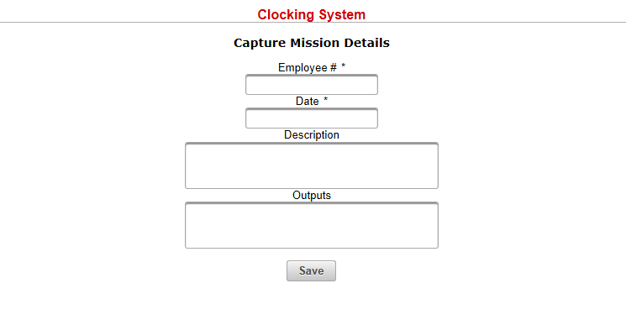
Logging Interface

Slide 3
Logging Interface Description
Designed to run on Tablet
The Tablet must be placed at Exit and Entry points
Employees simply input their Employee ID and Date for morning and evening clocking

Slide 4
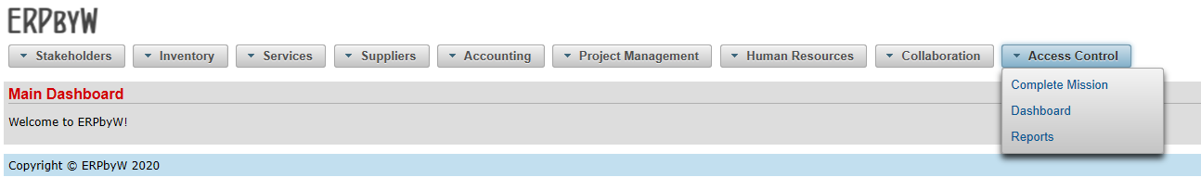
Administrative

Slide 5
Complete Mission
Add details to previous logging at your convenience
Specify Outputs, Return Date and Comments

Slide 6
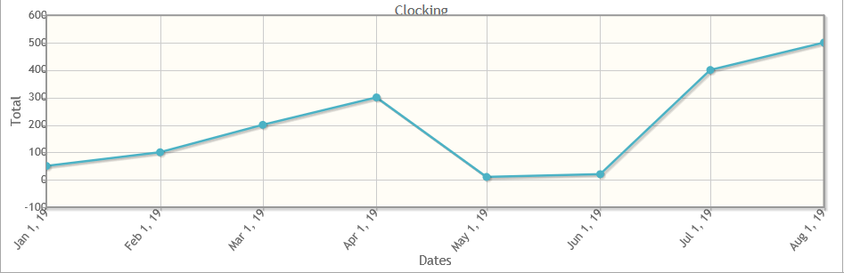
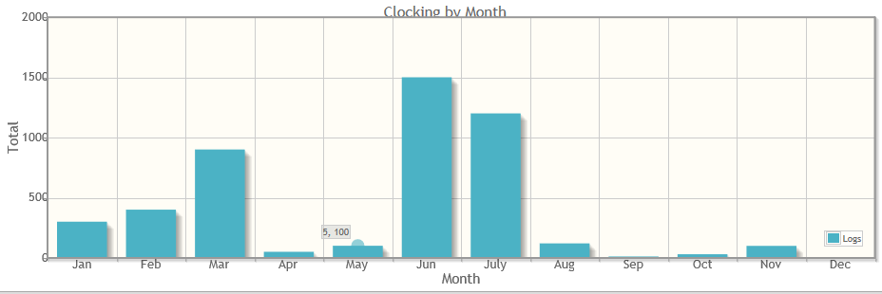
Dashboard

Slide 7
Prototype
This can be considered a functional Prototype
Can be implemented as a Cost Effective Access Management System
AMS includes Barcode / QR Code or Smart Card reader
Can also include equipment for linking system to door functionality (opening/closing)

