Slide 1
How to Find Awesome Open Source Projects
Featuring “Version Control --How to Use Git and GitHub”
Credits go Udacity, I have merely repackaged their content for presentation.
Notes:
https://medium.com/@hoffa/the-top-github-projects-per-country-92c275e19409

Slide 2
Introduction: Part 1
We’ll cover the concept of version control
Sorta like having a giant undo button for your projects
Save different versions of your files at different points in time
Restore previous versions
Compare to previous versions
Makes it easier to collaborate
Better than sending big zip files back and forth

Slide 3
Overview
Learn to use Git
A version control system
Learn to use GitHub
A code sharing and collaborating platform
Need to use a unix style command line
This will also make a little more sense to those with previous coding experience
Three Parts:
1: How version control is useful, and what different forms it can take on.
2: Learn more about Git and start using it
3: Practice sharing code and collaborating on GitHub

Slide 4
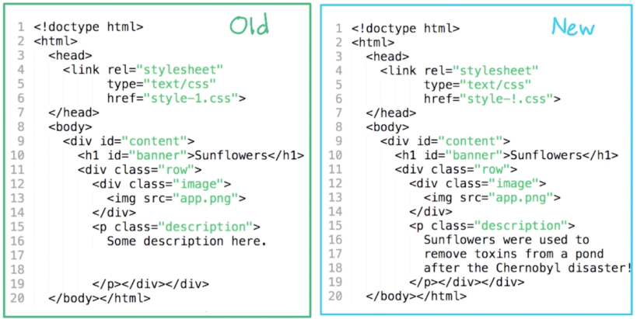
Differences Between Two Files
Lines 6, 16, 17 and 18 have changed
Notes:
*Quiz!
Imagine your friend is having trouble figuring out why his webpage isn’t working. The problem lies in the difference between the old and new version. Instead of manually having to find this difference, there are some helpful tools that will find them. Also having an old version saved can mean the different between spending minutes and hours debugging.

Slide 5
Finding Diffs Between Larger Files
What if there are 100’s or 1000’s of lines?
E.g, Asteroids Game
Try it here: http://dougmcinnes.com/html-5-asteroids/
There is a bug in this game!
Someone changed the key mappings
Up arrow -> Space
Space -> Enter
And now the engines don’t work! Typo? Where is it?
Download the two versions of the file
https://www.udacity.com/api/nodes/2960778928/supplemental_media/game-oldjs/download?_ga=1.32442489.672083044.1467344711
https://www.udacity.com/api/nodes/2960778928/supplemental_media/game-newjs/download?_ga=1.34079078.672083044.1467344711
Too long to compare the old version to the new version by hand. They are over 1000 lines!
Automatically compare files
Windows – FC (file compare)
cd directory/with/files
FC file1 file2
Mac or Linux – Diff
cd directory/with/files
diff -u file1 file2
-u stands for unified diff format (makes output easier to read)
Notes:
*Quiz
(FC output)
Lowercase = old file
Uppercase = new file
(diff output)
Lines with a + sign are added
Lines with a – sign are removed
Word with a type is “space”

Slide 6
Reflections
How did viewing a diff between two versions help you spot the bug?
Why should I?
It kinda helps cement the material
We’ll use this content for VC Practice
How?
One file per part
Plain-text, NOT rich-text

Slide 7
Reflect: Using diff to Find Bugs
Make sure you can access the command line
Choose a text editor
Notepad++, Sublime, Atom, Emacs, Vim, etc…
Make sure you can launch your editor from the command line (not required)
Set up your workspace
cd ~ # change directories to your home directory
mkdir version-control # make version-control directory
cd version-control # go to version-control directory
mkdir reflections # create reflections directory
cd reflections # go to reflections directory
subl lesson_1_reflections.txt # launch sublime (or any other editor) with a file called lesson_1_relfections.txt
pwd # print working directory – shows what directory your are in
ls # list the files in this directory
Use short lines
Git is less useful if your files contain very long lines. Remember to press enter to make a newline.
Do the first reflection exercise
lesson_1_reflections.txt
How did viewing a diff between two versions of a file help you see the bug that was introduced?
Create your document, write down your thoughts, and save the file.

Slide 8
Where Do Versions Come From?
Versions
Saving manual copies
Dropbox
Google Docs
Wikipedia

Slide 9
Reflect: Using History for Efficiency
How could having easy access to the entire history of a file make you a more efficient programmer in the long term?
Update your document.

Slide 10
Properties of a VCS For Code
Feature Comparison Chart
 | Any Editor | Use offline
Manual Saving | YES | YES
Dropbox | YES | NO
Google Docs | NO | NO
Wikipedia | NO | NO
When to Save:
As a programmer, when would you want to have a version of your code saved?
At regular intervals (e.g. every hour)
Whenever a large enough change is made (e.g. 50 lines)
Whenever there is a long pause in editing
When you choose to save a version
Notes:
*Quiz
1: Saves way more versions than you really need. You’ll also save at points that don’t really make sense (in the middle of typing a line). It might only be good if you’re very forgetful about saving.
2: Same problems as number 1, and we might get unusable versions. Also, you might not be able to save small, but important changes easily.
3: A little better, but might not save meaningful changes when you have to take a unplanned break.
4: Only downside is user error. It is the most flexible.

Slide 11
Manual Commits In Git
Feature Comparison Chart
 | Any Editor | Use offline | Manual Save
Manual Saving | YES | YES | YES
Dropbox | YES | NO | NO
Google Docs | NO | NO | NO
Wikipedia | NO | NO | YES
Git | YES | YES | YES
SVN | YES | NO | YES
Commits are user created checkpoints. Examples of commit messages are:
fix off-by-one bug
add cool new feature
Improve user docs
Notes:
Git was created in 2009 by Linus Torwalts
Git is British slang for something roughly equivalent to “unpleasant person”
“I’m an egotistical bastard, and I name all my projects after myself. First Linux, and now Git.”
Other version control systems include CVS, SVN (Subversion), Mercurial (HG after the elemental symbol for Mercury) which is similar to Git.

Slide 12
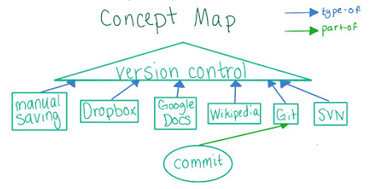
Creating a Concept Map

Slide 13
Using Git to View History
Viewing the history of a file on Git can be done completely offline (ex. game.js)
cd version-control/asteroids/
git log
Every commit that’s every been made, starting with the most recent
ID: Sorta like a serial number (unique identifier)
Author
Date
Message: Explains what has changed since the last commit
git diff commitID#1 commitID#2
Similar to FC or diff program, but compares different versions of a file within git
Output is similar to the output from diff
Colorized!!!

Slide 14
Concept Map: diff
If we were to put “git diff” on the map, which of the following existing concept(s) would we connect with it?
commit
Google Docs
git
Version Control
Notes:
*Quiz
I would connect it with commit and git.
Sort of indirectly related to version control
We’re creating a new relationship called “operates on”

Slide 15
One Commit Per Logical Change
How Often to Commit
Since you can choose when to make a commit, you might be wondering how often to commit your changes.
A good rule of thumb is to make one commit per logical change.
Commit Size
You commit all the changes required to add a new feature, which you’ve been working on for a week. You haven’t committed since you started working on it. (Too Big)
You find three typos in your README. You fix and commit the first. (Too Small)
You commit all the changes required to add a new feature, which you’ve been working on for an hour. (Just Right)
You fix two small bugs in different functions and commit them both at once. (Too Big)
It’s always a judgment call!
Notes:
*Quiz
Going a week without committing is going to make it hard to understand your changes
Better to fix all three typos, so you don’t just have a bunch of typo fixes in your history.
Good size! Single feature, and the diff is probably not too big.
Since the two bugs aren’t related, commit the fixes separately.
Answer any questions about README’s.

Slide 16
Reflect: Manual Commits
What do you think are the pros and cons of manually choosing when to create a commit, like you do in Git, vs having versions automatically saved, like Google Docs does?
Update your document.

Slide 17
Tracking Across Multiple Files
Tracking across files
E.g., Function in one file, call to that function in another file. If you add an argument to the function, you’ll need to change code in both files
Where does it make sense to track multiple files together rather than separately?
Competition-style coding
html and css files that make up a webpage (yes)
Photos you have photoshopped
A novel, split up by chapter (could go either way)
Notes:
*Quiz
Files aren’t interrelated
Files are very interrelated (a single change that adds an element to the html, and a style to the css)
Nope
Could go either way.

Slide 18
Git Commits Across Multiple Files
Commits with Multiples Files
Git calls this collection of files is called a repository
When you make a commit, you save a version of every file in your repository
Tracks the state of game.js, index.html, index.css; even if you don’t change all of them.
git log --stat
Gives some statistics about which files changed.
Green plus signs = additions
Red minus signs = deletions
Some commits affect more than one file
git diff commitID#1 commitID#2
File changed followed by a summary of the changes

Slide 19
Reflect: Multi-File Commits
Why do you think some version control systems, like Git, allow saving multiple files in one commit, while others, like Google Docs, treat each file separately?
Update your document

Slide 20
Installing Git
If you already have Git installed, check it’s version using the command git --version (1.8)
Otherwise install/upgrade Git here https://git-scm.com/downloads
Let me know if you have any problems

Slide 21
Cloning and Exploring the Repo
Cloning a Repository
git clone RepositoryURL
Asteroids URL
https://github.com/udacity/asteroids.git
Exiting git log
To stop viewing git log, press q (stands for quit)
Getting colored Output
Run git config --global color.ui auto
Copying and Pasting from the Command Line
Windows: Cntl + Shift + Insert (enable QuickEdit)
Mac: Cmd + C, Cmd + V
Ubuntu: Cntl + Shift + C, Cntl + Shift + V
Using git log and git diff
Running git log shows a list of the recent commits with info about them
Running git diff followed by the two commit ID’s compares the two versions
Entering commit IDs
It’s easier to enter just the first four or more characters of the commitID rather than the entire commit ID.
Notes:
*Quiz
Using git log and git diff
What is the ID of the commit with the message “Revert controls?”
B0678b161fcf74467ed3a63110557e3d6229cfa6
How many lines were added in that commit? 4
How many lines were deleted? 4
git diff first_id second_id

Slide 22
Reflect: Using Git to View History
How can you use the commands git log and git diff to view the history of files?
Update your document

Slide 23
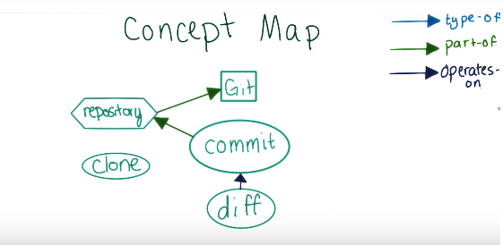
Concept Map: Repository, Clone, Log
Which concepts should log be connected to?
Notes:
*Quiz
Commit: Operates on (because it shows you a list of commits)

Slide 24
Git Errors And Warnings
Strange Warnings and Error Messages
Sometimes Git gives cryptic, confusing, or downright bizarre errors and warnings.
Which of the following is NOT a Git error or warning?
Should not be doing octopus
You are in ‘detached HEAD’ state
Panic! (the ‘impossible’ happened)
Notes:
*Quiz
- Octopus is a strategy Git uses to combine many different versions of code together!
HEAD is what Git calls the commit you are currently on. It’s not actually a bad thing.
Output by GHC, the compiler for Haskell. Reserved for particularly surprising errors!
I hope you were amused by these!

Slide 25
Checking Out Old Versions of Code
Checking Out Prior Commits
Temporarily changing our files back to the way they were at the time of that prior commit. This is called git checkout
Not the same as an svn checkout
Good for finding out which commit introduced a bug
Checkout the commit and run the code.
Running the Asteroids Code
Open the index.html file in a web browser
Find the file in Windows Explorer, Finder, etc
Open with Google Chrome or Firefox (not IE)
Endless stream of bullets is a bug!!!
Checkout the ‘revert controls’ commit, to see if it has the bug
git checkout commitID
Will get warning ‘You are in ‘detached HEAD’ state.’
git log, when run from an earlier commit will not show future commits.
Most recent commit ID is 3884eab839af1e82c44267484cf2945a766081f3
What is the ID of the first commit with the bug?
Notes:
Answer is 25ede836903881848fea811df5b687b59d962da3
“ a couple of missing ends with the ipad version “
Can use git diff to compare the commits and find out how the bug got introduced.

Slide 26
Reflect: Confidence from Version Control
How might using version control make you more confident to make changes that could break something?
Update your document

Slide 27
Git Workspace
Purple user name
Blue directory
Green commit ID
Star when changes have been made
Tab completion
Open a text editor when you want to write a commit message

Slide 28
Setting Up Your Workspace on Windows
Use a white background (you can skip this step)
Icon in upper left -> Defaults -> Colors
Set screen color to white, screen text to black
Close and reopen GitBash
Download this file for text completion
https://raw.githubusercontent.com/git/git/master/contrib/completion/git-completion.bash
Download this file for git features in the prompt
https://raw.githubusercontent.com/git/git/master/contrib/completion/git-prompt.sh
Download this file for configuring git bash
https://www.udacity.com/api/nodes/3341718587/supplemental_media/bash-profile-course/download
After downloading move the files
cd ~ (go to home directory)
mv Downloads/git-completion.bash.txt git-completion.bash
mv Downloads/git-prompt.sh.txt git-prompt.sh
mv Downloads/bash_profile_course .bash_profile
If you already have a bash profile, just copy and paste the content from this file into that file.
Feel free to modify the file if you don’t want to keep all of the things in it.
Configure Sublime (or any other text editor) (C:\ProgramFiles\Sublime Text 2)
git config --global core.editor “’path\to\sublime\sublime_text.exe’ –n –w”
N = new window
W = wait for you to close before trying to continue
Add this to your bash_profile (it could be a hidden file) – alias subl=“path\to\sublime\sublime_text.exe”
Run these config commands
Git config --global push.default upstream
Git config --global merge.conflictstyle diff3
Close and reopen for your changes to take effect.

Slide 29
Setting Up Your Workspace On Mac
Download this file for text completion
https://raw.githubusercontent.com/git/git/master/contrib/completion/git-completion.bash
Download this file for git features in the prompt
https://raw.githubusercontent.com/git/git/master/contrib/completion/git-prompt.sh
Download this file for configuring git bash
https://www.udacity.com/api/nodes/3341718587/supplemental_media/bash-profile-course/download
Right click > save as.
Save to Downloads directory
Uncheck “hide extension”
Rename to extension to be .bash or .sh
After downloading move the files
cd ~ (go to home directory)
mv Downloads/git-completion.bash git-completion.bash
mv Downloads/git-prompt.sh git-prompt.sh
mv Downloads/bash_profile_course .bash_profile
If you already have a bash profile, just copy and paste the content from this file into that file.
Feel free to modify the file if you don’t want to keep all of the things in it.
Linux users might need to rename this file .bashrc instead of .bash_profile
Configure Sublime (or any other text editor) (/Applications/Sublime \Text \2)
Add this to your bash_profile (it could be a hidden file) – alias subl=“/Applications/Sublime\ Text\ 2. app/Contents/SharedSupport/bin/subl”
git config --global core.editor “subl –n –w”
N = new window
W = wait for you to close before trying to continue
Git config --global push.default upstream
Git config --global merge.conflictstyle diff3
Close and reopen for your changes to take effect.
Notes:
Cool link on how prompts work in bash
http://www.cyberciti.biz/tips/howto-linux-unix-bash-shell-setup-prompt.html

Slide 30
Reflect: How Do You Want to Use Git?
Now that you have your workspace set up, what do you want to try using Git for?
Update your Document

Slide 31
Part 1 Summary
Saving different versions of your files can be useful
Practice using Git to review the history of existing projects
Now lets create a Git repository!

Slide 32
Introduction: Part 2
Learn how to use Git on your own machine, for solo projects
Create a new repository and make commits
Merging and Branching
Part 3: Using Git collaboratively

Slide 33
What Makes A Repository A Repository?
Looks like just another normal directory
The difference is that Git stores a bunch of metadata about the history of the repository
Tucked away in a hidden .git directory
Command ls –a can help you see these hidden files

Slide 34
Initializing a Repository
All this can be done offline
Creating a Git repository
ls –a (you won’t see a .git directory)
Run git init in either an existing directory
ls –a (now you will!)
How many commits do you think the new repository contains?
0! (Git could create an initial commit, but what if you don’t want to commit everything in the directory?)
Running git log can prove this
Notes:
*Quiz
A commit is a snapshot of a Git repository
What command could you use to find out?
Git log

Slide 35
Examining the New Repository
Running git log produces:
fatal: bad default revision ‘HEAD’
Running git status will prove that this is still a Git repository
You will be on the master branch
The commit will be ‘initial commit’
All of your files should be untracked
Creating your reflections repository
Run the commands git init and git status in the directory with your reflections
Notes:
*Quiz
On branch master
Initial commit
Untracked files:
(use "git add <file>..." to include in what will be committed)
lesson_1_reflections.txt
nothing added to commit but untracked files present (use "git add" to track)

Slide 36
Reflect: Initializing a Repository
Create a new file called lesson_2_reflections.txt
What happens when you initialize a repository? Why do you need to do it?
You might want to run git status after you create the file. You should see that now both files are listed as untracked files.

Slide 37
Staging Area
Choosing what changes to commit
Working directory (your hard drive)
git commit doesn’t just send stuff from your working directory to the repository
The staging area makes it easier to choose what changes you want to commit
Git bundles the entire contents of the staging area into a single commit and adds that to the repository
git add fileToAdd
For example:
git add cake-recipe.txt
git add frosting-recipe.txt
git status shows that these files are now changes to be committed
Adding reflections to the staging area
Use git add to add whatever reflections files you would like to the staging area
Could be separate because they are for different lessons
Could be together, whatever you want to do.
Notes:
*Quiz
If you accidentally add a file to the staging area, you can remove it using git reset. For example, run git reset lesson_2_reflections.txt

Slide 38
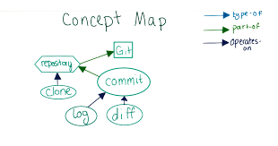
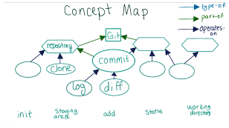
Concept Map: init, add, staging area
Previous Version
Where should the new concepts go?
Notes:
*Quiz
Init -> repository
Commit -> Staging area -> git
Add -> Staging Area
Status -> Staging Area
Status -> Working Directory

Slide 39
Reflect: Staging Area
How is the staging area different from the working directory and the repository? What value do you think it offers?
Update your document. We’ll learn how to commit it next.

Slide 40
Writing Good Commit Messages
How to write a commit message
You’re about to make your first commit to your reflections repository.
You can also specify a commit message via the command line by running git commit –m “Commit message” instead of just git commit.
Commit message style
Here is a link to some best practices.
http://udacity.github.io/git-styleguide/

Slide 41
Committing Changes
To commit the changes you added, run the command git commit.
Git should open the editor you configured so that you can write a commit message.
Standard practice to write your commit message as a command. E.g. “Add a recipe” rather than “Added a recipe”
Save the file and quit the editor. Use git log to ensure that the change has been committed.
Running git status should no longer show the files you committed as untracked.
Commit your changes in the staging area
git commit
Commit all changes
git add
git status
git commit
What is the output of git status after all your changes are committed?
Git cheat sheet
https://github.com/github/training-kit/blob/master/downloads/github-git-cheat-sheet.pdf
Notes:
*Quiz
Should be
On branch master
nothing to commit, working tree clean

Slide 42
Git Diff Revisited
Fixing the bug from the asteroids repository
Use git diff to compare the commit with the bug to the previous one
We need to re-add the line this.delayBeforeBullet = 10;
Use git diff (without any arguments) to compare the working directory to the staging area.
This probably won’t be something you need to do now, but with huge changes it can be a helpful way to remember what changes you made.
Use git diff --staged to compare the staging area to the most recent commit
This is a helpful way to make sure the files you’ve added are really what you want to commit.
Add game.js to the staging area and commit. Also try out git diff and git diff --staged
If you want to discard changes to the working directory or staging area, run git reset --hard (but be careful, this action is unreversible)
Basically only run it after running git diff and git diff –staged to make sure there are no changes in the working directory or staging area that you want to keep.
Notes:
Make an unneeded change to index.html to illustrate the git diff stuff.

Slide 43
What two versions does each form of git diff compare?
Choices:
Working directory
Staging area
Commit1
Commit2
git diff
Working directory, staging area
git diff --staged
Staging area, Commit1
git diff commit1 commit2
Commit1, Commit2

Slide 44
Commit the Bug Fix
Leave ‘detached HEAD’ state
Run git checkout master
Fix the delay bug
In game.js find the statement if (this.delayBeforeBullet <= 0) { (should be on line 423). On the next line, insert this.delayBeforeBullet = 10;
Stage your change
Add game.js to the staging area
Commit your change
Make sure to use a meaningful commit message!
Check out this link if you’re interested in learning more about Git internals and how commit ids are generated
http://git-scm.com/book/en/Git-Internals-Git-Objects

Slide 45
Reflect: Commit Size
How can you use the staging area to make sure you have one commit per logical change?
You may want to commit your changes to the file.

Slide 46
Branches
Sometimes you might want to make a commit history that branches out into multiple versions.
Linear makes sense for
Fixing bugs
Adding new features
Updating documentation
Branching makes sense for
Experimental features
Different versions of the same program (Spanish version)
Master is the name given to the main branch in most repositories
Other branches could be called
Spanish
Exp
Etc…
If you check out a branch and then make a commit, the branch label automatically updates to the new commit. It also stays checked out.
Current last commit on a branch is known as the tip of that branch.

Slide 47
Making a Branch
Make an experimental change in the asteroids repository (easy version)
We’ll make the asteroid break into only two smaller fragments instead of three.
Running git branch (with no arguments) shows you your current branches
Running git branch easy-mode will create a new branch with the name easy-mode
Running git branch again will show you that easy-mode has been created
Running git checkout easy-mode followed by git branch should change the star, which indicates the active branch.
Change 3 to 2 in the beneath the //break into fragments comment in game.js (line 678)
Add and commit changes making the game easier
The output of git status, once we’re done should be
On branch easy-mode
nothing to commit, working tree clean
Notes:
*Quiz
Create the easy-mode branch
Checkout that branch
Commit the change making the game easier
- line 678
Paste the output of git status here
On branch easy-mode
nothing to commit, working tree clean

Slide 48
Reflect: When to Use Branches
What are some situations when branches would be helpful in keeping your history organized? How would branches help?
You may want to commit your changes.

Slide 49
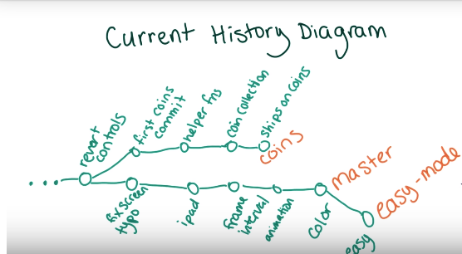
Branches for Collaboration
If you and your collaborators all make changes on the same branch, you can’t work on separate changes simultaneously.
Commonly we will make a separate branch for every feature or bug-fix
Then once the changes are complete, you can either update master to point to the tip of the new branch, or merge it with the current master.
For example, adding a coins feature to the asteroids game.
git checkout coins
Remote branch means that you didn’t create the branch
git log, for the reason why there is not color in this version
git log on master will show many newer commits
Viewing the commit history
Run git log --graph --online master coins
Notes:
*Quiz

Slide 50
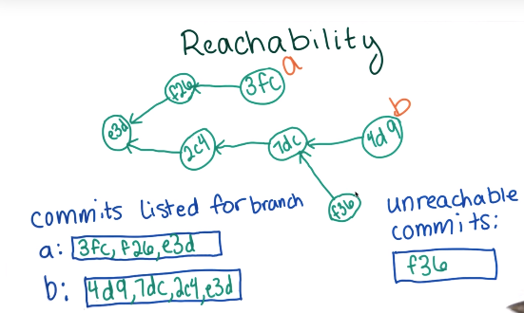
Reachability
git log doesn’t always show you every commit
Each commit knows about its parent
If you were on a branch when you made a commit, git only stores the commit ID of what was then the tip of the branch
Commit doesn’t care about branch names
git log will trace through the commit history until it finds a commit without a parent (initial commit)
Sometimes there are commits that aren’t reachable from certain branches
So if you check out a commit, and make a new commit from there, that would move HEAD to that commit. If you then checkout an existing branch, the commit you just made would be lost unless you remember the commit ID, because it’s not reachable by any of the other branches.
Notes:
*Quiz

Slide 51
Detached HEAD Revisited
Get this message when checkout out a commit, rather than a branch.
HEAD just means current commit
You are in 'detached HEAD' state. You can look around, make experimental changes and commit them, and you can discard any commits you make in this state without impacting any branches by performing another checkout.
If you want to create a new branch to retain commits you create, you may do so (now or later) by using -b with the checkout command again. Example:
git checkout –b new_branch_name
Notes:
Experimental because all of your commits won’t be on any branches.
Discard is okay because you’re not really in any branches, it’s not reachable.
If you then checkout an actual branch, it would be like these commits never existed.
Running git checkout –b new_branch_name is like running
git branch new_branch_name
git checkout ‘new_branch_name’
It just makes a new branch at your current commit.

Slide 52
Reflect: Visualizing with Diagrams
How to the diagrams help you visualize the branch structure?
You may want to commit your changes.

Slide 53
Combining Simple Files
How do we combine changes from multiple branches into a single version?
Could just update the label of master if no changes have been made
But if changes have been made to master we will have to combine both branches into one version
Merging Files
Jake
B, D, E
Rachel
A, B, C, D
What should be in the final file?
A?, B, C?, D, E?
Notes:
*Quiz
Did Rachel add A? or did Jake delete it? Same for C and E

Slide 54
Combining Simple Files Using Original
How do we solve the problem of knowing which lines to include?
It would help to know what the original looked like?
Merging files
Original: A, B, D
Jake: B, D, E
Rachel: A, B, C, D
Final: B, C, D, E
Notes:
*Quiz
Jake deleted A
Rachel added C
Jake added E

Slide 55
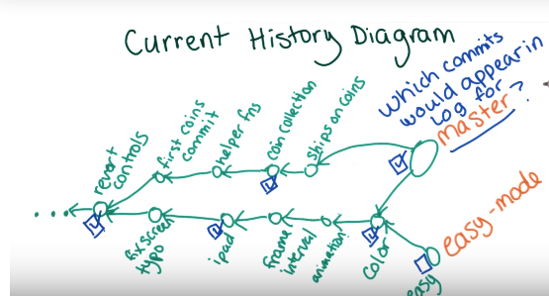
Merging Coins Into Master
Git can create a new commit that will merge two different branches together.
Both former branches become the parent of this commit.
The new commit should become the tip of the master branch “merge coins into master”
All of the commits from both branches get merges into the master branch as well.
You can delete old branches after they have been merged into another branch, since all of their commits are also accessible from the branch they were merged into. (this just deletes the label)
But if you deleted the coins branch before merging it into master, all of those commits would become unreachable.
Still accessible by commit ID until Git’s garbage collection runs. It happens automatically but you can also run it manually with the command git gc.
Notes:
*Quiz

Slide 56
Merging on the Command Line
Verify you are on the master branch
Run git branch
Create a merged version of the two branches
Run git merge master coins
Commit comes with a default commit message
View the merge commit
Run git log
Verify the merge worked
Run index.html in chrome
Viewing the diff between a commit that is not the parent of another commit can be misleading
Makes it look like there were many more changes than normal
View the diff between a commit and its parent
Run git show commitID
Will probably show a much smaller diff
Delete the old coins branch
Run git branch –d coins (d stands for delete)
Won’t commit the commits, just the label
Windows users might experience a merge conflict from Newline characters)
To resolve this run git config --global core.autocrlf True
More info here https://help.github.com/articles/dealing-with-line-endings/#platform-all
Notes:
*Quiz
Merging coins into master
Repeat my steps on your own
Optional: Make the coin solid and yellow
Did you merge the branches?
Yes and I made the coins yellow
Yes, and I did not make the coins yellow
No, I was not able to merge the branches
No, I chose not to merge the branches
A note about git merge
git merge will also include the currently checked-out branch in the merged version. So if you have branch1 checked out, and you run git merge branch2 branch3, the merged version will combine branch1 as well as branch2 and branch3. That’s because the branch1 label will update after you make the merge commit, so it’s unlikely that you didn’t want the changes from branch1 included in the merge. For this reason, you should always checkout one of the two branches you’re planning on merging before doing the merge. Which one you should check out depends on which branch label you want to point to the new commit.
Since the checked-out branch is always included in the merge, you may have guessed that when you are merging two branches, you don't need to specify both of them as arguments to git merge on the command line. If you want to merge branch2 into branch1, you can simply git checkout branch1 and then type git merge branch2. The only reason to type git merge branch1 branch2 is if it helps you keep better mental track of which branches you are merging.
Also, since the two branches are merged, the order in which they are typed into the command line does not matter. The key is to remember that git merge always merges all the specified branches into the currently checked out branch, creating a new commit for that branch.

Slide 57
Reflect: Merging Two Branches
What is the result of merging two branches together? Why do we represent it in the diagram the way we do?
You may also want to commit your changes

Slide 58
Merge Conflicts
Merging files
Can we always merge automatically?
Example:
Original: A, B, D
Jake: A, B’, D
Rachel: A, B’’, D
Final: A, B?, B’?, B’’?, D
We’re not sure which version should be included in the final file.
Notes:
*Quiz
B’ and B’’ are modified versions of the original file.
300 vs 400 vs 350 degrees to heat the oven…
Jake and Rachel probably need to talk to each other in this case.

Slide 59
Conflict Detection
Git just notes that these lines are different.
Git will note a merge conflict when we start with two identical files, and there are different changes made to both of those files in the same general area.
It would be near impossible to make Git know about all of the cases in which you might want to automerge.
Git chooses to leave the conflicts to be resolved by the users

Slide 60
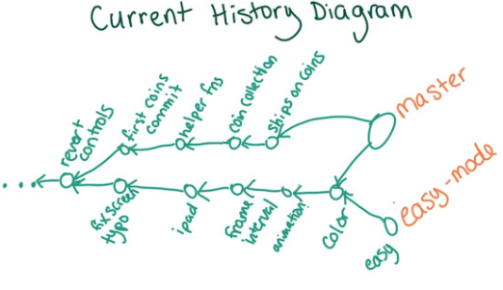
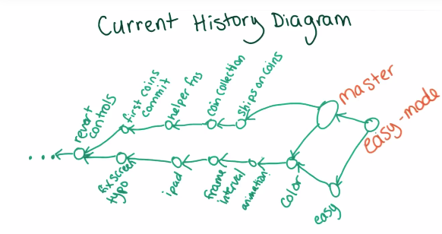
Update Easy Mode
Motivation
Master has updated since the easy-mode branch was created.
If you merge master into the easy-mode branch, what will the history look like afterward?
Previous version of the diagram
How could we update the diagram?
Diagramming tools
git log --graph
Gliffy https://www.gliffy.com/
yUML http://yuml.me/diagram/activity/draw
Notes:
*Quiz
We just move the label to the new commit.

Slide 61
Resolving Merge Conflicts
Don’t want to include easy-mode in master, since we want to maintain two separate difficulty’s. Here’s how to do this.
Run git checkout easy-mode (this updates easy-mode, rather than master)
Run git merge master easy-mode (merge conflict)
Open file where the conflict is and look for:
<<<<<<<< HEAD
Your code
||||||||| merged common ancestors
Original version that both branches modified
=========
Code in master
>>>>>>>> master
How should we resolve this conflict and still keep both changes
Function call plus number of asteroid fragments.
Notes:
*Quiz
Differences between middle section and top shows your changes
Differences between bottom and middle shows other persons changes
Sarah replaced code with a call to a function breakIntoFragments()
Find her function (change didn’t create a conflict)
Resolve the conflict by rewriting the code:
Leave only sarahs code, and change the number in the breakIntoFragments function to be 2
instead of 3.

Slide 62
Committing the Conflict Resolution
To let Git know the conflict is resolved, you should commit the resolution
Save the file
Run git status (to ensure the file is both modified)
Run git add game.js
Run git status (conflicts are fixed, still merging)
Run git commit (autofilled commit message)
Run git log (only one new commit created)
Resolving a merge conflict
Merge master into easy-mode on your computer
What is the output of git log –n 1?
(n mean that git only shows that number (1) of commits)
Notes:
*Quiz
Merge branch 'master' into easy-mode
Conflicts:
game.js

Slide 63
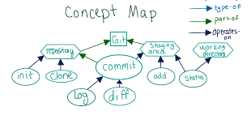
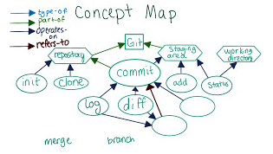
Concept Map: Branch, Merge
Old Version
New Version
Notes:
*Quiz
Merge (operates on) Commit
Log/diff (operates on) Branch (refers-to) Commit

Slide 64
Reflect: Automatic vs. Manual Merging
What are the pros and cons of Git’s automatic merging vs. always doing merges manually?
You may also want to commit your changes.

Slide 65
Part 2: Summary
Create a Git repository and added commits to it
Use the staging area to control exactly which version make it into your commit
Maintain parallel versions of your code using Git branches and merge branches together into one combined version
Next Up GitHub!

Slide 66
Part 3: Intro
Share your changes with other people
Bring other peoples changes into your own projects
GitHub is one of many projects designed for this

Slide 67
Intro to GitHub
A website that makes it easy to share an entire Git repository with other people
Ex: udacity/create-your-own-adventure
Can click around in the file structure
Can view the commit history
README displays on the main screen
We’ll practice contributing to this project
GitHub is home to many public projects
Most of which are open source
GitHub allows you to suggest changes that can be accepted by the owner of the project
Some are very small https://github.com/mathquill/mathquill (36 contributors)
Some are really big https://github.com/ipython/ipython (485 contributors) or https://github.com/twbs/bootstrap (853 contributors) or https://github.com/jquery/jquery (261 contributors) or https://github.com/atom/atom (357 contributors)
Anyone could theoretically contribute to these, but sometimes it can be hard to get your changes accepted by the person maintaining the project.
You can still keep your own version, even if they aren’t accepted into the project.
Private repositories cost money, but public repositories are free. This is part of GitHubs effort to promote open source.
Notes:
https://github.com/udacity/create-your-own-adventure

Slide 68
Creating a GitHub Account
Create a GitHub account
You’ll be sharing changes on GitHub, so you’ll need a GitHub account. Sign up by visiting https://github.com/ (choose the free plan)
Set up password caching
Every time you send changes to GitHub via the command line, you’ll need to type your password to prove that you have permission to modify the repository .
If you find this annoying follow the directions here https://help.github.com/articles/caching-your-github-password-in-git to have your password autofilled.
Windows users should follow instructions for mysysgit.

Slide 69
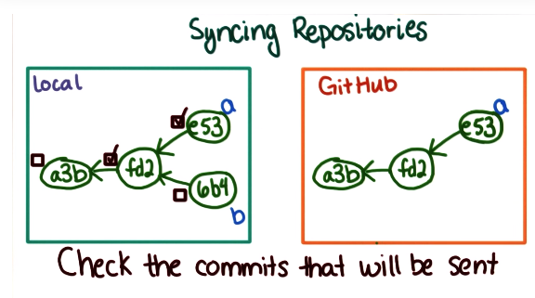
Keeping Repositories In Sync
Syncing Repositories
GitHub only hosts commits, so you have to stage and commit your changes before they can live on GitHub
GitHub lets you choose when to sync, so that your changes don’t go public before they’re ready
An empty repository on GitHub is a prerequisite to moving your local repository to GitHub
Git has a concept of a remote repository
This remote is used for pushing and pulling data to and from GitHub
You could push/pull a commit, but mostly you’ll want to push/pull branches
E.g., push master pushes all the commits in master to GitHub
Git doesn’t send commits that are already on GitHub
Notes:
*Quiz

Slide 70
Adding a Remote
Log into GitHub
Select + > New Repository
Name the repository “reflections”
Leave it as public
Don’t initialize the repository with a README
Add as a remote
Use git remote to see current remotes (empty)
Run git remote add origin <url> (origin is the standard name)
Running git remote should show that origin was created
Run git remote –v (v is for verbose) to see the url
Use git push origin master to send your changes to the remote
This copies all of the commits from master to origin (GitHub)
Refresh GitHub and you should see all of your files there.
Note:
Copy the HTTPS URL, not the SSH URL!
Go ahead and share your reflections, if you want to!
Notes:
*Quiz
Sharing changes on GitHub
Create a reflections repository on GitHub
Push your reflections to GitHub
Share links to your reflections with each other
Only initialize the repository with a README if you don’t have that repository already created somewhere else.
Format of git push is git push <remoteName> <localBranchName>

Slide 71
Editing Files On GitHub
View files in the repository
View the commit history by clicking on commits.
You’ll only see changes that have been pushed to GitHub
Adding content to GitHub
Click + to create a new file (lesson_3_reflections.txt)
Enter a commit message
Create file for lesson 3
Click “Commit new file”

Slide 72
Reflect: When to Use a Remote Repository
Make changes on GitHub
Use the GitHub website to create a new file for your lesson 3 reflections
When would you want to use a remote repository rather than keeping all your work local?
Commit your changes.

Slide 73
Pulling Changes
Now your local version is out of date with the remote (GitHub) version
Pull master back into the local version
Pull changes
Running git log shows that the most recent commit isn’t available in the local repository
Run git pull origin master. This will pull all commits reachable from the master branch into your local repository
Running git log shows that the new commit is present in your local repository
Notes:
*Quiz
Pulling changes from GitHub
Pull the changes you make on GitHub into your local repository
Which of the following is true?
Some changes in your local repository are not on GitHub
Some changes on GitHub are not in your local repository
Neither
Format for git pull is git pull <remote> <branch>

Slide 74
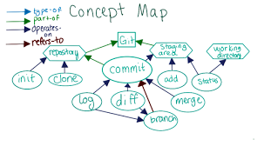
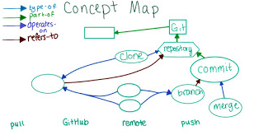
Concept Map: GitHub, Push, Pull, Remote
Previous Version
New Version
Notes:
*Quiz
Git (part of) GitHub (GitHub could operate on Git, or refer to Git)
Remote (refers to) repository
Push/Pull (operate on) remote/branch

Slide 75
Reflect: Manual vs. Automatic Pull
Why might you want to always pull changes manually rather than having Git automatically stay up-to-date with your remote repository?
You may want to commit and push changes.

Slide 76
Forking a Repository
Recipes repository
We should make these better
We could clone this repository and set it up as a remote, then create a new repository on GitHub and set up that repository as a remote and then push changes to the new remote
Anyone else who wants to could do this, but this is too involved and doesn’t give credit to the original author of the repository, since no one who clones a modified version would know about the original owner
Forking a Repository
Copy someone else’s repository on GitHub without having to pull it down to your local machine first.
A fork is just a clone that GitHub makes for you, but:
GitHub keeps track of the number of forks
GitHub makes it easier to push changes back to the original repository

Slide 77
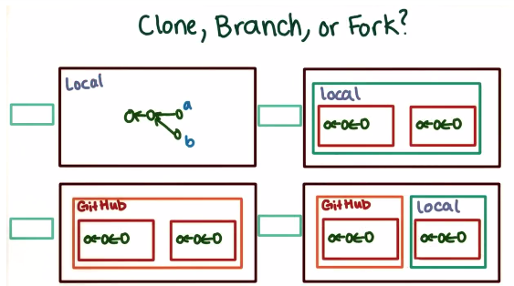
Notes:
*Quiz
Top left: Branch (branches happen on a single repository)
Top right: Clone (original repository could be remote or local)
Bottom left: Fork (forking is only used within the context of GitHub)
Bottom right: Clone (original repository could be remote or local)

Slide 78
Fork the Recipes Repository
Here is a link!
https://github.com/LarryMad/recipes
Click the Fork Button
Now there should be a copy of the repository on your GitHub profile
Clone the Fork to your local machine
Run git clone <url>
cd recipes
Git automatically sets up a remote when you clone a repository (verify with git remote –v)
Add others as collaborators on GitHub
Feel free to add each other
Notes:
*Quiz
Fork the recipes repository
Fork Larry’s repository
Clone your fork
Run git remote -v

Slide 79
Push Changes to the Recipes Repository
Add a new recipe to the repository
On your own computer, add a new recipe for a food you like and commit it on the master branch.
Push your changes
Push the master branch to your fork
Where was your commit present?
Right before running git push
Commit was present in your local repository
Right after running git push
Commit was present in your local repository and on your fork (on GitHub)
Notes:
*Quiz
Where was your commit present?

Slide 80
Reflect: Forks, Clones and Branches
Describe the differences between forks, clones, and branches. When would you use one instead of another?
You may also want to commit and push your changes.

Slide 81
Collaborations Cause Conflict
What if both repositories have commits reachable from the same branch?
When you pull, you want a combination of both commits from both versions
Just like merging, but you are merging the local and remote versions
This comes up when collaborating with others

Slide 82
Change the chili recipe
To get conflicting changes, you’ll want changes to be made by two people – you and someone named Sarah. First, you should make your change locally. Modify the chili recipe by adding a new spice that you like to the ingredients list, and modify step 2 of the directions to mention that spice. Commit your change, but don’t push the change to your fork yet.
Your branch should be ahead by one commit of origin.
Notes:
*Quiz

Slide 83
Sarah changes the chili recipe
Sarah doesn’t like cumin, so She’s going to push a change to the master branch that removes cumin from the chili recipe.
You will see Sarah’s change in your commit history.
GitHub is going to see this as a conflict, however, since you both changed the same line.
Notes:
Just remove cumin from the ingredients list and from the directions

Slide 84
Simulate Sarah’s Changes
Download sarah_changes.sh here
https://www.udacity.com/api/nodes/3108878699/supplemental_media/sarah-changessh/download?_ga=1.34385894.672083044.1467344711
To run it
cd to the directory where you saved it
Type bash sarah_changes.sh <url to your fork>
Where to these commits exist
Commit by Larry with the message “Add a chili recipe”
Exists locally, Exists on your fork
Commit by you adding a new spice to the chili recipe
Exists locally
Commit by Sarah with the message “Remove cumin from chili”
Exists on your fork
Notes:
*Quiz

Slide 85
Updating Local Copies Of Remote Branches
Merging Remote Changes
Git stores local copies of remote branches
For example this could be called origin/master
If you commit locally, the remote branch and the local copy of your remote branch don’t get updated until you push
You can update just your local copy of the remote, without updating your local branch, by running git fetch
This is nice when there are potential conflicting changes, so you can use git log and git diff to see what changes were introduced on the remote
You can also merge these two
Wow! So git pull is basically a combination of git fetch and git merge

Slide 86
On the command line with the recipes repo
Update local copies with git fetch origin
Inspect local copies with git log origin/master
Also git diff origin/master master works
Output before and after git fetch
Before:
git log origin/master: Add chili recipe
git status: Ahead
After:
git log origin/master: Add chili recipe, Remove cumin
git status: Out-of-sync
Notes:
*Quiz

Slide 87
Merging the Changes Together
Verify origin/master contains Sarah’s changes with git status (branches have diverged)
Ensure you have the master branch checked out and then run git merge master origin/master
Resolve the merge conflict
Now add and commit the resolved chili recipe
Could have run git pull origin/master
Now git status should indicate you are up to date
Notes:
*Quiz
Merging remote changes
Create a merged version of your changes and Sarah’s changes
Push the merged version to GitHub
Git Status should be
On branch master
Your branch is up-to-date with 'origin/master'.
nothing to commit, working tree clean

Slide 88
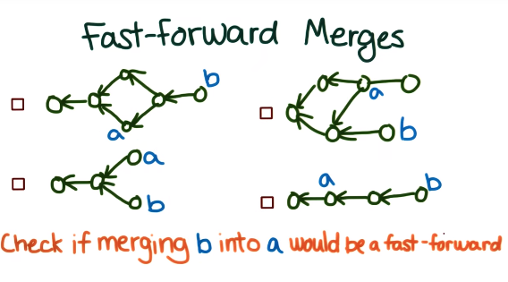
Fast-Forward Merges
Question: If git pull is the same as git fetch and then merging, why haven’t previous pull generated a merge commit?
Answer: Fast-Forward Merges!
This happens when you merge two commits and one is an ancestor of the other.
So instead of creating a new commit (since commit b would already know everything about commit a), we just update the label so that they now point to the same place.
Examples:
Notes:
*Quiz
Top left: Yes
Bottom Right: Yes

Slide 89
Reflect: Local Copies of Remote Branches
What is the benefit of having a copy of the last known state of the remote stored locally?
You may also want to commit and push your changes.

Slide 90
Making a Pull Request
How to get feedback on your changes before you update the master branch
First make your change locally in a separate branch
E.g., git branch different-oil
Checkout the branch and make the change
Push the change to your fork (still not in the master branch)
E.g., add, commit and push the changes (with git push origin different-oil)
You can view the branch on GitHub (same list as git branch)
Click pull request on GitHub
You might need to change the base fork from the original repository to your own fork
Hit create pull request
Someone else can review your changes and merge your pull request, they can otherwise leave comments if they notice a mistake.
Notes:
Could also think of this as a merge request “request for someone else to pull your changes into master”
Merge pull request only pops up if there’s no conflict.
Feel free to make a typo if you want a reason to update your pull request later on.

Slide 91
What gets Changed?
edit and save README.md
Local working directory
git add README.md
Local staging area
git commit
Local master branch
git pull origin master
Local master branch
git push origin master
GitHub master branch
merge alt pull request
GitHub master branch
Notes:
*Quiz

Slide 92
Updating a Pull Request
You’ll get an email if someone comments on your pull request
You can fix the issue and re commit it
git push origin different-oil
The commit message will show up under the comment
Make a pull request
Create a different-oil branch
Make a commit different-oil changing the oil
Push different-oil to your fork
Create a pull request from different-oil into master
Optional: Make another commit and update the pull request
Notes:
*Quiz
Link should look like https://github.com/woahboy/recipes/pull/1

Slide 93
Reflect: Collaboration using Git and GitHub
How would you collaborate without using Git or GitHub? What would be easier, and what would be harder?
You may also want to commit and push your changes.

Slide 94
Conflicting Changes
If someone else makes changes that conflict with your pull request
E.g., Sarah makes a pull request that increases the amount of oil (they are on the same line, so this is a merge conflict)
GitHub requires you to resolve merge conflicts on your own computer and then update the pull request with the merged version
Sometimes it’s only acceptable to make changes with pull requests, since if you just merged into master no one else would know that master changed.
Update the branch, and then merge master into your branch, and push the branch to GitHub (which updates the pull request).

Slide 95
Updating Your Local Repository
Run git pull origin master
Also could do
git fetch
git merge origin/master master
This is if you want to look at the changes before you merge them
Incorporate the changes into the different-oil branch
git checkout different-oil
git merge master different-oil
Resolve merge conflict
Now git commit the merge
git log should show both changes
https://www.udacity.com/api/nodes/3106648623/supplemental_media/sarah-changes-2sh/download?_ga=1.238512199.672083044.1467344711
Notes:
*Quiz
Updating pull request to resolve conflicts
Repeat these steps yourself:
Simulate Sarahs changes
Update your different-oil branch with Sarah’s changes
Push the different-oil branch
The following should be true
Your local master contains Sarah’s changes
Your local different-oil contains the merge commit
The pull request contains the merge commit
The “merge” button is green

Slide 96
Merging a pull request
If you finished everything from the last slide, then then “Merge” button on your pull request should be green. Now merge your pull request by pressing the button, then bring your local master up-to-date with the remote master using git pull
One you’re done, run git log –n 1 on the master branch and check the output. Should be similar to
Merge: ab4b834 610bbc6
Author: woahboy <justintime94@gmail.com>
Date: Thu Apr 27 15:49:10 2017 -0500
Merge pull request #1 from woahboy/different-oil
Please take another look
Notes:
*Quiz

Slide 97
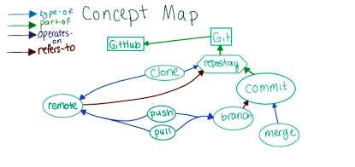
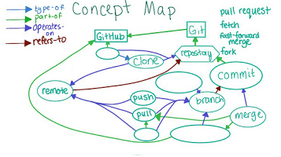
Concept Map: Fork, Fetch, Pull Request
Current version
New Version
Notes:
*Quiz
Fork (type of) clone, (operates on) repository, (part-of) GitHub
Fast-forward mege (operates on) branch
Merge (part-of) pull request (part-of) GitHub (operates on) branch
Fetch (operates on) branch, remote (part-of) pull

Slide 98
Reflect: When to use a separate branch
Way more complicated
Rather than pulling and pushing you…
Pull changes into local master
Merge the local master into your branch (different-oil)
Then push your branch to the remote
Finally merge your branch into master (locally or not GitHub)
Given this nightmare
When would you want to make changes in a separate branch rather than directly in master? What benefits does each approach have?
You may also want to commit and push your changes.

Slide 99
Modifying the Adventure Repository
Fork the repository and clone your fork
https://github.com/udacity/create-your-own-adventure
Make a change to the story
Read the README in the repository for instructions
Make a pull request
Click the “pull request” button from your branch like you did before, but this time, leave the original repository as the base
Ask for your pull request to be merged
A bot might be able to merge your pull request automatically. If that doesn’t happen, feel free to modify your pull request so that it does. Otherwise you’ll have to wait for someone to merge the pull request. (Could take a while)
If needed, update your pull request
If someone merges your pull request or leaves a comment, GitHub will email you and let you know.

Slide 100
Keeping a Fork Up-To-Date
Merge Conflicts in Pull Request
After you fork, and then clone your fork, make your change, and push back to your fork, someone else changes the repository on GitHub
You need to get their conflicting changes by adding a remote. Origin points to your fork, but you need one that points to the original repository. This is usually called upstream. Then upstream/master will be added into your local repository, and you can merge it with your change.
Run git pull upstream master
Merge the master branch into your change branch
Push the master and change branch into the fork
Notes:
*Quiz
Updating a cross-repository pull request
Complete the following steps:
Add the original repository as a remote in your clone
Pull the master branch from the original repository
Merge the master branch into your change branch
Push your change branch to your fork
Steps:
git remote add upstream <url>
git checkout master
git pull upsteam master
git log (chocolate sprinkler should be there)
git checkout stop-drop-roll
git merge master stop-drop-roll
Resolve merge conflict
git add fire.md
git commit
git push origin stop-drop-roll (origin is your fork, not upstream)
git checkout master (update master branch)
git push
Now the pull request should be good!

Slide 101
Part 3 Summary
Use remotes to push changes up to GitHub and pull changes down from other people
Use pull request to collaborate with other people
And now you can use Git!

