Slide 1
Clean vehicle Manual for Micron AATT

Slide 2
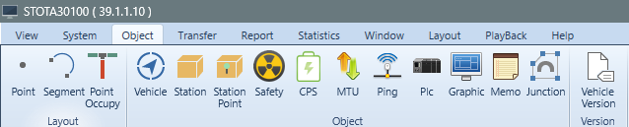


1. Clean Vehicle – Clean Mode On
1) Open Vehicle popup
- Menu bar -> Object -> Vehicle (Click)

Slide 3
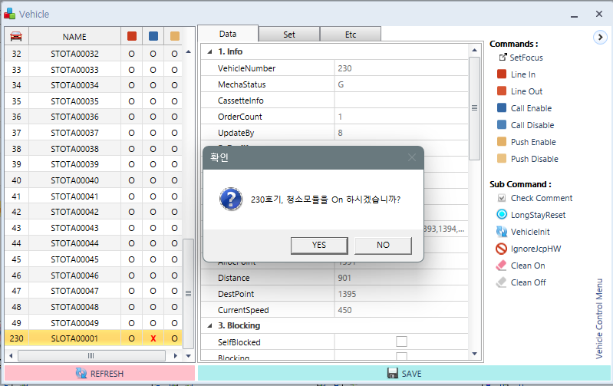
1. Clean Vehicle – Clean Mode On
2) Clean vehicle Clean mode turn on
Click Clean On -> Click Yes

Slide 4
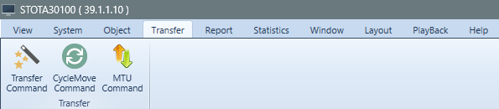
2. Start CycleMove
1) Open CycleMove Transfer Popup
Click Menu Transfer -> Click CycleMove Command Transfer

Slide 5
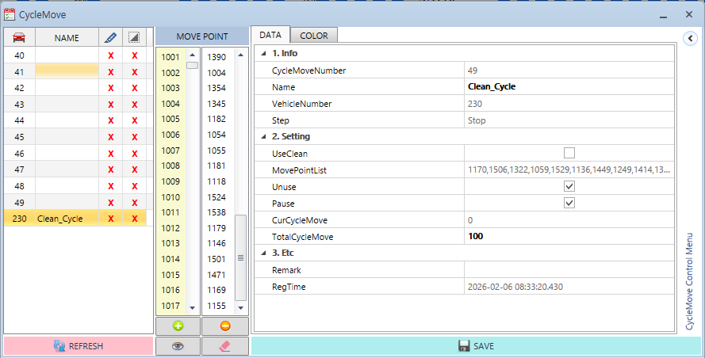
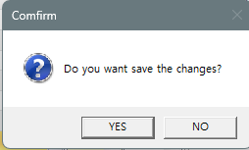


2. Start CycleMove
2) Cycle Move Start
Uncheck the Unuse Pause check box
Make sure TotalCycleMove has a larger value than CurCycleMove, if it is small, you need to modify it
Click Save -> Click Yes

Slide 6
3. Clean Vehicle – Clean Mode Off
1) Open Vehicle popup
- Menu bar -> Object -> Vehicle (Click)

Slide 7
3. Clean Vehicle – Clean Mode Off
2) Clean mode Turn off
Click Clean Off -> Click Yes

Slide 8
4. Stop CycleMove
1) Open CycleMove Transfer Popup
Click Menu Transfer -> Click CycleMove Command Transfer

Slide 9
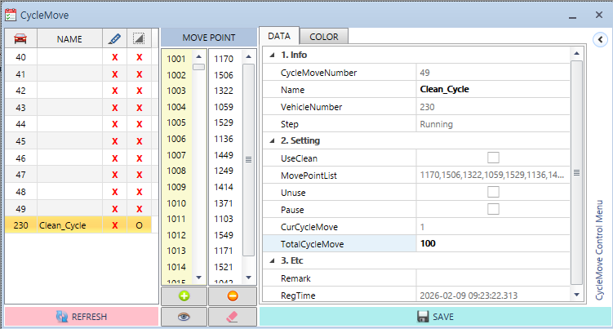
4. Stop CycleMove
2) Cycle Move Stop
check the Unuse Pause check box
Verify that the CurCycleMove value has increased
Click Save -> Click Yes

