Slide 1
EQ Monitoring Configuration
for Micron AATT L40 Server
2025.11

Slide 2
목차
1. Equipment Monitoring Overview
2. Equipment IP List (EQ Group Tag List)
3. Equipment SNMP List (EQ Tag List)
4. Applyng Method
5. Monitoring Method

Slide 3


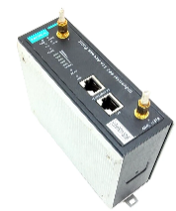
1. Equipment Monitoring Overview
EQ Monitoring List
EQ Number | Device name (Eq Group Name) | IP Address (subnet: 255.255.252.0) (gateway: 10.1.0.241) | ProtocolType (Port) | Tag name (Eq Tag Name) | Tag Address (SNMP OID / URL) | Tag Value
1,2 | OCS Server 1/2 (DL360 gen 11) | 1: 10.1.2.203 (iLO) 2: 10.1.2.204 (iLO) | SNMP (161) | FAN | 1.3.6.1.4.1.232.6.2.6.4.0 | Normal=2, Abnormal=1
 |  |  | SNMP (161) | POWER | 1.3.6.1.4.1.232.6.2.9.1.0 | Normal=2, Abnormal=1
 |  |  | SNMP (161) | DISK | 1.3.6.1.4.1.232.3.1.3.0 | Normal=2, Abnormal=1
2 |  | 10.1.2.204 (iLO) | REST API (443) | MEMORY | /json/health_summary | Normal=OP_STATUS_OK Abnormal=OP_STATUS_FAILED
 |  |  | REST API (443) | CPU | /json/health_summary | Normal=OP_STATUS_OK Abnormal=OP_STATUS_FAILED
 |  |  | REST API (443) | BATTERY | /json/health_summary | Normal=OP_STATUS_OK Abnormal=OP_STATUS_FAILED
3 | UPS (9px 3000i RT 2U) | 10.1.1.201 | SNMP (161) | UPS Alarm Count | 1.3.6.1.2.1.33.1.6.1.0 | Current number of active UPS alarms (int)
 |  |  | SNMP (161) | UPS OutputMode | 1.3.6.1.2.1.34.1.4.1.0 | UPS output source: 3=OnLine, 4=Bypass, 5=OnBattery (int)
 |  |  | SNMP (161) | Battery Charge Percent | 1.3.6.1.2.1.33.1.2.4.0 | Estimated battery charge remaining in percent (0–100)
 |  |  | SNMP (161) | Battery AgedStatus | 1.3.6.1.4.1.534.1.2.9.0 | Battery aged flag, normal=2, aged=1
 | M |  | SNMP (161) | Battery LowCapacityStatus | 1.3.6.1.4.1.534.1.2.10.0 | Battery low-capacity flag, normal=2, low=1
3 | AP ( MOXA AWK-3131A-US ) | 10.1.0.201 10.1.0.202 10.1.0.203 10.1.0.204 10.1.0.205 10.1.0.206 10.1.0.207 10.1.0.208 | SNMP (161) | Memory | 1.3.6.1.4.1.8691.15.33.1.11.25.2 | Integer (KB) – Total memory size
 |  |  | SNMP (161) | POWER | 1.3.6.1.4.1.8691.15.33.1.11.9.1.2 | The power input status Value : 0 -> off, 1 -> on
 |  |  | SNMP (161) | UPTIME | 1.3.6.1.4.1.8691.15.33.1.1.4.0 | DisplayString – System uptime
 |  |  | SNMP (161) | Temperature | 1.3.6.1.4.1.8691.15.33.1.11.13.1.7.1 | Normal = Under 70

Slide 4
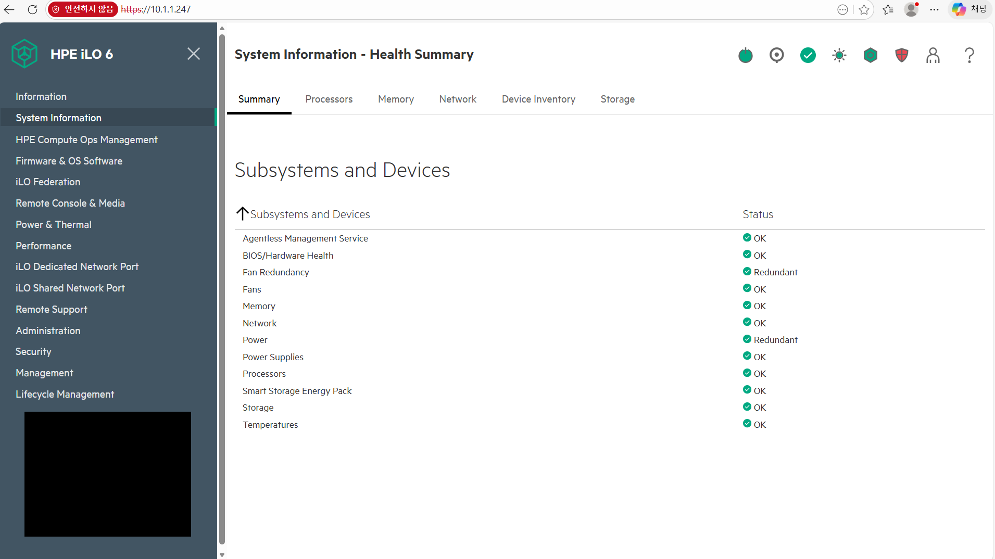
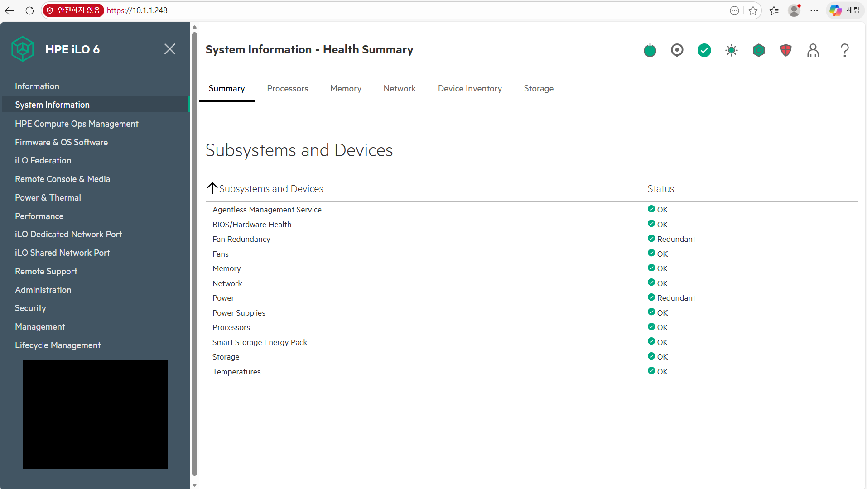
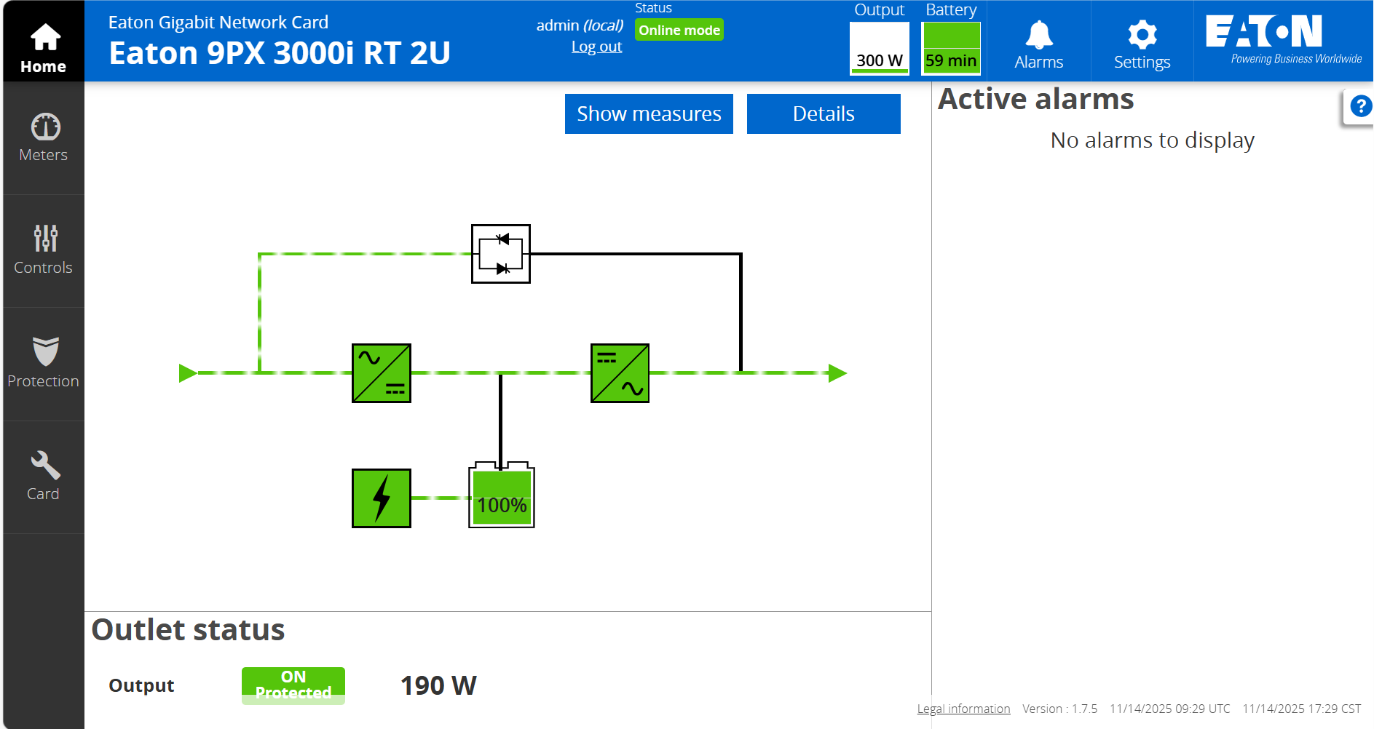
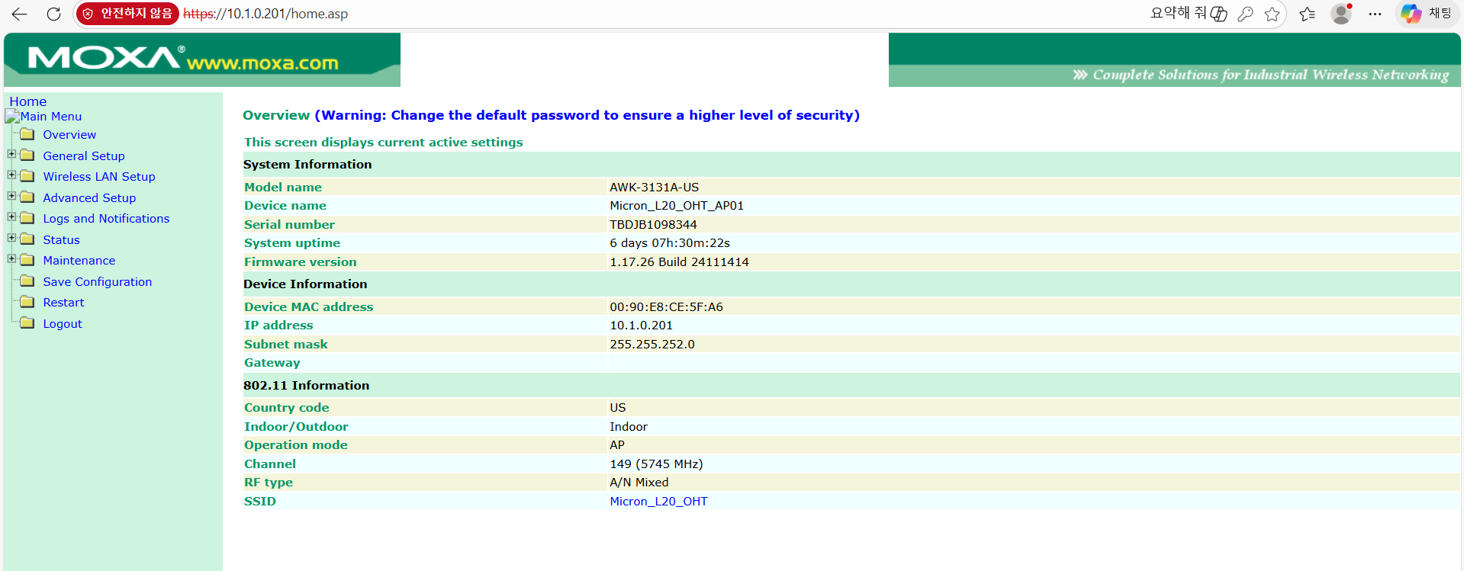
2. Equipment IP List (EQ Group Tag List)
Equipment IP List
EQ Number | Device name (Eq Group Name) | IP Address (subnet: 255.255.252.0) (gateway: 10.1.0.241) | Web Address | ID / Pwd | Web Image
1 | OCS Server 1 | 10.1.2.203 (iLO) L20 : 10.1.1.247 | 10.1.2.203 L20 : 10.1.1.247 | administrator / !1234qwer
2 | OCS Server 2 | 10.1.2.204 (iLO) L20 : 10.1.1.248 | 10.1.2.204 L20 : 10.1.1.248 | administrator / !1234qwer
3 | UPS | 10.1.1.201 L20 : 10.1.1.249 | 10.1.1.201 L20 : 10.1.1.249 | admin / Rcp1(rcp2)
3 | AP | 10.1.0.201 10.1.0.202 10.1.0.203 10.1.0.204 10.1.0.205 10.1.0.206 10.1.0.207 10.1.0.208 | 10.1.0.201 10.1.0.202 10.1.0.203 10.1.0.204 10.1.0.205 10.1.0.206 10.1.0.207 10.1.0.208 | admin / moxa

Slide 5
3. Equipment SNMP List (EQ Tag List)
EQ Tag List
EqGroupNumber | TagName | TagNumber | TagProperty | TagPollingSecond | Address | Value | Normal Value
1 | FAN | 1 | STATUS | 5 | 1.3.6.1.4.1.232.6.2.6.4.0 | 2 | 2
1 | POWER | 2 | STATUS | 5 | 1.3.6.1.4.1.232.6.2.9.1.0 | 2 | 2
1 | DISK | 3 | STATUS | 5 | 1.3.6.1.4.1.232.3.1.3.0 | 2 | 2
2 | FAN | 4 | STATUS | 5 | 1.3.6.1.4.1.232.6.2.6.4.0 | 2 | 2
2 | POWER | 5 | STATUS | 5 | 1.3.6.1.4.1.232.6.2.9.1.0 | 2 | 2
2 | DISK | 6 | STATUS | 5 | 1.3.6.1.4.1.232.3.1.3.0 | 2 | 2
3 | BATTERY | 1 | STATUS | 5 | .1.3.6.1.2.1.33.1.6.1.0 | 0 | 0
3 | BATTERY | 2 | STATUS | 5 | .1.3.6.1.2.1.33.1.4.1.0 | 3 | 3
3 | BATTERY | 3 | CHARGE | 5 | .1.3.6.1.2.1.33.1.2.4.0 | 100 | 98
3 | BATTERY | 4 | STATUS | 5 | .1.3.6.1.4.1.534.1.2.9.0 | 2 | 2
3 | BATTERY | 5 | STATUS | 5 | .1.3.6.1.4.1.534.1.2.10.0 | 2 | 2
Description
EQGroupNumber | EQ Number Device
TagName | Tag name displayed on the monitoring screen, label
TagNumber | Unique Identification Number in taggroup
TagProperty | Type of tag value (e.g. status, numeric value)
TagPollingSecond | SNMP polling interval in seconds
Address | SNMP OID(Object Identifier) used to retrieve the value
Value | Current value retrieved from the system
Normal Value | Reference value for normal condition

Slide 6
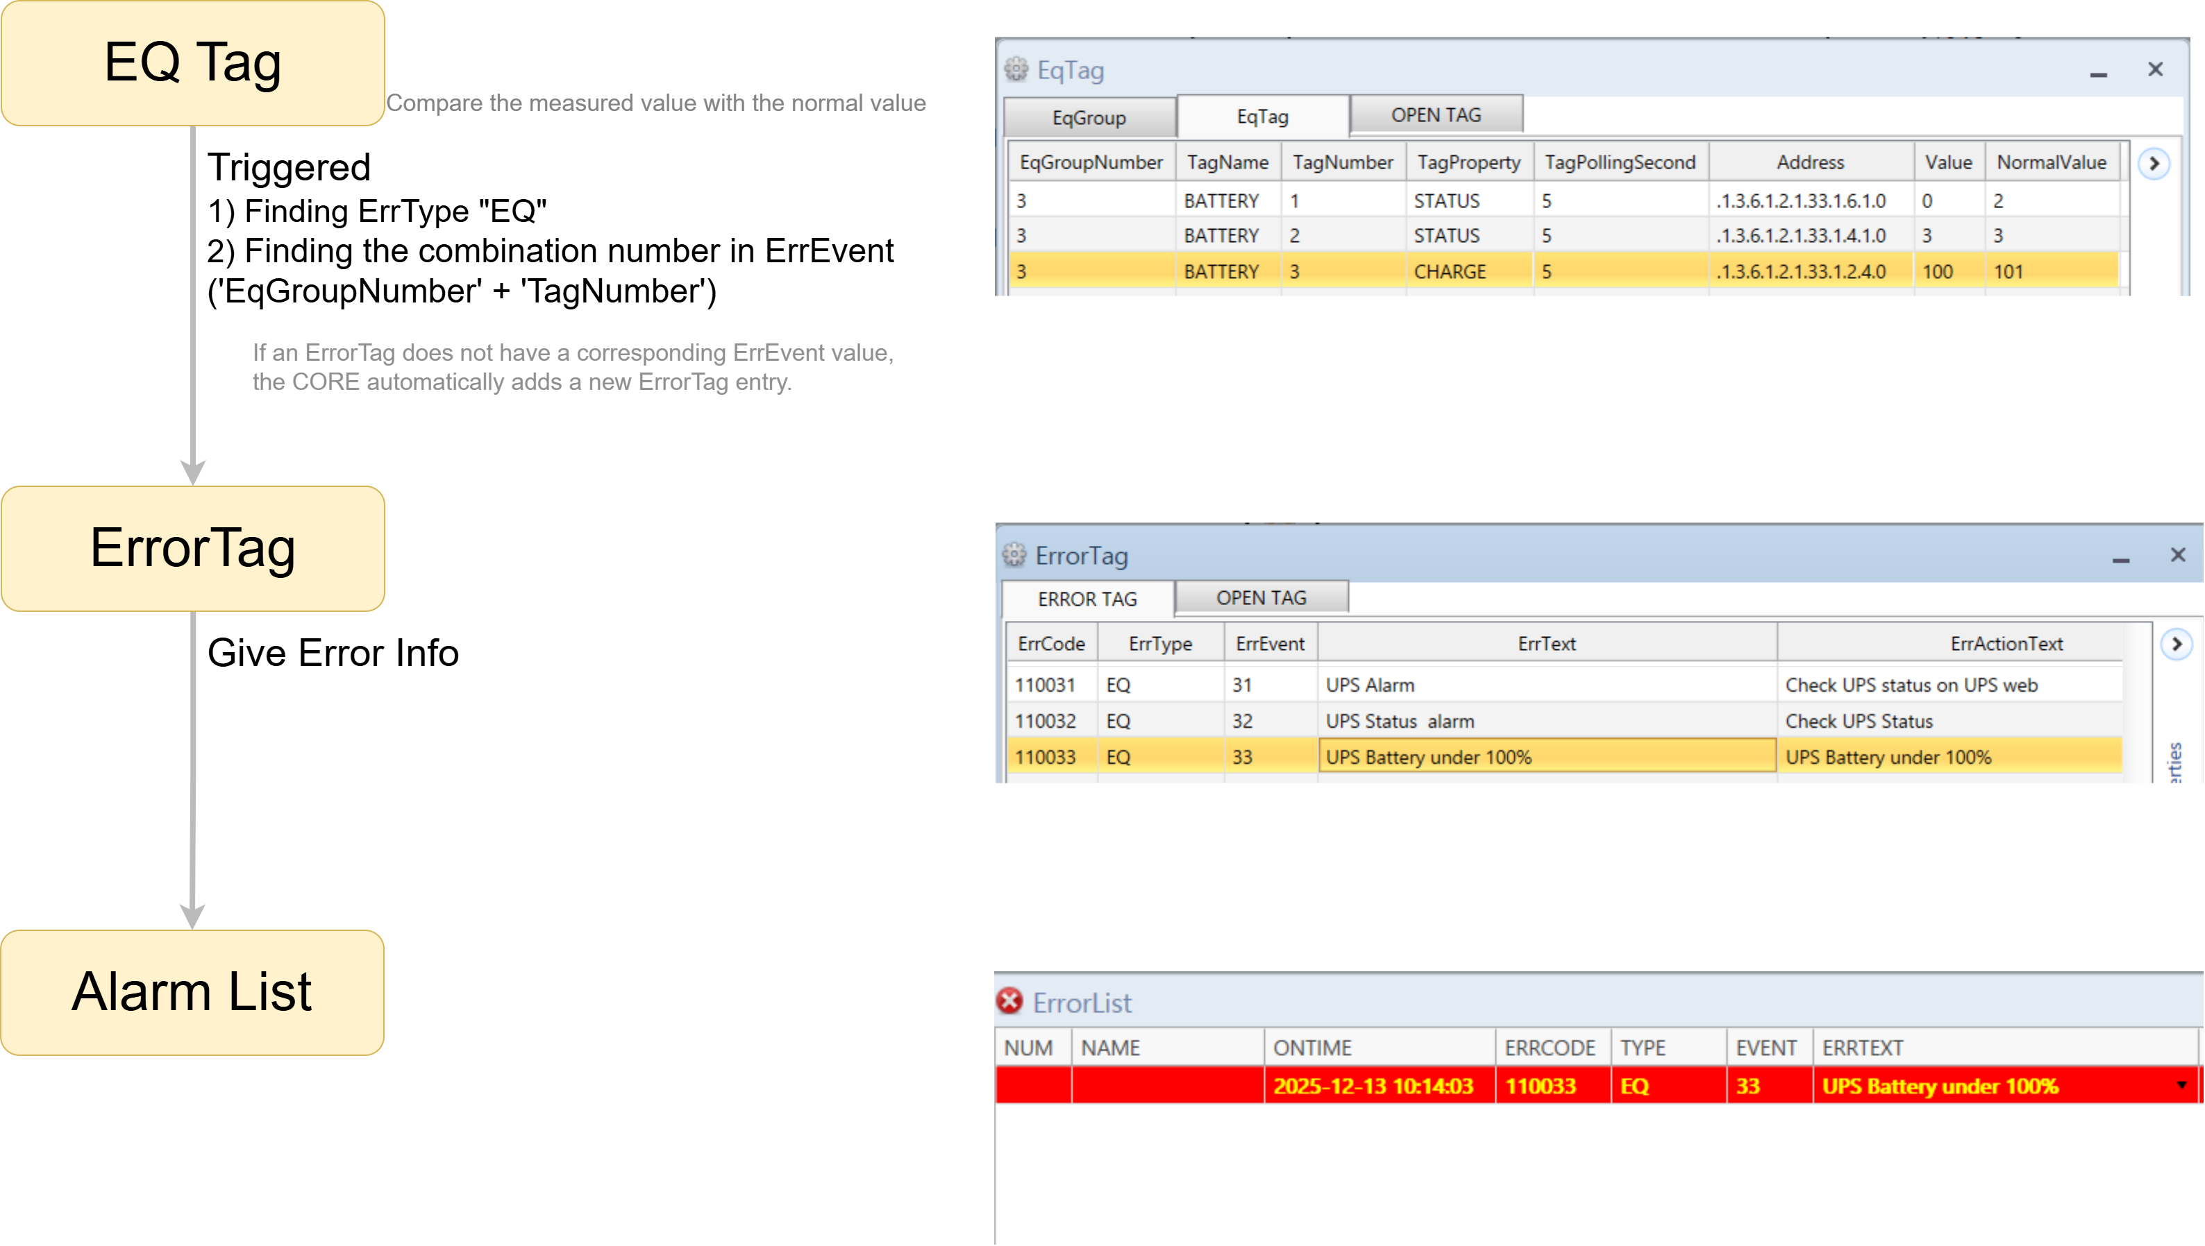
4. Applying Method
1) EQ Alarm Generation Flow

Slide 7
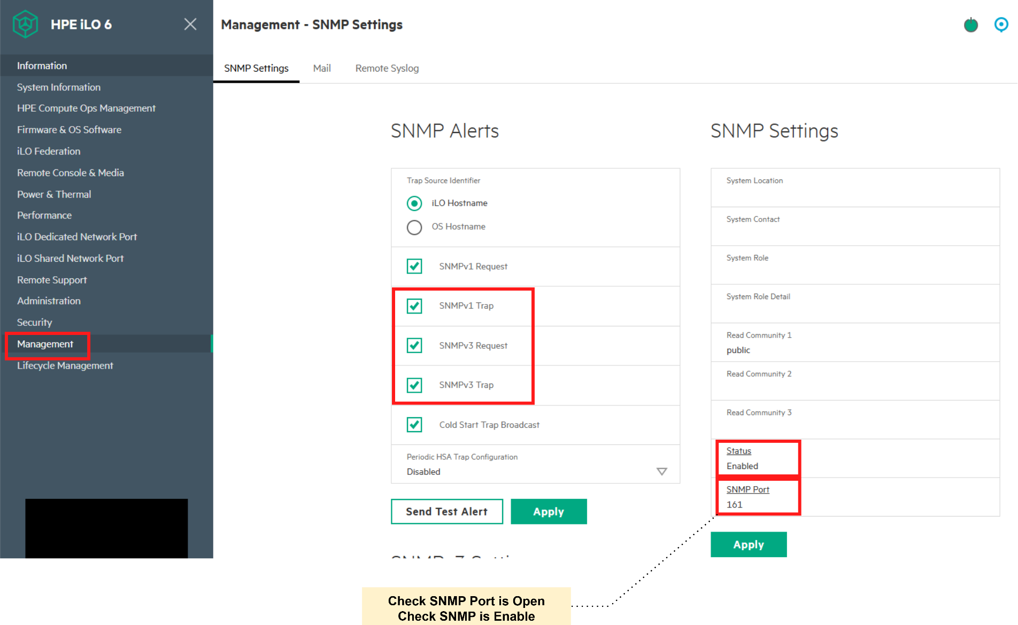
4. Applying Method
2) SNMP Configuration Check: ILO
- Verify that SNMP is enabled and UDP port 161 is open.

Slide 8
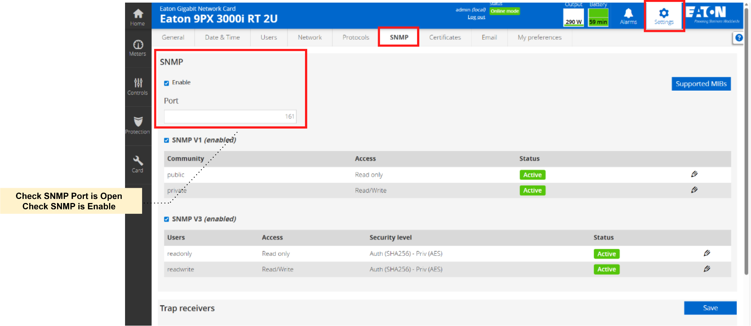
4. Applying Method
2) SNMP Configuration Check: UPS
- Verify that SNMP is enabled and UDP port 161 is open.

Slide 9
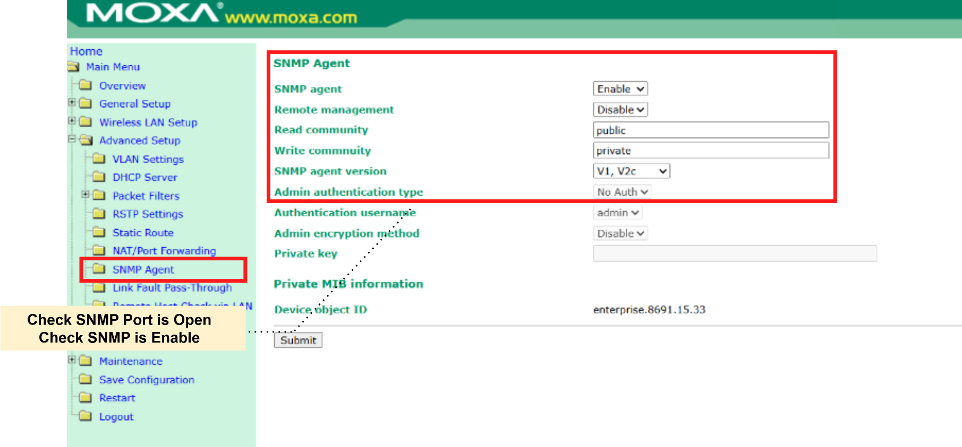
4. Applying Method
2) SNMP Configuration Check: AP
- Verify that SNMP is enabled and UDP port 161 is open.

Slide 10
4. Applying Method
3) SNMP OID Validation (Pre-Check)
- Use a MIB Browser to query and verify the SNMP OID value

Slide 11
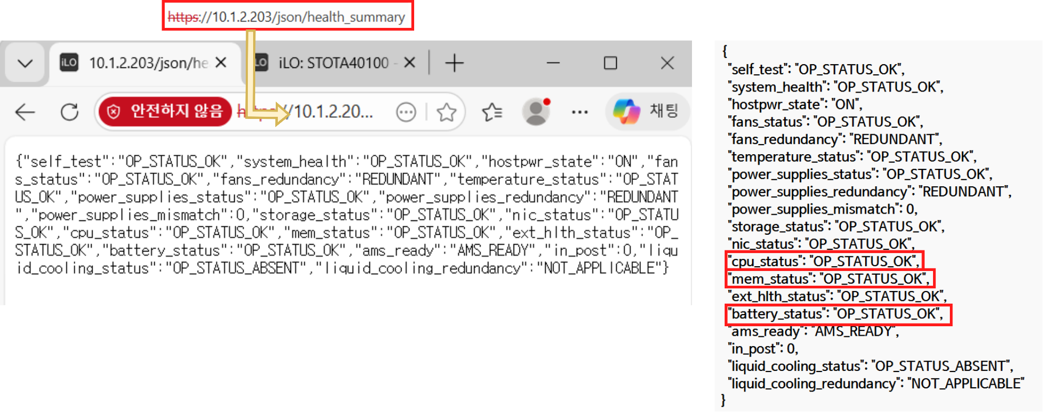
4. Applying Method
4) Rest API Validation (Pre-Check)
Open the endpoint URL in a web browser and verify that a valid JSON response is displayed.
Check whether the expected values are included and confirm each key’s return format.

Slide 12
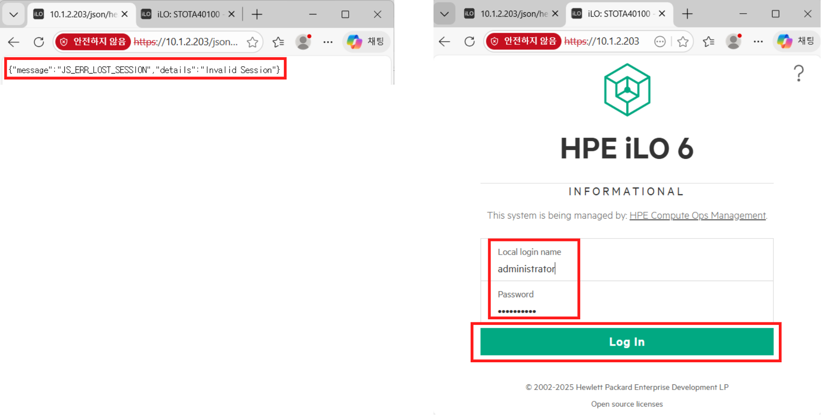
4. Applying Method
4) Rest API Validation (Pre-Check)
An authenticated session is required for web-based endpoint validation.
Sign in to the iLO web interface first to establish this session.

Slide 13
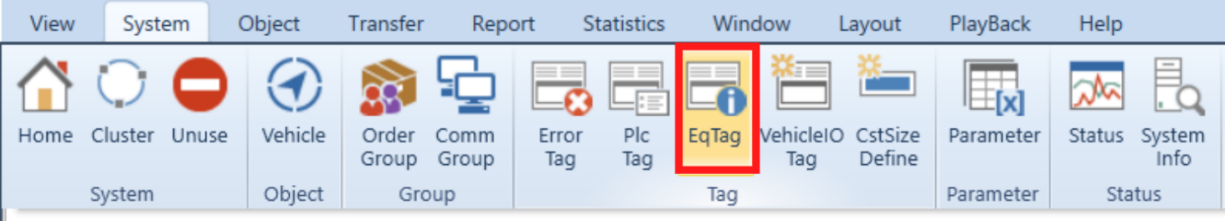
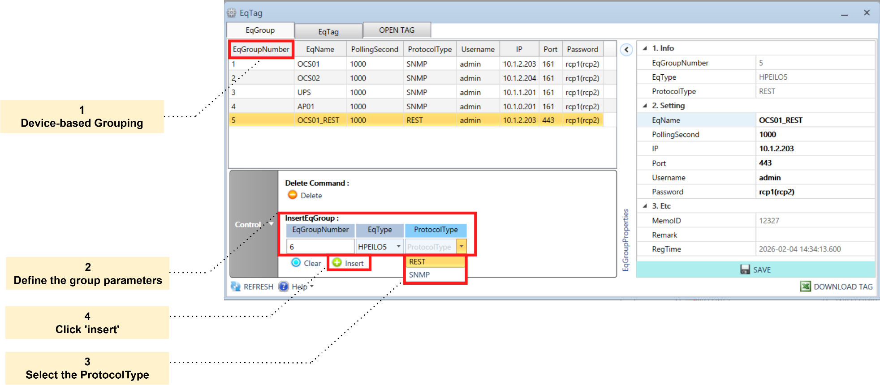
4. Applying Method
5) Adding EQ Group
- EQ Groups are created to manage devices by IP and define their communication protocols.

Slide 14
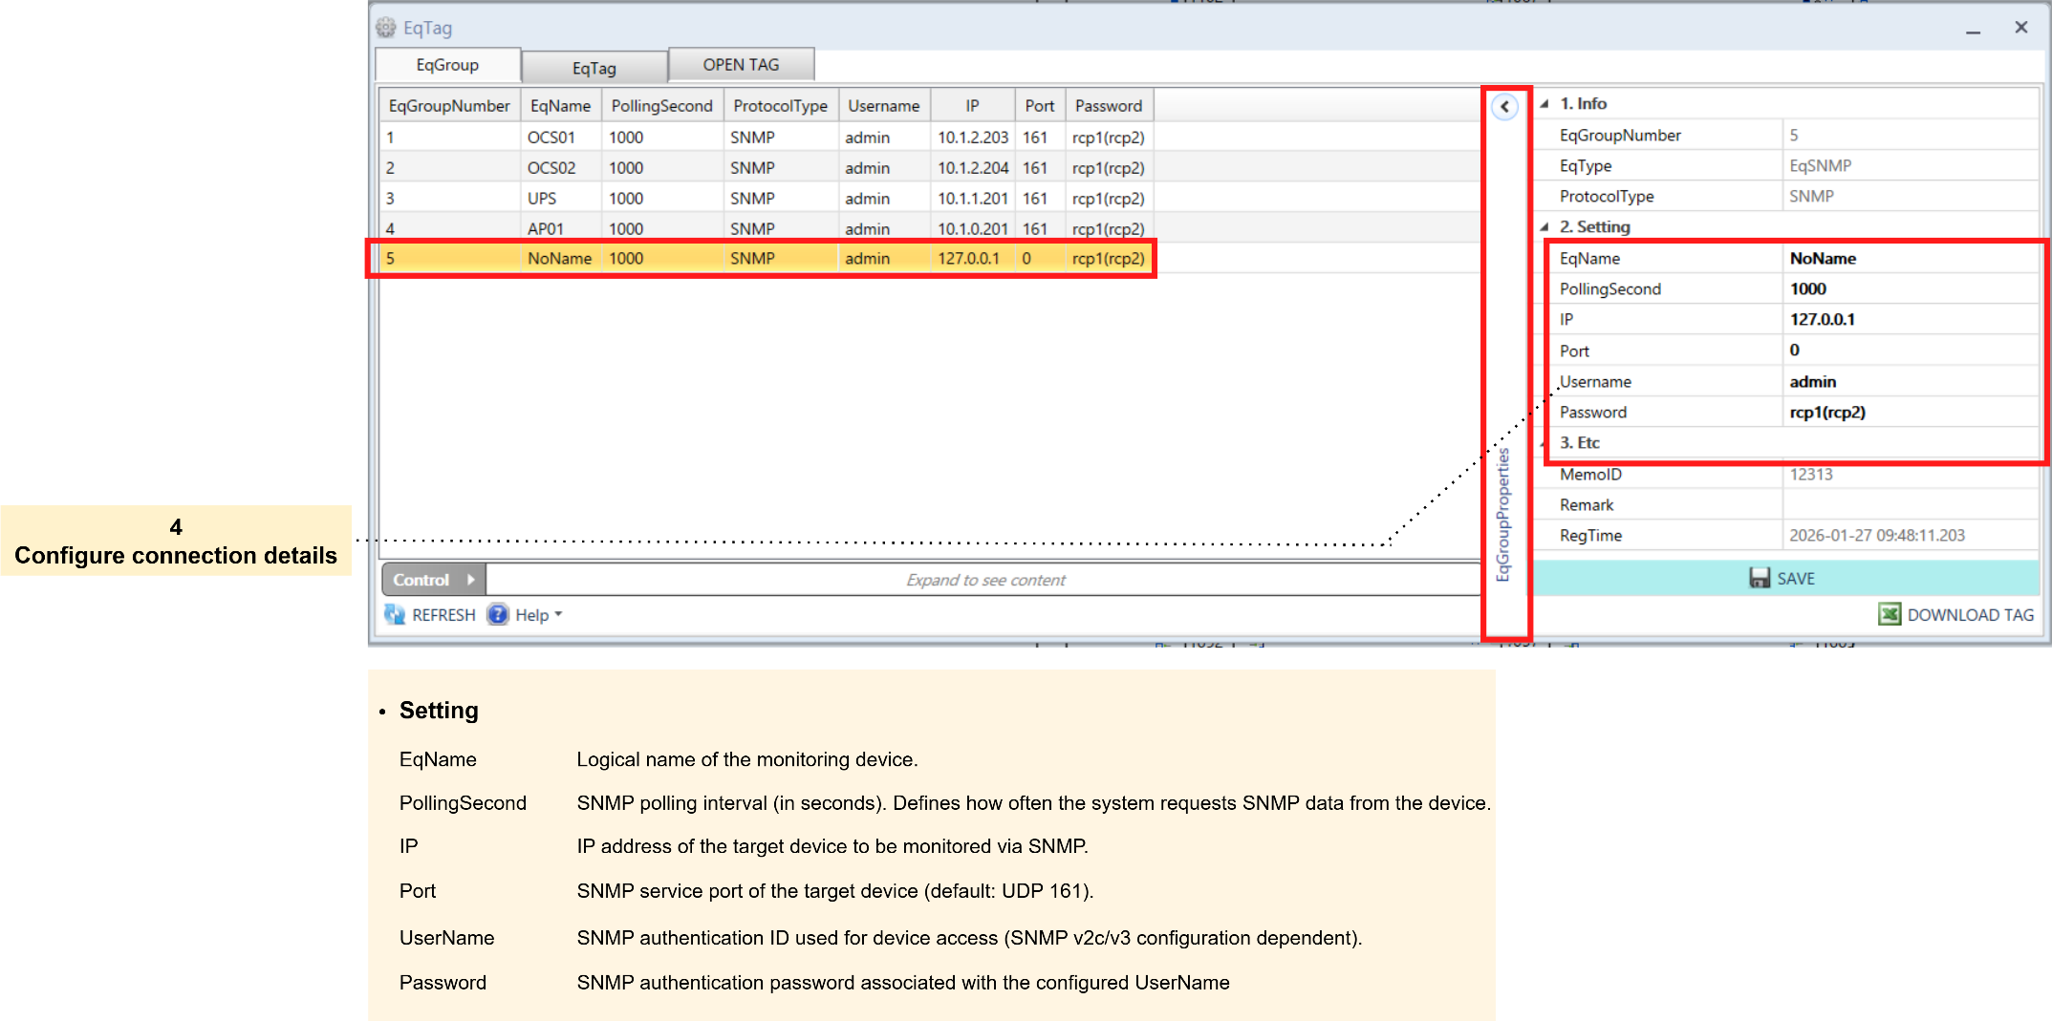
4. Applying Method
6) Set EQ Group Details: SNMP

Slide 15
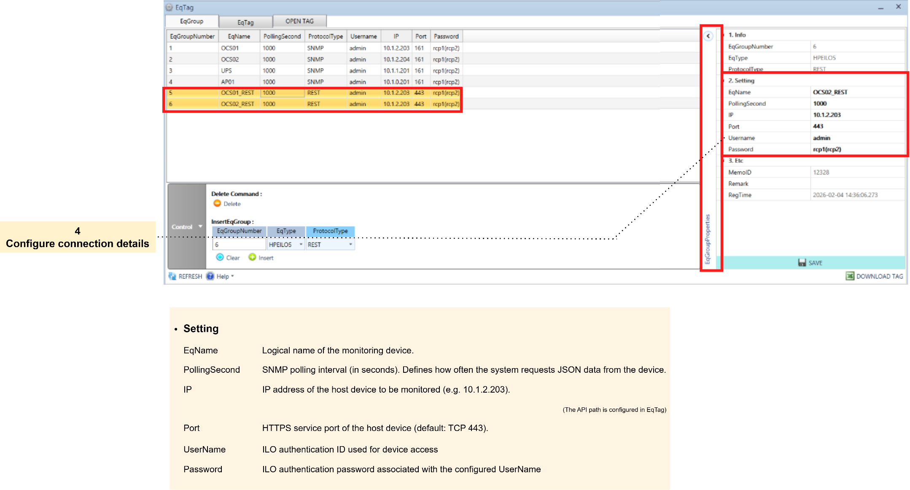
4. Applying Method
6) Set EQ Group Details: REST

Slide 16
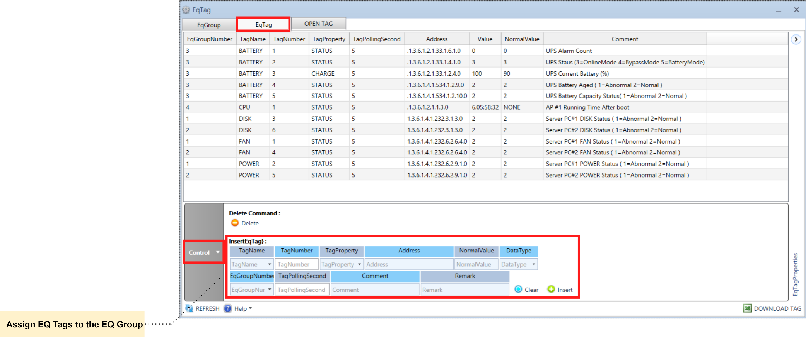
4. Applying Method
7) Adding EQ Tag
- This step defines monitoring tags and assigns them to an EQ Group.

Slide 17
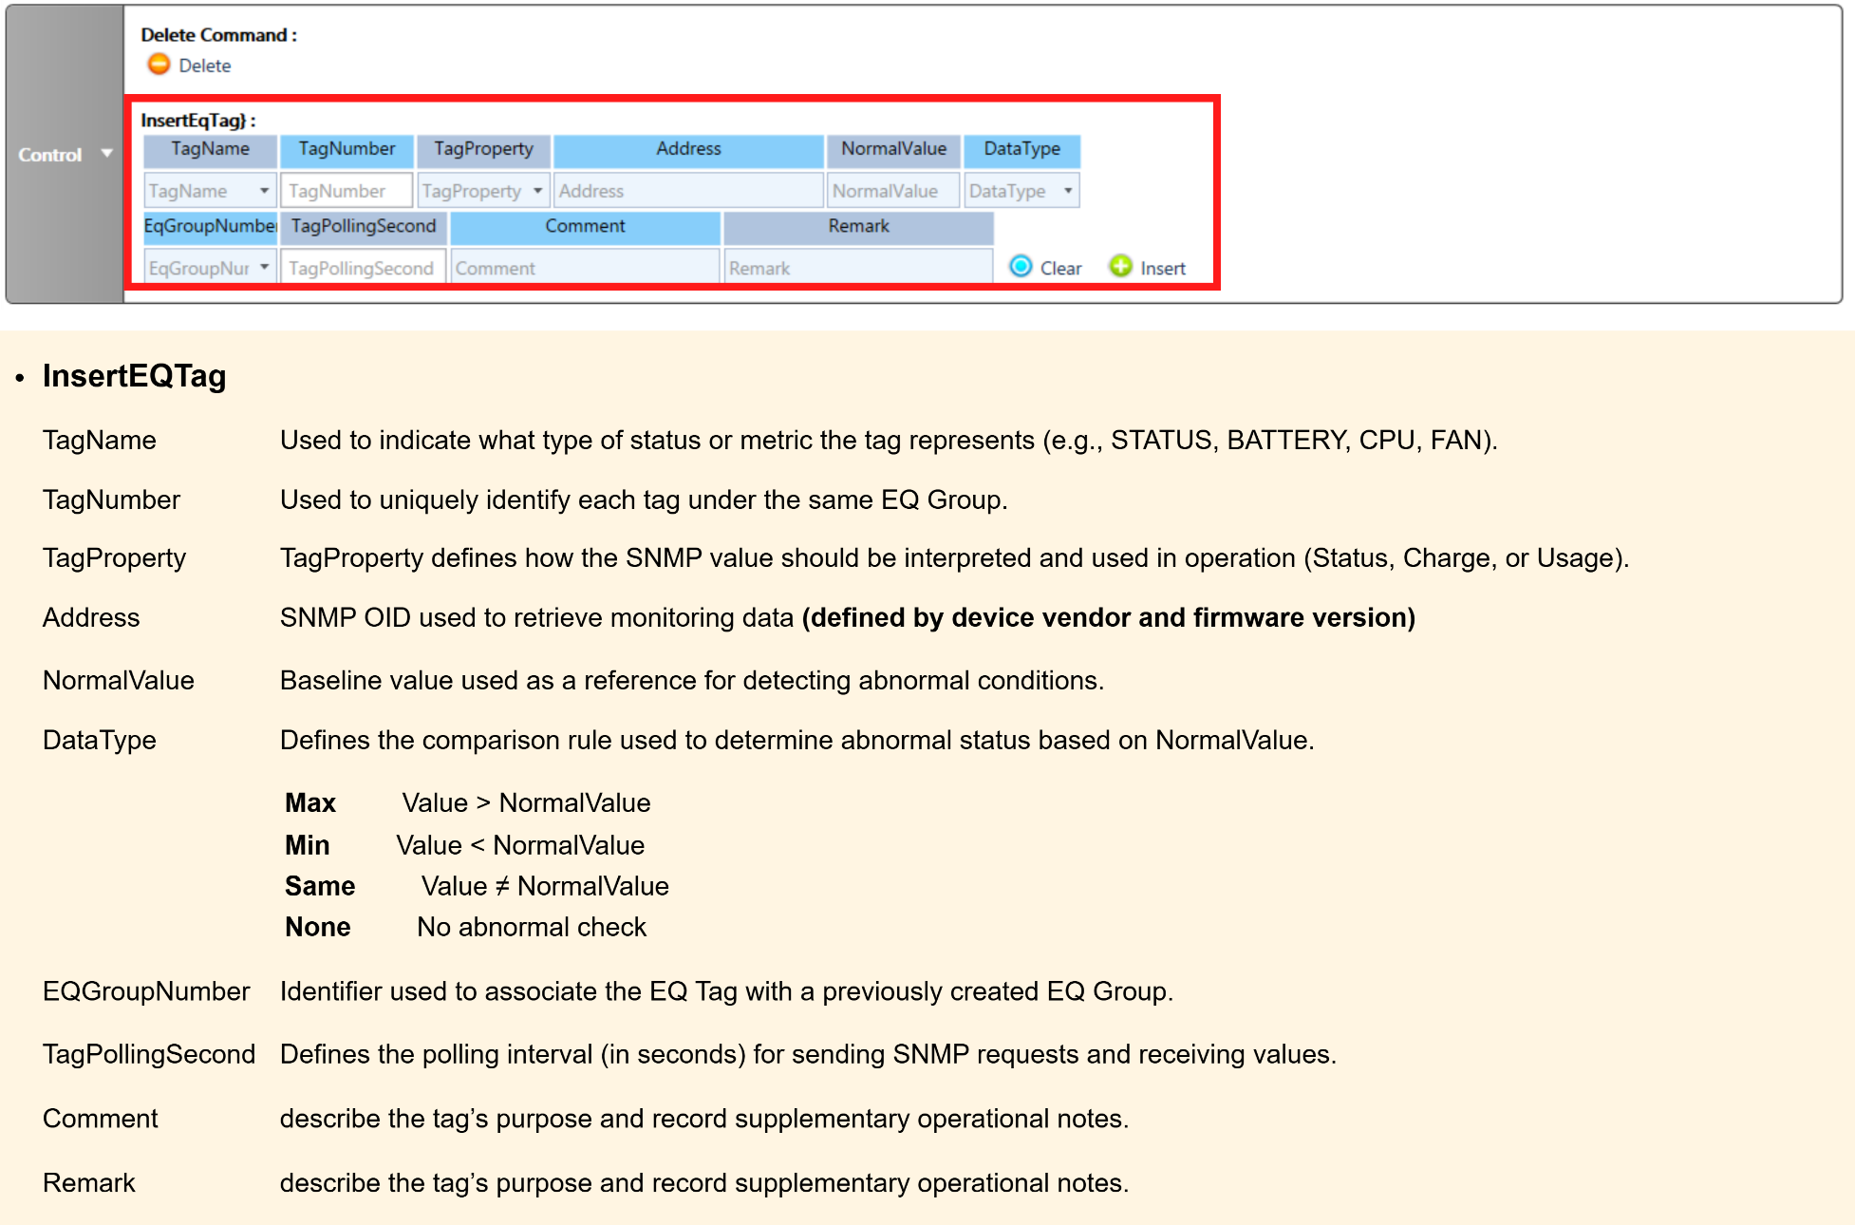
4. Applying Method
7) Adding EQ Tag: SNMP

Slide 18
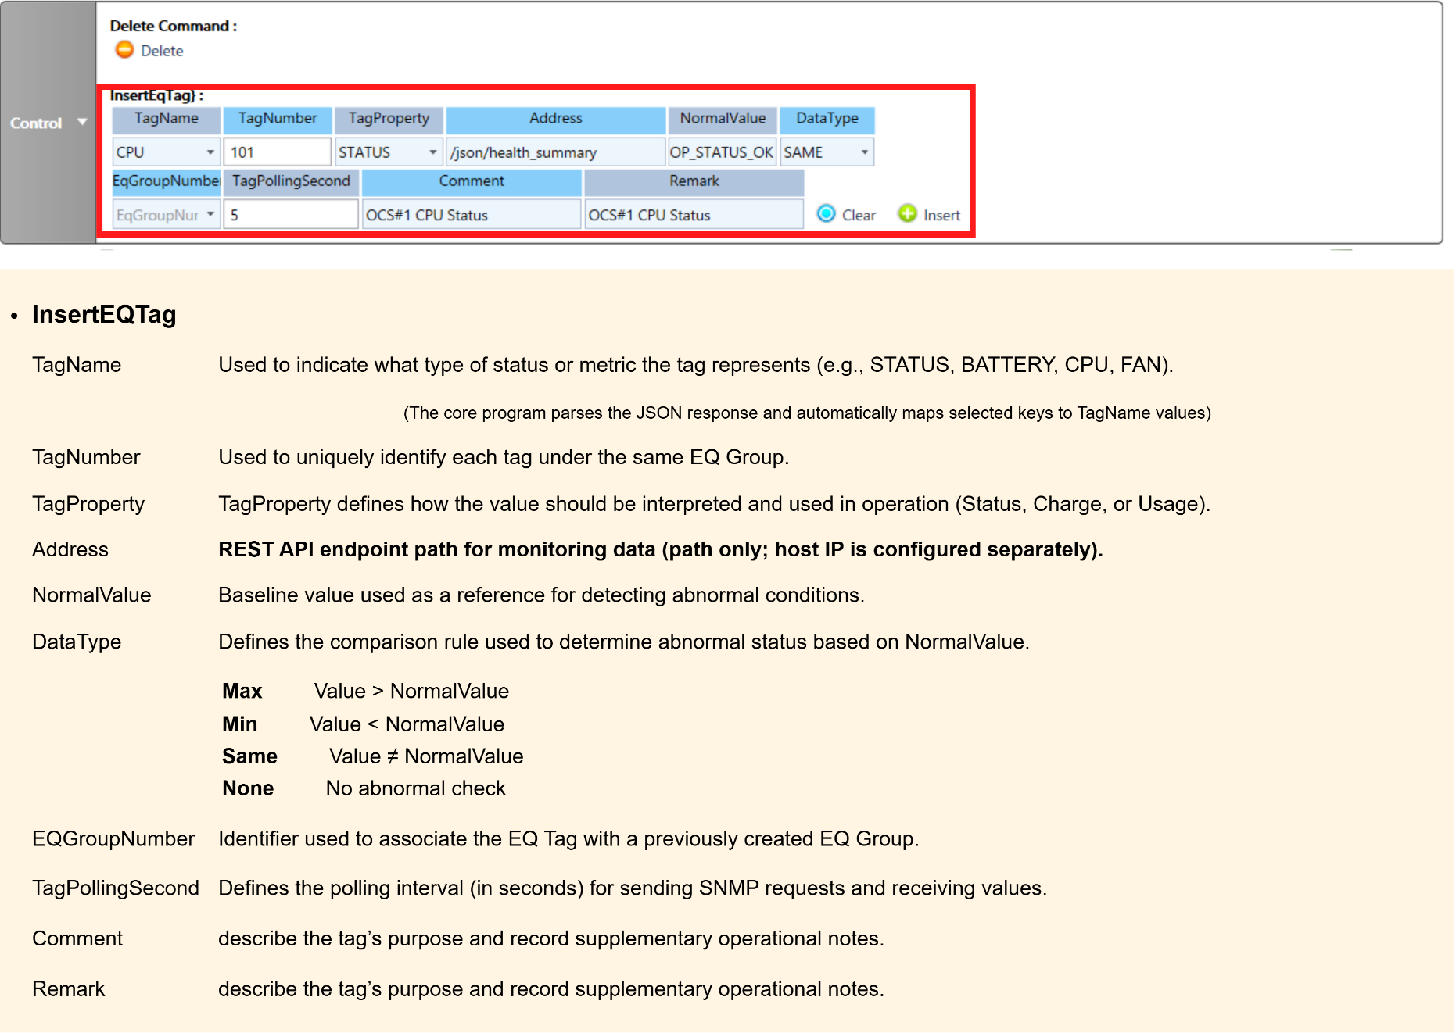
4. Applying Method
7) Adding EQ Tag: REST

Slide 19
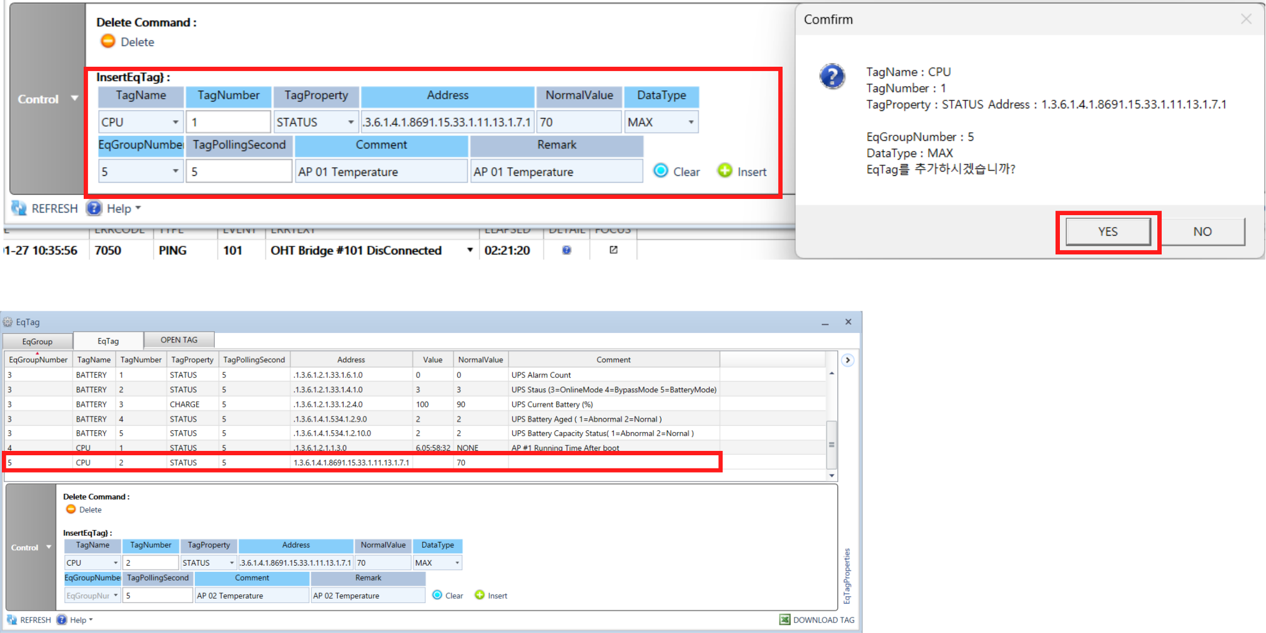
4. Applying Method
8) Check Items in EQ Tag
- Check whether the EQ Tag is correctly registered and linked to the EQ Group.
- Verify that real-time SNMP/REST values are being collected as expected.

Slide 20
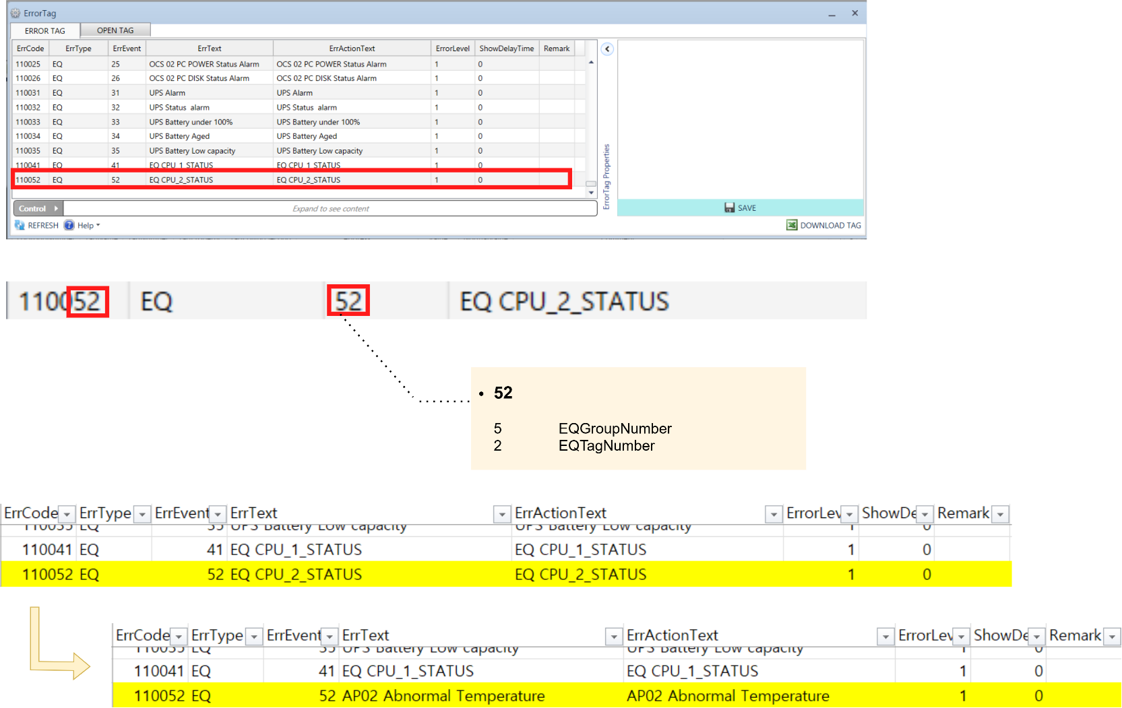
4. Applying Method
9) Check Items in Error Tag
- When an EQ Tag is added, the corresponding Error Tag is automatically generated.
- The Comment and Remark fields of the Error Tag can be modified as needed.

Slide 21
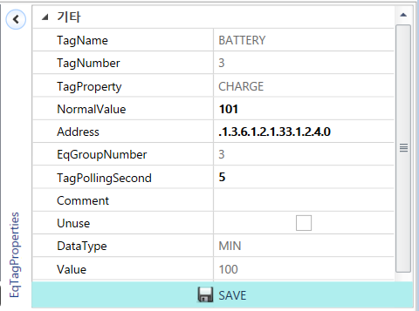
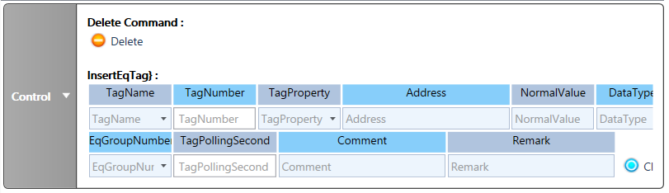
5. Monitoring Method
1) RCPGT Local Simulation Test
- an alarm can be triggered by modifying the Normal Value in the EQ Tag.
- Alternatively, the alarm can be triggered by updating the EQ Tag value.
This method is intended for test environments only.

Slide 22
5. Monitoring Method
2) Response Guide: OCS
- OCS-related FAN / DISK / POWER Alarm
Verify the hardware status within the accessible scope via ILO.
(The iLO interface is accessible via its assigned IP address.)
If the same alarm continues to occur, escalate the issue to the support team.

Slide 23
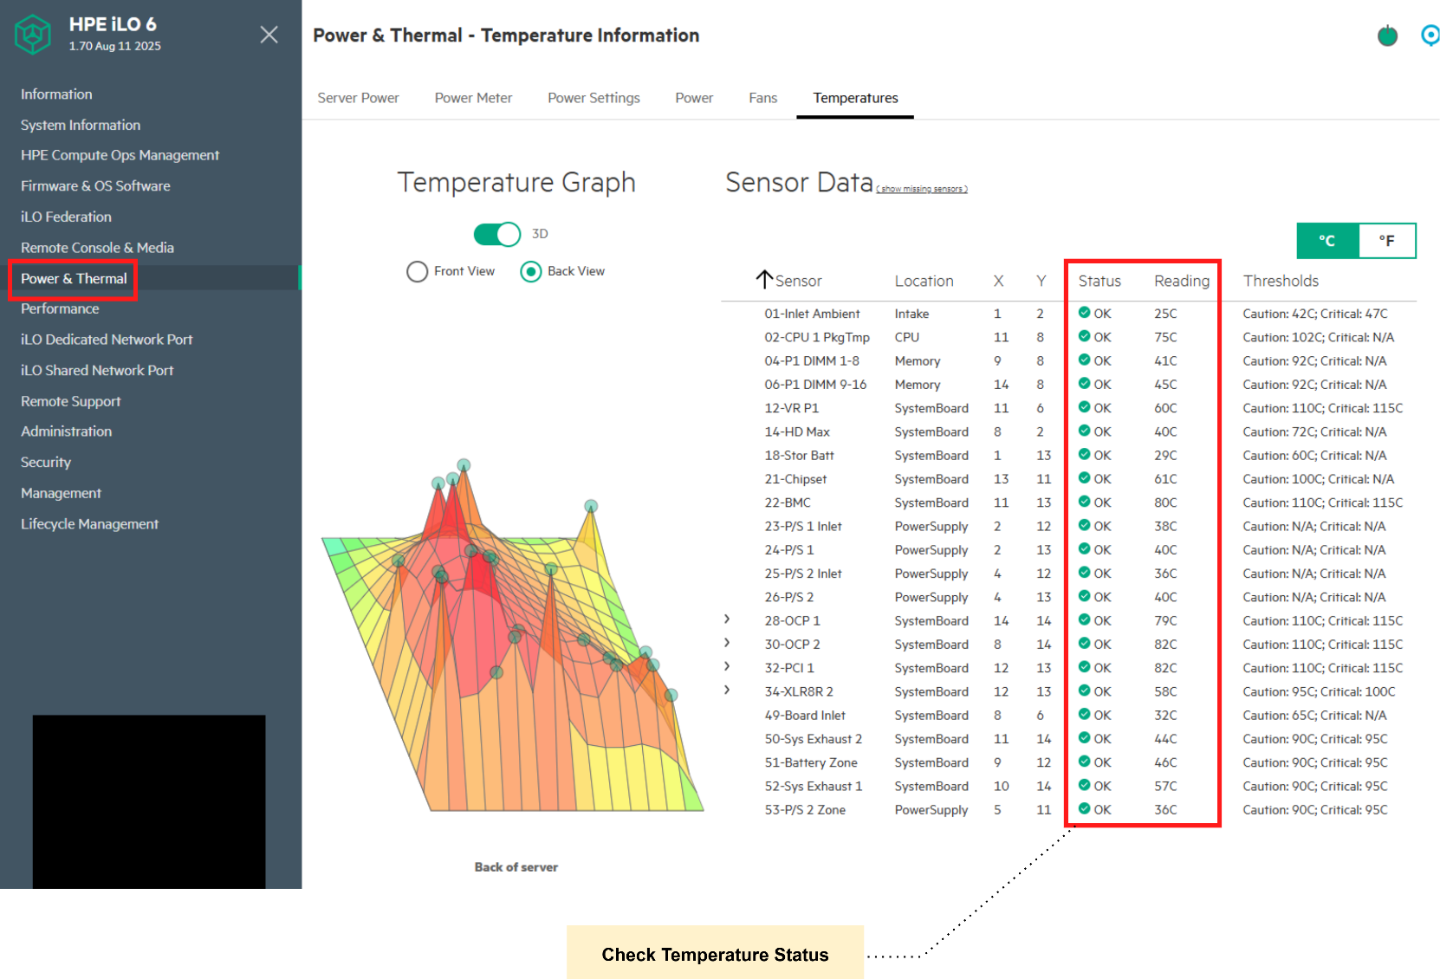
5. Monitoring Method
2) Response Guide: OCS
- Verify that all temperature sensors are operating within normal range.

Slide 24
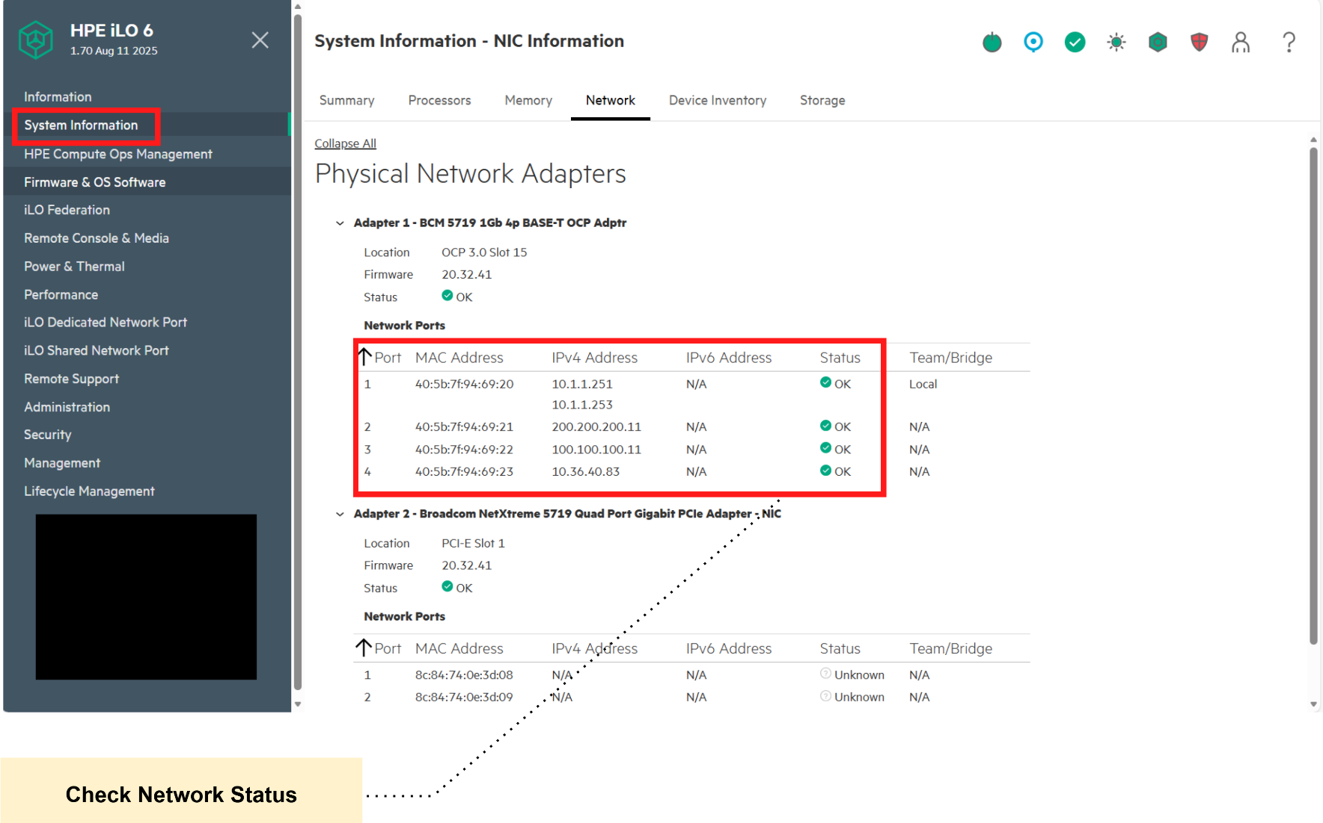
5. Monitoring Method
2) Response Guide: OCS
- Verify that all network ports show a normal status.

Slide 25
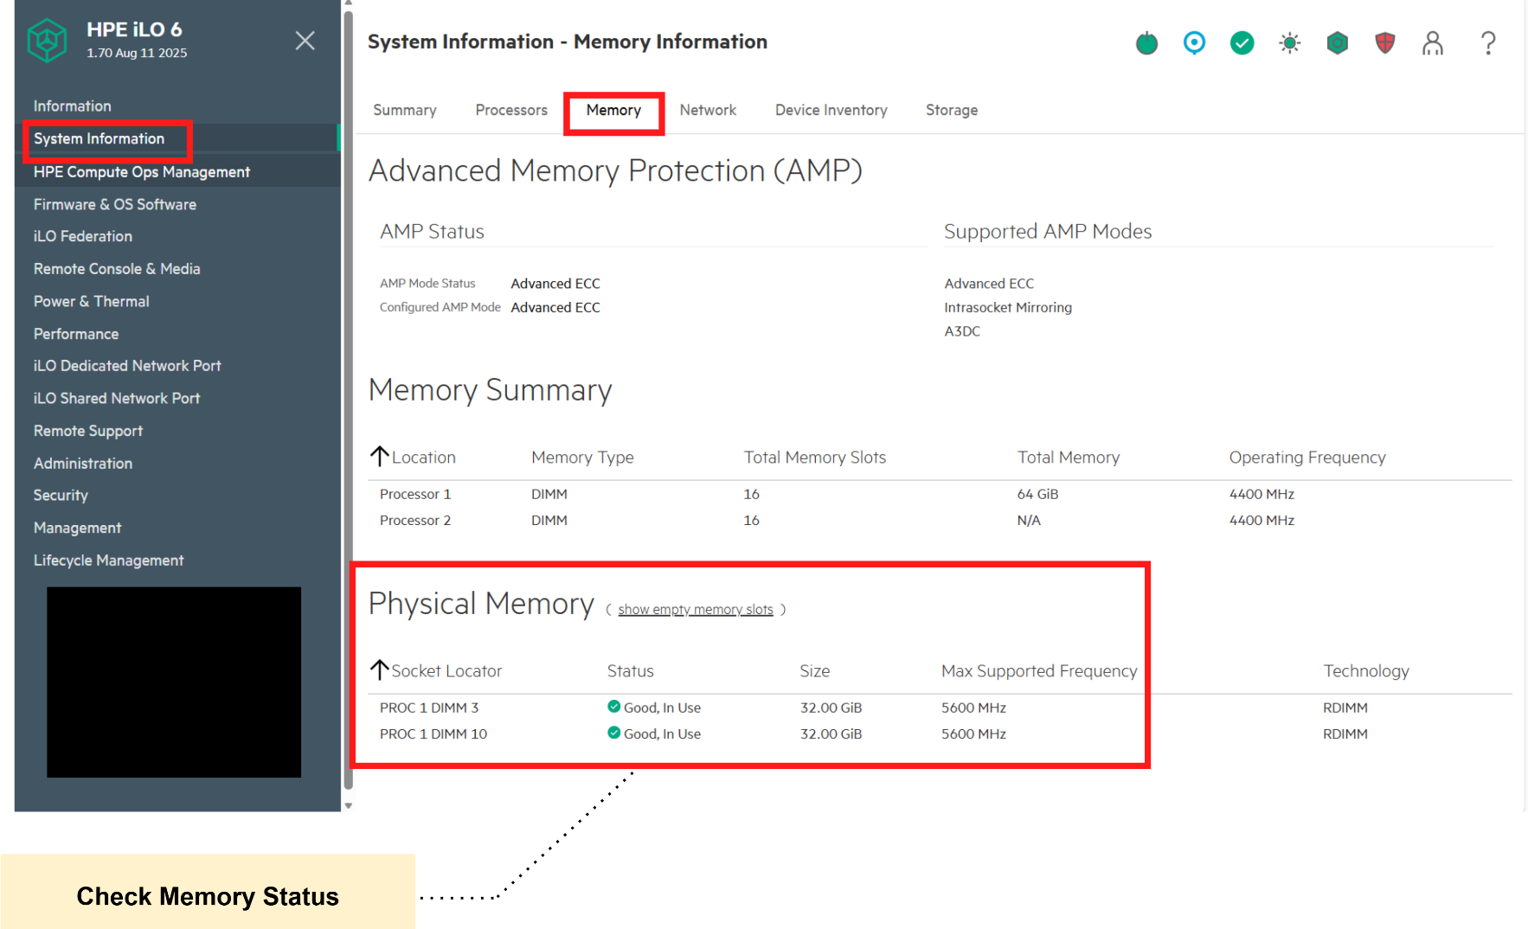
5. Monitoring Method
2) Response Guide: OCS
- Verify that all memory modules show a normal status.

Slide 26
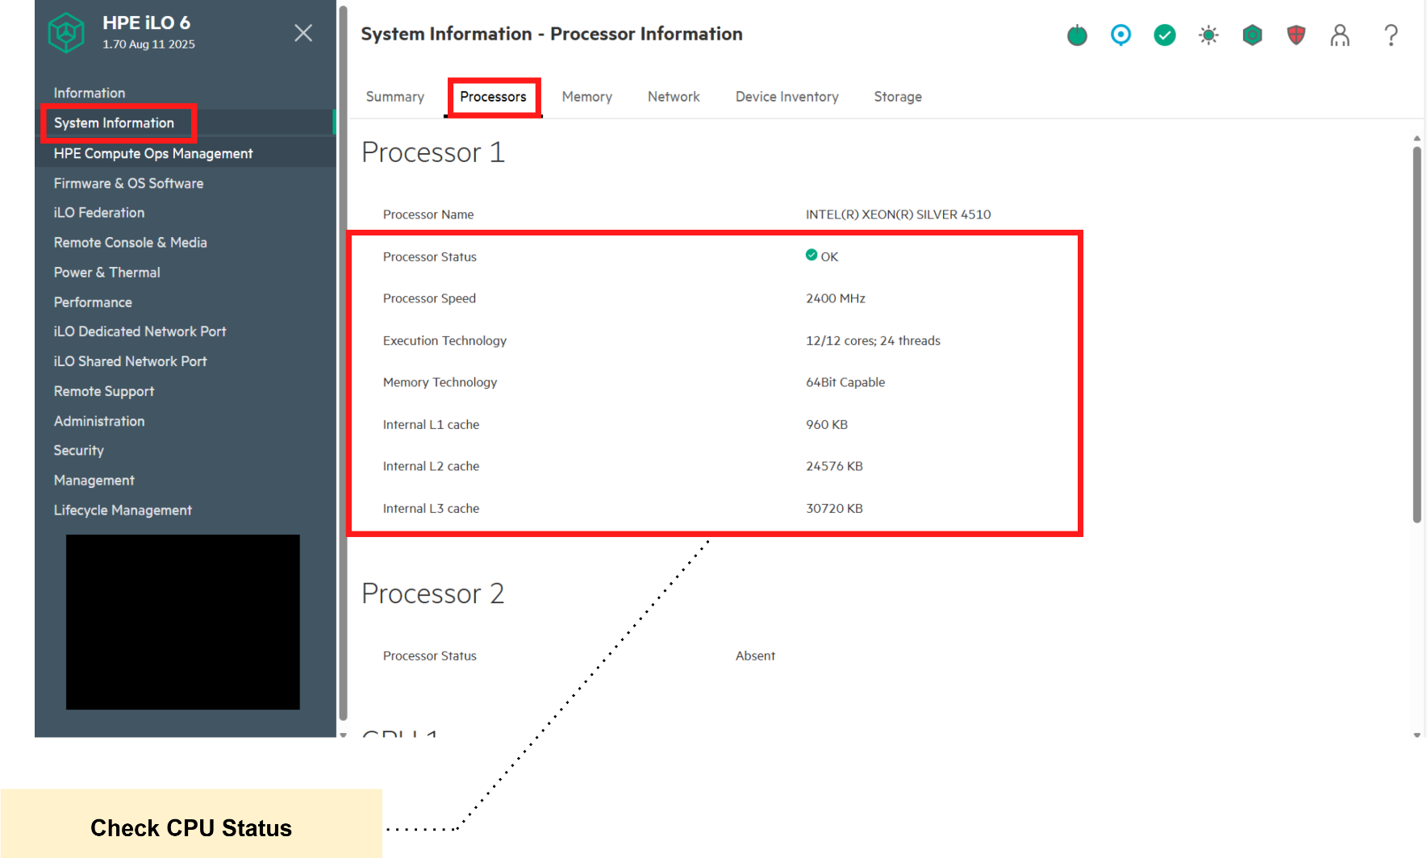
5. Monitoring Method
2) Response Guide: OCS
- Verify that all processors are operating normally.

Slide 27
5. Monitoring Method
3) Response Guide: UPS
- UPS-related Alarm
Check whether an SNMP alarm has been generated.
Check the OCS Server status indicators (LEDs).
Review the power status through the UPS management console.
(The UPS management console is accessible via its assigned IP address.)
If an abnormal power condition is suspected, escalate the issue to the relevant
responsible team according to the standard procedure.

Slide 28
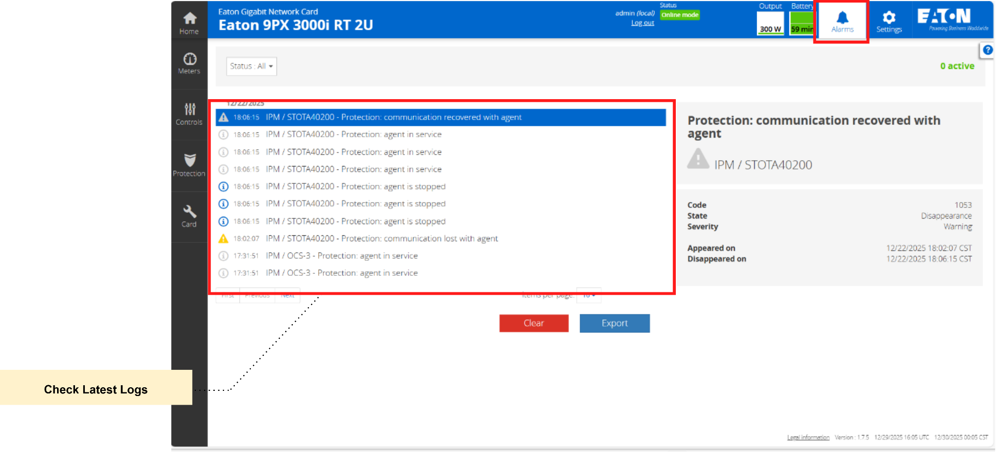
5. Monitoring Method
3) Response Guide: UPS
- Check the latest alarm logs in the UPS management console.

Slide 29
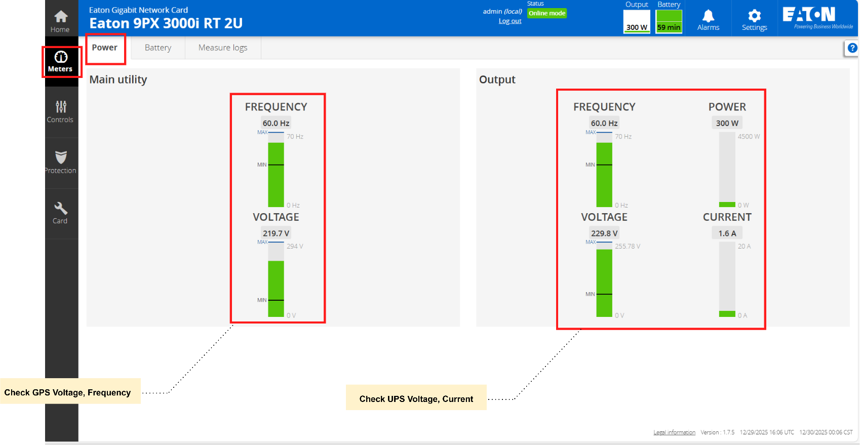
5. Monitoring Method
3) Response Guide: UPS
- Verify that the input GPS voltage and frequency are supplied normally.
- Verify that the UPS output voltage and current are supplied normally.

Slide 30
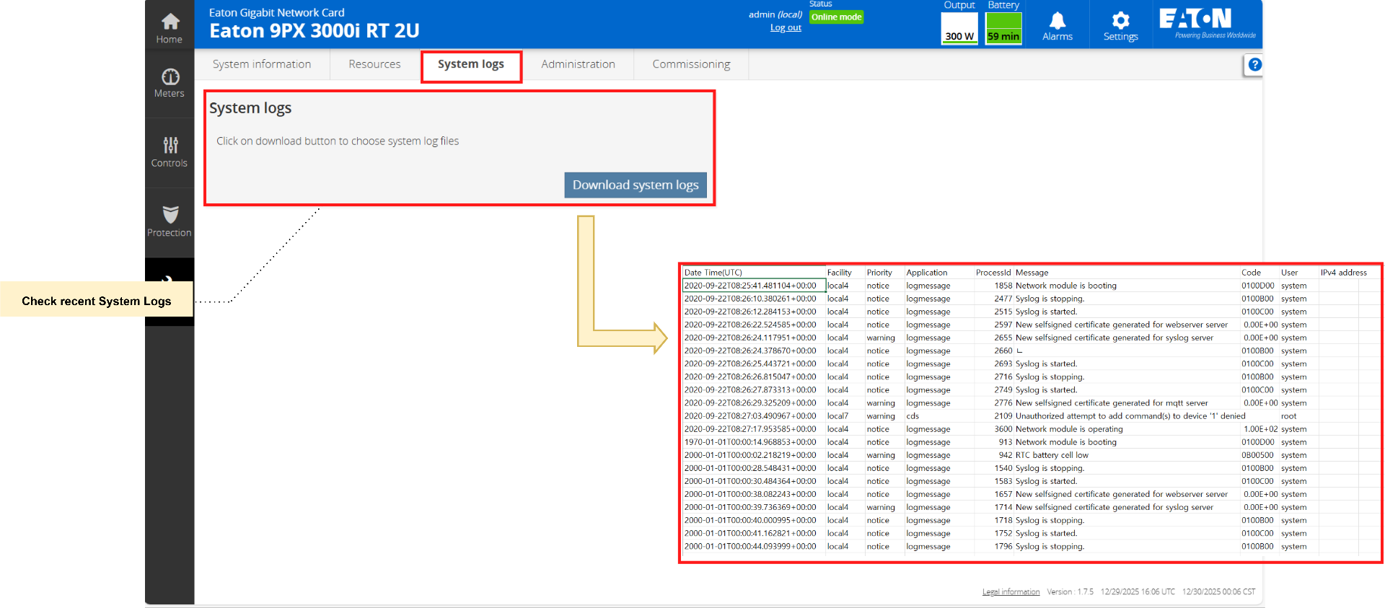
5. Monitoring Method
3) Response Guide: UPS
- Check the system logs to identify recent events or abnormal messages.

Slide 31
5. Monitoring Method
4) Response Guide: AP
- AP-related Alarm
Verify basic network connectivity by sending a ping to the AP IP address.
If the AP responds to the ping, access the AP management interface
(e.g., MOXA Web Console).
Review the system logs and device status.
If the AP does not respond to the ping, or if the same alarm continues to occur,
escalate the issue to the network or support team according to the standard procedure.

Slide 32
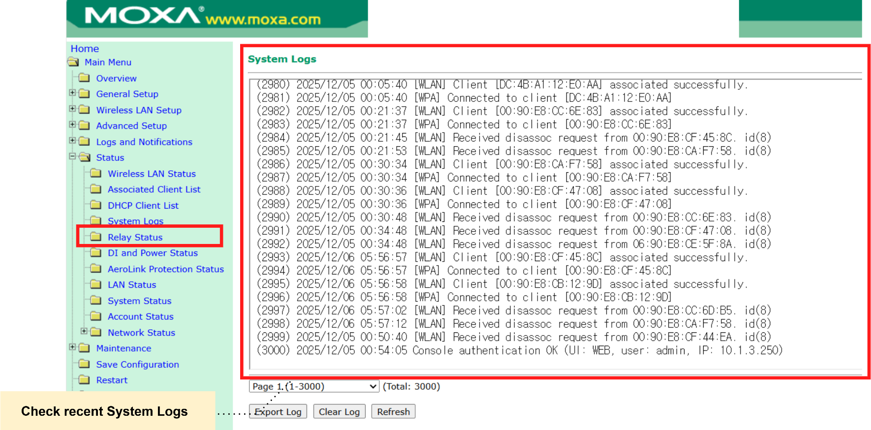
5. Monitoring Method
4) Response Guide: AP
- Check the system logs to identify recent events or abnormal messages.

Slide 33
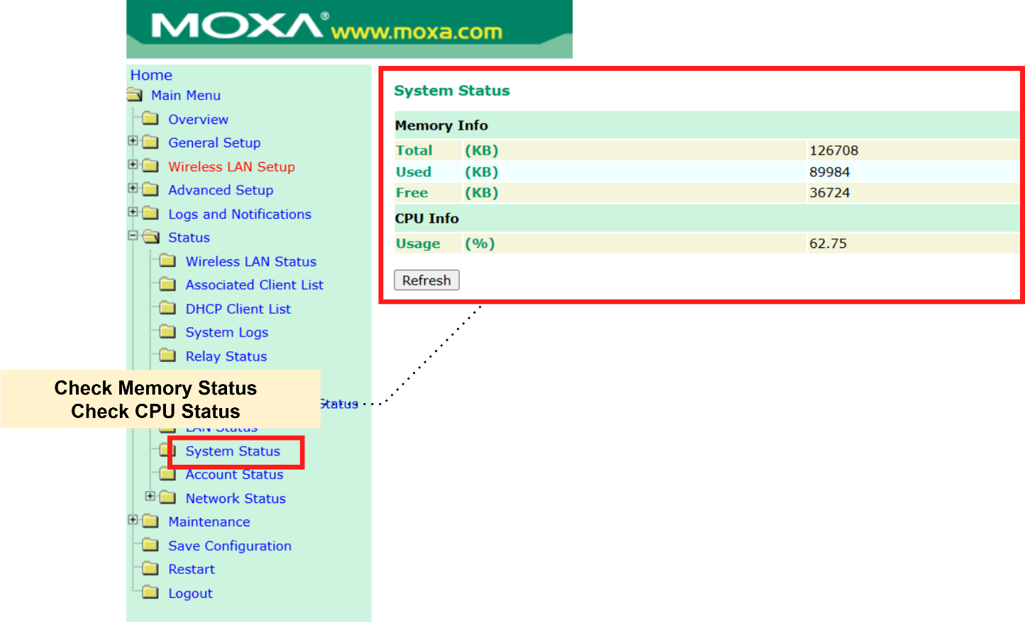
5. Monitoring Method
4) Response Guide: AP
- Verify that all processors are operating normally.
- Verify that all memory modules show a normal status.

Slide 34
Reference: Documents
- OCS
User guide
User Guide (system utility)
Trouble Shooting Guide
HPE ILO User Guide
- UPS
Eaton 9PX 1–3kVA Installation and User Manual
Eaton 9PX 1–3kVA Installation and User Manual (TW)
UPS-MIB
UPS-MIB(RFC-1628)
AP
AirWorks AWK-3131A User's Manual

