Slide 1
SFA OCS, OHT
NETWORK CHANNEL
2025.01.10

Slide 2

Contents
I. OCS NETWORK CHANNEL
Overview of DFS and SFS
2. DFS, SFS
3. Why SFS is the Better Choice
4. 165 CH for OHT and EQ PIO
5. Conclusion and Proposal

Slide 3
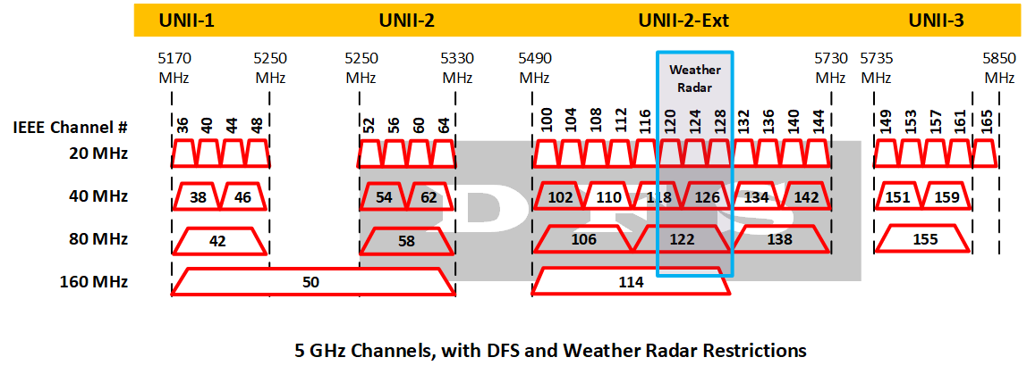
1. Overview of DFS, SFS
IEEE 802.11 a/n/ac Channel (5Ghz)
Dynamic Frequency Selection (DFS), Generally not used
  Channels shared with radar systems.
  Requires radar signal detection and channel switching,
  which can cause delays.
  Unreliable for real-time operations due to interruptions
  and uncertainty
Static Frequency Selection (SFS), Need 4 out of 8 Channels
  Fixed frequency channels that do not require swiching.
  Stable, uninterrupted communication.
  Ideal for real-time, high-speed environments like OHT.
ISM, Need 165 CH for OHT and Equipment PIO
<5Ghz Frequency Channel List ( 20Mhz Bandwidth )>
Frequency Band | Sub-band | Channel | Usable | ETC
5GHz | UNII-1 (Low Band) | 36 | O
 |  | 40 | O
 |  | 44 | O
 |  | 48 | O
 | UNII-2 (Middle Band) | 52 | X | DFS Required
 |  | 56 | X | DFS Required
 |  | 60 | X | DFS Required
 |  | 64 | X | DFS Required
 | UNII-2 Ext (Middle Band Extension) | 100 | X | DFS Required
 |  | 104 | X | DFS Required
 |  | 108 | X | DFS Required
 |  | 112 | X | DFS Required
 |  | 116 | X | DFS Required
 |  | 120 | X | DFS(Weather Radar)
 |  | 124 | X | DFS(Weather Radar)
 |  | 128 | X | DFS(Weather Radar)
 |  | 132 | X | DFS Required
 |  | 136 | X | DFS Required
 |  | 140 | X | DFS Required
 |  | 144 | X | DFS Required
 | UNII-3 (High Band) | 149 | O
 |  | 153 | O
 |  | 157 | O
 |  | 161 | O
 | ISM | 165 | △ | Industry, Medical

Slide 4
2. DFS, SFS
DFS (Dynamic Frequency Selection)
A system where channels are shared with radar systems, requiring radar signal detection and channel switching.
Key Characteristics:
  Channel Switching: When radar is detected, the AP must switch to another channel, potentially causing connection drops.
  Delays: Interruptions of 1-10 seconds are common.
  Channel Availability Check (CAC): May cause delays of up to 60 seconds during channel changes.
Issues:
  Unsuitable for real-time data transmission between OHTs and OCS.
  Increased risk of connection failure during roaming.
SFS (Static Frequency Selection)
A system where fixed frequency channels are pre-assigned, eliminating the need for channel switching.
Key Characteristics:
  Uninterrupted Communication: Ensures stable connections without delays, even during roaming.
  Real-Time Data Stability: Perfect for OHT and OCS environments where data continuity is crucial.
  Simplified Network Design: Fixed channels make the network easier to manage and configure.
  Reliable Operation: Free from radar interference or unexpected interruptions.

Slide 5
3. Why SFS is the Better Choice
SFS is Better Choice
Prevents Disruptions During Roaming:
  DFS may cause disconnections due to channel switching, but SFS avoids this entirely.
Ensures Stability for Real-Time Programs:
  Maintains consistent data transmission between OHT devices and the OCS.
Predictability:
  SFS delivers continuous and reliable performance without unnecessary channel changes.
Business Continuity:
  Avoids downtime or connection interruptions, ensuring operational efficiency.
Simplified Implementation:
  Fixed channels reduce complexity, lowering maintenance costs and management efforts.

Slide 6
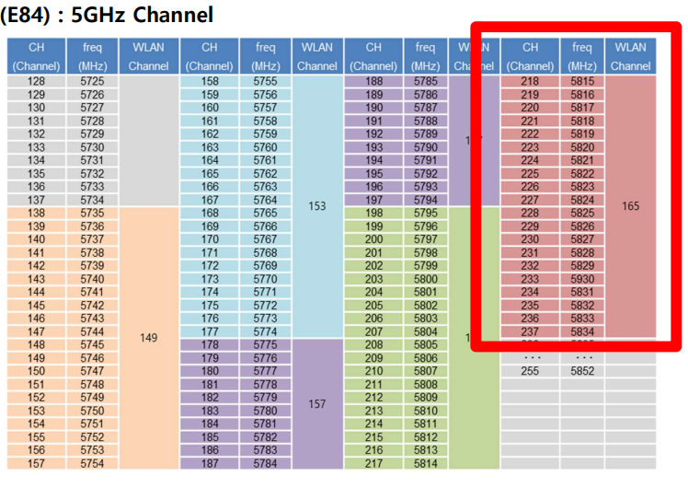
4. 165 CH for OHT and EQ PIO
VHL ↔ EQ PIO Communication Protocol
EQ PIO (E84) : 5GHz Channel

Slide 7
5. Conclusion and Proposal
Conclusion and Proposal
Conclusion :
  SFS channels offer stable, interruption-free performance, meeting the real-time data transmission needs of OHT and OCS.
  Avoids the uncertainty and delays associated with DFS, making SFS the most reliable choice.
  Channel 165 is a critical component for supporting E84 communication, ensuring data exchange stability between OHT and equipment.
Proposal :
  Allocate 4 High-Band SFS channels (149, 153, 157, 161) for uninterrupted and reliable communication within the OHT-OCS environment.
  Include Channel 165 in the network design to support E84 PIO communication between OHT and equipment.
  Leverage the benefits of SFS and Channel 165 to maximize productivity and operational efficiency.

Slide 8



