Slide 1
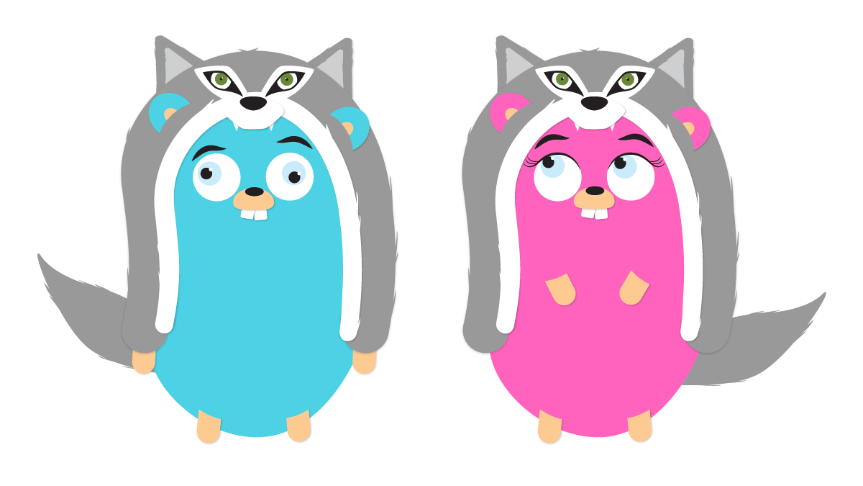
3. Wolfsburg-Gophers Meetup
28.02.2019

Slide 2
Topics
0) Any new faces?
1) Latest Go News
2) Talk: „Go mock it!“ (thx 2 Lars Gohr)
3) Open talk / miscellaneous
4) Next topics

Slide 3



Any new faces?
Who´s all here today?

Slide 4

Latest Go News

Slide 5
Latest Go News
16.01.2019 – Google Cloud Functions mit Go (Beta)
Go code can be used in Google Cloud Functions (Serveless Computing Plattform / Function as a Service)
https://cloud.google.com/blog/products/application-development/cloud-functions-go-1-11-is-now-a-supported-language
https://cloud.google.com/functions/docs/quickstart
20.01.2019 - https://www.youtube.com/watch?time_continue=748&v=RitskkjSih0

Slide 6
Latest Go News
22.01.2019 – Heise Developer beginners article
„Ein Einstieg in die Programmiersprache Go, Teil 1“
https://www.heise.de/developer/artikel/Ein-Einstieg-in-die-Programmiersprache-Go-Teil-1-4282998.html
  → Why did they start with Goroutines & Channels
26.02.2019 - „Ein Einstieg in die Programmiersprache Go, Teil 2“
https://www.heise.de/developer/artikel/Ein-Einstieg-in-die-Programmiersprache-Go-Teil-2-4317947.html

Slide 7
Latest Go News
02.02.2019 – Benchmarking Go vs Node vs Elixir
10k und 100k requests per seconds benchmark @ AWS (c5.2xlarge & c5.9xlarge)
Only Go und Elixir reached the 100k – Go with much better CPU efficiency!
https://stressgrid.com/blog/benchmarking_go_vs_node_vs_elixir

Slide 8
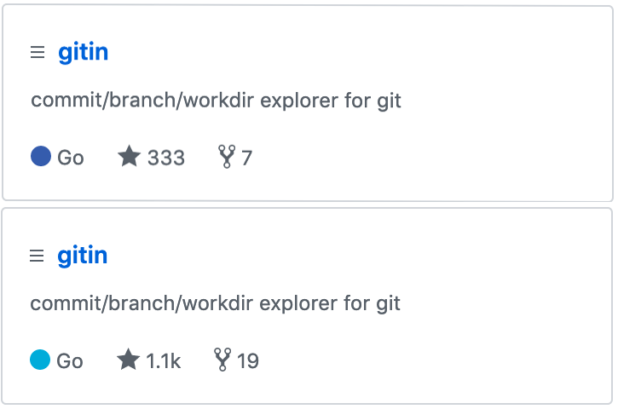
Latest Go News
08.02.2019 – Github silently changed the Go color
The main language indicator color matches the Gopher mascot now - yeah! :)
https://www.reddit.com/r/golang/comments/aofej0/github_silently_changed_color_of_go_now_it

Slide 9
Latest Go News
09.02.2019 – Building modern desktop apps in Go
Desktop Anwendungen mit Go & HTML5
https://www.youtube.com/watch?v=ANcU1g7ZWdU (Talk von der FOSDEM 19)
https://github.com/zserge/lorca

Slide 10
Latest Go News
15.02.2019 – basgo 0.1
BASIC-lang to Golang – why? :)
https://github.com/udhos/basgo/releases/tag/v0.1

Slide 11
Latest Go News
21.02.2019 – Awesome Go
1600+ Go Links, Libraries & Tools
https://awesome-go.com

Slide 12
Latest Go News
22.02.2019 – MongoDB Go Driver 1.0.0 RC1
Final 1.0.0 MongoDB Go Driver is close!
https://github.com/mongodb/mongo-go-driver/releases/tag/v1.0.0-rc1

Slide 13
Latest Go News
24.02.2019 – Practical Go
Real world advice for writing maintainable Go programs
https://dave.cheney.net/practical-go/presentations/qcon-china.html

Slide 14
Latest Go News
25.02.2019 – Go 1.12 is released
- TLS 1.3 opt-in support (default in Go 1.13)
- Improved Modules support
    Safe to invoke concurrently download of Modules (your fs needs file locking support)
    Test file locking support → flock ./anyfile true && echo ok || echo nok
            → „ok“ || flock: ./anyfile: No locks available
- Improved macOS & iOS forwards compatibility
    But last version compatible with macOS 10.10 (Yosemite)
    1.13 needs >= 10.11 (El Capitan)
https://blog.golang.org/go1.12

Slide 15
Latest Go News
26.02.2019 – Our slides are on Github now (yeah!)
https://github.com/wobgophers

Slide 16

Talks
Go mock it!

Slide 17

Open talk / miscellaneous

Slide 18

Next topics?

Slide 19
Thx for the Gophers goes to Cami & gopherize.me

Slide 20
Cu next time! :)

