Slide 1

COMPANY PROFILE

Slide 2

WHO WE ARE
Afriglobal Group is a conglomerate with business interests in the chemicals distribution, Logistics and healthcare industries. With an impressing turnover of over USD200m per annum, it is one of the fastest growing business concerns in Nigeria.
BRIEF HISTORY
The agship company – Nagode Industries, which started as the brainchild of a visionary man Mr B.
B. Garg, has since grown into a diversied entity with about ve dynamic and fast growing competent organizations. Each organization has developed into the market leader or one of the leading players in its own eld.
Incorporated in 1988, Afriglobal group has over time, expanded operations from Lagos to branches throughout Nigeria in Abuja, Kano, Aba and Onitsha, to effectively service its customers. Currently, beyond Nigeria, we have operations in Cameroun, Ghana, Djibouti, Ethiopia, Tanzania, Egypt. We also have ofces India, China and South Korea. However its international outlook notwithstanding, the Afriglobal Group of companies has remained true to its African Origin.
pg 02

Slide 3

VISION
An inspirational role model African institution that is at the forefront of emerging opportunities in healthcare, logistics and chemicals value chain
MISSION
Inspiring Africa
VALUES
Integrity
Respect for Individuals
Passion for Customer Success
Forward Thinking
pg 03

Slide 4

BUSINESS APPROACH
Afriglobal group is operated by Quality Management and effective strategy creation.
We have a diverse high performance, empowered and engaging management team.
We treat our employees with human dignity and continously enhance their competency.
pg 04

Slide 5
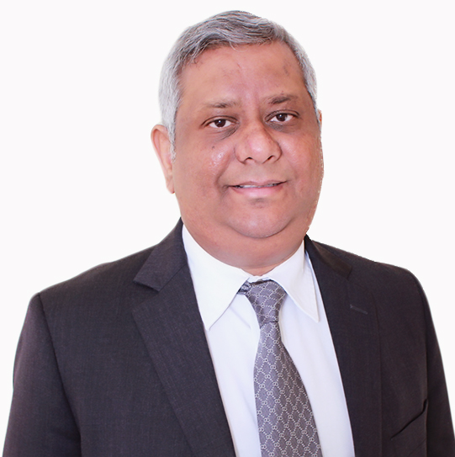
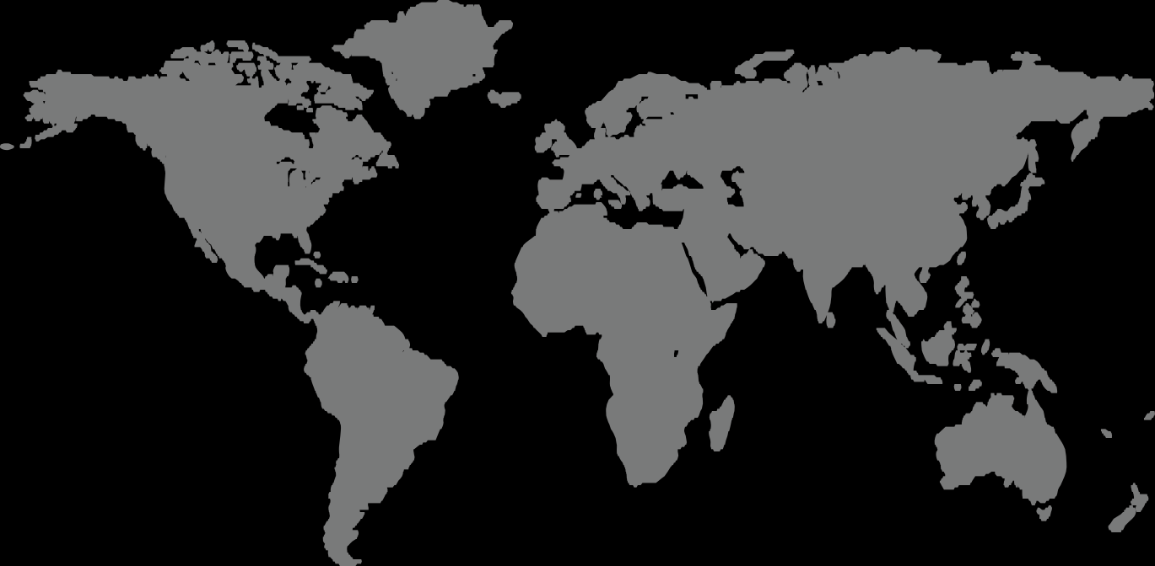
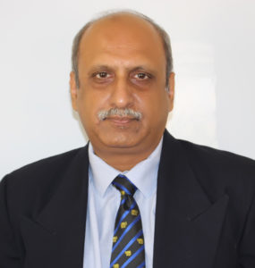
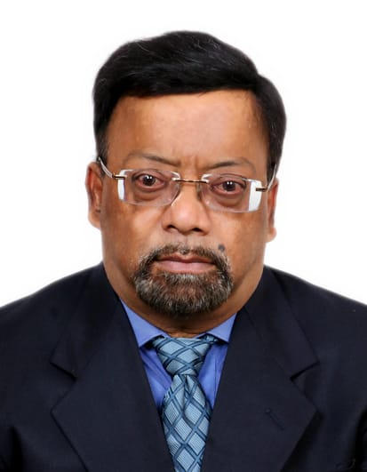
MANAGEMENT PROFILE/BOARD MEMBERS PROFILE
EXECUTIVE DIRECTOR:
GROUP CHIEF EXECUTIVE OFFICER
Mr. Maneesh Garg is a serial entrepreneur who has successfully transformed the Family business, Afriglobal Group from a trading and distribution company of raw chemicals and soft commodities to include other industries covering Healthcare, supply chain management and integrated logistics. He has a rst degree in Politics, Philosophy and Economics at the University of Oxford, UK and a Master's Degree in Economics at the North-Western University, US.
EXECUTIVE DIRECTOR:
GROUP EXECUTIVE DIRECTOR
Mr. Sandeep Kapoor has over 29 years' experience in marketing and sales across consumer, industrial & services businesses, including 5 years in East and West Africa. He has a B. Tech in Mechanical Engineering from IIT Delhi & MBA from IIM Ahmadabad. Currently he serves as the Group Executive Director.
DEBASIS MITRA ROY: NON EXECUTIVE DIRECTOR
Mr. Roy is an accomplished leader with powerful blend of professional background (CPA, CMA, ACMA & DBF), over 30 years of Global experience in Business& Finance Management and consistent history of achievements and recognition as ”Excellent Performer”. He has Worked & travelled across countries (India, UK, Europe, USA and Africa) with globally renowned groups including Tata, Reliance, GAIL & Dangote in diverse verticals spanning manufacturing and service sectors ( Engineering, Pharmaceuticals Cement, Oil & Gas, Telecom, Construction). He is currently Group Executive Director (earlier CFO & Business Head-Shared Services) of a $300 million regional conglomerate operating in West Africa.
pg 05

Slide 6
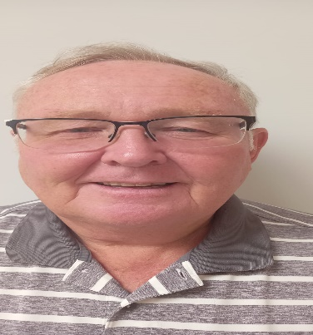
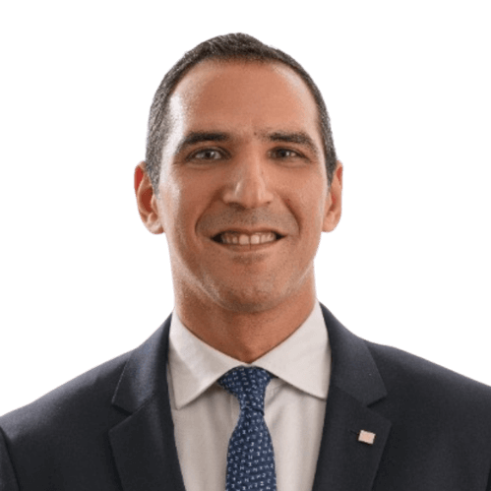
MANAGEMENT PROFILE/ BOARD MEMBERS PROFILE
DAVID EDWARDS: NON EXECUTIVE DIRECTOR
An experienced International Finance Director with proven success in Managing Strategic and Operational Activities, Corporate Restructuring and Multi-site General Management in a high growth environment. Highly motivated and enthusiastic, an excellent communicator at all levels, takes responsibility for issues and motivates the team to get the job done to time and budget. Confident and articulate with excellent interpersonal skills, leads from the front, delegates where appropriate, brings a ‘can do, will do’ attitude to every endeavour: interested in using skills acquired to support other organisations.
HISHAM MOUSSA : NON EXECUTIVE DIRECTOR
Mr. Hisham is a well-rounded Private Equity professional with expertise across origination, execution, post-acquisition monitoring, turnaround management and exit realization. Working knowledge across a wide range of industries with a deeper operating know-how into healthcare verticals. He is the Chief Executive Officer of The Sovereign Fund of Egypt which was established in 2018 to attract private investments to Egypt and promote and co-invest in state-owned assets to maximize their value and efficiency for the Egyptian economy.
pg 07

Slide 7
GROUP CHIEF FINANCE OFFICER

Slide 8

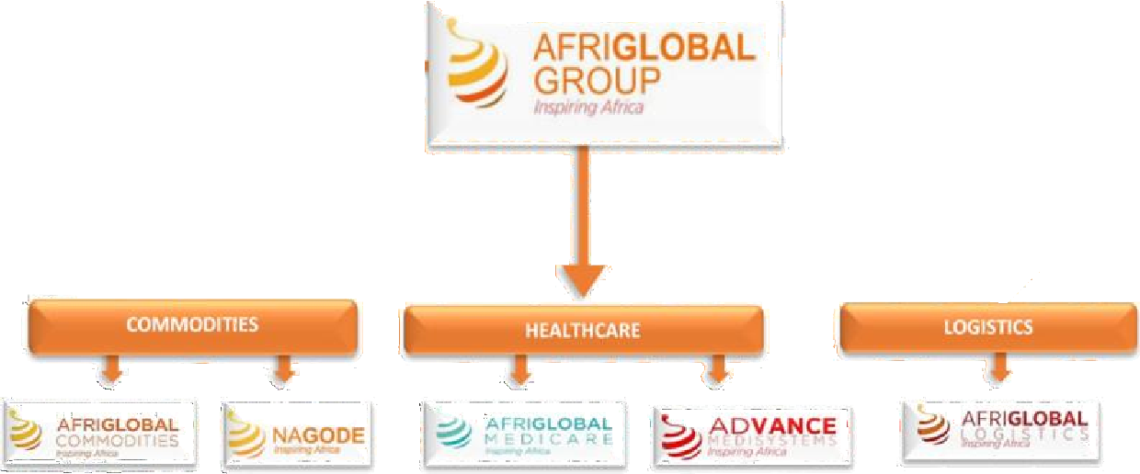
AFRIGLOBAL GROUP
AT A GLANCE
AFRIGLOBAL GROUP
Summary |  | Healthcare|Commodities|Logistics
Companies | Nagode Industries Limited | Afriglobal Commodities Limited | Afriglobal Medicare Limited | Advance Medisystems Limited | Afriglobal Logistics Limited
Competencies | Raw chemical distribution Imports warehousing | Trading Distribution | Healthcare Diagnostics (Pathology, Radiology, Cardiology) Wellness | Sales and Setup of Laboratory and Diagnostics equipment | Ocean Freight Air Freight Trucking Haulage Warehousing and Distribution
Sectors | Chemical/Allied | Chemical/Allied | Health | Health | Supply Chain Management
pg 08

Slide 9



HEALTHCARE | COMMODITIES
www.afriglobalgroup.com
| LOGISTICS

