Slide 1
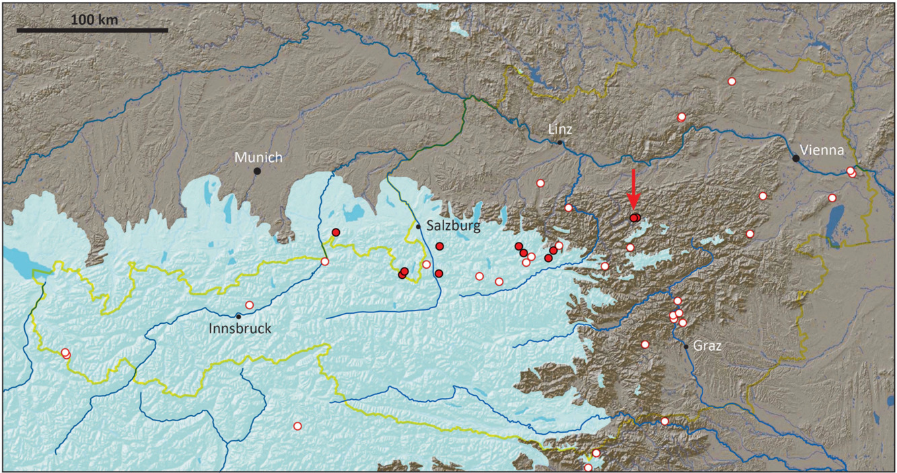
Cave bear occupation in Schwabenreith Cave, Austria, during the early last glacial: constraints from 230Th/U‐dated speleothems
Journal of Quaternary Science, Volume: 34, Issue: 6, Pages: 424-432, First published: 23 July 2019, DOI: (10.1002/jqs.3110)
Notes:
Map showing cave bear sites in Austria and neighbouring countries (red circles) as well as the location of Schwabenreith Cave (arrow). Sites where Ursus spelaeus eremus was identified are shown by solid red dots. The extent of the Alpine ice sheet during MIS 2 is shown for reference in light blue. Source map: Geological Survey of Austria. [Color figure can be viewed at wileyonlinelibrary.com].
IF THIS IMAGE HAS BEEN PROVIDED BY OR IS OWNED BY A THIRD PARTY, AS INDICATED IN THE CAPTION LINE, THEN FURTHER PERMISSION MAY BE NEEDED BEFORE ANY FURTHER USE. PLEASE CONTACT WILEY'S PERMISSIONS DEPARTMENT ON PERMISSIONS@WILEY.COM OR USE THE RIGHTSLINK SERVICE BY CLICKING ON THE 'REQUEST PERMISSIONS' LINK ACCOMPANYING THIS ARTICLE. WILEY OR AUTHOR OWNED IMAGES MAY BE USED FOR NON-COMMERCIAL PURPOSES, SUBJECT TO PROPER CITATION OF THE ARTICLE, AUTHOR, AND PUBLISHER.

