Slide 1
Hopfield Neural Network Solving Shortest path problem

Slide 2
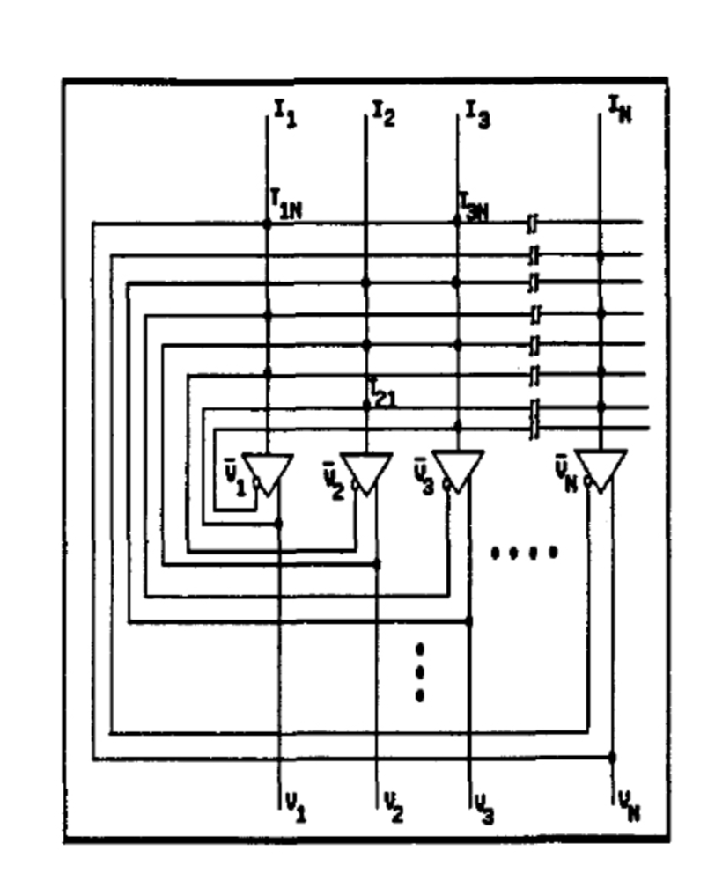
Hopfield Neural Network
A Hopfield network is a form of recurrent artificial neural network popularized by John Hopfield in 1982.
serve as content-addressable memory systems with binary threshold nodes

Slide 3
Modeling HNN for SP Graph
Directed graph G=(N,A)
arc(i,j) has nonnegative cost of Cij
Distance from source to destination Lsd = ∑ Cij thus, (i, j)∈P
Finding a path from source to destination with minimum length

Slide 4
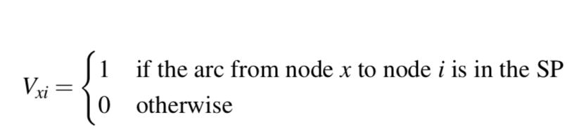
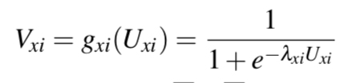
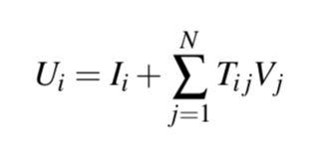
Modeling HNN for SP Output and Input
V_{i} = output
U_{i} = input
I_{i} = external Bias
T_{ij} = connection matrix

Slide 5
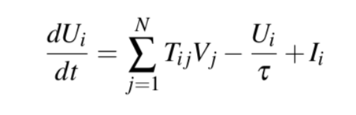
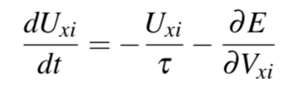
Modeling HNN for SP Dynamics of HNN
τ circuit’s time constant
Hopfield (1984) shown that for symmetric T with sufficiently large λi, the dynamics of the neurons follow a gradient descent of the quadratic energy function.

Slide 6
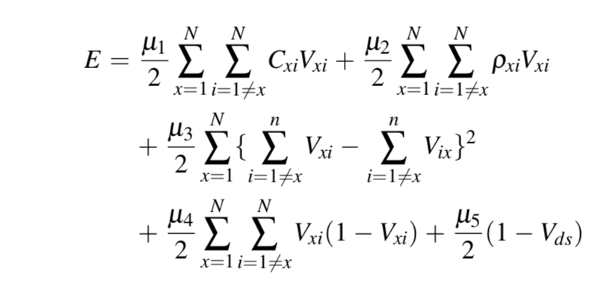
Modeling HNN for SP Energy Function
μ1 minimizes total length of a path
μ2 penalty to including nonexistent path into solution
μ3 number of incoming arc equal outgoing arc
μ4 pushes the state of the neural network to converge
μ5 preference of include V_{ds} as part of solution

Slide 7
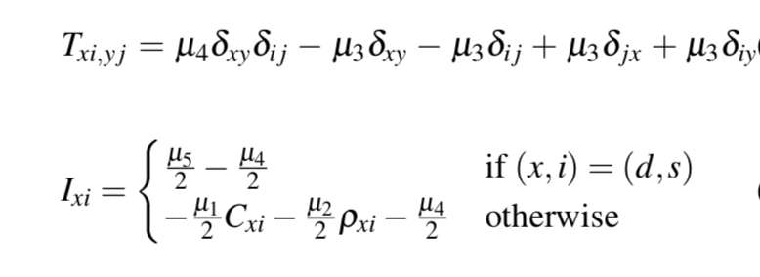
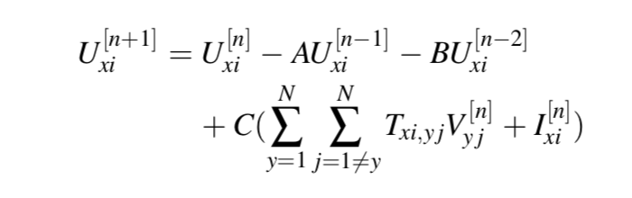
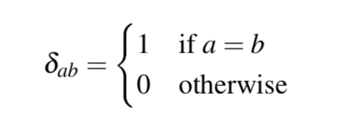
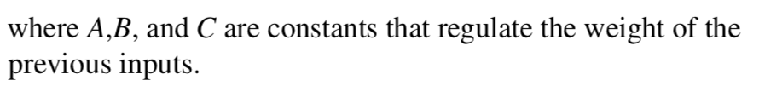
Modeling HNN for SP Connection Matrix and Biases

Slide 8
Modeling HNN for SP Implementation
Parameter | Value
µ1 | 950
µ2 | 2500
µ3 | 1500
µ4 | 475
µ5 | 2500
A | 0.0001
B | 0.00001
C | 0.00001
𝜆 | 1
input update | 1000
graph | 5000

Slide 9
Modeling HNN for SP Result and Discussion
Compare with Dijkstra
Advantage: Characteristic of ANN
Disadvantage: Converge to local minimum

