Slide 1
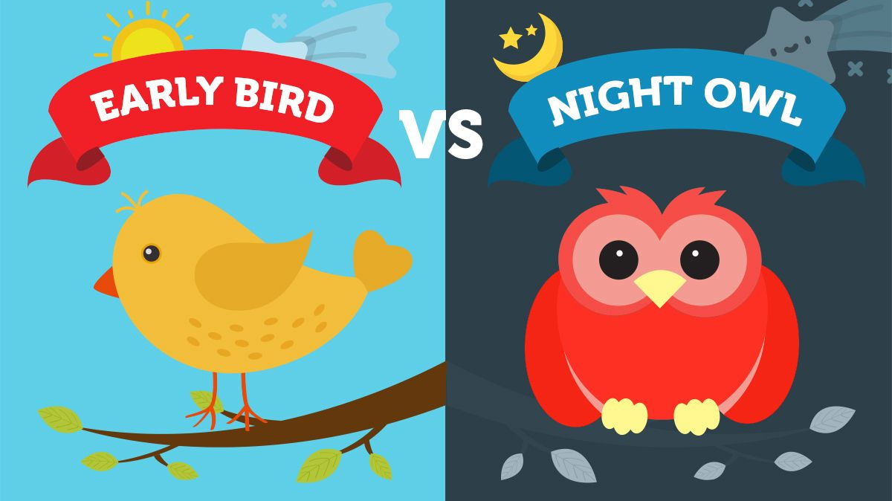
Project by: Malaikah Hafeez, Naphtali Odinakachi, Rebecca Bronczyk, Veeresh Thummadi

Slide 2


AGENDA
PROJECT DESSCRIPTION
METHOD
RESULTS
CHALLENGES
FUTURE PLANS

Slide 3
PROJECT DESCRIPTION
Assign author to a label
Are night owls or early birds more productive, based on the amount of commits made?

Slide 4
METHODS
Getting data from the projects through the world of code
1
Saving data from the server to the local machines
2
Analyzation
4
Operationalisation
3
Night owl: 0 - 5
Early bird: 6 – 24
Correlation
Graphs

Slide 5



CHALLENGES
EXTRACTING DATA FROM WORLD OF CODE
Copy data from ssh to our machines
Many authors make visualisation difficult
Get location from time zone

Slide 6
RESULTS
Early bird OR night owl?
 | Early Bird | Night Owl | Total
Coded as | 0 | 1
Ember | 155 (95.68%) | 7 (04.32%) | 162
React | 421 (92.73%) | 33 (07.27%) | 454
Angular | 758 (91.66%) | 69 (08.34%) | 827
Total | 1334 (92.45%) | 109 (07.55%) | 1443

Slide 7
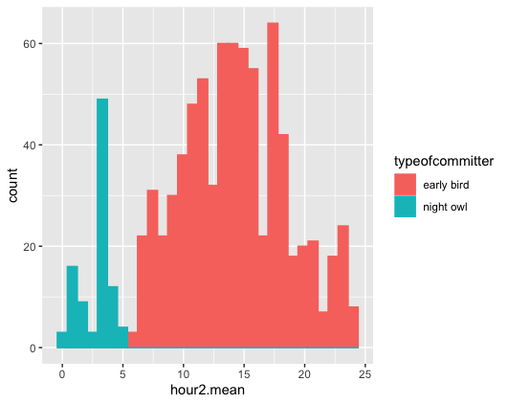
RESULTS
Pre Angular

Slide 8
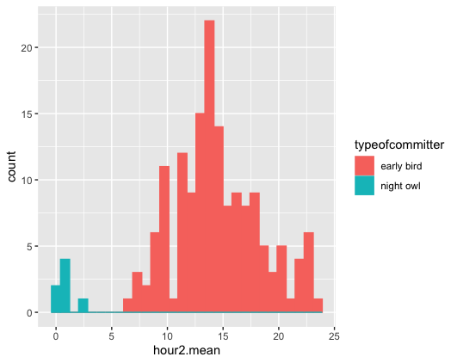
RESULTS
Pre Ember

Slide 9
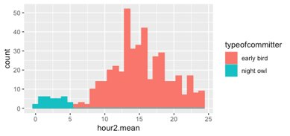
RESULTS
Pre React

Slide 10
RESULTS
React Pre & Post
Coefficients | Estimate | Std. Error | T value | Sig (p)
Intercept | 1.6703 | 0.2011 | 8.304 | 3.31e-16
Night owl | -1.6097 | 0.7759 | -2.075 | 0.0383 *
Significance codes: 0 ‘***’ 0.001 ‘**’ 0.01 ‘*’ 0.05 ‘.’ 0.1 ‘ ’ 1
Early birds are more productive in react

Slide 11




FUTURE PLANS
CONTROL FOR AUTHOR ALIASING
COMPARING THE THREE PROJECTS
EFFECTS OF
CAUSALITY
EFFECT OF LOCATION ESTIMATION

Slide 12
CONTRIBUTIONS
Malaikah Hafeez
Research Question, Problem solving,
Data Presentation
Naphtali Odinakachi
Data extraction, Converting files
Rebecca Bronczyk
Research Question,
First steps at data extradition, Data Presentation
Veeresh Thummadi
Data Analysis,
Graphs

